Slide 1
Data Availability & Resources
Notes:
So, you might ask me, what kind of information is available about industry sectors on Qualityinfo.org? Let’s take a look and see.

Slide 2
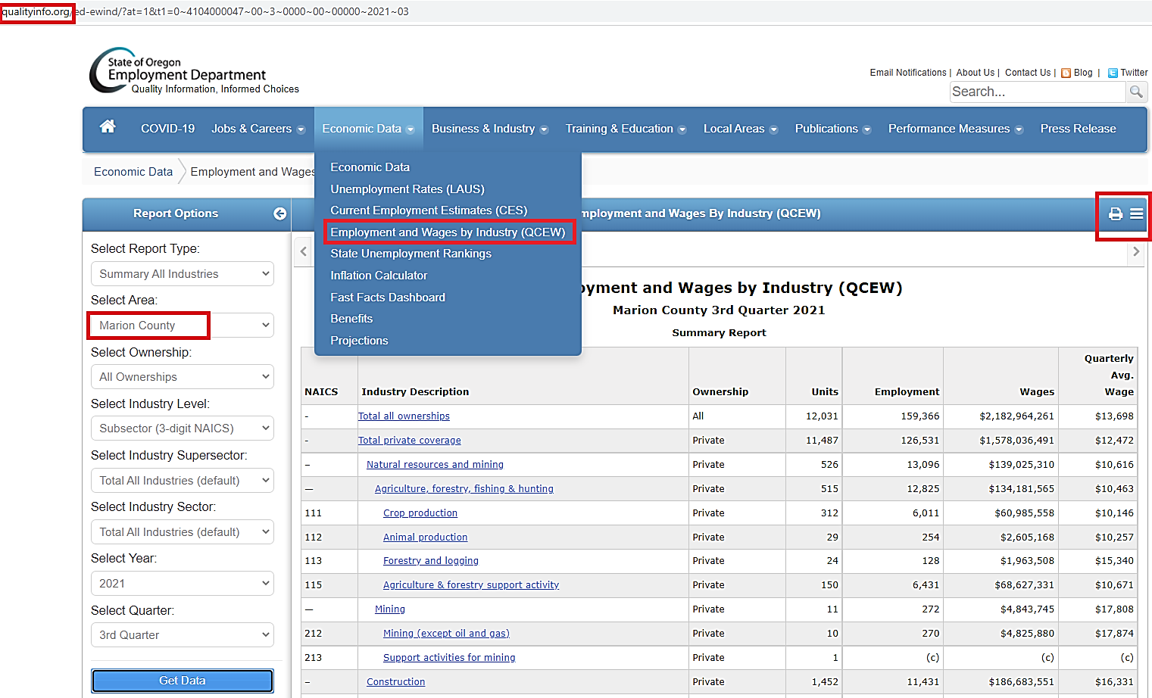
Qualityinfo.org

Slide 3
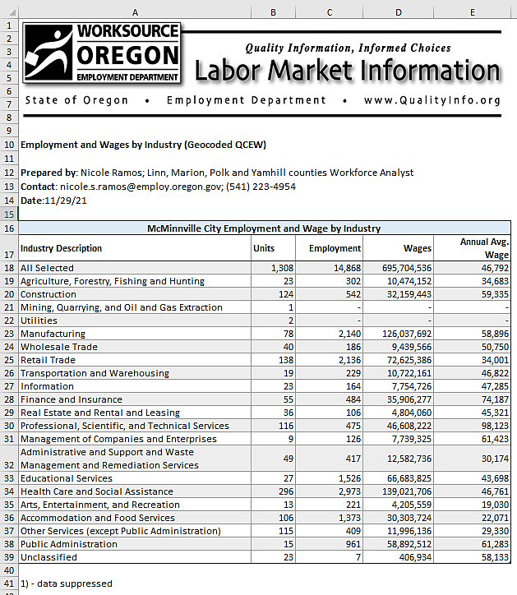
Contact me for Geocoded data

Slide 4
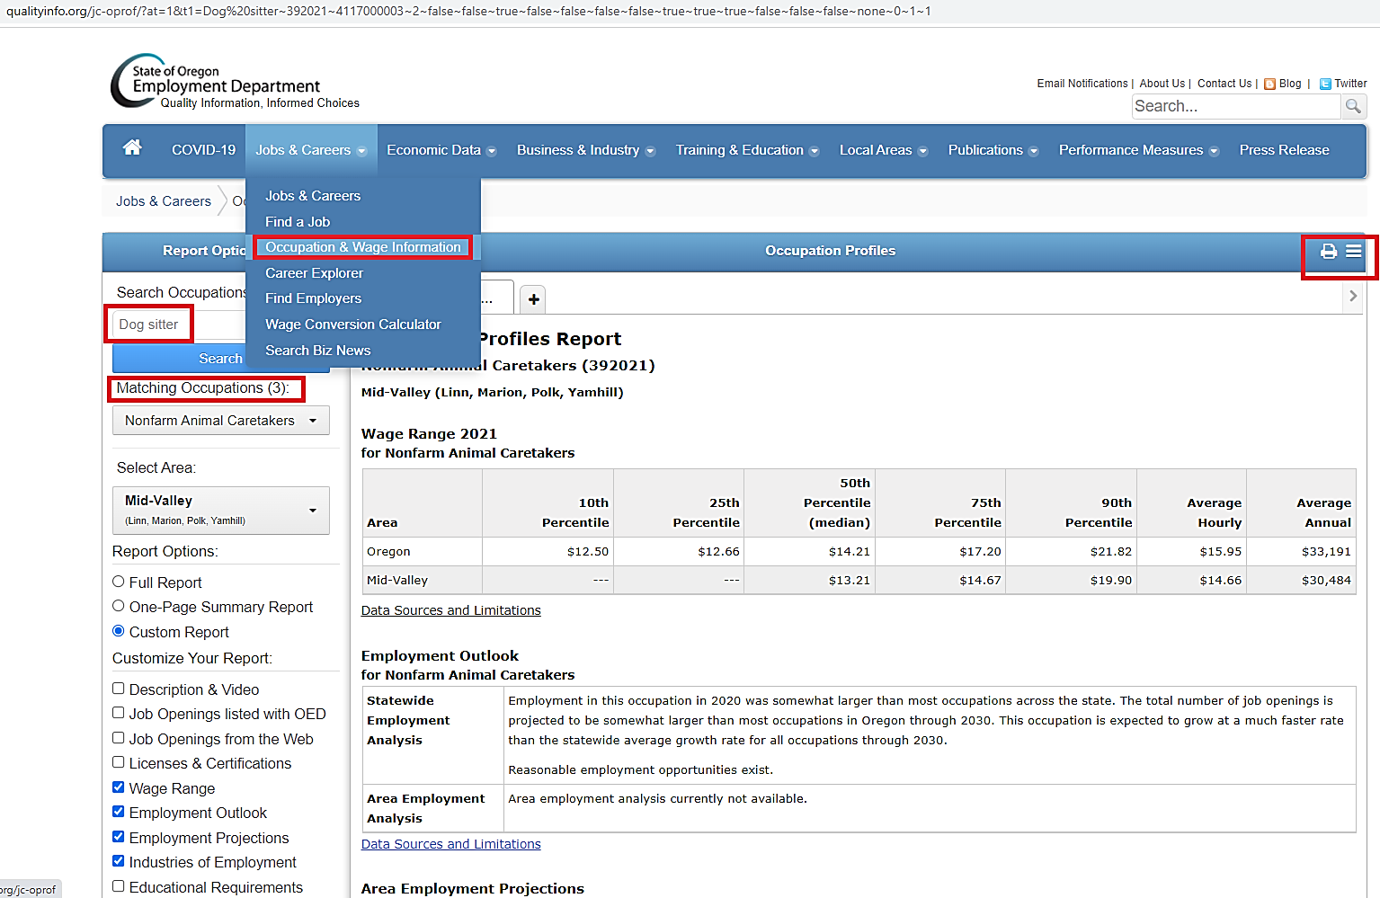

Slide 5
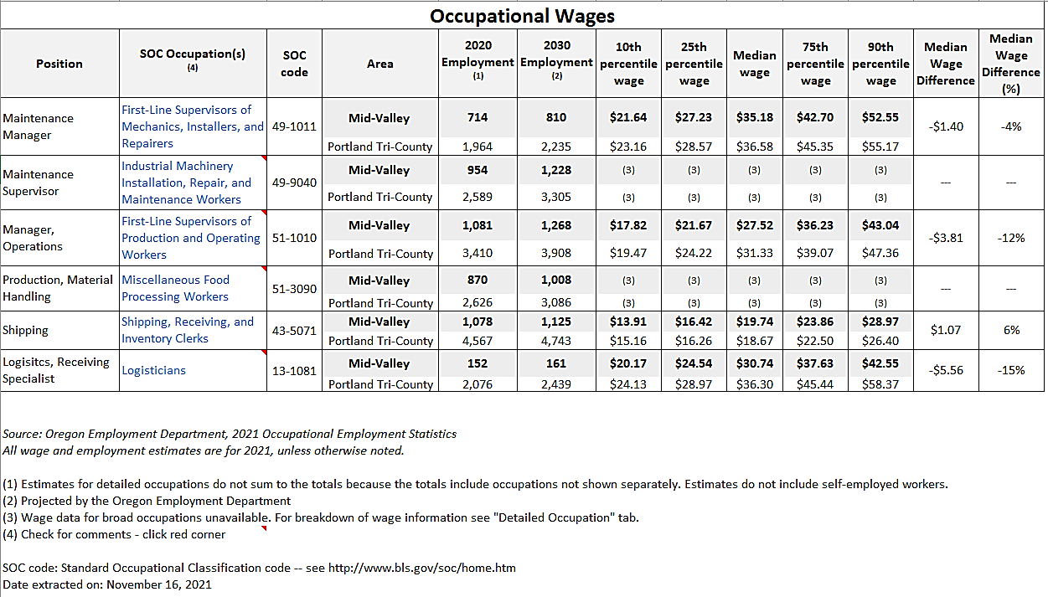
Workforce Analyst

Slide 6
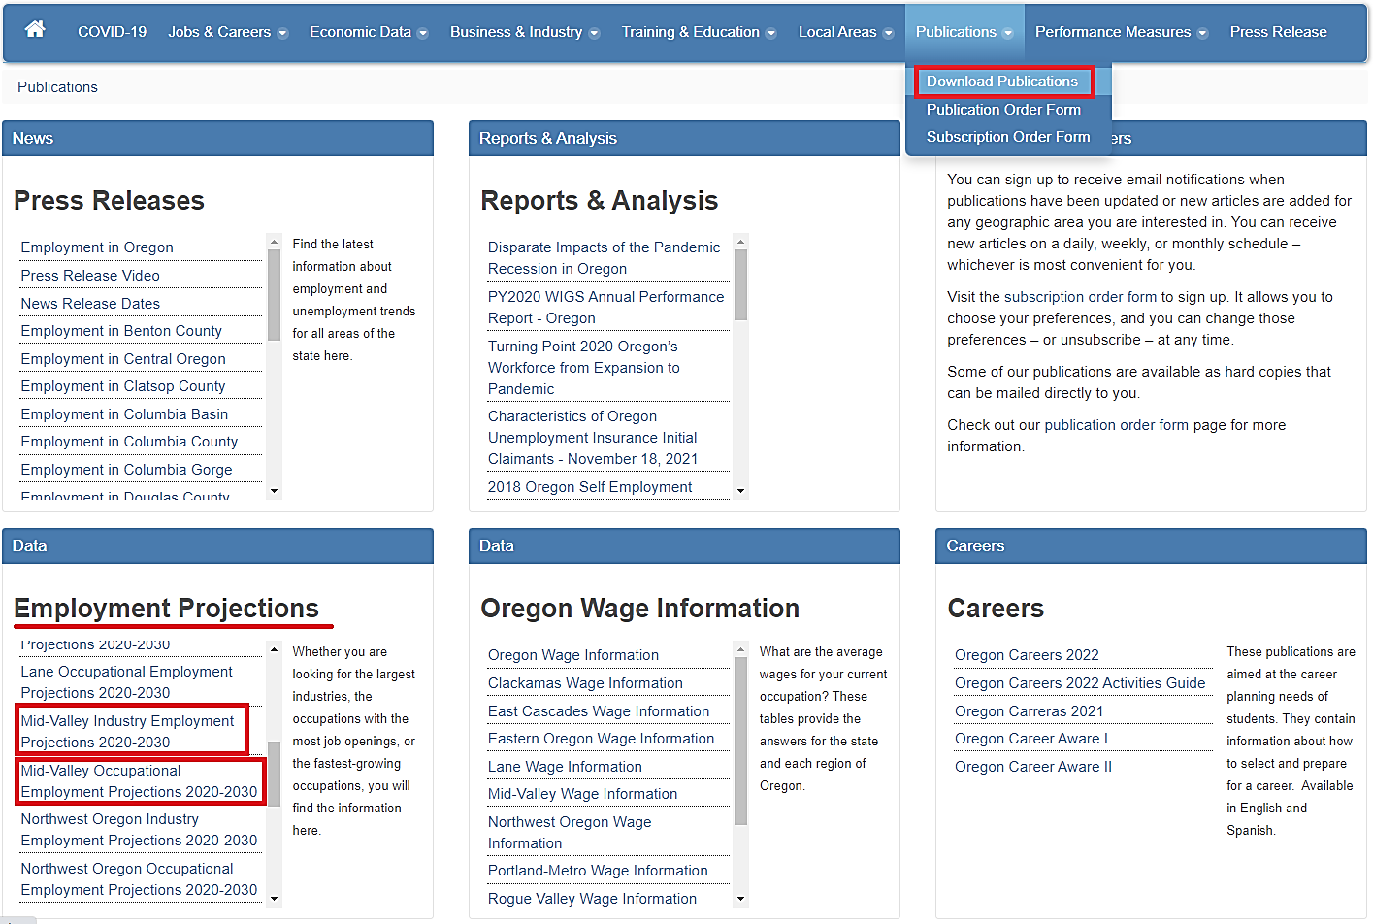

Slide 7
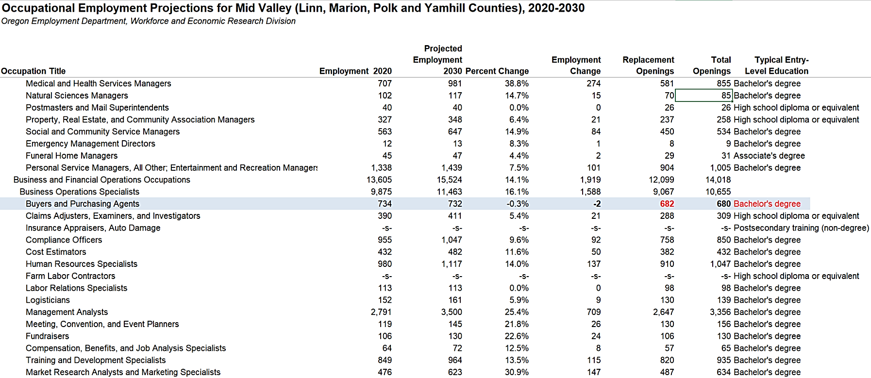
Projections Excel From Website

Slide 8
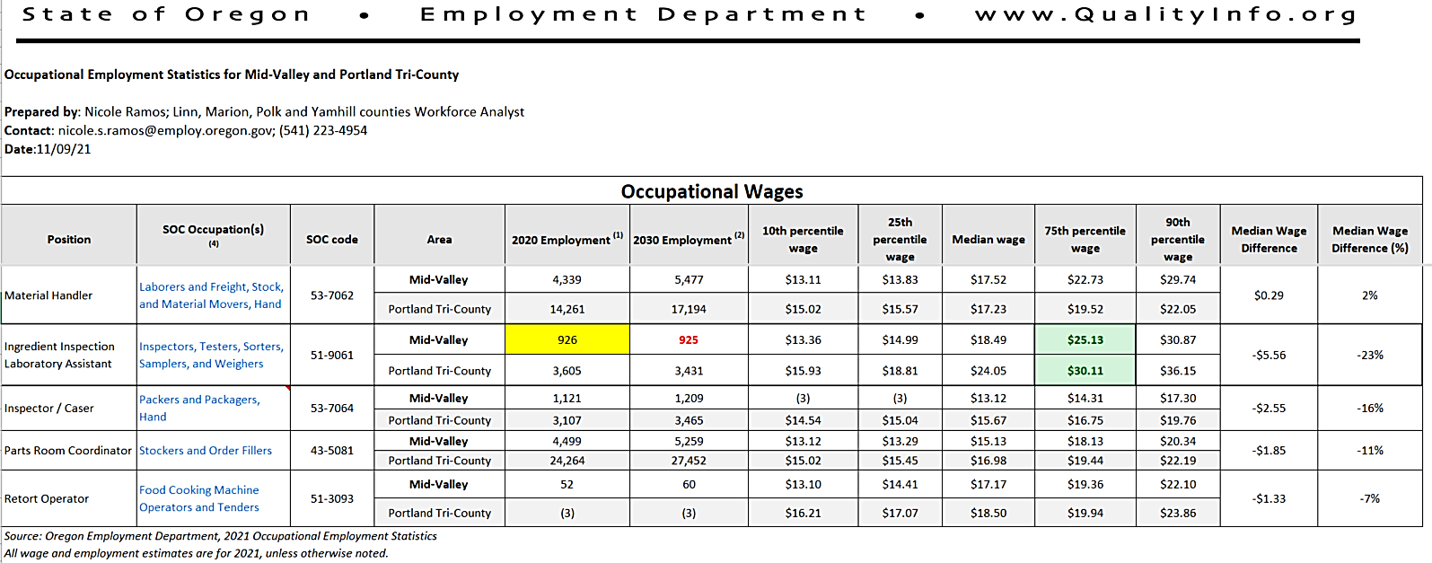
Workforce Analyst

Slide 9
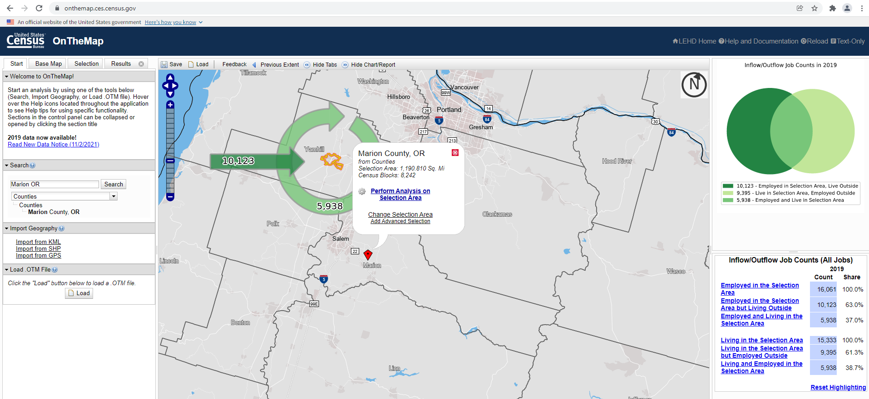
https://onthemap.ces.census.gov/

Slide 10
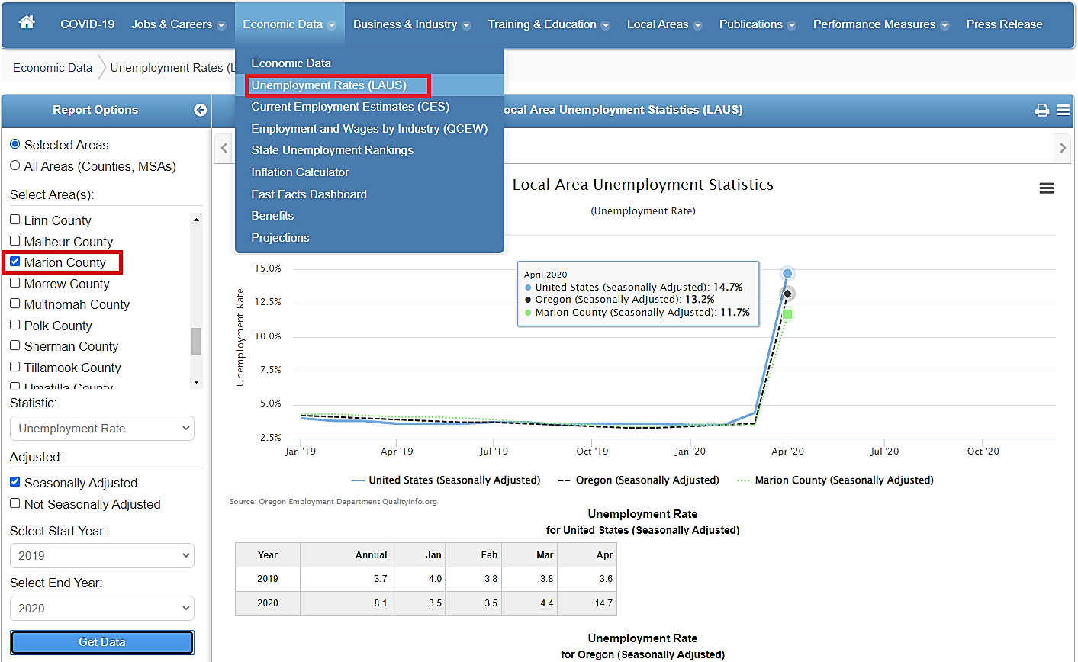
Qualityinfo.org

Slide 11
Other Examples

Slide 12
Thank you

