Slide 1
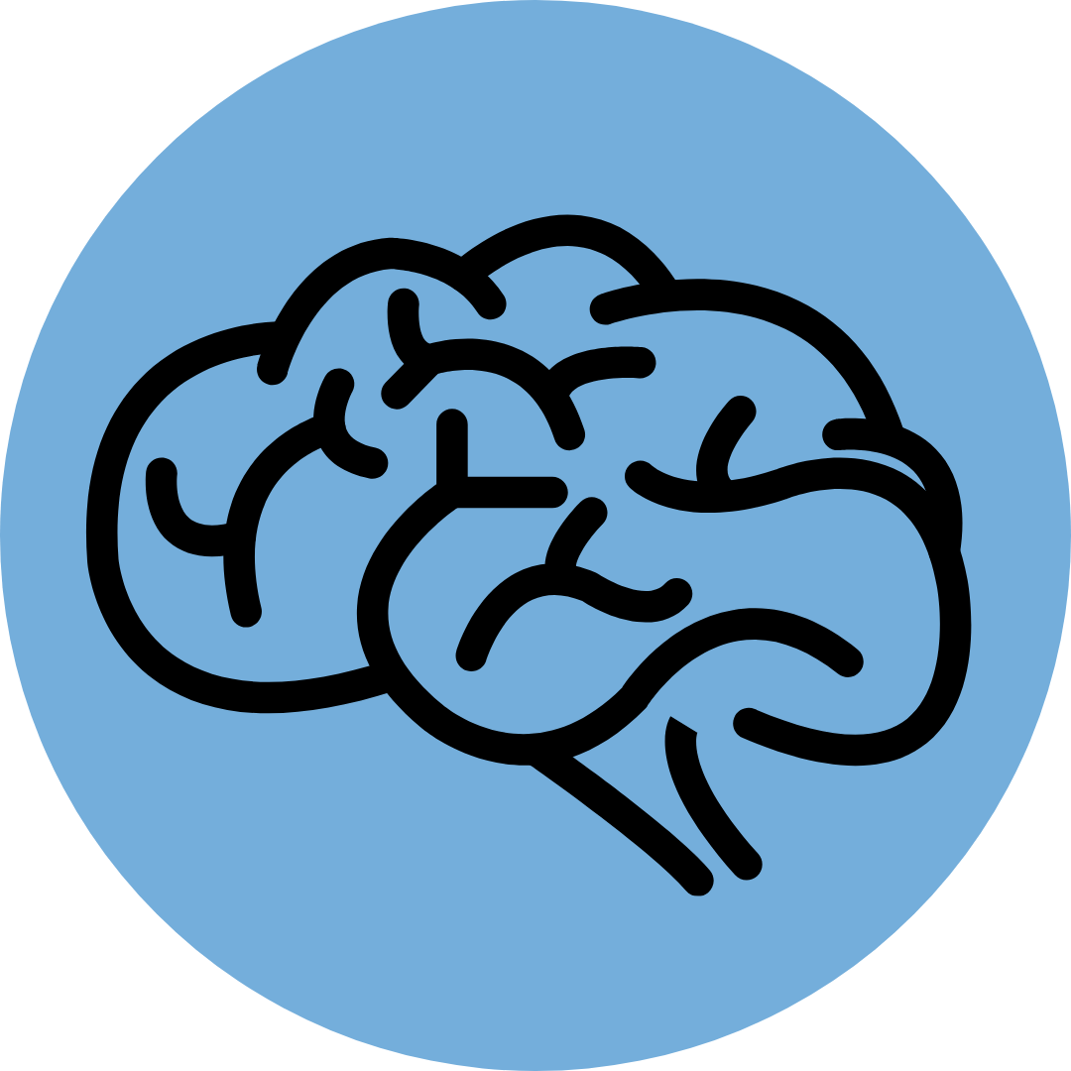
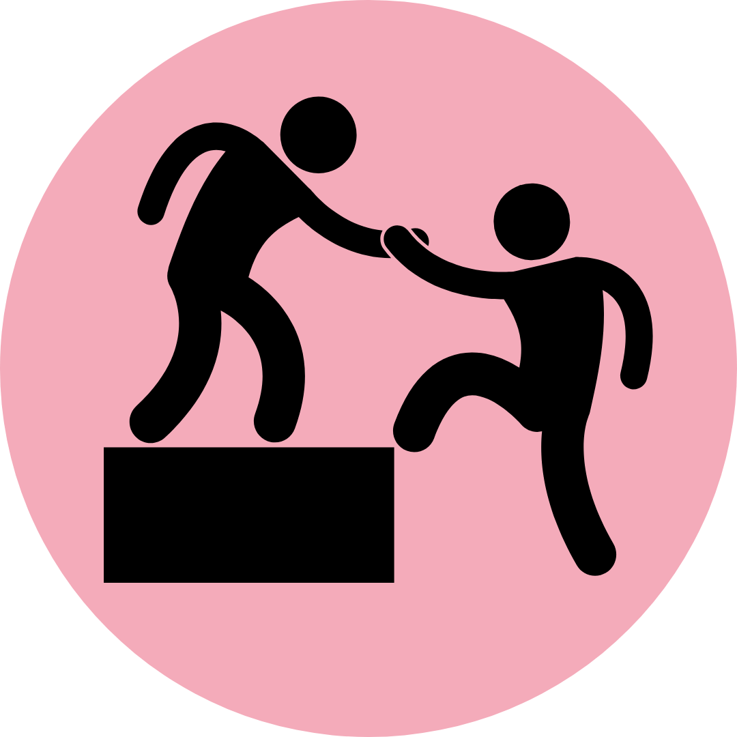
Making sense of Problem Gambling & Behavioral Addictions
Prepared by
Addictions & the Brain
Facts
Industry Tactics
Getting Help
Notes:
Many of us know that alcohol, tobacco, and drug use can lead to poor health consequences and addiction. But what about other things we choose to do in our life, like risky and potentially harmful habits? Today, we are going to discuss a specific activity that carries risk – gambling – and how this activity relates to alcohol, tobacco, and drug use.
_____________________________________________
Acknowledgements:
This toolkit was created by the Marion County Problem Gambling Prevention Program, located in Salem, Oregon. This toolkit was finalized for classroom use on 9/7/2021. It was revised on 1/6/2022
Future versions of this toolkit as well as complementary activities and documents may be found at https://www.co.marion.or.us/HLT/PH/PS/gambling/Pages/YouthandGambling.aspx.
This document is free for use and distribution.

Slide 2
Definitions:
Behavioral Addiction (or Disorder): Similar to drug addiction except that the individual is not addicted to a substance, but the behavior or the feeling brought about by the relevant action.¹
Gambling: Risking money or something of material value on an event with an uncertain outcome with the hope of winning something of even greater value.²
Problem Gambling: Gambling despite negative personal, social, or financial consequences.²
Disordered Gambling: Moderate to severe problem gambling, where 4 or more signs of problem are identified by a medical professional.
Notes:
Optional Slide: Read slide. These definitions are also available in the student guide and described throughout the lessons.
_____________________________________________
Citation:
¹ Alavi SS, Ferdosi M, Jannatifard F, Eslami M, Alaghemandan H, Setare M. 2012. Behavioral Addiction versus Substance Addiction: Correspondence of Psychiatric and Psychological Views. Int J Prev Med. 3(4):290-294.
² More TL. 2018. Gambling and Problem Gambling in Oregon. Oregon Council on Problem Gambling. Retrieved from: https://oregoncpg.org/the-gambling-landscape-in-Oregon

Slide 3
Addictions & the Brain
Prepared by
Problem Gambling Prevention Program
Notes:
Before we break down problem gambling and other behavioral addictions and disorders, we should discuss how addictions affect the brain. First, addiction is a disease and recovery is difficult. Our brains process substance use and harmful behaviors in similar ways. Lets explore this in more detail, and what the risks are of forming addictions in general.
Estimated length: 20 minutes

Slide 4
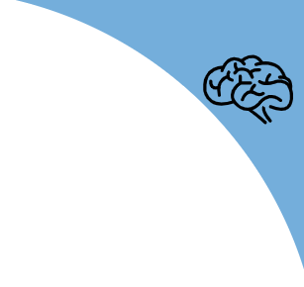
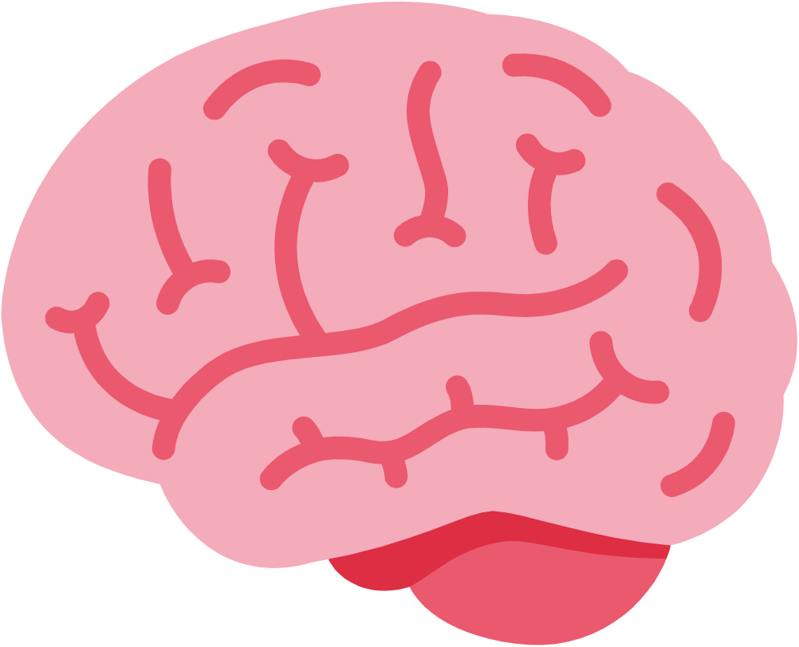
What is Addiction?
Addictions & the Brain
1
Addiction is a physical and psychological dependence on a substance or activity despite its negative health effects. It is a chronic disease affecting the brains memory and risk/reward functions.
Quick class discussion: Name an example of something you can form an addiction to.
Substance-Use Disorders. This can include:
Alcohol
Tobacco
Marijuana
Prescription drugs
Other hard drugs (cocaine, meth, heroin, etc).
Behavioral Addictions/Disorders. These are activities that carry risk:
Gambling
Video games
Social media
Other risky behaviors
We are learning more about these types of disorders everyday.
Notes:
Instructions: Read slide.
Briefly, for :30sec – 1m ask students: name something you can develop an addiction to?

Slide 5
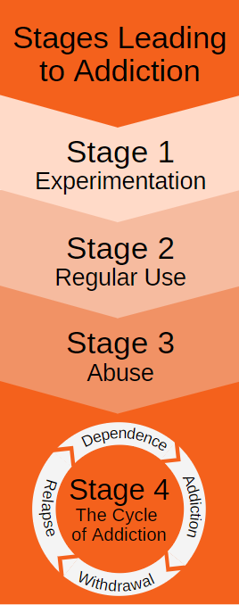
How does addiction happen?
Addictions & the Brain
*Gambling, gaming, etc.
2
Cocaine, Meth, Heroin
Certain substances change the way your brain responds to reward, and this is what creates addiction. Addiction can also occur when you form harmful habits over time, producing an effect in the brain similar to that of hard drugs.
Lets break down habits & the brains’ reward network
Notes:
Instructions: Read below.
Certain substances change the way your brain responds to reward, and this is what creates addiction. Addiction can also occur when you form harmful habits over time, producing an effect in the brain similar to that of hard drugs.
4 Stages Leading to Addiction:
🔍Student Activity Idea: Write down the stages leading to addiction
1. Experimentation (trying it)
2. Regular use (continuing it)
3. Abuse or Misuse (problems begin)
4. The Cycle of Addiction (when the addiction occurs)
Addiction can occur after a few uses or gradually over years of harmful habits.
⏭️ Many hard drugs – such as crack cocaine, meth, or heroin – can cause someone to move through these stages quickly if used.
Tobacco, alcohol, and marijuana (while legal at 21) are also addictive substances, especially if you begin using them before age 21. Addiction can occur quickly or from continued use over time.
⏭️ Gambling, gaming, and other behaviors can lead to addiction over time.
To understand this, we need to understand how our brain’s reward network forms habits.

Slide 6
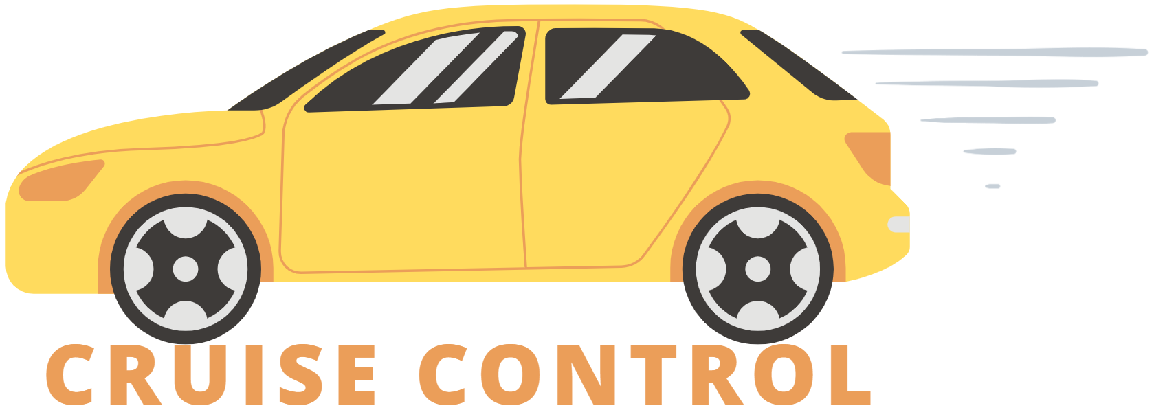
The Reward Network & Forming Habits
Addictions & the Brain
3
3
Top-Down Control Network:
Pre-frontal cortex
Like the breaks in a car.
Develops until age 25.
Habit Hub:
Dorsal Striatum
Like cruise control (autopilot) in a car.
Reward Hub:
Ventral Striatum
Like the gas pedal in a car.
Notes:
Instructions: Read slide.
Next 3 slides break this down.
_____________________________________________
Citation for Slides numbered 3 – 11:
³ Balodis I, Querney D, et al. 2017. Brain Connections: Problem Gambling Series. Gambling Research Exchange of Ontario and the Ministry of Health and Long-Term Care. Available from: https://brainconnections.ca/get-the-handouts

Slide 7
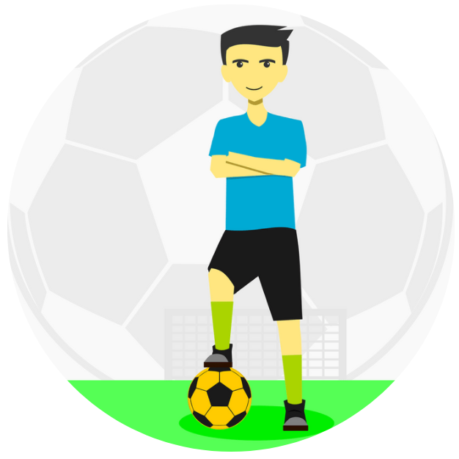
The Reward Network & Forming Habits
Addictions & the Brain
4
Reward Hub (Ventral Striatum):
This is like the gas pedal in a car.
Gives us the go signal to things we enjoy. In the brain, the reward chemical dopamine is released.
Allows us to want or anticipate rewarding things.
This is how we discover what we like, such as food and activities.
Notes:
Instructions: Read slide.
🔍Student Activity Idea: have students write down something interesting or surprising about how the brain forms habits from the next four slides.

Slide 8
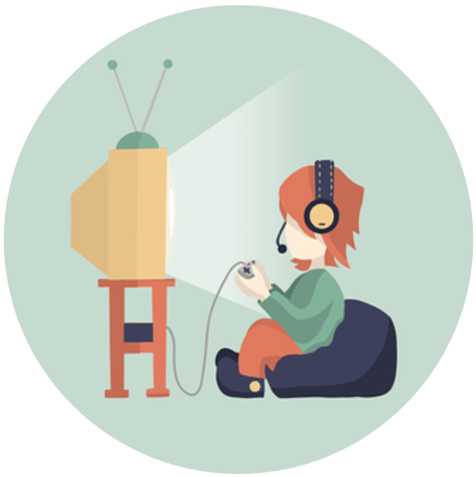
The Reward Network & Forming Habits
Addictions & the Brain
5
Habit Hub (Dorsal Striatum):
This is like cruise control in a car.
When we experience repeated rewards, we develop habits to repeat them. This is how we continue in activities we like.
For healthy habits, regular use helps increase knowledge and experience.
For some things like alcohol or gambling, losing control can lead to addiction.
Join a team, practice
Playing a video game
Continue eating foods you like
Notes:
Instructions: Read slide.

Slide 9
The Reward Network & Forming Habits
Addictions & the Brain
6
Top-Down Control Network:
Pre-frontal cortex
This is like the breaks in a car.
Processes information and allows us to make logical decisions.
Keeps us from overdoing activities or consuming too much.
This is developing until age 25.
Your brain could become wired for addiction as it develops if you start some things too early.
This is why we have age limits for alcohol, tobacco, marijuana, and even gambling.
Notes:
Instructions: Read slide.

Slide 10
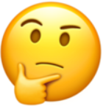
Top-Down Control Network in Action Scenario example: Hungry
Addictions & the Brain
7
GO!
Notes:
Instructions: Read below.
The Top-Down Control Network helps us stay healthy and apply logic to situations.
⏭️ So let’s say if you are hungry, and you remember when you ate too much sugar, you got sick.
⏭️ The Top-Down Control Network will keep you from overeating again.
⏭️ Learning how something is harmful to you can help prevent unwanted outcomes.
This is the same process for other things we choose to do, such as gambling, playing video games, and other activities.

Slide 11
What if the Top-Down Control Network isn’t working right?
Addictions & the Brain
8
“Are these breaks working?”

Slide 12
Addictions & the Brain
Stage 3: Abuse – Communication problem between “Gas and Brake Pedal”
9
This is when problems and negative effects develop.
Tolerance is developed: the amount of dopamine released in the brain is not enough, the desired effect is only achieved by increasing use.
Stay on cruise control, you start missing or ignoring signs to stop.
Seeing images of alcohol, drugs, or gambling triggers the brain to crave it because it was pleasurable or easy to escape other life problems.
150mph 50mph
Notes:
Instructions: Read slide.
Additional things to note:
Due to tolerance, the more you misuse or abuse a substance or risky behavior, it becomes less and less pleasurable.
It may be hard to stop, but you haven’t completely lost control.

Slide 13
Stage 4: The Cycle of Addiction
Addictions & the Brain
10
When someone loses control and is unable to stop easily – not really about doing it for fun anymore.
Becoming dependent:
The brain has changed to need that substance or activity.
Continued use can cause worsening health, stress, & depression.
Trying to quit is very difficult – treatment is available and designed to help break the cycle of addiction.
Notes:
Instructions: Read slide.
Examples of difficulty to quit:
Tobacco: It takes the average person 7 times to quit tobacco use when addicted.
Alcohol: In extreme cases, physical withdrawal can cause death.
Additional things to note:
For gambling, this is called disordered gambling: Moderate to severe problem gambling identified by a medical professional.
When someone recognizes they have a problem, support from family and friends is important to help break the cycle of addiction.

Slide 14
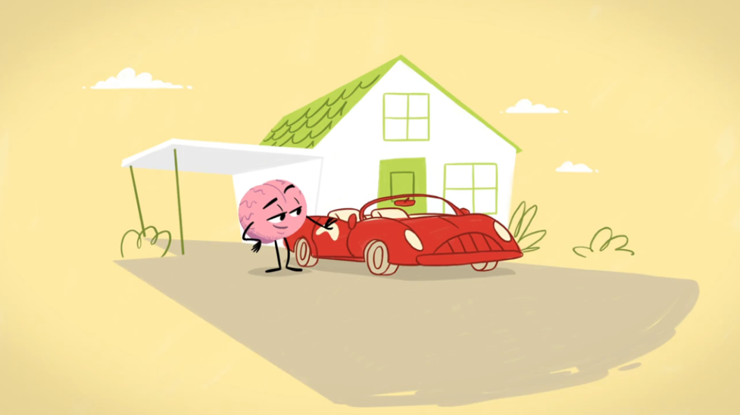
Gambling and the Brain
Addictions & the Brain
11
Brain Connections: www.youtube.com/watch?v=OGIz8mocgGo
Notes:
Instructions: Play video (stop at 2:07m mark).
🔍Student Activity Idea: have students write down something that sticks out to them from the video.
Video: Brain Connections, found at: www.youtube.com/watch?v=OGIz8mocgGo

Slide 15
Okay… So am I at risk for developing a problem?
Addictions & the Brain
12

Slide 16
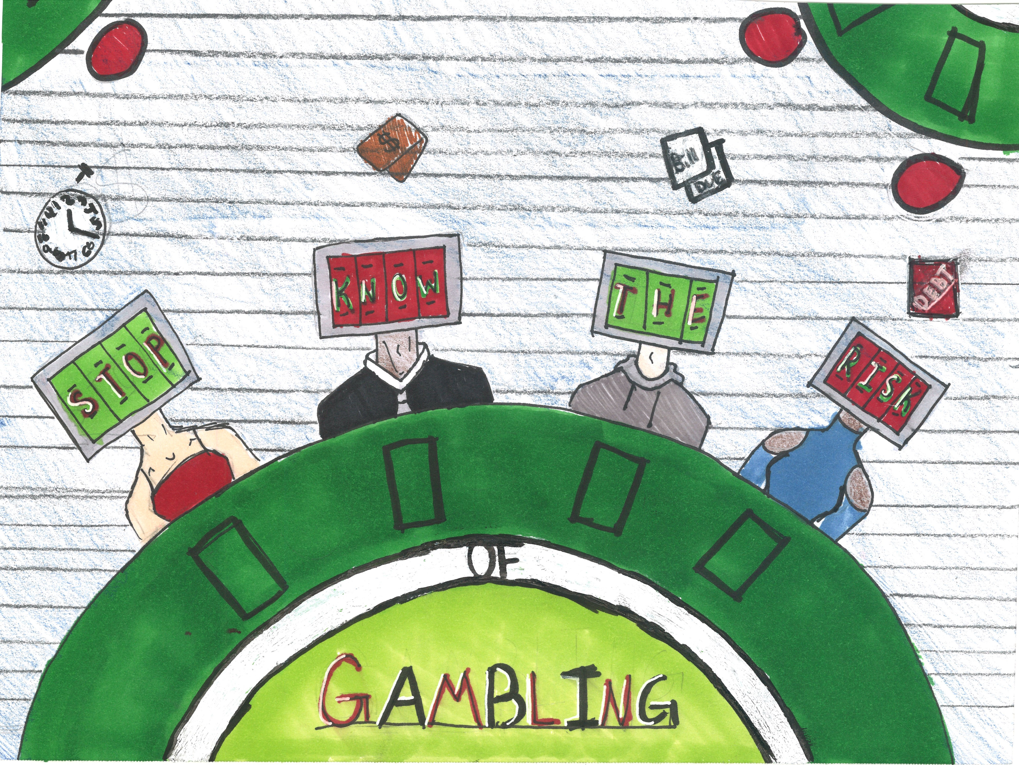
Risk Factors for Alcohol, Drugs, and Gambling Problems
Addictions & the Brain
4
13
Genetics: People with alcohol, drug, or gambling problems or addictions in their family are more likely to have a problem with the same thing.
Age: The Top-Down Control Network develops later for teenagers and young adults.
Difficulty controlling impulses.
Your brain may not develop properly.
Mental Health: Having a mental health condition, such as depression.
Notes:
Instructions: Read slide. Risk factors continued on next slide.
Additional things to note:
None of these risk factors mean you will automatically form an addiction. They increase the chances of forming an addiction.
_____________________________________________
Citation:
⁴ NIDA. 2018, June 6. Understanding Drug Use and Addiction DrugFacts. Retrieved from https://www.drugabuse.gov/publications/drugfacts/understanding-drug-use-addiction on 2021, July 22

Slide 17
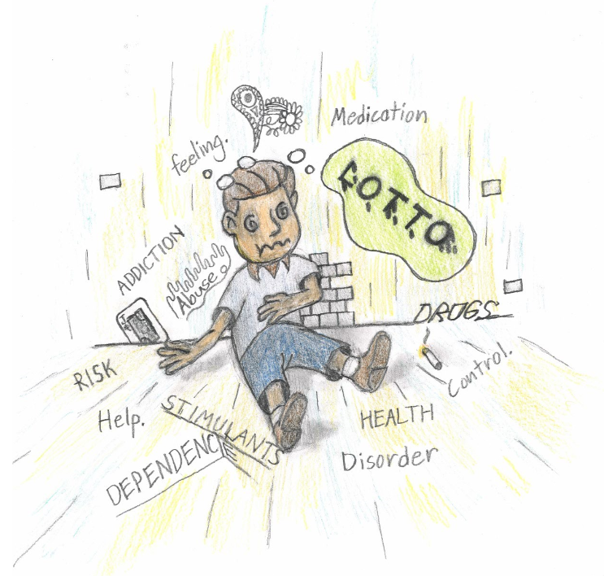
Risk Factors for Alcohol, Drugs, and Gambling Problems
Addictions & the Brain
4
14
Environment:
Access: Having access to gambling, alcohol, and drugs.
Friends: Having friends who do it.
Other Addictions: When someone experiences an addiction, it is common for them to struggle with other addictions at the same time. ^{3,4}
Stress: Trying to escape from stressful times in life or traumatic situations.
Notes:
Instructions: Read slide.
Additional things to note:
None of these risk factors mean you will automatically form an addiction. They increase the chances of forming an addiction.
Some of these risk factors can be applied to other behaviors you can form addictions to, like problem video gaming.
Citation:
⁴ NIDA. 2018, June 6. Understanding Drug Use and Addiction DrugFacts. Retrieved from https://www.drugabuse.gov/publications/drugfacts/understanding-drug-use-addiction on 2021, July 22

Slide 18
Gambling Facts
Prepared by
Problem Gambling Prevention Program
Notes:
Now that we have a better understanding of how addiction work in our brain, lets discuss some facts about gambling that are important to remember.
Estimated length: 10 minutes

Slide 19
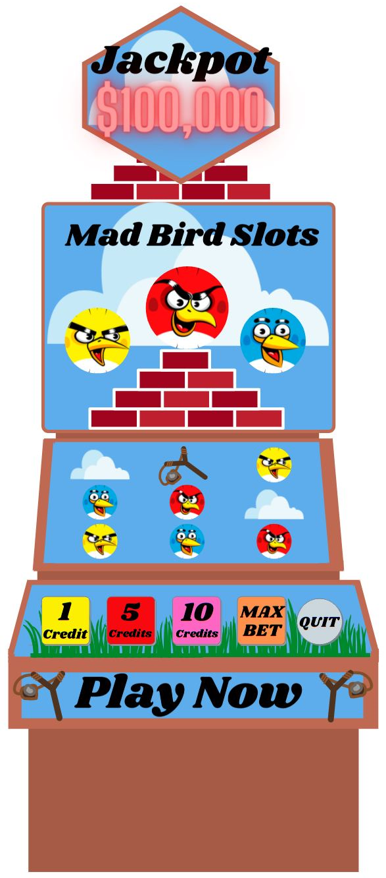
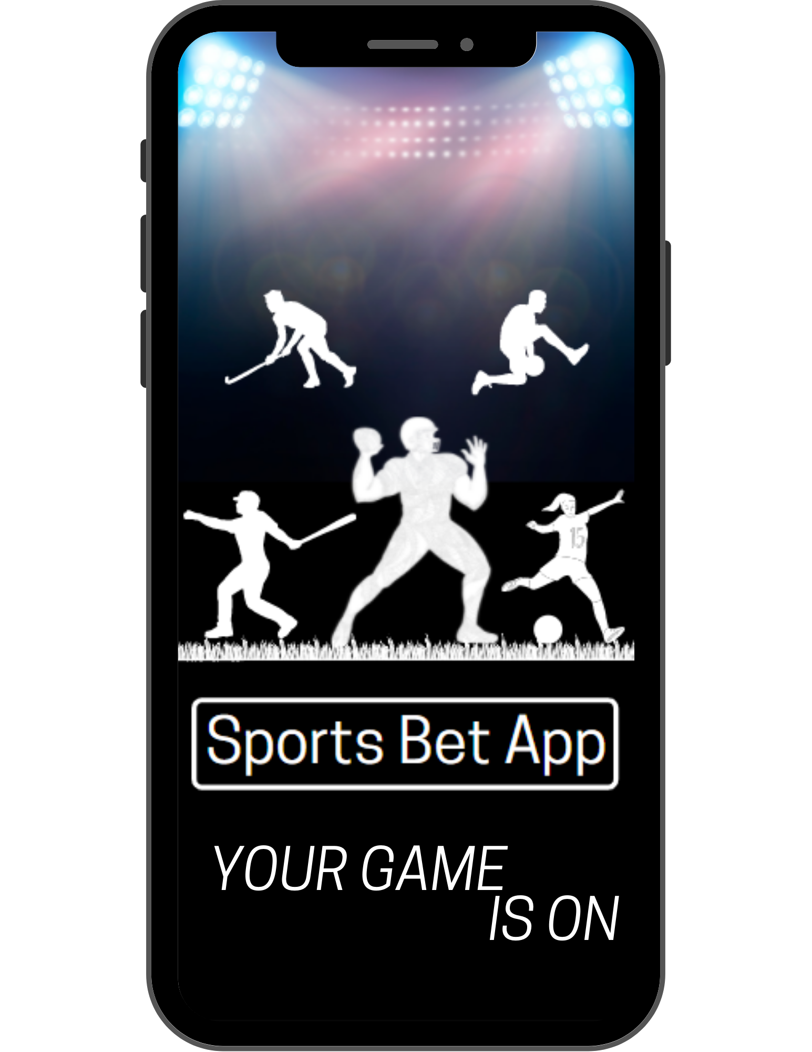
History of Gambling in Oregon
Gambling Facts
1933: Gambling on dog and horse races legalized nationally
1984: Oregon Lottery ratified into Oregon Constitution
1988: Indian Gambling Regulatory Act authorizes tribal casinos
1992: Video Lottery introduced & problem gambling treatment programs begin
2005: Problem gambling prevention programs begin
2014: www.OPGR.org website launched
2019: Sports betting becomes available on mobile devices
Notes:
Optional Slide: Read slide

Slide 20
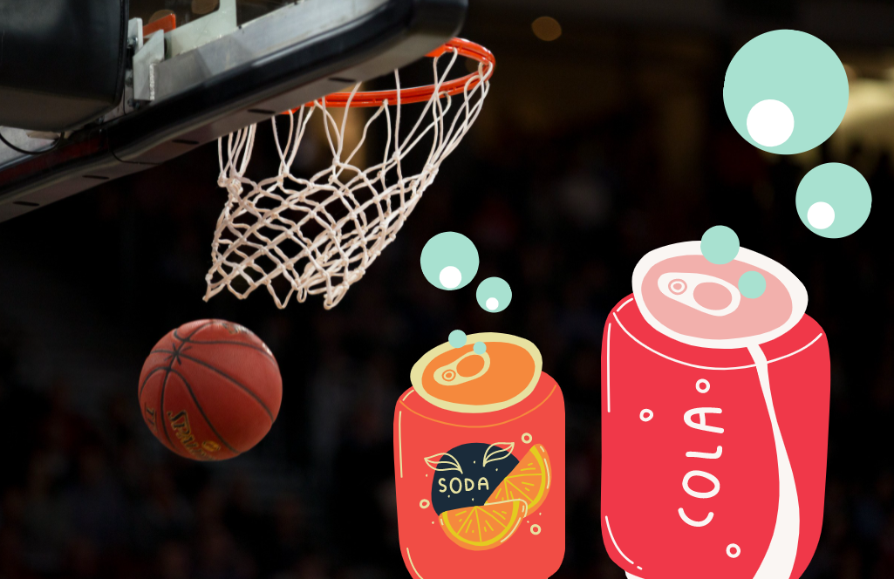
Gambling isn’t just about money
Gambling Facts
1
Gambling: Risking money or something of material value on an event with an uncertain outcome with the hope of winning something of even greater value.
So… Betting a soda on
a game of basketball is
considered gambling
Notes:
Instructions: Read slide.
Examples include:
Betting a soda on a game of basketball is considered gambling.
Betting your chores with a sibling.
When a serious problem for an adult, betting a car or money needed to pay the bills.

Slide 21
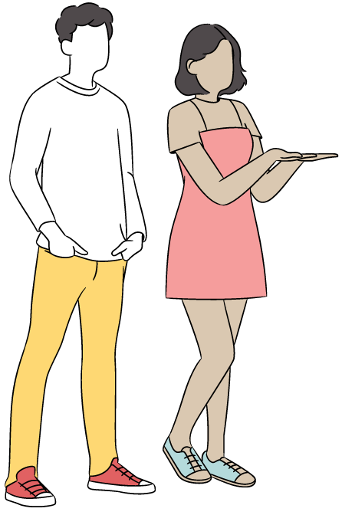
Gambling is a risky activity.
Gambling Facts
Oregon Teens:
Most teenagers don’t gamble regularly.
Teens who do gamble regularly, regardless of if they lose a bunch of money or not, are more likely to experience:
Depression
Suicidal thoughts
Drug and alcohol use
Lower grades
2
5
Notes:
Instructions: Read slide.
_____________________________________________
Citation:
⁵ Oregon Health Authority. 2018. Student Wellness Survey. Retrieved from https://www.oregon.gov/oha/PH/BIRTHDEATHCERTIFICATES/SURVEYS/Pages/Student-Wellness-Survey.aspx

Slide 22
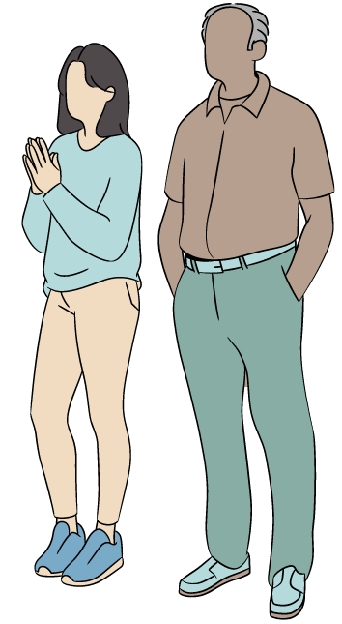
Gambling is a risky activity.
Gambling Facts
Oregon Adults:
Most adults who gamble regularly don’t have a problem gambling.
8% of adults are estimated to have a low to severe gambling problem: that is 269,489 people!
Adults with a gambling problem are more likely to experience:
Depression
Suicidal thoughts
Drug and alcohol problems
3
2
Notes:
Instructions: Read slide.
(On bullet one): If adults choose to gamble, they should do it responsibly by setting a time limit, setting a money limit, and not playing to make money.
(On bullet two): You could fill the Moda Center where the Portland Trail Blazers play over 12 times with 269,489 people!
_____________________________________________
Citation:
² More TL. 2018. Gambling and Problem Gambling in Oregon. Oregon Council on Problem Gambling. Retrieved from: https://oregoncpg.org/the-gambling-landscape-in-Oregon

Slide 23
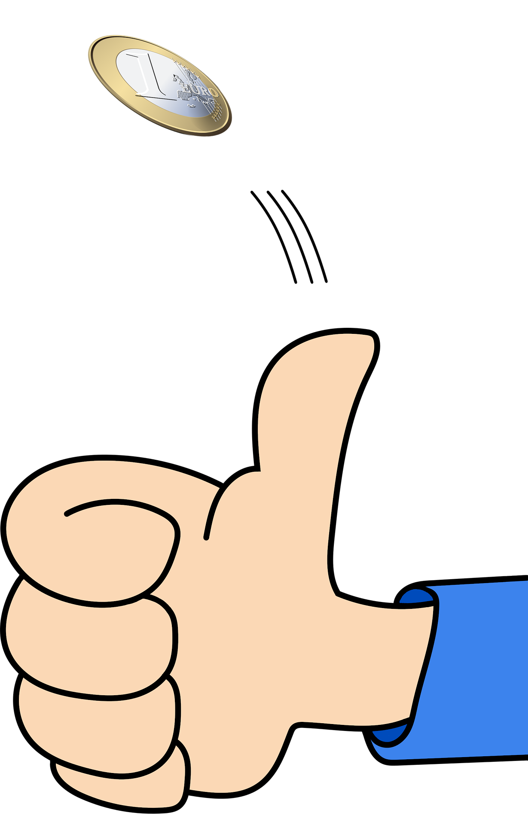
How Gambling Odds Work
Gambling Facts
4
The odds are the same each time a person gambles. Past events do not change future outcomes.
Example: Flipping a coin. A coin flip is a 50-50 chance heads or tails. If it comes up heads 5 times in a row, it still has a 50-50 chance of coming up heads or tails.
People experiencing a problem with gambling may forget this!
Notes:
Instructions: Read slide.

Slide 24
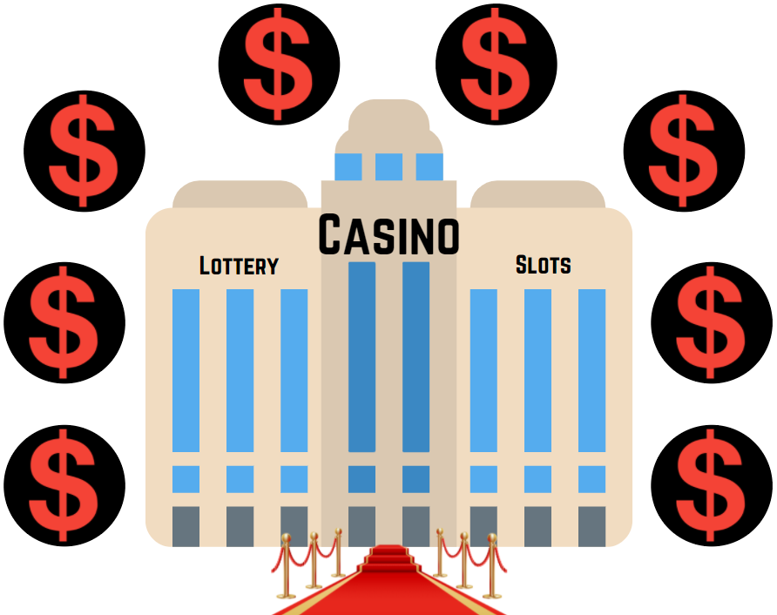
The House Always Wins!
Gambling Facts
5
WHY?
Statistical Law of Large Numbers: The more a game of chance is played, the more likely the overall outcome will match the odds. ²⁰
Gambling odds are never in your favor! Statistically, it is impossible to make money gambling in the long run.
Notes:
Instructions: Read slide.
Example: if you have a 20% chance of winning money on a certain gambling game, you might win a few times, but over time you will lose close to 80% of the time.
_____________________________________________
Citation:
²⁰ Routledge, R. (2016, October). Law of large numbers. Encyclopedia Britannica. Obtained from https://www.britannica.com/science/law-of-large-numbers

Slide 25
Powerball Jackpot Simulation
Gambling Facts
Class Activity!
Write down 6 different numbers between 1 & 70.
Stand when all your numbers are written.
Calling Numbers:
Sit if any of your numbers were not called.
Match all 6 numbers in exact order, you win!
Notes:
Optional Slide: Read slide.
Have the students write on their student worksheet (or notebook) their six numbers.
Ask students to be honest and not cheat.
Use a random number generator between 1 and 70 to quickly pick numbers. Google has one.
Call numbers until everyone is seated. It’s all or nothing!

Slide 26
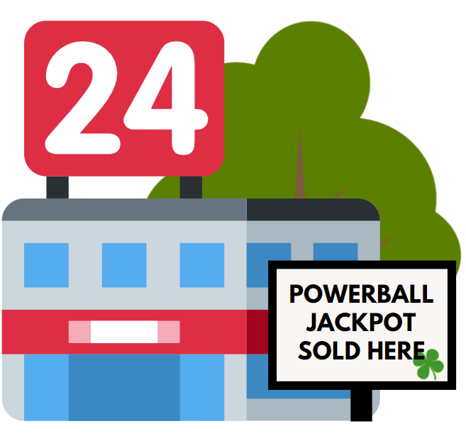
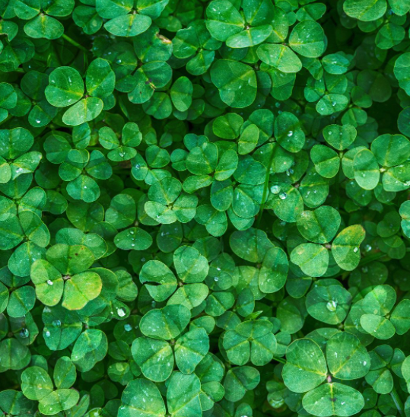
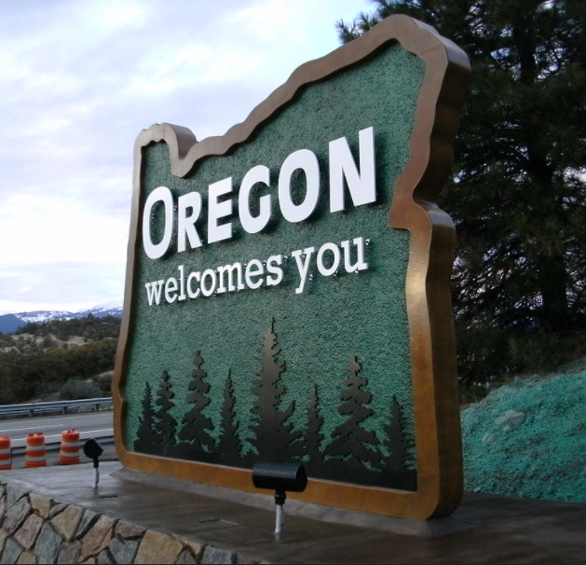
Winning the Powerball Jackpot Grand Prize
Gambling Facts
6
Odds of a four leaf clover:
1 in 10,000 ⁶
Odds of being struck by lightning: 1 in 500,000 ⁷
Odds of any Oregon Adult being picked to win: 1 in 3,368,619 ⁸
Odds of winning the Powerball Jackpot: 1 in 292,200,000 ⁹
Notes:
Instructions: Read slide.
🔍Student Activity Idea: have students write down the odds of winning the Powerball Jackpot.
After reading Powerball Jackpot Odds:
If you bought 10 tickets every day, you would average a Powerball Jackpot win once every 80,000 years.
No amount of skill will improve the odds of winning a “game of chance.”
_____________________________________________
Citations & Photo Credit:
⁶ Knowles E. 2016. What Are Your Chances of Finding a Four-Leaf Clover? The Science Explorer. Retrieved from http://thescienceexplorer.com/nature/what-are-your-chances-finding-four-leaf-clover on July 22, 2021.
⁷ Centers for Disease Control & Prevention. 2013. Lightning Strick Victim Data. Retrieved from https://www.cdc.gov/disasters/lightning/victimdata.html on July 22, 2021.
⁸ US Census. 2019. Retrieved from https://data.census.gov/cedsci/table?q=Oregon&tid=ACSDT1Y2019.B01003&hidePreview=true on July 22, 2021.
⁹ Powerball. Multi-State Lottery Association. Retrieved from https://www.powerball.com/games/home on July 22, 2021.
Oregon Sign Photo Credit: Oregon Department of Transportation, obtained from https://www.flickr.com/photos/oregondot/5136383424. This photo was not edited.

Slide 27
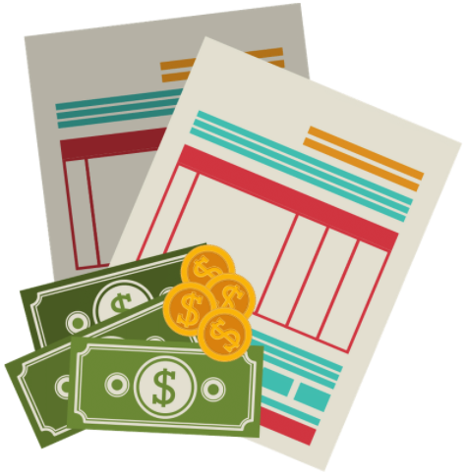
How much money do adults in Oregon lose by gambling each year?
Gambling Facts
7
2020 revenue from the Oregon Lottery:¹⁰
$1.14 billion
2017 gaming revenue from nine Oregon Tribal Casinos:¹¹
$499 million
Money from other gambling activities: ^{Unknown}
In Oregon, the average person in treatment for problem gambling owes gambling related debts of:²
$23,375
Notes:
Instructions: Read slide.
Additional notes:
We don’t know exactly how much Oregon adults spend out of state, informally, or illegally.
After reading debts: $23,375 debt means they lost money they had and then went into this amount of debt.
Gambling problems can be an easily hidden addiction.
_____________________________________________
Citations:
¹⁰ Oregon Lottery. 2020. Oregon Lottery Comprehensive Annual Financial Report. Oregon State Lottery. 22. Retrieved from https://www.oregonlottery.org/assets/wp-content/uploads/2020/12/FY-2020-Oregon-Lottery-CAFR-FINAL.pdf on July 22, 2021.
¹¹ Rollier J, Whelan R. Nov 25, 2019. The Contributions of Indian Gaming to Oregon’s Economy in 2016 and 2017. EcoNorthwest. 17. https://www.otga.net/wp-content/uploads/FINAL-2016-2017-OTGA-Report-Nov-25-2019.pdf

Slide 28
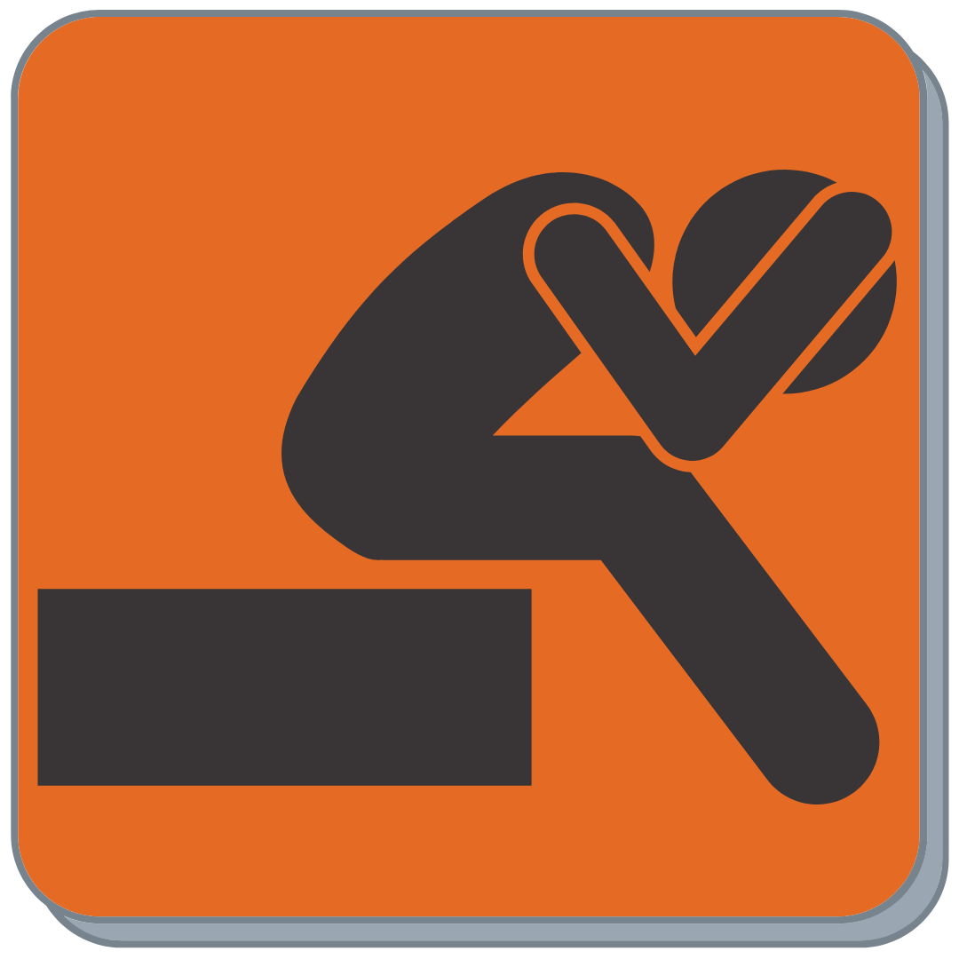
Signs of a problem: For both Gambling & Alcohol^{12, 13}
Gambling Facts
Increasing time/money spent
Escaping problems (stress, anxiety, depression, etc.)
Withdrawal (irritable or sick when stopped)
Cravings (think about it a lot)
Increases risky behaviors
Less desire to engage in other activities or interests
Creates problems with loved ones, work, or school
Unsuccessful attempts to stop
Notes:
Optional Slide: Read slide.
Increases risky behaviors: For gambling, this could be playing with money needed for something else, or chasing losses (trying to win back money lost).
_____________________________________________
Citations:
¹² Oregon Problem Gambling Resource. Retrieve from https://www.opgr.org/prevention-resources/ on July 22, 2021.
¹³ National Institute on Alcohol Abuse and Alcoholism. Retrieved from https://www.niaaa.nih.gov/alcohols-effects-health/alcohol-use-disorder on July 22, 2021.

Slide 29
Video gambling: one of the most addictive types of gambling.
Gambling Facts
8
70%
2,000
MOST
of Oregonians in treatment for problem gambling say video gambling is their main form of gambling.²
locations have video gambling across
Oregon.¹⁴
of the money made from casinos and the Oregon Lottery comes from video gambling machines (slots, video poker, video lottery).^{10,11}
Notes:
Instructions: Read slide.
_____________________________________________
Citations:
¹⁴ Oregon Lottery. Retailer List. Oregon State Lottery. Retrieved from https://www.oregonlottery.org/retailers/list/ on July 22, 2021.

Slide 30
Industry tactics
Prepared by
Problem Gambling Prevention Program
Notes:
How does the gambling industry try to get people to gamble more? In this section, we will look at how their products, casinos, and advertisements try to influence our decisions.
Estimated length: 10 minutes

Slide 31
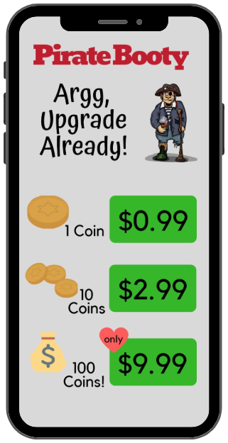
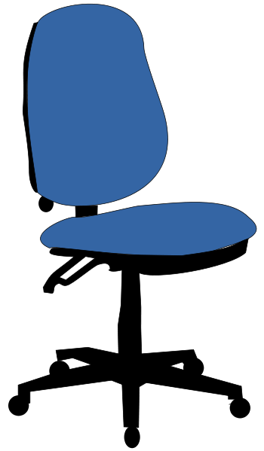
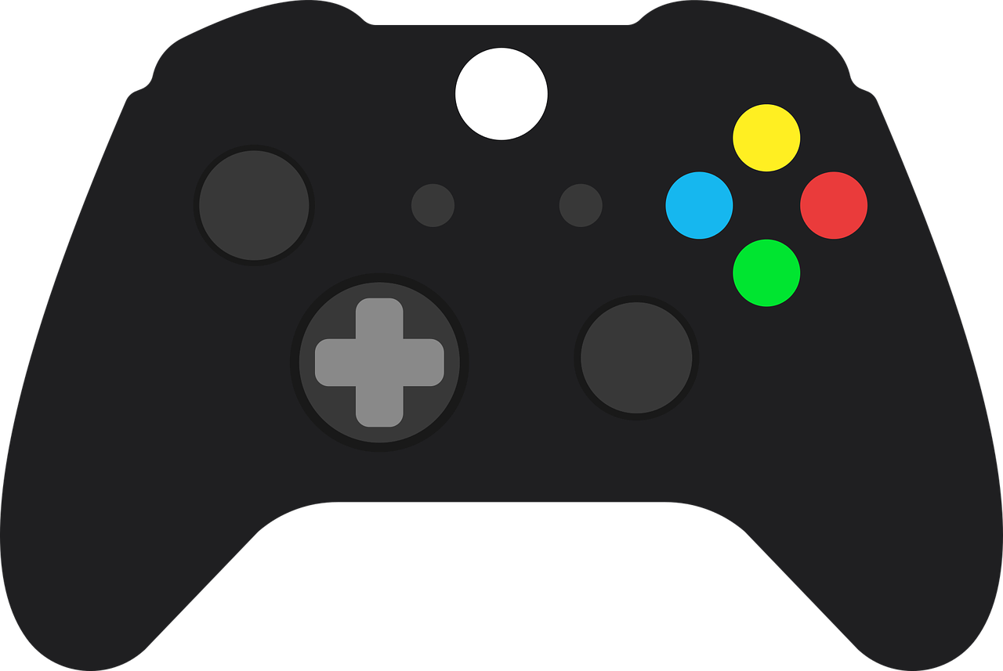
Discussion: What are some similarities between video gambling and video games (on a phone or console) to get people to use their products more?
Appealing Products: Gambling & Gaming
Industry Tactics
1
Flashy graphics, lights, sounds
Faster play
Play with credits
Gambling in video games
Tons of games
Lose track of time
Spending more money to increase reward
On a comfortable device
Notes:
Instructions: Read below.
Briefly, for :30sec – 1m ask students: What are some similarities between video gambling and video games (on a phone or console) to get people to use their products more?
🔍Student Activity Idea: have students write down similarities between video gambling and gaming.
Explanation with each similarity:
⏭️ Flashy graphics, lights, sounds: makes games more exciting.¹⁶
⏭️ Faster play:
Video Slot Machines use buttons to bet every few seconds.¹⁷
Video game companies might design some games that you complete faster so you want to buy a new one sooner.
⏭️ Play with credits: Some slot machines and phone games have in-game currency or credits, removing dollars from the game purchases used to advance.¹⁸
⏭️ Gambling in video games: loot boxes and other gambling themes are incorporated into games. ¹⁹
⏭️ Tons of games: If you get bored with one video gambling or video games, there are more options for other games.
⏭️ Lose track of time: Some video games and video gambling machines are designed to immerse people into the game, losing sense of time. This is how people can play video games or gamble for hours on end.¹⁷
7. ⏭️ Spend more money to potentially increase reward:
Video gambling machines have options to bet more to “increase your odds.” This could mean betting x10 or more to slightly increase your odds, so you lose faster.¹⁷
In App purchases and loot boxes will show ask you to spend more for more reward. However, what you’re purchasing is often worthless.
⏭️ Played on a comfortable device:
Video Slot Machines have ergonomic chairs and easy to use buttons and touch screens so you can spend hours without getting tired.¹⁷
Video game controllers and phones are made to fit your hand so it doesn’t cramp. Phones are also a device we use every day.
Overall message: These products are intentionally designed to make money, and they use human psychology and scientific research to make their products more appealing – and potentially addicting!
_____________________________________________
Citations:
¹⁶ Marcia L. Spetch, Christopher R. Madan, Yang Liu, Elliot A. Ludvig. Effects of Winning Cues and Relative Payout on Choice between Simulated Slot Machines. Addiction, 2020; DOI: 10.1111/add.15010. Retrieved from https://pubmed.ncbi.nlm.nih.gov/32056323/ on July 22, 2021.
¹⁷ Plumer B. March 2015. Slot-machine science. Vox. Retrieved from https://www.vox.com/2014/8/7/5976927/slot-machines-casinos-addiction-by-design on July 27, 2021.
¹⁸ Fong J, Lee D. July 2016. How free mobile games are designed to make money. Vox. Retrieved from https://www.vox.com/2016/7/21/12247428/how-free-games-make-money on July 22, 2021.
¹⁹ Zendle D, et al. July 2019. Paying for loot boxes is linked to problem gambling, regardless of specific features such as cash-out and pay-to-win. Computers In Human Behavior. Retrieved from https://www.researchgate.net/publication/334318121_Paying_for_loot_boxes_is_linked_to_problem_gambling_regardless_of_specific_features_such_as_cash-out_and_pay-to-win on July 27, 2021.

Slide 32
Appealing Casinos: Keeping People Gambling
Industry Tactics
Discovery News: www.youtube.com/watch?v=9THLOo7WWoQ
Notes:
Optional Slide: Play video on Youtube.
This video discusses ways the gambling industry gets you to gamble more (video length, 4:24):
Video Name: How Casinos Trick You Into Gambling More on Youtube: https://www.youtube.com/watch?v=9THLOo7WWoQ
If needed for time, stop video at 2:24
Please mention to students: This is what big casinos in Vegas do. Tribal casinos may use some of these tactics in Oregon, but they are a much smaller industry.

Slide 33
Appealing Advertisements: Tobacco, Alcohol, & Gambling
Industry Tactics
Discussion: What is the purpose of advertising in general?
2
Advertisers try to convince individuals that using their product will make their life better or more enjoyable.
Actors are often young, healthy people, celebrities, or cartoon mascots.
Ads may not tell you the risks of the product, or downplay the risks or potential harms.
Smoking, drinking, and gambling are learned habits. The industry tries to get people to acquire and maintain that habit.
Notes:
Instructions: Read slide.
Briefly, for :30sec – 1m ask students: What is the purpose of advertising in general?
(Possible answers: Persuade people to buy their product; portray an appealing product)

Slide 34
Getting Help
Prepared by
Problem Gambling Prevention Program
Notes:
There are things you can do to prevent an addiction or use disorder, and if you do develop a problem, recovery is possible! In this section, we will discuss how to get help for problem gambling, mental health, and other substance use problems.
Remember: Your worth is constant – You Matter! Everyone is worthy of a happy, fulfilling life!
Estimated length: 5 minutes

Slide 35
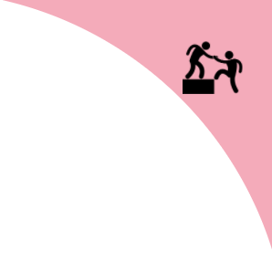
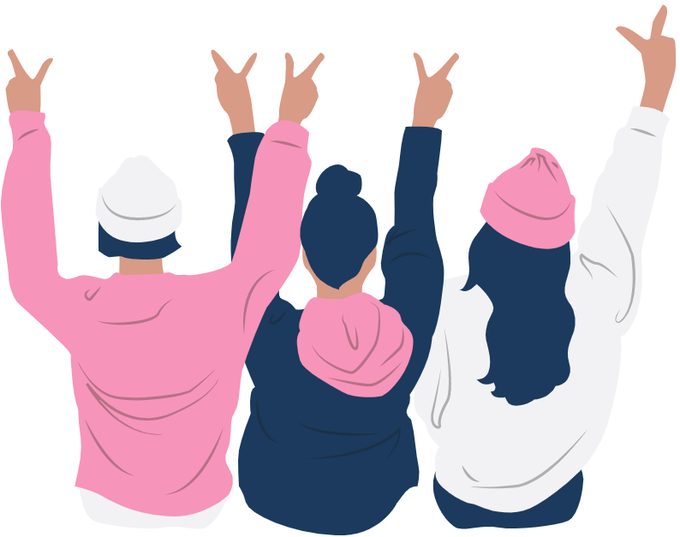
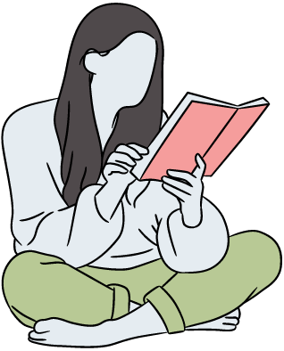
How to Prevent Addictions and Misuse Disorders
Getting Help
15
1
Participate in your favorite hobbies, like sports, music, and clubs.
Strengthen healthy relationships with friends and family.
Learn a new skill and enhance skills you have.
Maintain a strong bond to school.
Reach out for help when life is hard.
Notes:
Instructions: Read slide.
Briefly, for :30sec – 1m ask students: What do you do to avoid addictions?
_____________________________________________
Citation:
¹⁵ Youth.gov. Retrieved from https://youth.gov/youth-topics/risk-and-protective-factors on July 22, 2021.

Slide 36
If someone in your life struggles with a disorder or addiction, remember the 7 C’s:
Getting Help
2
I didn’t cause it.
I can’t control it.
I can’t cure it.
I can learn to cope with it.
By taking better care of myself.
By communicating my feelings.
By making healthy choices.
Notes:
Instructions: Read slide.

Slide 37
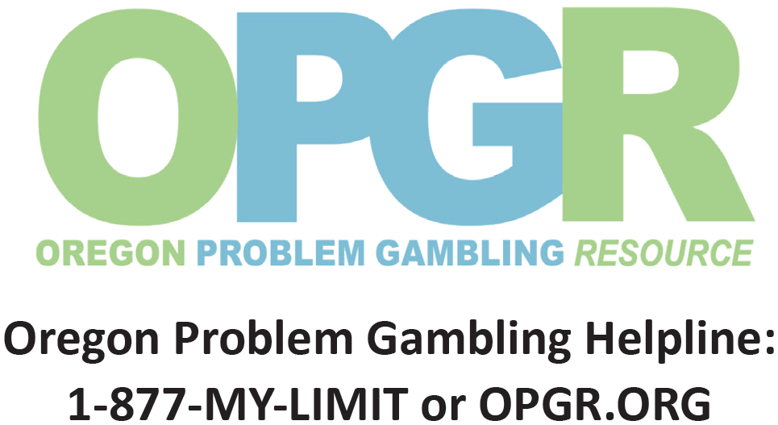
Problem Gambling Help in Oregon
Getting Help
3
Help is FREE in Oregon
Confidential
For people who gamble
For family and friends of a person who gambles
Notes:
Instructions: Read slide.

Slide 38
Additional Help & Support for Teens
Getting Help
4
School Counselor
Al-Anon / Alateen: support for a family members’ alcohol problems
Helplines: FREE help for tobacco, alcohol, and drugs at Helplines.MCHealthy.net
Oregon YouthLine: Teen’s helping teens with stress, anxiety, mental health, and more. No problem is too big or small!
Notes:
Instructions: Read slide.
🔍Student Activity Idea: have students write down one person they can talk to during times of crisis.

