Slide 1

deschutes county road department gravel road conversion pilot projects
(otta seal and AC grindings)
March 15, 2016 enhanced gravel road workshop

Slide 2
Existing gravel road maintenance program
System Data:
  200 miles of gravel road
  Maintenance demand/service levels:
Activity/Data | High | Medium | Low
Grading frequency | 2 or 3 times per year | Annually or every other year | Infrequent/upon request
Dust palliative | Annual | None | None
Material add | 8+/- years | 12+/- years | >20 years
$/Mile/Year | $5,000/$7,500 | $2,500/$3,500 | <$1,500
# of miles +/- | 50 | 70 | 80
Local/Residential road annual surface maintenance (paved): $6,000/$8,000/mi/yr.

Slide 3
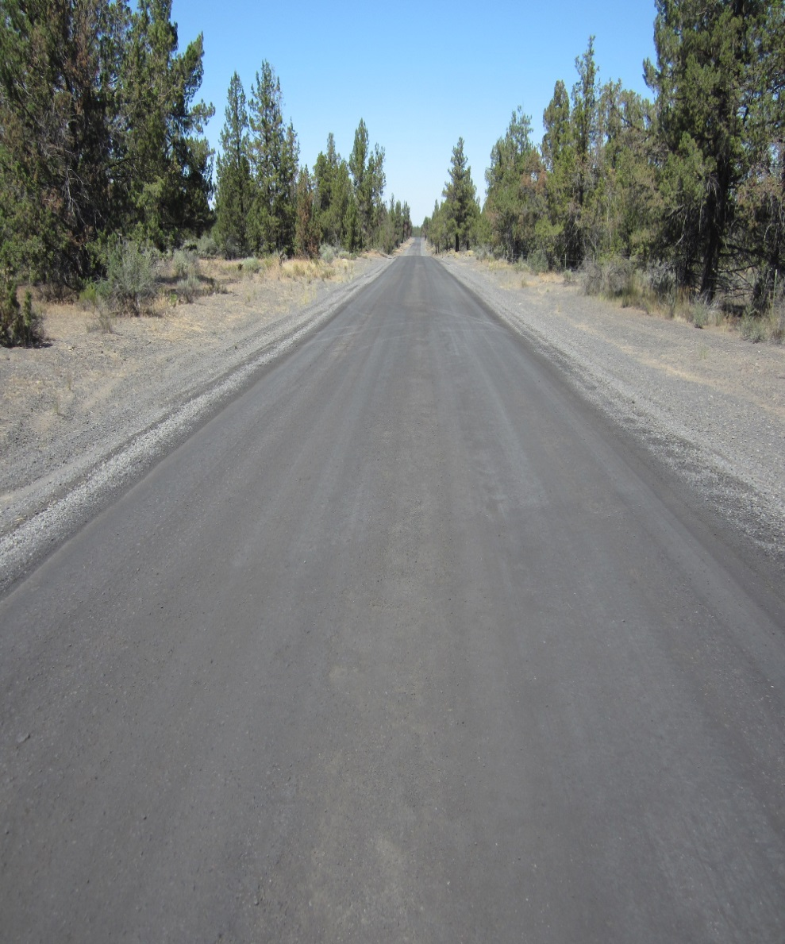
Current Dust abatement program
Deschutes County has used Magnesium Chloride for 10-15 years.
Magnesium Chloride is hygroscopic. It draws and attracts moisture from the atmosphere to provide a wet looking surface and reduce airborne dust particles.
Deschutes County has experimented with other products.
Magnesium Chloride: The best dust palliative for roads in the high desert.
  Hygroscopic in low humidity
Added benefit of material stabilization.

Slide 4

The problem: high maintenance gravel roads
1. Negative attributes of Magnesium Chloride dust palliative.
  Draws fines to surface which create slick and mucky conditions during freeze/thaw periods.
  Sticks to tires/wheels and tracks into driveway/garage.
  Can impact some roadside vegetation (Juniper kill).
2. Customer dissatisfaction with road condition and negative attributes:
  Leads to more service requests
  Higher costs
3. Rural gentrification
  City folk moving to the country
4. Other issues

Slide 5
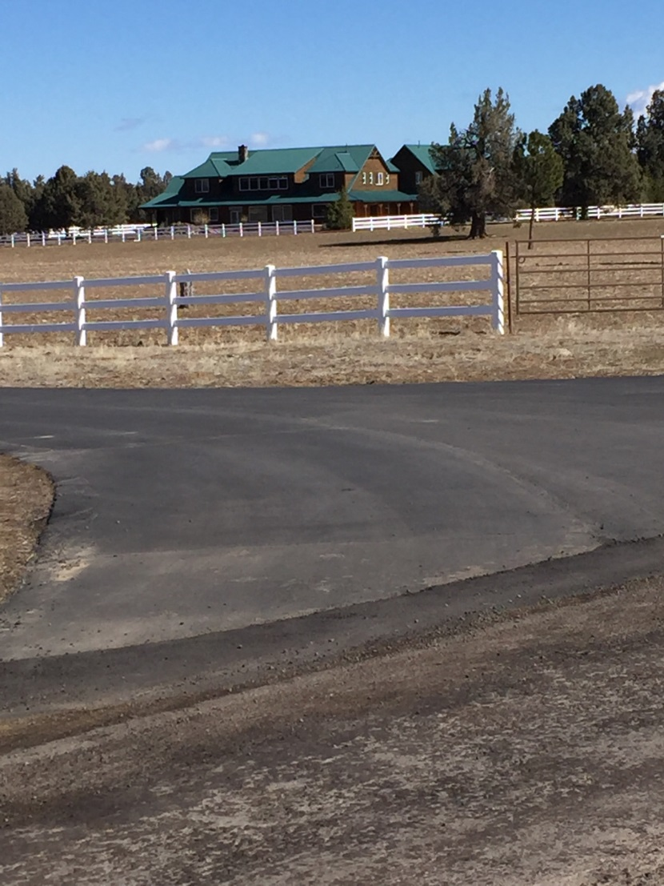
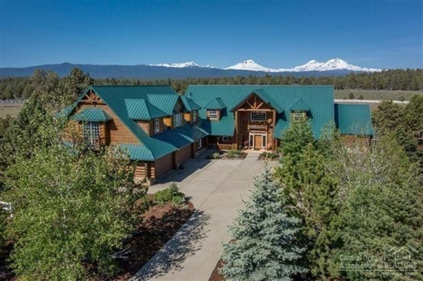
18540 nw plainview road: $1.4M

Slide 6
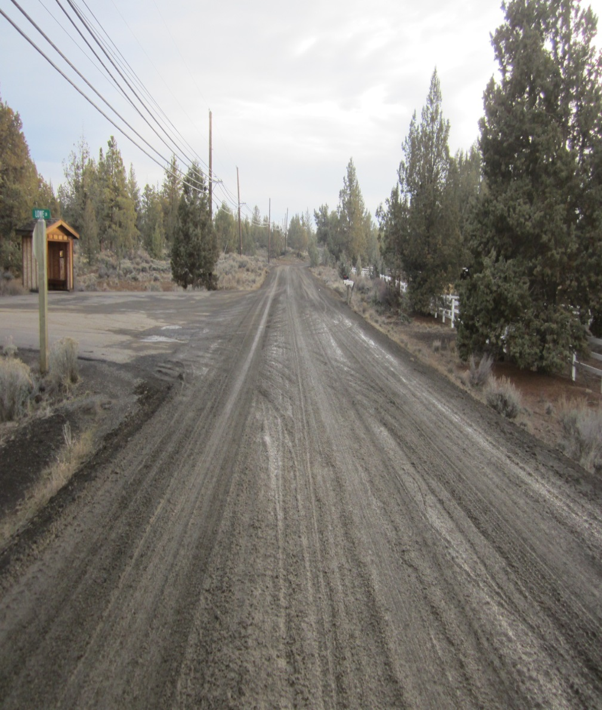
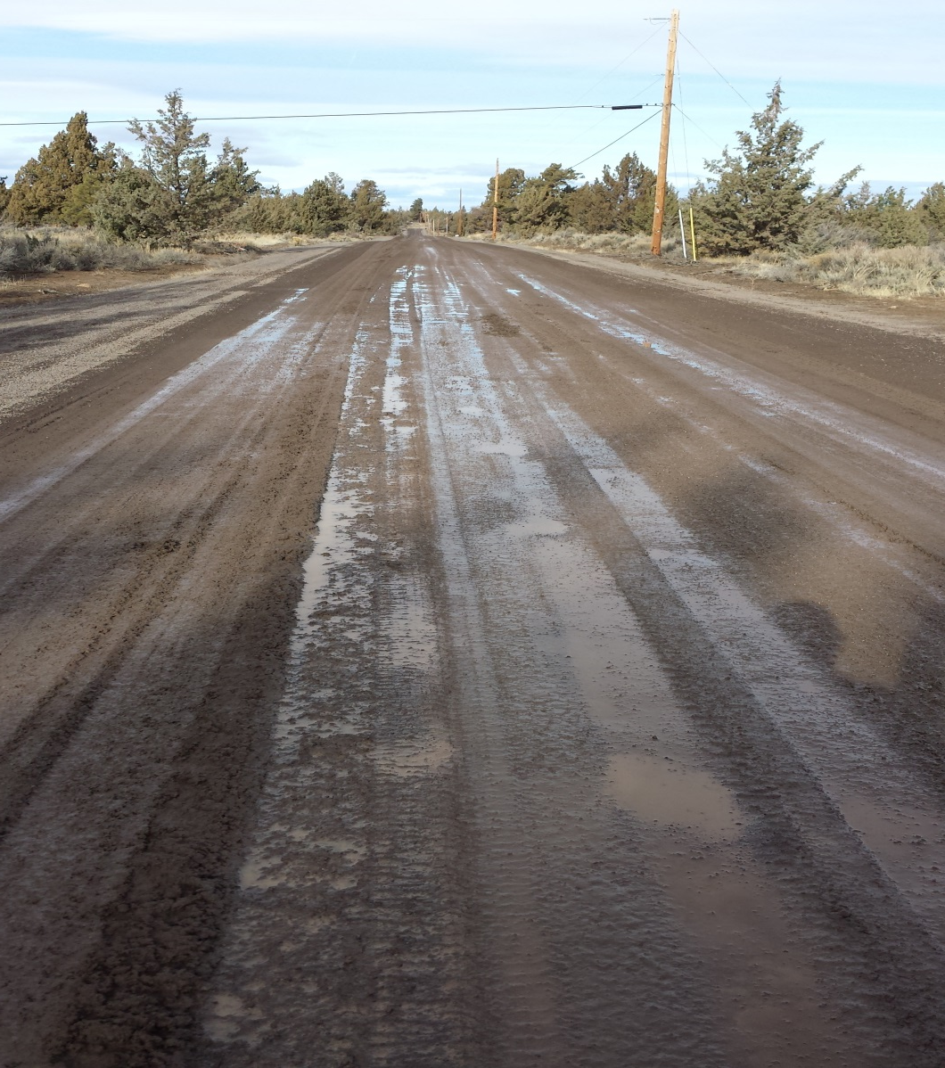
Road treated with Magnesium Chloride freeze/thaw

Slide 7
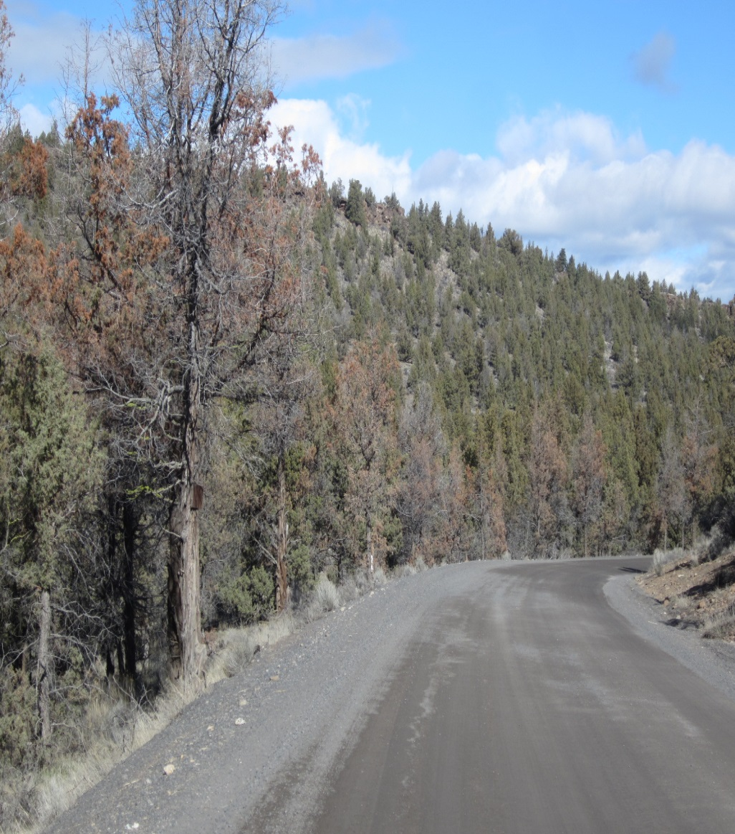
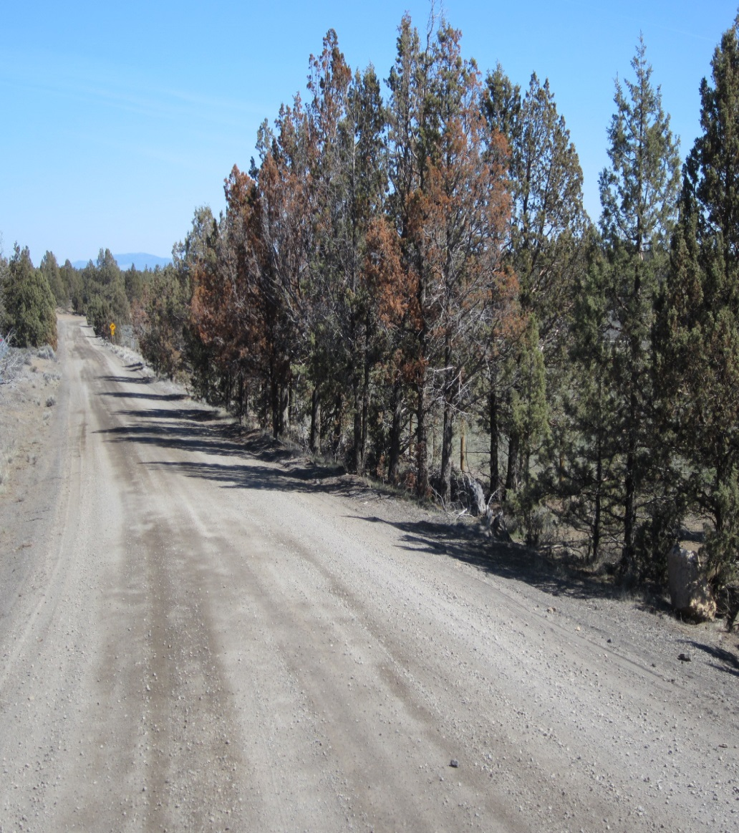
Road treated with magnesium chloride tree kill

Slide 8
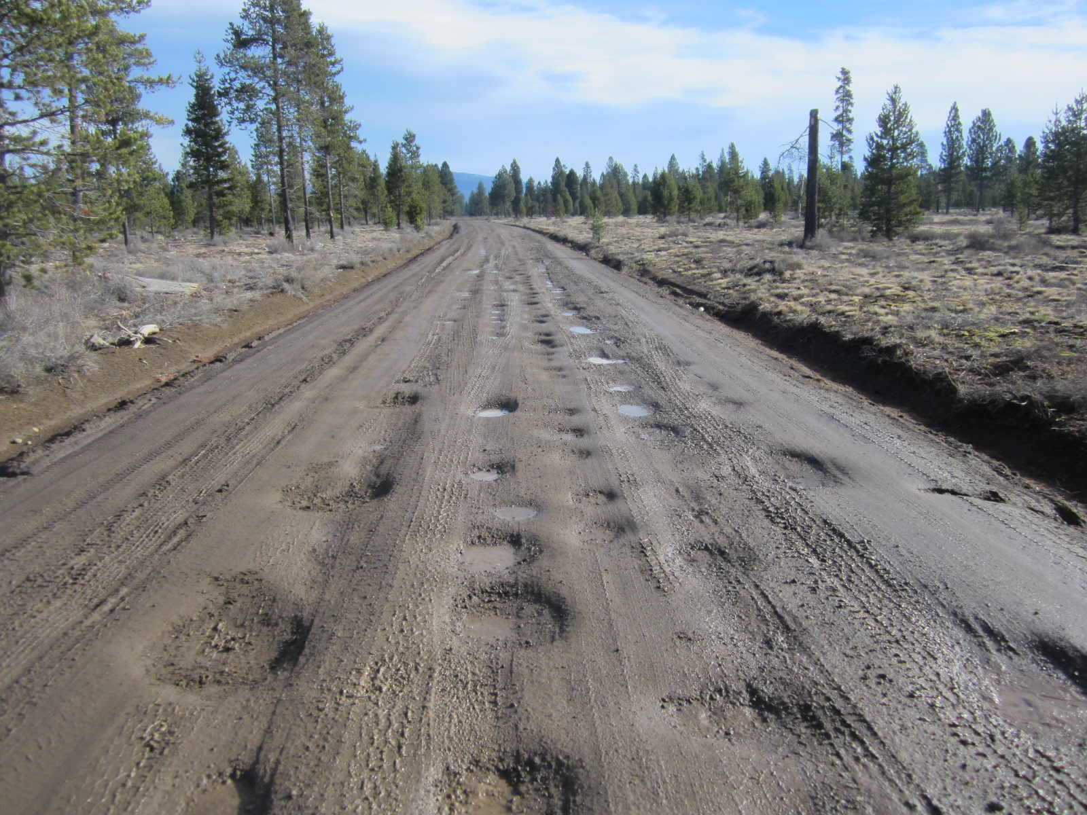
Road treated with magnesium chloride potholing

Slide 9
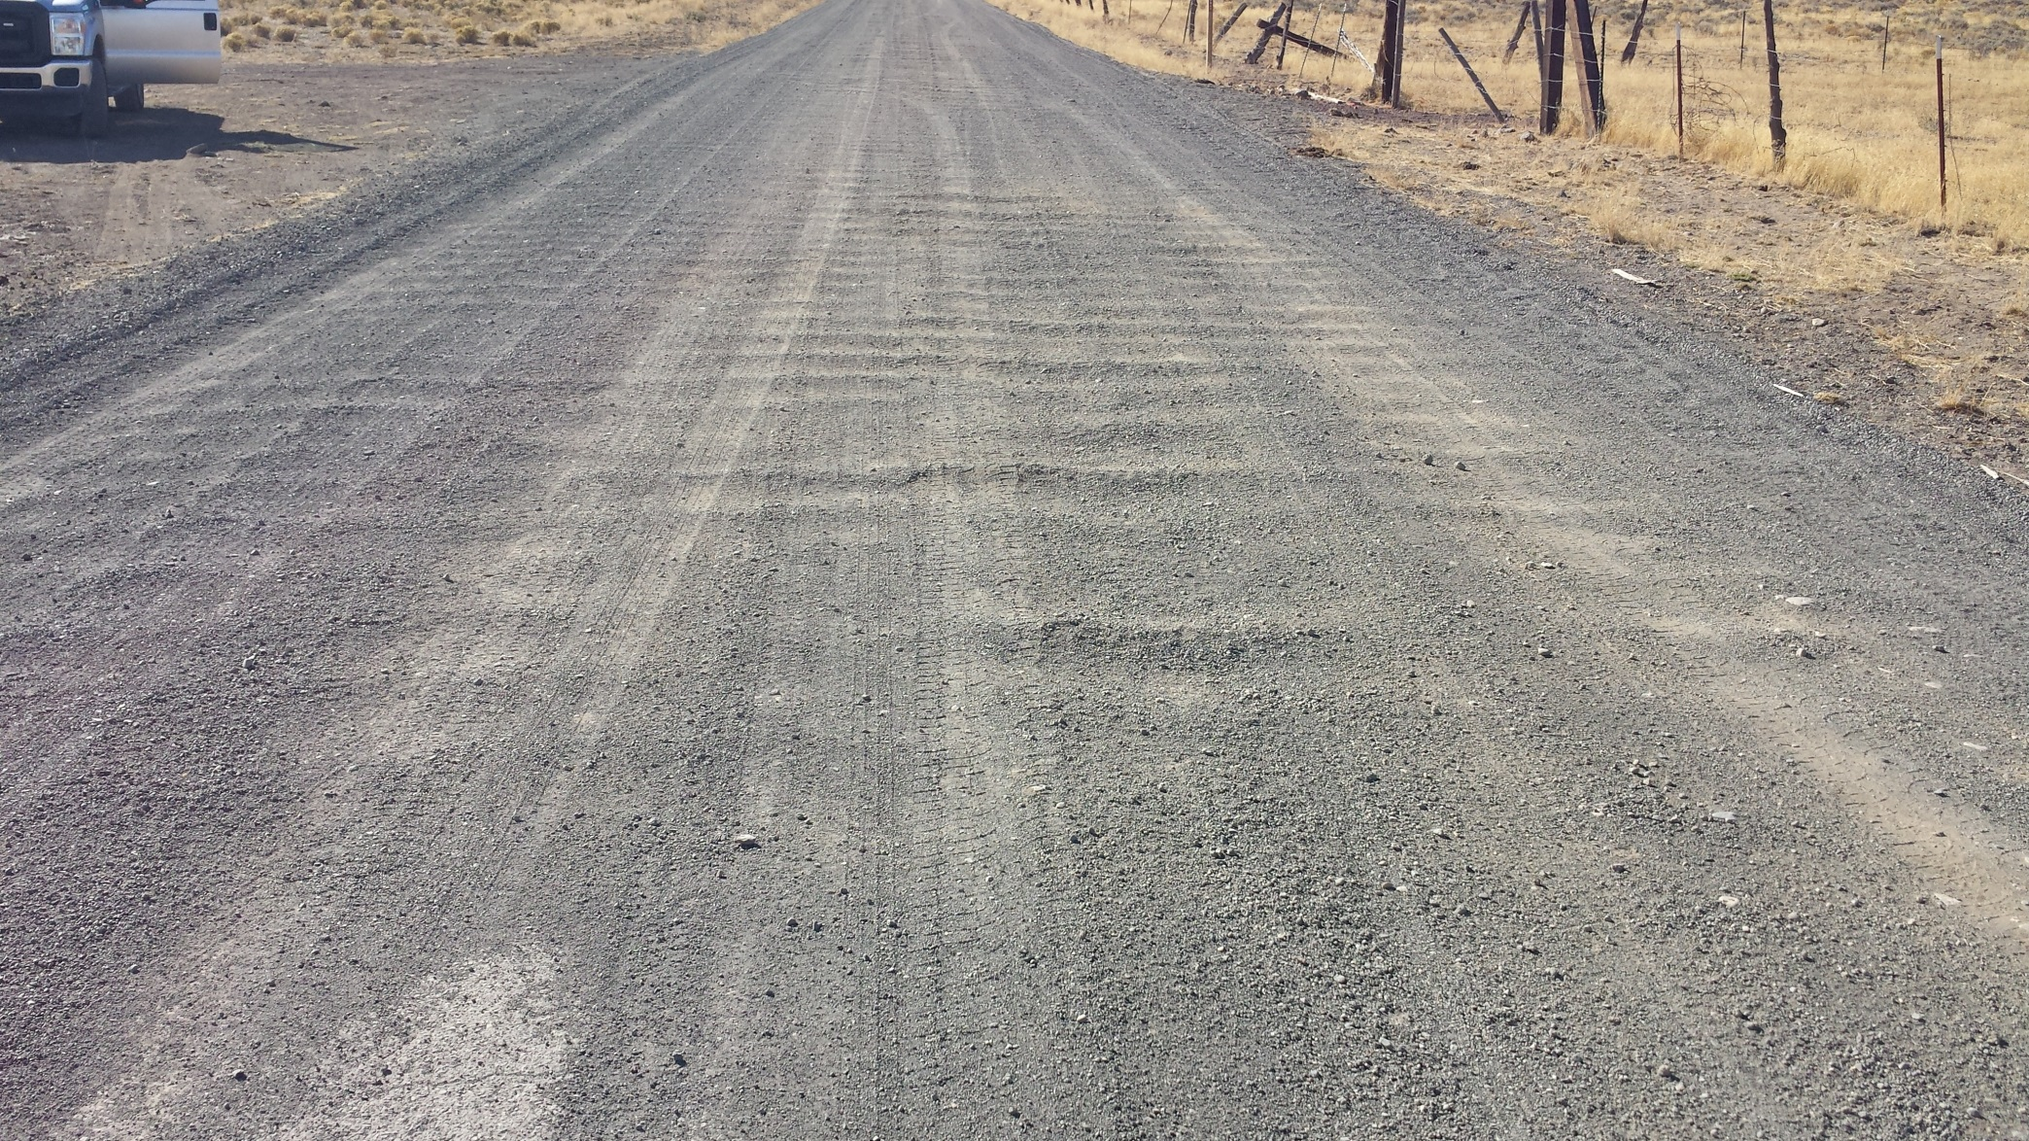
Typical gravel road washboarding

Slide 10
The goal
Find an improved low-cost surface treatment with annual surface maintenance costs that are at or near that of a high maintenance gravel road ($5,000/$7,500/mi/yr.)
Target low-volume Local/Residential facilities.
Evaluate/estimate long-term maintenance costs and strategies.
Potentially develop/evaluate partnership opportunities with adjacent property owners (ie, a “maintenance LID”) to fund the upgrade.

Slide 11
Pilot project treatments
Otta Seal
Developed in Norway in 1960s. Relatively new to USA.
Aggregate (1”-minus) rolled into a layer of high-float liquid asphalt.
Life Expectancy: 8-12 yrs.
A poor-man’s oil mat.
Paving with Asphalt Grindings
Asphalt grindings are milled from County roads prior to certain overlay projects.
Asphalt grindings are becoming more frequently used in a variety of maintenance applications.
  From “high-end gravel” replacement to reconstituted asphalt mix.
Life Expectancy: Varies

Slide 12
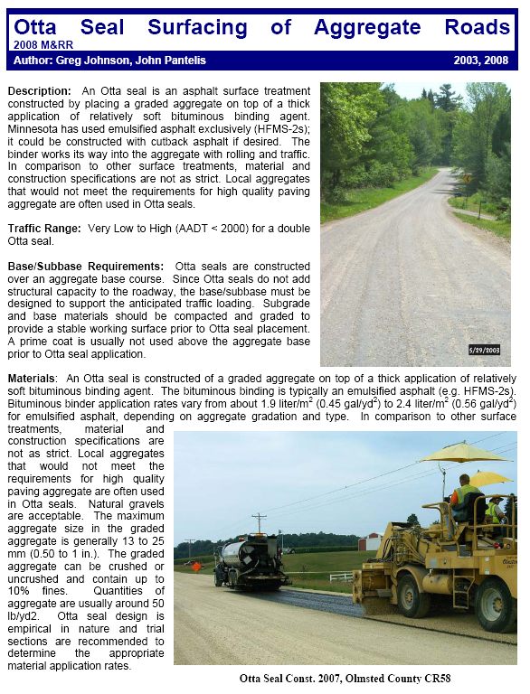
Otta seal: research
Various webinars, conferences and seminars introduced concept.
Various publications: Minnesota DOT
Internet searches, etc.
Vendor experience with similar seals
  Bituminous surface treated (BST)

Slide 13
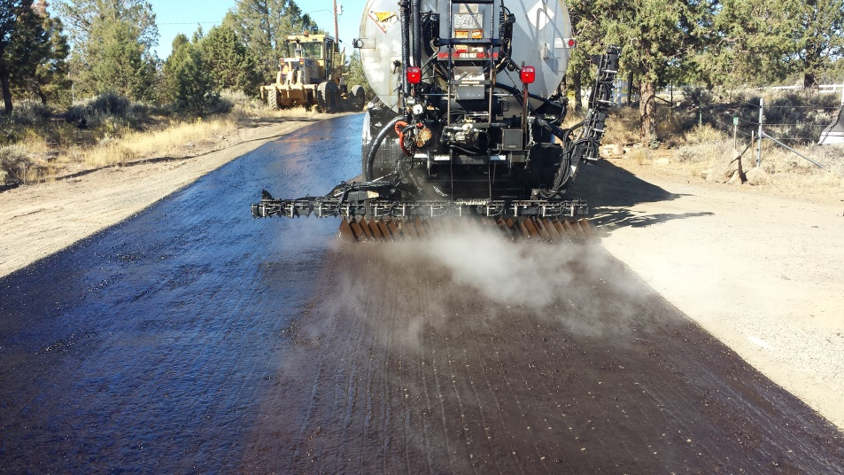
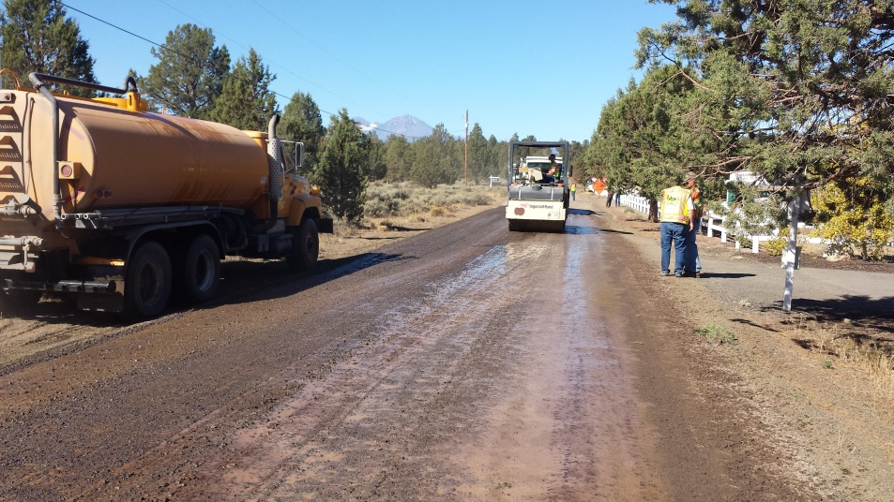
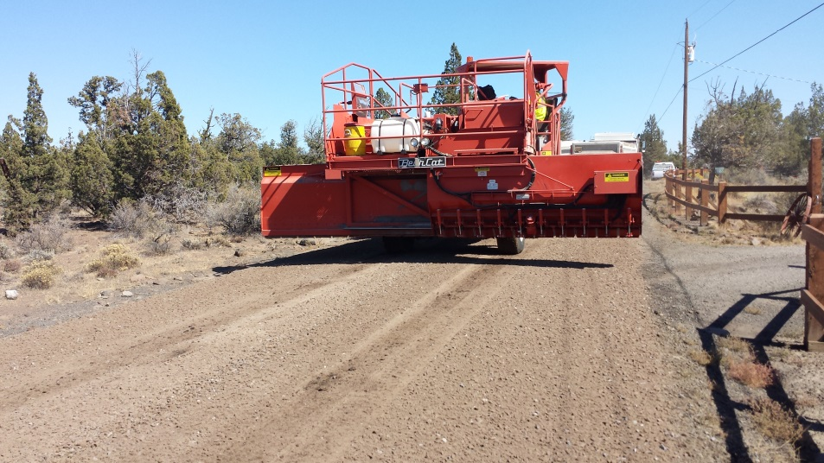
Otta seal equipment
Asphalt Distributor
Chip Spreader
Pneumatic-tired roller
Steel roller
Broom
Water Truck

Slide 14
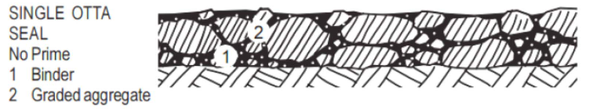
Otta seal materials
Binder: High Float Medium Set Oil: HFMS-2
Aggregate: Gradation varies based on traffic loading
  Low quality, non-paving spec rock
  0.5” to 1” Max
  Up to 10% fines
  Dirty!
Again…..A Poor Mans Oil Mat

Slide 15
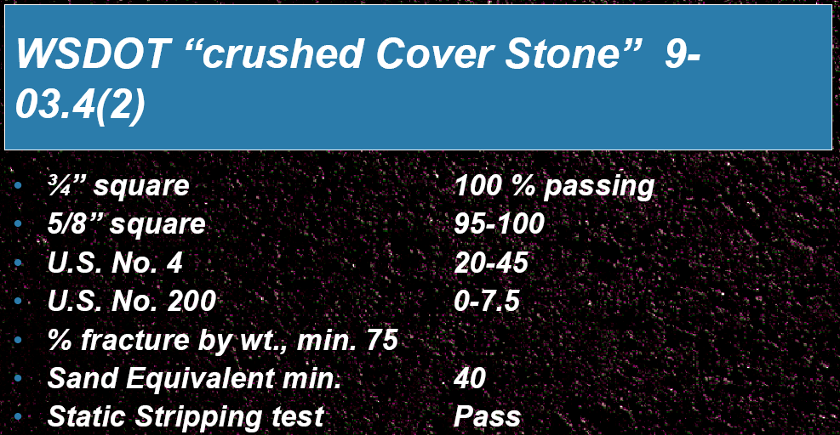
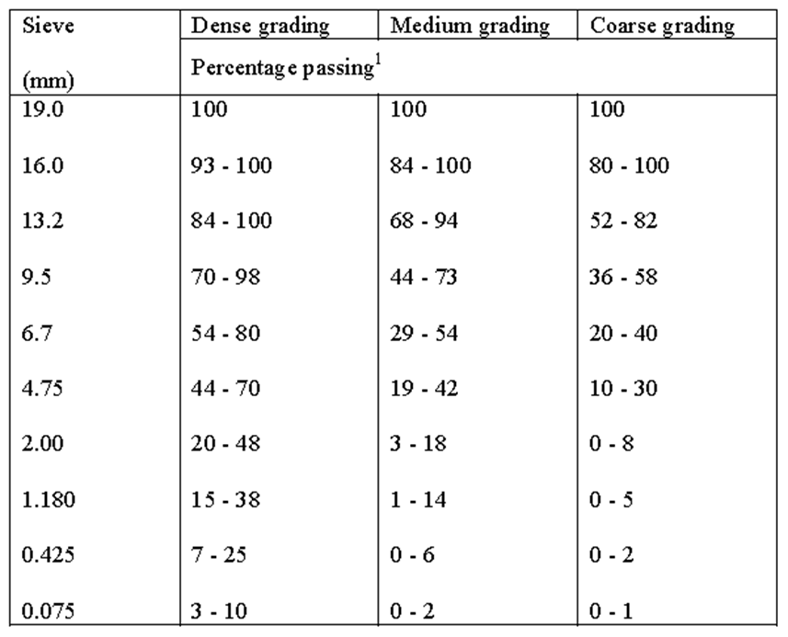
Some gradation spec examples
Washington vendor presentation
International Focus Group
Dense = Higher than 100 ADT

Slide 16
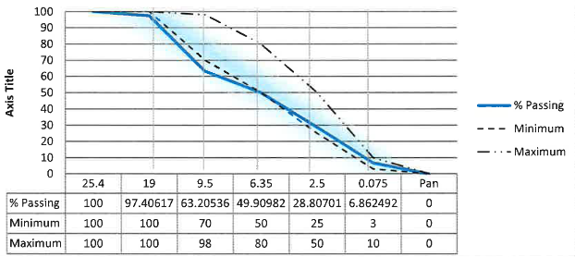
Deschutes county otta seal rock
Dense Specification: (19 mm = ¾” and 0.075mm = #200 sieve)

Slide 17
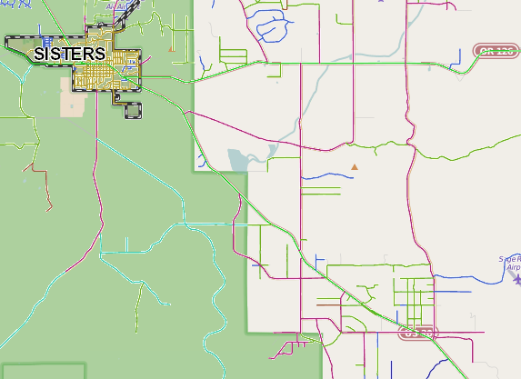
Pilot project – otta Seal
Plainview road
Plainview Road:
  East of Sisters (Fryrear Road)
  0.90 mile segment, 18’ – 20’ wide
  Local/Residential classification, dead end.
  Low ADT (110± vpd)
  Frequent calls for maintenance
    Dust complaints (residences are close to the road).
    Grading requests.
    Juniper tree kill.

Slide 18
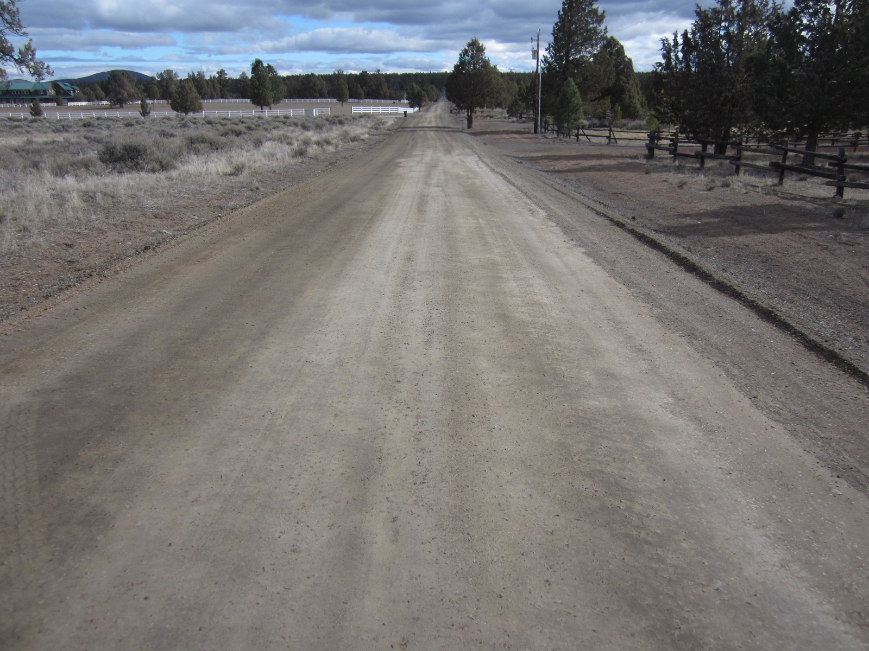
Pre-installation
(typical of post grading)

Slide 19
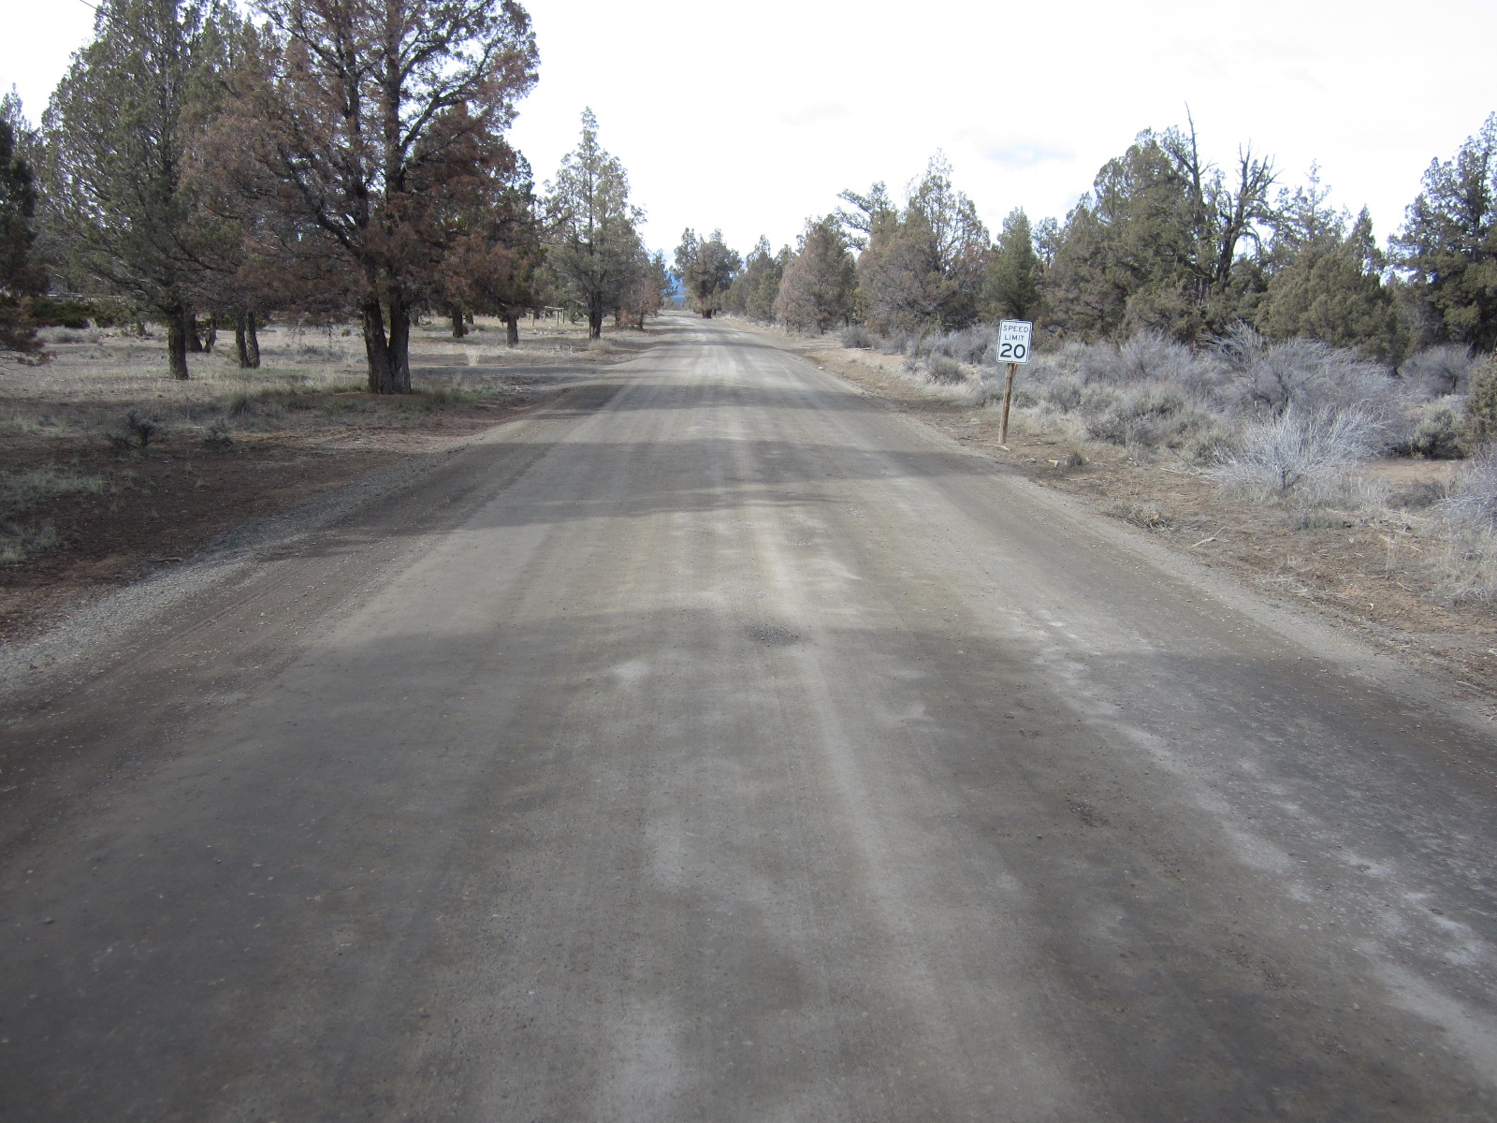
Pre-installation
(note: dying roadside junipers)

Slide 20

HFMS-2 Application (0.48-50 Gal/sy)
(road pre-wet, 1-hour prior)

Slide 21
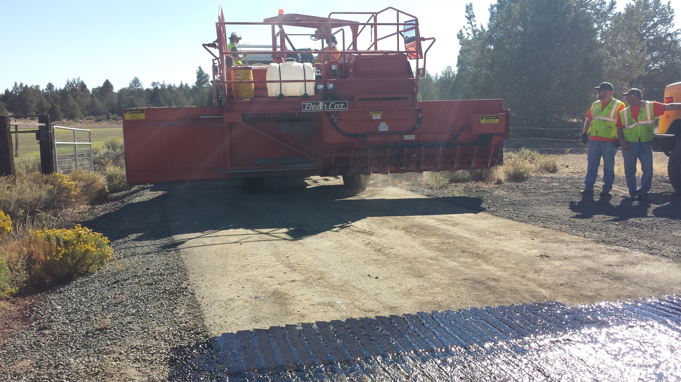
Single pass with chip spreader
(1”–minus “dirty” Material)

Slide 22
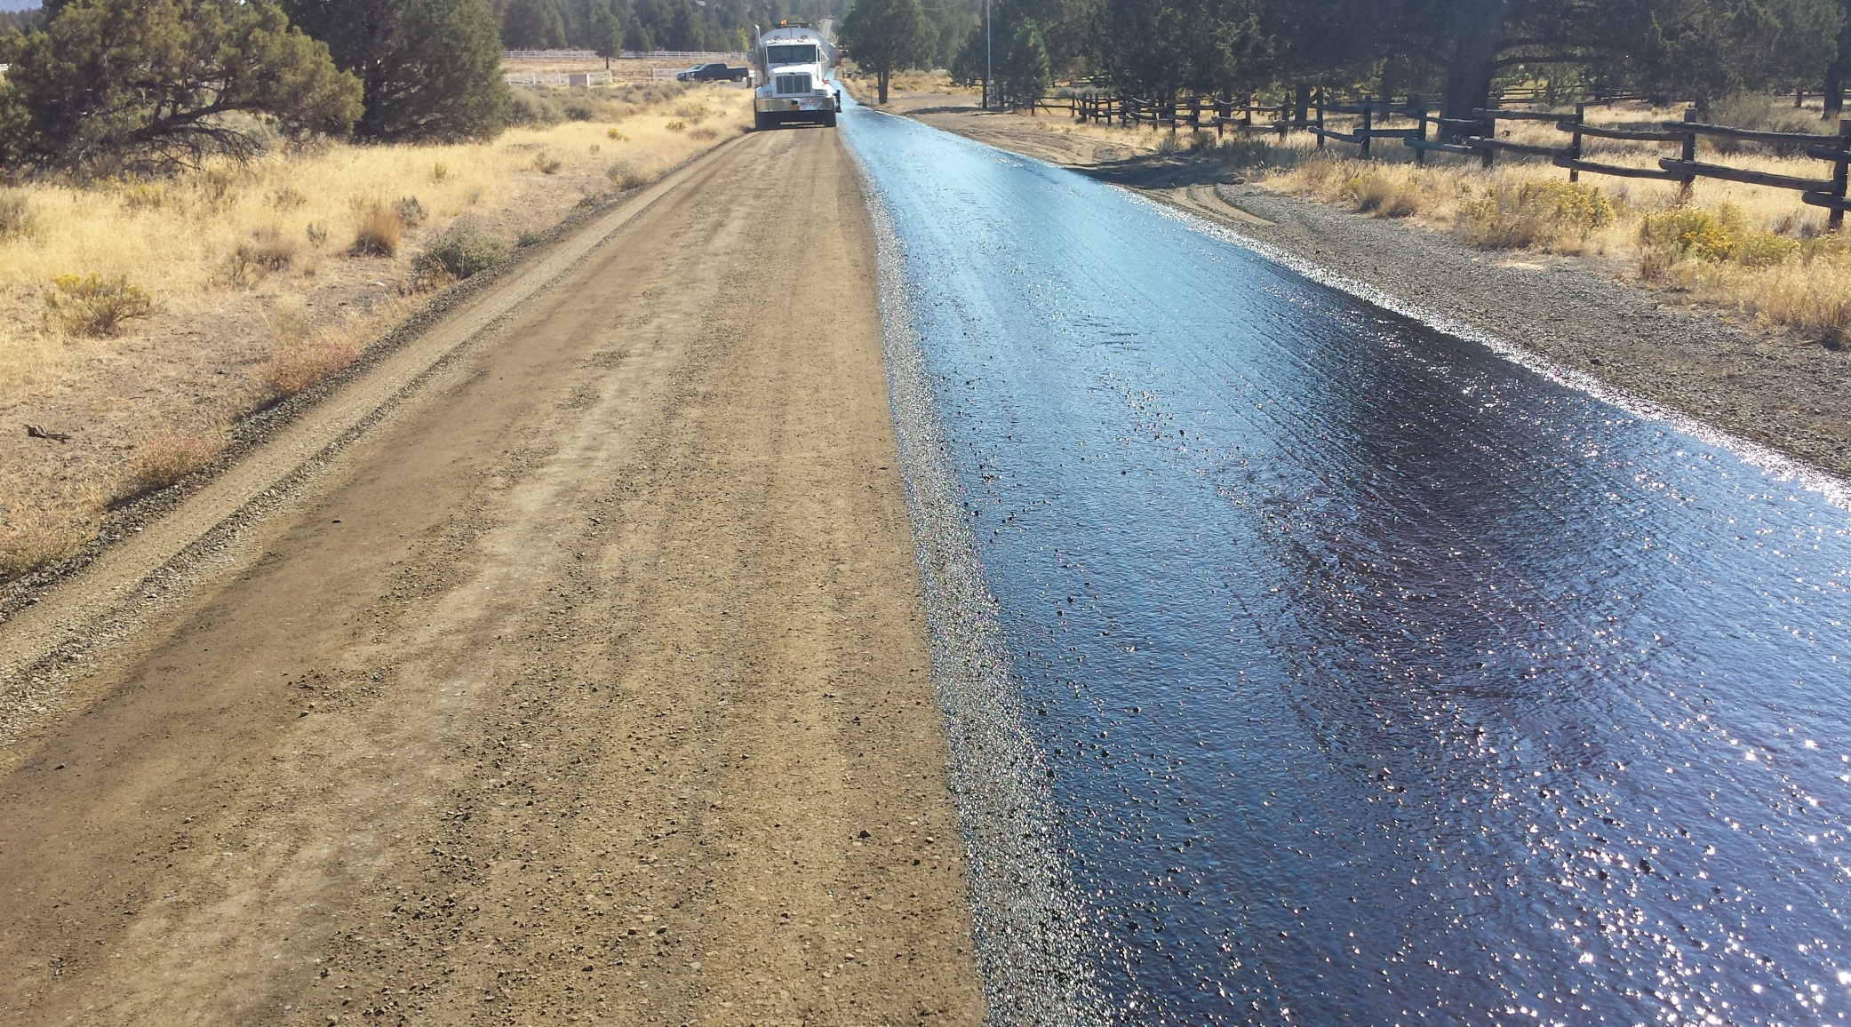
Break of HFMS
(Medium set)

Slide 23
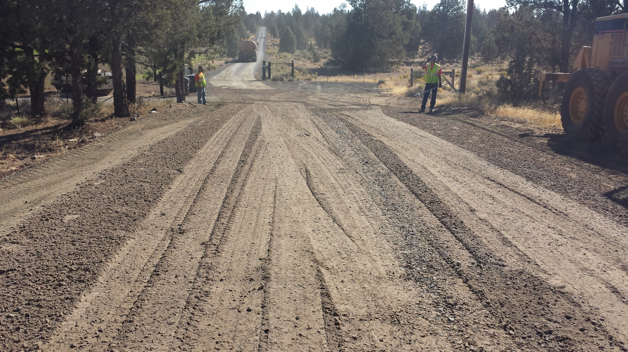
Immediate Post agg application ready to roll

Slide 24

Otta seal installation

Slide 25
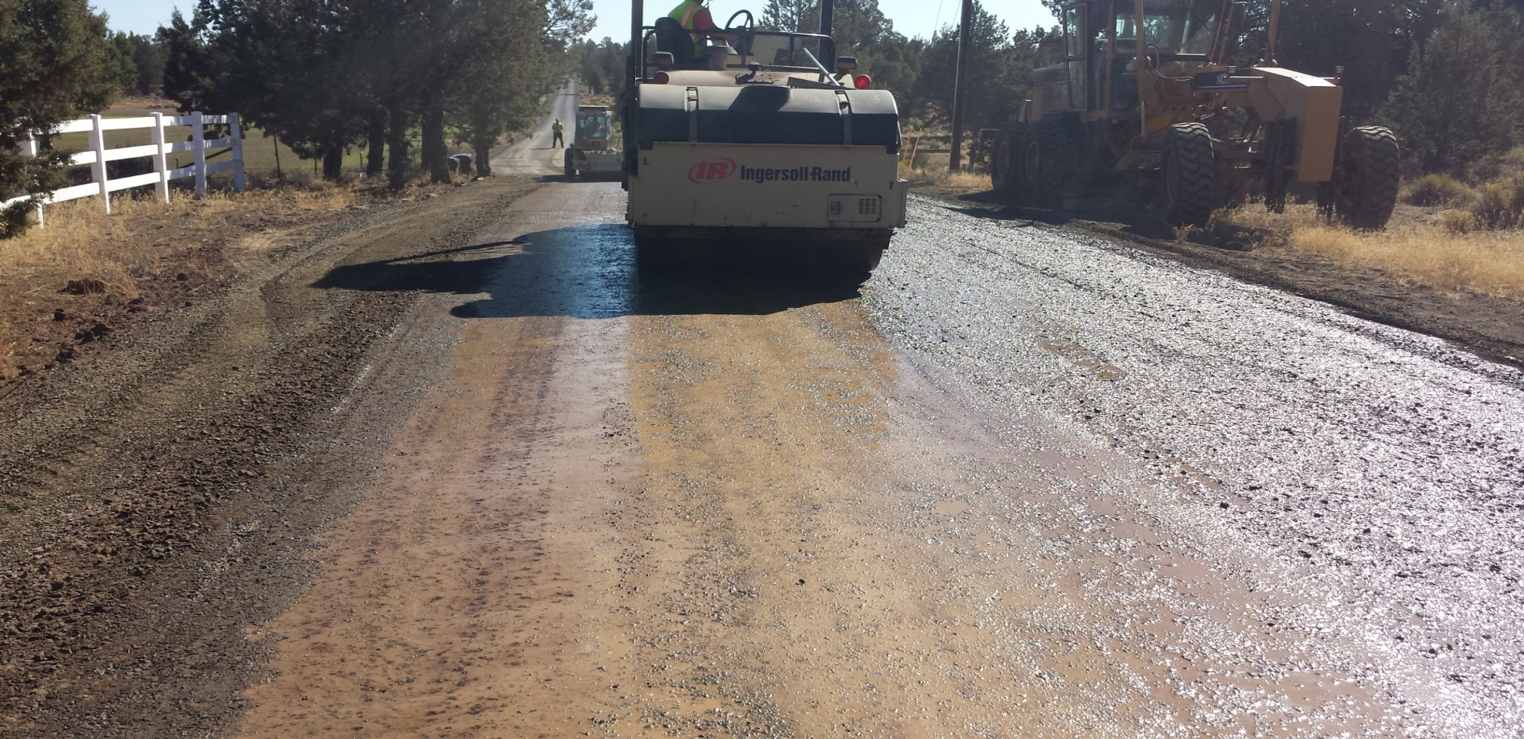
Otta seal installation
Application recommendations = Roll, roll, roll, roll, roll
DC Experience: 8-hrs (on installation day)

Slide 26
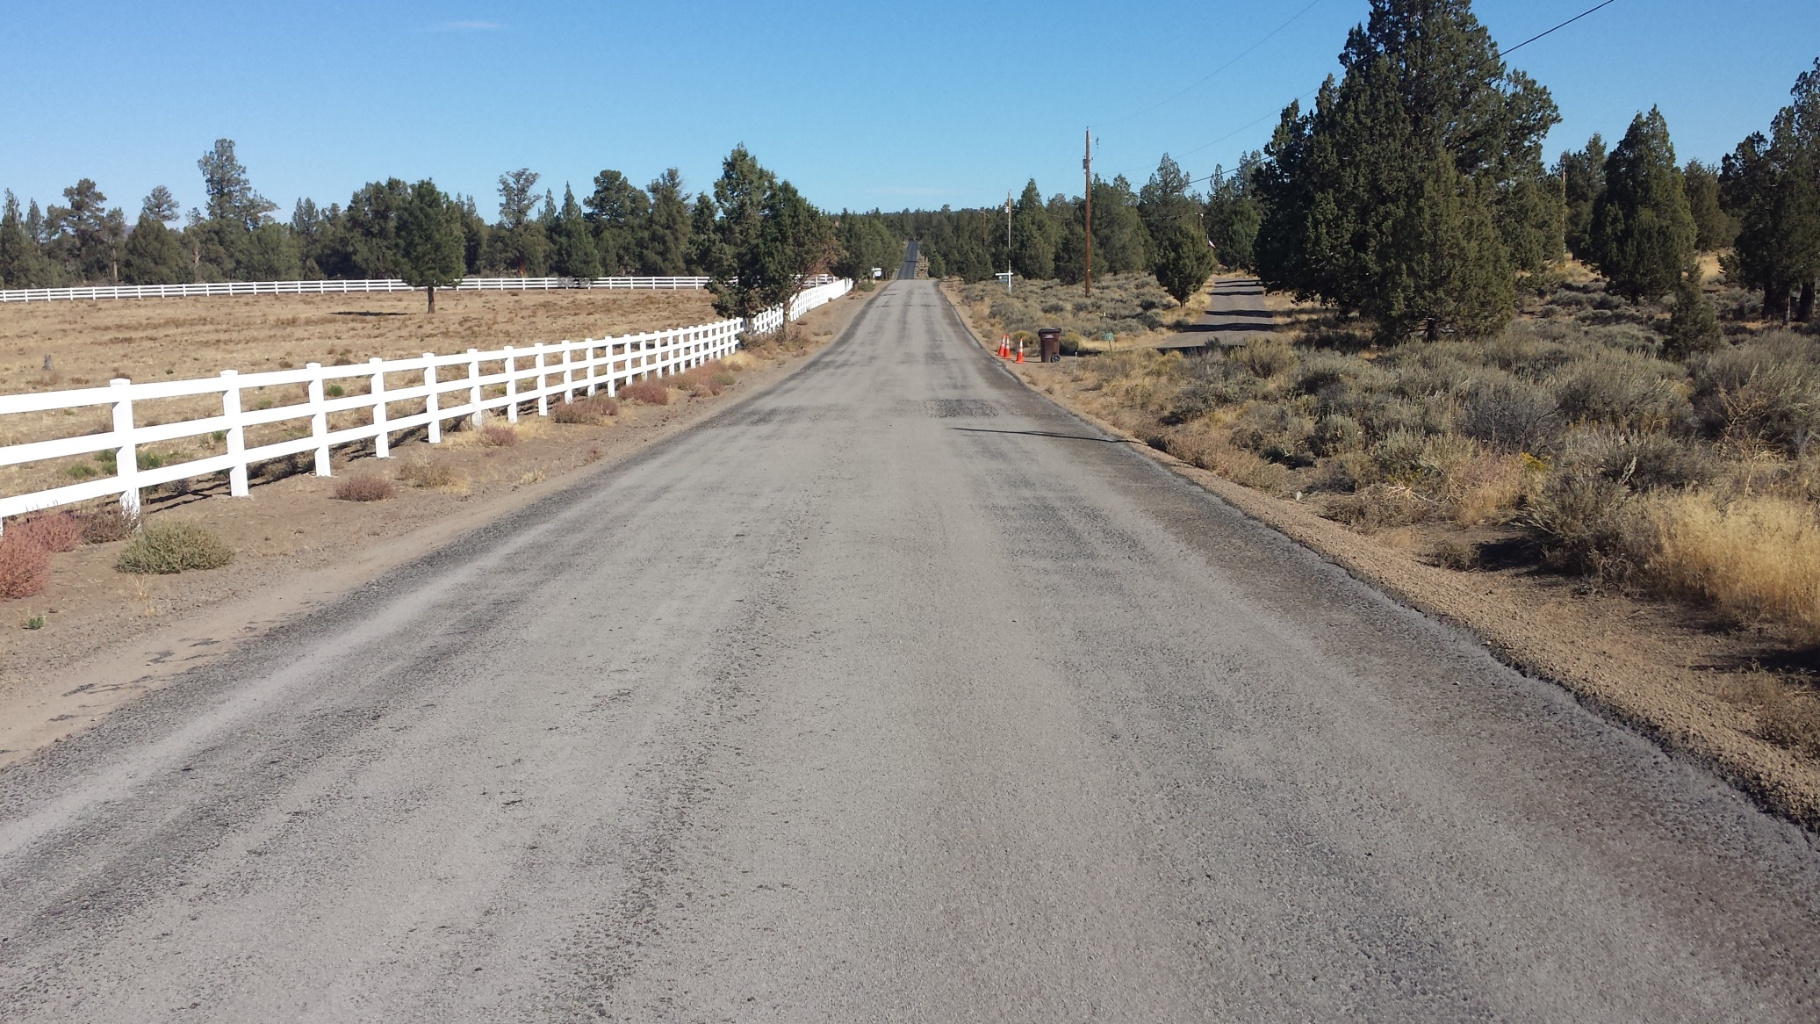
Otta seal installation post installation with sand seal – first week

Slide 27
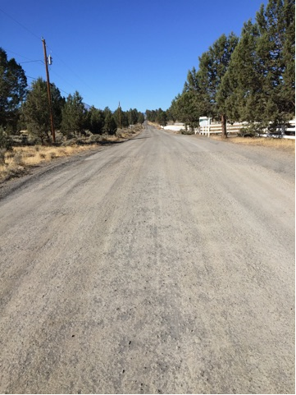
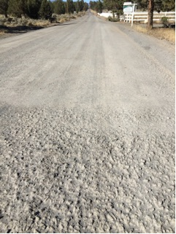
At 1-month

Slide 28
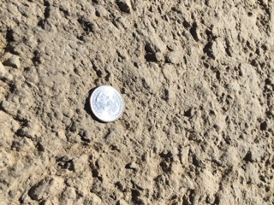
Surface integrity
(very dirty appearance)

Slide 29
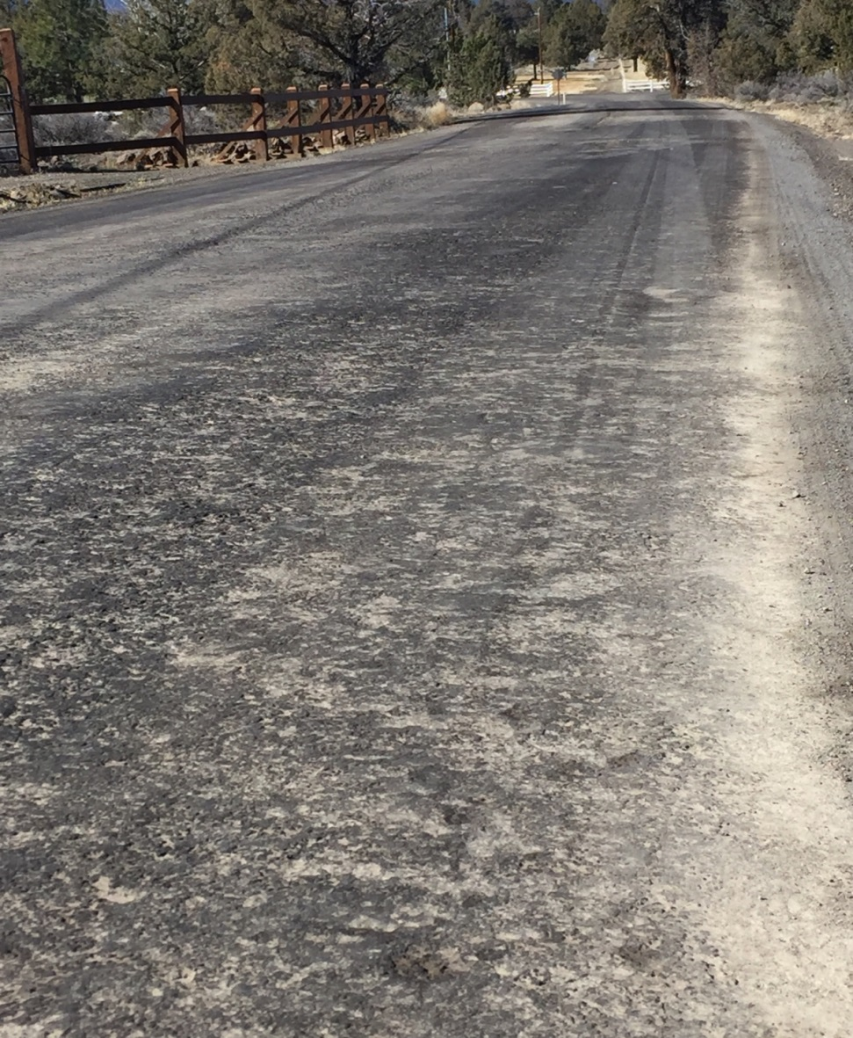
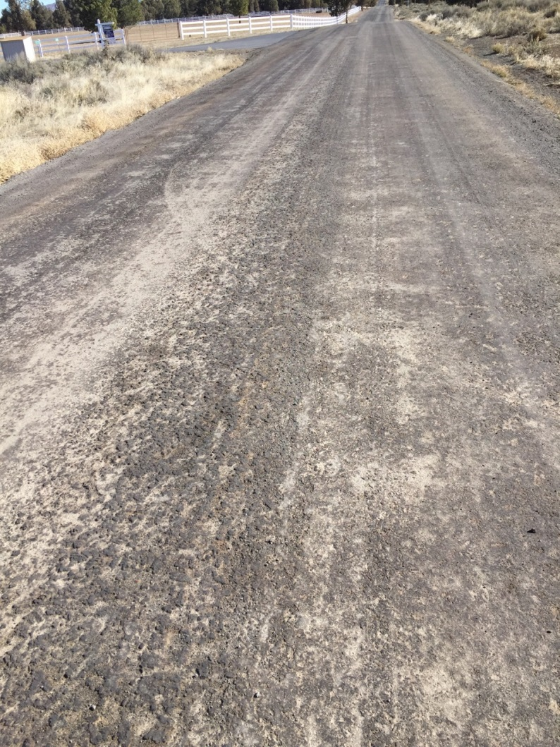
7 months later…

Slide 30
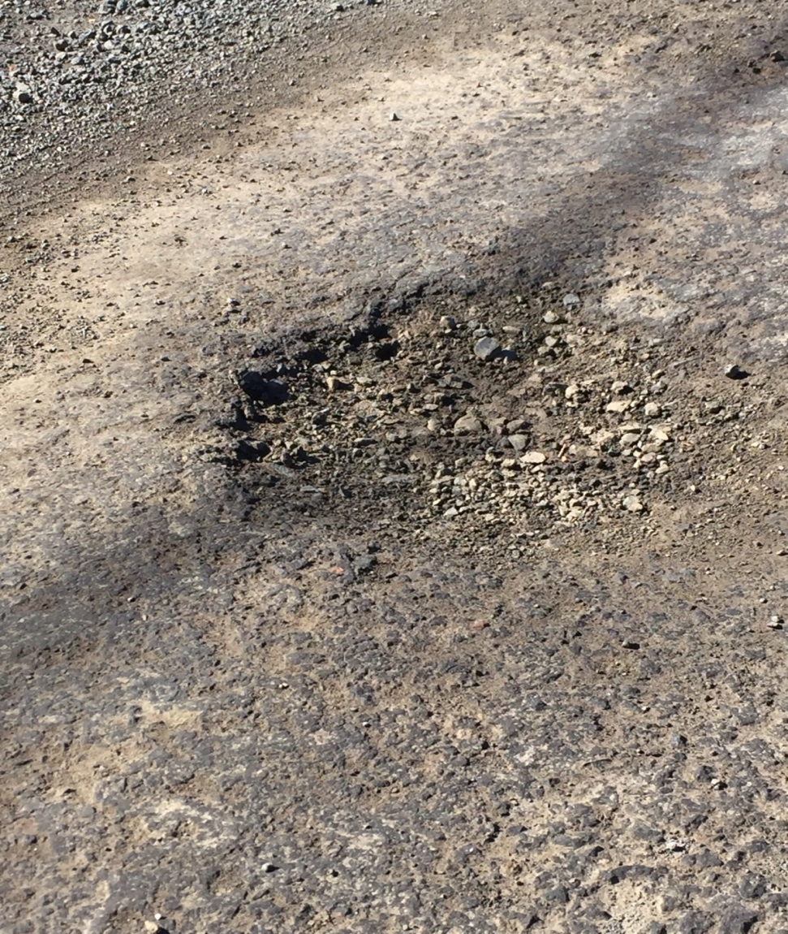
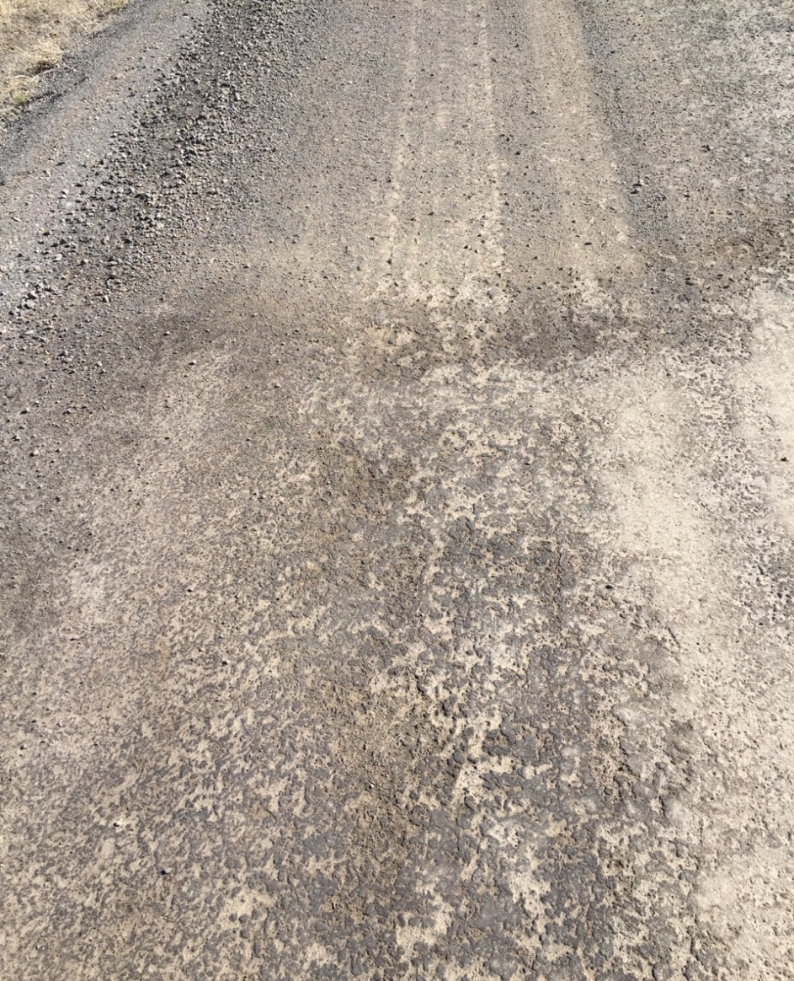
At 7 months: Some flaws

Slide 31
Otta seal installation cost
Hypothetical break-even point: 7.3 years
Notes:
Personnel Rate Multiplier: 3.15 (fully loaded, with overhead)
Equipment rates include depreciation.

Slide 32
Otta seal: lessons learned
Felt aggregate was “too dirty” and difficult to apply uniformly.
  Was it too dirty or could the chip spreader not “keep up”
  May use aggregate with fewer fines in future Otta seal.
Will not use 10-ton double-drum roller again.
  Too much vibe or weight promoted “sticking” to drums
  Lighter rollers preferred.
Segregation in chip spreader – especially in center.
  Will seal one lane at a time to narrow width of spread.
  Fewer fines will help alleviate some segregation – maybe?
Deschutes County has 2.0 miles of Otta Seal planned in 2016 (fall)

Slide 33
Next steps – otta seal
1. Evaluation of Treatments
  Monitor initial degradation and estimate near-term and long-term maintenance needs.
    Is this a product we can chip seal and roll into our Pavement Management Program?
      If so, at what interval for first chip seal and what is the subsequent frequency of treatments?
      If not, what alternative maintenance treatments or strategies are necessary?
2. Cost Analysis
  How do the initial and projected maintenance investment levels compare to the annual average maintenance investment for gravel roads?
3. Refine the Process
  What refinements can we make to our application technique to reduce the initial application cost of the Pilot Projects?

Slide 34
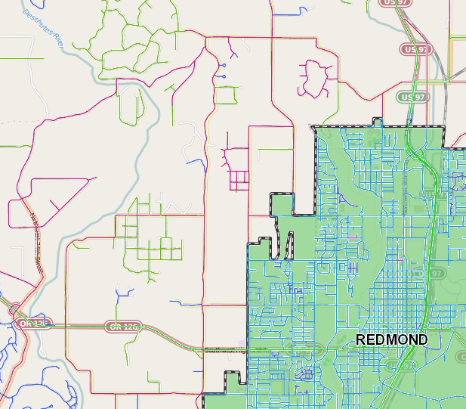
Pilot project – AC Grindings
Ivancovich Way
Ivancovich Way:
  Northeast of Redmond
  Local/Residential classification, dead end.
  0.60 mile, 24’ wide
  Low ADT (150± vpd)
  Frequent calls for maintenance
    Grading requests to address washboarding.
    Tracking of muck layer during freeze/thaw and wet periods.

Slide 35
Ac grinding Project
Goal: Low-cost application of grindings – could apply hot mix for $9-$12/SY
Age of grindings: 2-years
Re-ground to 1/2”
2 – 2” lifts
Added water prior to compaction
Experimented with adding diluted tack mid-compaction

Slide 36
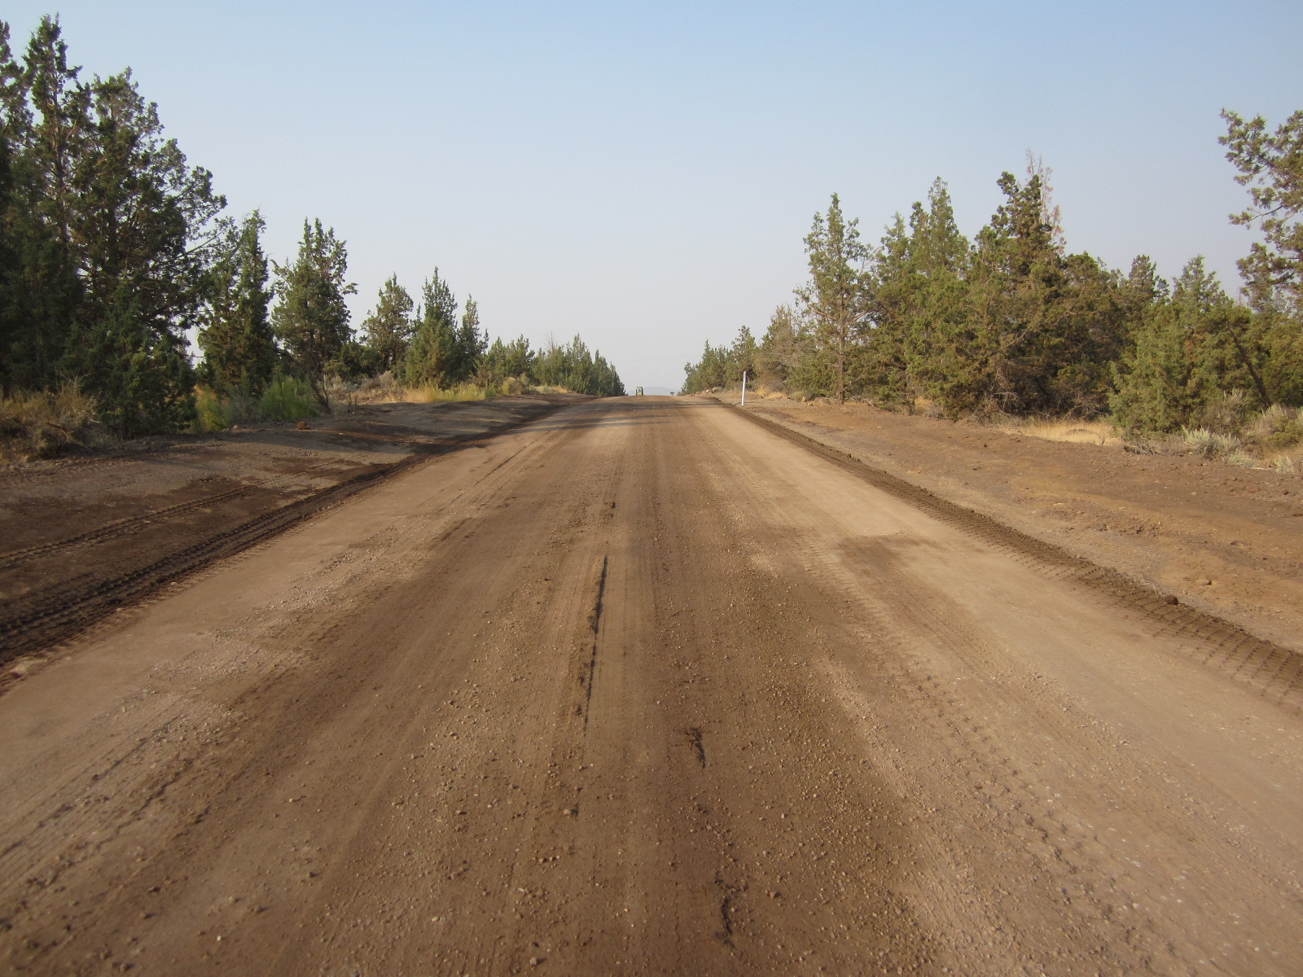
AC Grindings installation pre-installation

Slide 37
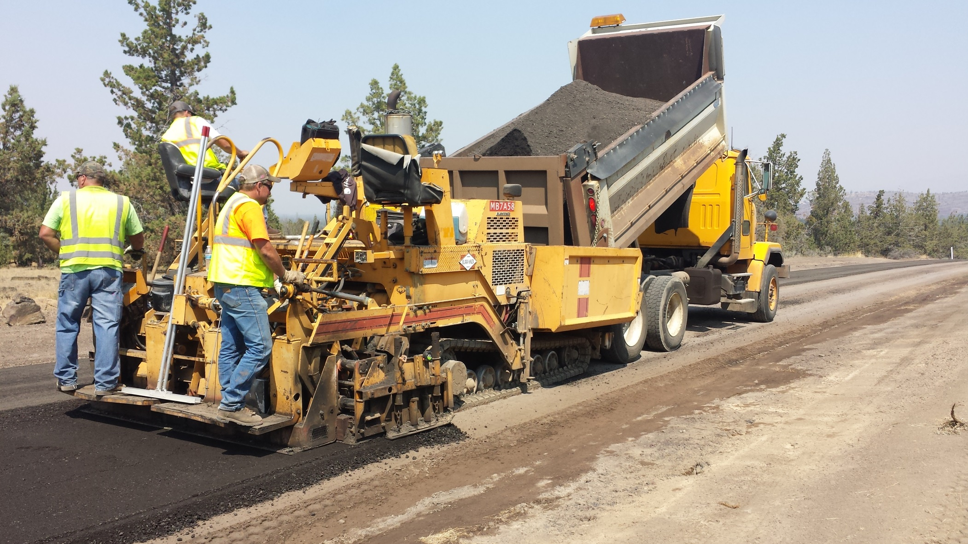
Ac grindings installation
2-2” lifts

Slide 38
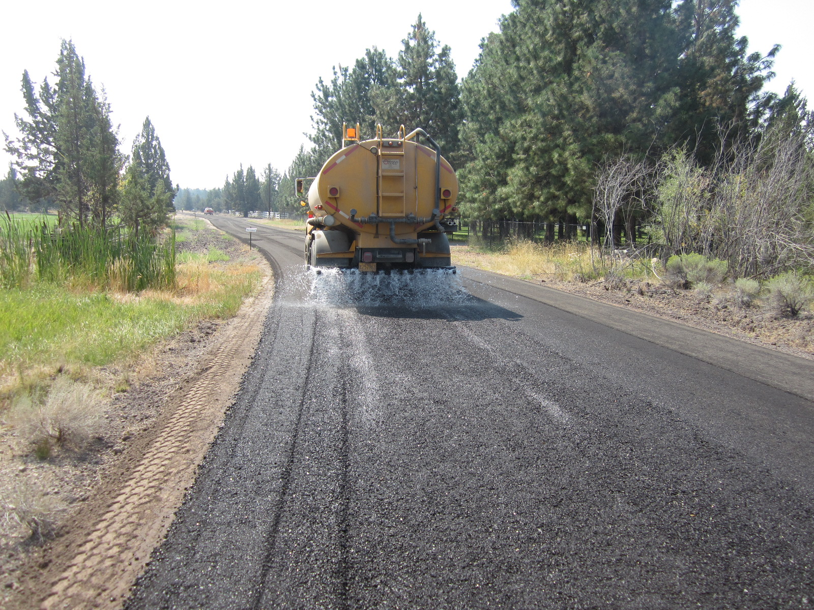
Ac grindings installation water/tack with compaction

Slide 39
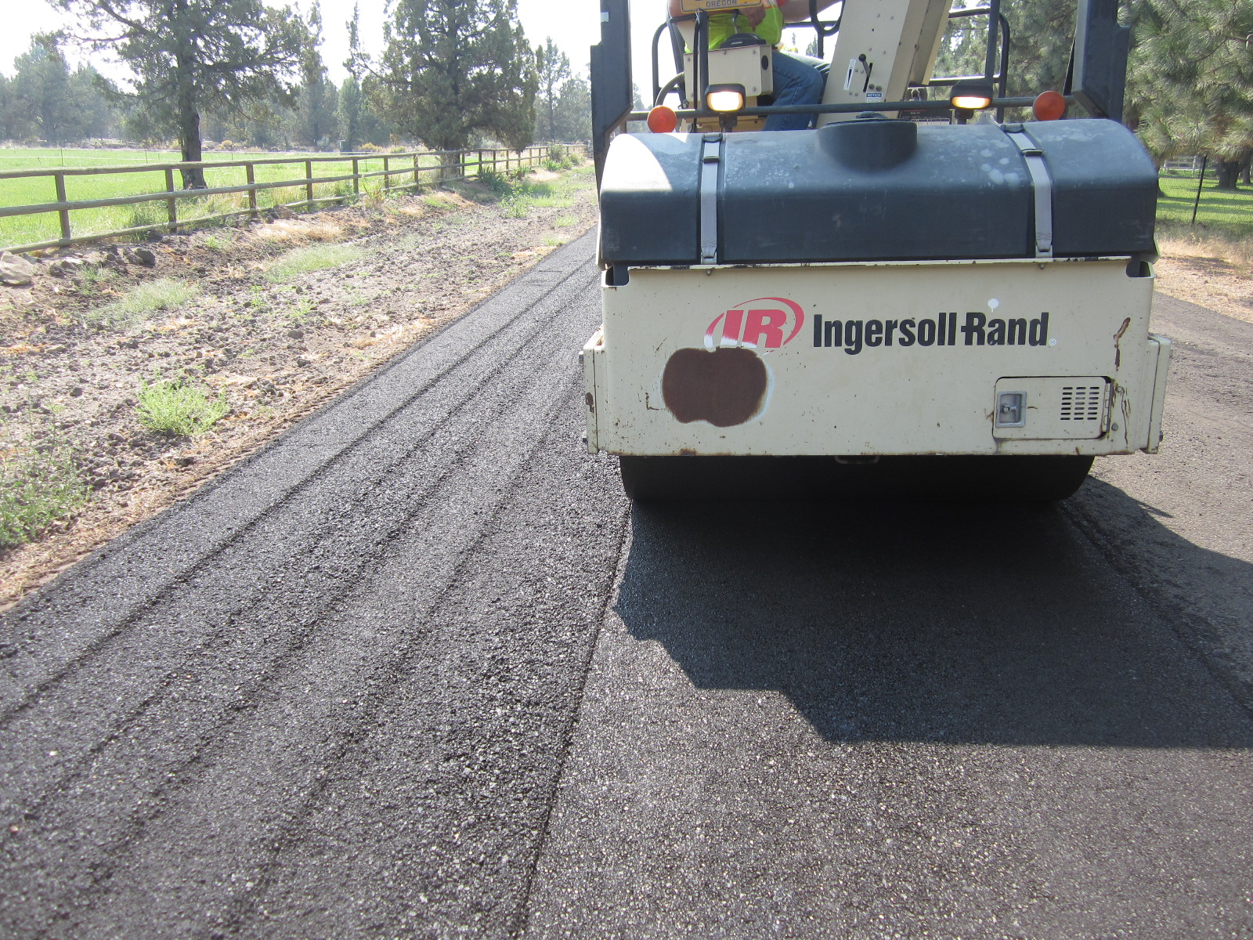
Ac grindings installation

Slide 40
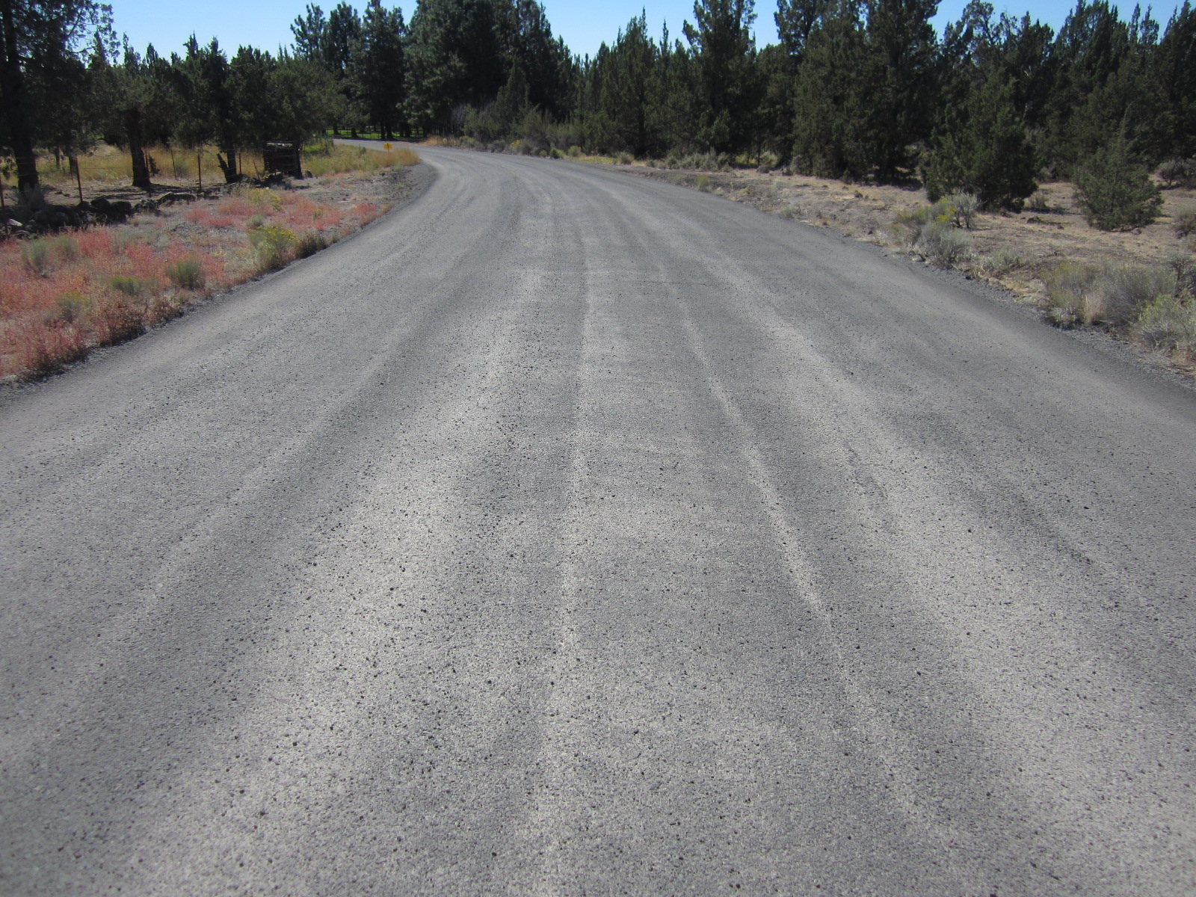
Ac grindings installation sand seal finish

Slide 41
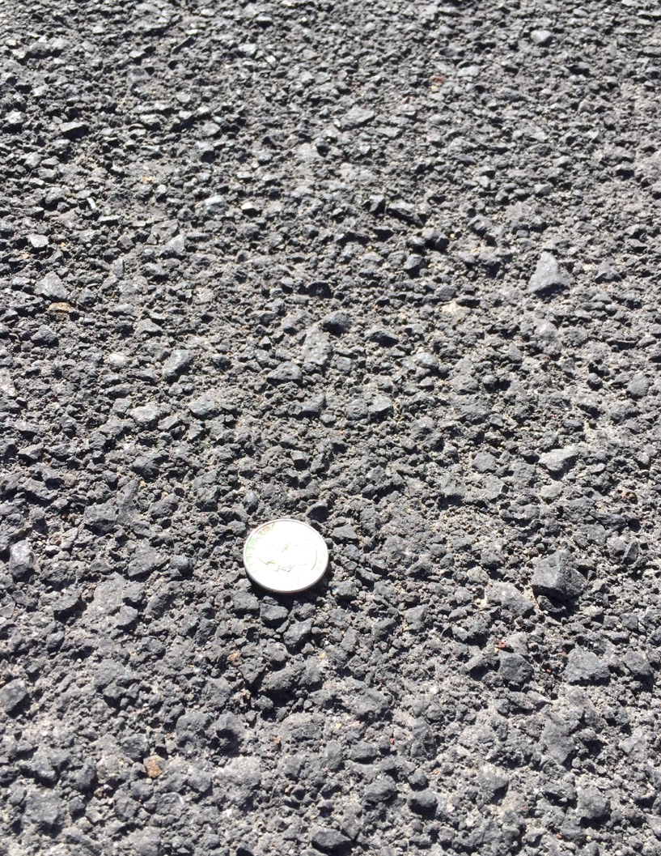
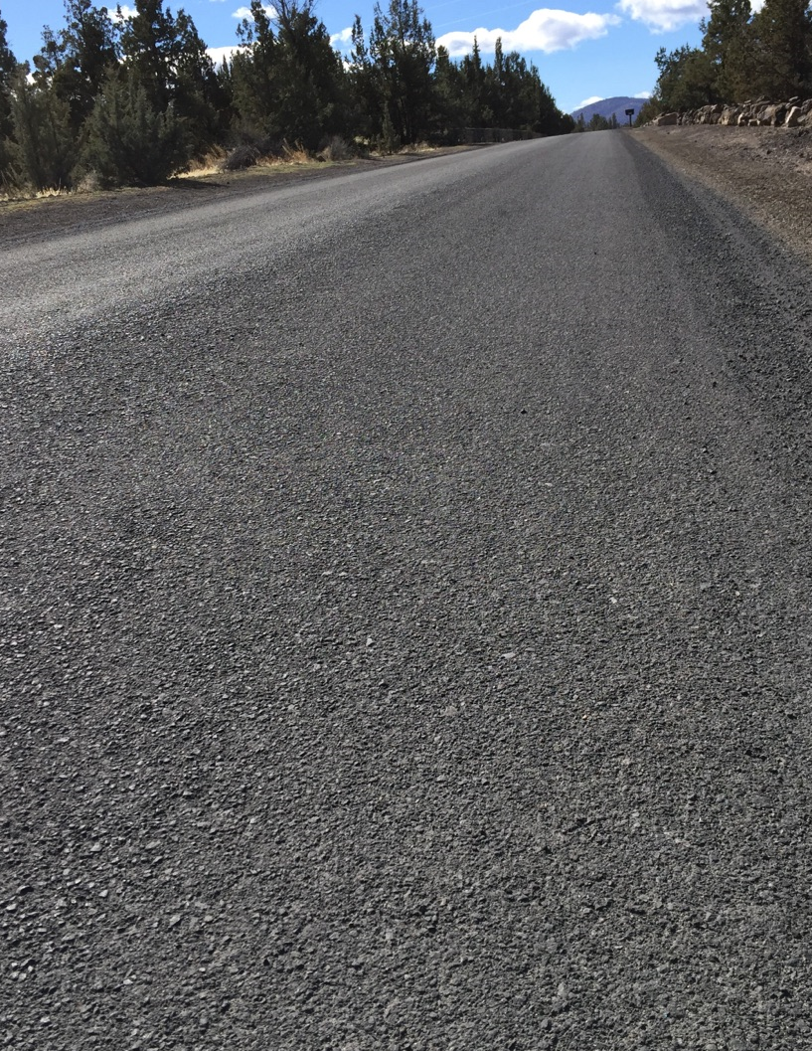
At 7 months

Slide 42
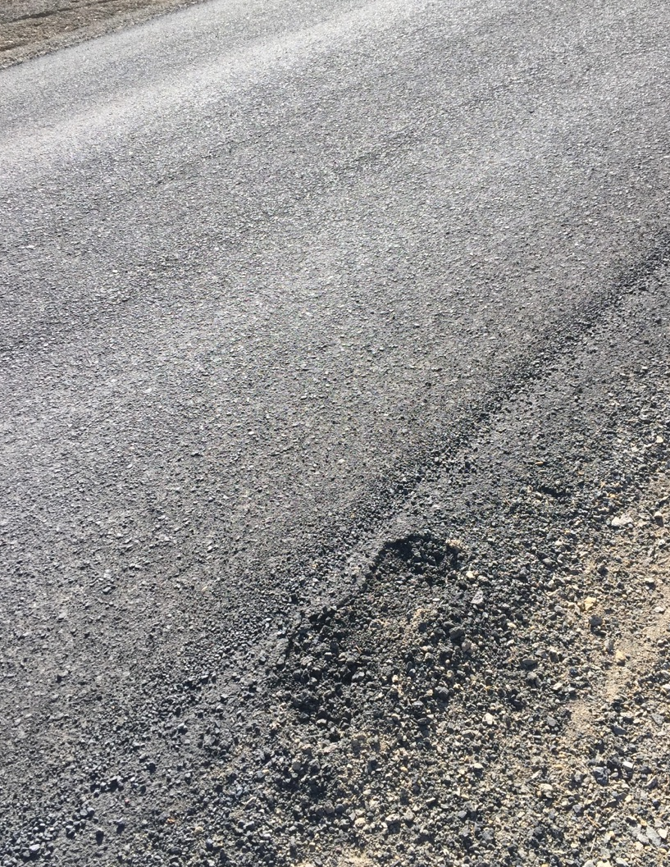
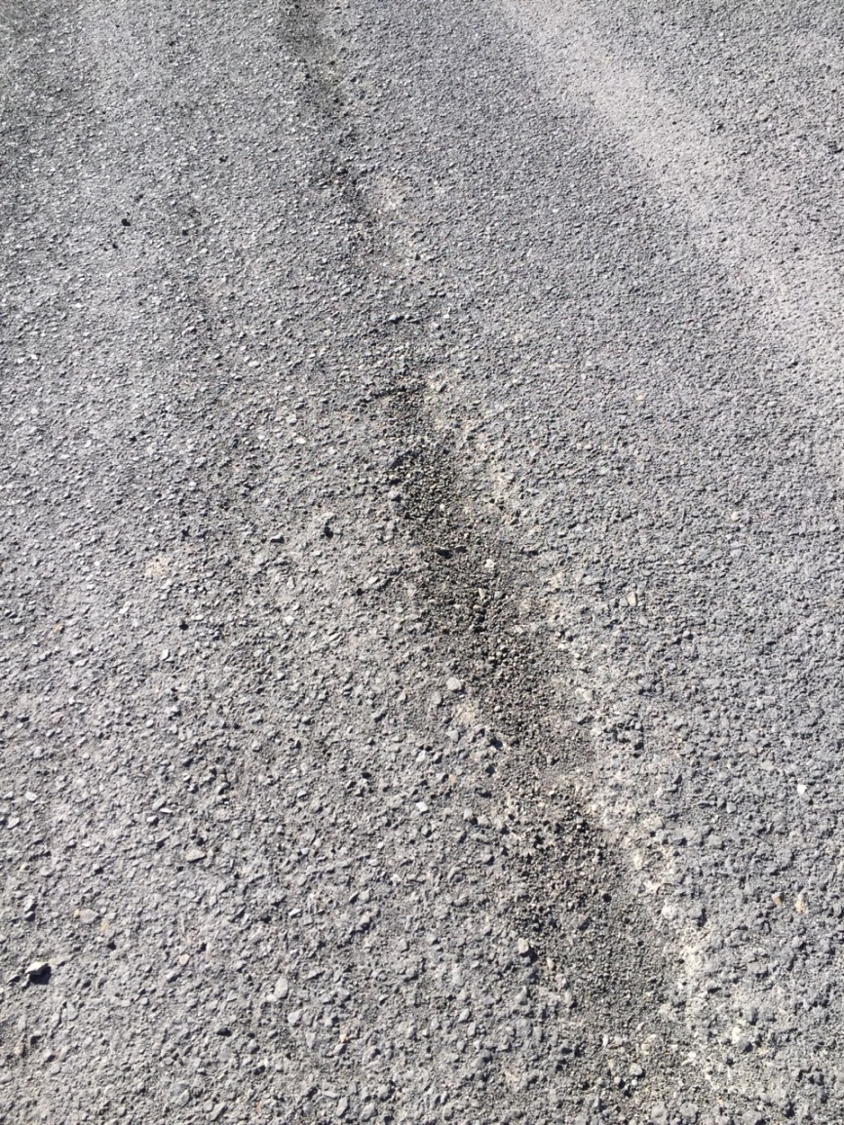
At 7 months – some flaws

Slide 43
Lessons Learned
Heat is your friend.
  Very concerned during morning period - feared project failure.
  Afternoon heat allowed material to bind – saved the project.
Be mindful of over-compaction during initial roll – especially vibratory.
Ease into the rolling effort.
Rock shoulders quickly – edges can be soft and need support.
Early to mid-Summer installation (heat) versus late Summer.
Community education to drive slow during first month +/-; curing period.

Slide 44
AC Grindings installation cost
Hypothetical break-even point: 10.6 years
Notes:
Personnel Rate Multiplier: 3.15 (fully loaded, with overhead)
Equipment rates include depreciation.

