Slide 1
2023 Chip Seal Workshop
Curry County Chip Seal Program
Presented by Gary Wolford and Allan Avery

Slide 2
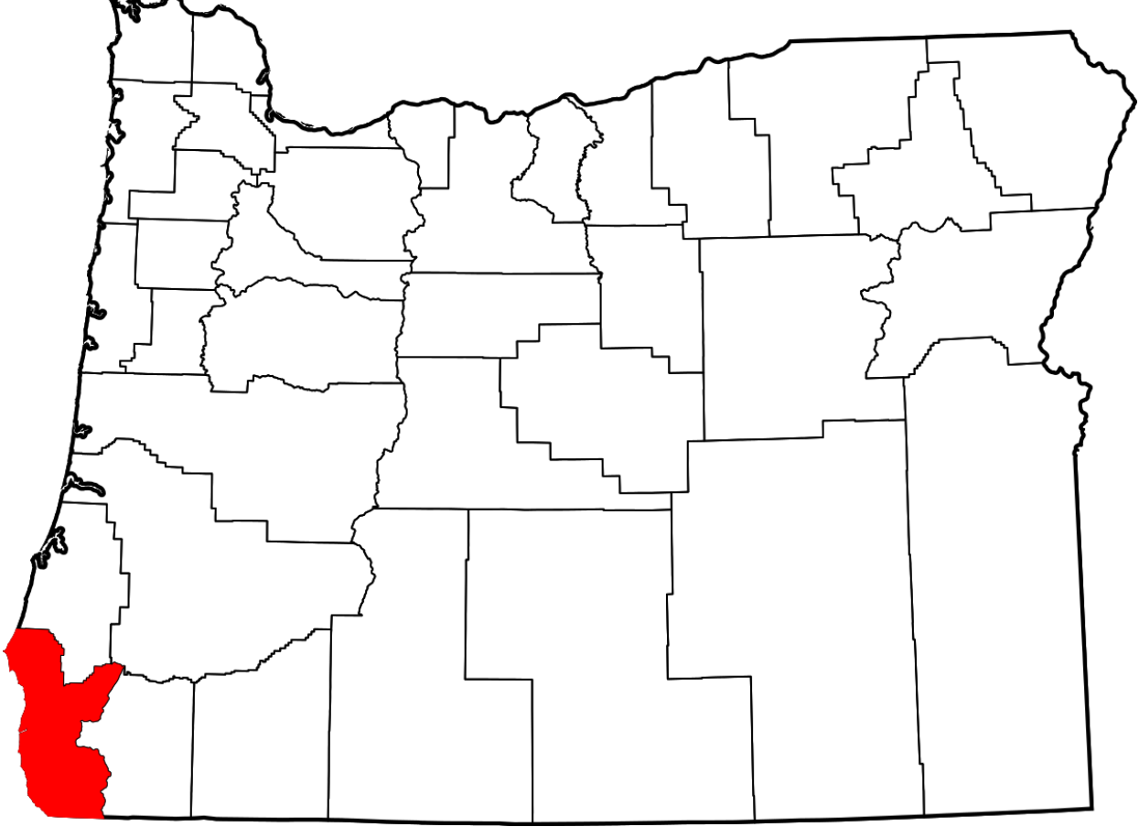

Slide 3
Curry County Statics
Square miles: 1,648
Population: 22,915 (2021)
Road miles: 225 miles
Paved miles: 191 plus 9 miles oil mat
Road department budget: $6.0-6.5 Million

Slide 4
Curry County Vision and Strategic Plan
Efficiency – make all maintenance programs efficient
Effectiveness – chip seals that have a 7-10-year service life
New Materials – utilize new improvements in emulsion oils
New Equipment – upgrade distributor, chip spreader and rollers
Interagency Agreements – partner with USFS and ODOT
Training – pre-season classroom and operational training

Slide 5
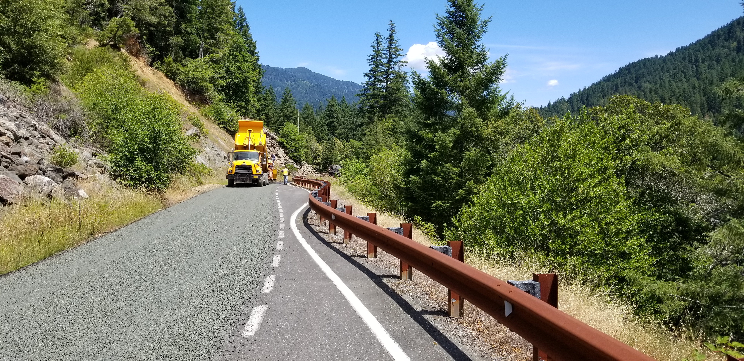
Why Curry County Chip Seals
Budget shortfall of $3M to $3.5M due to loss of timber receipts
Contract 2-inch asphalt overlay about $210,000 per mile
Self-preformed chip seal about $38,000 per mile
Can chip seal 5.5 miles of road per 1 mile of overlay

Slide 6
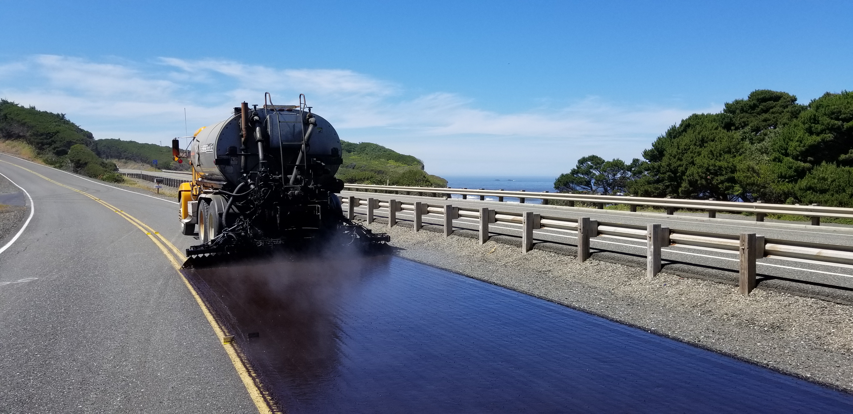
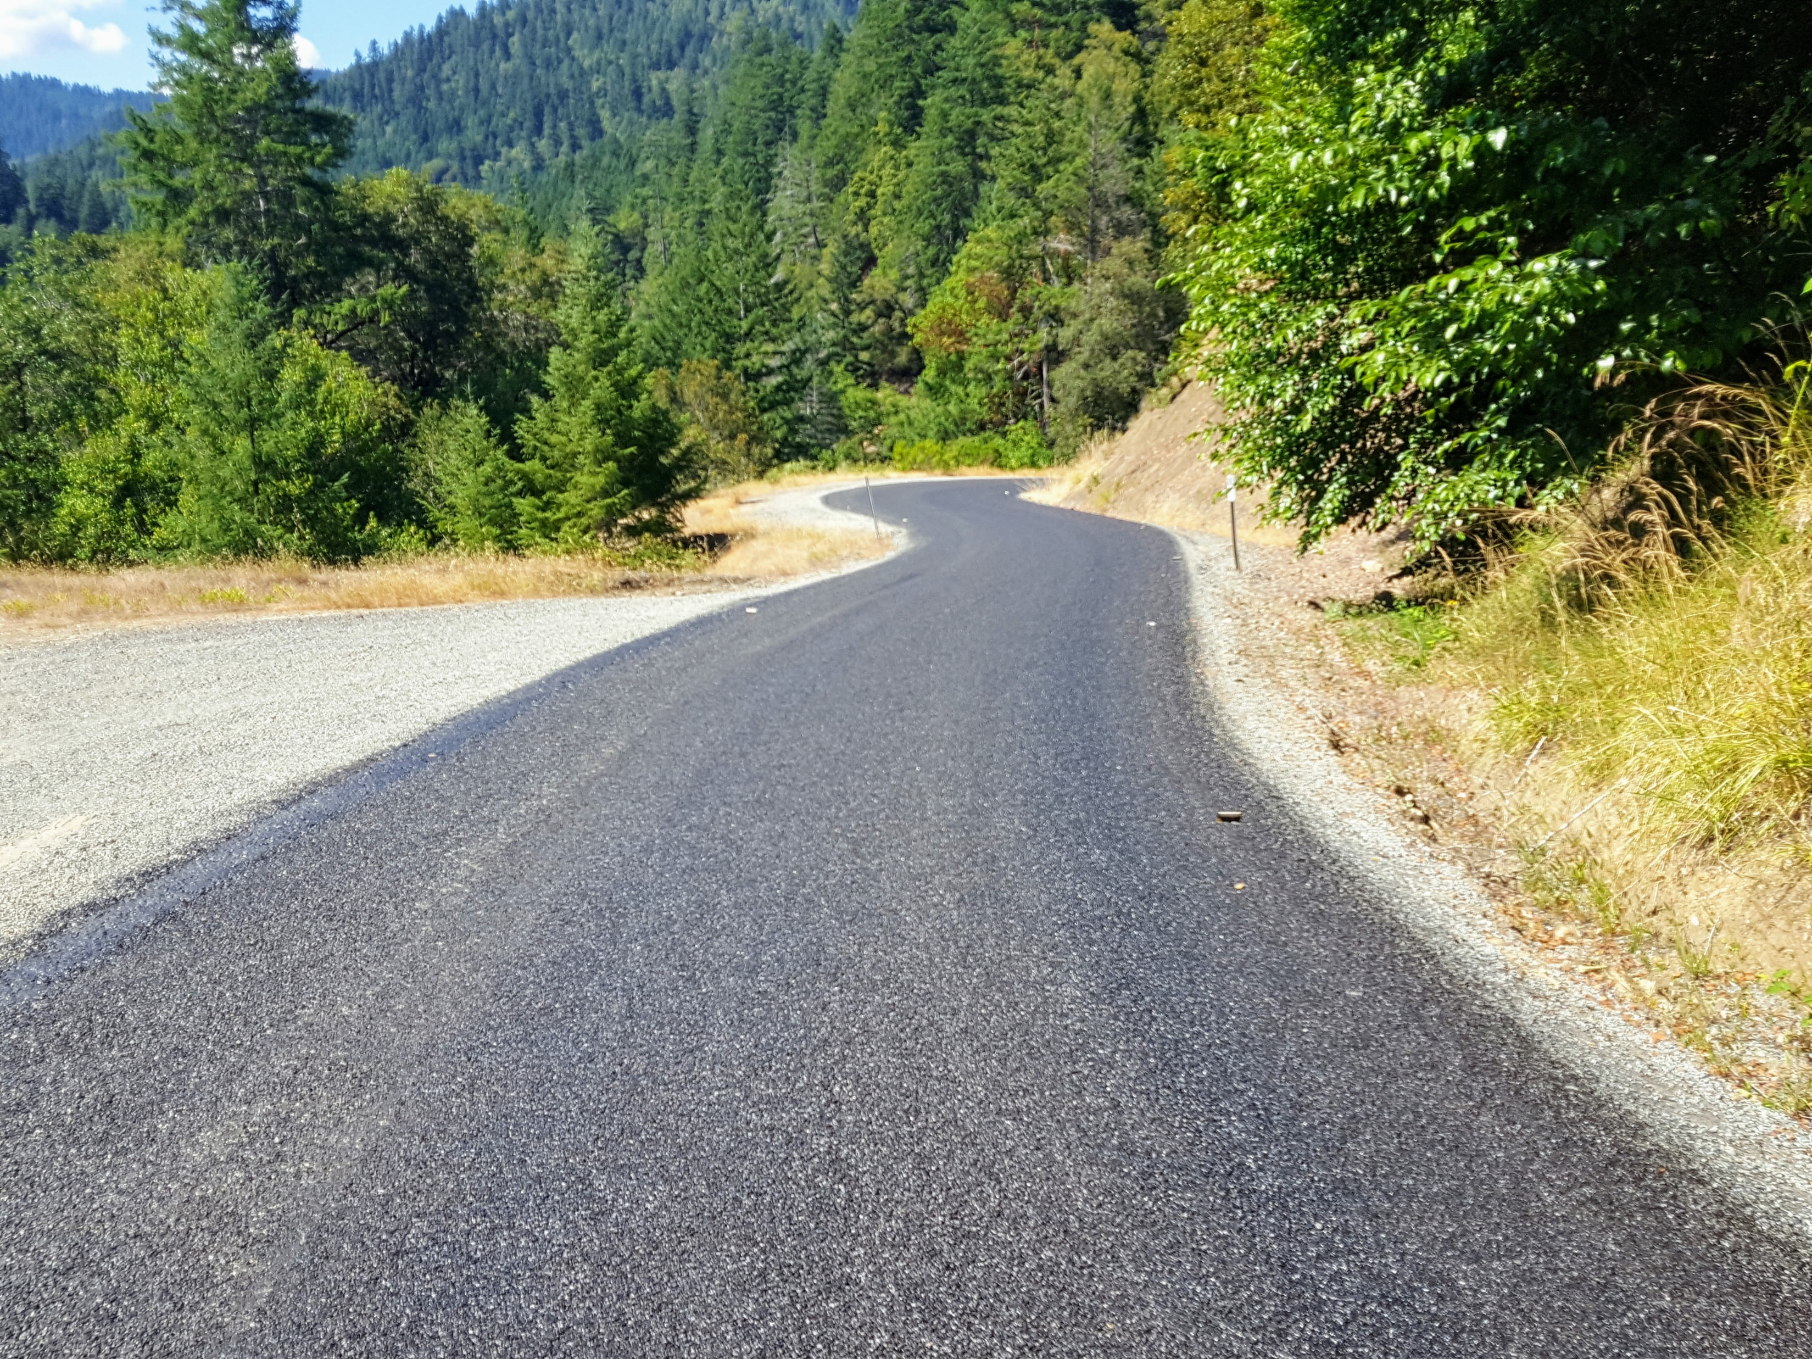
Curry County Climate Challenges
SW Oregon Coast two distinct climates
Coastal fog belt - average temperature about 65 degrees
Hot interior - interior valleys average about 89 degrees

Slide 7
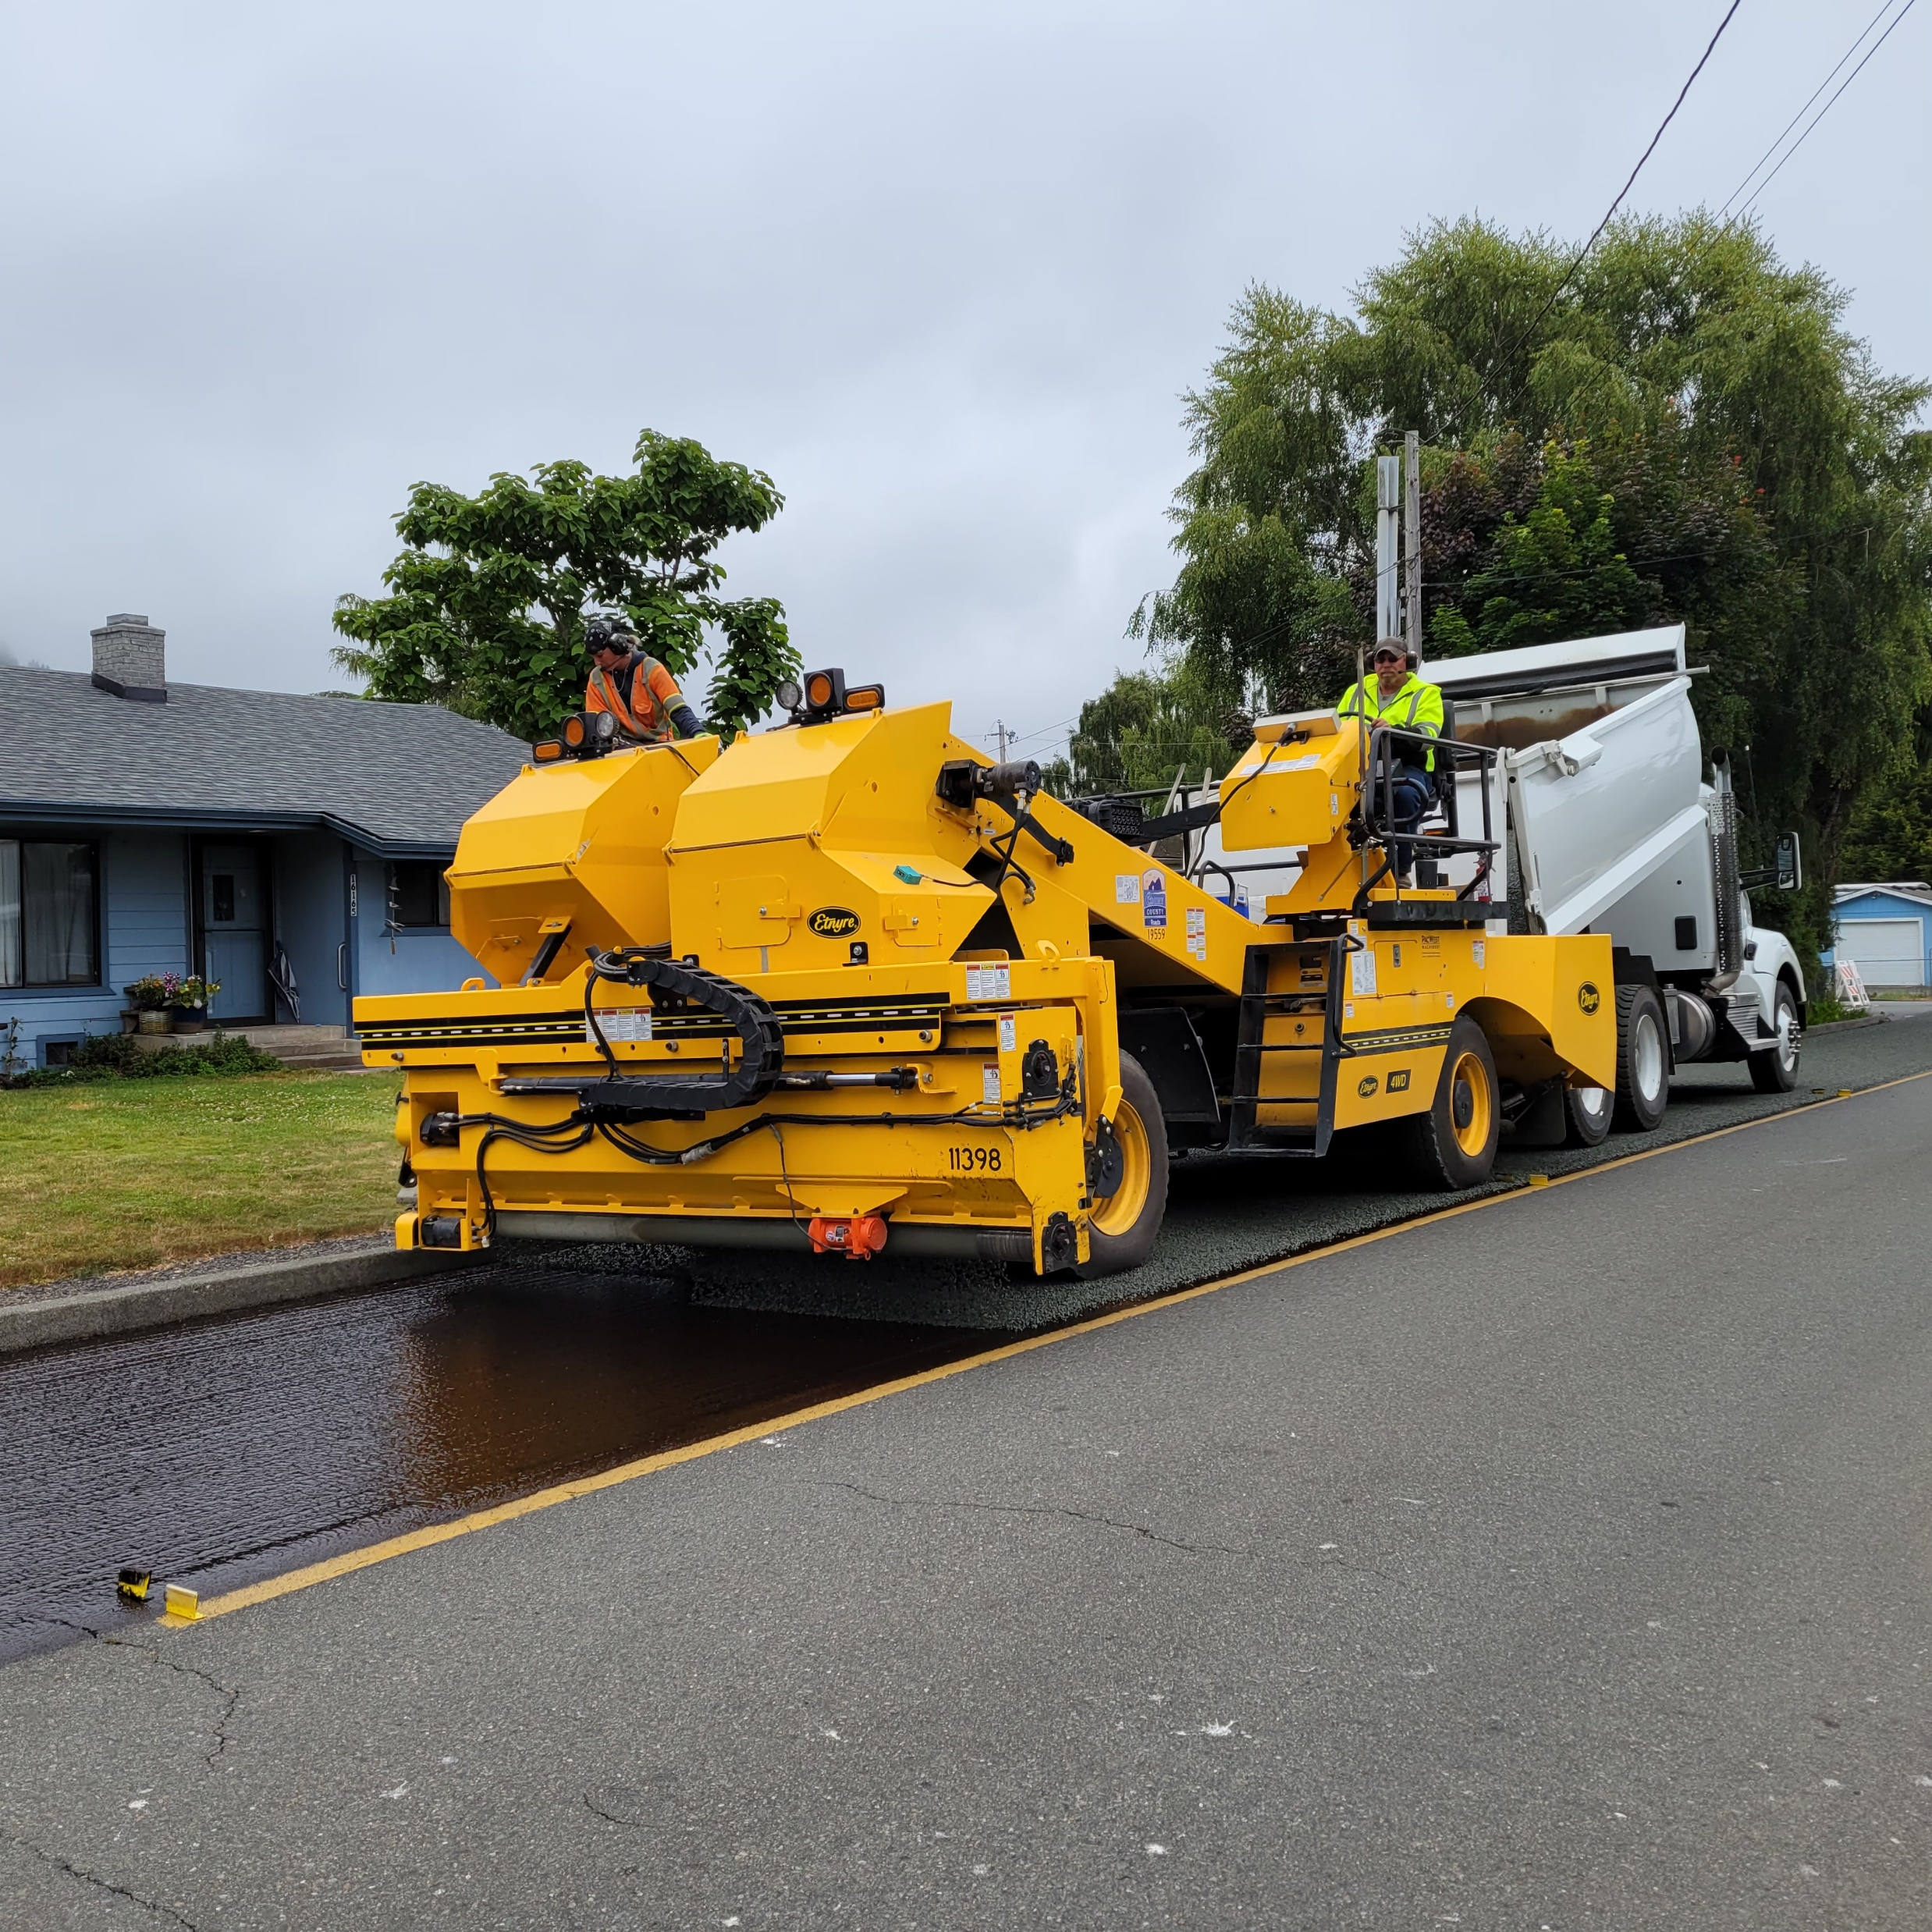
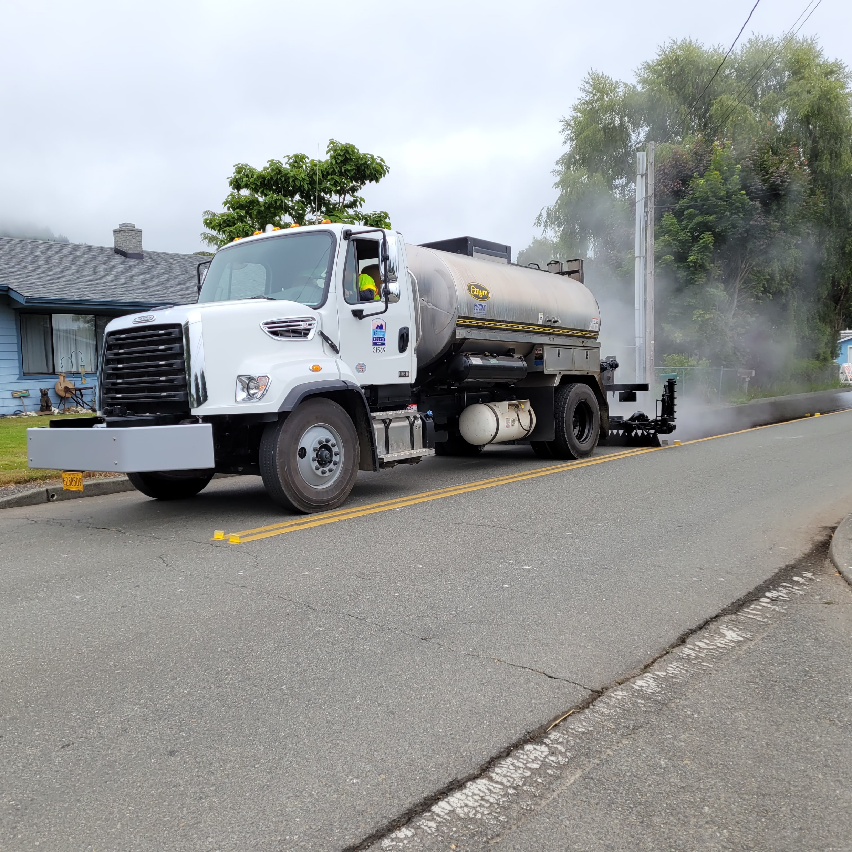
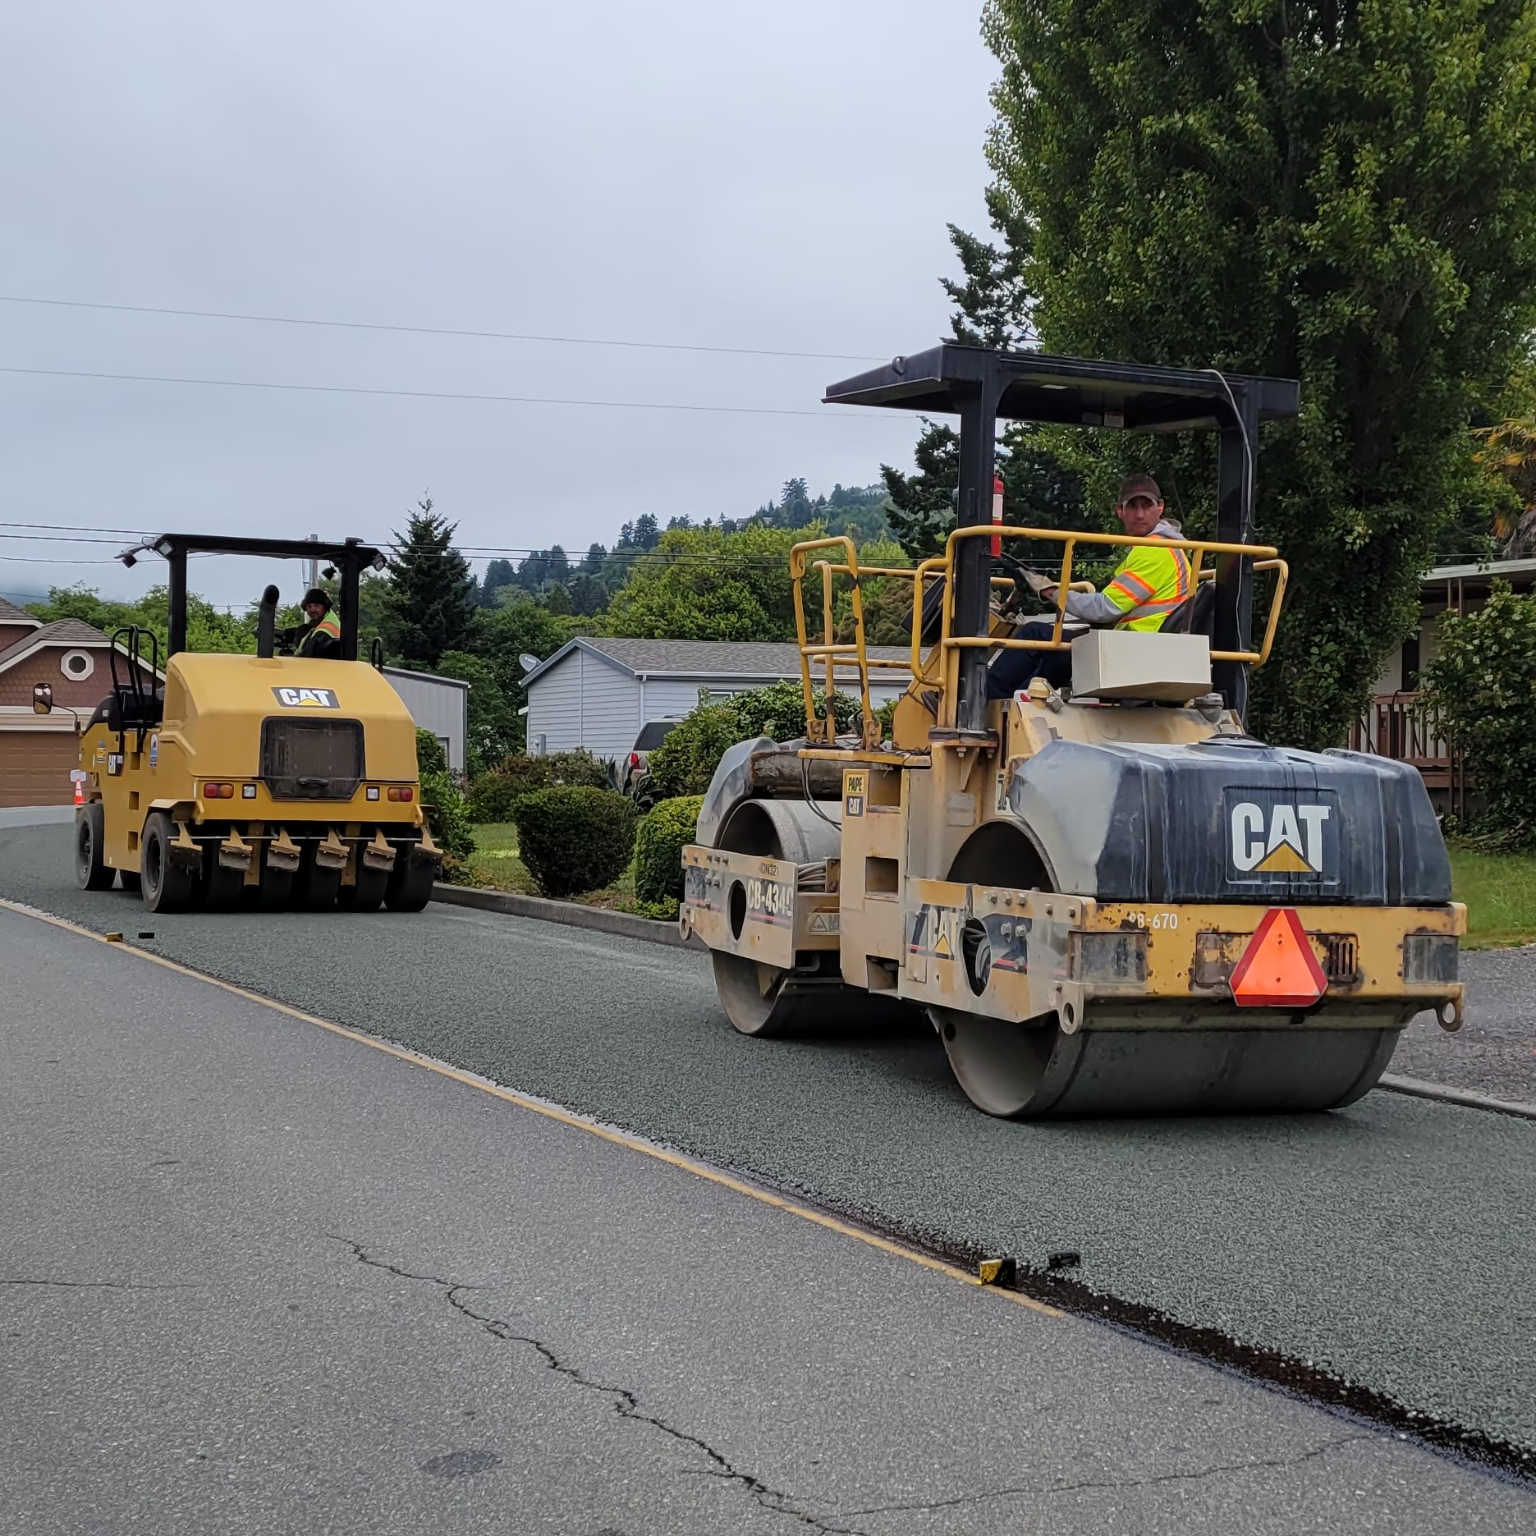
Equipment Purchasing Strategy
Cut back on overlay miles from 6 miles to 3 miles
Increased chip seal by 5 miles
Saved $500,00 per year for new equipment
Purchased new chip spreader, distributor and rollers

Slide 8
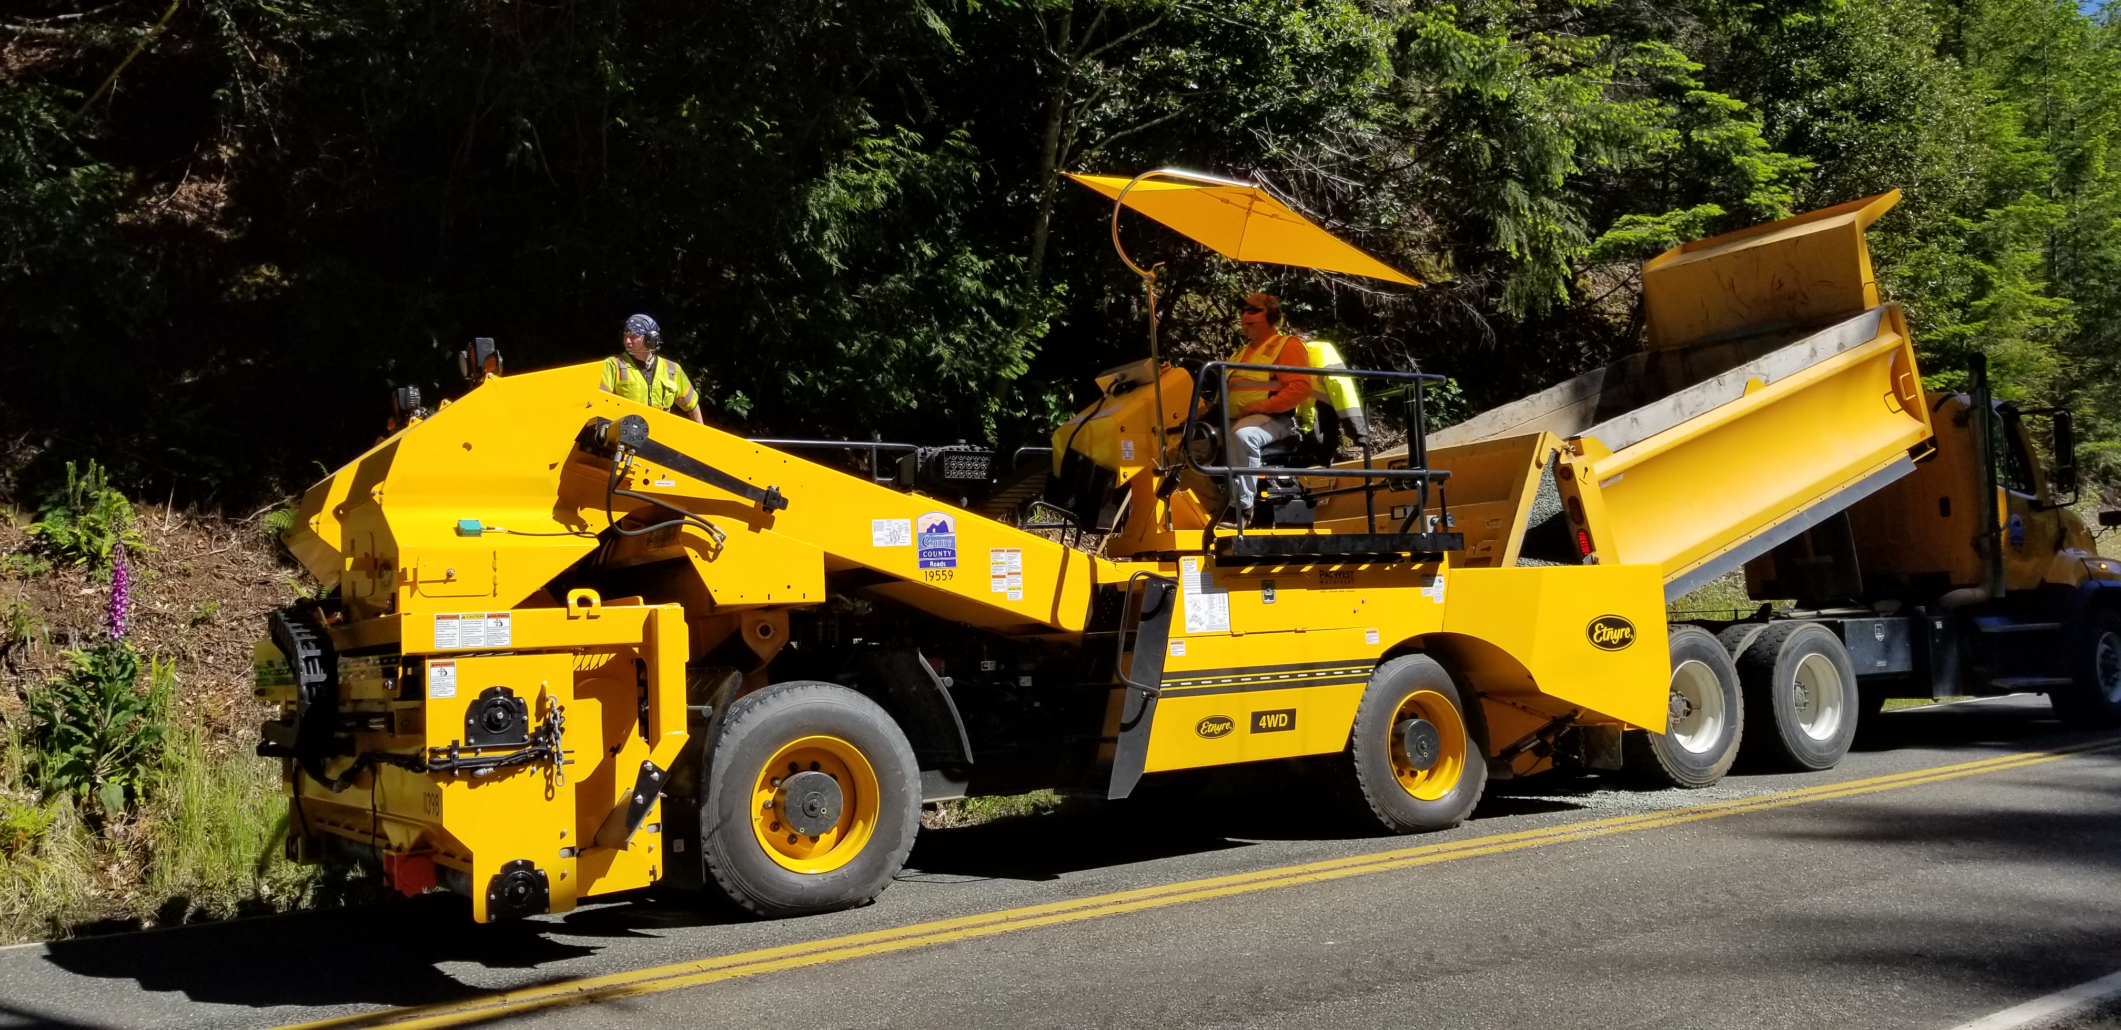
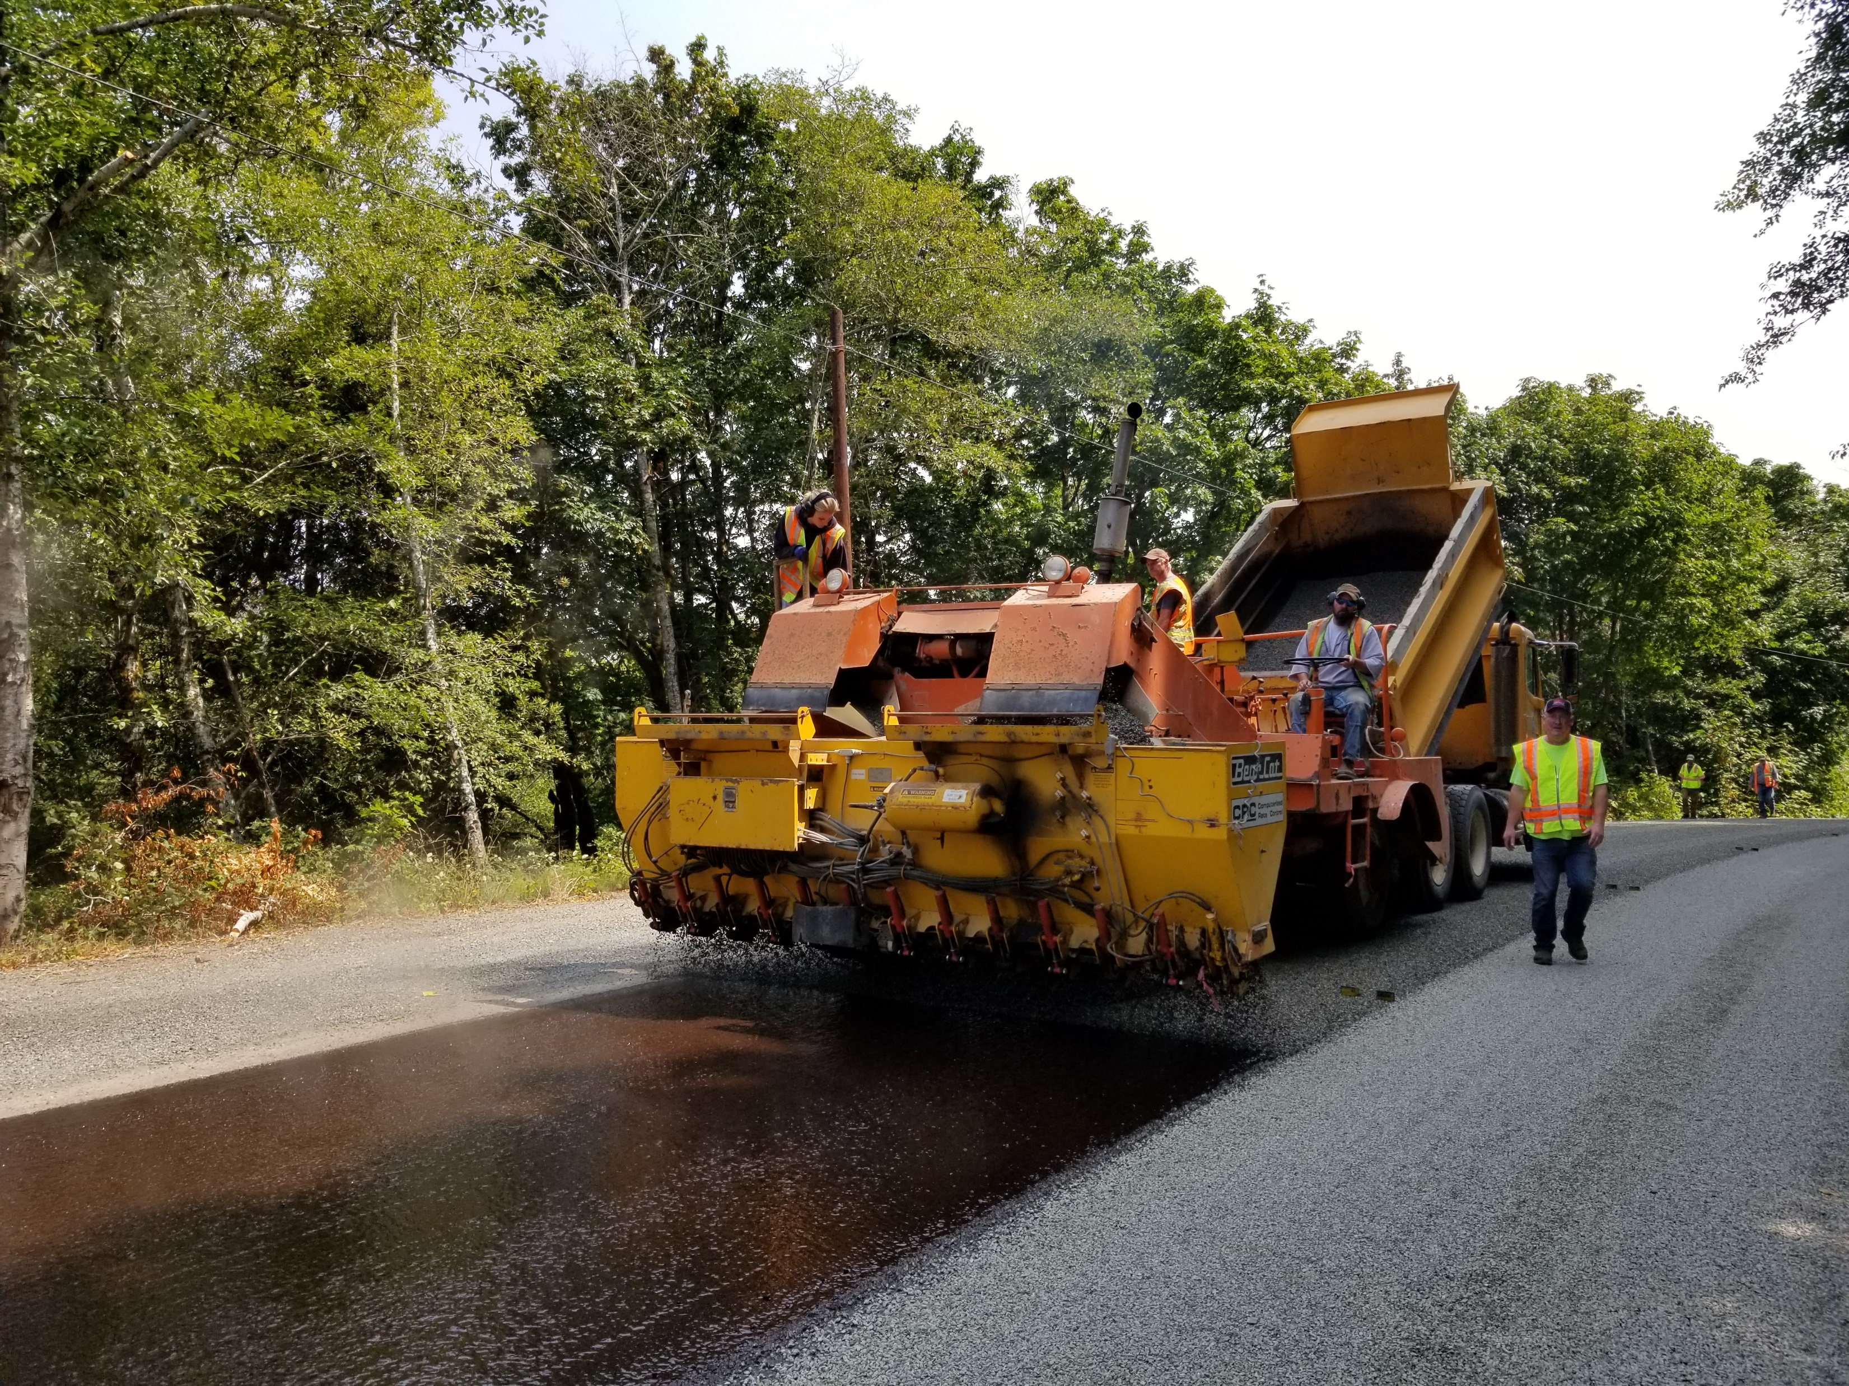
Chip Spreader Upgrade

Slide 9
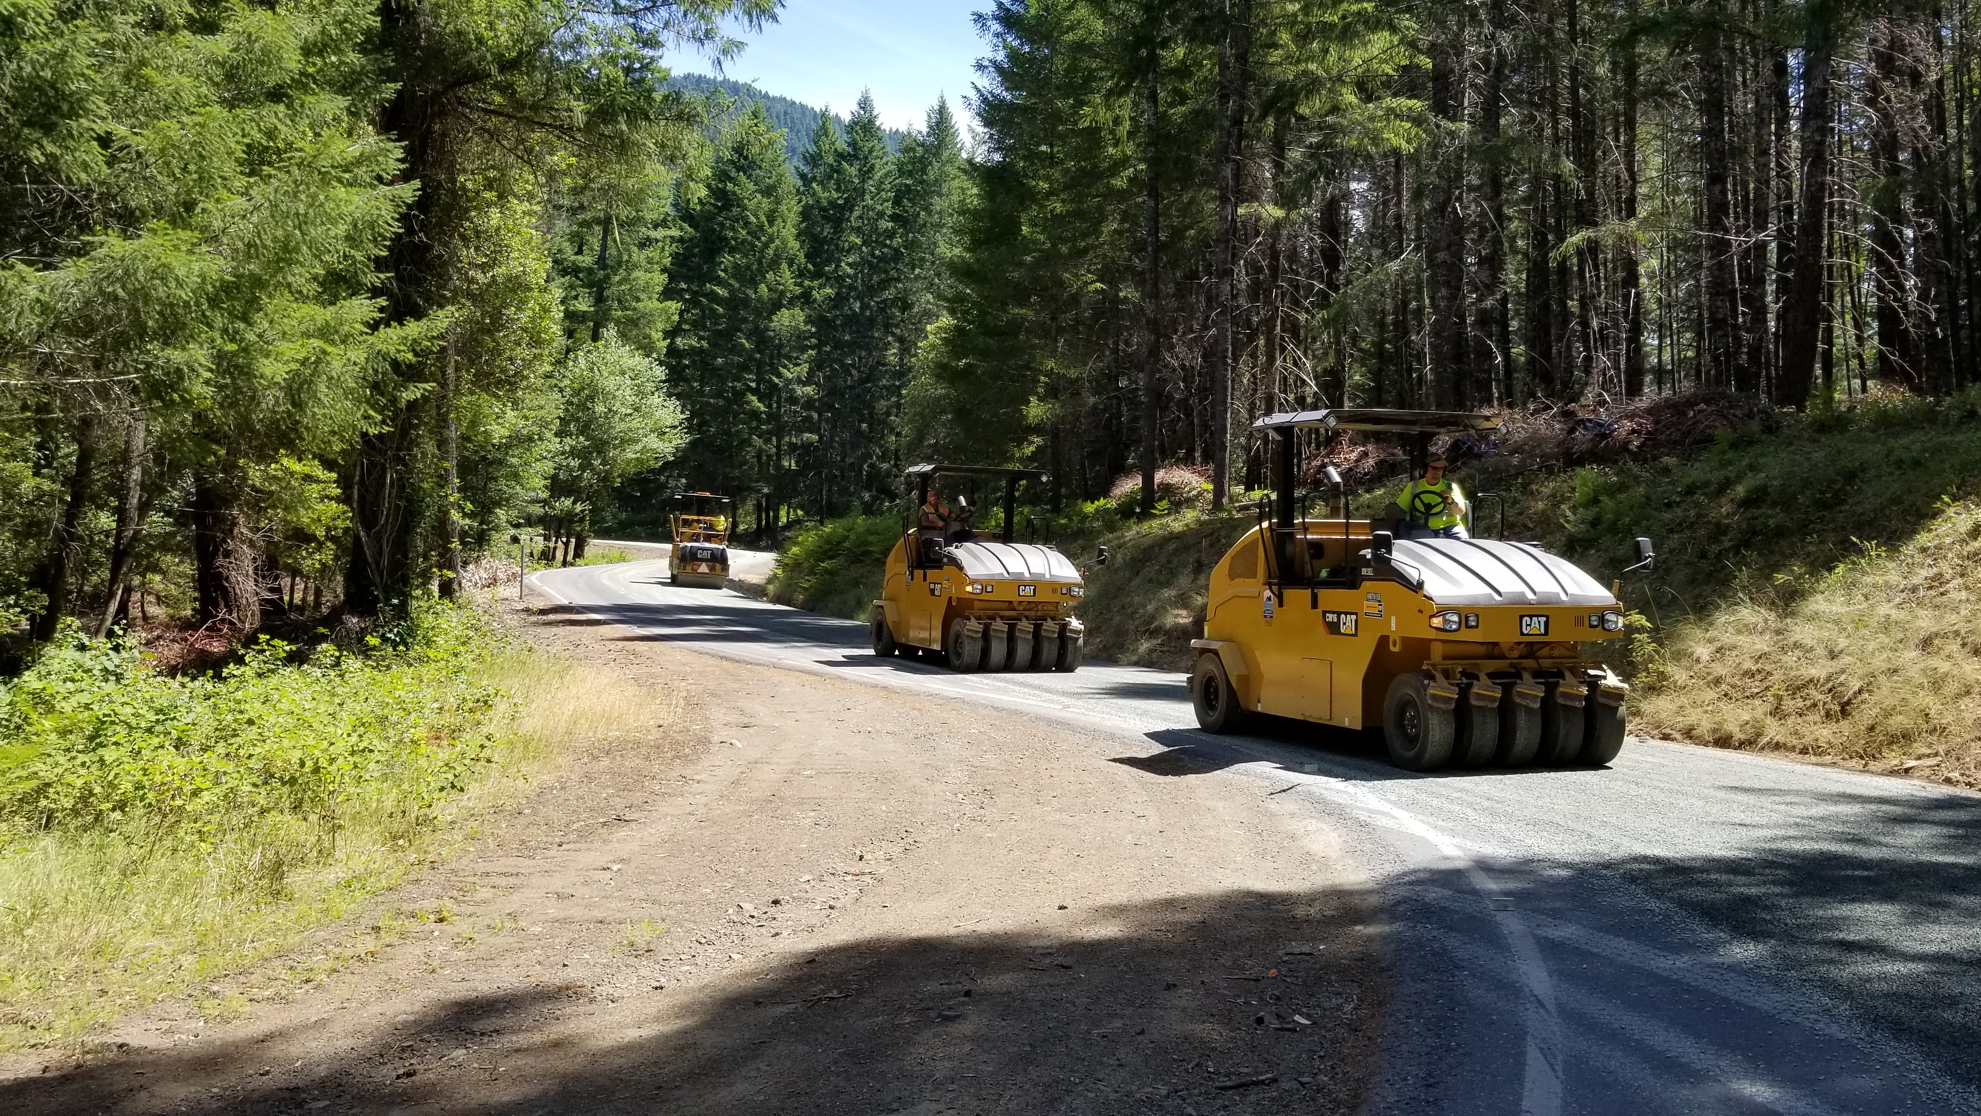
Curry County Rollers

Slide 10
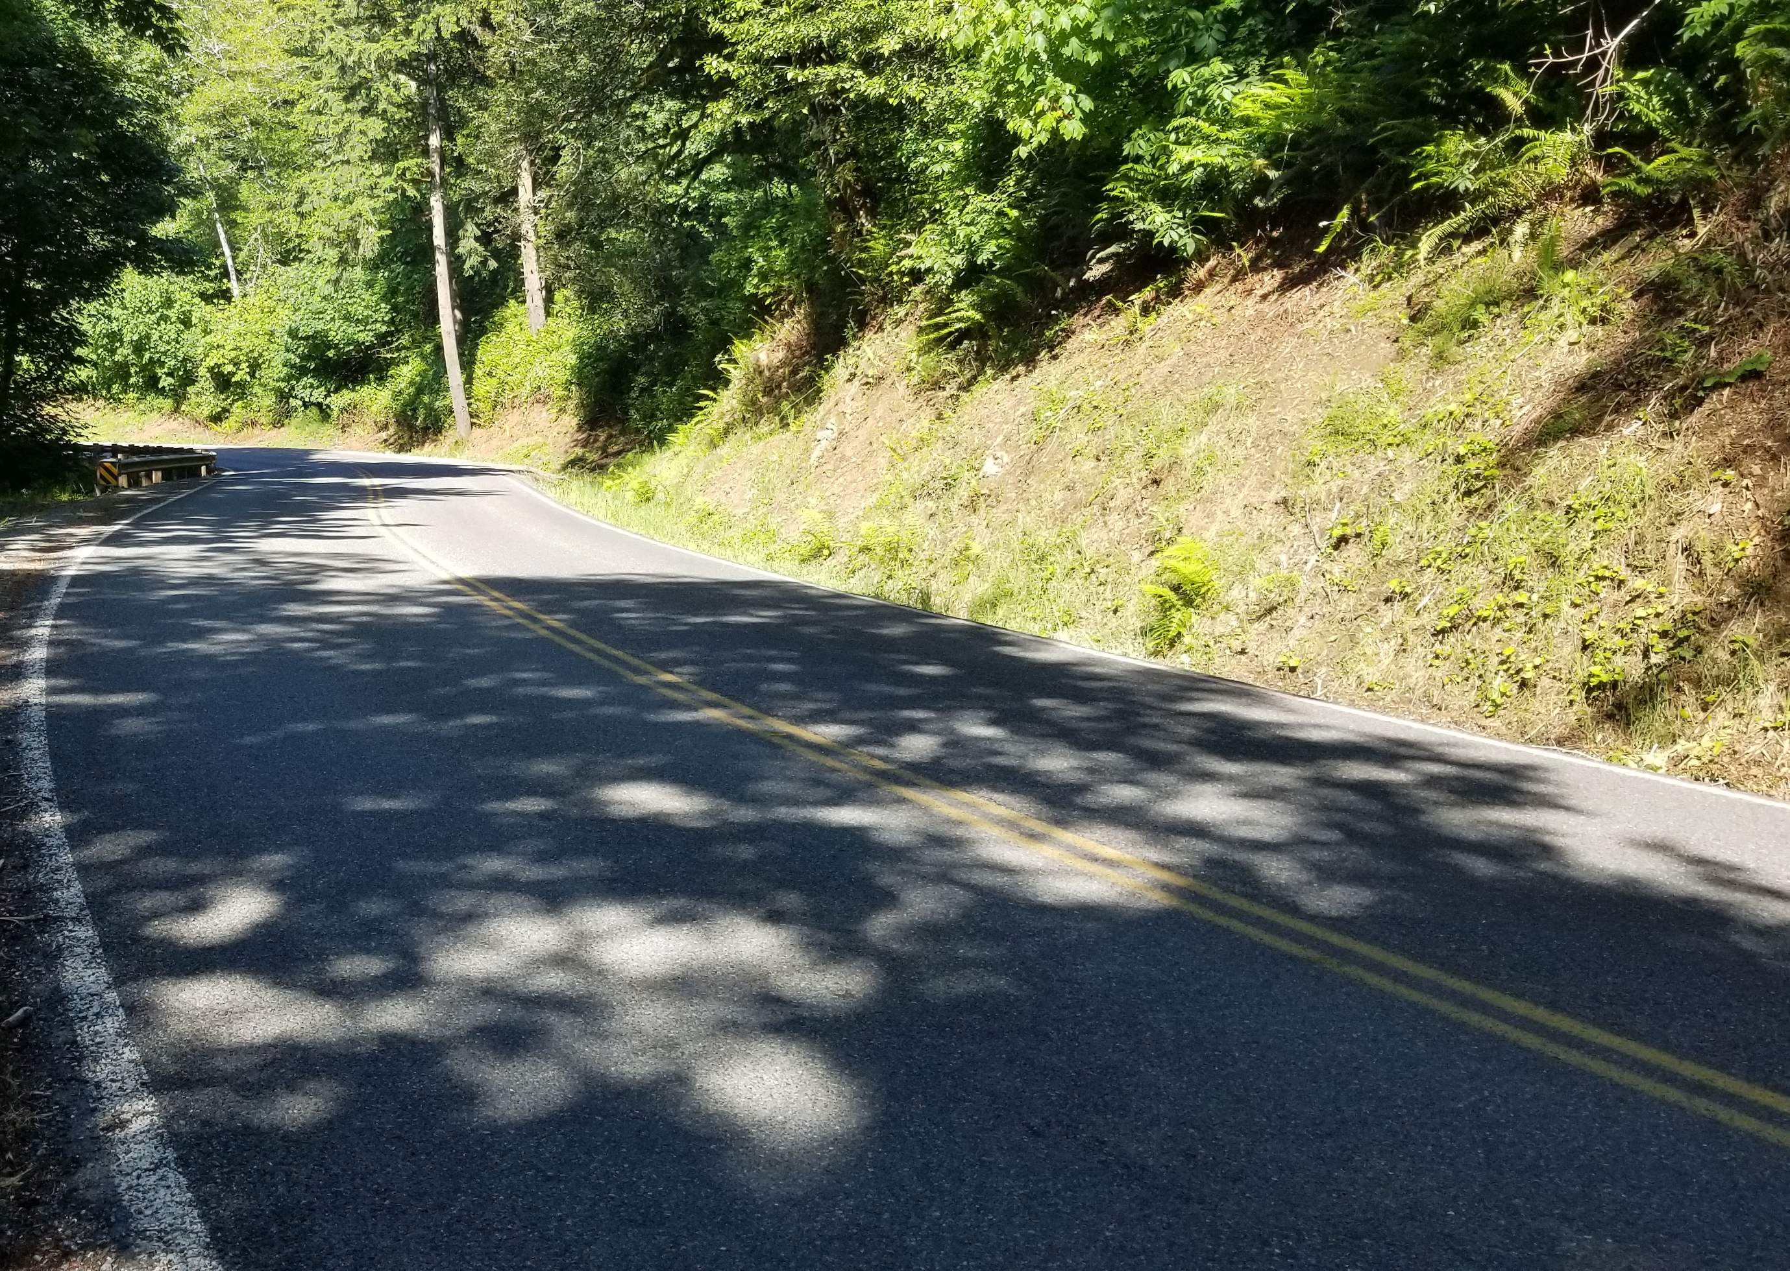
South Bank Chetco River Road
Canopy
Moisture from coastal fog
Along the Chetco River
North side of mountains

Slide 11
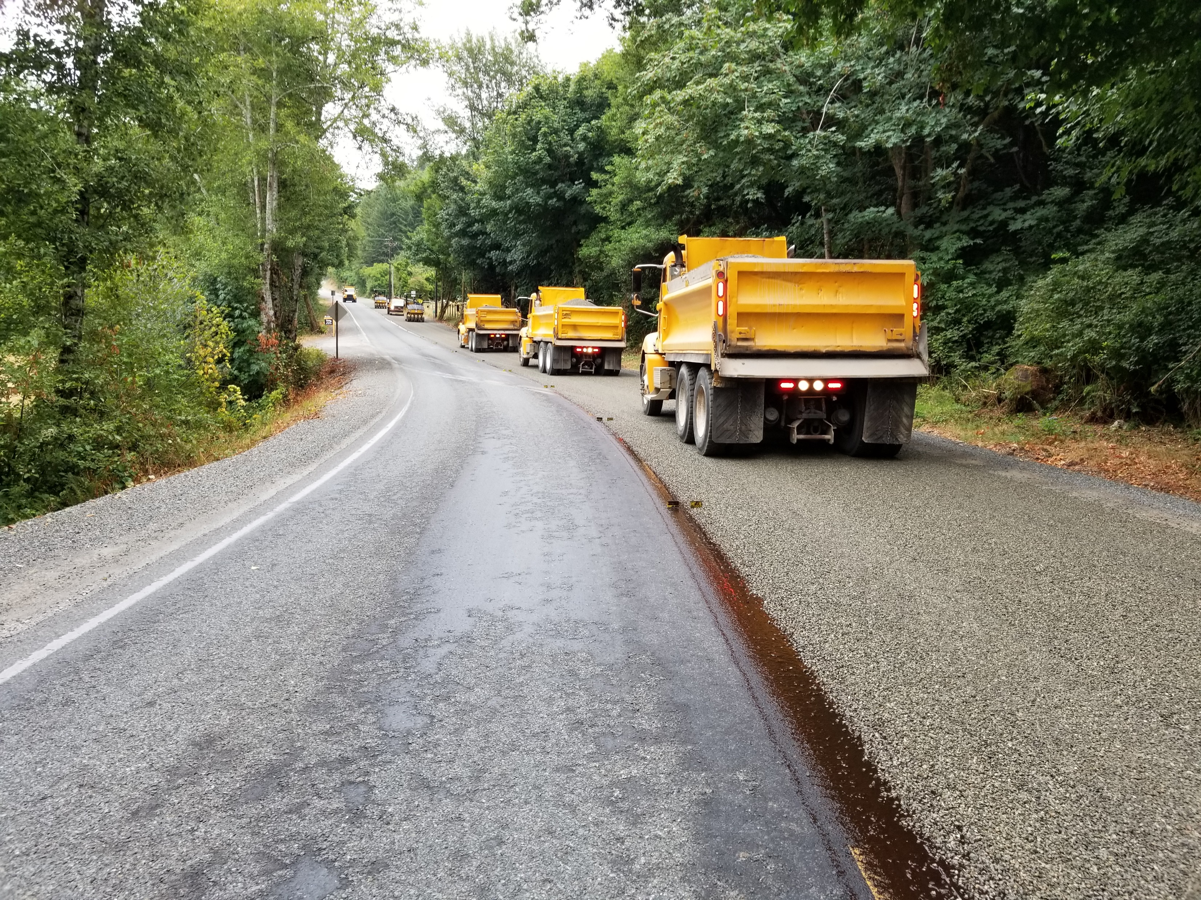
Chip sealing with RS-LTP in 2018
One year old chip seal CRS-2P chip sealed in 2017

Slide 12
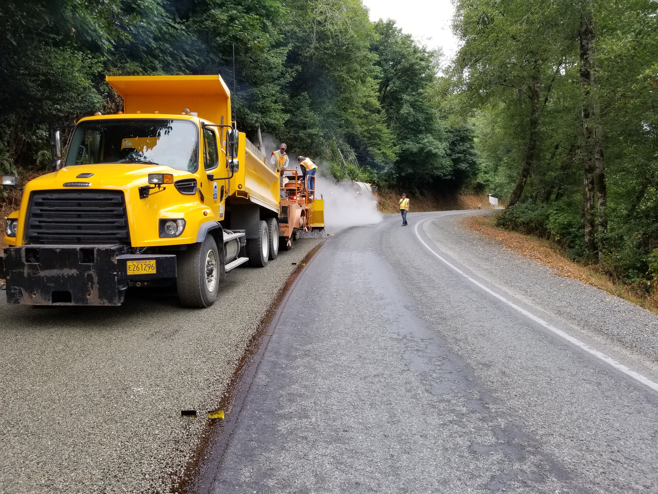
Aggregate loss from previous chip seal

Slide 13
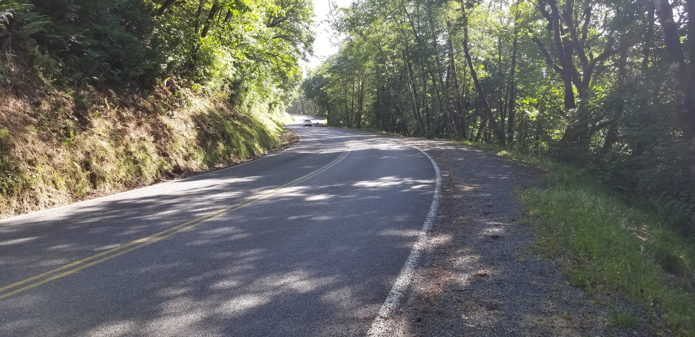
South Bank Chetco River Road in 2020

Slide 15
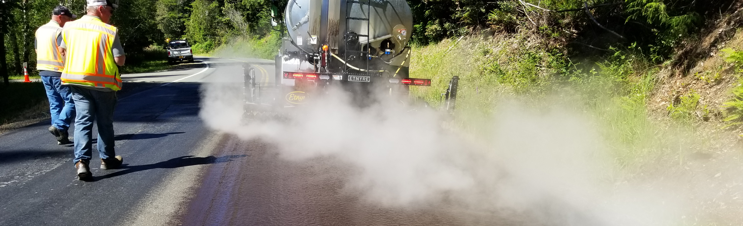
Collaboration with Other Agencies
Through interagency agreements:
Curry County chip sealed 29 miles for ODOT in 2020, 2021
Curry County chip sealed 17 miles for the UFFS in 2022

Slide 16
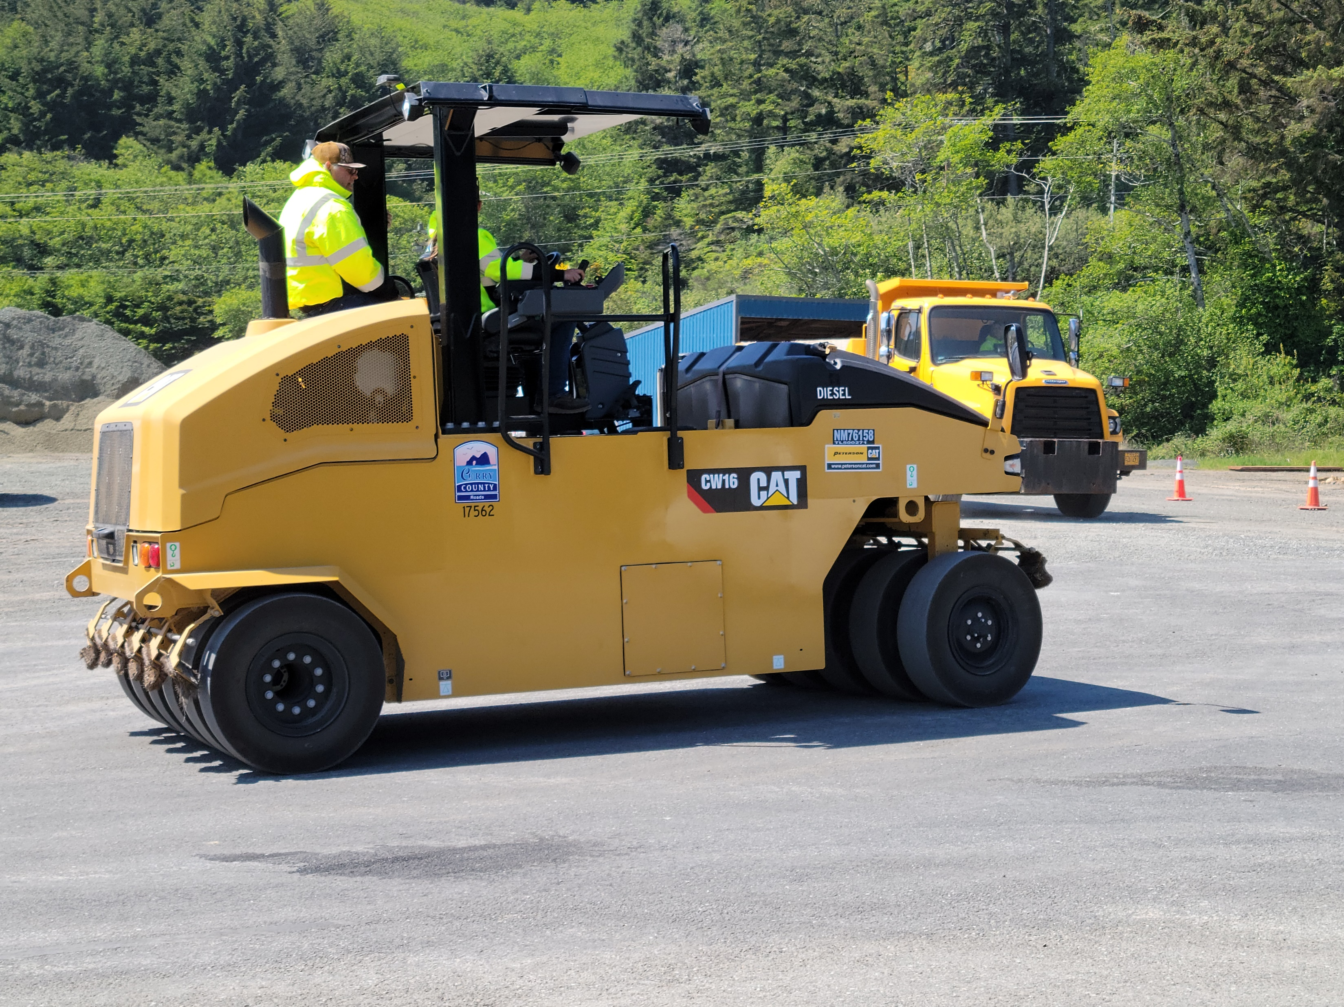
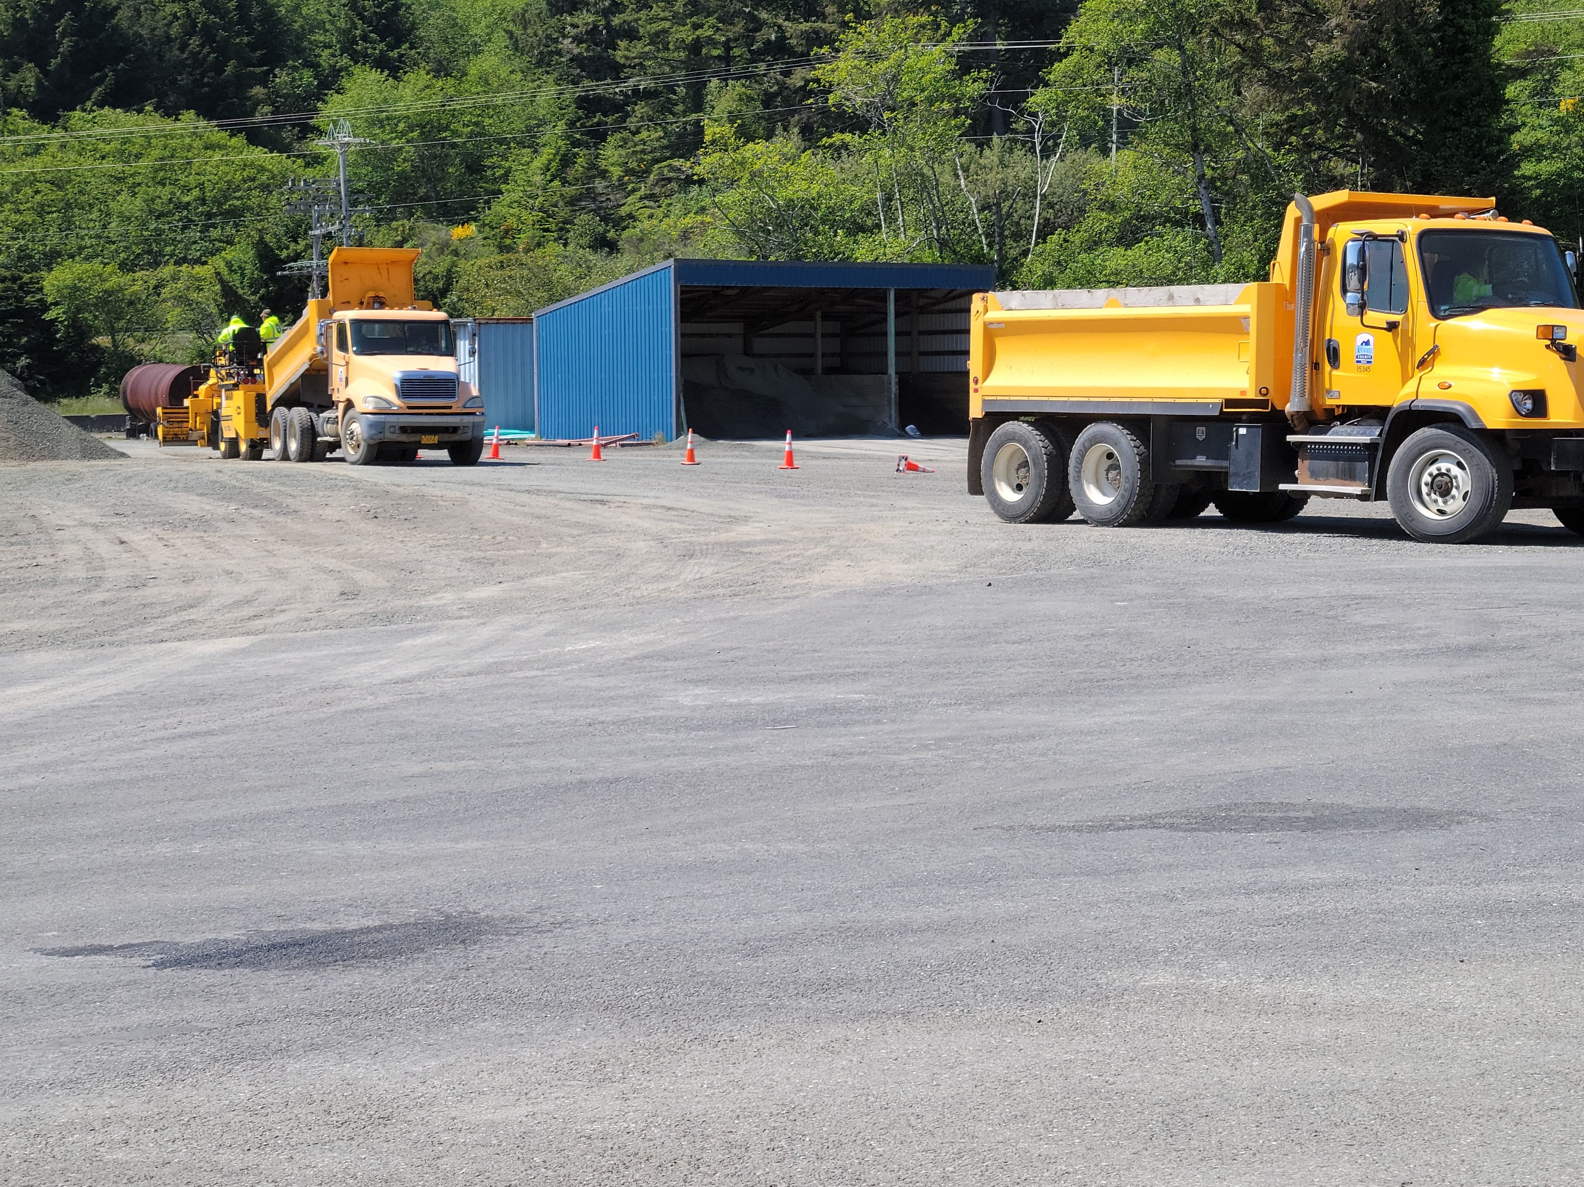
Pre-Season Chip Seal Training

Slide 17
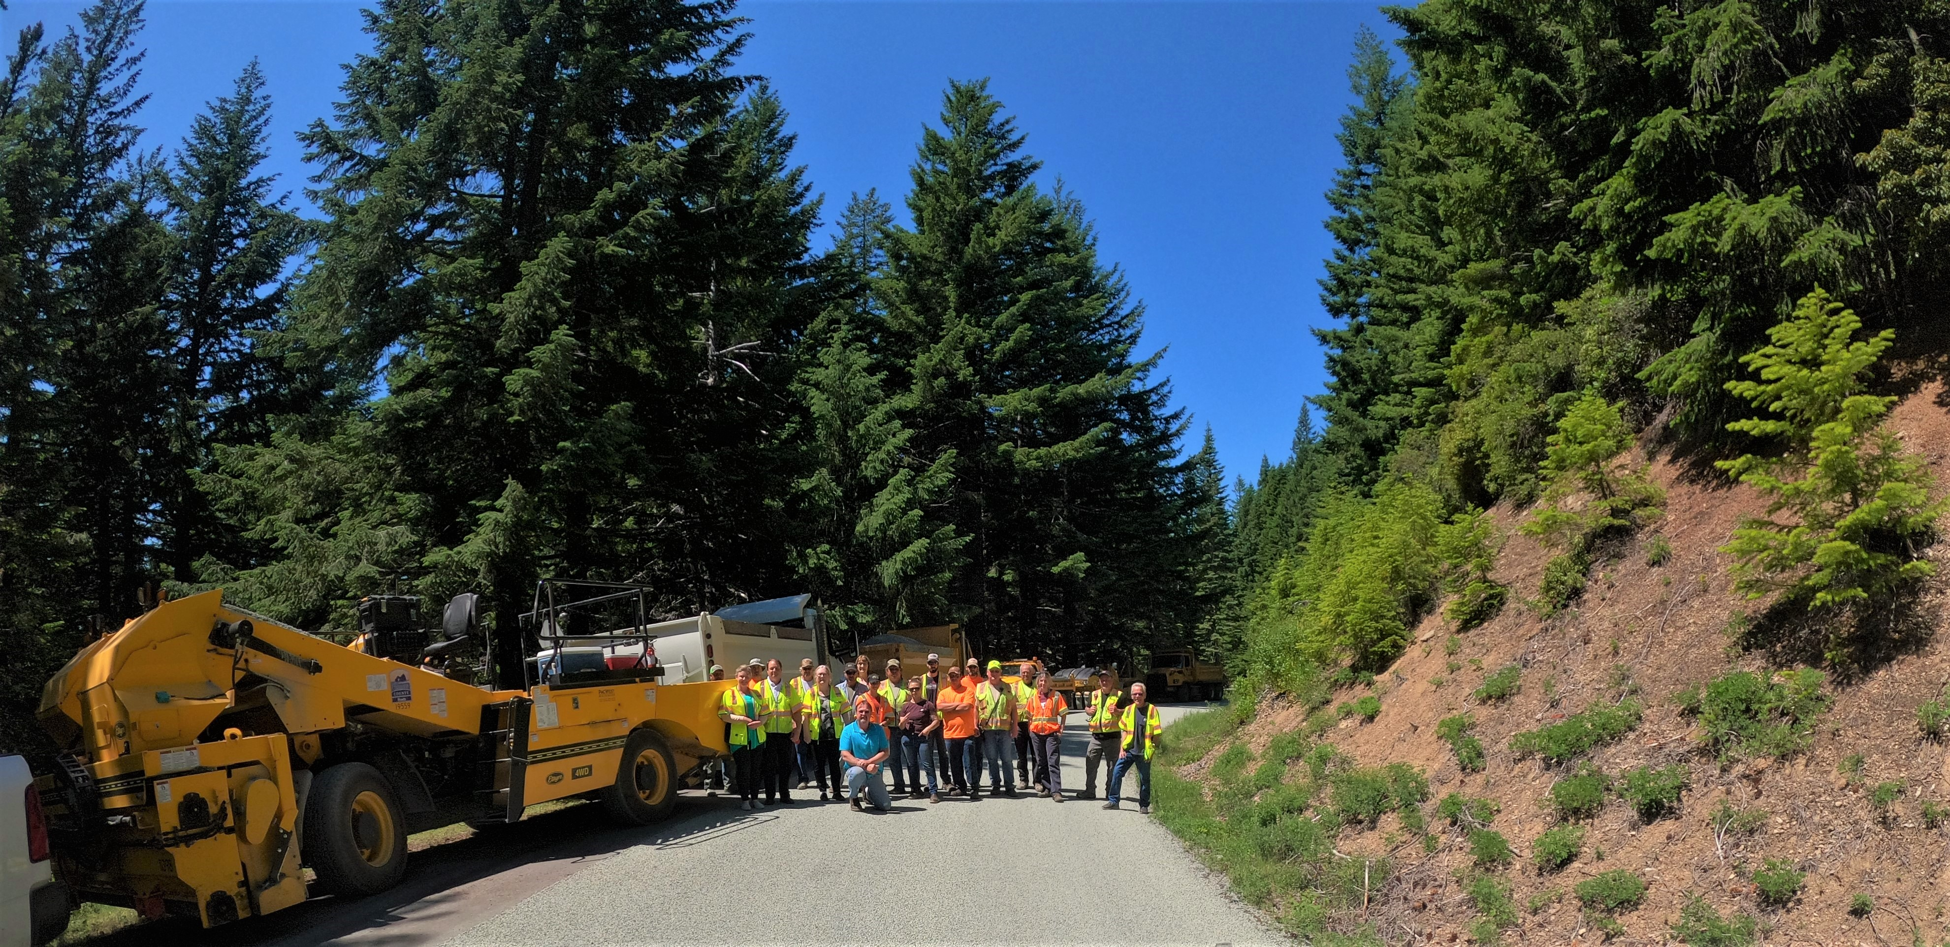
Curry County Chip Seal Crew

