Slide 1
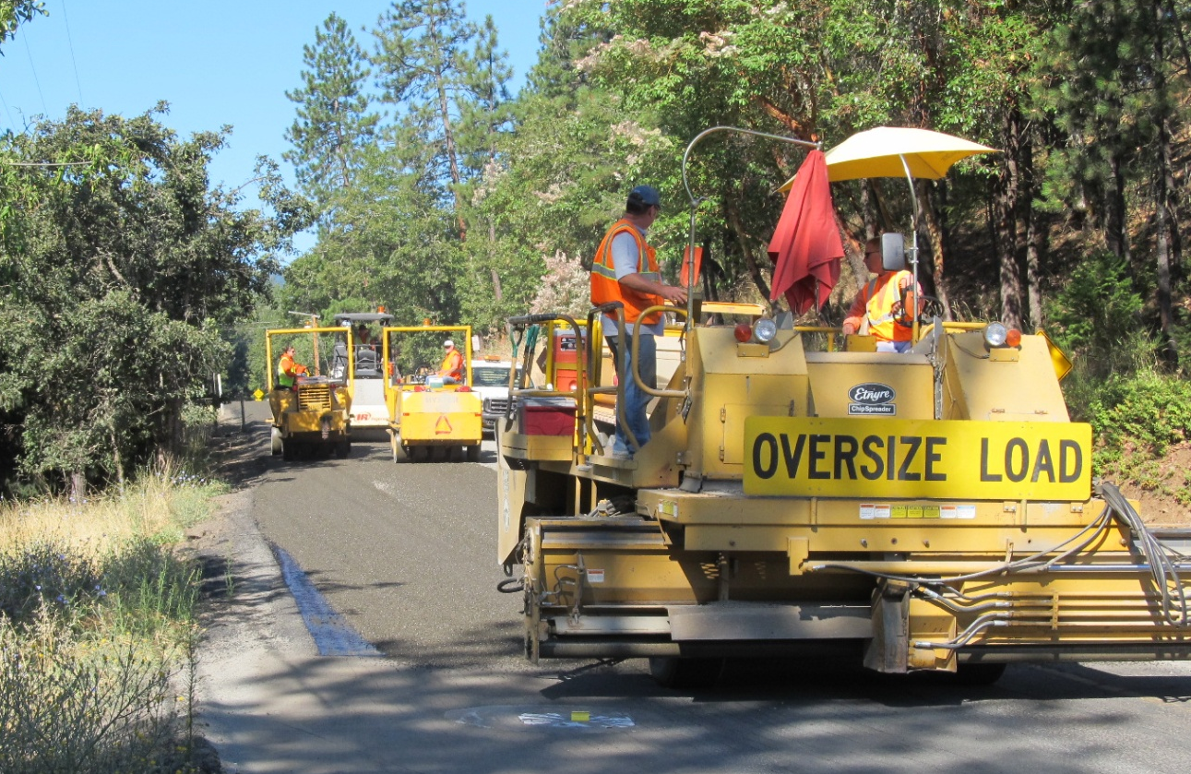
JACKSON COUNTY Chip Seal Program

Slide 2
Today’s Discussion:
Pick the Right Roads in the Right Condition to Chip Seal
Good Preparation can bring a Road into the Right Condition – Perpetual Chip Seal
The Evolution of Jackson County’s Chip Seal Program

Slide 3
Pick the Right Roads in the Right Condition to Chip Seal
Not a Good Candidate
(In Current Condition)
A Good Candidate

Slide 4
Chip Seal a Road that is in the Wrong Condition and/or without Proper Preparation and the Seal will Fail Quickly Chip Seal a Road in the Proper Condition and the Seal should last 7 to 12 years Perform Proper Preparation to a Road in the Wrong Condition, bringing the Road up to a Proper Condition, and the Seal can last 7 to 12 years

Slide 5
Good Preparation can bring a Road into the Right Condition – Perpetual Chip Seal
This is what we believe Constitutes Good Preparation …

Slide 6
From, Not a Good Candidate

Slide 7
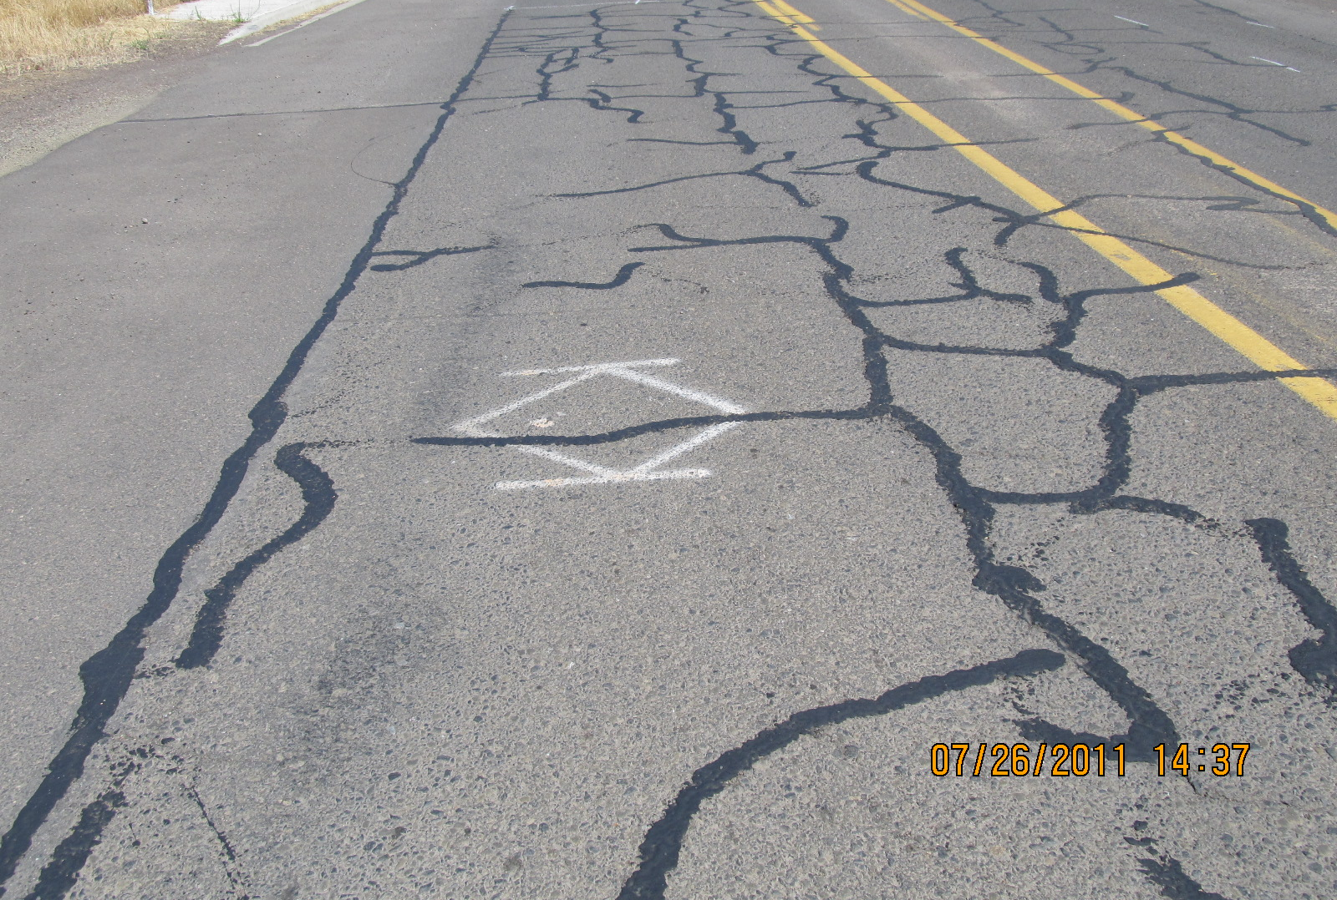
Crack Filling

Slide 8
Grind and Inlay To Repair Pavement Failures

Slide 9
Blade Patch To Correct Grade and Shape

Slide 10
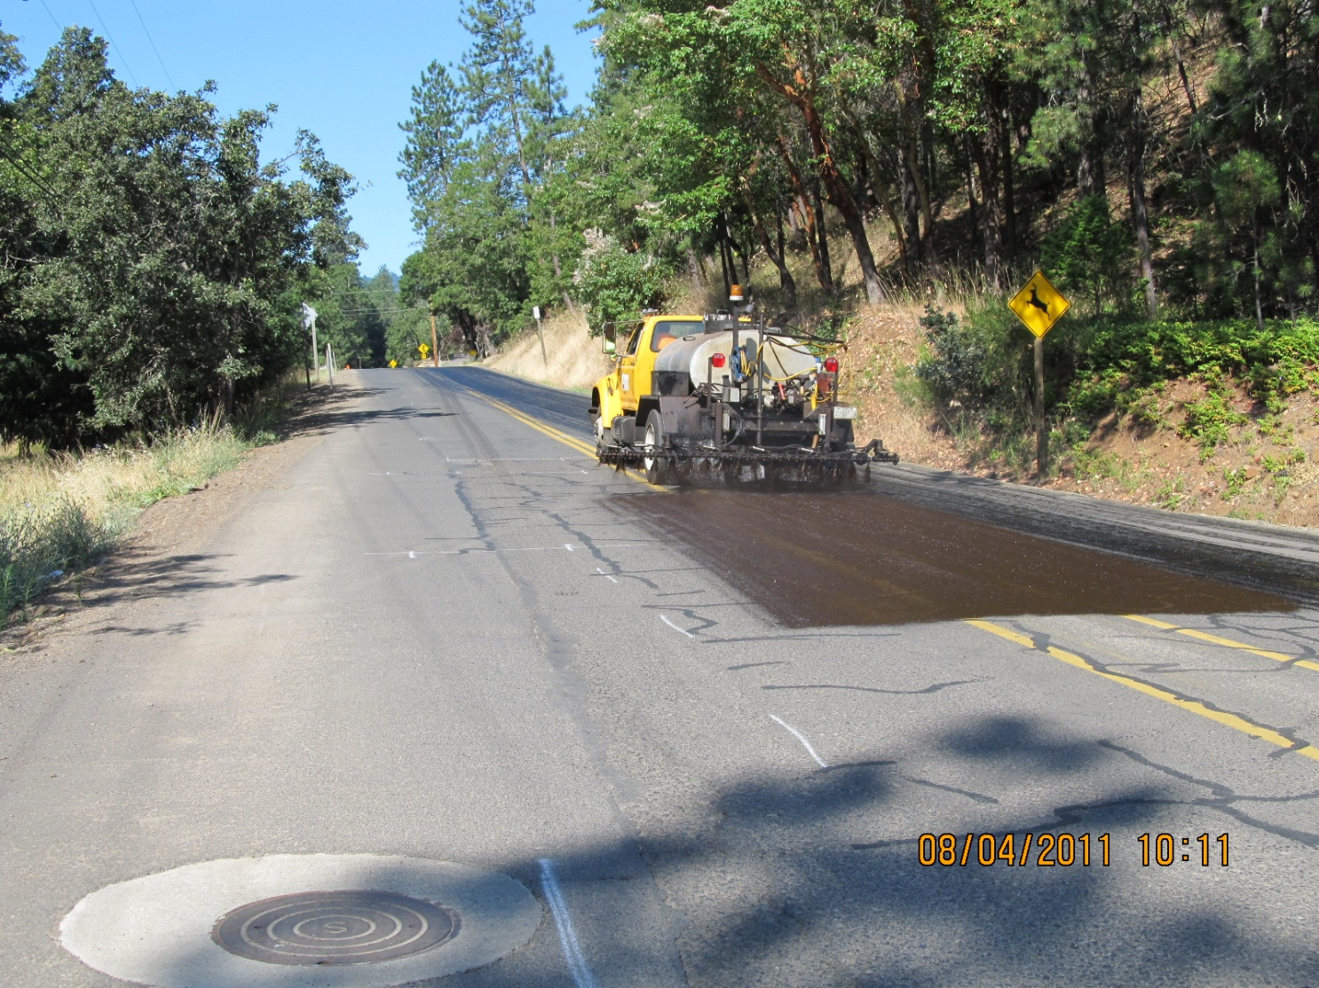
Fog Seal Fresh Repairs So Chip Seal will Adhere

Slide 11
Chip Seal

Slide 12
Fog Seal

Slide 13
With Proper Preparation, Perpetual Chip Seal
From This
To This

Slide 14
The Evolution of Jackson County’s Chip Seal Program
Where We Started:
45 Tons of Oil per day
11.5 Crew Hours per day
3 Hours and 40 minutes of Chip Spreader Operation per day

Slide 15
“Don't mistake activity with achievement.” ― John Wooden

Slide 16
Problems Identified:
Green Manager
Chip Seal List with No Detail
An Uninspired Lead Worker
A Poorly Maintained Oil Distributor
And More…

Slide 17
Achieving Perfection Through Incremental Improvement

Slide 18
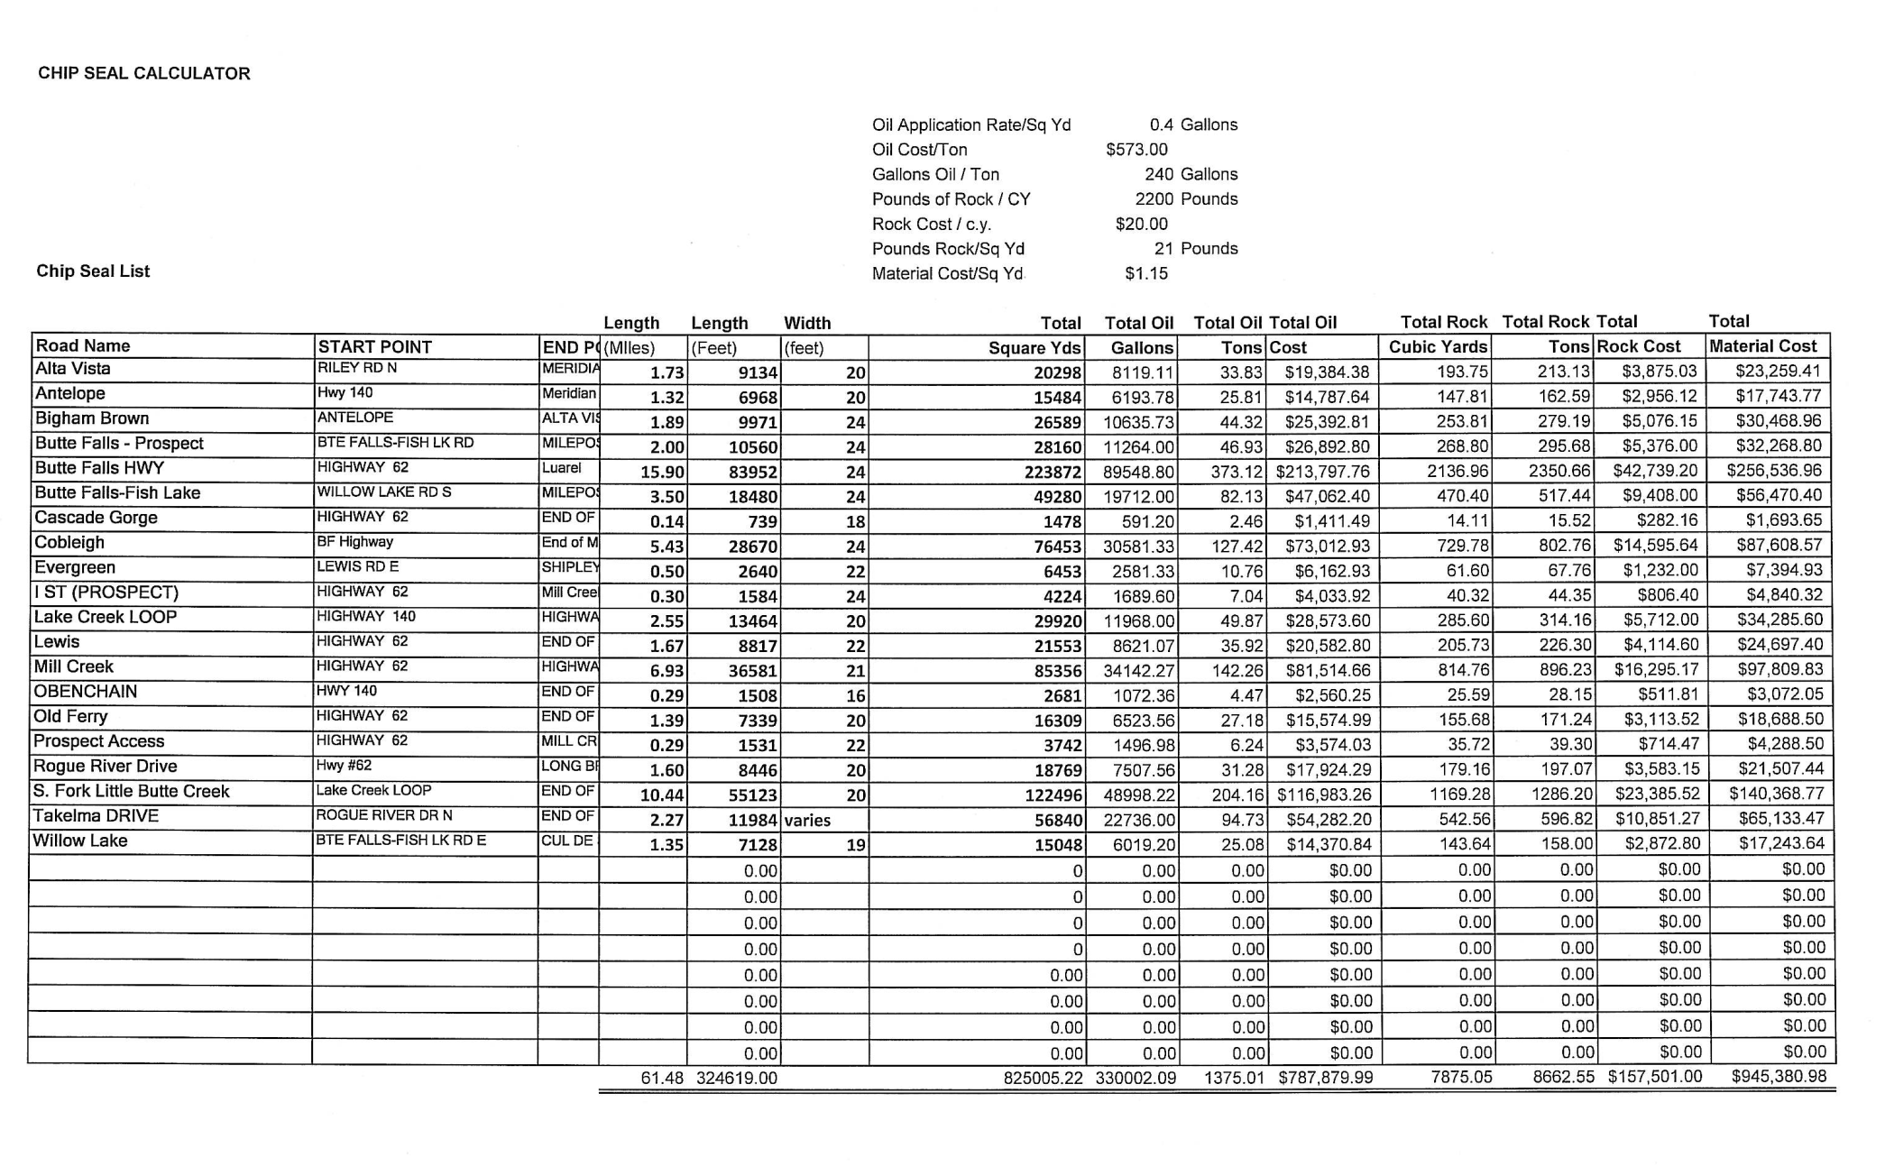
Chip Seal Calculator

Slide 19
Who knows the per hour composite hourly cost of your chip seal crew?

Slide 20
Changes We’ve Made
Assigned a field mechanic to stay with the crew, full time.
Clean the spray bar every day.
Change suction screen when needed.
Track post-trip truck inspections.
Shoot with traffic.
Knife centerline nozzle.
Don’t begin shooting at intersections.

Slide 21
Changes We’ve Made
Mark intersections for distributor operator.
Use 4 rollers most days.
Have a designated lead traffic control person.
Use right amount of trucks.
Broom operators, tab setter and lead traffic Worker offer lunch breaks.
Do lot’s of math.
Plus 43 more.

Slide 22
Results
115 Tons of Oil Per Day (vs. 45 Tons)
11.5 Crew Hours per day (Same Ave. Day)
We believe we are about 85% to our goal –
“Chip Sealing to our Crew’s Maximum Potential”

Slide 23
Questions?

