Slide 1
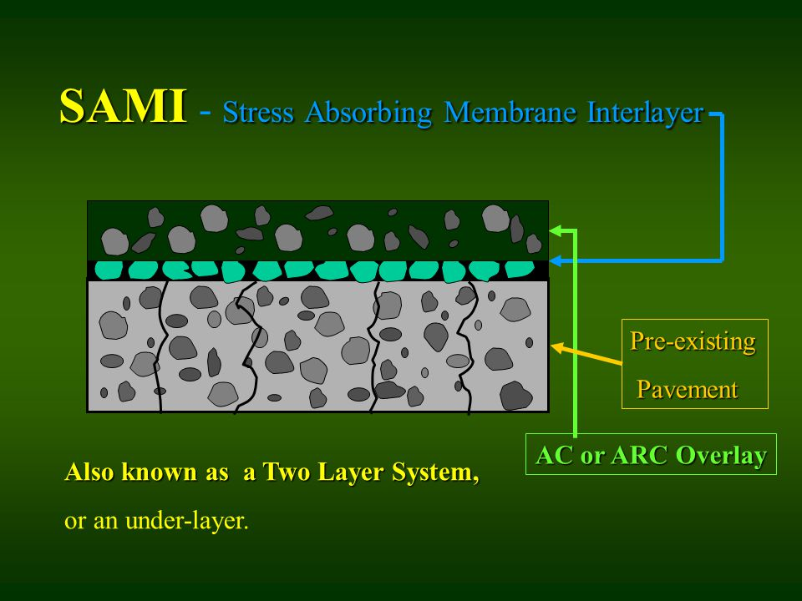
SAMI
OACES Chipseal Workshop
March 21-22, 2023
Hood River OR
Stress Absorbing Membrane Interlayer

Slide 2
Arndt RD NE -SAMI Treatment
OACES Chipseal Workshop
March 21-22, 2023
Hood River OR
1.3-mile segment located in northern Marion County. Completed July 2022
Collector in the northern region that connects Aurora area to St Paul Hwy with ADTs of 1,892
High maintenance section with regular pothole repairs and patching with a PCI of 14.
Pavement design recommended full depth reconstruction and a 6” HMA overlay.
Urgent need to repair due to increased traffic from the current ODOT I-5 Aurora/Donald Interchange Project.

Slide 3
OACES Chipseal Workshop
March 21-22, 2023
Hood River OR
Preliminary prep work involved filling in potholes and delaminated areas

Slide 4
OACES Chipseal Workshop
March 21-22, 2023
Hood River OR
Applied levelling courses over the patches

Slide 5
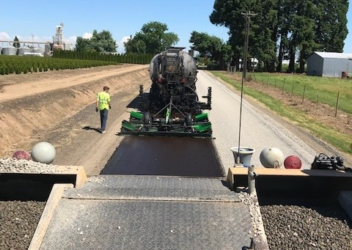
OACES Chipseal Workshop
March 21-22, 2023
Hood River OR
Single shot scrub seal (Sierra Santa Fe) using a polymer modified rejuvenating emulsion (PMRE)
Shot rate = ~.38 gal/sq yd.

Slide 6
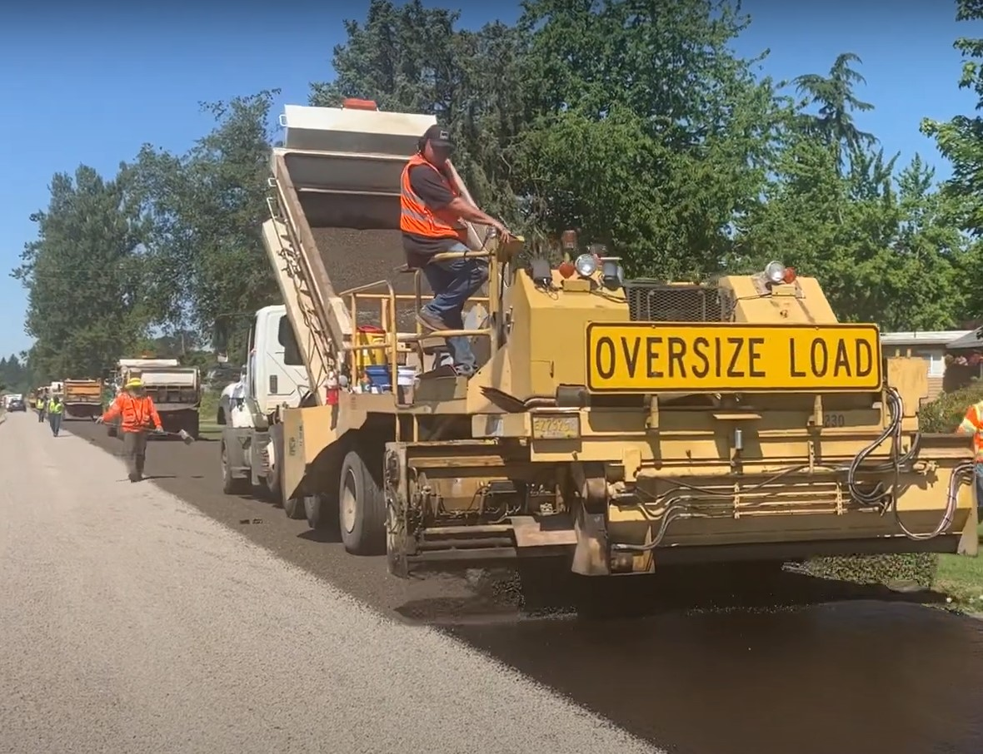
OACES Chipseal Workshop
March 21-22, 2023
Hood River OR
Applied a single layer of 3/8”- #4 chip over the scrub seal
@ ~ 25 lbs/sq yd

Slide 7
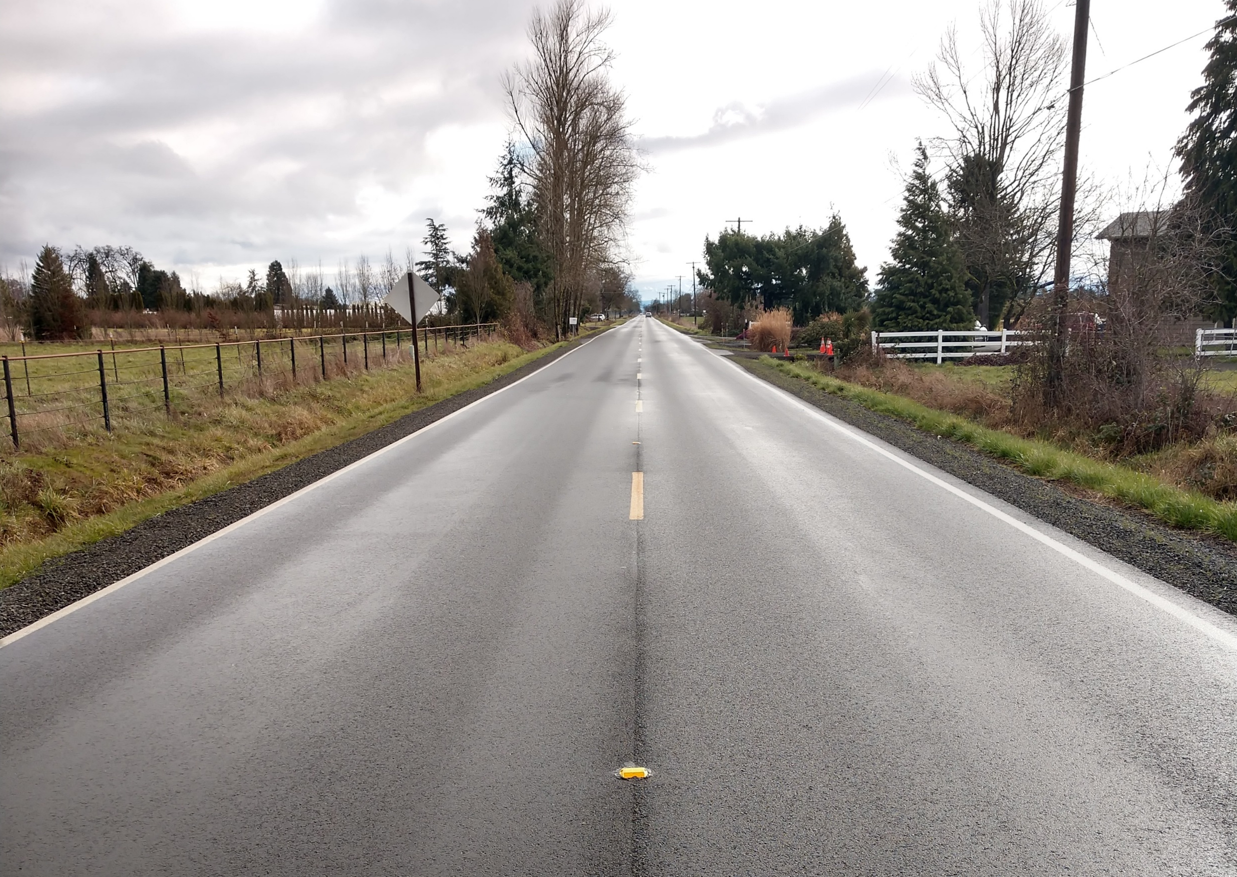
OACES Chipseal Workshop
March 21-22, 2023
Hood River OR
Followed up with two lifts of 1” & 2” AC overlay.
QUESTIONS?

