Slide 1
2021-2025 Marion County
Consolidated Plan
and Analysis of Impediments
Welcome to the
Public Input Meeting!

Slide 2
Why Prepare a
Consolidated Plan?
In exchange for receiving HUD funds, recipients must prepare four things:
1. A Five-Year Consolidated Plan
2. Annual Action Plan
3. Performance and Evaluation Report
4. Analysis of Impediments to Fair Housing Choice

Slide 3
Purpose of the
Five-Year Consolidated Plan
Help us identify housing and community development needs, priorities and strategies
Guide for County to prioritize how federal funds will be allocated to address these needs and activities over five years
Develop Annual Action Plan for Year 1

Slide 4
Purpose of this Focus Group
Review preliminary data
Get your input and perspective on community needs
Take the Surveys!

Slide 5
Entitlement Resources
(2021)
CDBG: $1,538,522
HOME: $621,125

Slide 6
Funds benefiting Low-to-moderate income households and neighborhoods
CDBG funds: public services, infrastructure, public facilities, etc.
HOME funds: rental and homeowner housing; new and rehabilitation

Slide 7
CDBG
Community Center ADA upgrades
Sidewalk and Pedestrian Safety in LMI neighborhoods
Public Services (15% cap) food banks, youth programs, transportation for seniors
HOME
Homeowner housing rehabilitation
Rental Assistance
Down payment assistance
Activity Examples

Slide 8
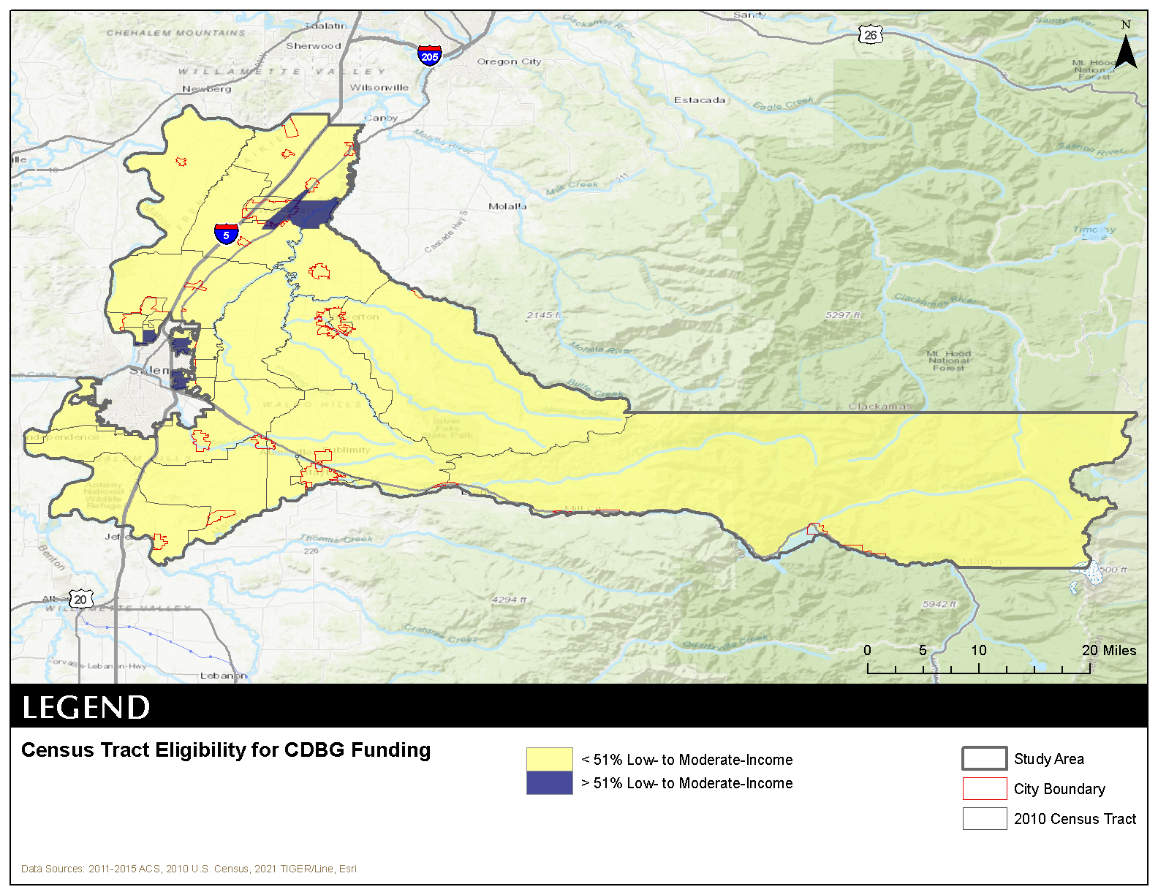
LMI Areas
Study Area:
Marion County minus Salem = Marion County Service Area

Slide 9
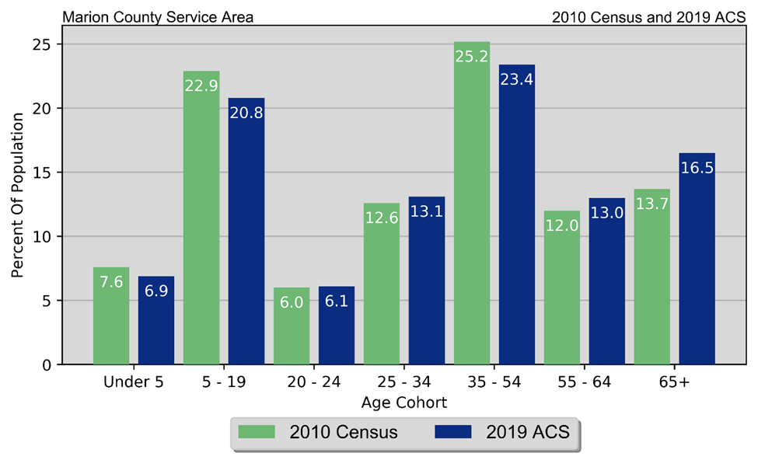
Demographics
Aging Population
What Implications does that have on services and housing needs?

Slide 10
Demographics
Not much change in racial and ethnic makeup
Population by Race and Ethnicity Marion County Service Area 2010 Census & 2019 Five-Year ACS
Race | 2010 Census |  | 2019 Five-Year ACS
 | Population | % of Total | Population | % of Total
White | 145,260 | 78.5% | 161,475 | 81.8%
Black | 1,265 | 0.7% | 2,106 | 1.1%
American Indian | 2,949 | 1.6% | 1,626 | 0.8%
Asian | 2,500 | 1.4% | 3,309 | 1.7%
Native Hawaiian/ Pacific Islander | 963 | 0.5% | 882 | 0.4%
Other | 25,418 | 13.7% | 15,296 | 7.7%
Two or More Races | 6,582 | 3.6% | 12,736 | 6.5%
Total | 184,937 | 100.0% | 197,430 | 100.0%
Non-Hispanic | 136,884 | 74.0% | 142,866 | 72.4%
Hispanic | 48,053 | 26.0% | 54,564 | 27.6%

Slide 11
Demographics
Disability Rate
Over half of people over 75 have a disability
Disability by Age Marion County Service Area 2019 Five-Year ACS Data
Age | Male |  | Female |  | Total
 | Disabled Population | Disability Rate | Disabled Population | Disability Rate | Disabled Population | Disability Rate
Under 5 | 17 | 0.3% | 60 | 0.9% | 77 | 0.6%
5 to 17 | 1,267 | 6.9% | 638 | 3.5% | 1,905 | 5.2%
18 to 34 | 1,564 | 7.2% | 1,563 | 7.7% | 3,127 | 7.5%
35 to 64 | 4,719 | 13.4% | 5,625 | 15.2% | 10,344 | 14.3%
65 to 74 | 2,600 | 30.1% | 2,795 | 26.3% | 5,395 | 28.0%
75 or Older | 3,105 | 52.6% | 3,794 | 50.9% | 6,899 | 51.7%
Total | 13,272 | 13.8% | 14,475 | 14.5% | 27,747 | 14.1%

Slide 12
Homelessness
Limitations in PIT count
Homeless Count
Marion and Polk Counties
2016-2020 PIT Count
Year | 2016 | 2017 | 2018 | 2019 | 2020
Total | 1,617 | 1,152 | 1,218 | 1,462 | 624

Slide 13
Economics
Households by Income Marion County Service Area 2010 & 2019 Five-Year ACS Data
Income | 2010 Five-Year ACS |  | 2019 Five-Year ACS
 | Households | % of Total | Households | % of Total
Less than $10,000 | 3,532 | 5.5% | 2,521 | 3.7%
$10,000 to $14,999 | 3,149 | 4.9% | 2,461 | 3.6%
$15,000 to $19,999 | 3,796 | 5.9% | 2,673 | 3.9%
$20,000 to $24,999 | 4,025 | 6.2% | 3,025 | 4.4%
$25,000 to $29,999 | 3,606 | 5.6% | 2,993 | 4.4%
$30,000 to $34,999 | 3,666 | 5.7% | 3,403 | 5.0%
$35,000 to $39,999 | 3,649 | 5.6% | 3,181 | 4.7%
$40,000 to $44,999 | 3,915 | 6.0% | 2,762 | 4.1%
$45,000 to $49,999 | 3,379 | 5.2% | 3,603 | 5.3%
$50,000 to $59,999 | 6,177 | 9.5% | 5,410 | 8.0%
$60,000 to $74,999 | 7,695 | 11.9% | 8,207 | 12.1%
$75,000 to $99,999 | 8,505 | 13.1% | 10,197 | 15.0%
$100,000 to $124,999 | 4,573 | 7.1% | 6,579 | 9.7%
$125,000 to $149,999 | 1,834 | 2.8% | 3,916 | 5.8%
$150,000 to $199,999 | 1,758 | 2.7% | 4,321 | 6.4%
$200,000 or more | 1,459 | 2.3% | 2,778 | 4.1%
Total | 64,718 | 100.0% | 68,030 | 100.0%
Incomes are Rising
Households making at least $60k a year increasing

Slide 14
Economics
Poverty by Age Marion County Service Area 2010 & 2019 Five-Year ACS Data
Age | 2010 Five-Year ACS |  | 2019 Five-Year ACS
 | Persons in Poverty | % of Total | Persons in Poverty | % of Total
Under 6 | 3,986 | 24.9% | 2,624 | 17.2%
6 to 17 | 7,232 | 22.1% | 6,058 | 18.2%
18 to 64 | 13,221 | 12.4% | 13,521 | 11.8%
65 or Older | 1,802 | 7.5% | 1,916 | 5.9%
Total | 26,241 | 100.0% | 24,119 | 100.0%
Poverty Rate | 14.6% | . | 12.3% | .
Poverty is decreasing

Slide 15
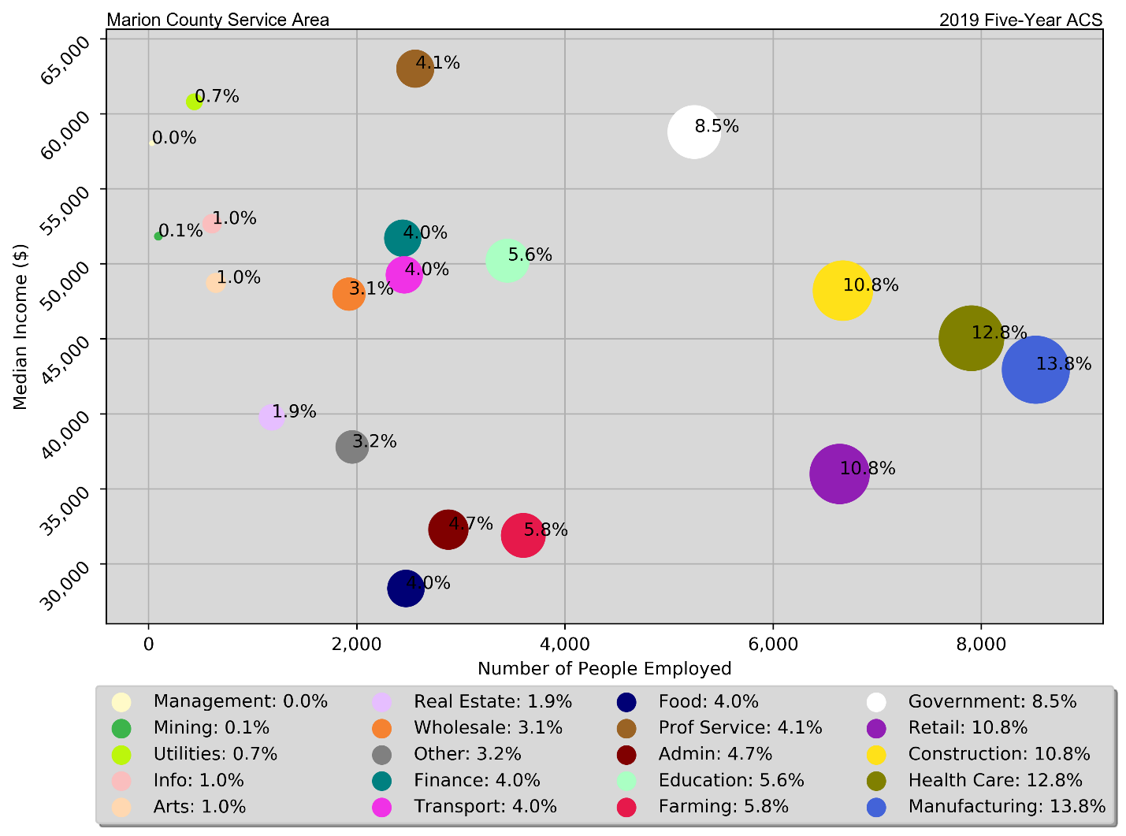
Economics
Employment and Median Earnings by Industry
Majority of Workers are in moderately paid industries

Slide 16
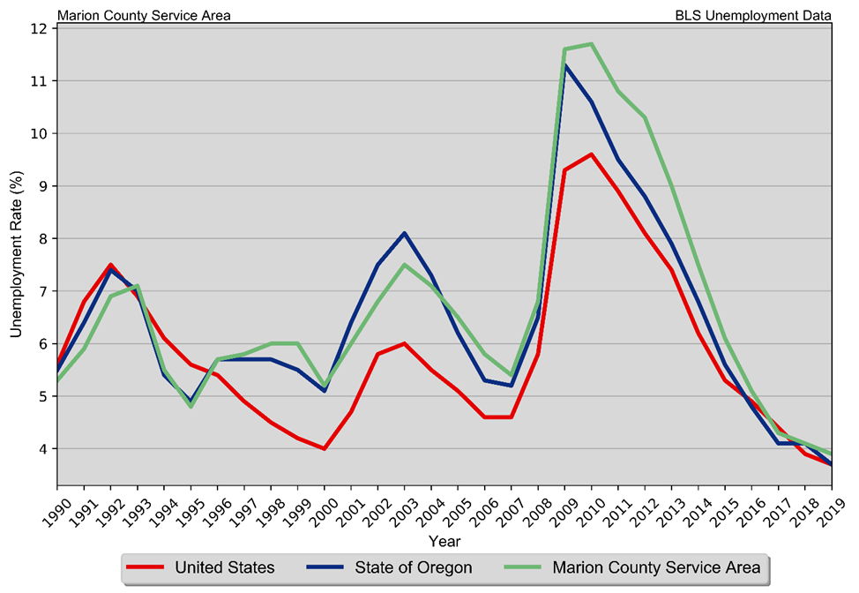
Economics
Annual Unemployment Rate
Marion County Service Area
1990 – 2019 BLS Data
Unemployment Falling
Impacts of COVID-19

Slide 17
Housing
Housing Units by Type Marion County Service Area 2010 & 2019 Five-Year ACS Data
Unit Type | 2010 Five-Year ACS |  | 2019 Five-Year ACS
 | Units | % of Total | Units | % of Total
Single-Family | 48,099 | 70.3% | 50,591 | 69.6%
Duplex | 2,164 | 3.2% | 2,182 | 3.0%
Tri- or Four-Plex | 3,434 | 5.0% | 3,722 | 5.1%
Apartment | 7,980 | 11.7% | 8,376 | 11.5%
Mobile Home | 6,637 | 9.7% | 7,620 | 10.5%
Boat, RV, Van, Etc. | 144 | 0.2% | 201 | 0.3%
Total | 68,458 | 100.0% | 72,692 | 100.0%
Types of Housing Not Changing Much

Slide 18
Housing
Owner-occupied Units Maintaining
Housing Units by Tenure Marion County Service Area 2010 Census & 2019 Five-Year ACS Data
Tenure | 2010 Census |  | 2019 Five-Year ACS
 | Units | % of Total | Units | % of Total
Occupied Housing Units | 65,098 | 93.4% | 68,030 | 93.6%
Owner-Occupied | 43,183 | 66.3% | 44,890 | 66.0%
Renter-Occupied | 21,915 | 33.7% | 23,140 | 34.0%
Vacant Housing Units | 4,634 | 6.6% | 4,662 | 6.4%
Total Housing Units | 69,732 | 100.0% | 72,692 | 100.0%

Slide 19
Housing
Households by Year Home Built Marion County Service Area 2010 & 2019 Five-Year ACS Data
Year Built | 2010 Five-Year ACS |  | 2019 Five-Year ACS
 | Households | % of Total | Households | % of Total
1939 or Earlier | 4,528 | 7.0% | 4,620 | 6.8%
1940 to 1949 | 2,531 | 3.9% | 2,102 | 3.1%
1950 to 1959 | 4,673 | 7.2% | 4,214 | 6.2%
1960 to 1969 | 7,999 | 12.4% | 7,565 | 11.1%
1970 to 1979 | 16,888 | 26.1% | 17,670 | 26.0%
1980 to 1989 | 7,245 | 11.2% | 6,890 | 10.1%
1990 to 1999 | 13,047 | 20.2% | 12,545 | 18.4%
2000 to 2009 | 7,807 | 12.1% | 9,921 | 14.6%
2010 or Later | . | . | 2,503 | 3.7%
Total | 64,718 | 100.0% | 68,030 | 100.0%
Majority of Units build between 1960 and 2010

Slide 20
Housing
“Other” vacant units are increasing
Disposition of Vacant Housing Units Marion County Service Area 2010 Census & 2019 Five-Year ACS Data
Disposition | 2010 Census |  | 2019 Five-Year ACS
 | Units | % of Total | Units | % of Total
For Rent | 1,610 | 34.7% | 1,014 | 21.8%
For Sale | 906 | 19.6% | 720 | 15.4%
Rented Not Occupied | 89 | 1.9% | 36 | 0.8%
Sold Not Occupied | 170 | 3.7% | 147 | 3.2%
For Seasonal, Recreational, or Occasional Use | 868 | 18.7% | 954 | 20.5%
For Migrant Workers | 16 | 0.3% | 7 | 0.2%
Other Vacant | 975 | 21.0% | 1,784 | 38.3%
Total | 4,634 | 100.0% | 4,662 | 100.0%

Slide 21
Housing Problems*
Households are considered to have housing problems if they have one of more of the four problems:
1. Housing unit lacks complete kitchen facilities;
2. Housing unit lacks complete plumbing facilities;
3. Household is overcrowded; and
4. Household is cost burdened.
*As defined by HUD
Cost Burdened defined as spending more than 30% of household income on housing

Slide 22
Housing Problems
Households with Incomplete Plumbing Facilities 2010 and 2019 Five-Year ACS Data
Households | 2010 Five-Year ACS | 2019 Five-Year ACS
With Complete Plumbing Facilities | 64,447 | 67,871
Lacking Complete Plumbing Facilities | 271 | 159
Total Households | 64,718 | 68,030
Percent Lacking | 0.4% | 0.2%
Small Percentage of households lacking kitchen or plumbing facilities
Households with Incomplete Kitchen Facilities Marion County Service Area 2010 and 2019 Five-Year ACS Data
Households | 2010 Five-Year ACS | 2019 Five-Year ACS
With Complete Kitchen Facilities | 63,922 | 67,246
Lacking Complete Kitchen Facilities | 796 | 784
Total Households | 64,718 | 68,030
Percent Lacking | 1.2% | 1.2%

Slide 23
Housing Problems
Overcrowding and Severe Overcrowding Marion County Service Area 2010 & 2019 Five-Year ACS Data
Data Source | No Overcrowding |  |  | Overcrowding |  | Severe Overcrowding |  | Total
 | Households | % of Total | % of Total | Households | % of Total | Households | % of Total
Owner
2010 ACS | 42,194 | 97.3% |  | 914 | 2.1% | 255 | 0.6% | 43,363
2019 ACS | 43,574 | 97.1% |  | 1,064 | 2.4% | 252 | 0.6% | 44,890
Renter
2010 ACS | 19,192 | 89.9% |  | 1,511 | 7.1% | 652 | 3.1% | 21,355
2019 ACS | 21,314 | 92.1% |  | 1,435 | 6.2% | 391 | 1.7% | 23,140
Total
2010 ACS | 61,386 | 94.9% |  | 2,425 | 3.7% | 907 | 1.4% | 64,718
2019 ACS | 64,888 | 95.4% |  | 2,499 | 3.7% | 643 | 0.9% | 68,030
Small Percentage of households experiencing overcrowding

Slide 24
Housing Problems
Cost Burden and Severe Cost Burden by Tenure Marion County Service Area 2010 & 2019 Five-Year ACS Data
Data Source | Less Than 30% |  |  | 31%-50% |  |  | Above 50% |  |  | Not Computed |  |  | Total
 | Households | % of Total | % of Total | Households | % of Total | % of Total | Households | % of Total | % of Total | Households | % of Total | % of Total
Owner With a Mortgage
2010 ACS | 17,333 | 57.0% |  | 8,835 | 29.1% |  | 4,175 | 13.7% |  | 54 | 0.2% |  | 30,397
2019 ACS | 20,859 | 71.0% |  | 5,667 | 19.3% |  | 2,817 | 9.6% |  | 36 | 0.1% |  | 29,379
Owner Without a Mortgage
2010 ACS | 10,823 | 83.5% |  | 1,291 | 10.0% |  | 741 | 5.7% |  | 111 | 0.9% |  | 12,966
2019 ACS | 13,571 | 87.5% |  | 1,127 | 7.3% |  | 682 | 4.4% |  | 131 | 0.8% |  | 15,511
Renter
2010 ACS | 10,546 | 49.4% |  | 5,042 | 23.6% |  | 4,551 | 21.3% |  | 1,216 | 5.7% |  | 21,355
2019 ACS | 11,677 | 50.5% |  | 5,115 | 22.1% |  | 5,011 | 21.7% |  | 1,337 | 5.8% |  | 23,140
Total
2010 ACS | 38,702 | 59.8% |  | 15,168 | 23.4% |  | 9,467 | 14.6% |  | 1,381 | 2.1% |  | 64,718
2019 ACS | 46,107 | 67.8% |  | 11,909 | 17.5% |  | 8,510 | 12.5% |  | 1,504 | 2.2% |  | 68,030
30.0% of households are cost burdened
43.8% of renters are cost-burdened

Slide 25
HCD Survey
156 Responses to date
https://www.surveymonkey.com/r/HCD_MarionCountySurvey
Providing Decent and Affordable Housing
Marion County
Housing and Community Development Survey
Question | No Need | Low Need | Medium Need | High Need | Don’t Know | Missing | Total
Please rate the need for the following HOUSING activities in the county (outside the City of Salem):
Rental housing for very low-income households | 2 | 11 | 18 | 79 | 9 | 37 | 156
Supportive housing for people who are experiencing homelessness | 10 | 12 | 16 | 77 | 3 | 38 | 156
Construction of new affordable housing for home ownership | 6 | 13 | 24 | 75 | 3 | 35 | 156
Construction of new affordable rental housing | 8 | 8 | 23 | 75 | 6 | 36 | 156
First-time home-buyer assistance | 7 | 9 | 21 | 74 | 10 | 35 | 156
Energy efficiency improvements | 5 | 9 | 28 | 67 | 10 | 37 | 156
Rental assistance | 8 | 7 | 25 | 66 | 13 | 37 | 156
Housing located adjacent or near transportation options | 4 | 12 | 27 | 61 | 14 | 38 | 156
Homeownership for racial and ethnic minority populations | 11 | 10 | 24 | 58 | 16 | 37 | 156
Supportive housing for people who have disabilities | 3 | 7 | 40 | 58 | 11 | 37 | 156

Slide 26
Providing Decent and Affordable Housing
Marion County
Housing and Community Development Survey
Question | Strongly Agree | Agree | Neither Agree or Disagree | Disagree | Missing | Total
Which, if any, of the following are barriers to the development or preservation of affordable housing in the county (outside the City of Salem)?
Cost of materials | 60 | 38 | 11 | 4 | 43 | 156
Not In My Back Yard (NIMBY) mentality | 52 | 35 | 17 | 4 | 41 | 156
Cost of land or lot | 49 | 46 | 15 | 4 | 42 | 156
Permitting/construction fees | 45 | 28 | 33 | 7 | 41 | 156
Permitting process | 43 | 26 | 36 | 8 | 41 | 156
Lack of affordable housing development incentives | 41 | 43 | 21 | 8 | 41 | 156
Cost of labor | 39 | 47 | 19 | 10 | 41 | 156
Planning site plan review and approval process | 39 | 29 | 40 | 5 | 42 | 156
Lack of affordable housing development policies | 37 | 34 | 31 | 4 | 43 | 156
Density or other zoning requirements | 33 | 31 | 37 | 9 | 44 | 156
Lack of property maintenance code enforcement | 25 | 30 | 35 | 19 | 42 | 156
Lack of available land | 24 | 27 | 29 | 28 | 43 | 156
Lot size | 22 | 26 | 50 | 14 | 42 | 156
Building codes | 20 | 26 | 51 | 11 | 46 | 156
Lack of understanding of property care-taking | 19 | 30 | 40 | 19 | 42 | 156
Lack of police patrol | 18 | 16 | 36 | 27 | 41 | 156
Lack of street lighting | 17 | 35 | 37 | 16 | 43 | 156
ADA codes | 14 | 23 | 49 | 24 | 43 | 156
Lack of qualified contractors or builders | 7 | 23 | 47 | 32 | 43 | 156

Slide 27
HCD Survey
Providing a Suitable Living Environment
Marion County
Housing and Community Development Survey
Question | No Need | Low Need | Medium | High Need | Don’t Know | Missing | Total
 |  |  | Need
Please rate the need for the following INFRASTRUCTURE activities in the county (outside the City of Salem):
Sidewalk improvements | 6 | 14 | 33 | 52 | 5 | 46 | 156
Street and road improvements | 0 | 12 | 51 | 44 | 3 | 46 | 156
Bridge improvements | 5 | 17 | 28 | 44 | 15 | 47 | 156
Bicycle and walking paths | 10 | 24 | 29 | 43 | 4 | 46 | 156
New tree planting | 16 | 21 | 26 | 40 | 6 | 47 | 156
Water quality improvements | 7 | 23 | 27 | 33 | 20 | 46 | 156
Water system capacity improvements | 5 | 16 | 29 | 32 | 28 | 46 | 156
Sewer system improvements | 7 | 14 | 26 | 32 | 31 | 46 | 156
Park and recreation improvements | 10 | 23 | 41 | 32 | 4 | 46 | 156
Storm sewer system improvements | 4 | 16 | 34 | 26 | 29 | 47 | 156
Flood drainage improvements | 3 | 19 | 37 | 24 | 27 | 46 | 156
Other | 1 | 0 | 2 | 10 | 8 | 135 | 156

Slide 28
HCD Survey
Providing a Suitable Living Environment
Marion County
Housing and Community Development Survey
Question | No Need | Low Need | Medium | High Need | Don’t Know | Missing | Total
 |  |  | Need
Please rate the need for the following HUMAN AND PUBLIC SERVICES in the county (outside the City of Salem).
Mental health services | 4 | 6 | 14 | 76 | 9 | 47 | 156
Substance abuse services | 2 | 7 | 14 | 74 | 12 | 47 | 156
Homelessness services | 5 | 11 | 17 | 68 | 8 | 47 | 156
Services for youth aging out of foster care | 5 | 7 | 17 | 64 | 15 | 48 | 156
Food banks | 3 | 18 | 23 | 58 | 6 | 48 | 156
Childcare services | 8 | 8 | 20 | 55 | 16 | 49 | 156
Services for survivors of domestic violence | 3 | 7 | 27 | 54 | 17 | 48 | 156
Transportation services | 5 | 12 | 30 | 53 | 8 | 48 | 156
Youth services | 4 | 9 | 33 | 52 | 11 | 47 | 156
Rental assistance | 8 | 12 | 21 | 51 | 16 | 48 | 156
Fair housing activities | 10 | 11 | 21 | 48 | 17 | 49 | 156
Healthcare services | 7 | 16 | 27 | 47 | 10 | 49 | 156
Utility assistance | 7 | 12 | 31 | 46 | 13 | 47 | 156
Veterans services | 3 | 12 | 32 | 44 | 15 | 50 | 156
Eviction prevention | 13 | 10 | 24 | 43 | 18 | 48 | 156

Slide 29
HCD Survey
Needs of Special Populations
Marion County
Housing and Community Development Survey
Question | No Need | Low Need | Medium | High Need | Don’t Know | Missing | Total
 |  |  | Need
Please rate the need for the following HOUSING types for special needs populations in the county (outside the City of Salem):
Emergency shelters for persons who are experiencing homeless | 2 | 10 | 16 | 74 | 4 | 50 | 156
Shelters for youth experiencing homelessness | 3 | 8 | 16 | 72 | 7 | 50 | 156
Transitional housing | 4 | 6 | 16 | 67 | 11 | 52 | 156
Rental assistance for homeless households | 8 | 8 | 14 | 66 | 9 | 51 | 156
Permanent supportive housing, such as subsidized housing that offers services for persons with mental disabilities | 3 | 13 | 10 | 63 | 15 | 52 | 156
Housing designed for persons with disabilities | 3 | 10 | 28 | 42 | 20 | 53 | 156
Senior housing, such as nursing homes or assisted living facilities | 6 | 13 | 33 | 36 | 16 | 52 | 156

Slide 30
Community Input – Public Services
What groups of people at most in need?
What types services do households need in Marion County?

Slide 31
Community Input - Housing
What are the housing needs in the community?
What challenges are households facing in accessing housing?
What types of affordable housing are needed?
New or rehabilitated housing?

Slide 32
Community Input - Housing
What barriers do you see for developing affordable housing?
How can the County encourage more affordable housing?

Slide 33
Community Input
How can the County develop its coordination and outreach?
What would you like to see the County do as it is starts this process?

Slide 34
Community Input
Other comments?

Slide 35
Next Steps
Continuing to Collect Data and Public Input
Draft for Public Review
Final Plan
Adoption of final plan and submission to HUD

Slide 36
Consolidated Plan
Contact:
Lisa Trauernicht
Senior Policy Analyst
LTrauernicht@co.marion.or.us

