Slide 1


Marion County community & economic development
June 25, 2026, CDBG/HOME Interested Applicant Workshop
Steve Dickey, CDBG / HOME Program Manager

Slide 2
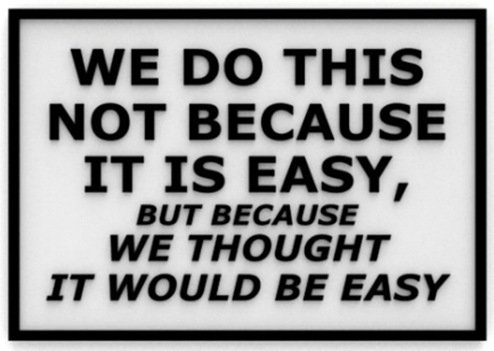
WHAT IS CDBG/HOME
Community Development Block Grant (CDBG)
  Funded through the U.S. Department of Housing and Urban Development (HUD)
  Projects or Programs Must Meet One of the CDBG National Objectives
    Benefit low- and moderate-income (LMI) persons
    Aid in the prevention or elimination of slum and blight
    Meet a need having particular urgency (referred to as urgent need) Rare-has specific requirements

Slide 3
WHAT IS CDBG/HOME
Home Investment Partnerships Program (HOME)
  Funded through the U.S. Department of Housing and Urban Development (HUD)
  Designed exclusively to provide decent, affordable housing to low-and-moderate income households
  Can be used in a variety of ways including:
  -Building new housing
  -Preserving existing housing
  -Rental assistance
  -Homebuyer assistance

Slide 4

FUNDING SOURCE –
U.S. FEDERAL GOVERNMENT
Critical Details to Consider:
  CDBG and HOME funds are federal grants subject to numerous federal regulations
  The grants are paid on a reimbursement basis, no federal funds paid in advance of work being completed
  The grant agreement is a legally binding contract with terms and conditions for the grant recipient
  Failure to follow the terms and conditions of the grant can result in repayment of the grant funds, civil penalties, etc.

Slide 5
CDBG FUNDING CRITICAL AREAS OF COMPLIANCE
  The following apply to the entire ‘project’, not just the portion funded by CDBG:
  The environmental review process
  Prevailing wage / Davis Bacon Act requirements
  Build America, Buy America requirements
  Procurement requirements for bids, proposals, and purchases

Slide 6
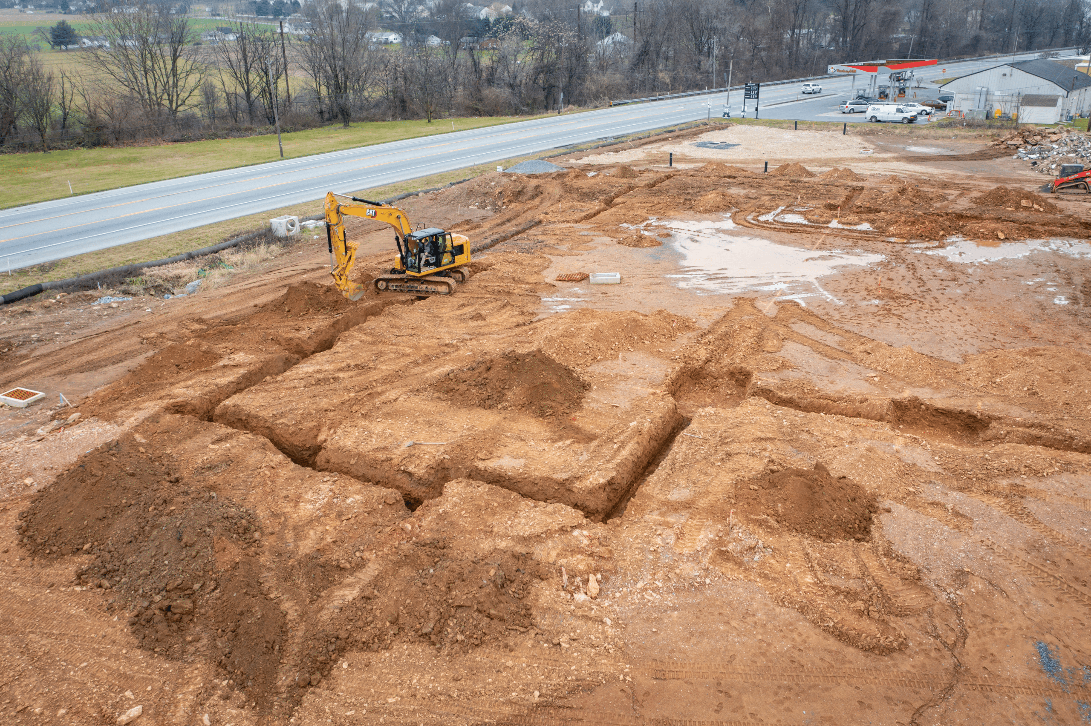
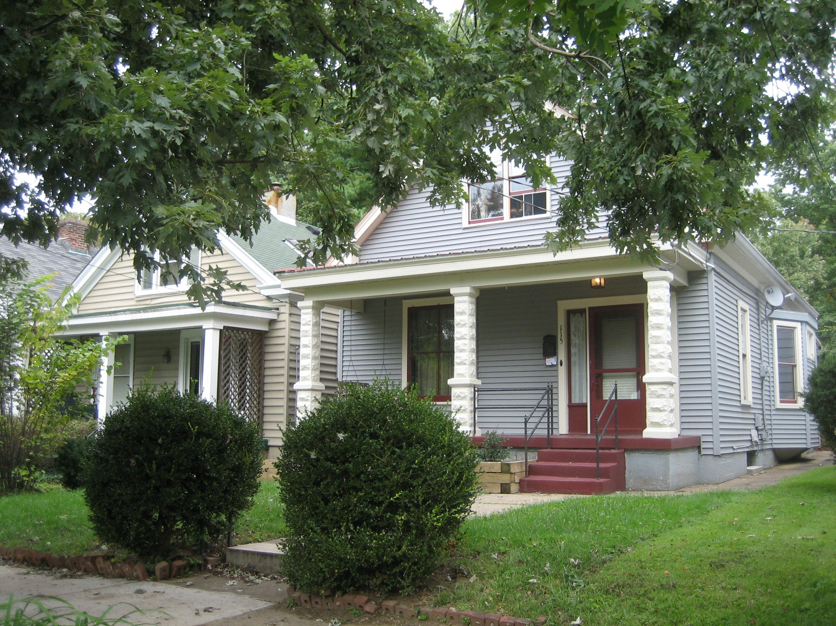

ENVIRONMENTAL review
All Projects are Subject to Environmental Review
Difference Between –
  Exempt
  Categorical Exclusion Not Subject To (CENST)
  Categorical Exclusion Subject To (CEST)
  Environmental Assessment
  Environmental Impact Statement
Required Tribal and Historic Preservation Consultation
All Projects and Programs are Subject to 24 CFR, Part 58, Part 51 (noise), Part 55 (floodplains)

Slide 7
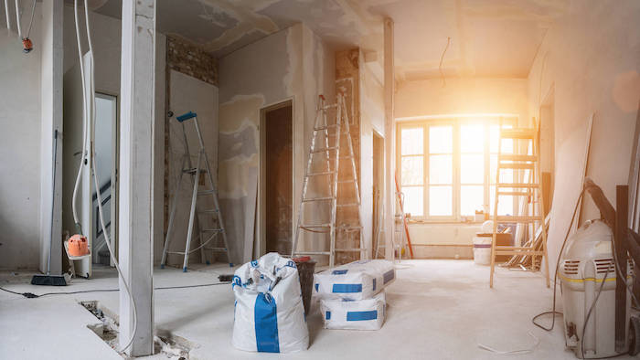


PREVAILING WAGE /
DAVIS BACON
Prevailing Wage is required for the entire project:
  Any construction, alteration, or repair activities over $2,000 funded in whole or in part with CDBG funds. It applies to laborers, mechanics, trades involved with construction, alterations, or repairs
  Residential repairs are exempt for residential structures of seven or fewer units
  Weekly certified payroll reports and onsite wage verification inspections are part of the prevailing wage requirements
  All Projects and Programs are Subject to 29 CFR, Part 5, and HUD Handbook 1344.1 REV-3, January 2023 Chapter 2 2-1

Slide 8

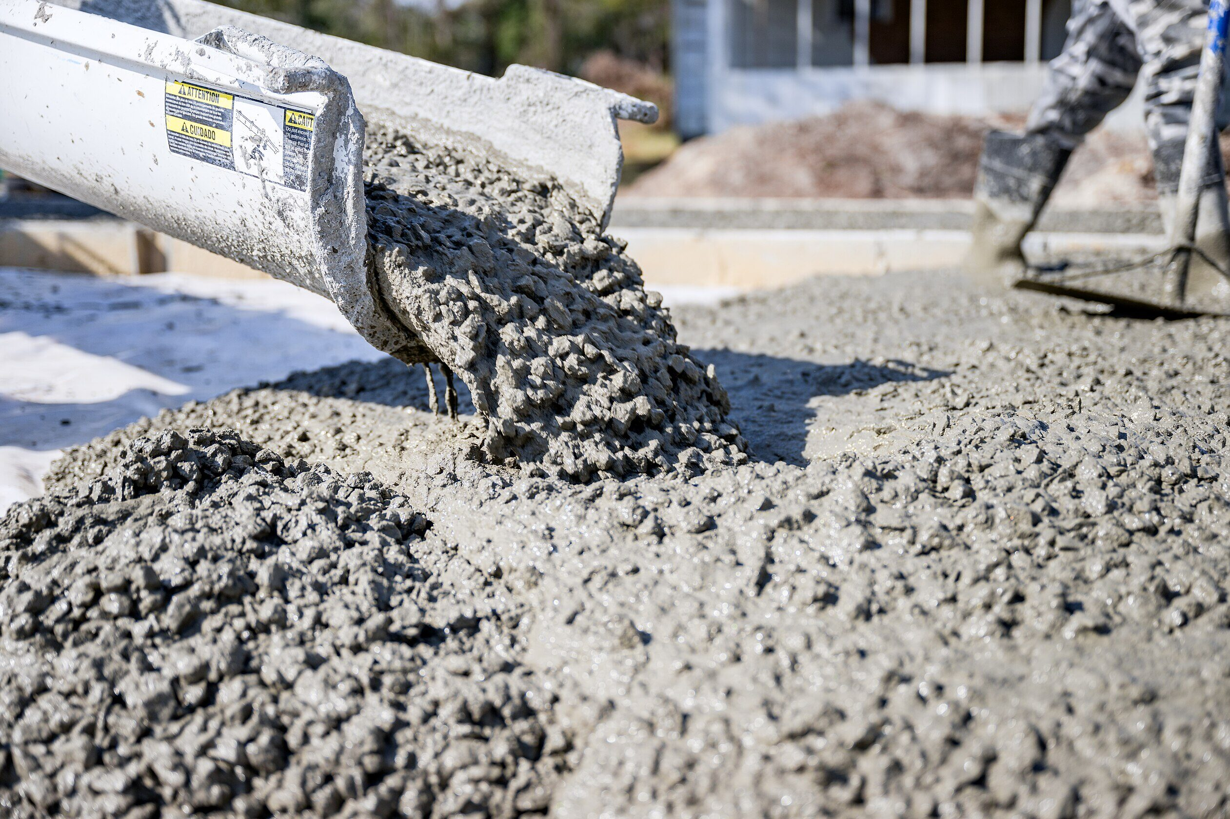

Build America, buy America (BABA)
BABA Requires:
  All iron, steel, manufactured products, and construction materials used in federally funded infrastructure projects are produced in the United States.
  All projects and programs are Subject to 2 CFR, Part 184

Slide 9
PROCUREMENT / ACQUISITION
Statutory Requirements Subject to 2 CFR 200 and 24 CFR Part 570
Difference Between –
  Invitation to Bid (ITB)
  Request for Proposals (RFP)
  Architectural and Engineering (A&E) solicitations and the Brooks Act
Conflict of Interest and Other Ethics Violations
The Principle of Open and Fair Competition

Slide 10
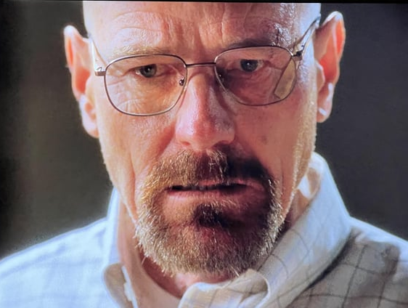
STILL INTERESTED?

Slide 11
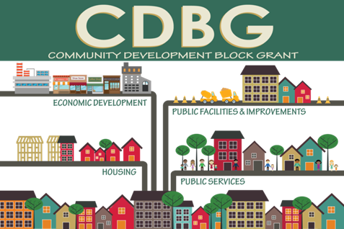
Current COUNTY BASED PROGRAMS
CDBG Funds:
  Homeowner Residential Rehabilitation Program for LMI Households
    Zero percent, partially forgivable loans for critical home repairs
HOME Funds:
  Homebuyer Assistance Program for LMI Households
    Zero percent, partially forgivable loans for down payments, closing costs, interest rate(point) buydown
Examples of Impact
  Allows homeowners to stay in their homes
  Provides home ownership opportunity for LMI households

Slide 12
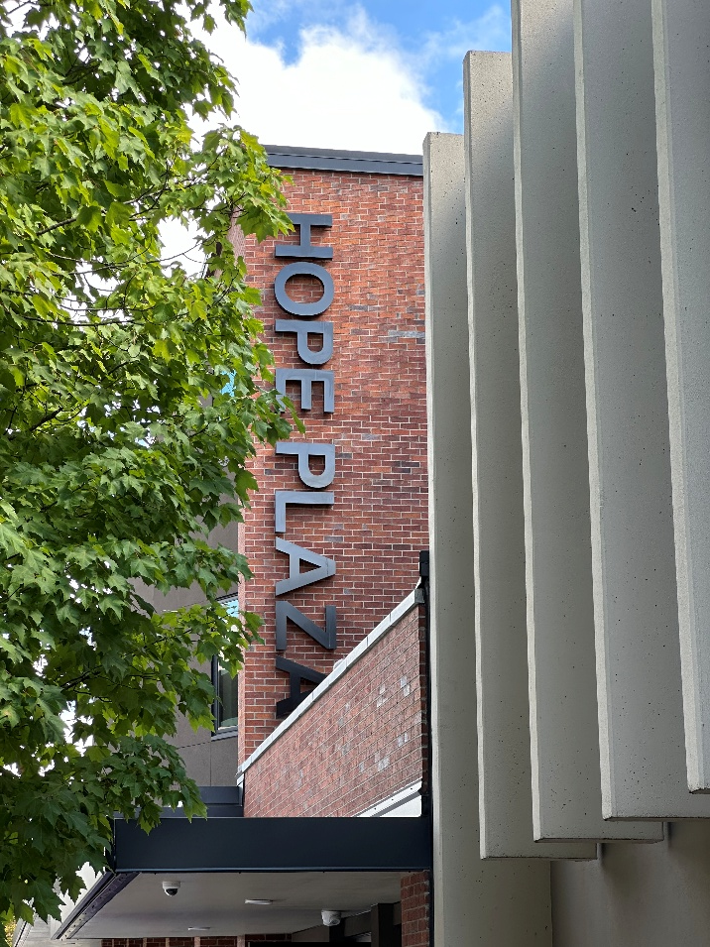
CURRENT COMMUNITY programs
CDBG / HOME Support for Local Communities and Non-Profit Organizations
  Renovation of existing community facilities
  Construction of new facilities
  Infrastructure improvements
  Support to services benefitting LMI households or individuals
Examples of Impact
  Building/renovating facilities that benefit local LMI populations
  Funding for delivery of essential social services

Slide 13
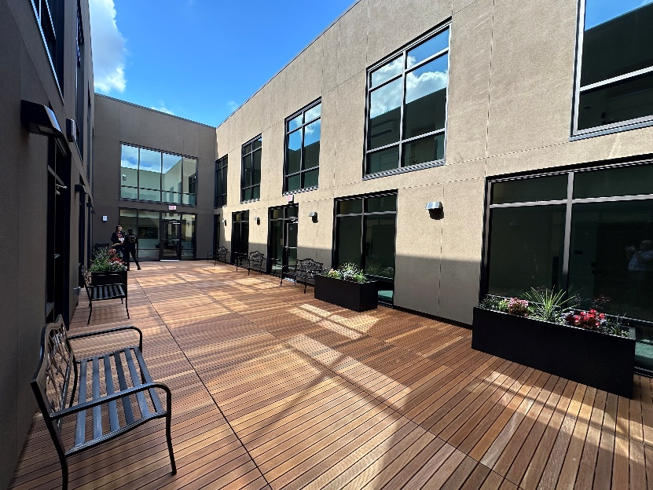
CDBG / HOME Application
Who’s Eligible to Apply?
  Local government entities with projects benefitting LMI populations
  Non-profits serving LMI populations
  For-profit companies supporting LMI populations
  When to Apply?
  Annual applications will be accepted October 12, 2026, thru December 18, 2026
When are Funds Available?
  If awarded, agreement is signed and eligible expenses can be reimbursed after July 1st following the award of grant funds by the Board of Commissioners

Slide 14
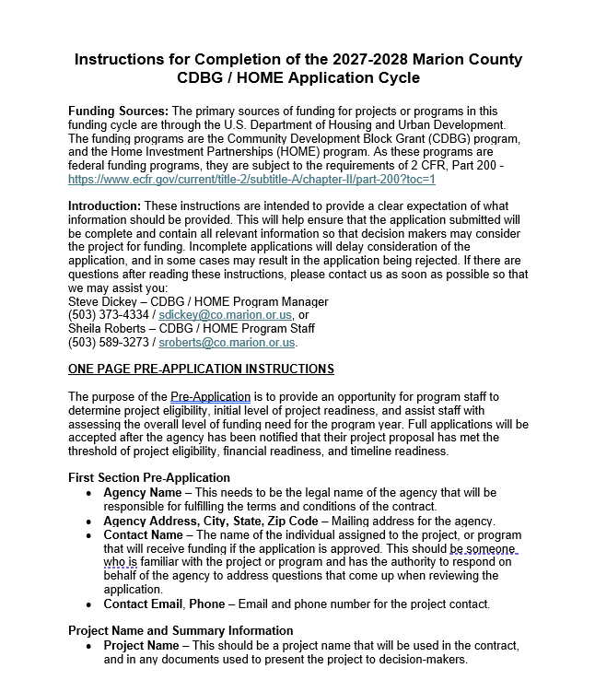
The funding interest form
Provides an Opportunity to:
  Present a program or project idea prior to application
  Helps program staff provide early technical assistance to improve application quality
  Provides an early assessment of the community need

Slide 15
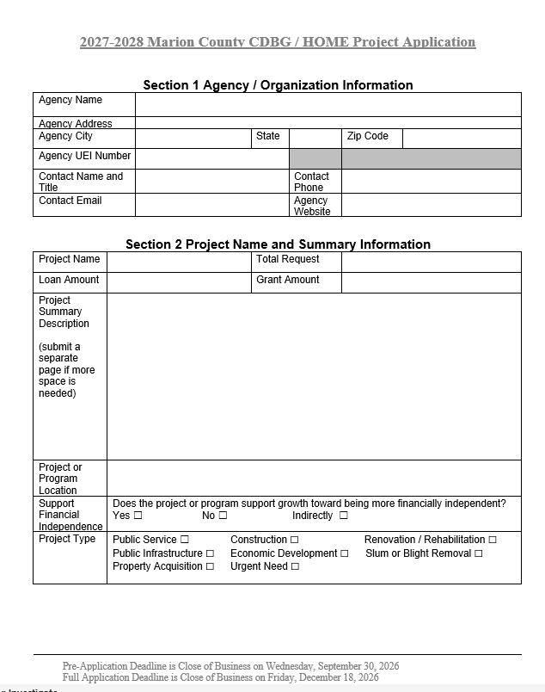
The full application form
Specific Detail and Clarity is Essential:
  Provides all essential information needed to evaluate the project for funding
  If funded, the information will be used to develop a legally binding grant agreement
  Is the official record of request for funding through the CDBG or HOME programs and is a public document

Slide 16
The full application form
Section 1 - Agency / Organization Information:
  Agency name and address must be the legal name and the physical address of the applicant
  UEI Number is the Unique Entity ID number, formerly known as a DUNS Number
    This is required to receive federal funds and can be obtained at SAM.gov
  Contact information – This is the person who is familiar with the project details and can answer questions related to the application

Slide 17
The full application form
Section 2 – Project Name and Summary Information:
  Provide a project name that will be used in the grant agreement
  Choose whether this is a request for a loan or a grant and provide the amount of the request
  Project summary description must describe what the project is and the measurable outcome
  Project location is an address or area of benefit description
  Does the project support financial independence?
  Project Type-Infrastructure, facility, service, etc…

Slide 18
The full application form
Section 3 – Project Timeline and Milestones:
  Funding requests must have a specific timeline tied to project milestones
  All projects must have at least one to two milestones between the start and end dates

Slide 19
The full application form
Section 4 – Project Funding / Budget:
  The total project budget must be listed at the top
  Identify the amount requested to be funded with CDBG or HOME funds
  Status of funding components
    Secured – legally committed through an agreement or contract, or in possession
    Committed – a formal decision has been made to dedicate the funding, but no legal contract
    Applied for – an application is in process, but no decision has been made

Slide 20
The full application form
Section 5 – Income and Location Data:
  Total number of individuals or households served
  Percentage of that total that qualify as low-to moderate-income
  Percentage of that total that live in Marion County, but outside the Salem city limits

Slide 21
The full application form
Section 6 – Discrimination is Strictly Prohibited:
  Section 6 provides an assurance that the provision of services is not based on discriminatory criteria
  Are there specific qualifications to receive benefits or services from the service provider?
  Discrimination-based on immutable characteristics such as race, age, ethnicity, etc…
  Qualifications to receive services based on need such as financial situation, or disability are not prohibited

Slide 22
The full application form
Section 7 – Required Signatures:
  There are two lines that must be completed and signed, even if they are the same person
    The name and title of the person completing the application form
    The name of the person authorized to submit the form and commit the agency/organization to the terms and conditions of the legal grant agreement

Slide 23

conclusion
Time and Attention to Detail:
  A successful application requires careful attention to detail
  Projects need to be well thought out, and given serious consideration before applying
  Funding is limited and the requests for funding far exceed what is available
  Do your best to make your application as clear as possible for the decision makers

Slide 24
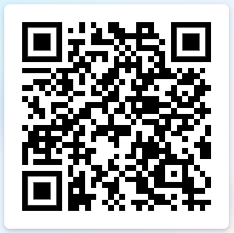
Questions?
For more information, please contact:
Steve Dickey
sdickey@co.marion.or.us 503-373-4334
or
Sheila Roberts
sroberts@co.marion.or.us 503-589-3273
https://www.co.marion.or.us/CS/Pages/Community-Development.aspx

