Slide 1


Making sense of
Problem Gambling
& Behavioral Addictions Pt. 2
Prepared by
Notes:
Today we will discuss perspectives of people with a gambling problem and healthy decision making.

Slide 2




Problem Gambling Lessons in Review
Notes:
First, lets review important information we should know from previous lessons.
Estimated length: 5 minutes

Slide 3

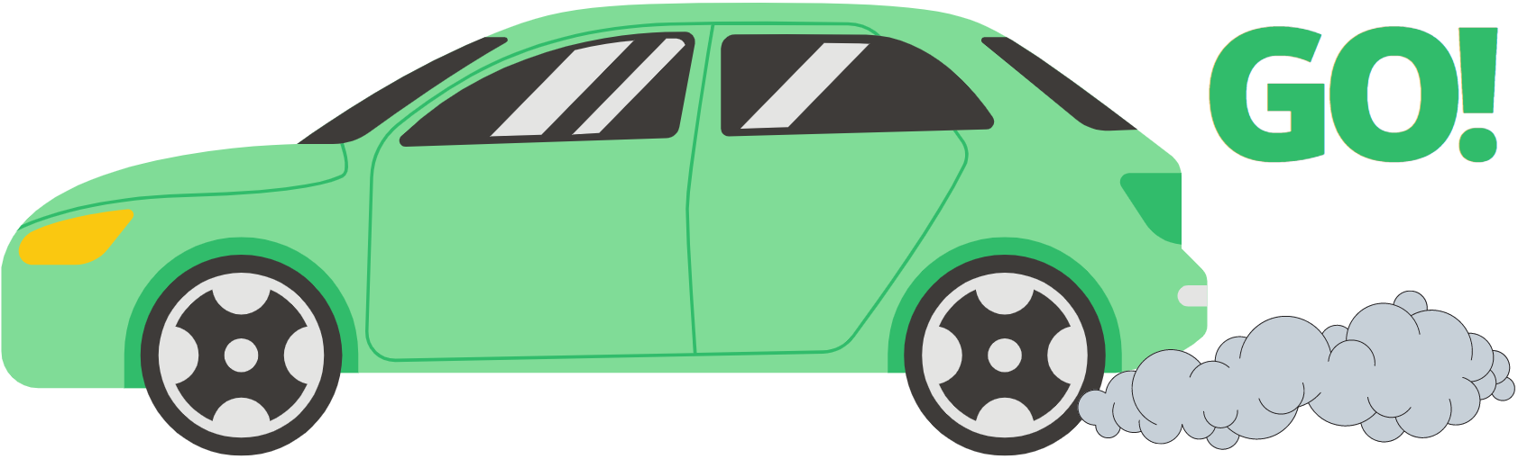


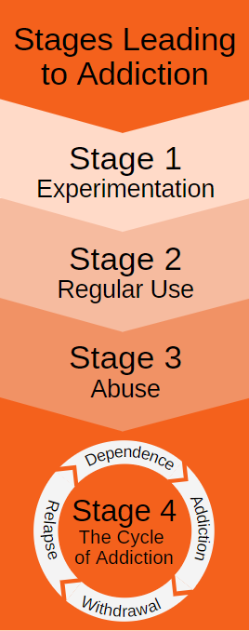
Review: Addictions & The Brain
Addictions & the Brain
Reward Hub: Why we start behaviors
Habit Hub: How we repeat behaviors (good/harmful)
Top-Down Control Network: logical decision making, develops until age 25.
Stages Leading to Addiction
Experimentation
Regular Use
Abuse
The Cycle of Addiction
Important takeaways:
It is possible to form an addiction to a behavior over time.
There are risk factors that contribute to addiction: genetics, age, environment, other addictions, mental health, stress, and more.
Problems occur when the Habit Hub makes harmful decisions instead of the Top-Down Control Network (logic center).
This can lead to the cycle of addiction where the behavior (example: gambling) or substance (example: alcohol) is needed to feel normal.
Notes:
Instructions: Read slide.

Slide 4

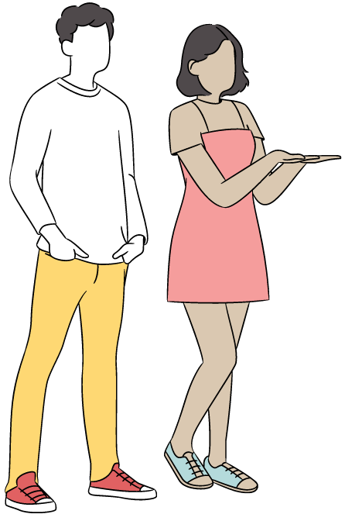
Review: Gambling Facts
Gambling Facts
Important takeaways:
Most teenagers don’t gamble regularly. Teens who do gamble regularly are more likely to struggle with depression, suicidal thoughts, drug and alcohol use, lower grades.
The odds for almost all gambling games are not in your favor.
In Oregon, the average person in treatment for problem gambling owes $23,375 in gambling related debts.
Video gambling is one of the most addictive type of gambling.
Notes:
Instructions: Read slide.

Slide 5

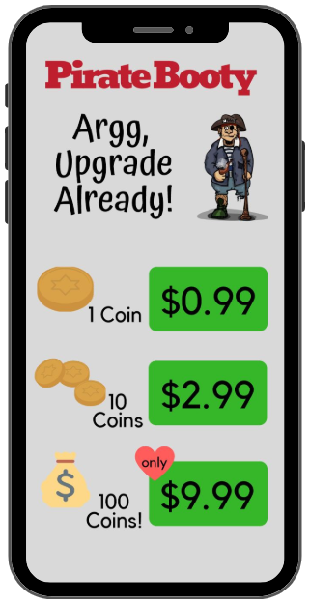
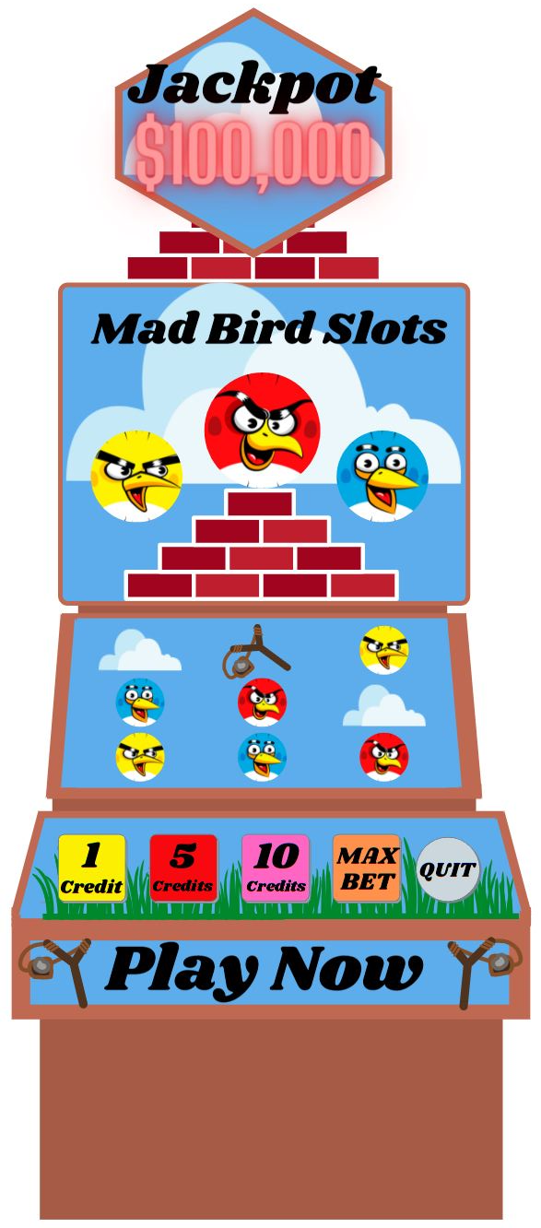

Review: Industry Tactics
Industry Tactics
Important takeaways:
Video gambling slot machines, just like video games themselves, use scientific studies to create products that affect people’s decision making to make more money.
Casinos also use scientific studies to influence peoples’ decision to gamble and spend more money.
Advertising for gambling, alcohol, and tobacco try to influence your habits to use their products.
Notes:
Instructions: Read slide.

Slide 6

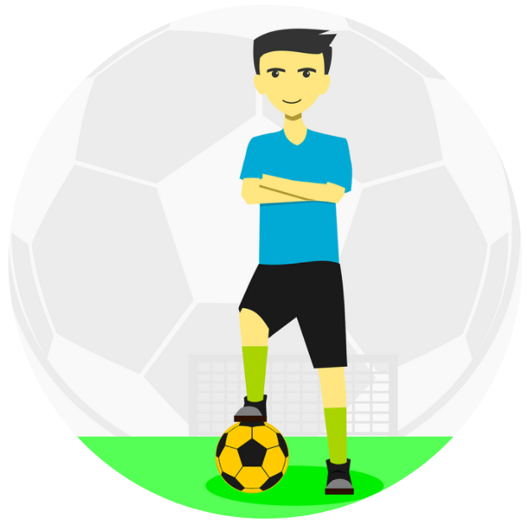

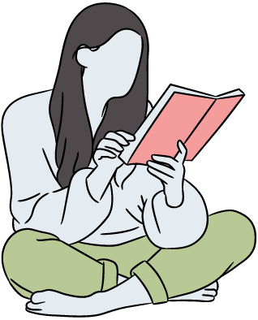

Review: Getting Help
Getting Help
Important takeaways:
Ideas to prevent addictions: participate in favorite hobbies, strengthen healthy relationships, form a strong bond with school, and get help when needed.
www.OPGR.org is FREE for individuals and their loved ones struggling with problem gambling.
Helplines.MCHealthy.net has FREE resources to help for individuals and loved ones struggling with addiction.
Notes:
Instructions: Read slide.

Slide 7


Perspectives of People Experiencing a Problem with Gambling
Prepared by
Problem Gambling Prevention Program
Notes:
In order to gain a better understanding of problem gambling, we should discuss what it is like to be a person experiencing problem gambling, or worse – Disordered Gambling.
Estimated length: 15 minutes

Slide 8

Scale of Problem Gambling
Perspectives
1
Like with any unhealthy behavior, the severity of problem gambling occurs on a scale.
About 4% of 8th Graders show a sign of a problem
8th Graders: Most (68%) 8th grade students don’t gamble.⁵
Adults: Most adults either don’t gamble or don’t have a gambling problem.²
269,489 people!
An estimated 8% Oregon adults show signs of or have a problem
87,584 people!
An estimated 2.6% have a gambling disorder
Notes:
Instructions: Read slide.

Slide 9
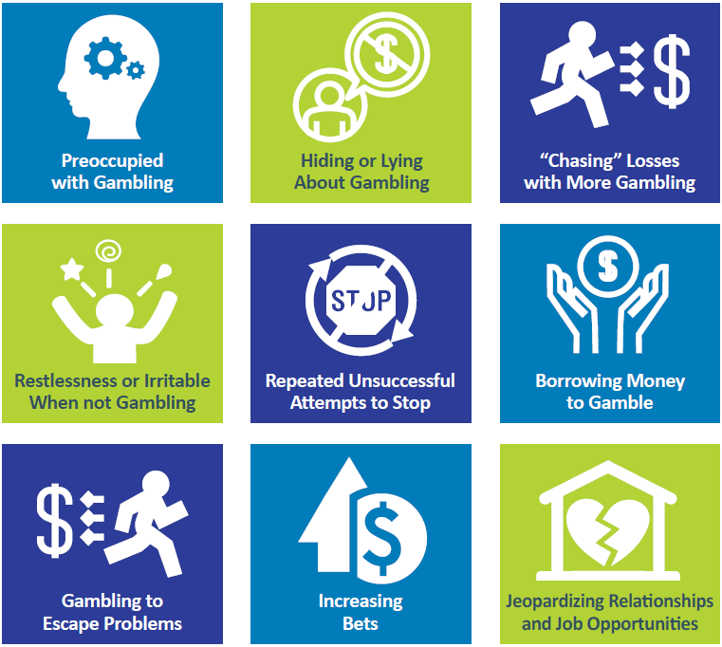
Developing a Gambling Disorder
Perspectives
2
2
Problem Gambling:
Gambling despite negative personal, social, or financial consequences.
If any of these criteria are met.
Disordered Gambling: (moderate to severe problem gambling)
4 or more criteria met in the diagnosis of a gambling disorder.
Notes:
Instructions: Read below.
Problem Gambling: gambling despite negative personal, social, or financial consequences. This is if any of the criteria to the right are met.
Disordered Gambling: when someone has a moderate to severe problem with gambling. 4 or more of the criteria to the right are met, someone can be diagnosed with Disordered Gambling.
Description of each point if needed:
Preoccupied with gambling: thinking too much about gambling when you aren’t gambling, to the point that it disrupts daily life.
Hiding or lying about gambling: not being truthful about gambling behaviors or outcomes.
“Chasing” losses with more gambling: gambling over budget to try and win back money lost.
Restlessness or irritable when not gambling.
Repeated unsuccessful attempts to stop gambling.
Borrowing money to gamble.
Gambling to escape problems: this could be in the form of escaping life responsibilities, depression, pain, stress, etc.
Increasing bets.
Jeopardizing relationships and job opportunities.

Slide 10


Gambling Fallacies
Perspectives
Errors in logical decision making from a person experiencing a problem with gambling.
3
Fallacy: Normalizing behavior
  Comparing yourself to others around you.
  If others around you are experiencing warning signs of problem gambling, you may think that behavior is normal.
Fallacy: Confusing often with memorable
  Thinking a rare big win happens more often then it does.
Notes:
Instructions: Read slide.
_____________________________________________
Citations:
Leonard CA, Williams RJ, Vokey J (2015) Gambling Fallacies: What are They and How are They Best Measured?. J Addict Res Ther 6:256. doi:10.4172/2155-6105.1000256

Slide 11



Gambling Fallacies
Perspectives
Errors in logical decision making from a person experiencing a problem with gambling.
4
Fallacy: Superstition
  Having a ritual or object to bring you luck.
  Fact: superstitions do not change the odds!
Fallacy: Ignoring the Odds
  Continuing to gamble knowing you will lose.
Fallacy: Forgetting the Law of Large Numbers
  The more a game of chance is played, the more likely the overall outcome will match the odds. ²⁰
Notes:
Instructions: Read slide.

Slide 12

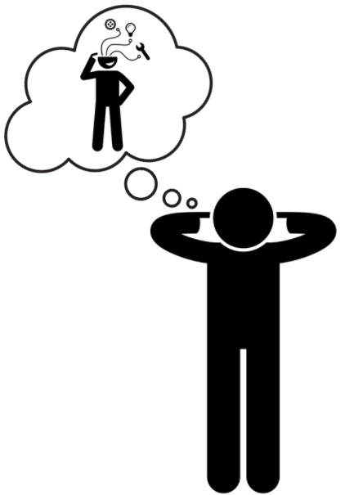
Gambling Fallacies
Perspectives
Errors in logical decision making from a person experiencing a problem with gambling.
5
Fallacy: Early wins and occasional rewards encourage false hope
  Problem gambling may begin when someone wins big. Continued small wins can cause playing on hope, overlooking continued losses.
Fallacy: Attributing success to skill and failure to bad luck
  Winning is often attributed to skill, and failure to something out of their control.
Notes:
Instructions: Read slide.

Slide 13


Action Problem Gambling
Perspectives
Gambling for the excitement, rush, and action.
6
Phases:
Winning: seeking excitement! May win initially, which could encourage false hope for future wins.
Chasing Losses: Trying to win back money lost, forgetting or ignoring law of large numbers.
Panic: Lost money, relationships, and more could lead to panic, regret, and remorse.
Notes:
Instructions:
Highlight the following: Gambling fallacies and signs of a problem can show in a person in different ways. We are going to discuss two types problem gambling: Action Problem Gambling and Zone Problem Gambling.
Read Slide.

Slide 14
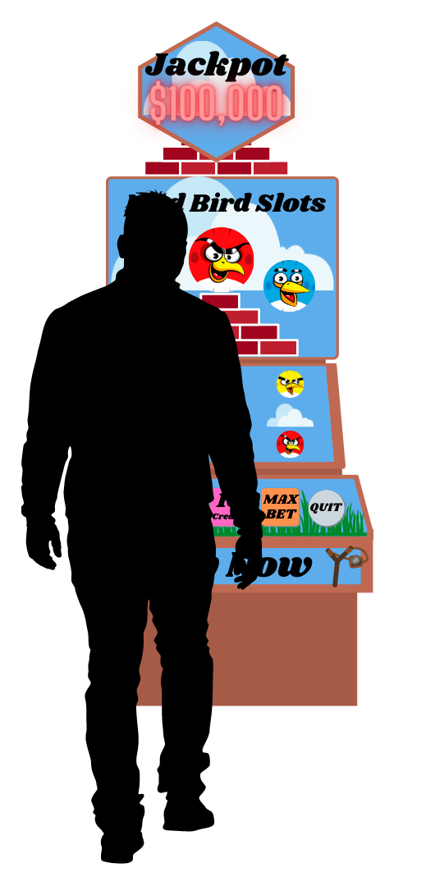
Zone Problem Gambling
Perspectives
Gambling to escape into “the zone.”
7
Becoming completely absorbed into the game, the zone becomes a new reality.
Often used to escape pain, stress, or discomfort in life.
May take place at a slot or video gambling machine, where gambling is isolated and lonely.
When most severe, a person who gambles to escape into “the zone” may need to spend everything they have to feel satisfied.
Notes:
Instructions: Read slide.

Slide 15

Zone Gambling: Escaping into “the Zone”
Perspectives
8
Slot machines and “The Zone:” https://www.youtube.com/watch?v=yMZHbJ6LxUA
Notes:
Instructions: Read slide.
This video discusses the perspective of a person who recovered from a problem with gambling (video length, 1:37):
Video Name: Extra: Slot machines and “The Zone” on Youtube: https://www.youtube.com/watch?v=yMZHbJ6LxUA

Slide 16



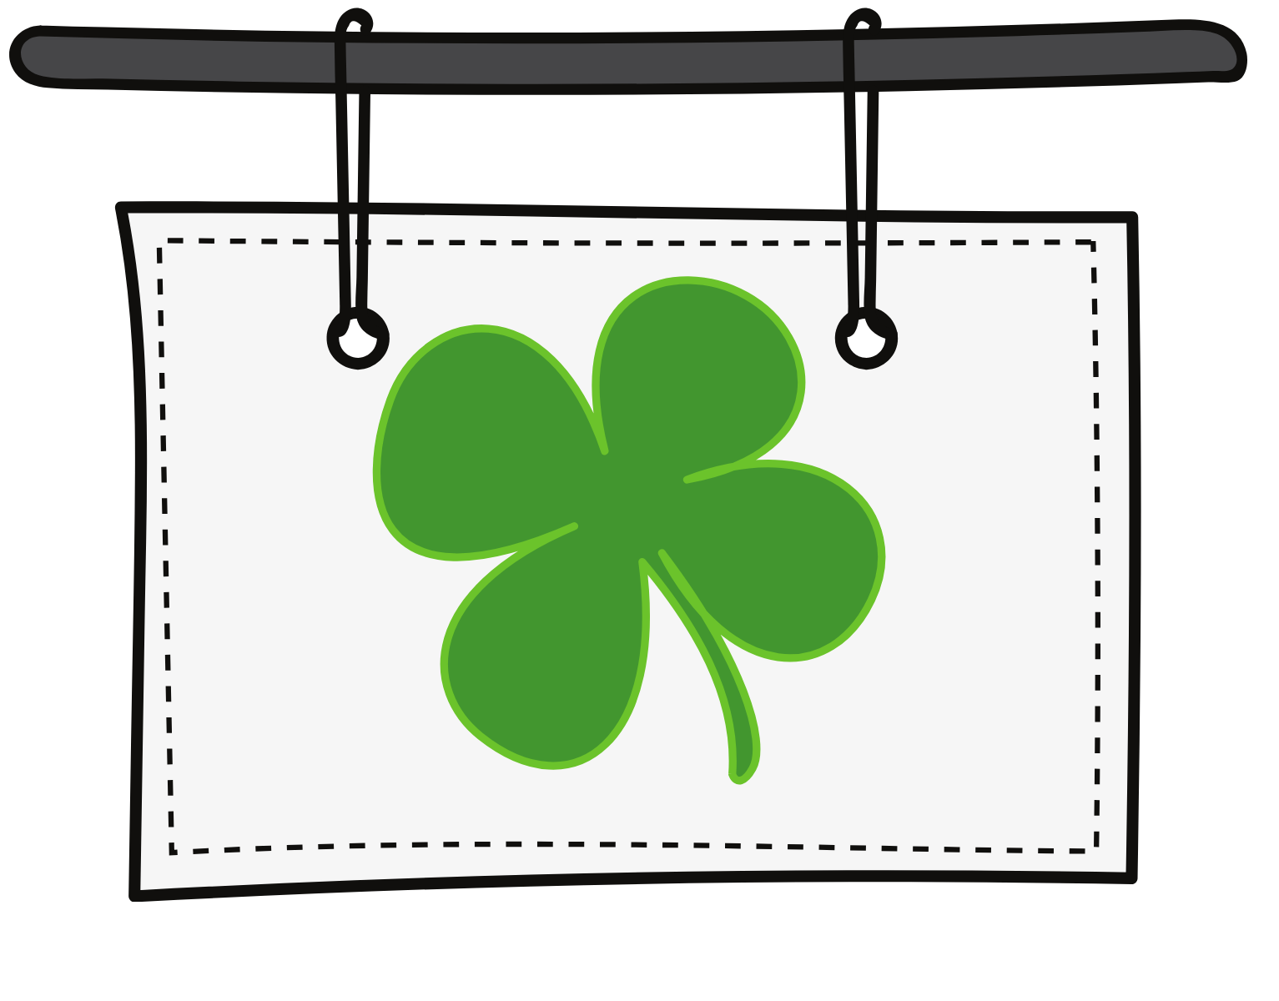




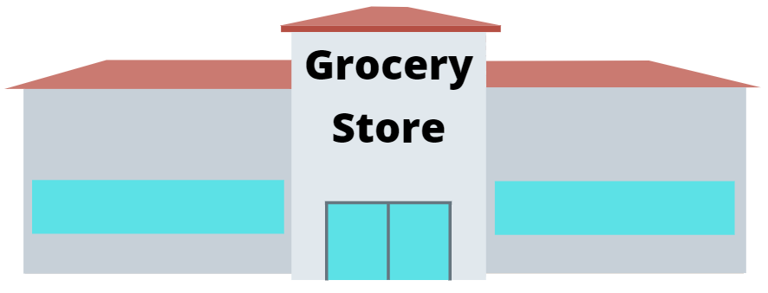
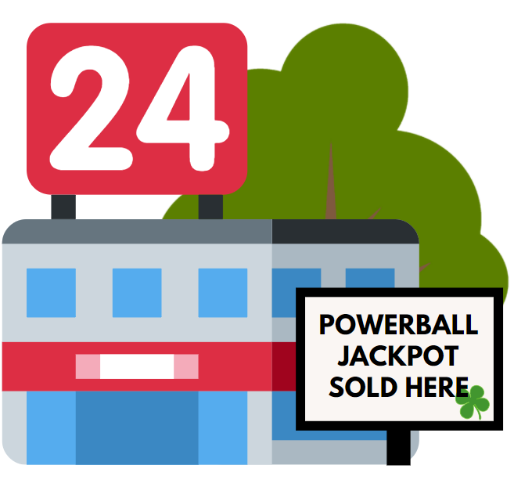

Gambling Opportunities: In our community
Perspectives
9
Jackpot
Notes:
Instructions: Read Below.
The woman in the video mentioned that when she sees images of slot machine or a symbol of gambling, it triggers her to want to gamble again. That is how powerful an addiction can be.
Consider this reality: When someone develops a problem with gambling, or they are now in recovery – imagine how difficult it is for them to not gamble when they see gambling opportunities or symbols.
You are at home on the computer or watching TV, and a gambling ad comes on. This makes you want to gamble.
⏭️ You decide to go to your favorite restaurant and you see video gambling machines. This makes you want to gamble.
⏭️ You stop at a gas station and there are lottery tickets. This makes you want to gamble.
⏭️ You stop at the grocery store and they also have lottery tickets. This makes you want to gamble.
⏭️ You drive around town and see signs and a billboard to gamble. This makes you want to gamble.
⏭️ You are on your phone, and another gambling ad pops up. This makes you want to gamble.
Gambling opportunities are everywhere, and it is very difficult to stay away. When the habit hub in your brain takes over your desire to gamble, cues and triggers take over your decision making.
This is what happens to people struggling with tobacco, drugs, and alcohol use disorders too. Try to have empathy for people struggling with addiction because it is a disease and it is hard to quit.
Remember, hope and help is available to teach people how to overcome addictions!

Slide 17

Healthy Decision Making
Prepared by
Problem Gambling Prevention Program
Notes:
Now we know that gambling is an activity that carries risk, and can be harmful for anyone at any age if we develop harmful habits. Next, lets explore how to make a healthy, positive decision when you are uncertain what to do.
Estimated length: 15 minutes

Slide 18
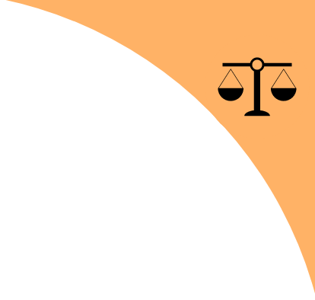

Positive Risk Taking & Decision Making
Healthy Decision Making
1
Life in a way is a gamble, we take risks every day.
Discussion: When you take a positive & healthy risk, what could you gain?
  Confidence
  Skills
  Friendships
  Self-esteem
  Accomplishing your goals
  Recognition for accomplishing goals
  Healthy body and mind
Making negative risky decisions could result in losing these things!
Notes:
Instructions: Read slide.
Give students 30sec-1m to answer the discussion question.

Slide 19
Positive Risk Taking vs Negative Risk Taking
Healthy Decision Making
2
Likely to improve your life
Odds of success are in your favor
Something you can afford to lose
What you could win is of significant value to you
Likely to disrupt or cause problems in life
Odds of success may not be in your favor
Something you cannot afford to lose, or do not want to lose
What you could win doesn’t improve your life in a meaningful way to you
What decision is worth taking a risk on?
Notes:
Instructions: Read slide.
Ask students what ideas they have for decisions worth taking a risk on. Advance to next slide for examples.

Slide 20


Examples of Positive Decision Making
Healthy Decision Making
3
Completing your education
  Achieve knowledge, skills, and experience.
  Earn more money: on average the more education you have, the more money you earn.
  Receive scholarships for high academic achievement.
Trying out for a sports team and/or music group (band, orchestra, choir)
  Improve skills and experience.
  Make new friends and strengthen relationships.
  Improve self-esteem and perseverance.
Notes:
Instructions: Read slide.

Slide 21
Why people make negative risky decisions &
Healthy Decision Making
What to do instead
4
Didn’t weigh all pros vs cons
Not enough time
Lack of knowledge
Acting impulsively
Peer pressure
Don’t care or low self-esteem
Take time to weigh pros vs cons.
Plan ahead / choose positive outcome.
Learn the facts from a reliable source.
Think it through.
Difficult decisions gain respect from those who matter.
Remember, you matter!
Notes:
Instructions: Read below.
Examples of things to do instead
Didn’t weigh all pros and cons: Instead, make time to think through the decision if you can.
Not enough time: Instead, think situations through ahead of time, and if in a pinch, trust your conscience on what decision will give you a positive outcome. You can also ask a trusted adult.
Lack of knowledge: Instead, learn the facts from reliable sources. The more you know about decisions you could make improves your chances for a positive outcome.
Acting impulsively: Instead, use your top-down logical decision making. For example: don’t eat to many ice cream cones and get sick! You could also use the DECIDE Model, which we will learn in a few minutes.
Peer pressure: Instead, making a positive and difficult decision often gains respect from those who matter.
Don’t care: Remember, you matter! You are worthy of a healthy, happy life filled with positive loving relationships. Stay true to you and your values.

Slide 22

How to determine a risk is positive
Healthy Decision Making
5
Weigh the pros (possible gains) and cons (possible losses).
The risk has these outcomes:
  The odds are in your favor, or you gain something positive from the experience.
  Likely to improve your life.
  You don’t risk losing something significant.
Be an objective problem solver.
  Try not to make the decision emotionally.
  Give yourself the same advice you’d give a friend.
Ask a trusted adult or a neutral person about their knowledge, experience, and insight.
  If you don’t know, ask for help!
Notes:
Instructions: Read slide.

Slide 23

Practice: The DECIDE Model
Healthy Decision Making
6
Class activity! Start #1-4 of the DECIDE Model for a decision you make (personal or school related) and complete #5-6 at home.
1. | D | Define the decision | Determine what decision needs to be made.
2. | E | Explore your options | Determine what your options are.
3. | C | Consider the pros & cons | Outline the pros (possible gains) and cons (possible losses) of the options.
4. | I | Identify your values | Outline your values that relate to the decision and options.
5. | D | Decide and act | Make a choice and act.
6. | E | Evaluate the results | Take time to reflect on your choice after it was made.
Notes:
Instructions:
🔍Student Activity, the DECIDE Model Worksheet: pass out worksheet.
Read slide, then use example below for greater understanding of assignment.
Example of the DECIDE Model:
D: Stay up late on a school night and play video games.
E: Options: Go to bed on time or stay up late.
C:
Go to bed on time: PROS – more rested, feel better, maintain a good night time routine; CONS – miss out on game time.
Stay up late: PROS – more game time; CONS: tired, may be late for school, may be grumpy, parents upset you stayed up late, may miss breakfast because slept in, may develop an unsustainable routine.
I: Sleep, being happy in the morning, being pleasant to be around, value entertainment, value experience with other people.
D: Go to bed on time.
E: Evaluate at the end of the next day. Possible outcomes…
If going to on time: Feel good, can concentrate, patient with friends, stayed awake in class, understood the lessons in class, got done with school work early so you had less homework, had more time the next day to continue video game.
If staying up late: Tired, short tempered, snippy with friends, fell asleep in class, took longer to finish homework at home because you didn’t understand the lesson, missed out on time playing video game the next day.

Slide 24

Reminder: Help & Support for Teens
Getting Help
School Counselor
Al-Anon / Alateen: support for a family members’ alcohol problems
Helplines: FREE help for gambling, tobacco, alcohol, and drugs at Helplines.MCHealthy.net
Oregon YouthLine: Teen’s helping teens with stress, anxiety, mental health, and more. No problem is too big or small!
Notes:
Instructions: Read slide or leave it up at the end of class for students.

