Slide 1
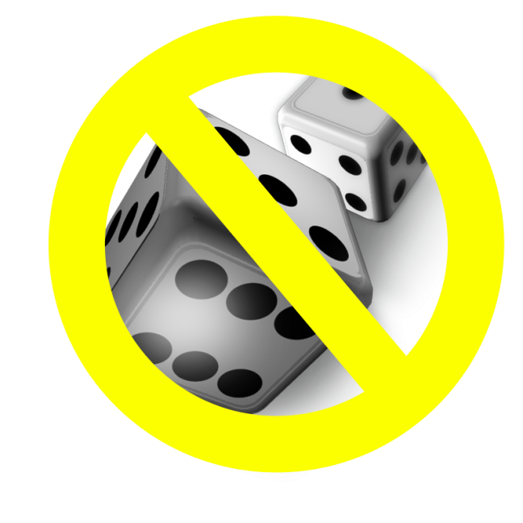
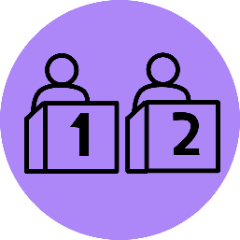
Are you ready to play…
Deal or No Dice
Notes:
Instructions:
Divide class into two teams.
On a white board or class display, keep track of correct answers.
Think about providing winning team with a prize (contact Marion County Problem Gambling program for possible prizes: MCHDPrevention@co.marion.or.us).
_____________________________________________
Photo credit: Thanks for Playing the Game Show Show by Kevin Standlee. https://www.flickr.com/photos/8638651@N07/7333198146/in/photostream/. No changes were made to the photo, just components overtop of it.

Slide 2
Name at least one typical consequence that a problem gambler may have due to their gambling problem?

Slide 3
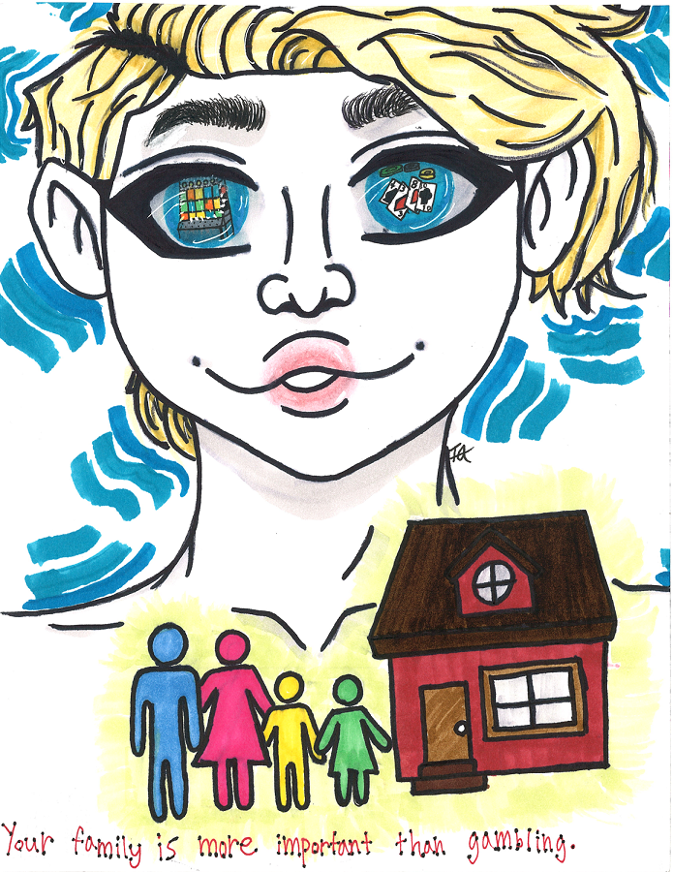
Most Common Consequences:
Debt
Crime
Depression/Suicide
Relationship problems
Employment problems
Alcohol and/or drug problems

Slide 4
True or False?
Betting on a soda with someone who will win a basketball game is gambling.

Slide 5
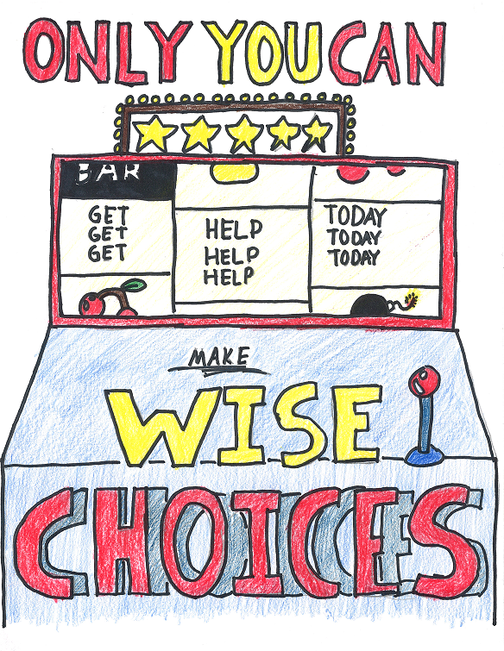
True!
Gambling is any behavior that involves risking money or things of value on a game, contest, or any other event.

Slide 6
What are the odds of winning or sharing the Powerball Jackpot in any drawing?
1 in 146,000
1 in 2,922,000
1 in 146,000,000
1 in 292,200,000

Slide 7
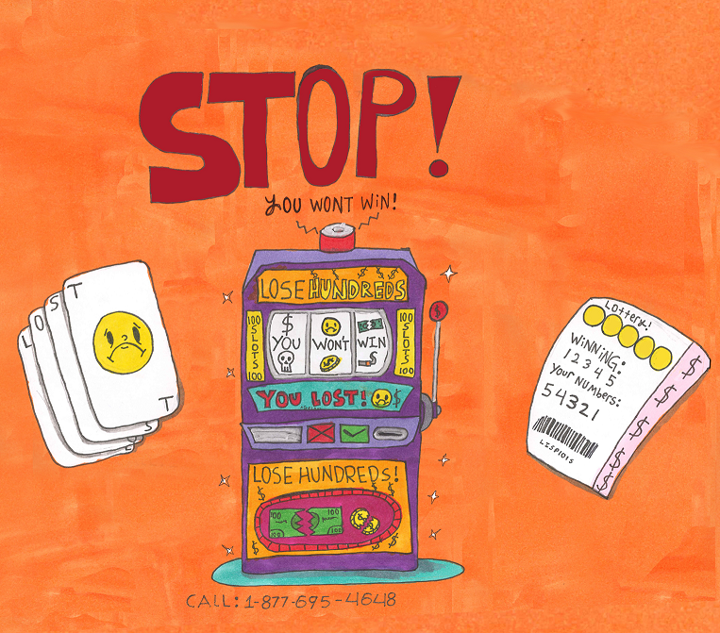
Odds of winning or sharing Powerball Jackpot
D. 1 in 292,200,000

Slide 8
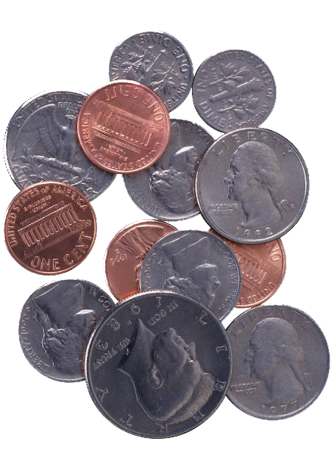
A coin comes up “heads” 5 times in a row. On the next flip of the coin, on which side is the coin more likely to land?
Heads
Tails
Either

Slide 9
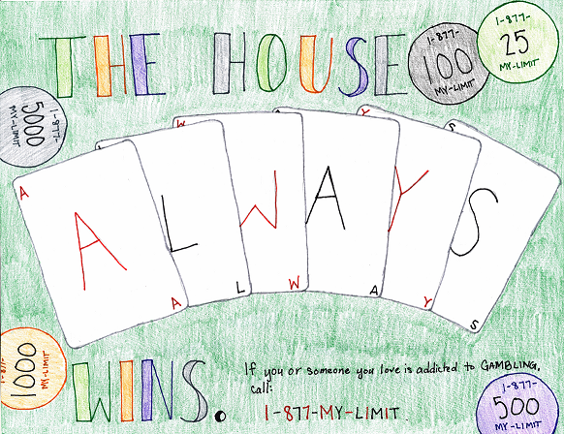
On the next flip, the coin is more likely to land…
C. Either
A coin flip is completely random because it is a 50/50 chance each time.
The chance of winning almost all gambling games is not in your favor.

Slide 10
True or False?
Gambling is a safe alternative for people with alcohol or drug problems?

Slide 11
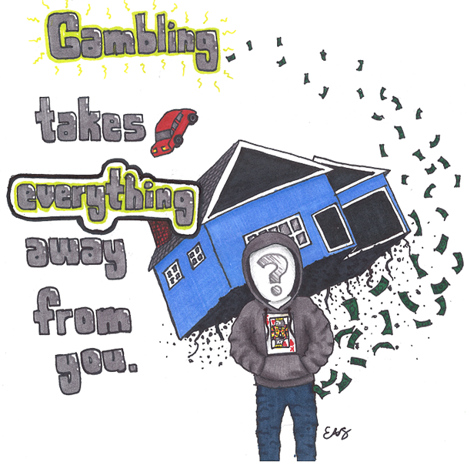
False!
Gambling is not a safe alternative for people with alcohol or drug problem.

Slide 12
What is considered to be the most “addictive” type of gambling?
Sports Betting
Lottery Tickets
Video & Online
Bingo & Raffles

Slide 13
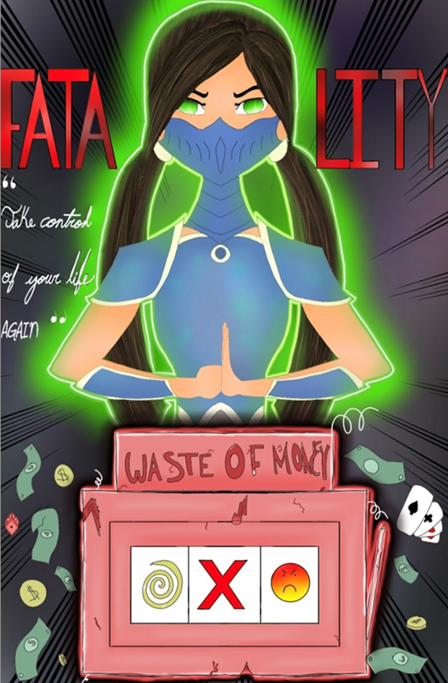
Video & Online Gambling
For Oregonians in problem gambling treatment, machine based games were there primary gambling activity.

Slide 14
When does
“RESPONSIBLE” GAMBLING
PROBLEM GAMBLING?
become
Gambles once in a while
Hopes to win but expects to lose
Gambling is for entertainment
Sticks to limits of money to play with
Gambles a lot / spends more time gambling
Expects to win and keeps playing to win back losses
Gambling is becoming a chore and/or escape
Chasing losses with money that is needed, borrowed, or stolen

Slide 15
Final question: How much does treatment cost for problem gambling in Oregon?

Slide 16
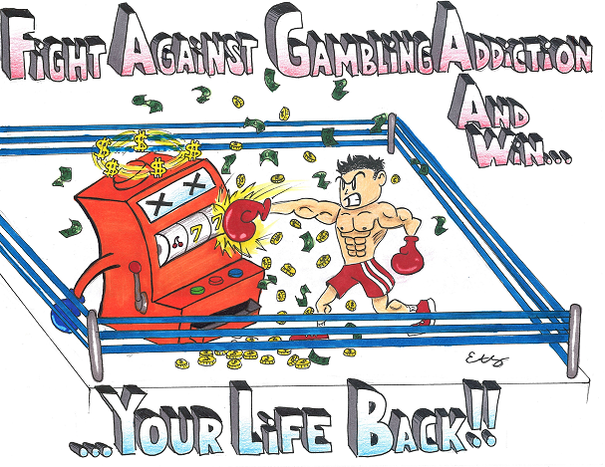
$0
Problem gambling treatment is FREE in Oregon for gamblers AND loved ones.
www.OPGR.org

Slide 17
Thank you for playing…
Deal or No Dice

