Slide 1

Spokane County
Public Works
Road Maintenance and Chip Seal

Slide 2
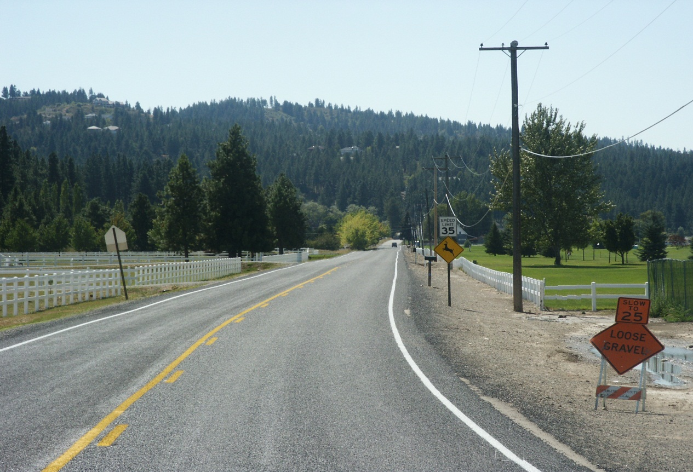
Spokane County
Population: 475,735 (2012)
Square Miles: Approx 1625 (unincorporated area only)
Total Road Miles: 2505 (of which 1378 are paved/concrete)
Vast Terrain: Mountains to Farmland

Slide 3
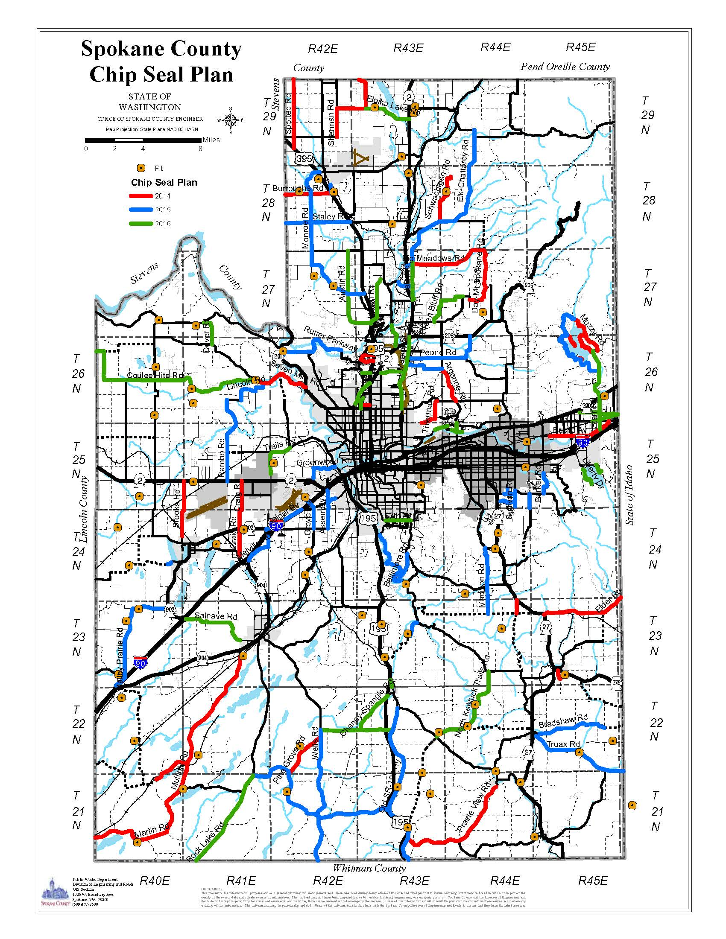
Miles chip sealed
over the last 3 yrs
2014 – 88 miles
2015 – 81 miles
2016 – 81 miles
Projected Miles to be chip sealed
2017 – 74 miles
2018 – 75 miles
2019 – 80 miles

Slide 4
Chip Seal Crew
Base crew consists of:
Two (2) 4000 gal distributors w/20’ bars
One (1) Etnyre Chip Spreader 22’ wide
Three (3) nine tire pneumatic packers and one (1) double steel drum.
Generally operate with 10 dump trucks that run from district shops. Traveling distance varies from stockpiles to jobsite which can influence the number of dump trucks needed
Sixteen crew members w/one lead flagger and 13 summer help flaggers
Full-time mechanic working with the crew

Slide 5
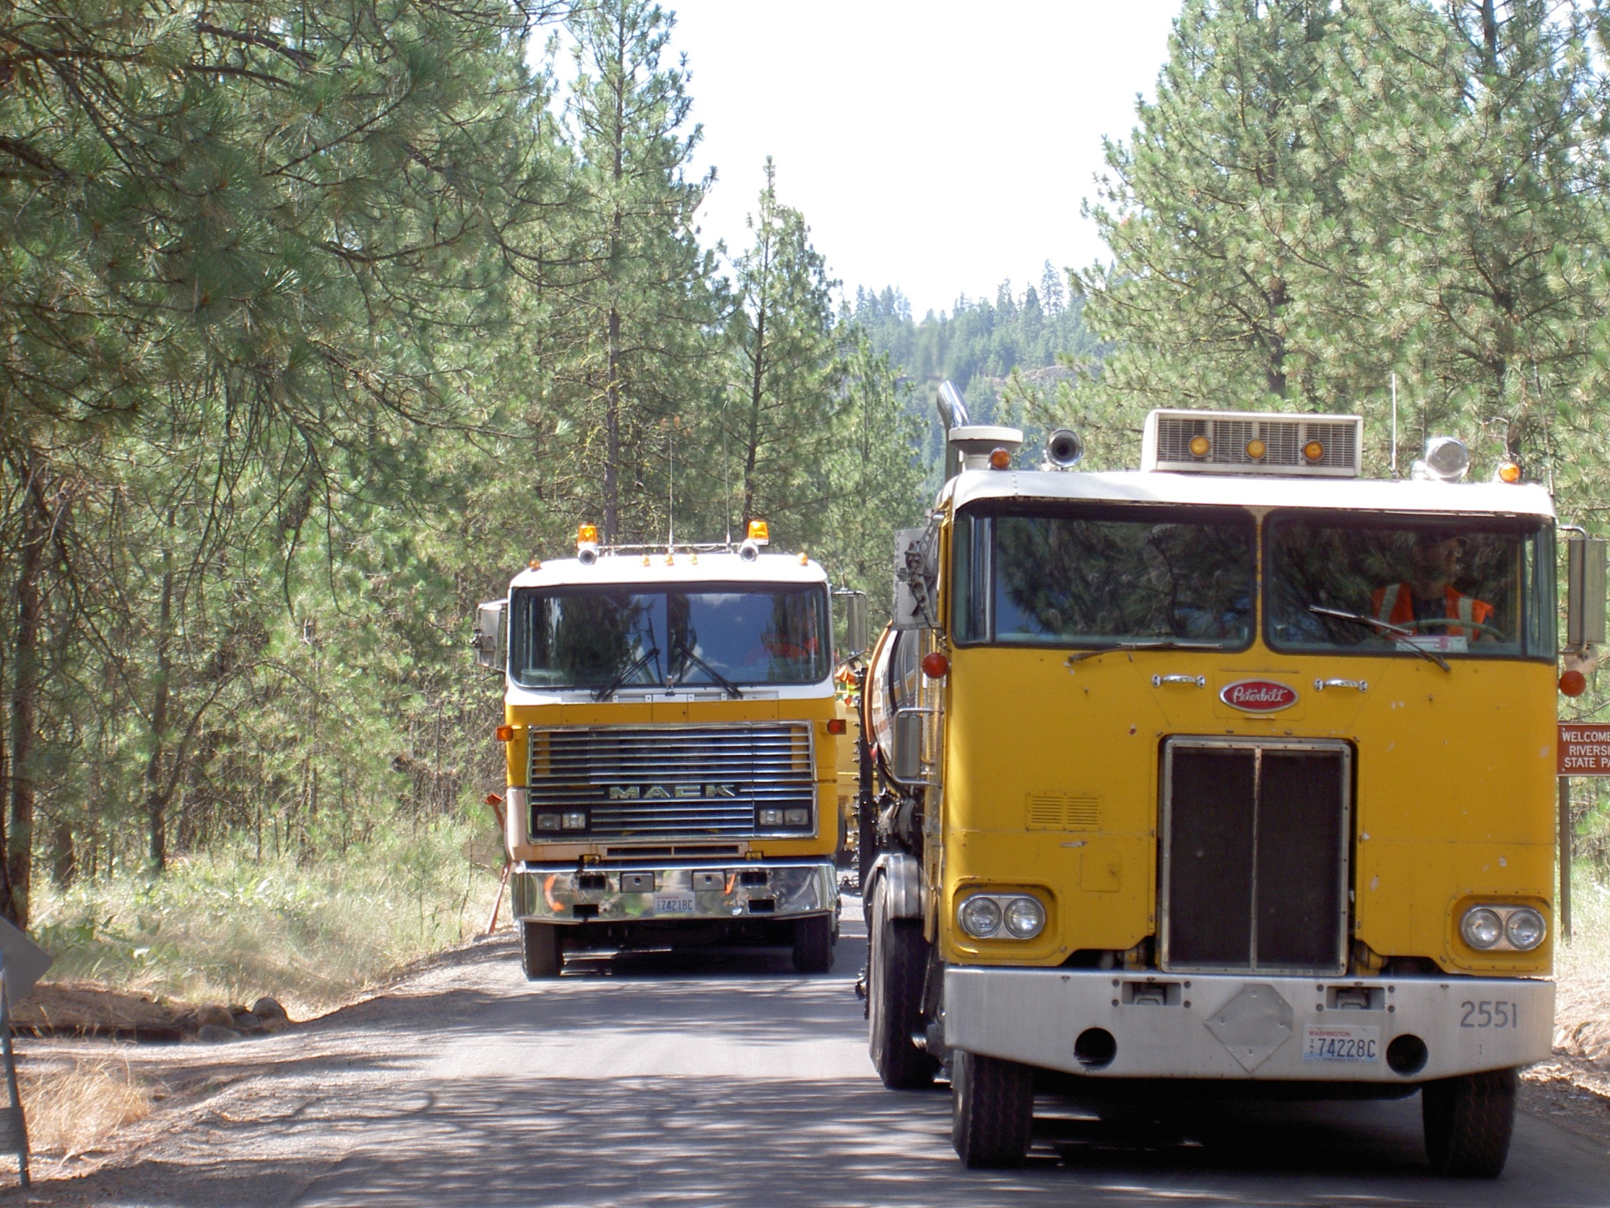
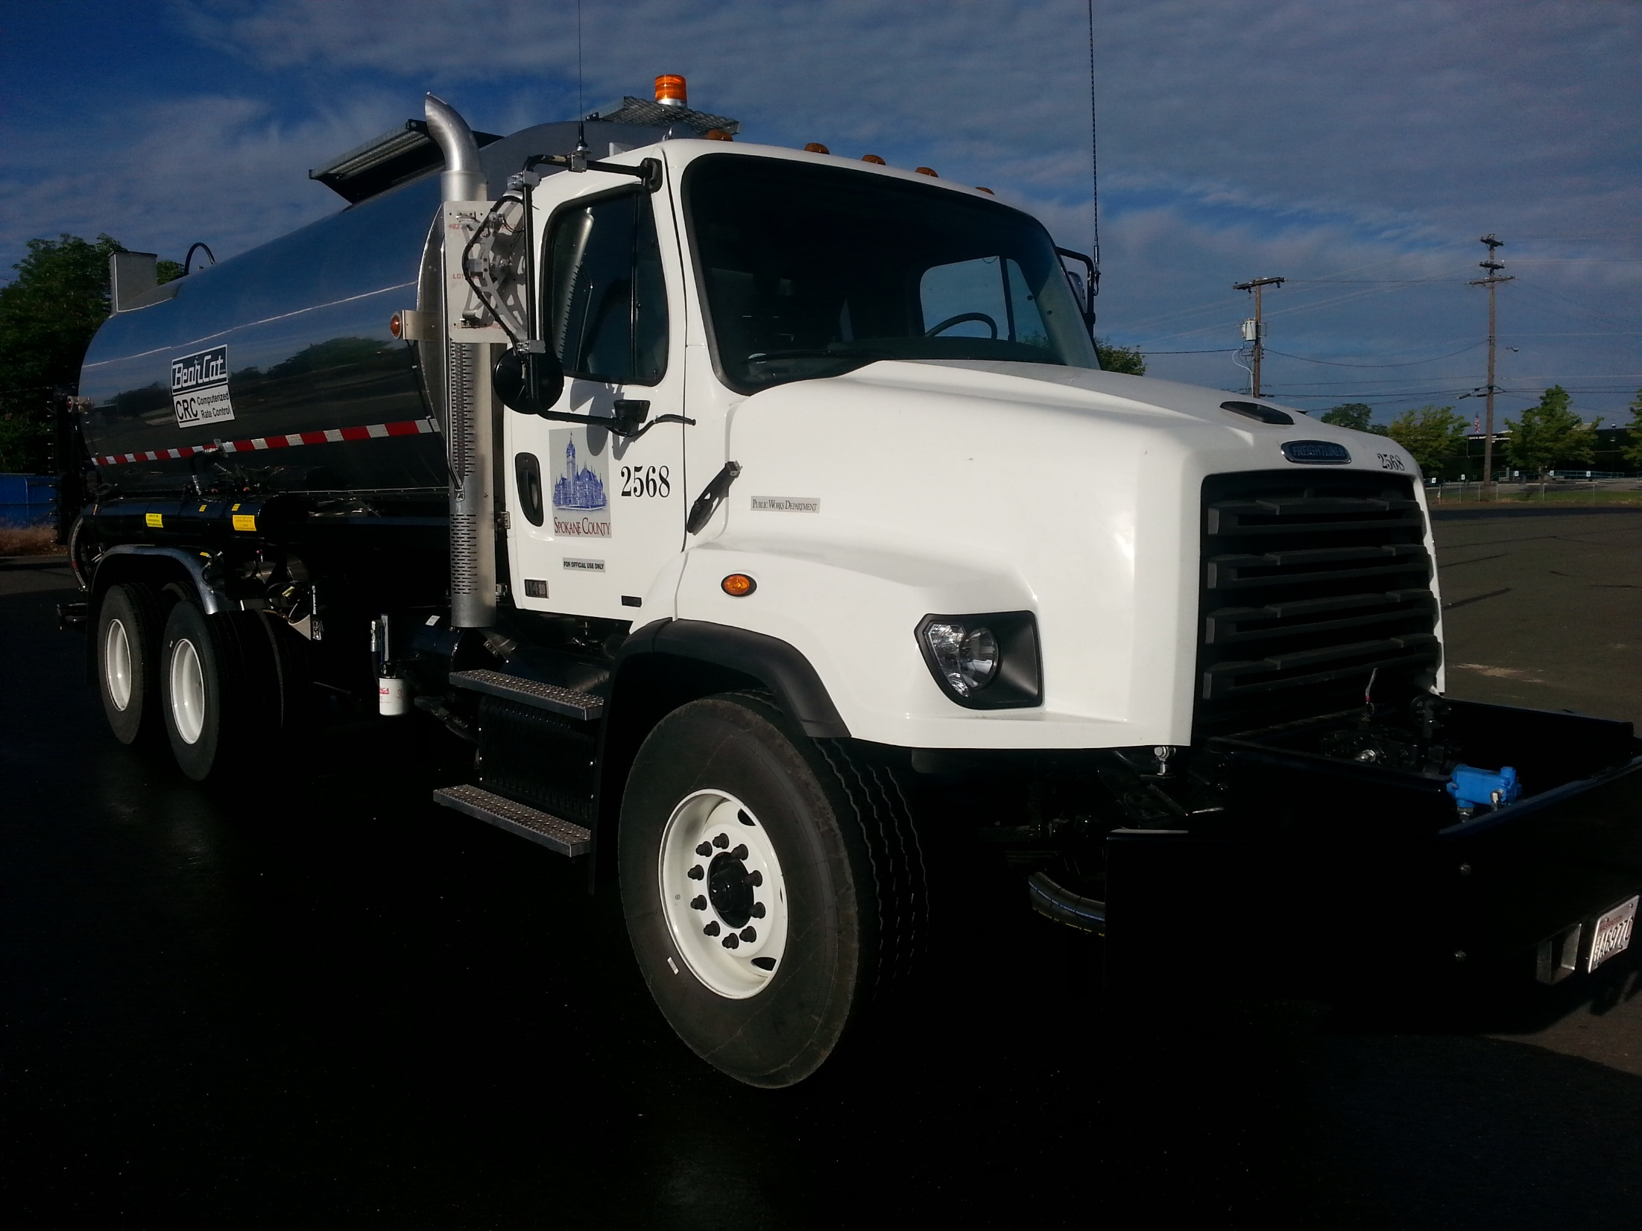

Slide 6
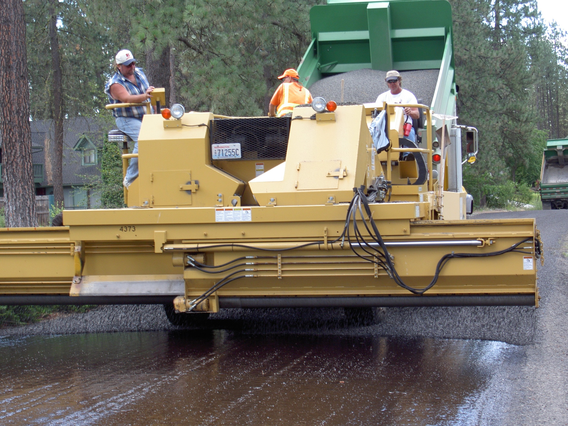

Slide 7
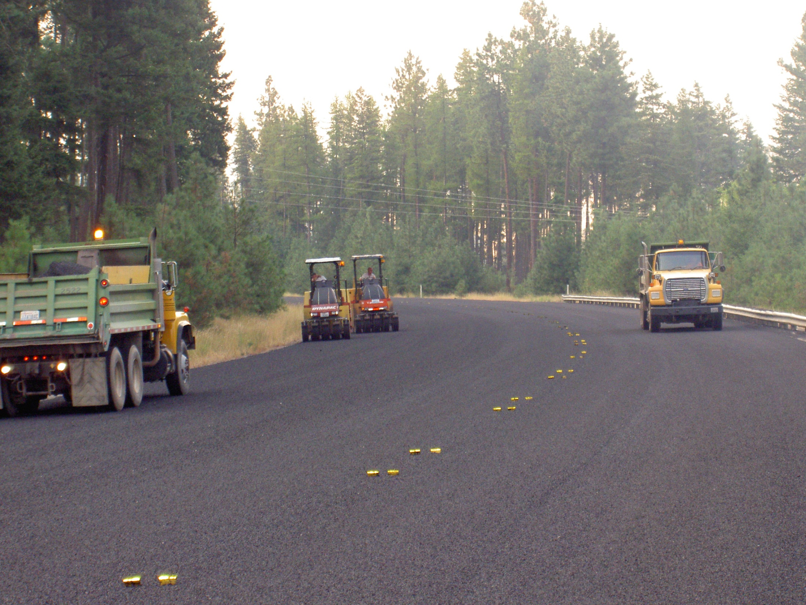

Slide 8
Project Selection
Spokane County is progressively moving towards a “best first” pavement repair strategy. Traditionally, Spokane County has allowed the ride quality and structural condition of a pavement to deteriorate from fair to poor condition before taking steps to rehabilitate the pavement.
The aim of the rehabilitation is to repair structural damage and restore pavement conditions--a costly, time-consuming activity.
But now, by applying a series of low-cost preventive maintenance treatments, each of which lasts a few years, agencies can extend the pavements service life. This translates into a better investment and a better ride quality at a reduced cost over time.
Each dollar spent on pavement preservation could save up to six dollars in the future. With these savings and added revenue we can begin the process of rehabilitating the roads in bad condition and managing them in the future under the “best first” strategy.

Slide 9
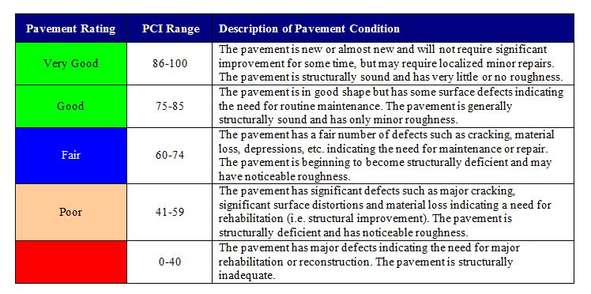
Pavement Definitions
Spokane County Pavement Management Department visually inspects the paved arterial road system every 2 years and uses this data to evaluate and prioritize the paved road network as mandated by the County Road Administration Board (CRAB) WAC 136-70-040. In addition, local access roads are visually inspected every two years. The visual pavement rating data is converted to a pavement score ranging from 0 to 100 according to the Washington State Visual Rating Guide Method.
Failed

Slide 10
Chip Seal Preparation
Shouldering and ditching the road
Crack seal and hand patch
Blade patch or Pavement, Repair and Removal (PR&R) as necessary for leveling and cracking
Fogging the patches or sanding with dirty sand
Sweeping roads with a kick broom a least one day to a week prior

Slide 11
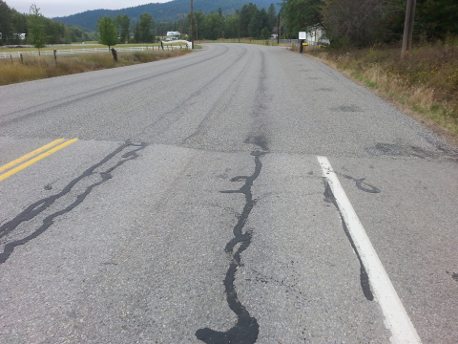
Chip Seal Preparation
Step One: Shouldering and ditching the road
Step Two: Crack seal and hand patch
Step Three: Blade patch or Pavement, Repair and Removal (PR&R) as necessary for leveling and cracking
Step Four: Fogging the patches or sanding with dirty sand
Step Five: Sweeping roads with a kick broom a least one day to a week prior

Slide 12
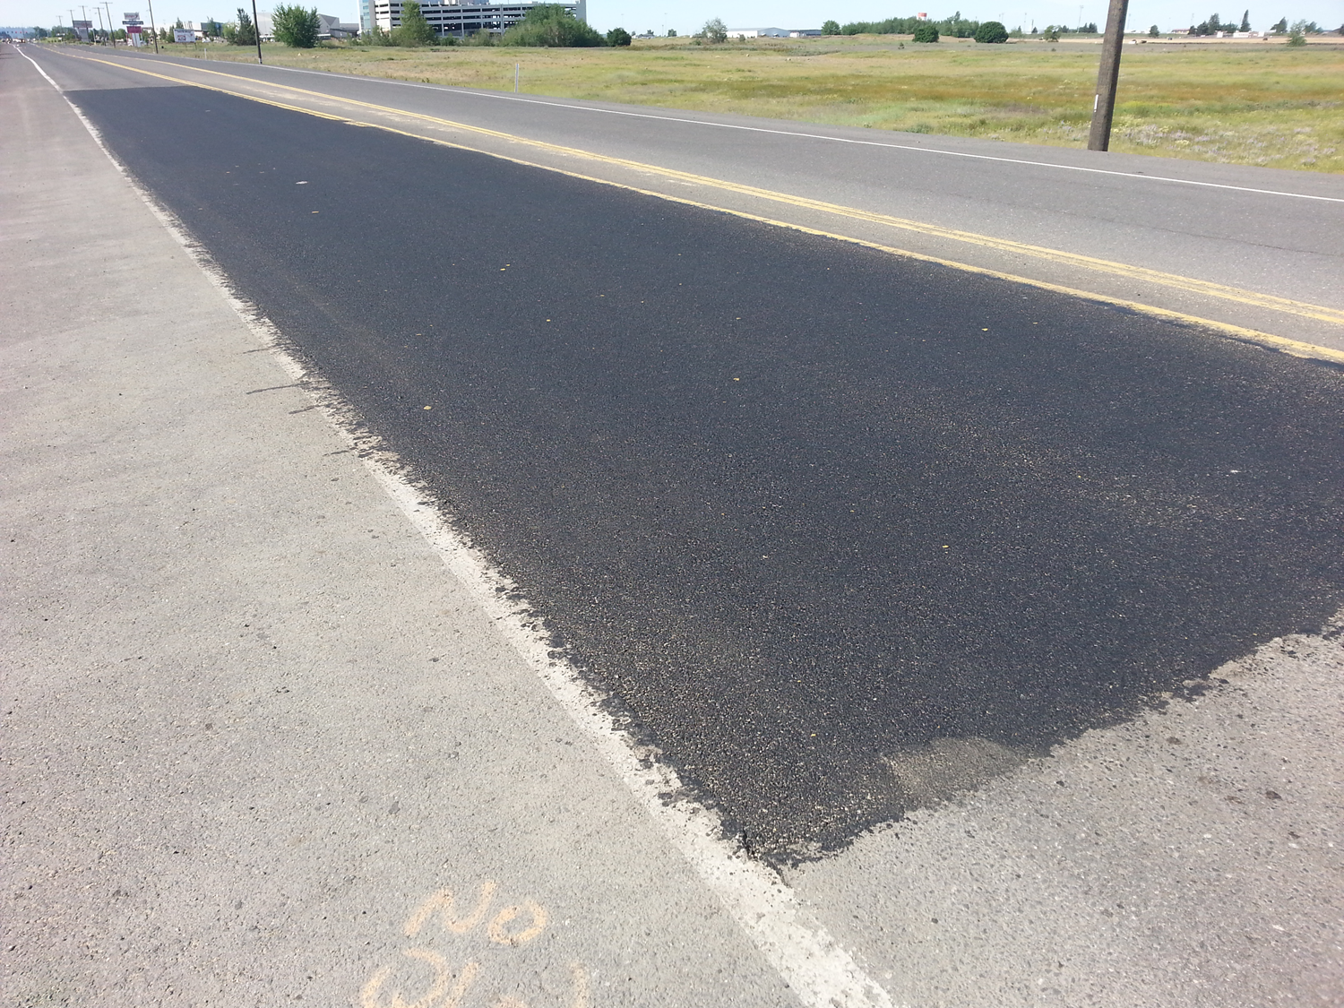

Slide 13
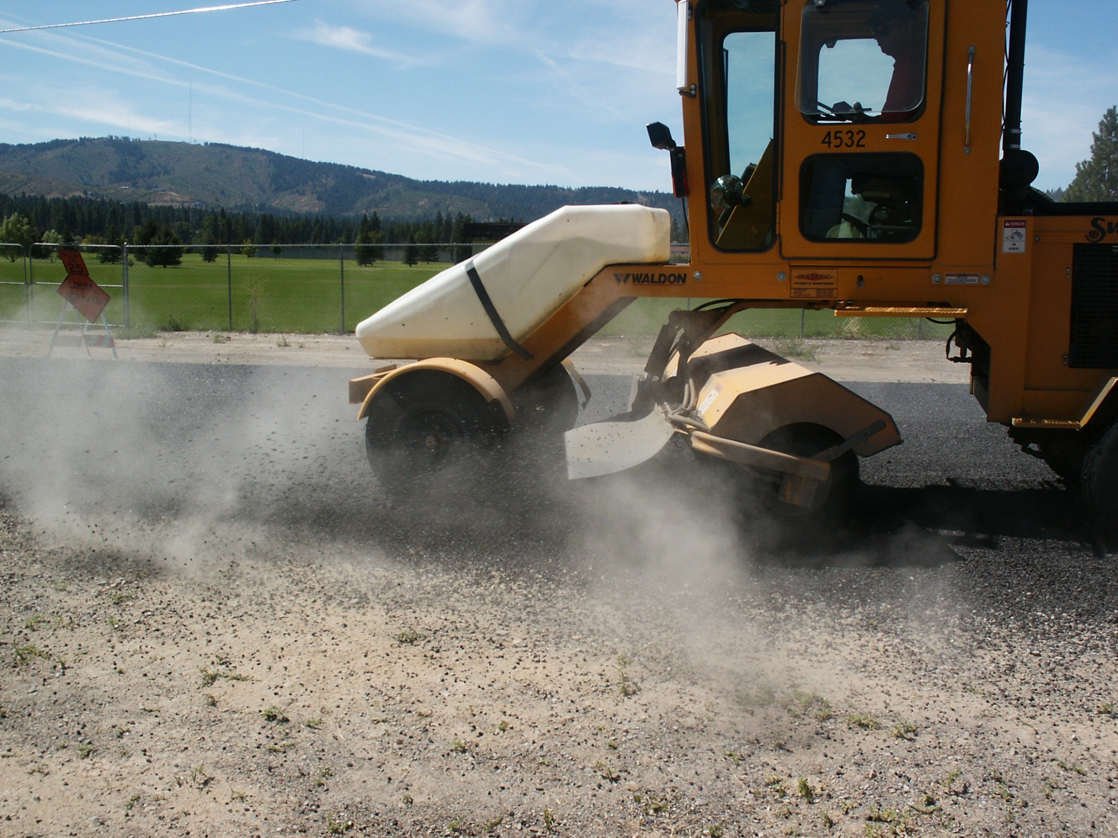

Slide 14
Chip Seal Operations
Efficient process is keeping the chip spreader moving
Use two (2) distributors, one is spraying and one is loading off a tanker truck
Chip spreader runs 100’ – 200’ behind the distributor
Rollers run behind spreader making at minimum of 3 passes
Dump trucks come from the stock pile to the jobsite and do not travel loaded over fresh seal coat whenever possible
Drivers don’t follow the same track (break track) to aid in compaction
Private vendors used to deliver oil to the jobsite. Averaging 4 deliveries per day (7,200 gals per delivery)

Slide 15
Application
Standard seal varies from high traffic urban to low traffic rural.
On high traffic roads, the shot rate for ⅜” chips is .450 to .500 taking into consideration traffic flow and temperature. Rock rate with ⅜” chips is 20# per sq. yard.
Low traffic rural roads, the shot rate is .500 to a .550 if heavily shaded or using ½” chips. Rock rates with ⅜” chips is 20# per sq. yard and ½” chips 22# per sq. yard.

Slide 16
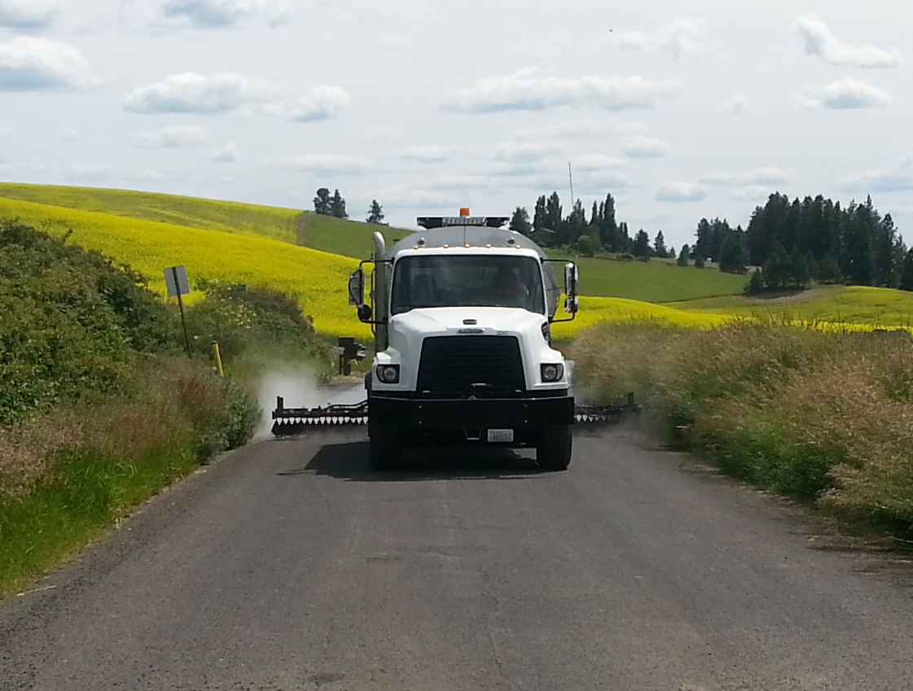

Slide 17
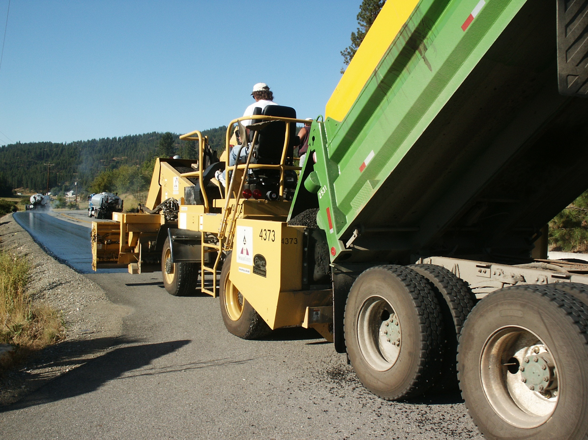
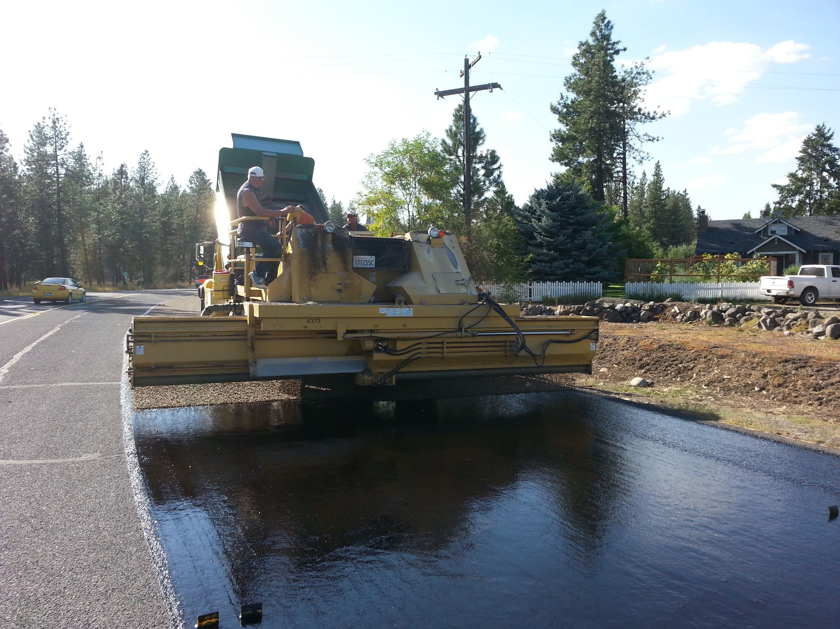

Slide 18
Fogging Process
Two types of oil: CSS1-DiL, Quick Seal Emulsified Asphalt
Shot rates range between .050 to .150
Currently 20% of chip sealed roads are fogged

Slide 19
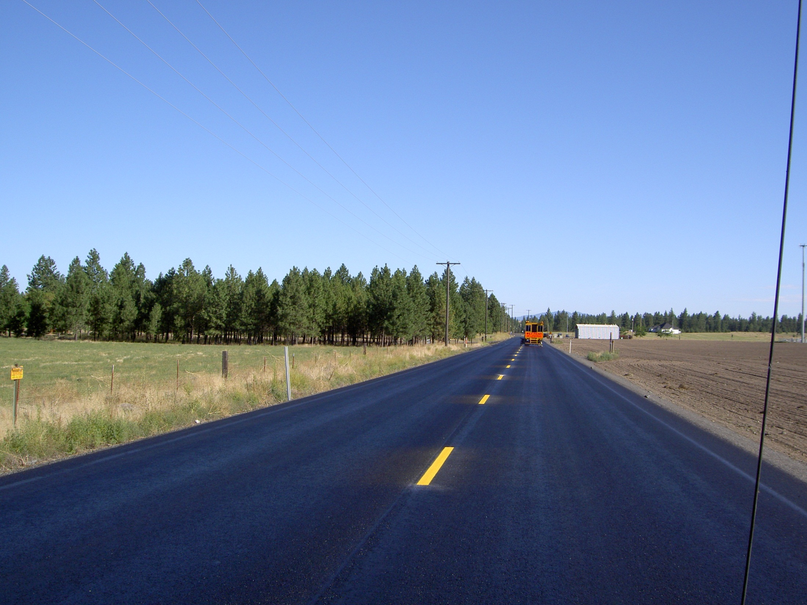
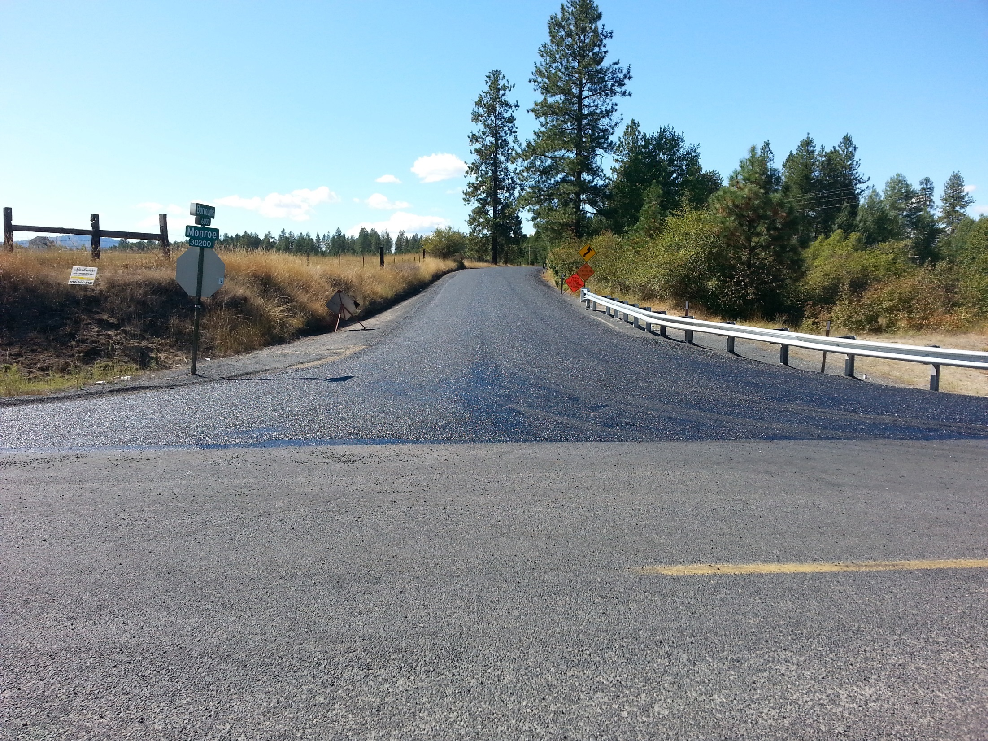

Slide 20
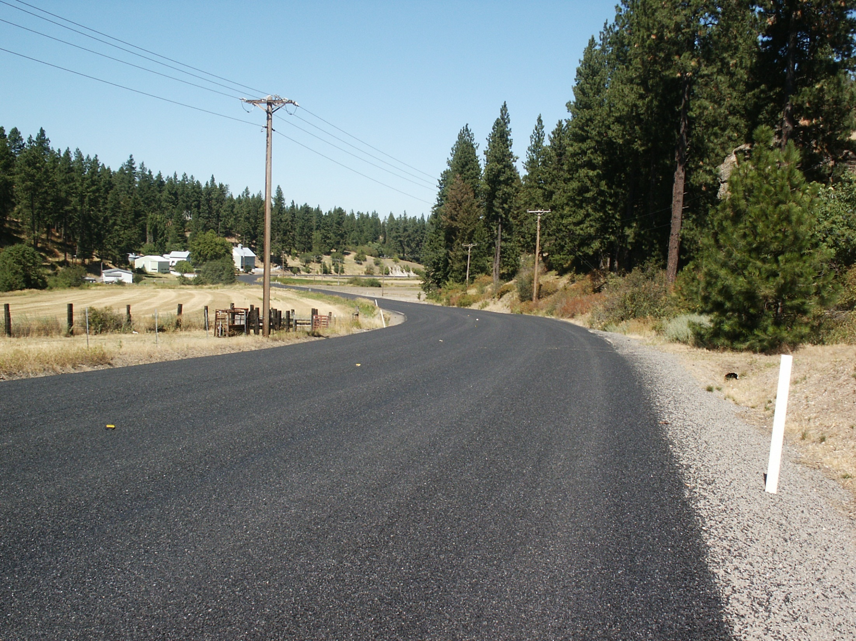
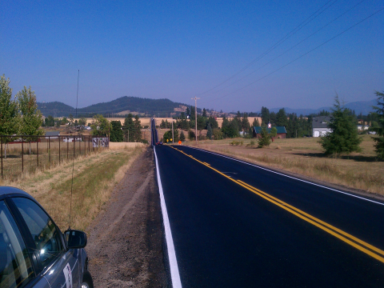

Slide 21
Alternate Techniques
HFE-150 Oil over existing paved roads, that are of poor quality and low traffic, to create a new thicker mat
Chipping residential streets with ¼“-10 inch chips

Slide 22
HFE-150 Oil Penetration
On gravel, wet road surface with water
Distributor shoots .600
Chip spreader waits 10 minutes for oil to turn
Spreads chip at 40 lbs. per sq. yd.
Three pneumatic rollers follow with five passes each
Two steel drum rollers follow with three passes each, with a light vibe
On hot days, light watering is applied between rollers

Slide 24
FA-2 Seal
Uses CRS-2P, ¼”-10 chips and then fog sealed with Quick Seal
CRS-2P shot at .25
Chips spread at 16lbs/sq. yd.
After sweeping fog seal, shooting Quick Seal at .12

Slide 26
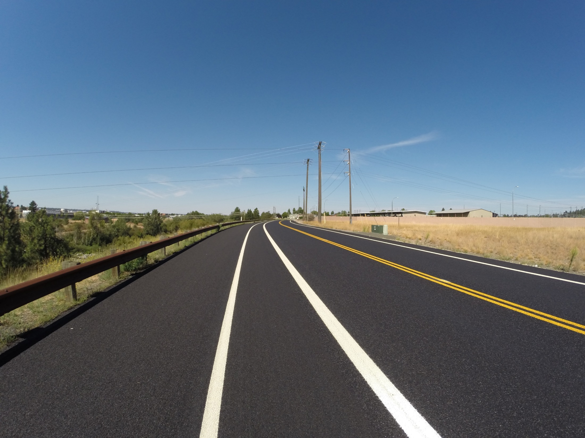

Slide 27
