Slide 1
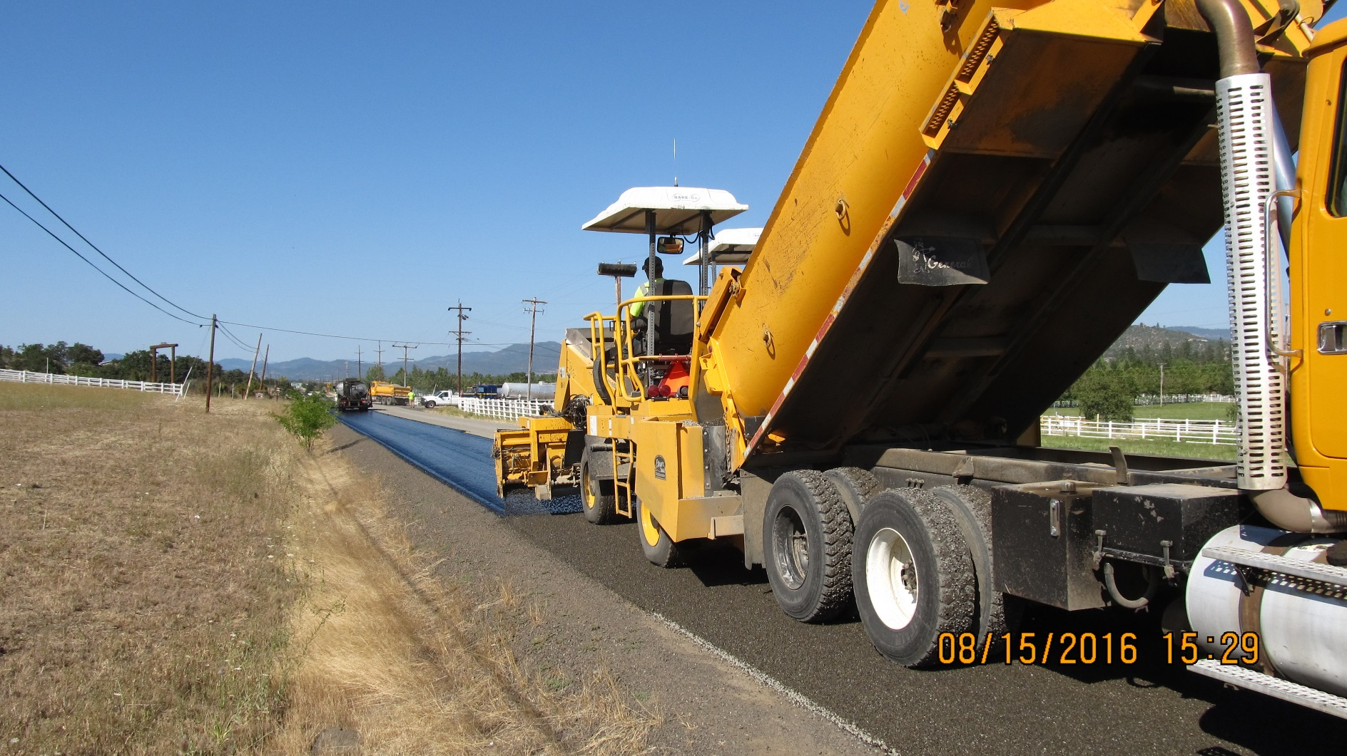
Chip Seal Prep
Jackson County

Slide 2
Change in Approach to Pavement Maintenance
Jackson County – 765 center line miles of surfaced roads
Much are matt coated with multiple layers of chip seals
2006 - Headed towards a cliff
Chip seal program = 32 miles
24 years until the whole system would be chip sealed
No overlay program
PCI was tanking
2016 - Pavement condition improving
Chip seal effort = 72 miles
10.6 years until the system would be chip sealed
PCI predicted to be 76 this FY and headed up
Corresponding increase to chip seal preparation
- THIS HAS BEEN KEY!

Slide 3
Jackson County
Pavement Condition Index (PCI)

Slide 4
Include the Cost of Chip Seal Prep with your Chip Seal Budget
Often the cost of the chip seal is stated as the cost of Chips + Oil
(w/ labor and equipment already budgeted)
Include prep costs and shorten chip seal list if you cannot do adequate prep
Example: 2016 Season @ 72 CL miles (950K yd²)
 | Tons | Cost | Cost/Mile
½" C-Mix | 12,500 | $637,500 | $8,854
Emulsion | 1,239 | $675,255 | $9,376
Chips | 9,592 | $143,887 | $1,998
Total |  | $1,456,642 | $20,228

Slide 5
So what would we recommend for chip seal prep?
1. All chip seal prep you do before the chip seal is a good thing – but more is better.
- Preferably a season ahead of the chip seal
2. Steal every good idea you have ever seen or heard
- Lane County – Blade Patching
- ODOT – grind / inlays
3. Be honest in looking at your shortcomings
- All too often we celebrate how good we are doing when in reality we need to improve
4. Develop “tools” for chip sealing – be creative

Slide 6
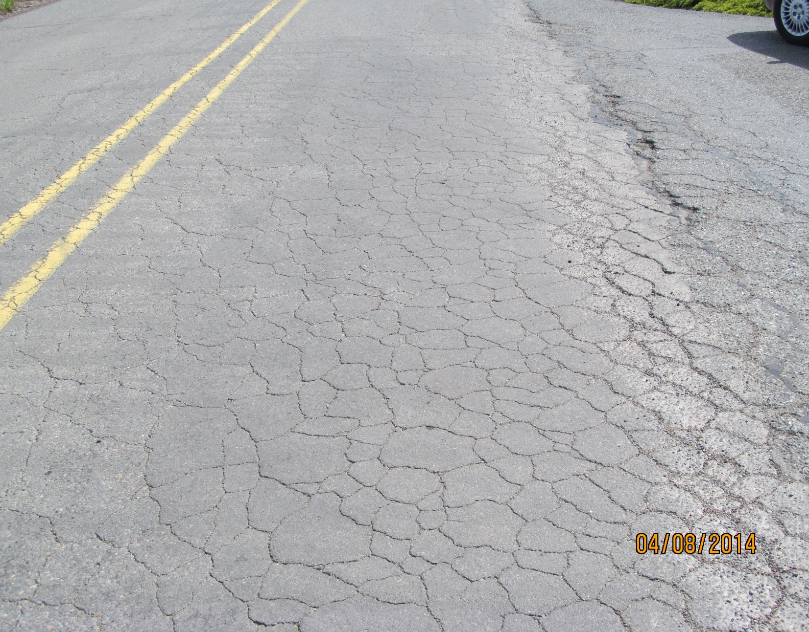
Don’t Chip Seal Junk (w/out fixing it)
Prep Needed:
Medium alligator cracking
Medium to high severity distortions
High severity longitudinal and transverse cracking
High severity failed patches
Medium to high severity rutting

Slide 7
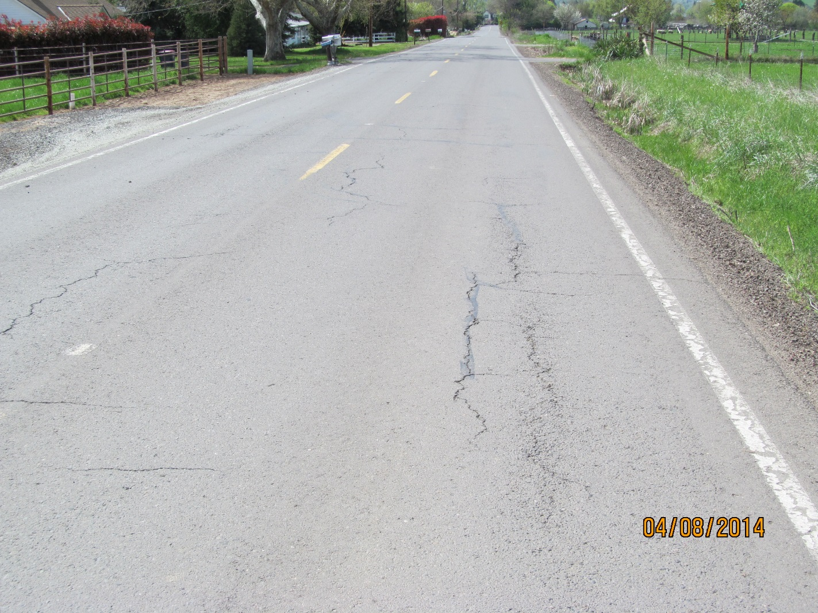

Slide 8
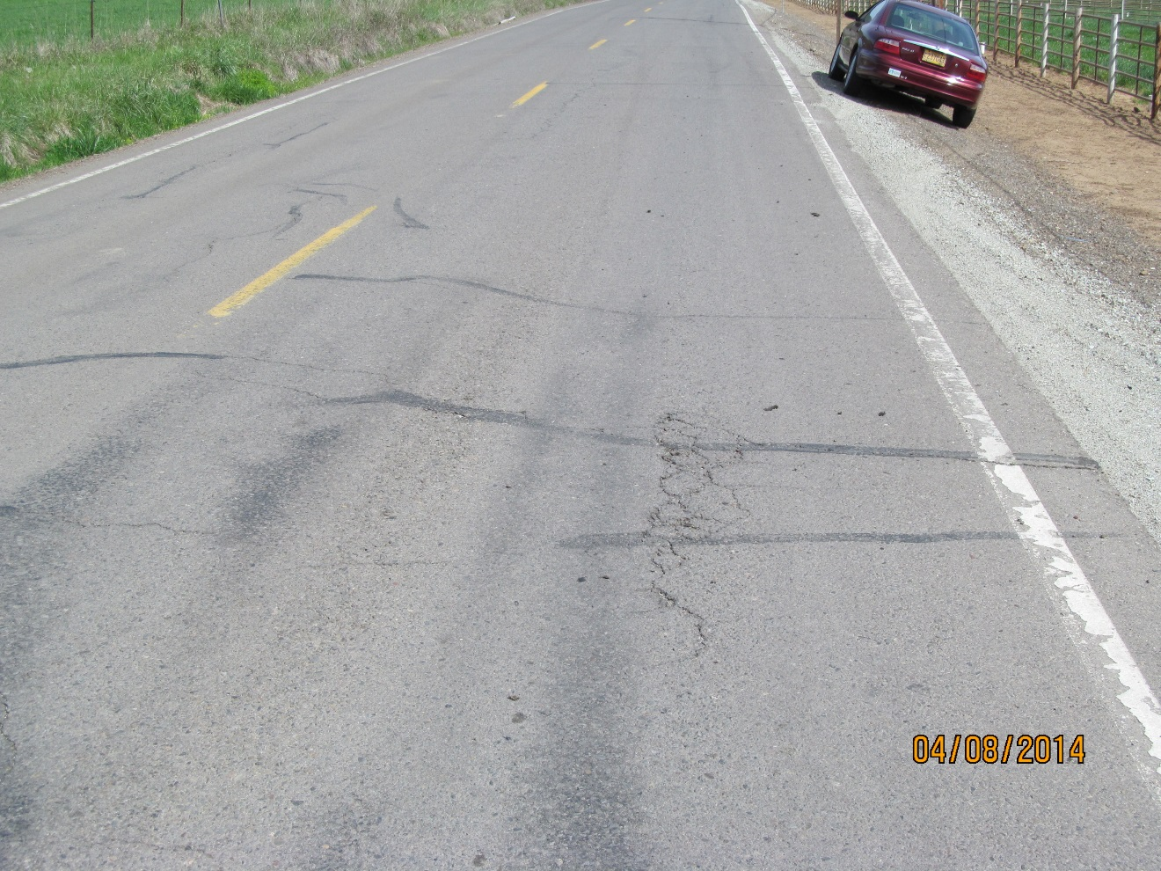

Slide 9
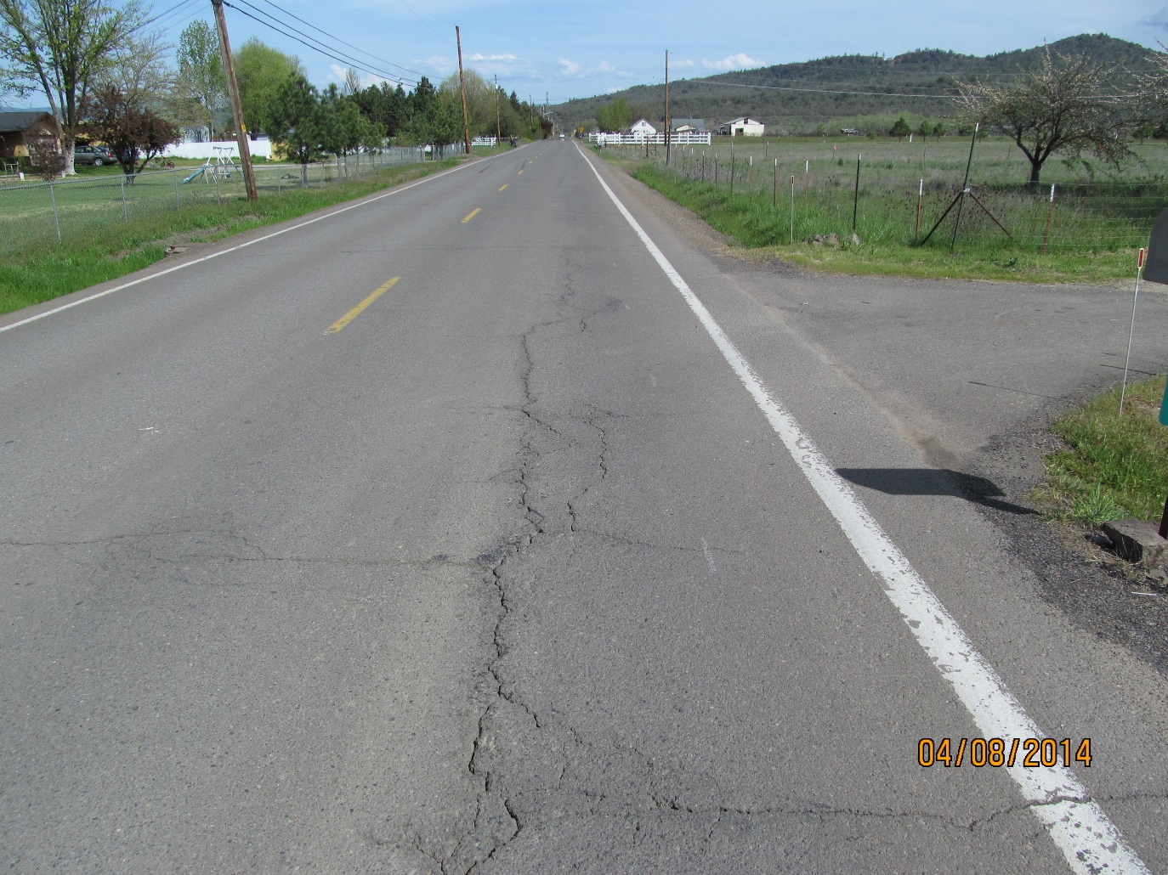

Slide 10
Chip Seal Prep Tool Box
Using our tool box (along with good drainage), Jackson County typically gets 9-12 years out of a 3/8” chip seal
Tool Box
Grind / Inlay Patches
Blade Patch
Crack Seal
Chip Seal “Patches”
Scrub Seals
Fog Seals

Slide 11
Grind / Inlay Patches

Slide 12
Grind / Inlay Patching
Beg, borrow, rent, contract for or steal a grinder – it will change your program – we love our Wirtgen 100
Steps:
Remove failed area 2.5” – 4” deep
Sweep grind - skid steer w/ front broom works best for us
Tack w/ CSS-1 (we hate our Lee Boy Tack Tank)
Spread AC w/ chute box by an experienced dump person
Straddle patch w/ push screed and loader – Adjust as needed
Rake out edges, highs, lows, sides and ends (raking is critical)
Roll to finish
Fix what you missed
Water the patch

Slide 13
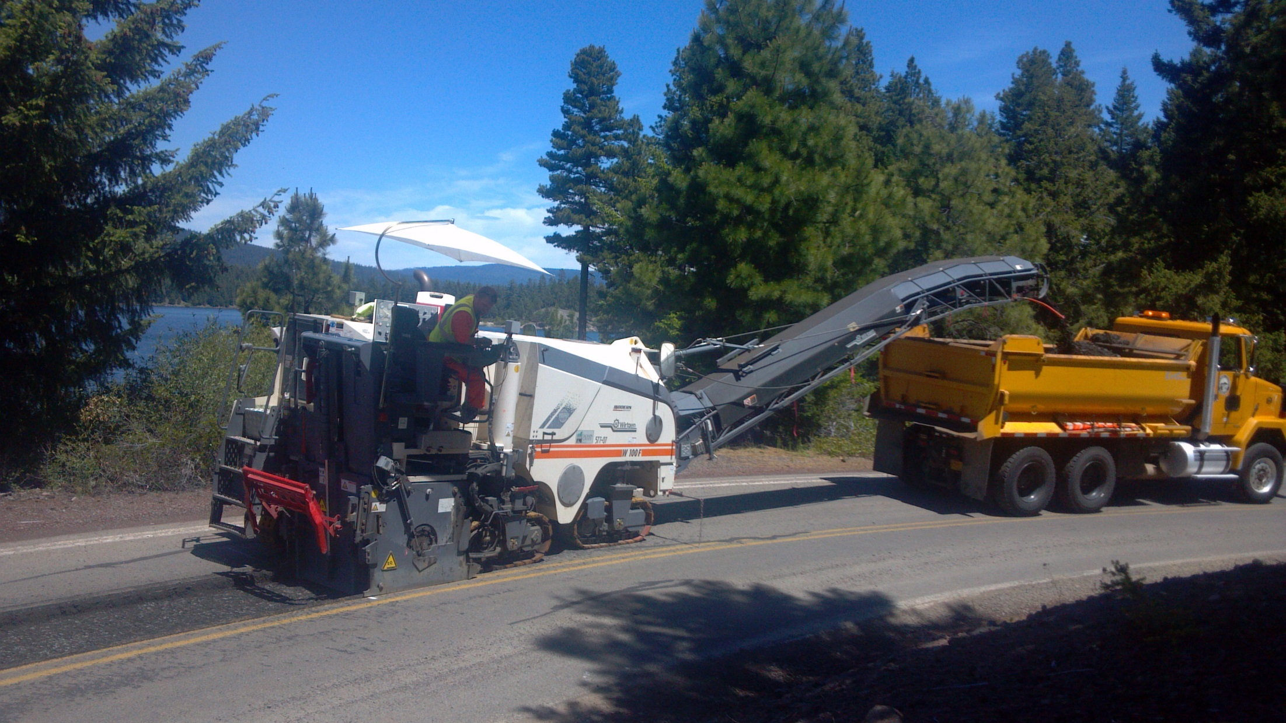

Slide 15
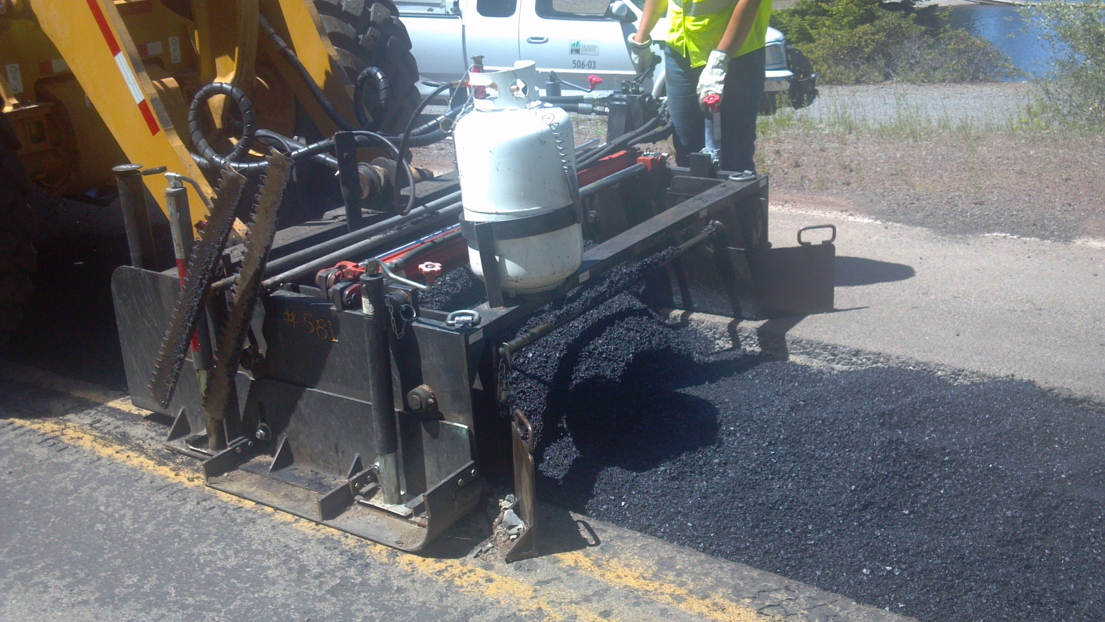

Slide 16
5 functions: depth, side shift, angle tilt and width adjustment
Being able to pave an edge grind w/o a strong shoulder is golden to us
We do leave loader tracks on the patch so we use slicks

Slide 17
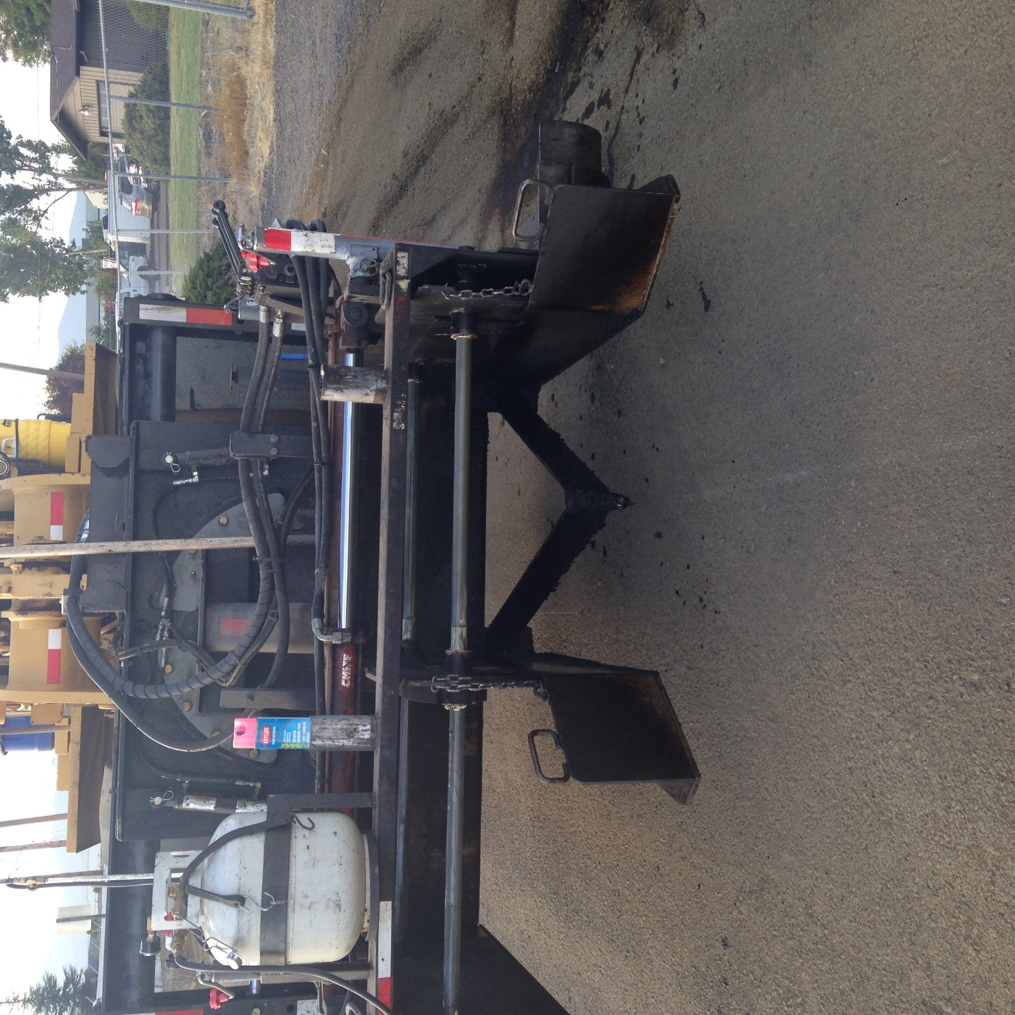

Slide 19
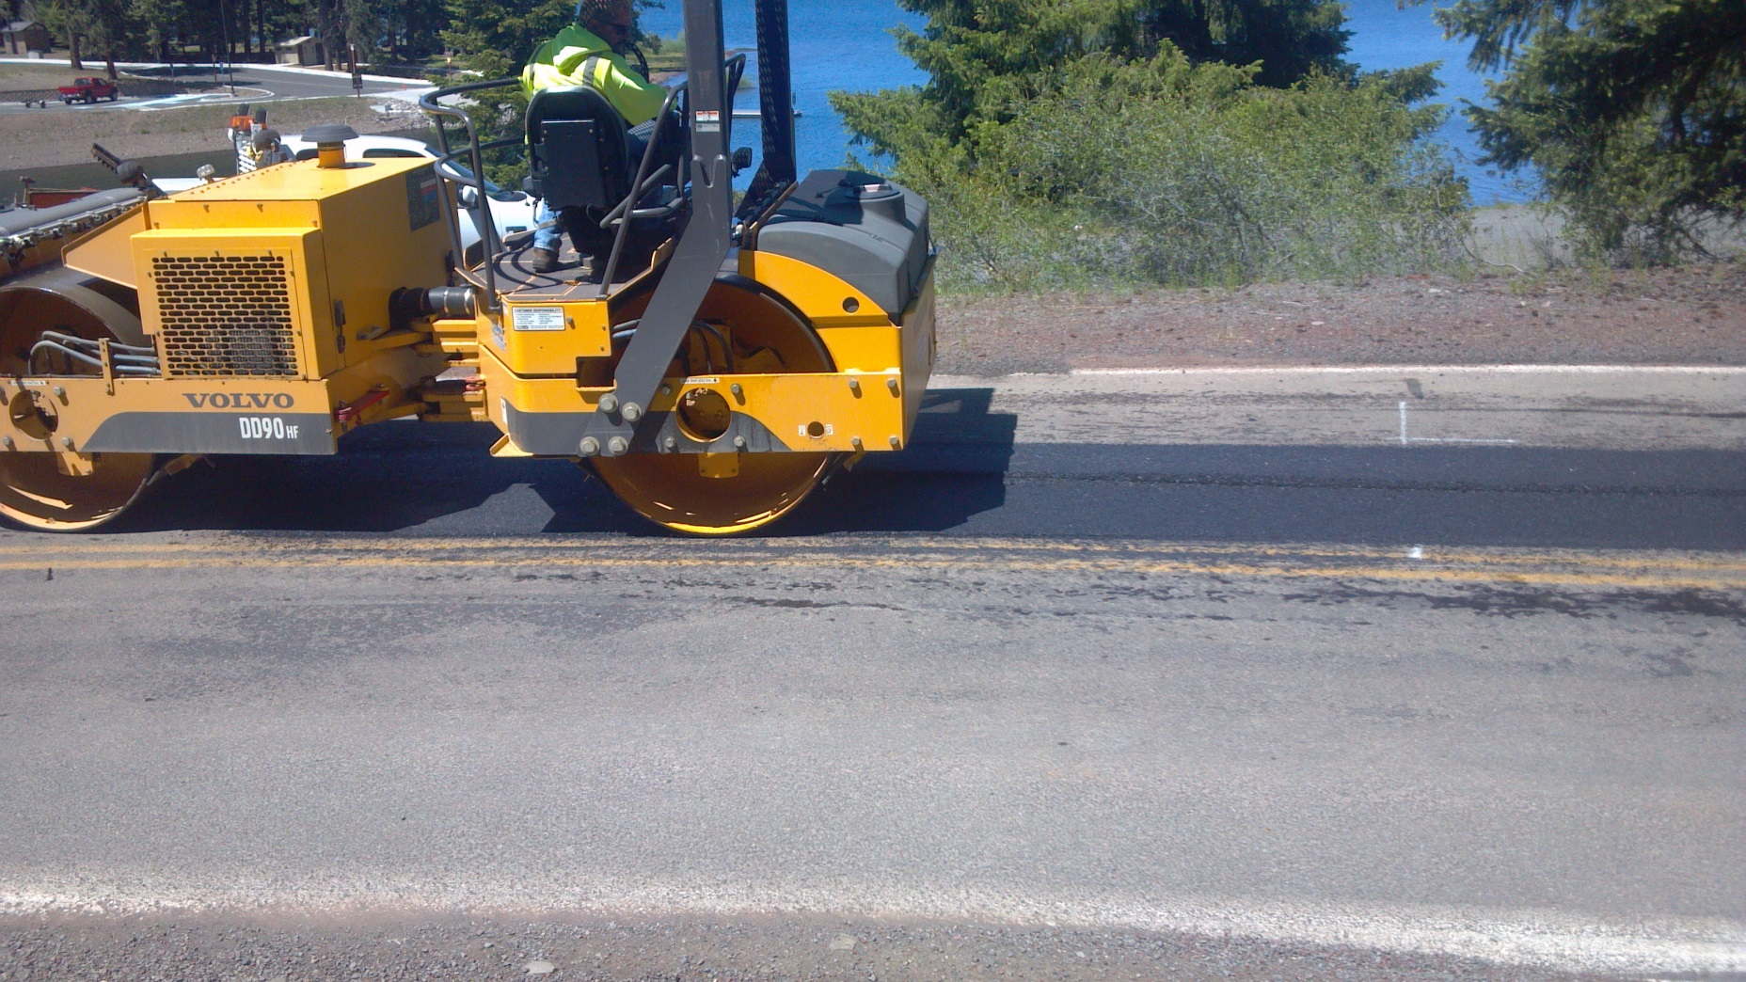
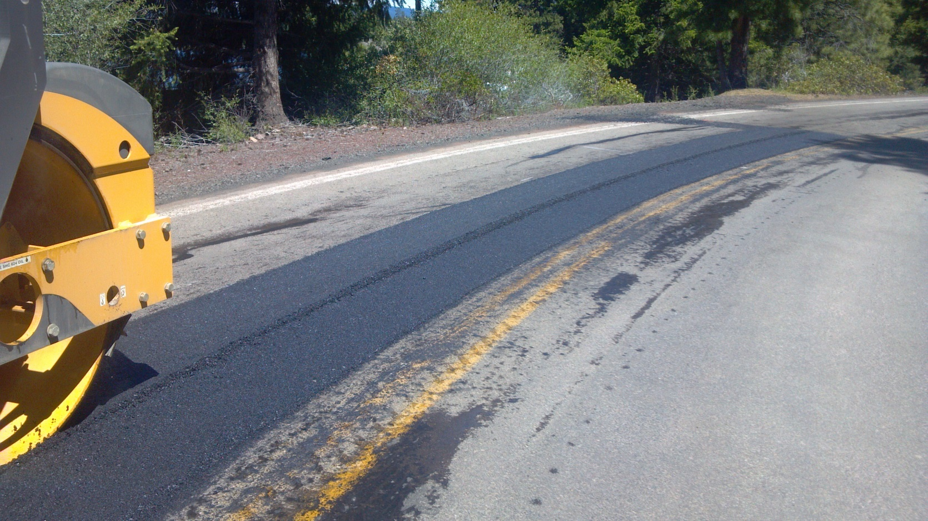
This needs to be completed in good order or the crew gets spread out

Slide 20
Blade Patches
Sunken grades
High severity Distortions
High severity rutting and depressions
High severity raveling

Slide 21
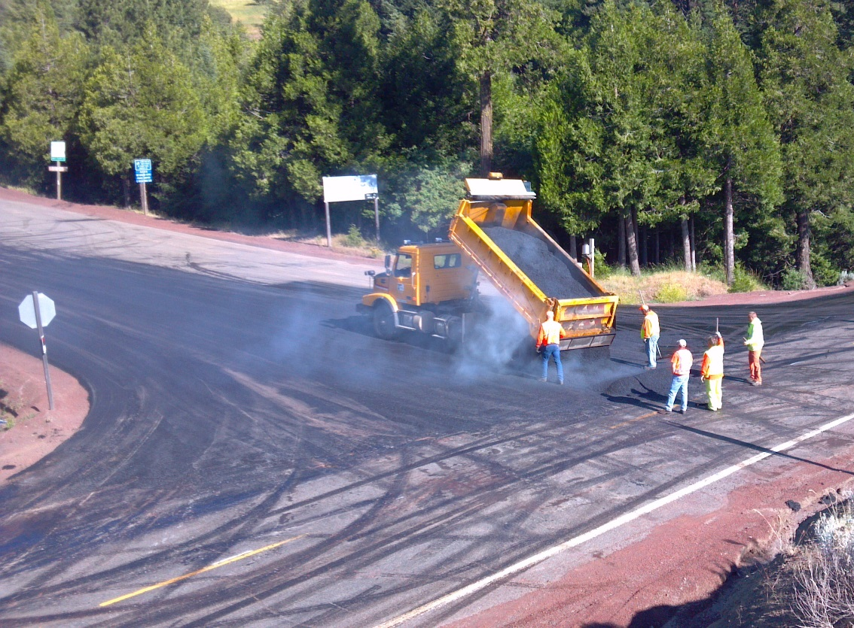
Tack low area
Spread mix
Remove Knife River clods
Lay out mix
Rake off bones
Roll & Water

Slide 22
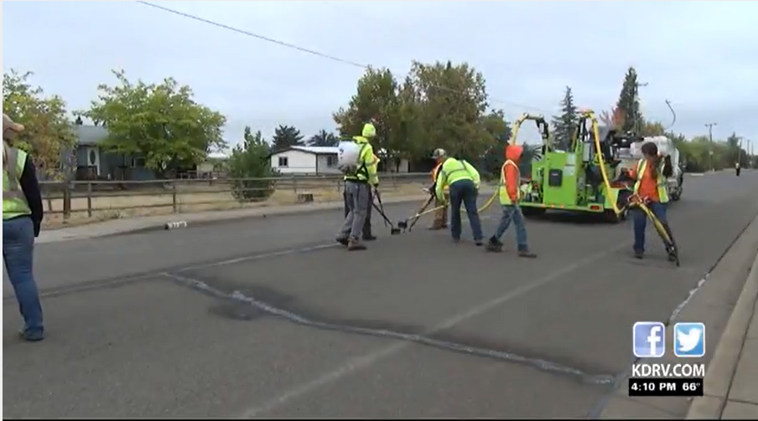
Crack Sealing
Graze, pick and blow clean cracks. 1” – 2” deep ¼” or wider
Fill crack with the proper filler with a very thin overband
Detac if picking is evident
As a last resort we mist with a water truck to break surface stick

Slide 23
Adds more value than often given credit for
Staffing this crew is getting increasing harder

Slide 24
Chip Seal “Patches”
Fill shallow ruts with one or two layers of chip seal
3/8” -#8 covered by ¼” - #10 and then chipped over

Slide 25
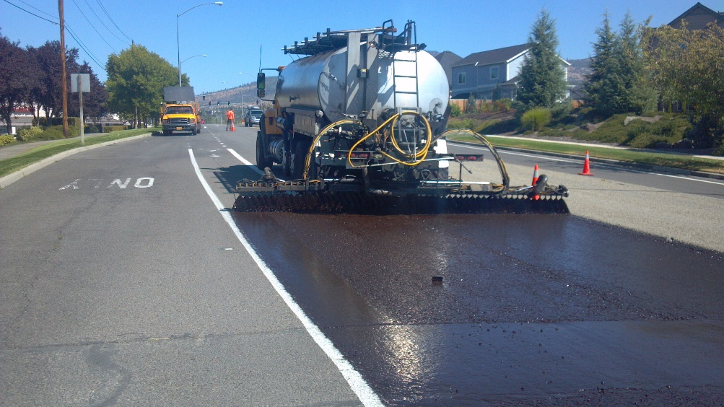
Scrub Seals / Fog Seals
Scrub Seals
When the road is sound but fully cracked.
Avoiding massive overband fields
Jackson County completed 5 + miles last season
Chipped over the Scrub Seal
Fog Seals
Choking fresh patches with emulsion and sand to prevent chip loss
.10 to .25 (.25 thanks to bad knife river RAP mix)

Slide 26
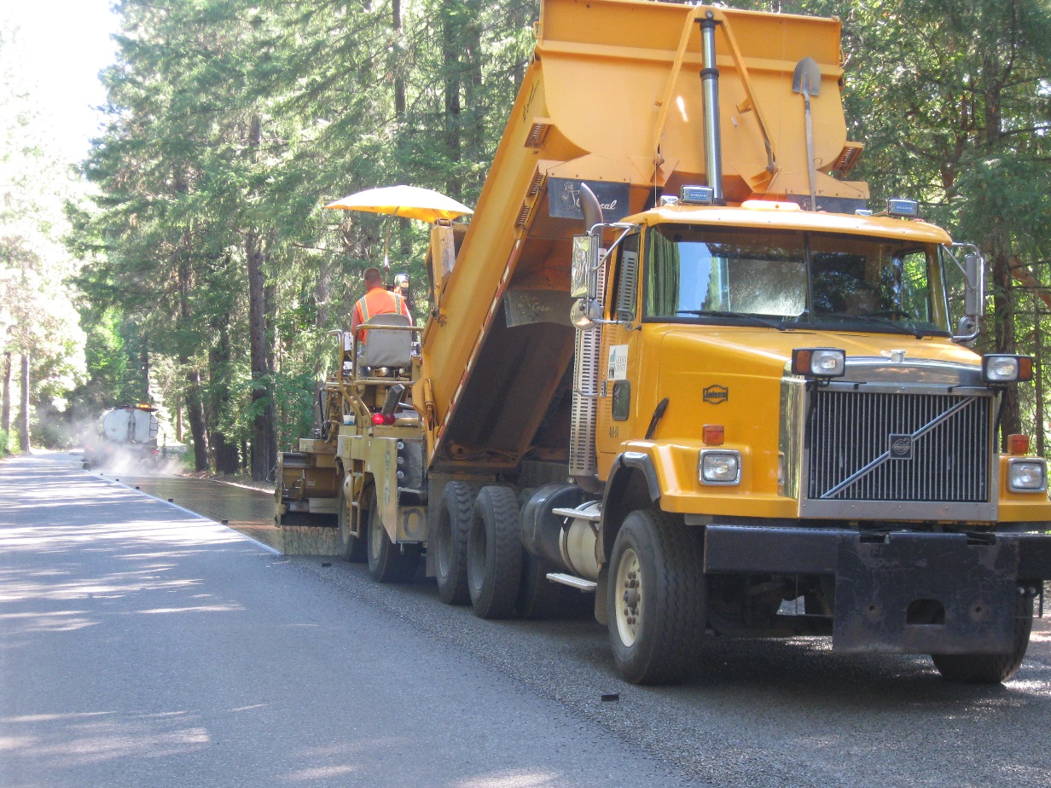
Chip Seal Prep
Jackson County
Questions

