Slide 1
Matt Scrivner / Assistant Road Master

Slide 2
Full depth Reclamation Double chip seal

Slide 3
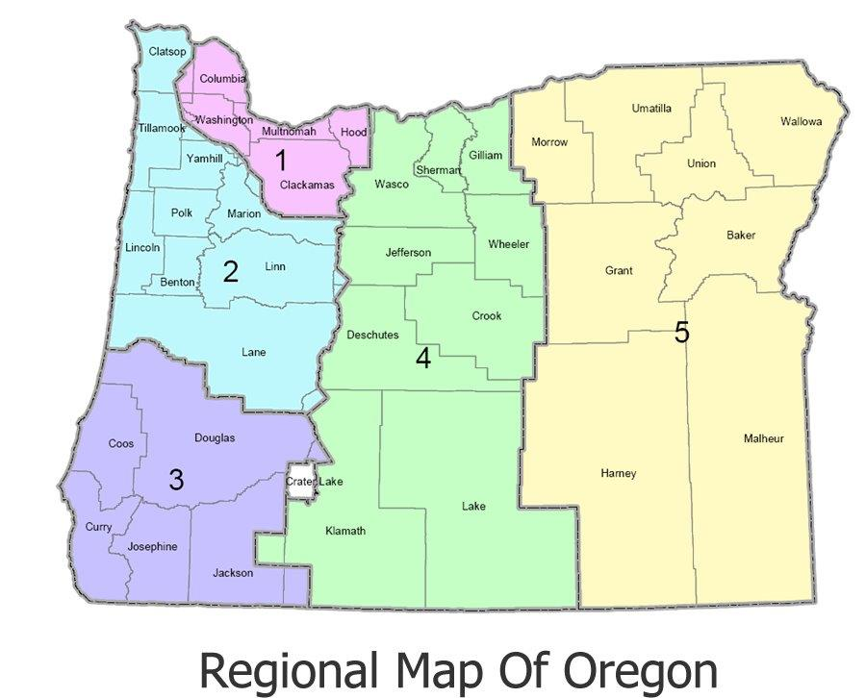
Population 11,173
2,049 square miles
15,773 Registered Vehicles
State funding $863,654.00
County road system:
959 total centerline miles 358 miles Paved road
601 miles Gravel road
Road Crew:
Public Works Director
Management Assistant
Asst. Road Master
Working Foreman
(14) Maintenance Specialists
Mechanics
General maintenance
Snow removal
Sign repair and install
Bridge repair
Paint striping
Paving and Chip seals

Slide 4
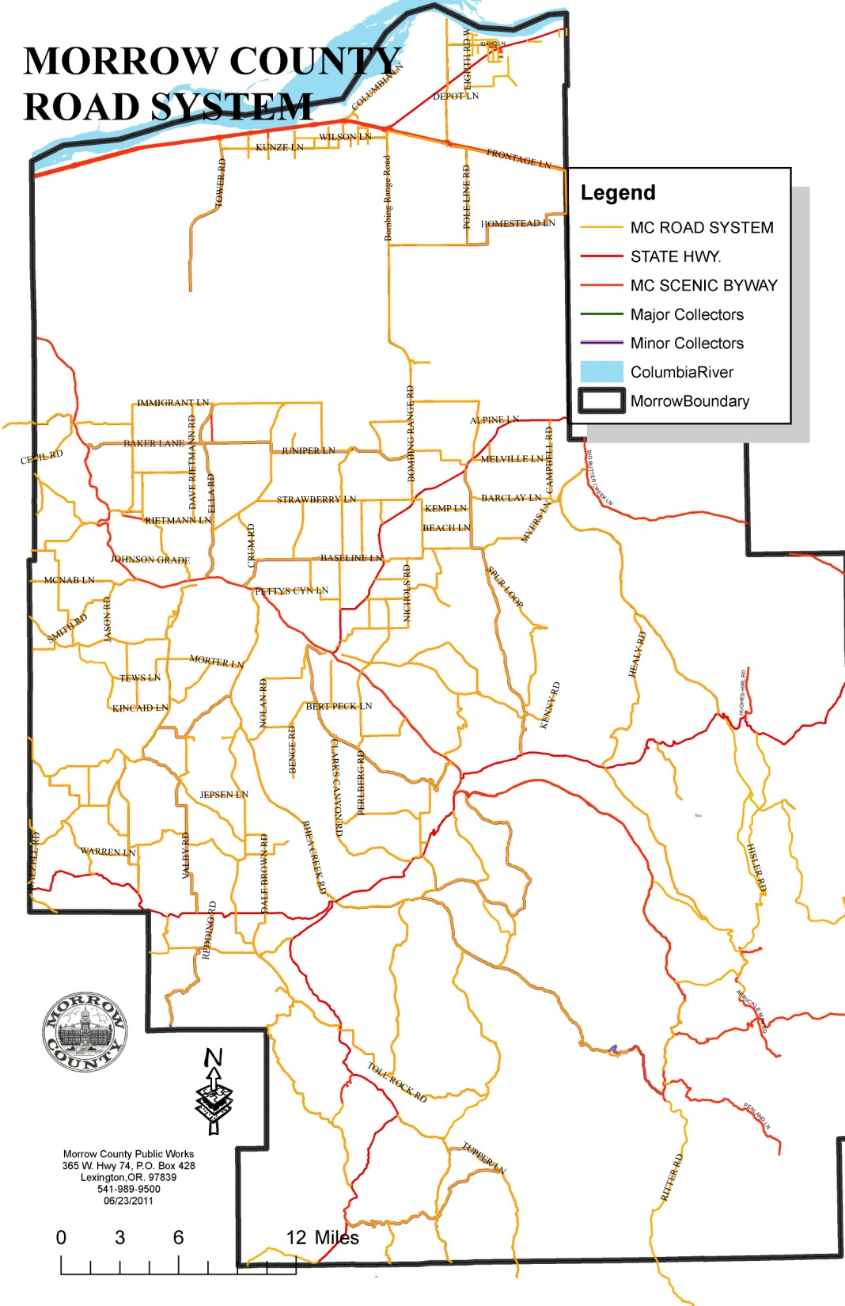
IONE-GOOSEBERRY Project 6.5 miles

Slide 5
Asphalt overlay VS. Reclaim and Chip seal
Asphalt overlay of 6.5 miles of 24’ road
10,296 tons @ $62.50 (2015 pricing)
$643,500.00
Trucking would have been 1 ½ hours
One way from the plant. Estimated 575 tons per day. Would be 18 days of hauling to this project.
Same project at 2016 pricing would be
$ 548,262.00

Slide 6
Reclaim with D6 and Roller

Slide 7
Reclaimed Product
Large chunks that required multiple workings to get down to a size that was able to blade and compact for a drivable surface.

Slide 8
RM 500

Slide 9
Surface of road was 18’-20’ in width, patching had been done for many years. Severe alligator cracking on outer 4’ of both shoulders. An asphalt overlay would have been wasted dollars on this road.

Slide 15
Very good product, 12” depth of reclaim on average

Slide 16
Poor planning

Slide 18
1/2 mile rebuild of Peterson grade

Slide 19
Grindings

Slide 20
Compacted grindings

Slide 21
Asphalt / Compacted grindings

Slide 22
Timeline: May 2015 – Reclaim roadway *Bladed 3 times as standard gravel road June 6th-7th 2016 – Final grading / Compaction June 8th-9th 2016 - Soil Stabilization July 5th-19th 2016- Chip seal August 8th 2016 – Fog seal

Slide 23
Earthbind applied at .40 shot rate (2nd coat shot rate of .10-.25)

Slide 24
Wet on left / Cured on Right

Slide 25
Cured / loose rock

Slide 26
One month after Earthbind application

Slide 27
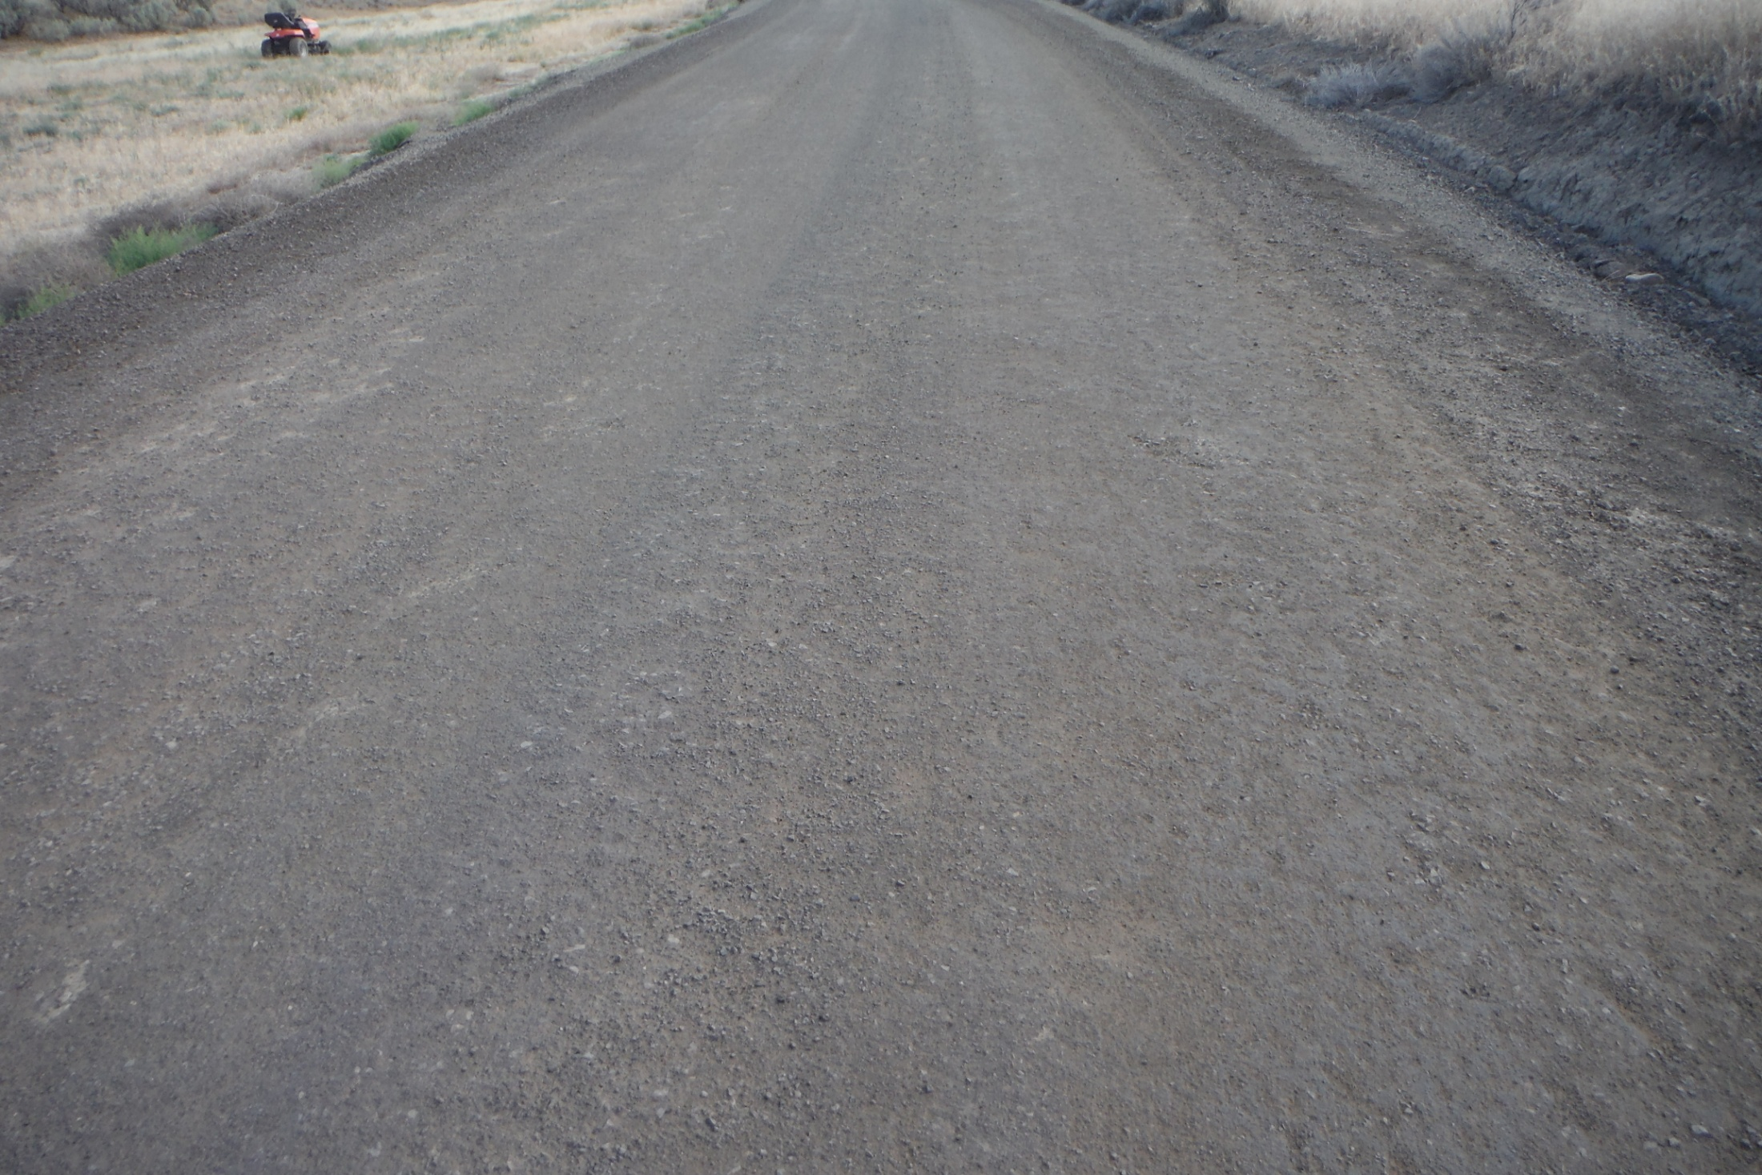

Slide 28
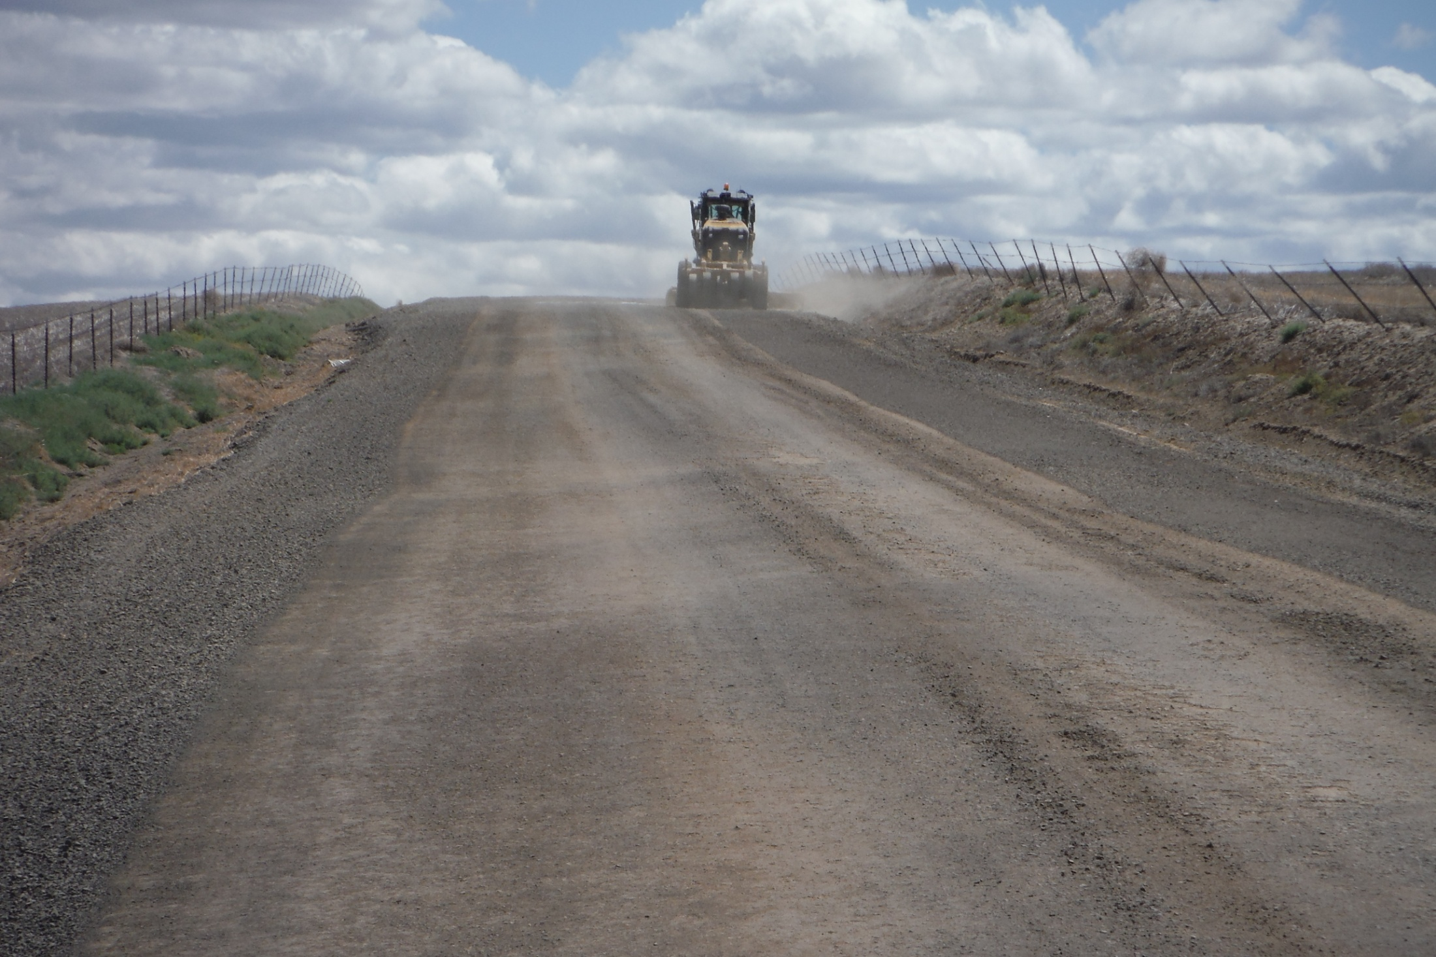

Slide 29
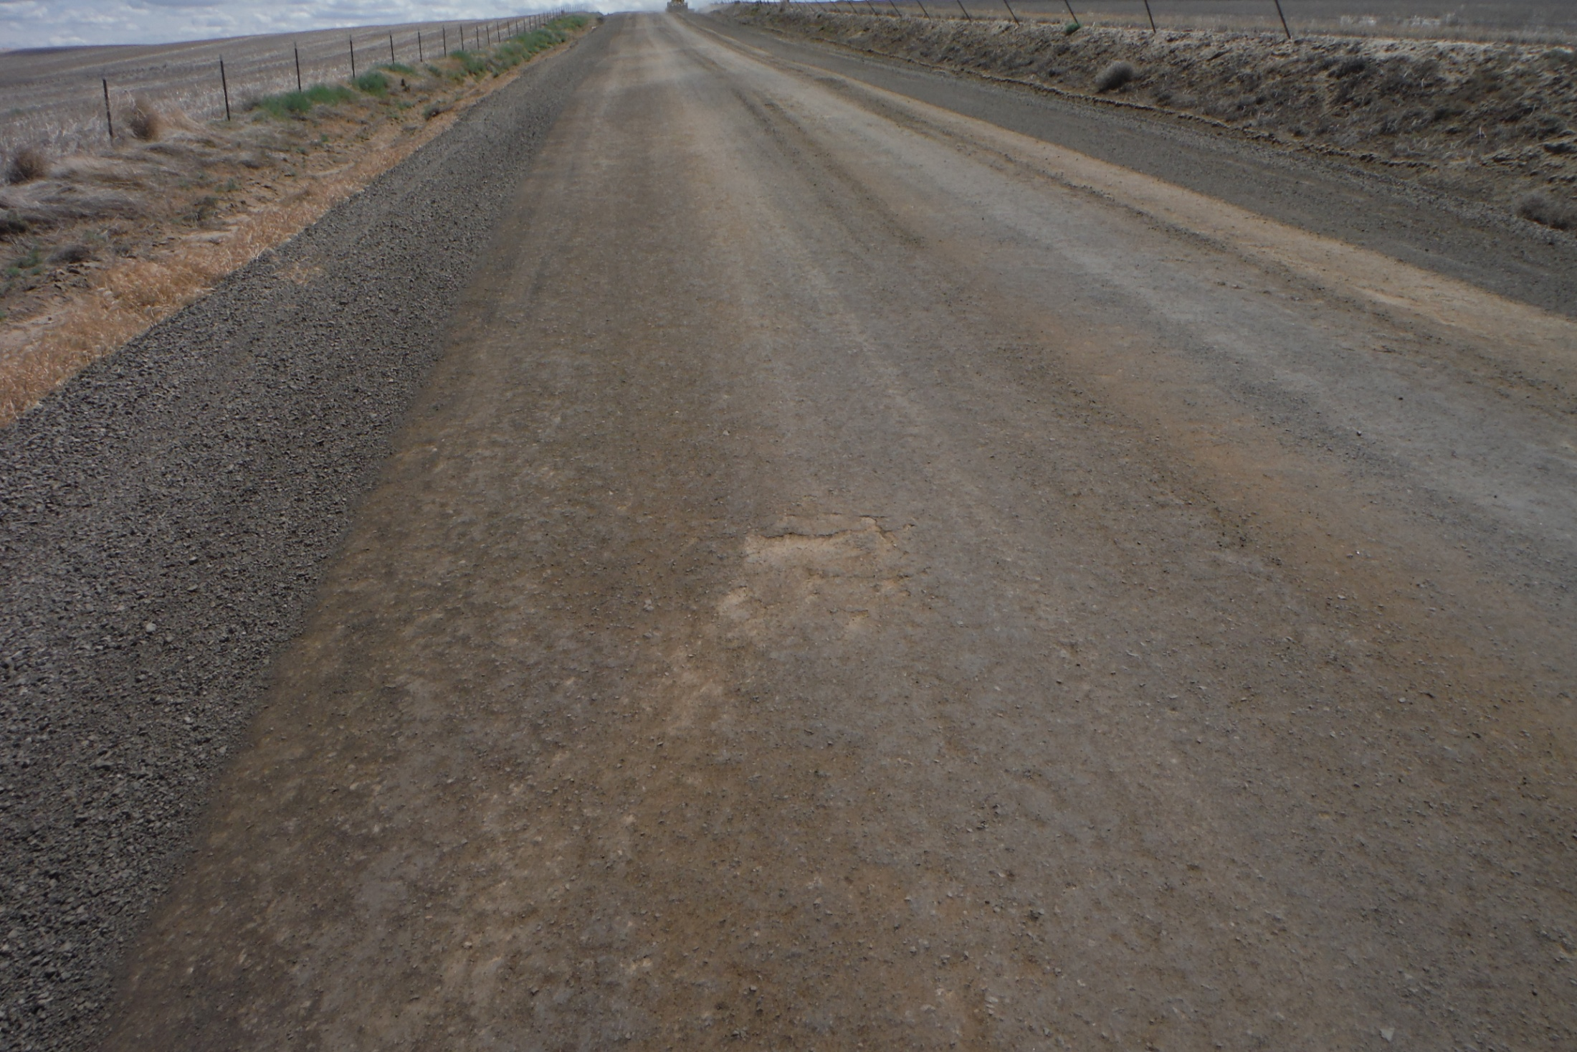

Slide 30
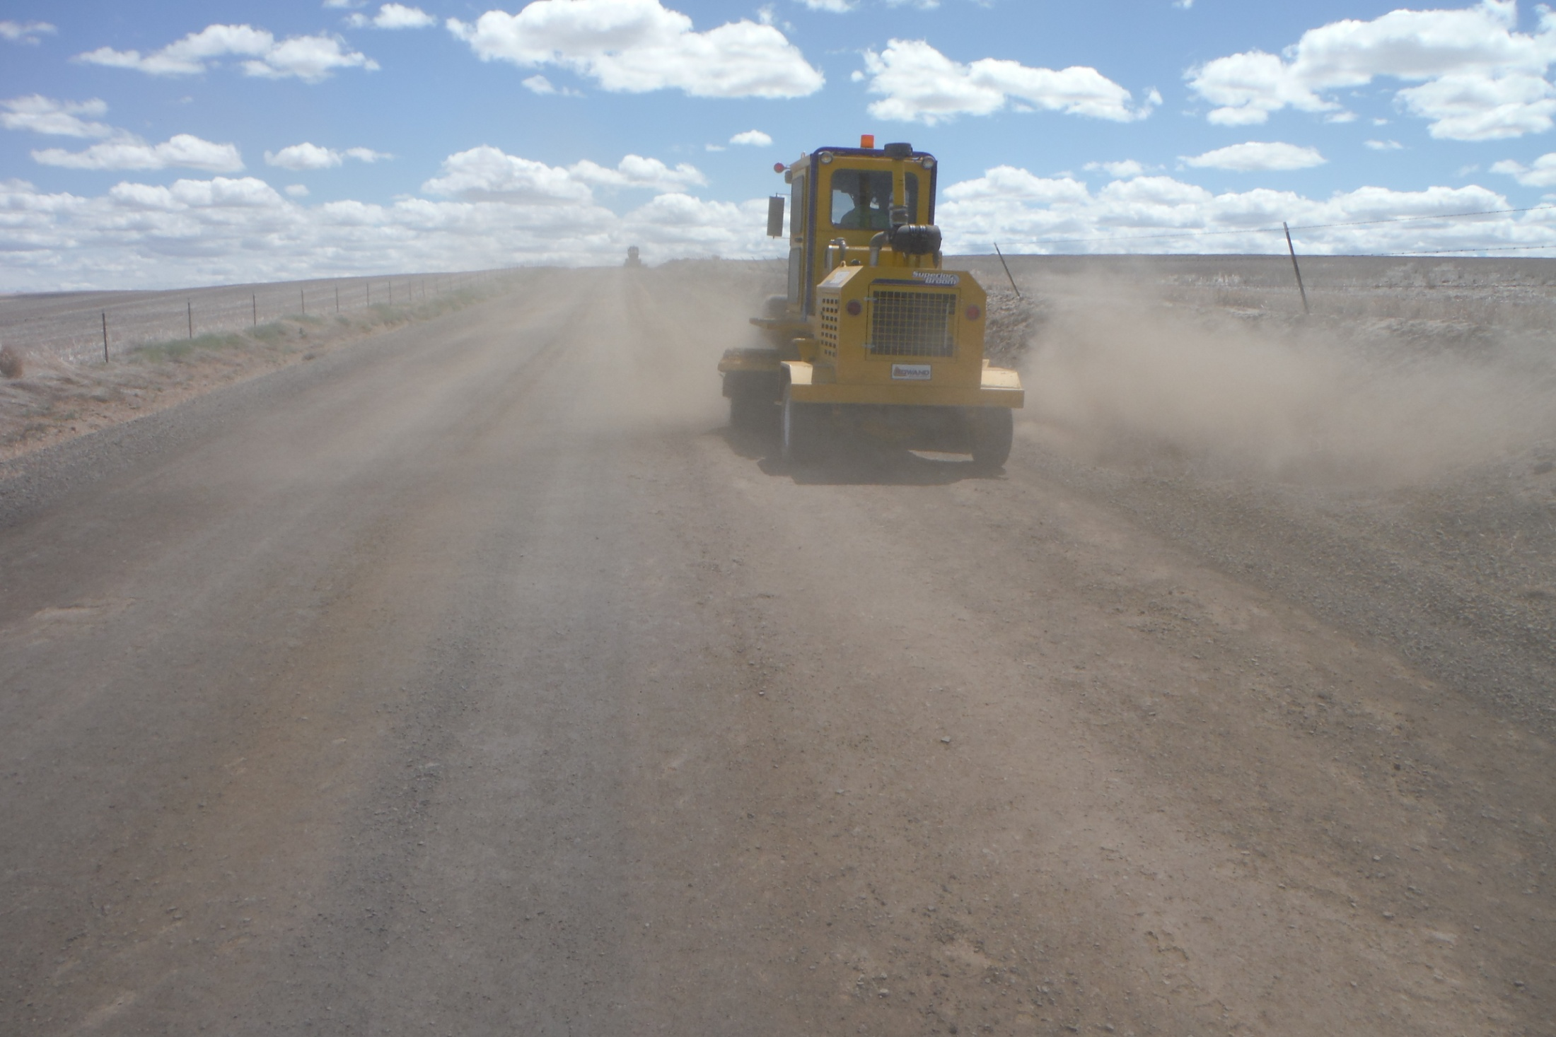

Slide 31
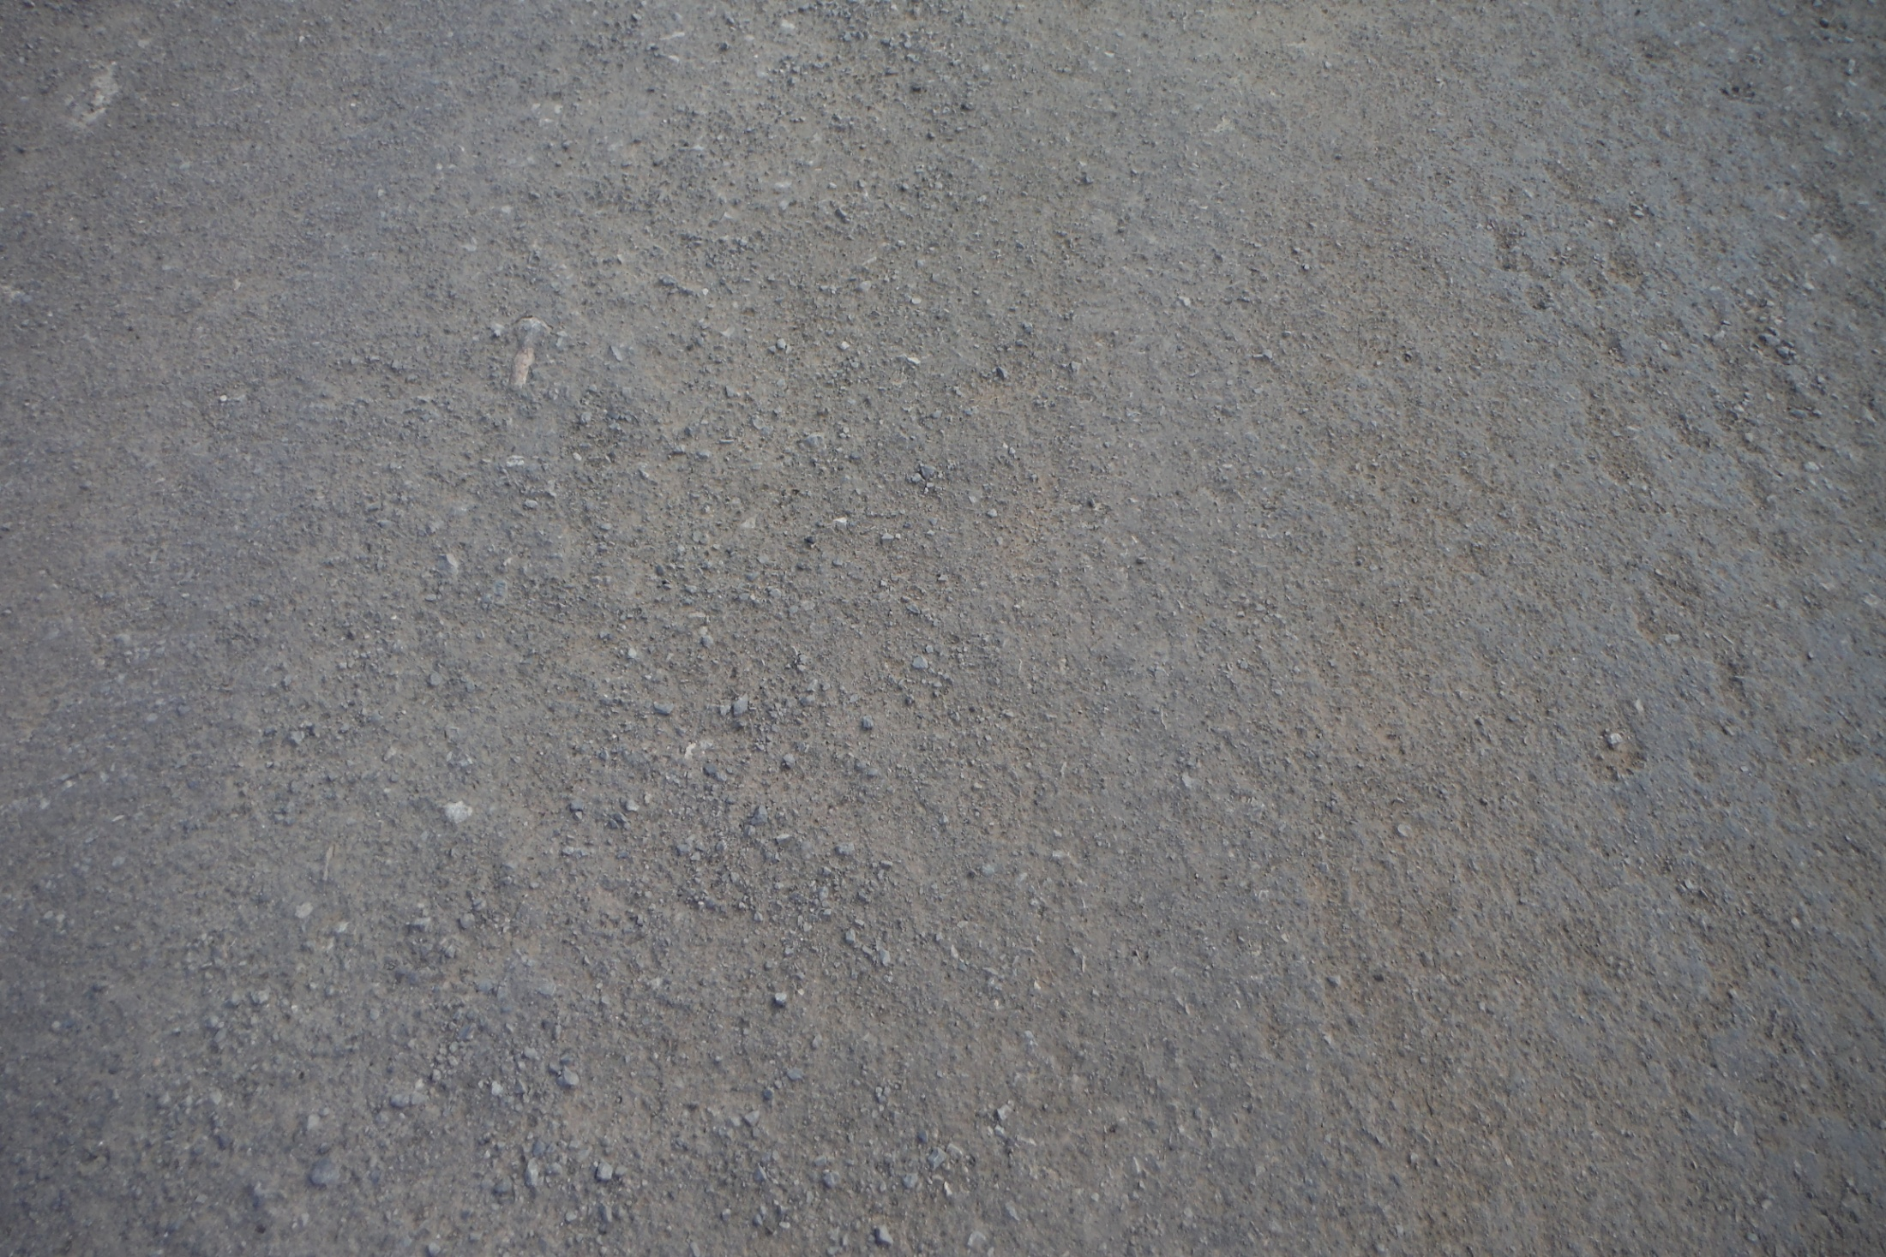

Slide 32
First lift of chip seal ½” – ¾” rock & CRS 2PE oil at .60 shot rate

Slide 33
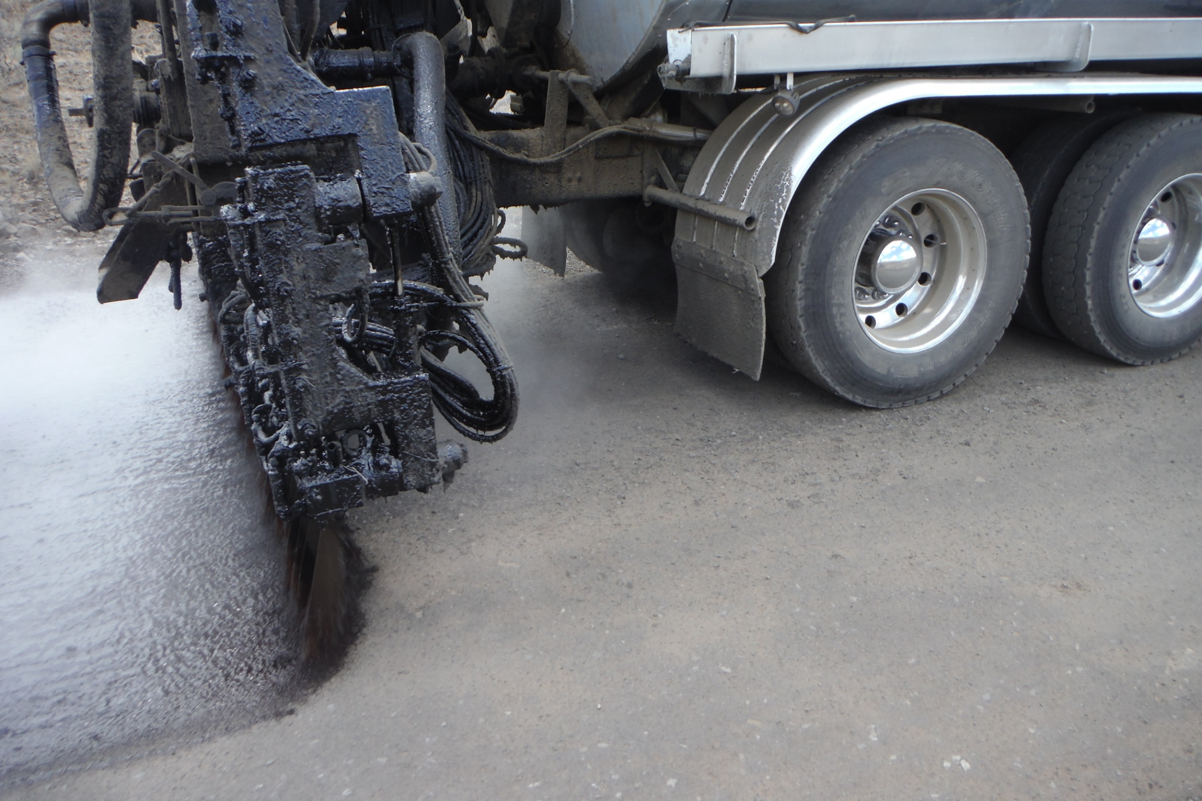

Slide 34
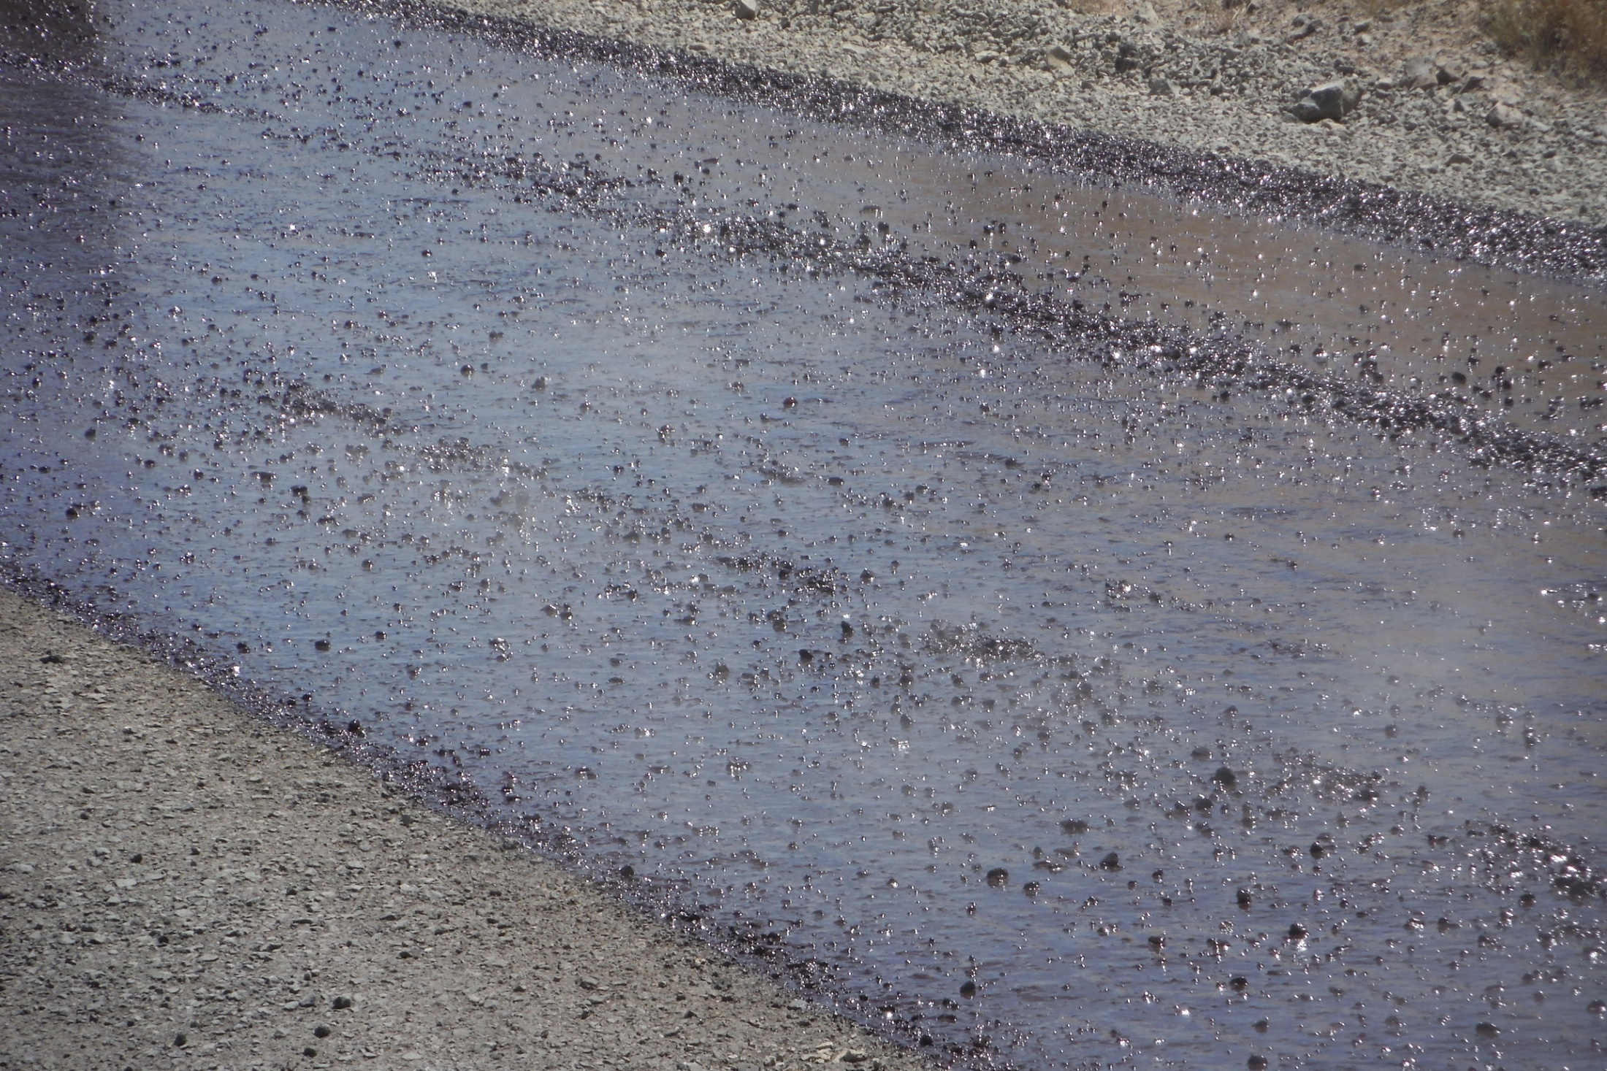

Slide 35
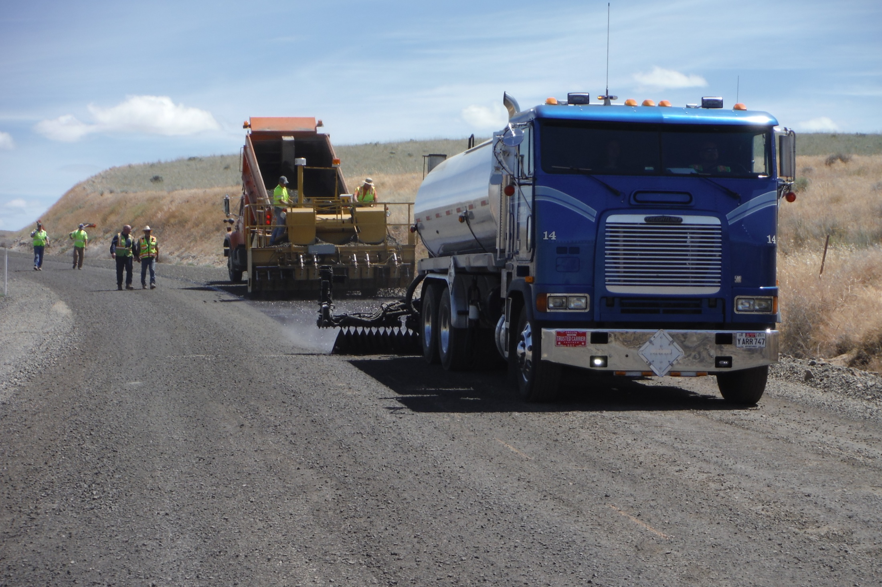

Slide 36
1ST LIFT

Slide 39
Broom loose rock before 2nd lift

Slide 40
1st lift sweeping

Slide 41
¼” - 1/2” rock & CRS 2PE oil at .54 shot rate 2nd lift

Slide 43
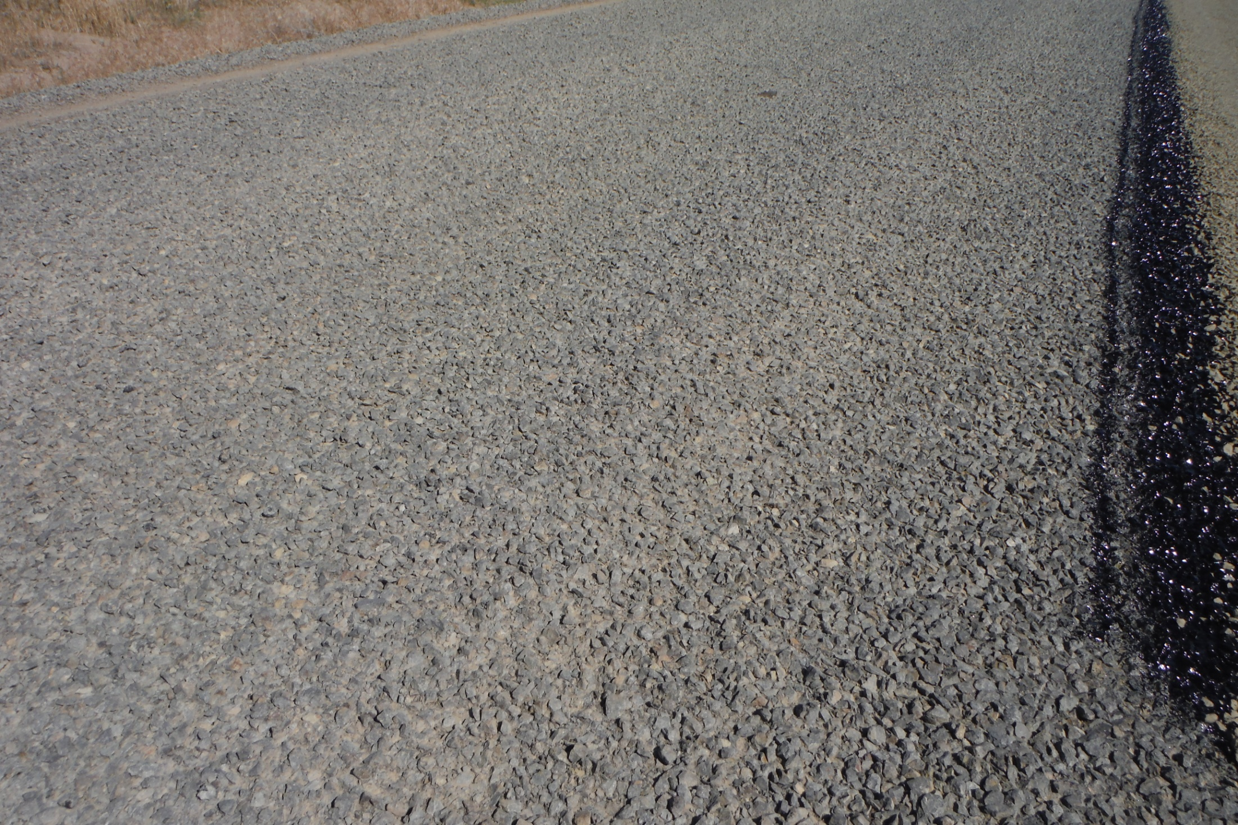

Slide 44
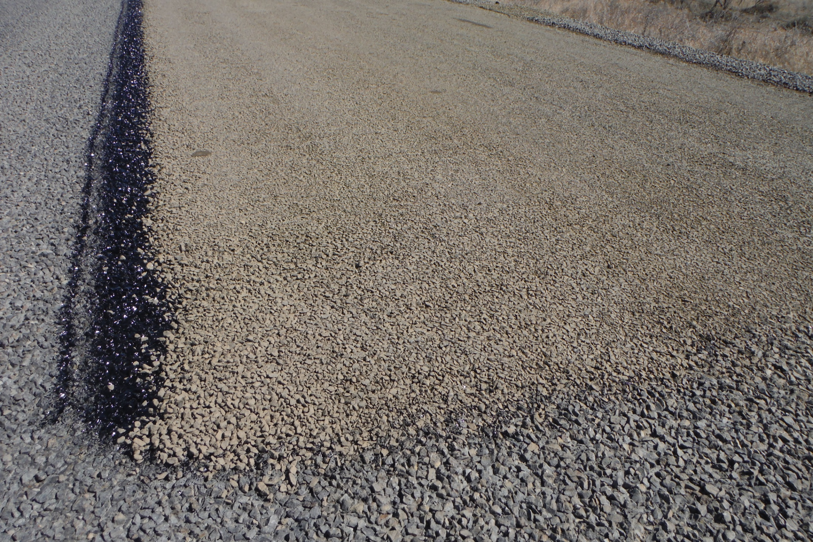

Slide 45
Sandi

Slide 46
Final sweeping before fog seal

Slide 47
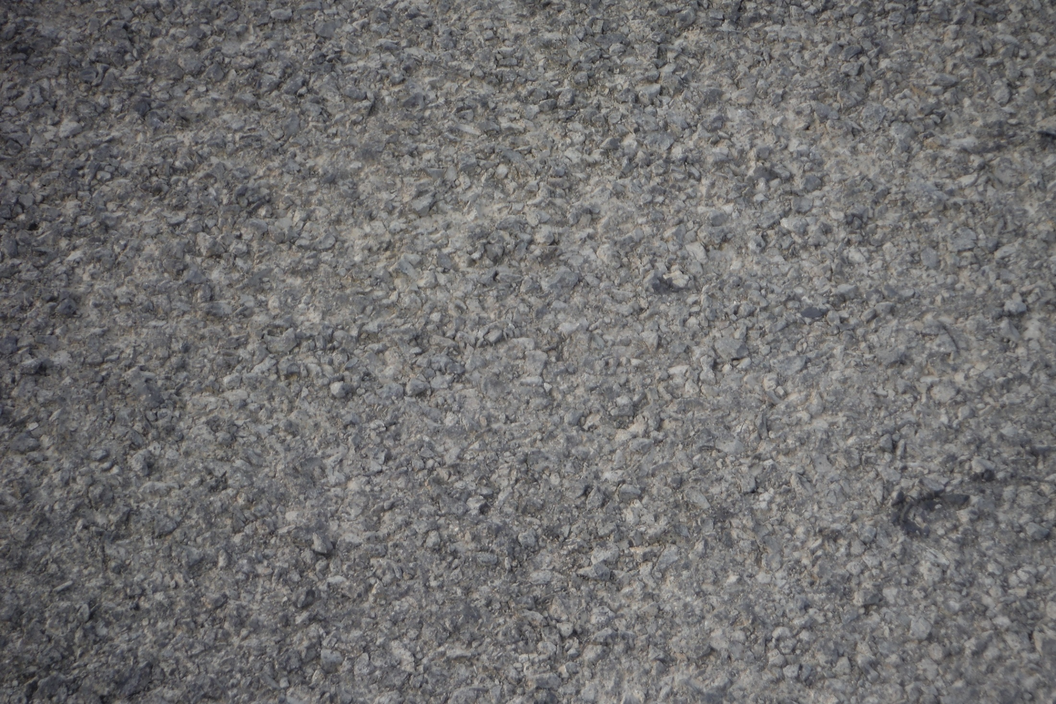

Slide 48
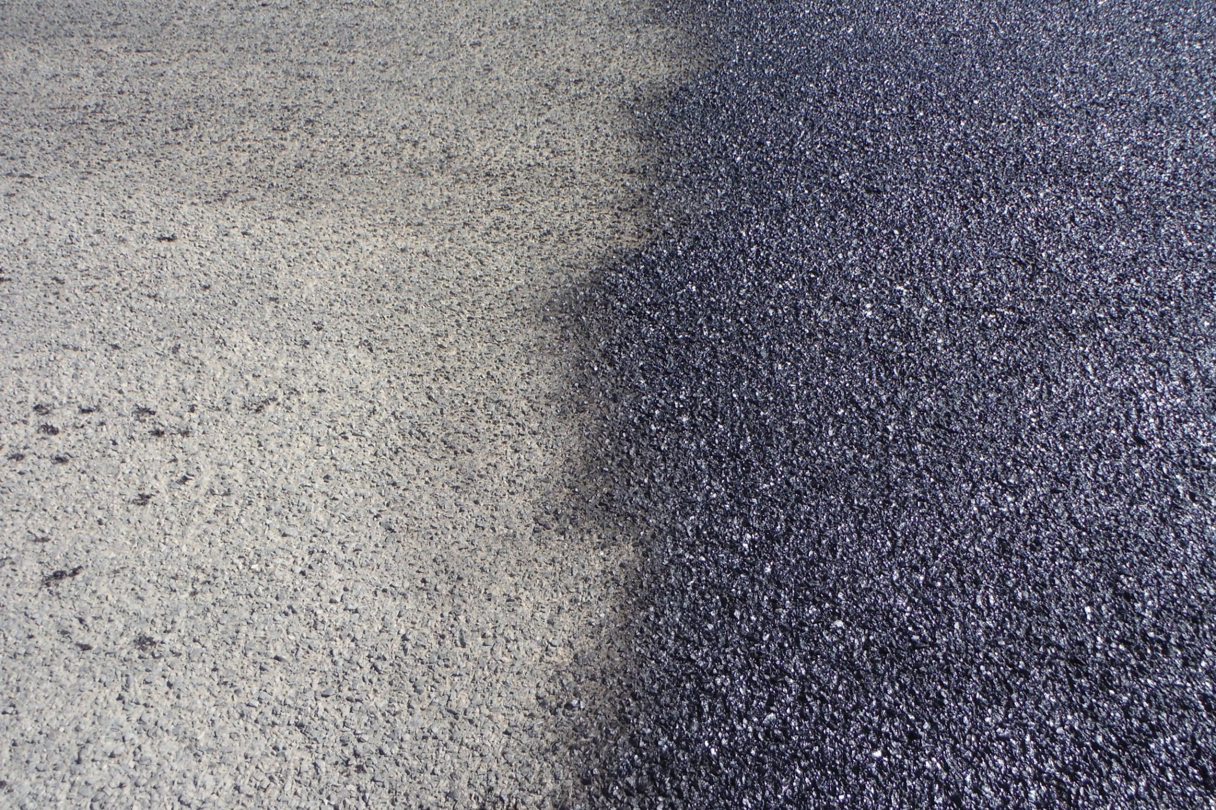

Slide 49
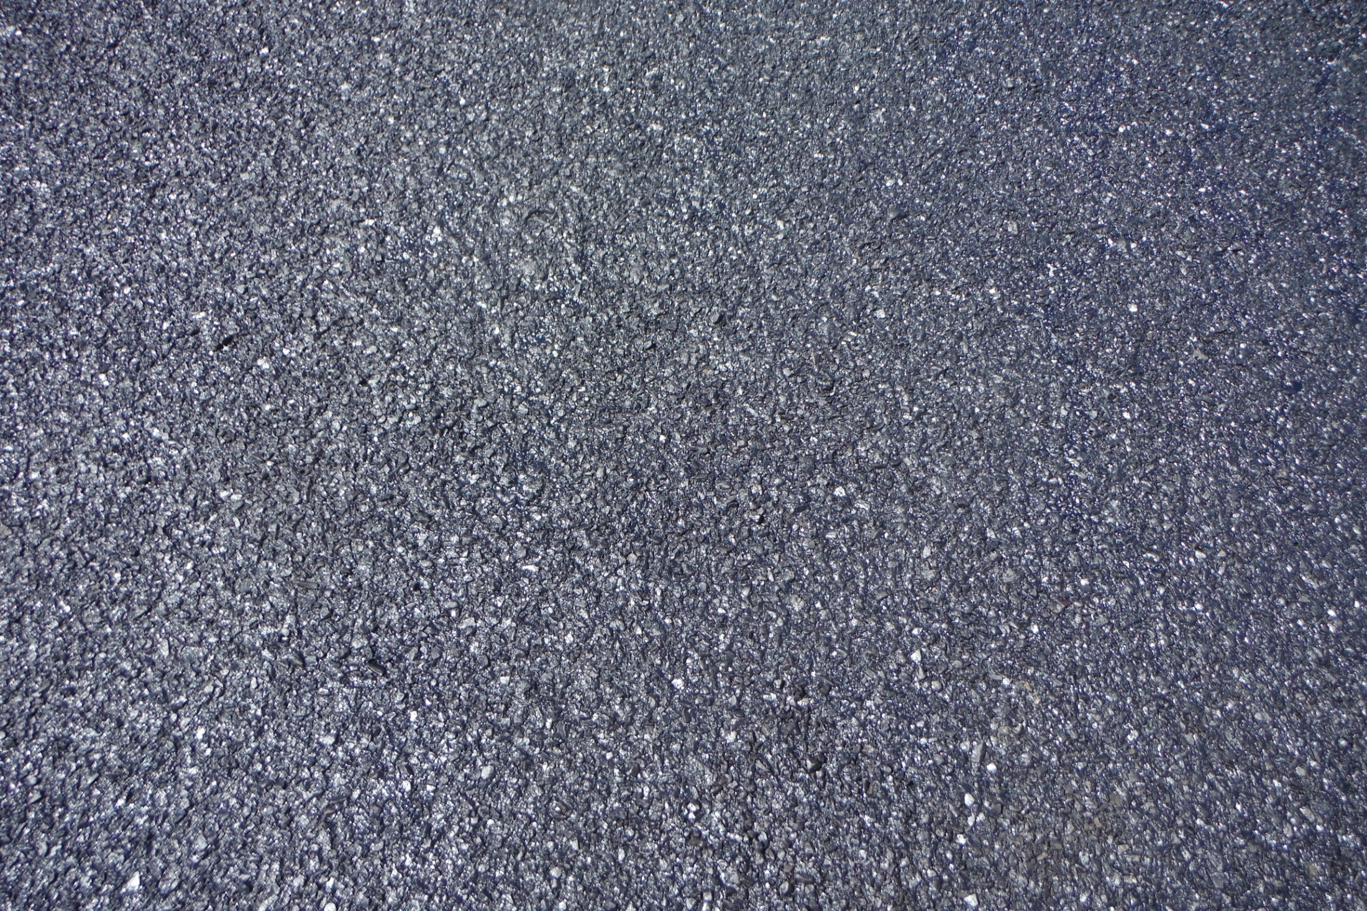
Earthbind fog seal @ .12 shot rate

Slide 50
Dirt pockets / Fog seal lifting

Slide 51
Total oil cost for Project
Earthbind (Soil Stabalization)
.50 shot rate of solution $ 36,742.93
CRS 2PE (1st lift / ¾-1/2 rock)
.60 shot rate $ 100,098.60
CRS 2PE (2nd lift / ½-1/4 rock)
.54 shot rate $ 90,085.80
Earthbind (Fog seal)
.12 shot rate $ 12,868.20
Total project cost $ 239,795.53

Slide 52
Cost comparison

Slide 53
Carlson lane / Ione-Gooseberry intersection
Before
After

Slide 54
Peterson Grade
Before
After

Slide 55
Dry-fork / Ione-Gooseberry intersection
Before
After

Slide 56
Questions
Matt Scrivner
Assistant Road Master
Morrow County Public Works
mscrivner@co.morrow.or.us
541-989-8584
Burke O’Brien
Public Works Director
Morrow County Public Works
bobrien@co.morrow.or.us
541-989-8317
Troy Tindall
Blue Line Transportation
troy@bluelinetrans.com
503-702-1236

