Slide 1
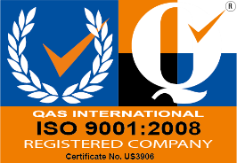
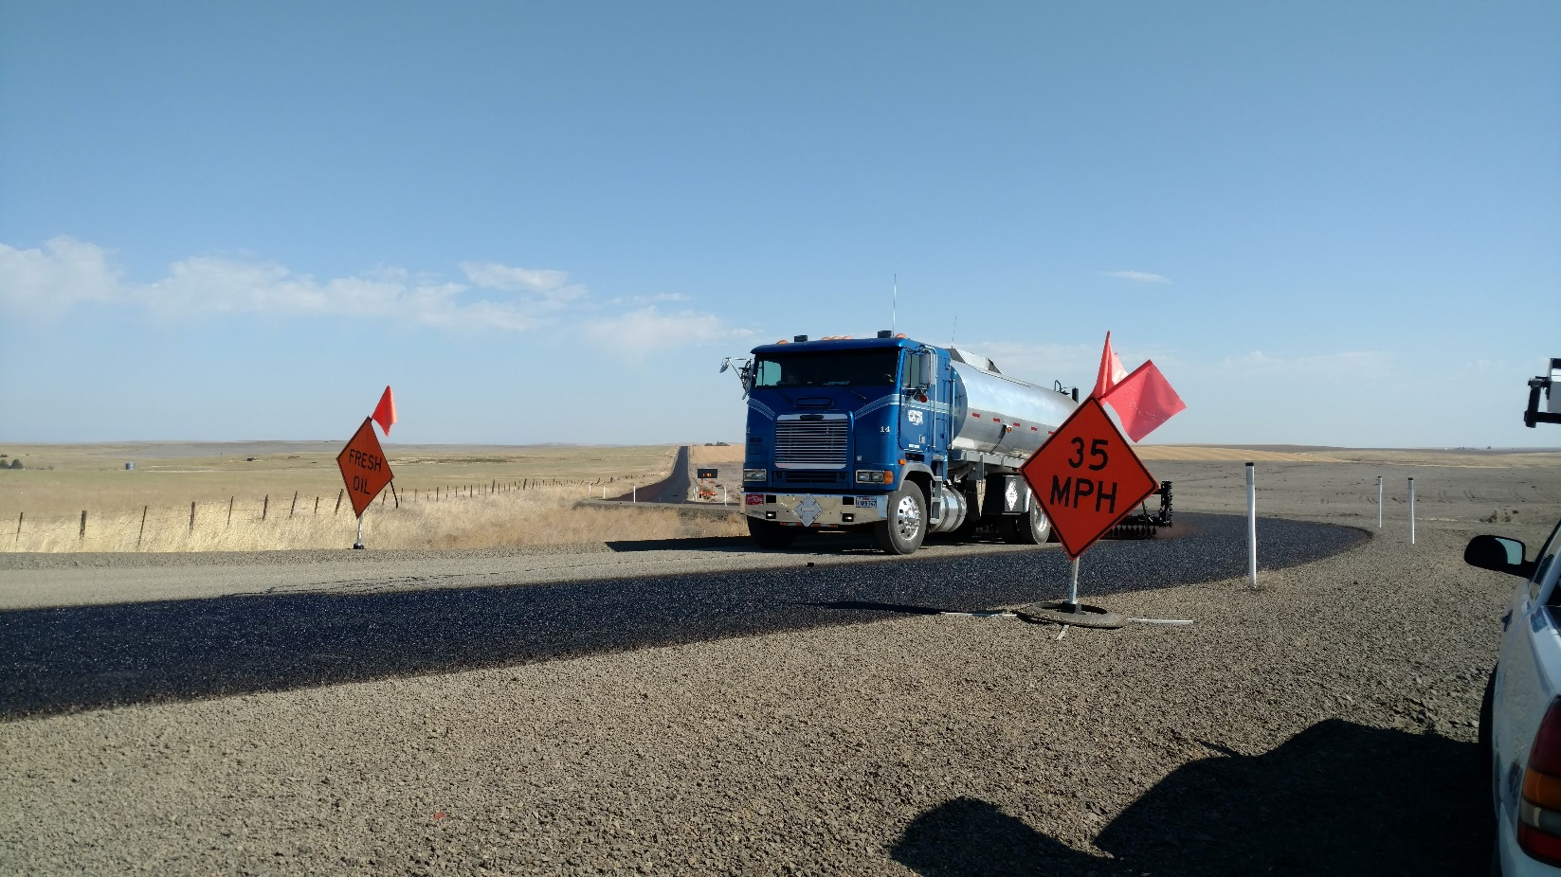
EarthBind™ Rejuvenating bonding coat
L.L.C.
2606 North Newark Street, Portland Oregon 97217 ® 2016

Slide 3
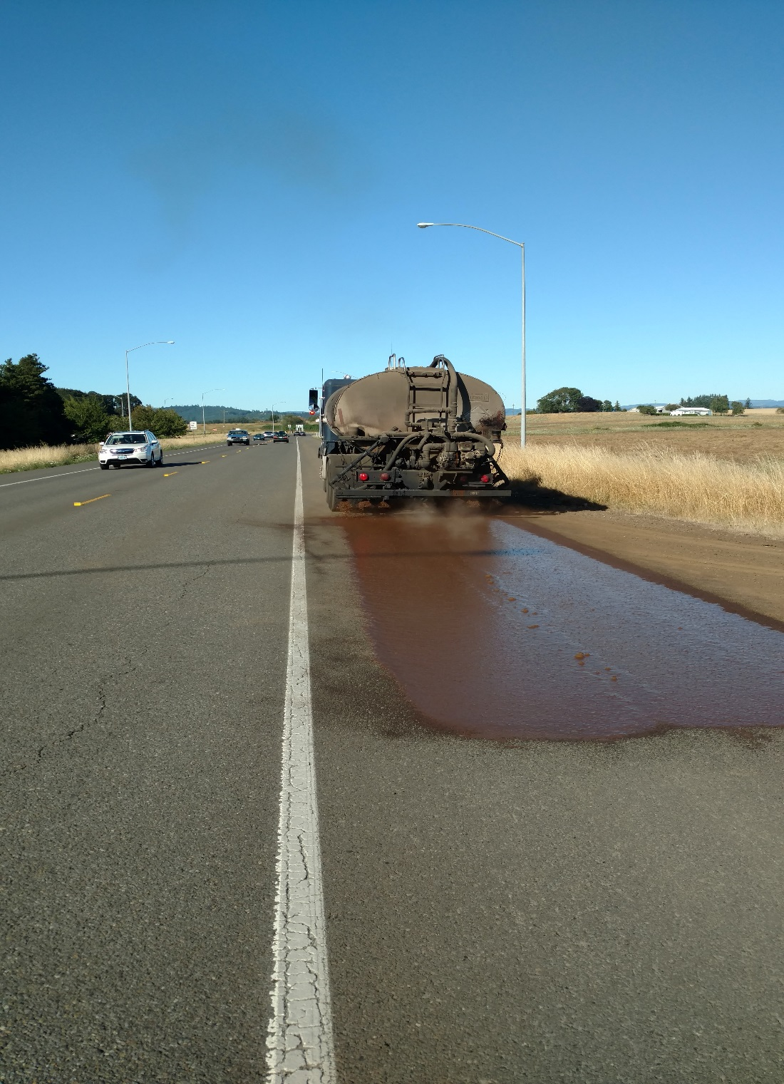

Slide 4
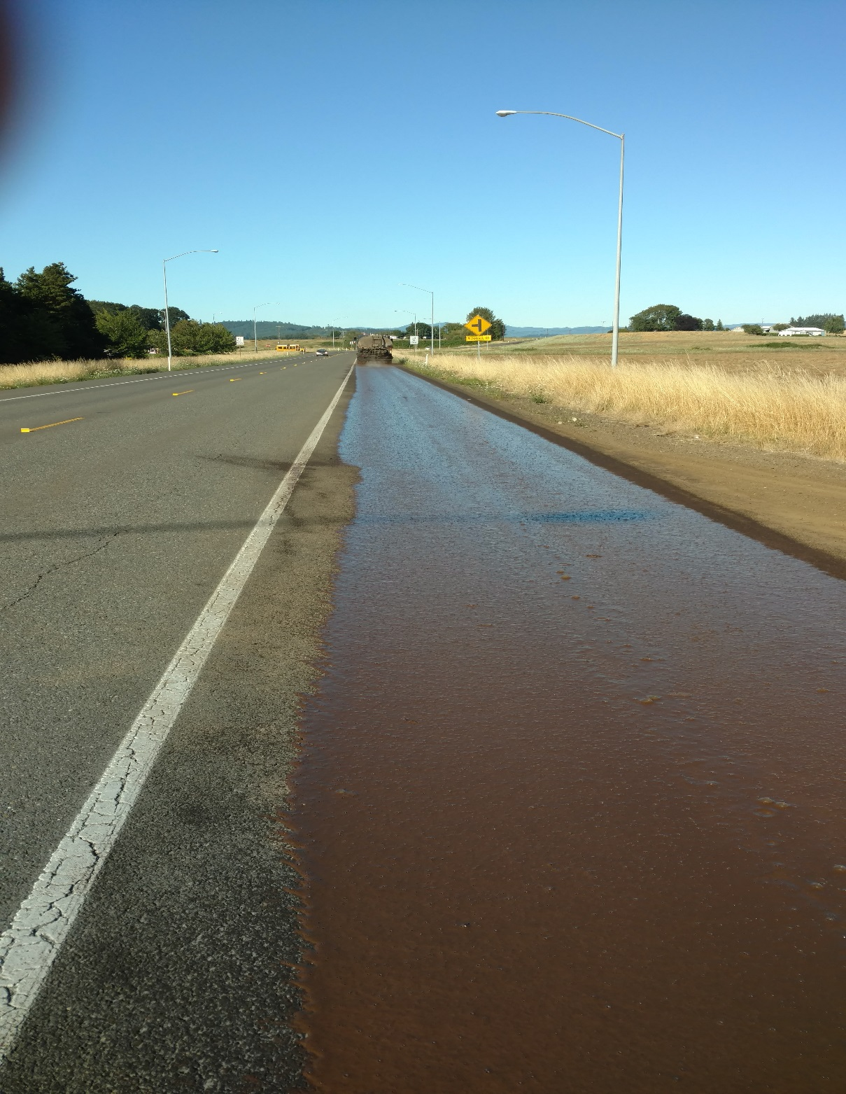

Slide 17
Thank you
QUESTIONS??

