Slide 1

Bike Lane
Maintenance Treatments
Deschutes County Road Department
2016 OACES CHIP SEAL WORKSHOP
December 07, 2016
Chris Doty, Director
Tom Shamberger, Operations Division Manager

Slide 2

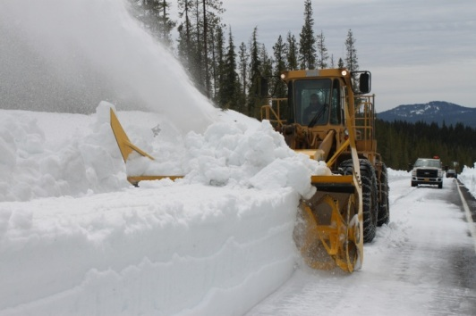
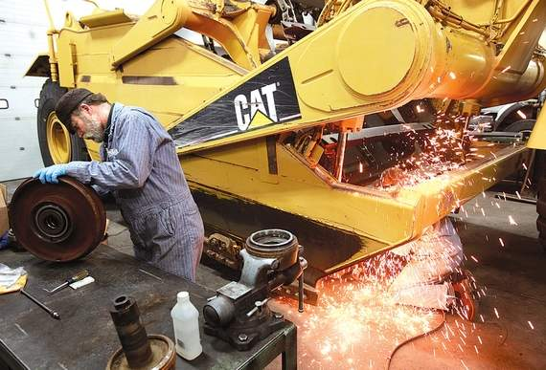
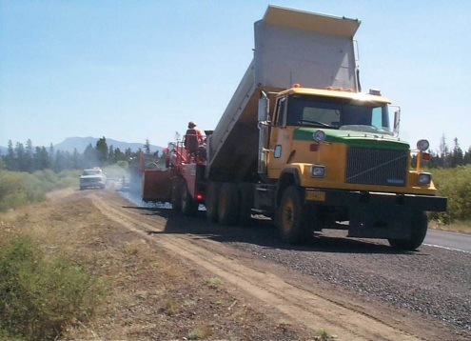
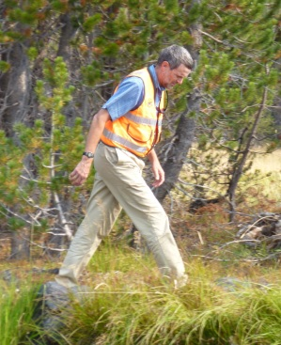
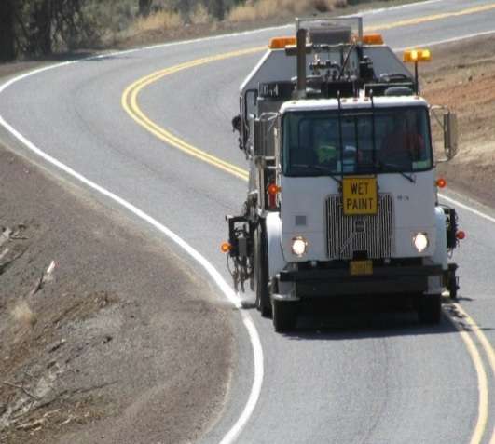
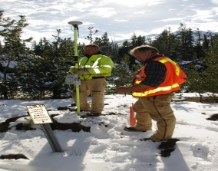
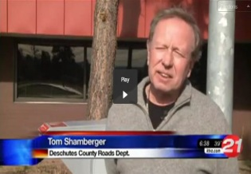
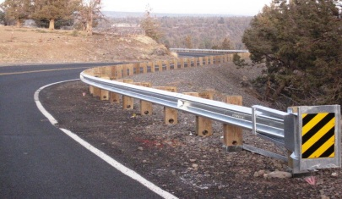
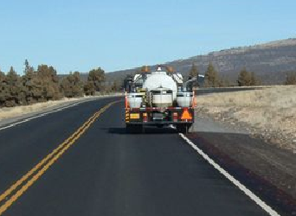

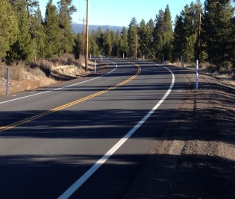
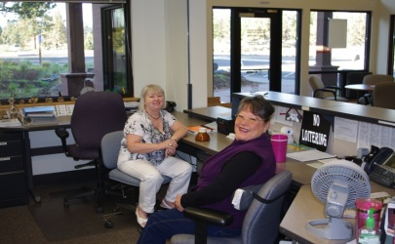
Road Department
Mission Statement
  We strive to maintain the quality and improve the experience for all users of the Deschutes County transportation system.

Slide 3
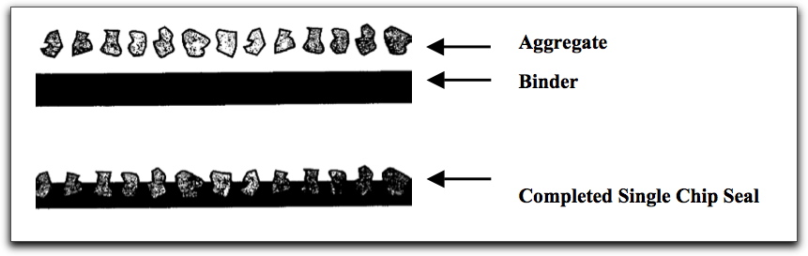
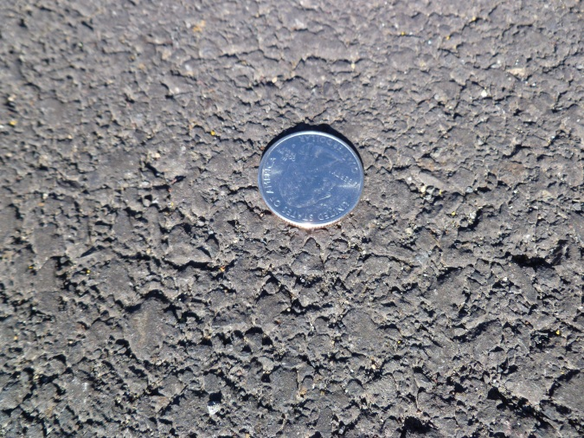
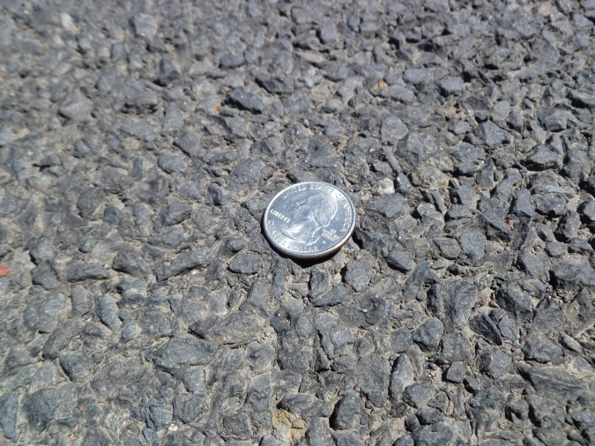
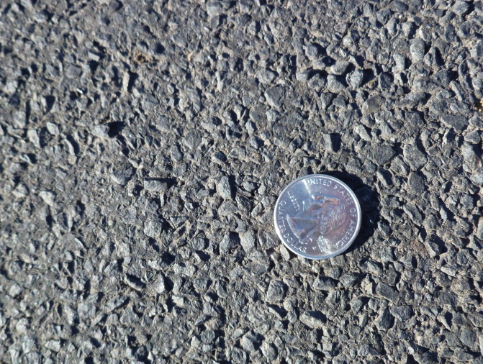
Cross-section of a Chip Seal
New Asphalt
3/8” Coated Chip Seal
1/4” Coated Chip Seal

Slide 4
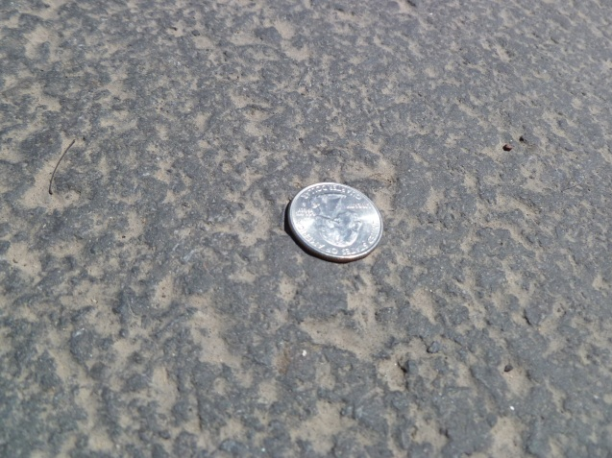

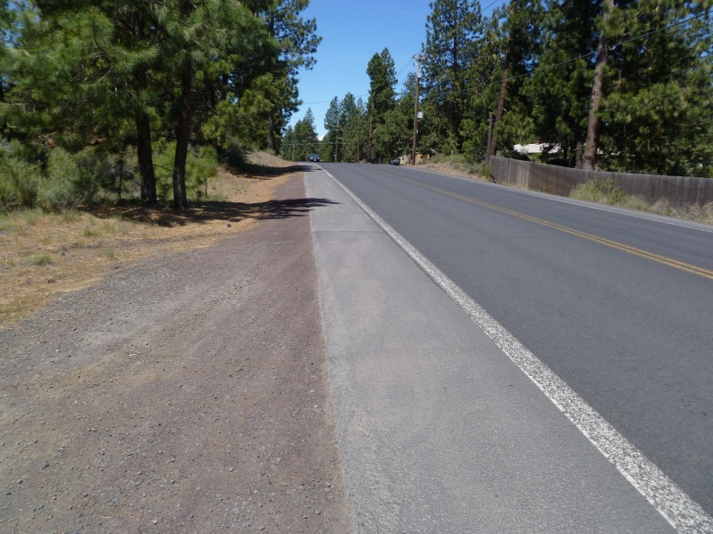
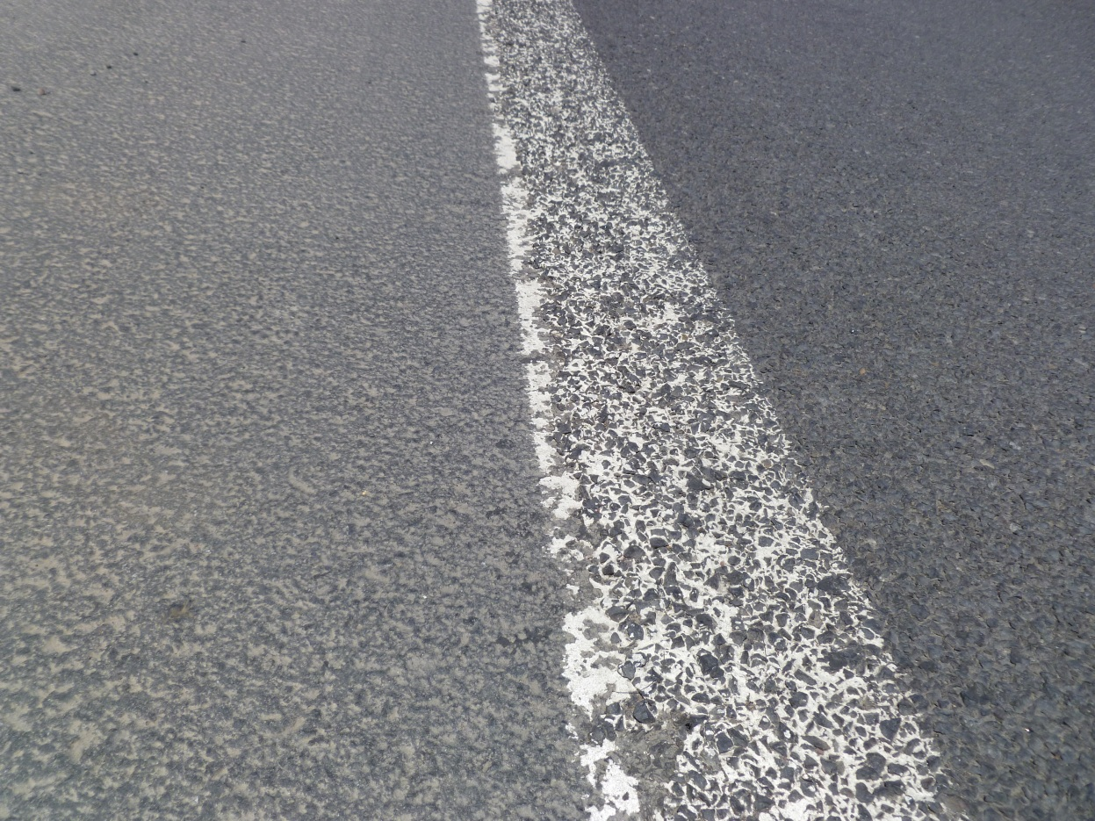
Past trial effort:
Use of seal coat in bike lane
Baker Road, SE Bend Area
Carbon Seal®
Bike Lane
3/8” Chip Seal
Travel Lane
FY 11/12
Baker Road/China Hat Rd
Camp Polk Road
FY 12/13
Deschutes Market Road
Knott Road
Butler Market Road
FY 13/14
Old Bend Redmond Highway

Slide 5
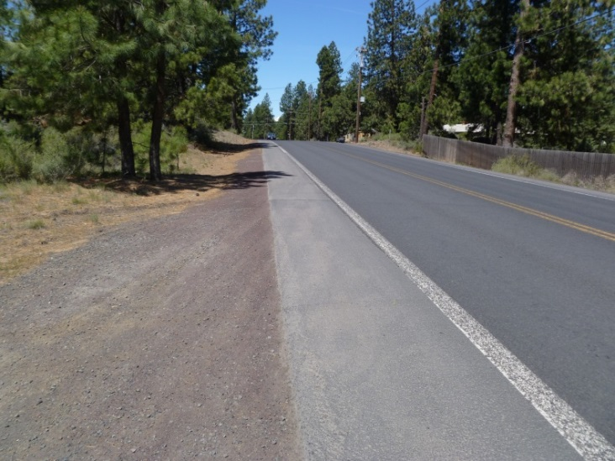
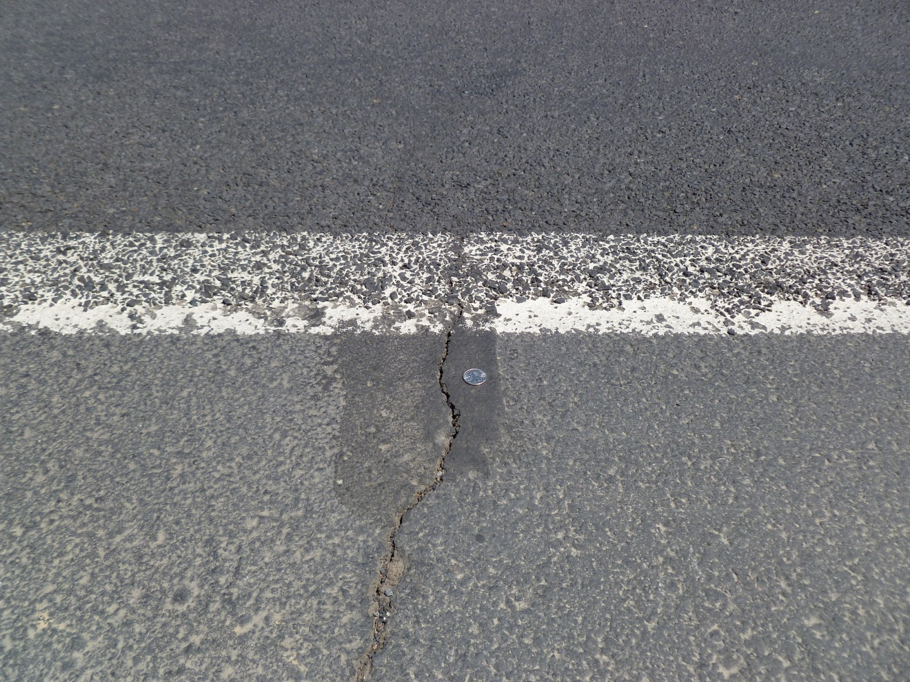
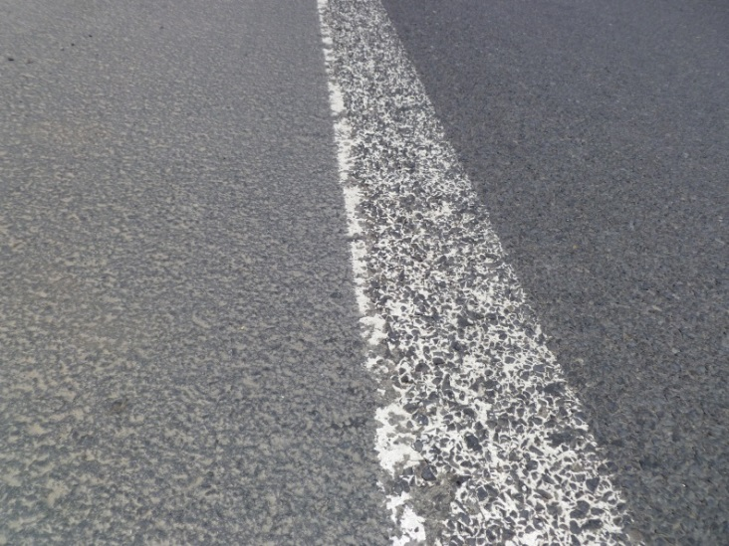
Deschutes County use of seal coat in bike lane
3/8” Chip Seal
Carbon Seal®

Slide 6
Current Bike Lane
Maintenance Practices
  1. Install smaller chip rock (1/4” minus) on all facilities with designated bike lanes (or where we can achieve width with lane narrowing on high use cycling routes).
  2. Reduce lane width to 11’ (from 12’+) on all striped facilities (unless high truck volume or existing 5-foot bike lane)

Slide 7
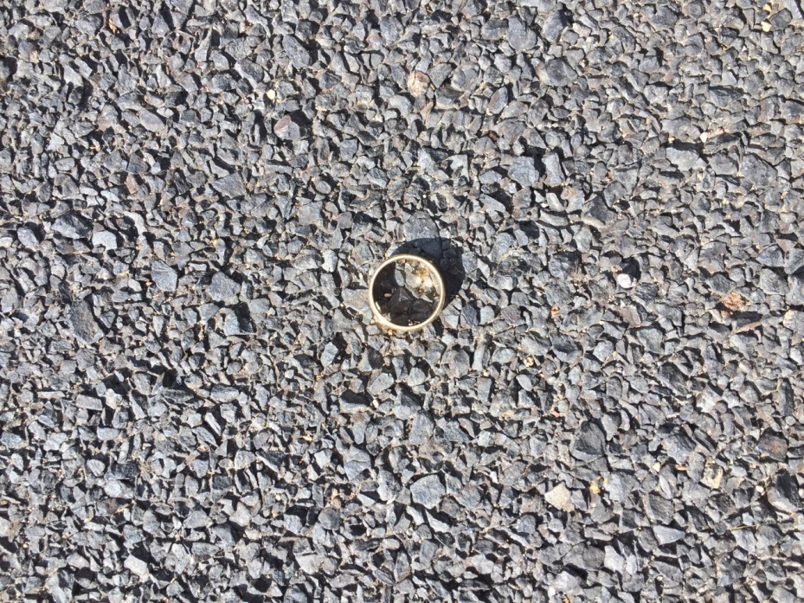
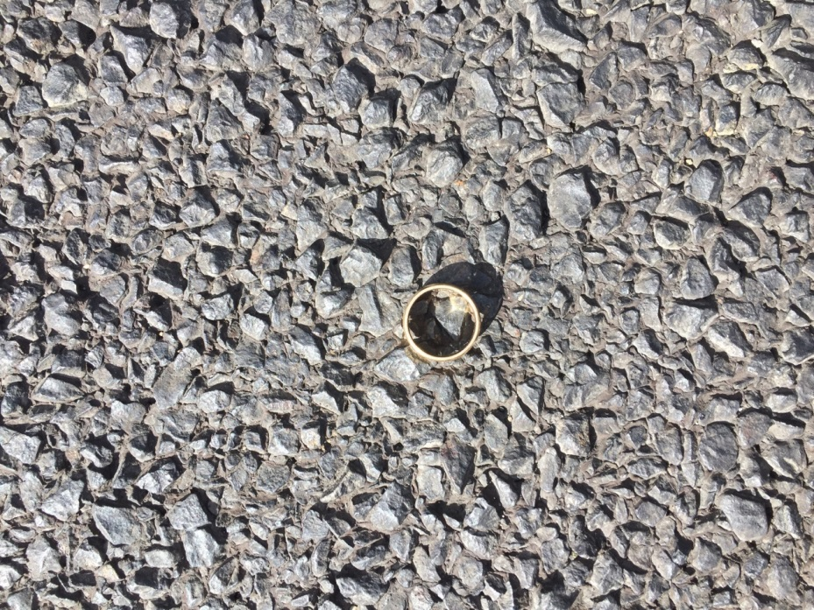
Johnson Road Treatment

Slide 8
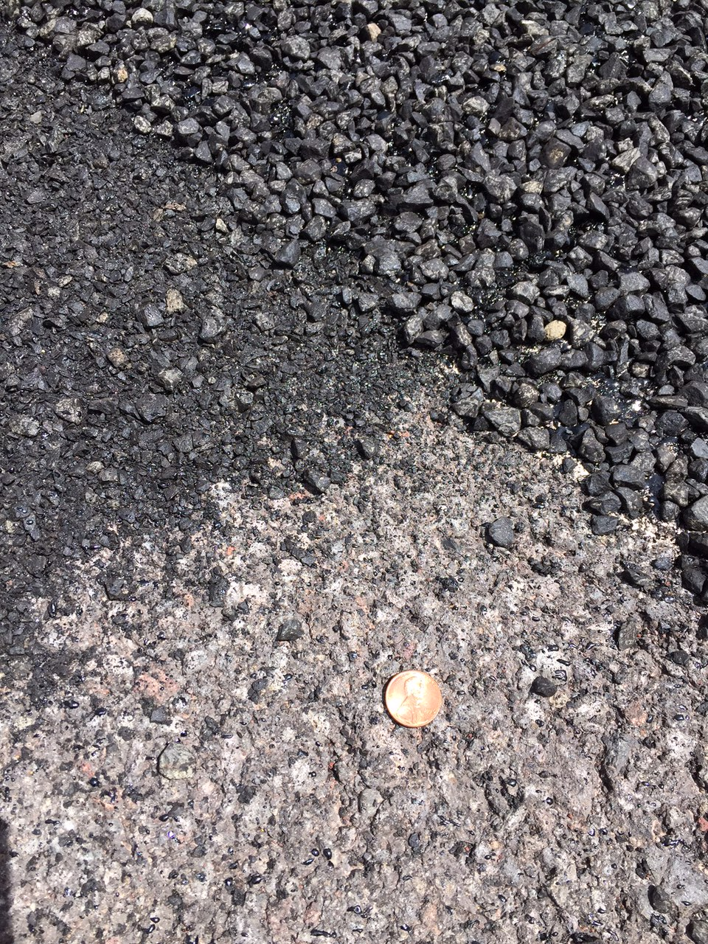
TRAVEL LANE CHIP SEAL
EXISTING ASPHALT
BIKE LANE CHIP SEAL

Slide 9
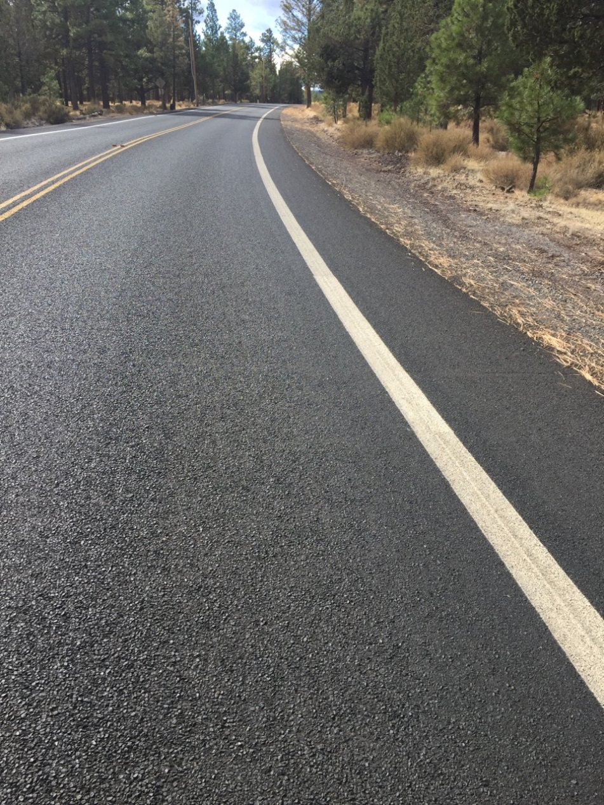
Johnson Road Lane Treatment
with ¼” - #10 chip rock.
3/8-#8
¼-#10

Slide 10
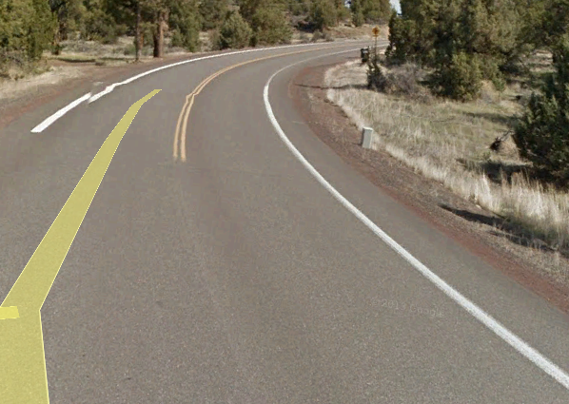
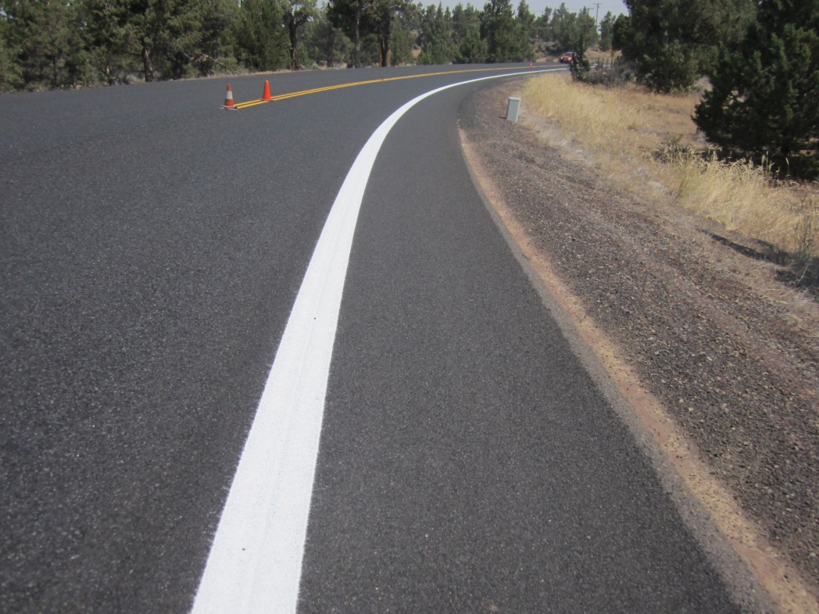
1/4” - #10 bike lane chip adjacent to 3/8” - #8 travel lane chip
3/8-#8
¼-#10
Cline Falls Road: pre chip seal
12’ travel lanes, 3’ shoulder
Cline Falls Road: post chip seal
3/8” chip travel lane
1/4” chip bike lane
11’ travel lanes, 4’ bike lane

Slide 11
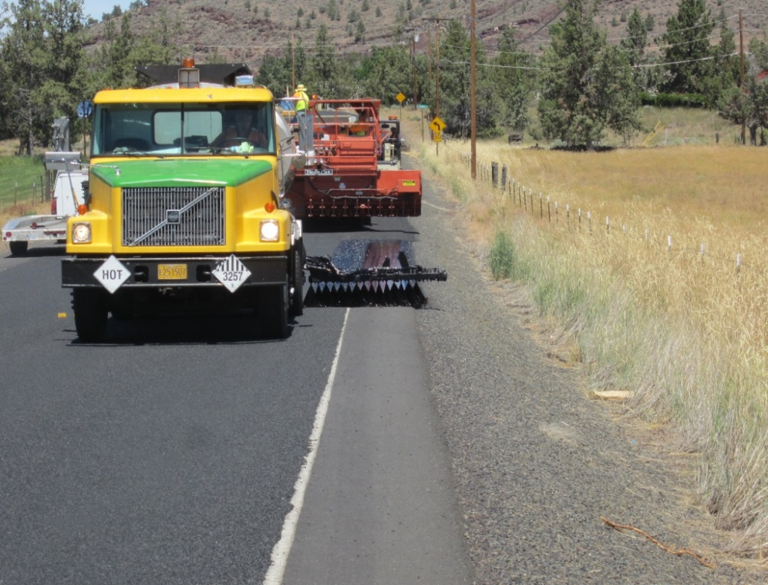
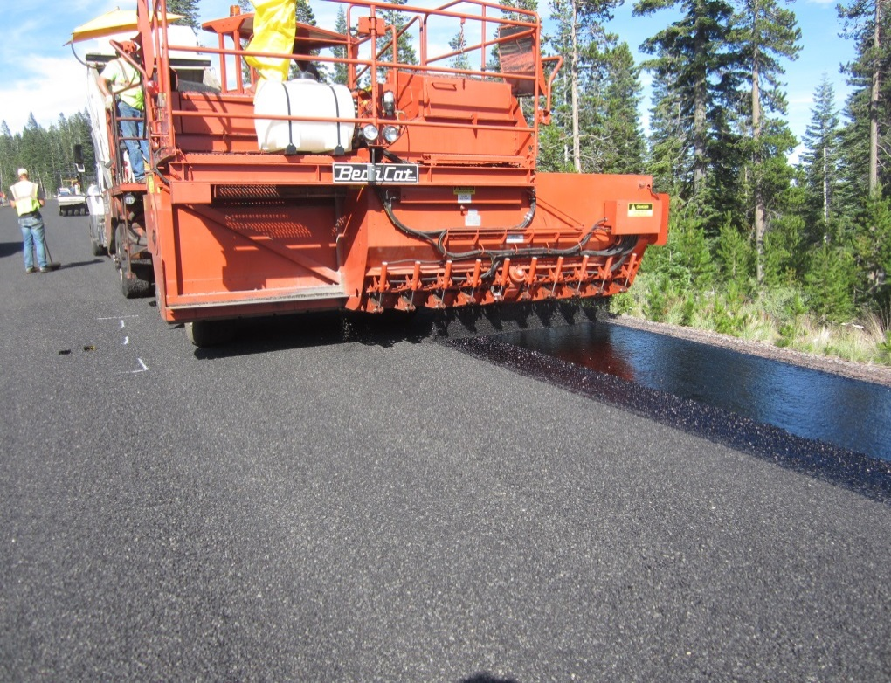
1/4” - #10 bike lane chip adjacent to 3/8” - #8 travel lane chip
¼-#10
  Northwest Way
3/8” chip travel lane
1/4” chip bike lane
11’ travel lanes, 3’ shoulder
River Summit
3/8” chip travel lane
1/4” chip bike lane
11’ travel lanes, 4’ bike lane

Slide 12
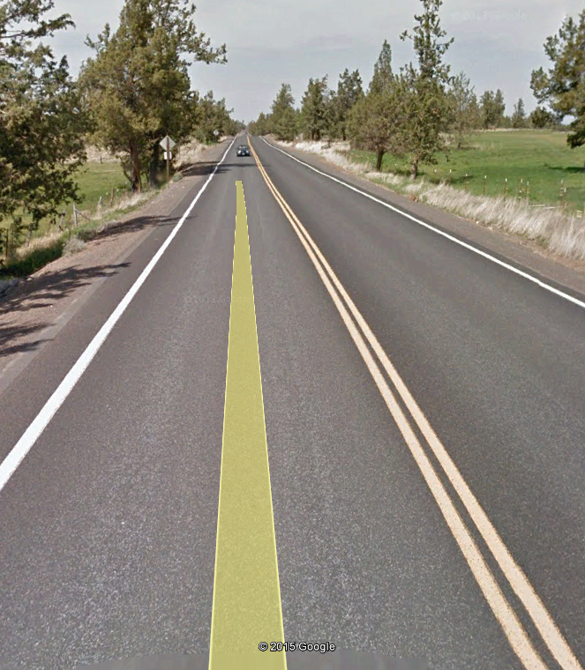
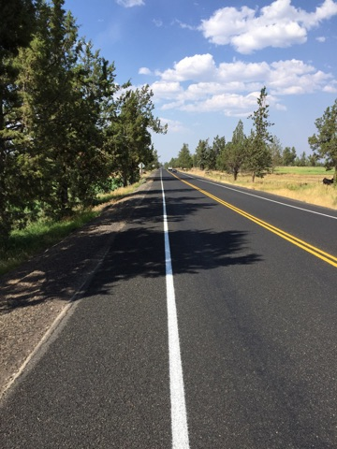
Pre Lane Width Adjustment
Powell Butte Highway
Post Lane Width Adjustment
Powell Butte Highway

Slide 13
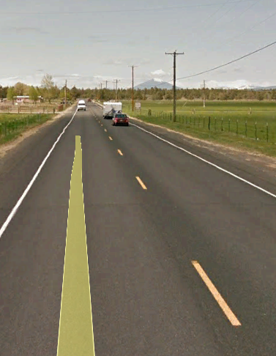
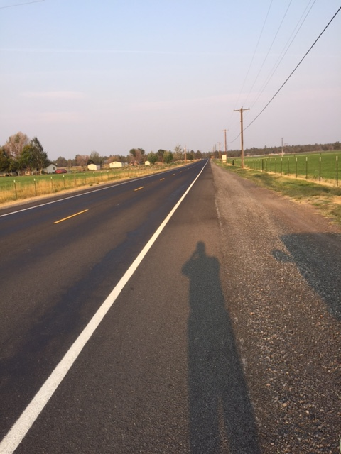
Pre Lane Width Adjustment
Lower Bridge Road
Post Lane Width Adjustment
Lower Bridge Road

Slide 14
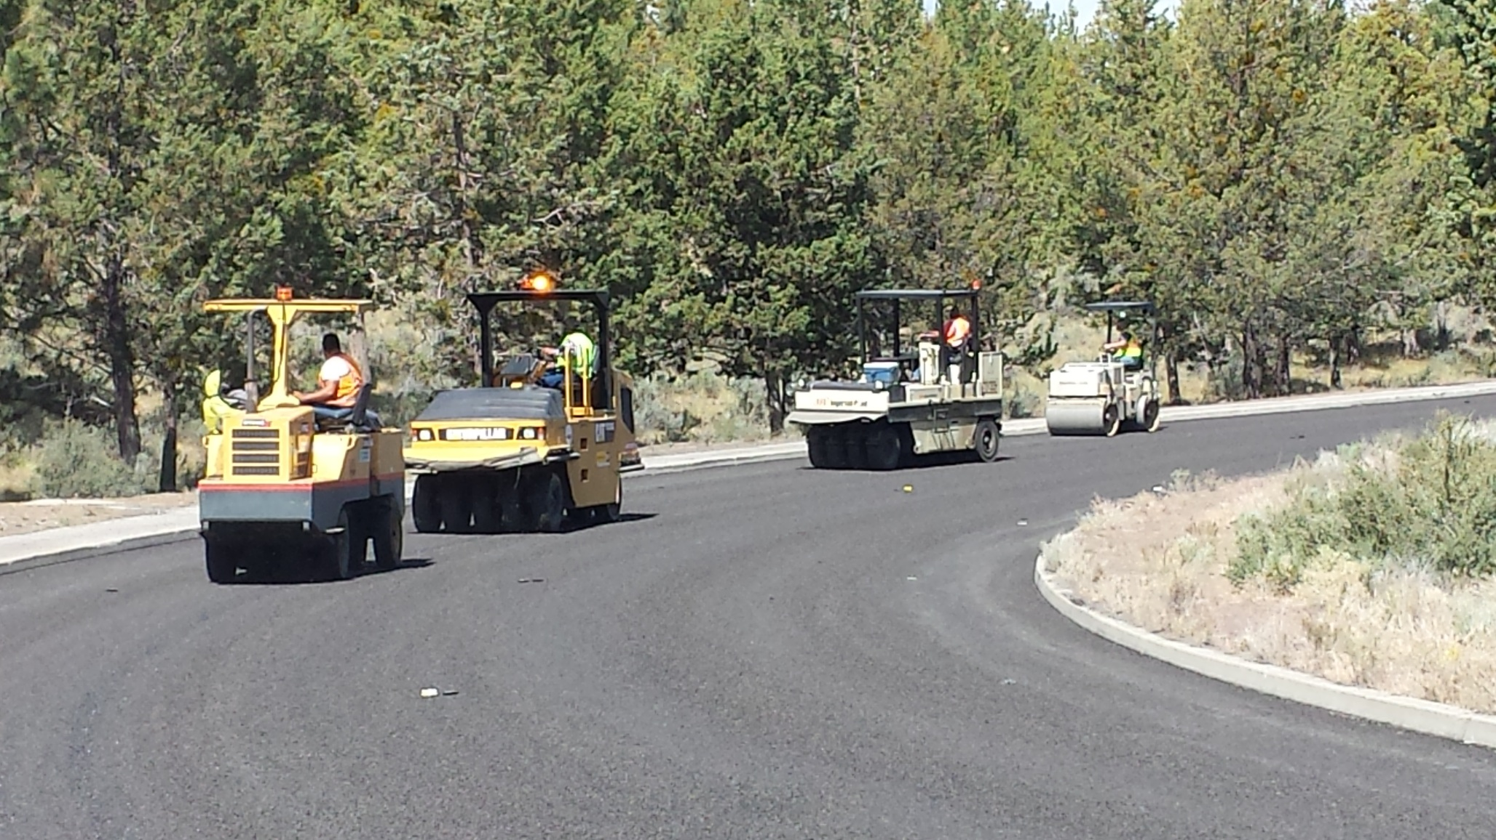
Use of small steel roller in
Bike Lanes

Slide 15
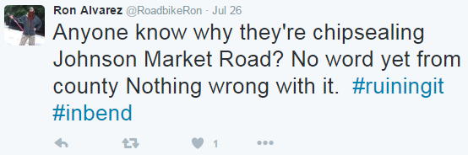
Feedback on County Roads and Chip Seals
Via email: “I rode my bike on the chip seal that you guys did west of Shevlin Park. It was pretty nice. I think it was the smoothest chip seal I have ever ridden on.”
Public tweet:

Slide 16
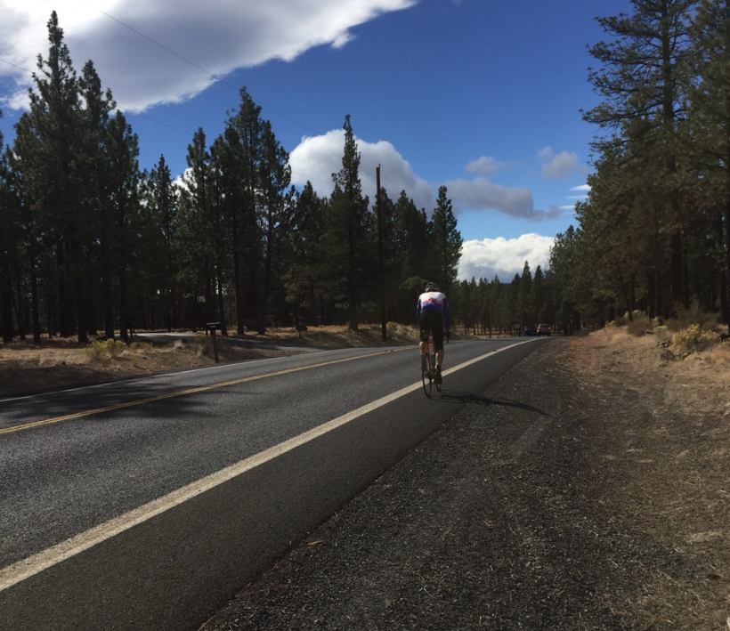
Questions

Slide 17
DOUBLE CHIP SEAL
Maintenance Treatments
Deschutes County Road Department
2016 OACES CHIP SEAL WORKSHOP
December 07, 2016
Chris Doty, Director
Tom Shamberger, Operations Division Manager

Slide 18
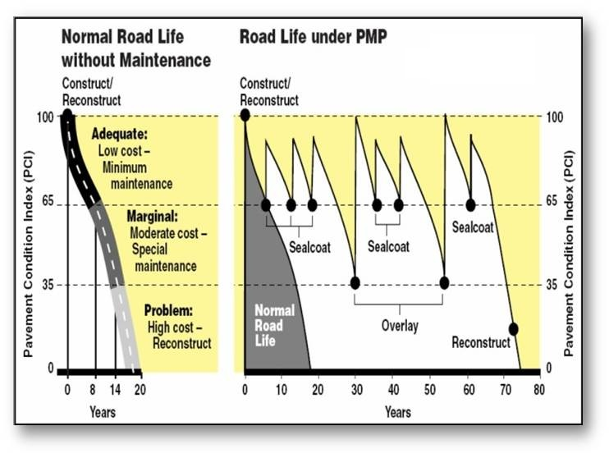
Strategic Pavement
Investment
Chip seal = $
Overlay = 6 to 8 x $
Full Depth Rec = 15 to 20 x $
Reconstruct = 20 to 40 x $
Chip seal
Chip seal
Chip seal

Slide 19
Pavement Maintenance Strategy
Arterials – Full depth, overlay or grind and inlay
Collectors – Full depth, overlay or grind and inlay
Local Roads – Chip Seal

Slide 20
Options for Local Roads
PCI 65 to 80:
Crack Seal
Asphalt Patch
Single Chip Seal
PCI – 45 to 65
Road has good profile
Asphalt patch
Double Chip Seal

Slide 21

BENEFITS OF DOUBLE CHIP SEAL
Doubles the protection from oxidation and deterioration from moisture
Can be successfully used on moderate to severely deteriorated and cracked roads
Extremely durable and flexible surface which reduces and significantly delays cracking
Improves skid resistance and winter traction due to the textured surface

Slide 22
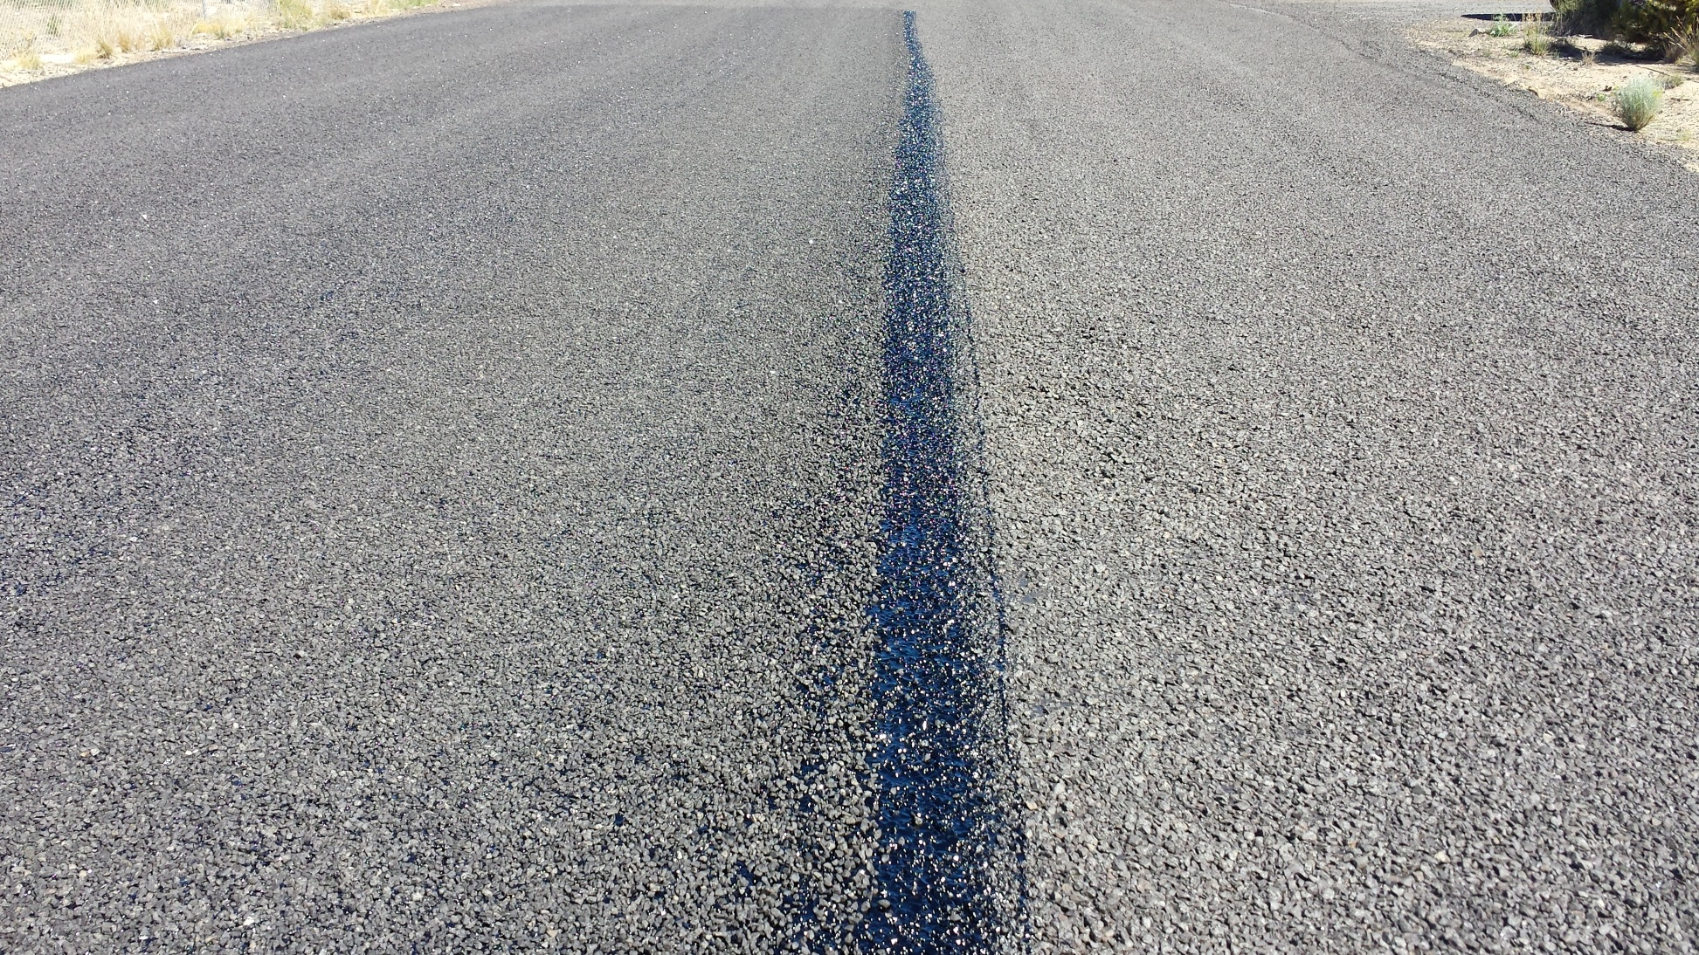
Double Chip Seal
3/8 - #8
1/2” – 1/4”

Slide 23

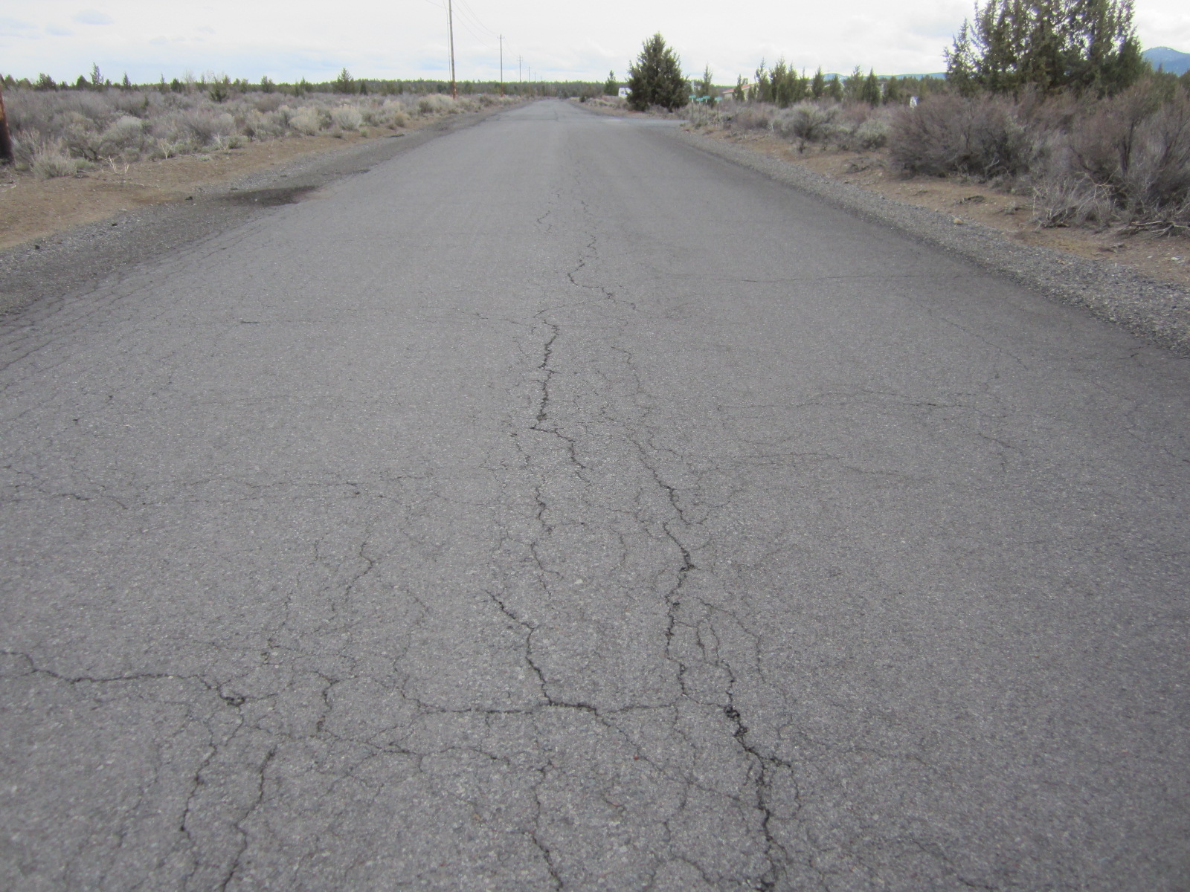
Double Chip Seal Candidate
PCI of 38

Slide 24
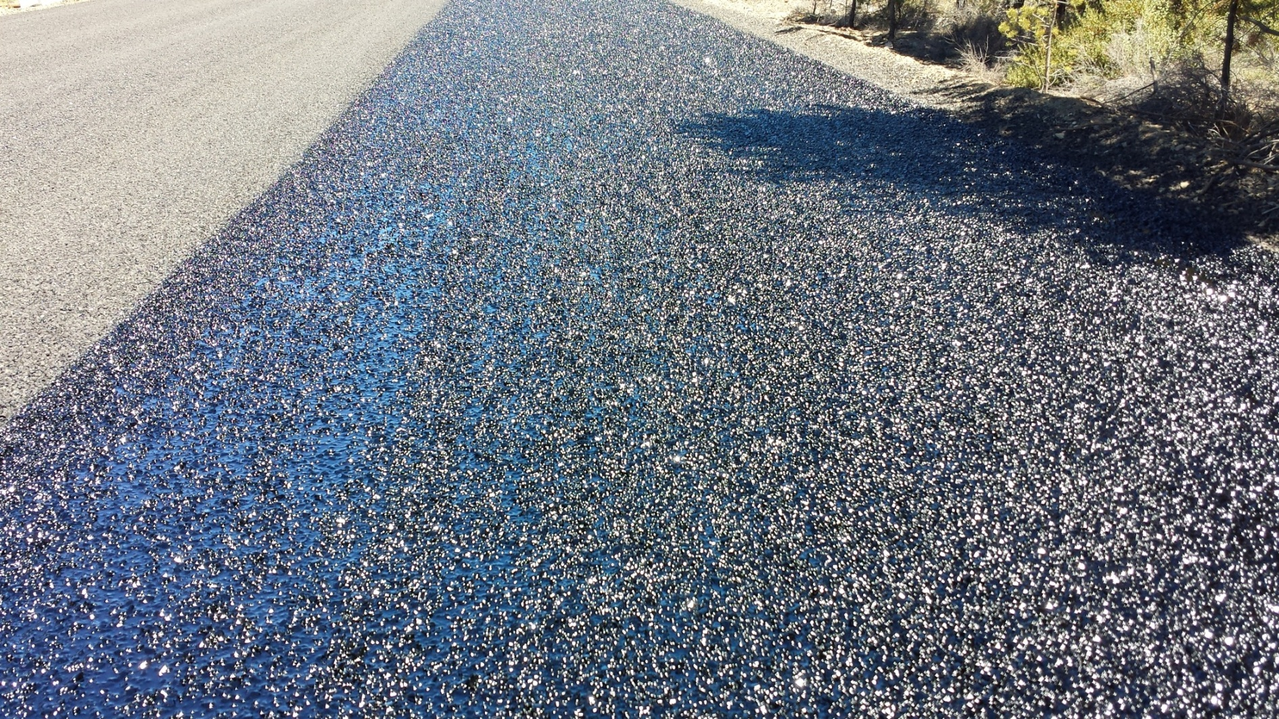
Second Lift On Double Chip Seal

Slide 25
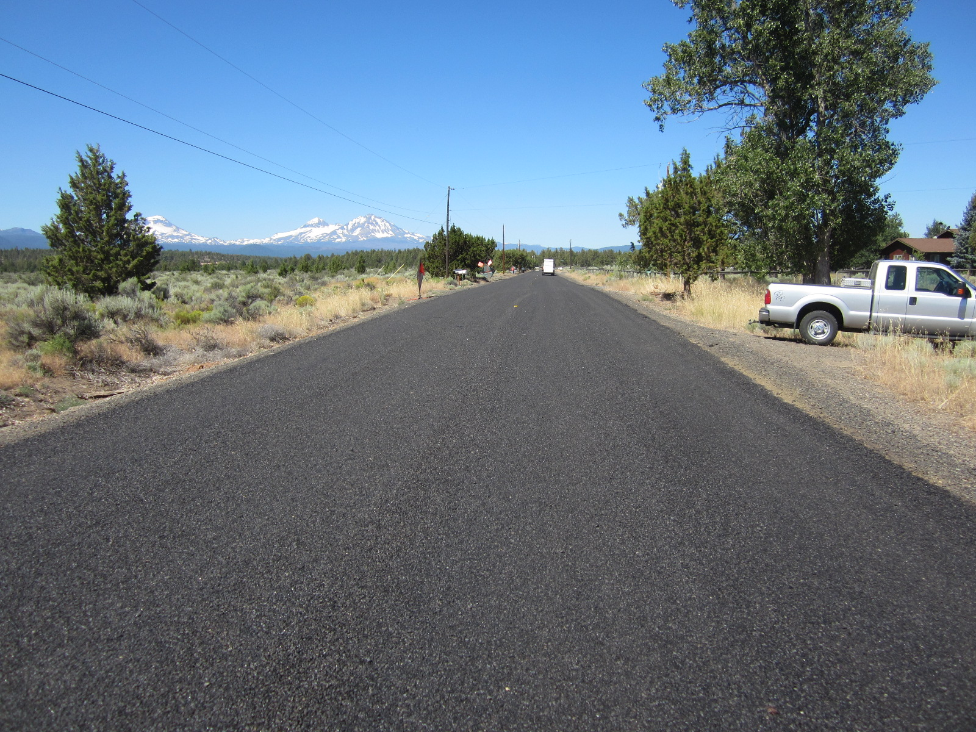
½” - ¼” chip seal keyed with 3/8-8

Slide 26
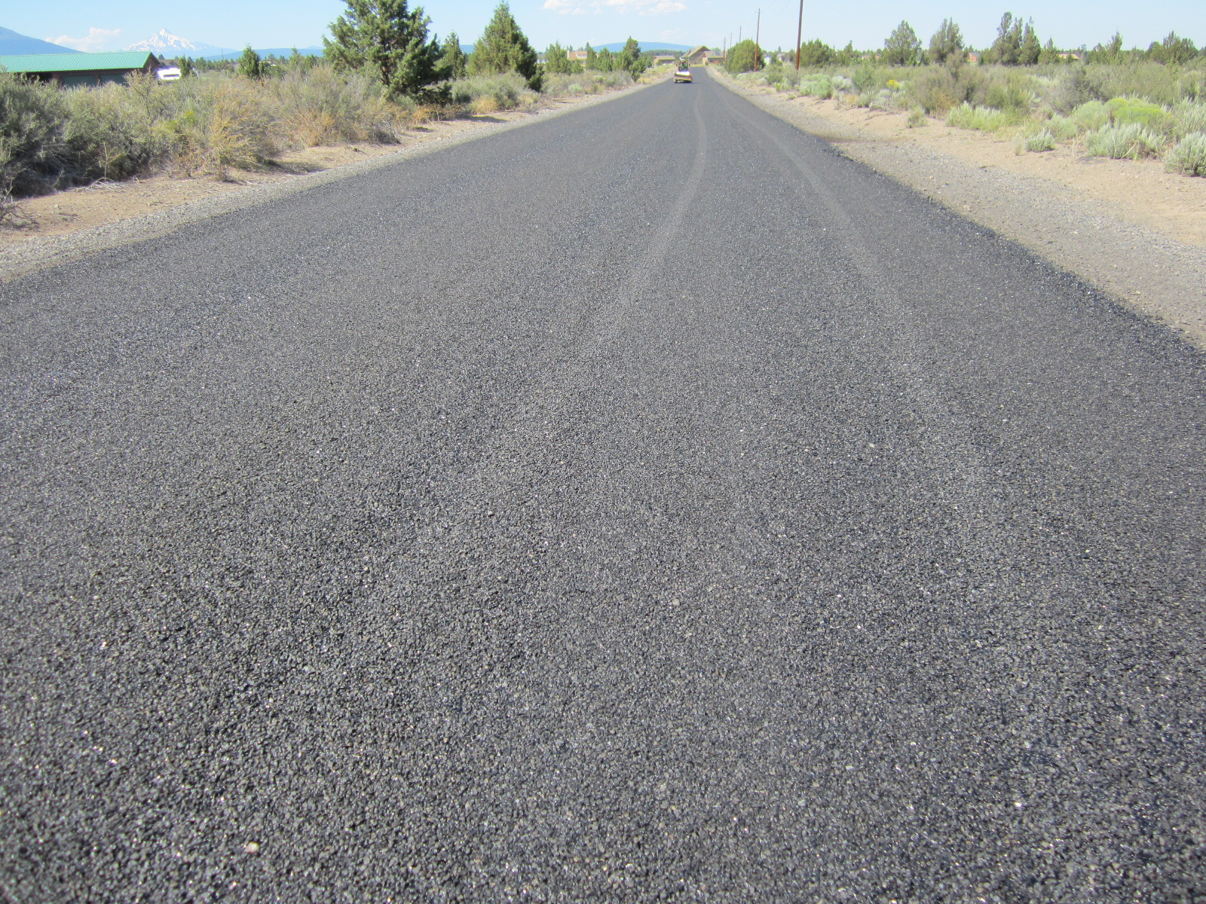
Double Chip Seal
PCI of 84 two years later

Slide 27
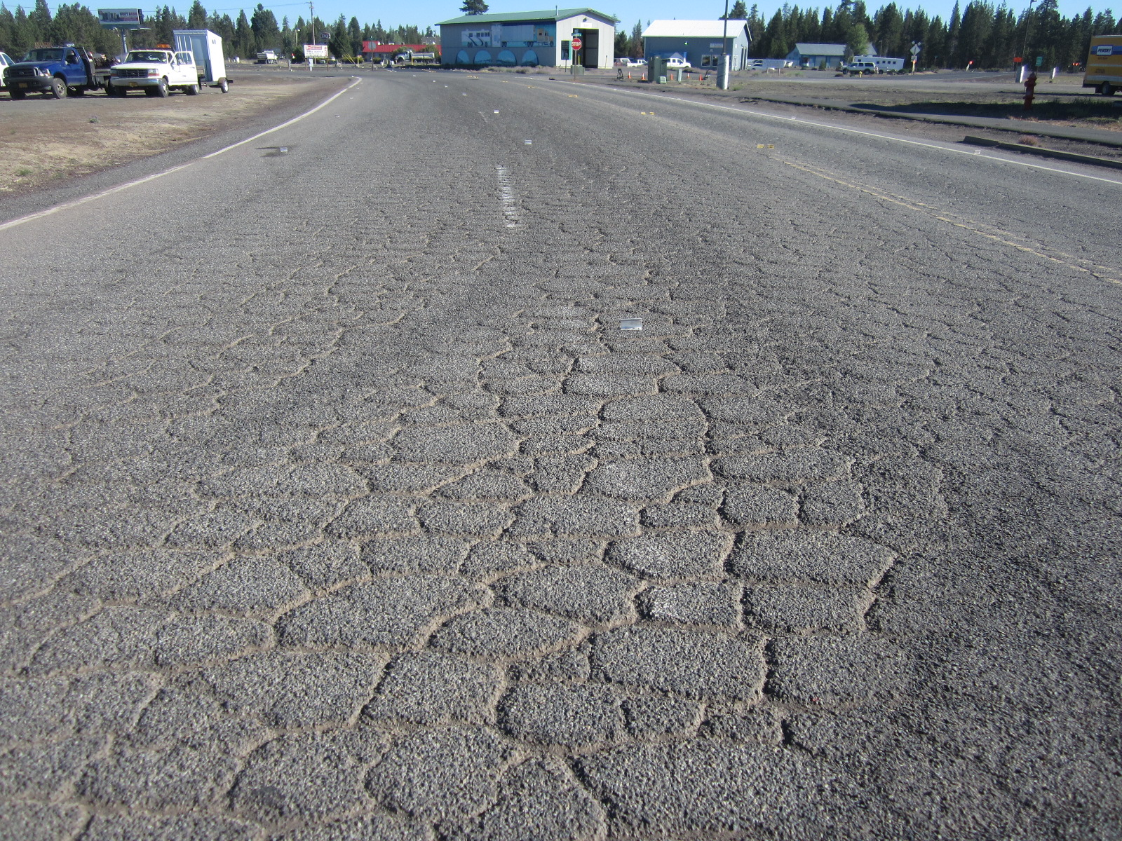
Wendy Road – La Pine
Road into truck stop
PCI of 20

Slide 28
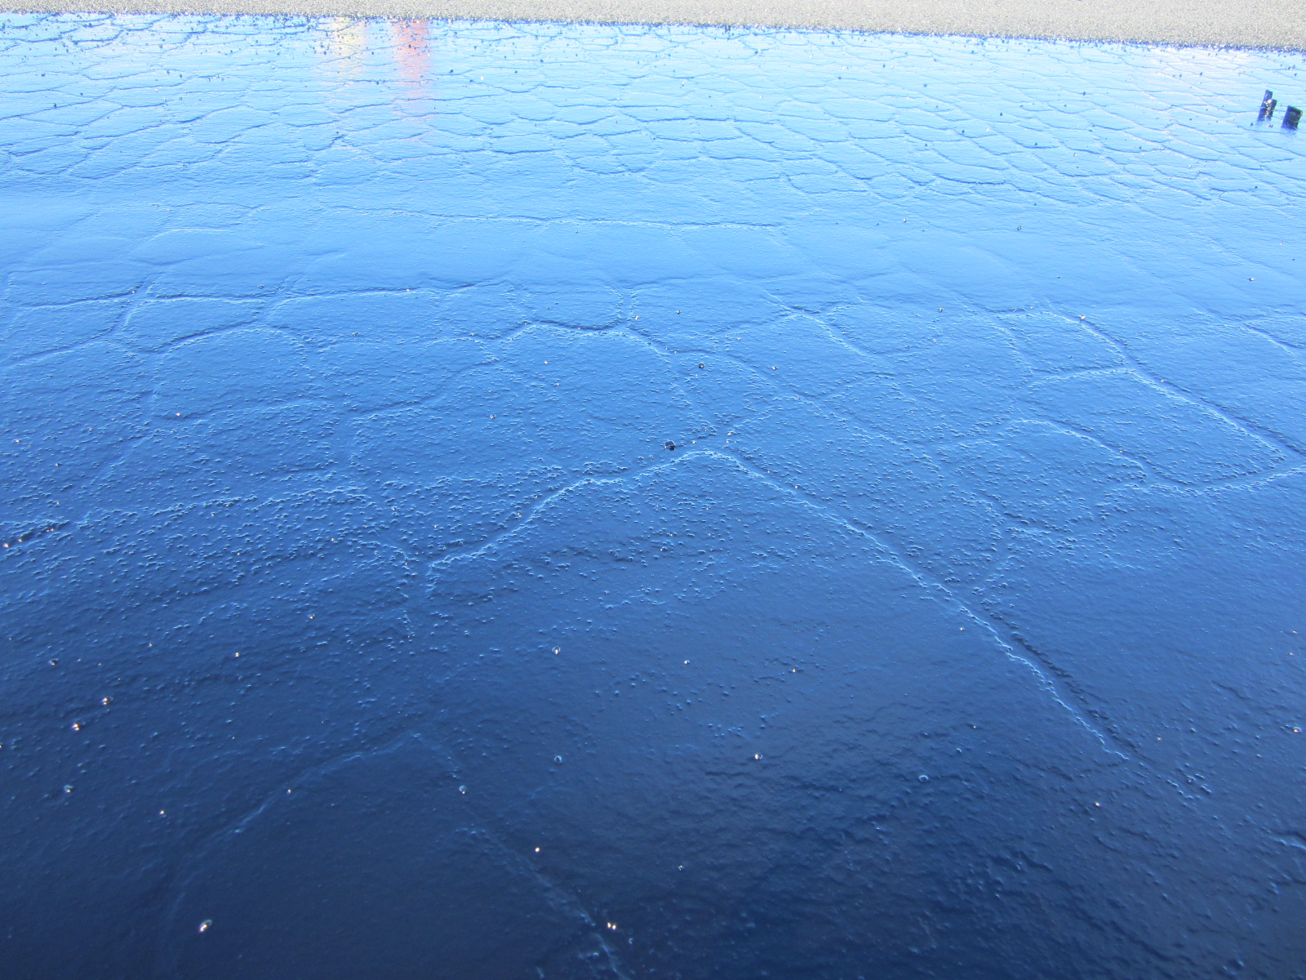
First Lift at .52 Gallon / sq. yd.
Cracks filled with oil

Slide 29
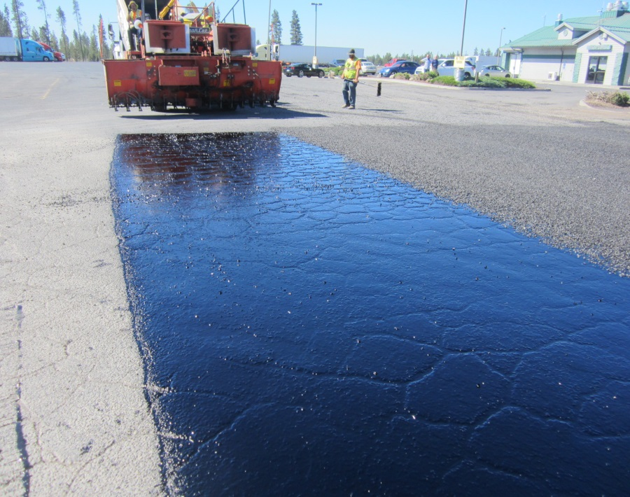
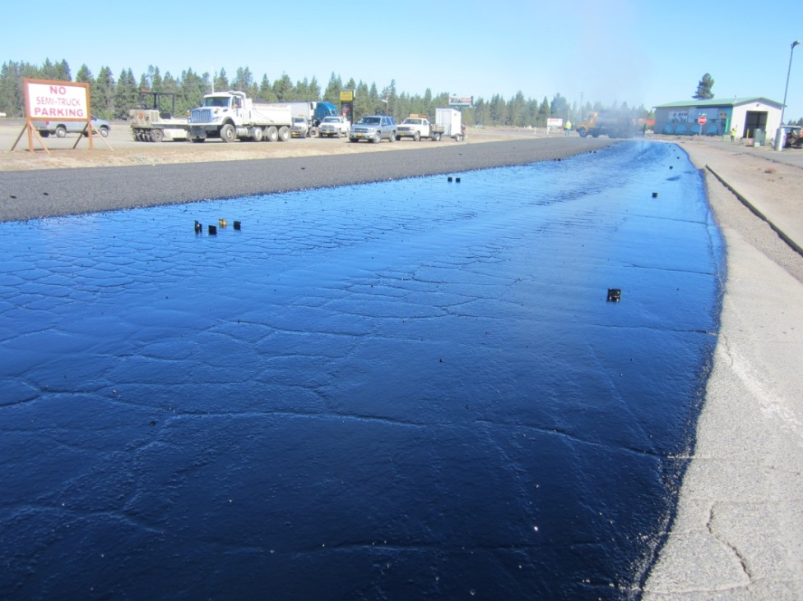
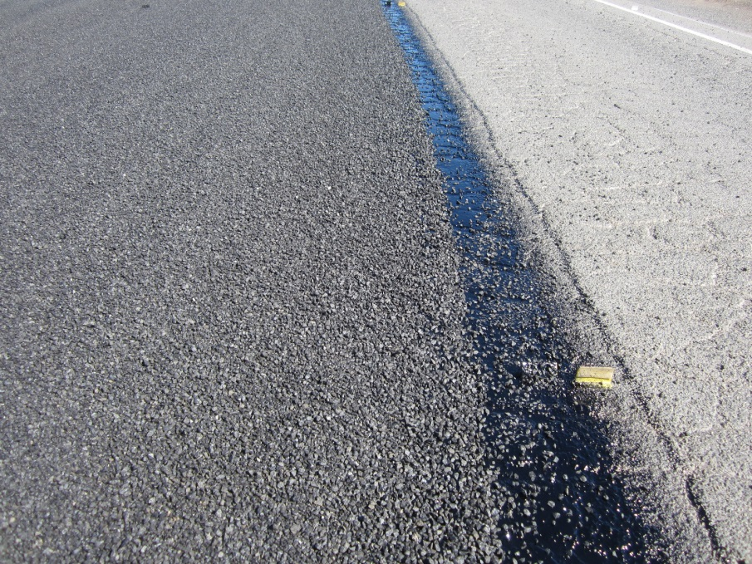
Oil Shot Rate: 1st Lift - .52 gal./sq. yd.
2nd Lift - .41 Gal /sq. yd.
Rock Rate: 1/2” - 1/4” - 25 lbs. / sq. yd.
3/8” - # 8 - 17 lbs. / sq. yd.

Slide 30
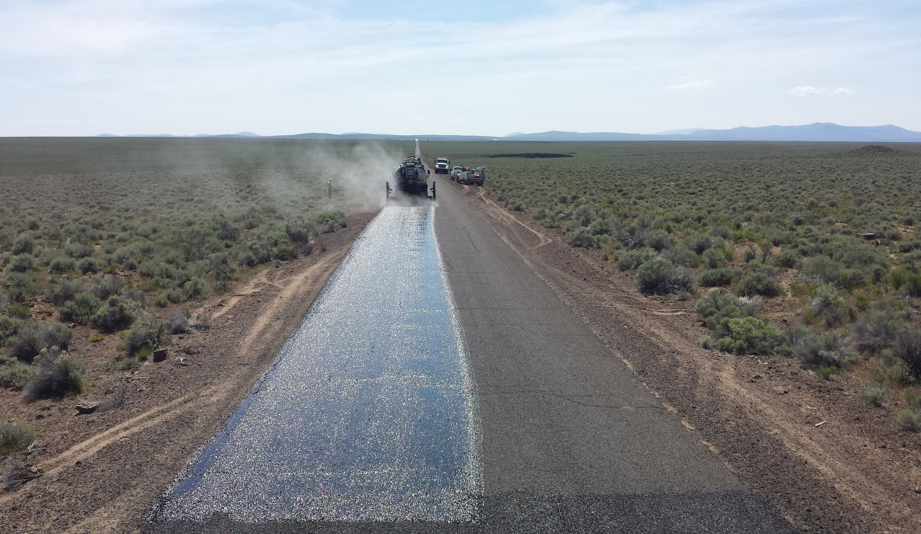
Desert Road

Slide 31
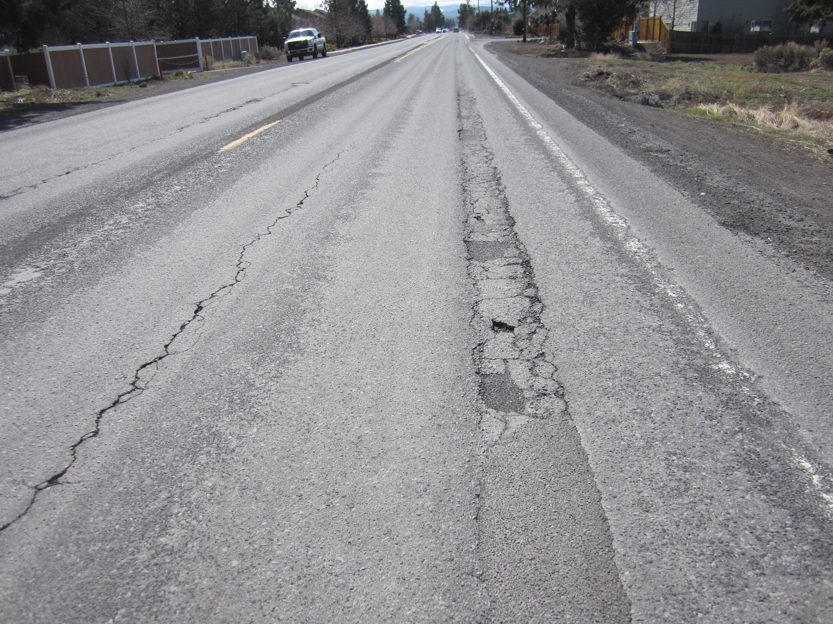
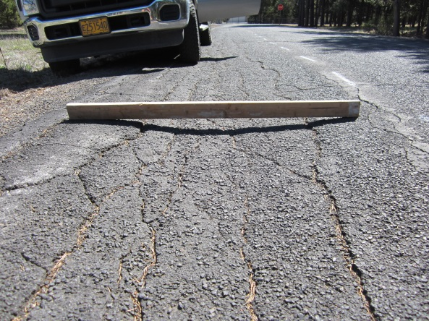
Severe Rutting not candidate for double chip

Slide 32

Questions
Tom Shamberger, Operations Manager
Deschutes County Road Department
Tom.Shamberger@deschutes.org
(541) 322-7120

