Slide 1
deschutes county road department otta seal gravel road conversion pilot project December 7, 2016 oaces chip seal workshop

Slide 2
Existing gravel road maintenance program
System Data:
200 miles of gravel road
Maintenance demand/service levels:
Activity/Data | High | Medium | Low
Grading frequency | 2 or 3 times per year | Annually or every other year | Infrequent/upon request
Dust palliative | Annual | None | None
Material add | 8+/- years | 12+/- years | >20 years
$/Mile/Year | $5,000/$7,500 | $2,500/$3,500 | <$1,500
# of miles +/- | 50 | 70 | 80
Local/Residential road annual surface maintenance (paved): $6,000/$8,000/mi/yr.

Slide 3
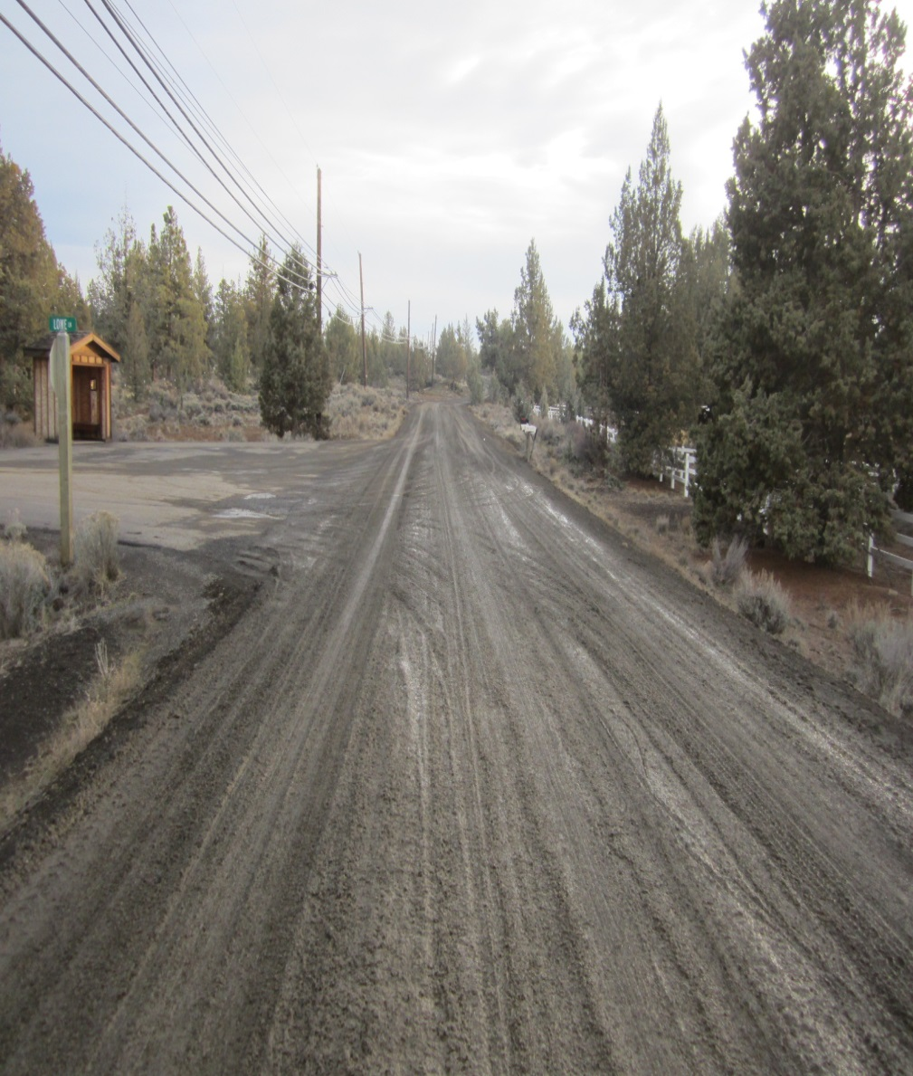
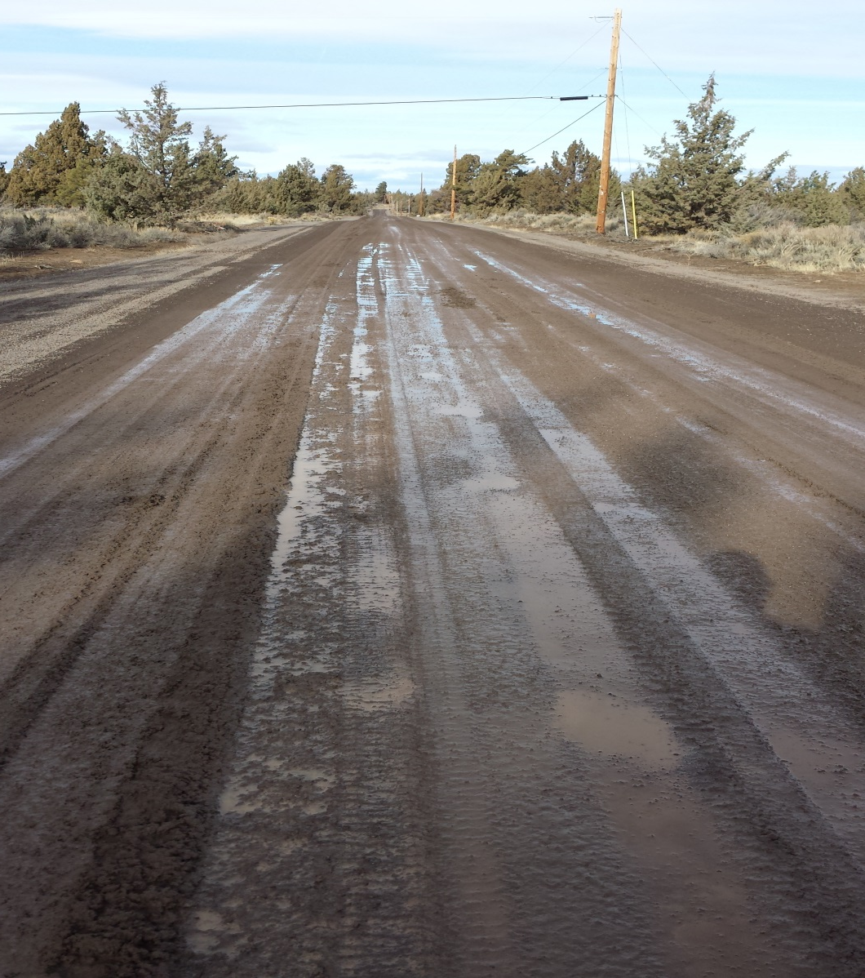
Road treated with Magnesium Chloride freeze/thaw

Slide 4
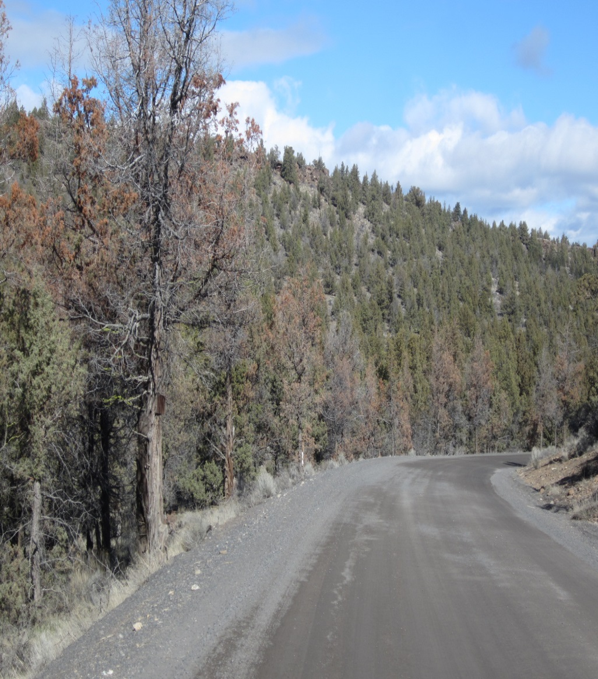
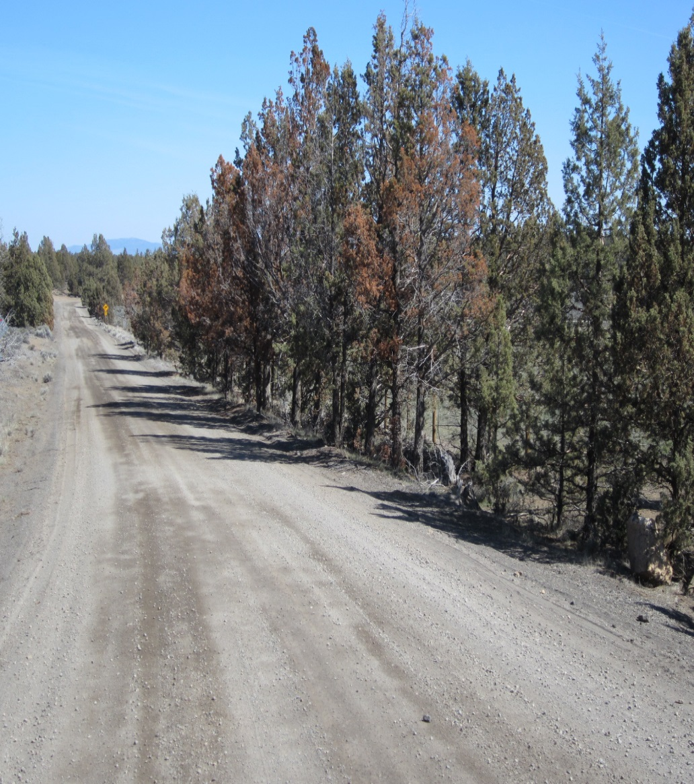
Road treated with magnesium chloride tree kill

Slide 5
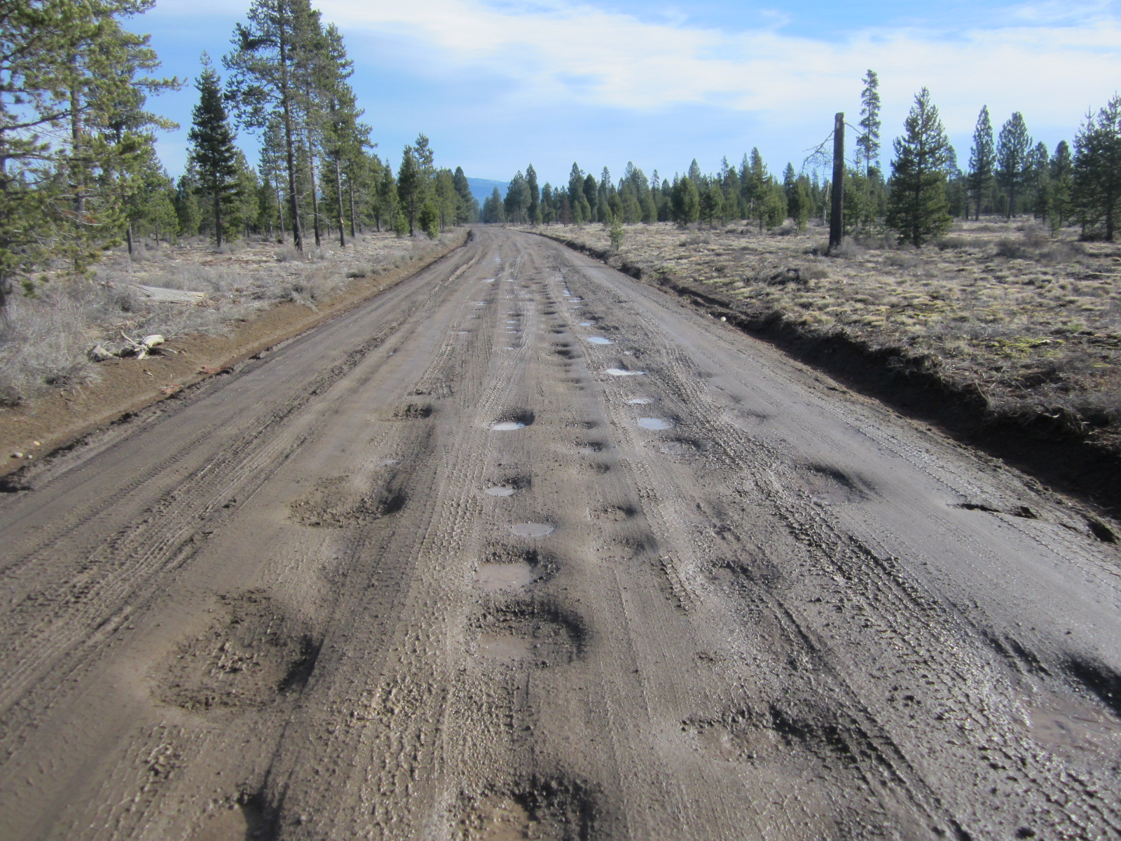
Road treated with magnesium chloride potholing

Slide 6
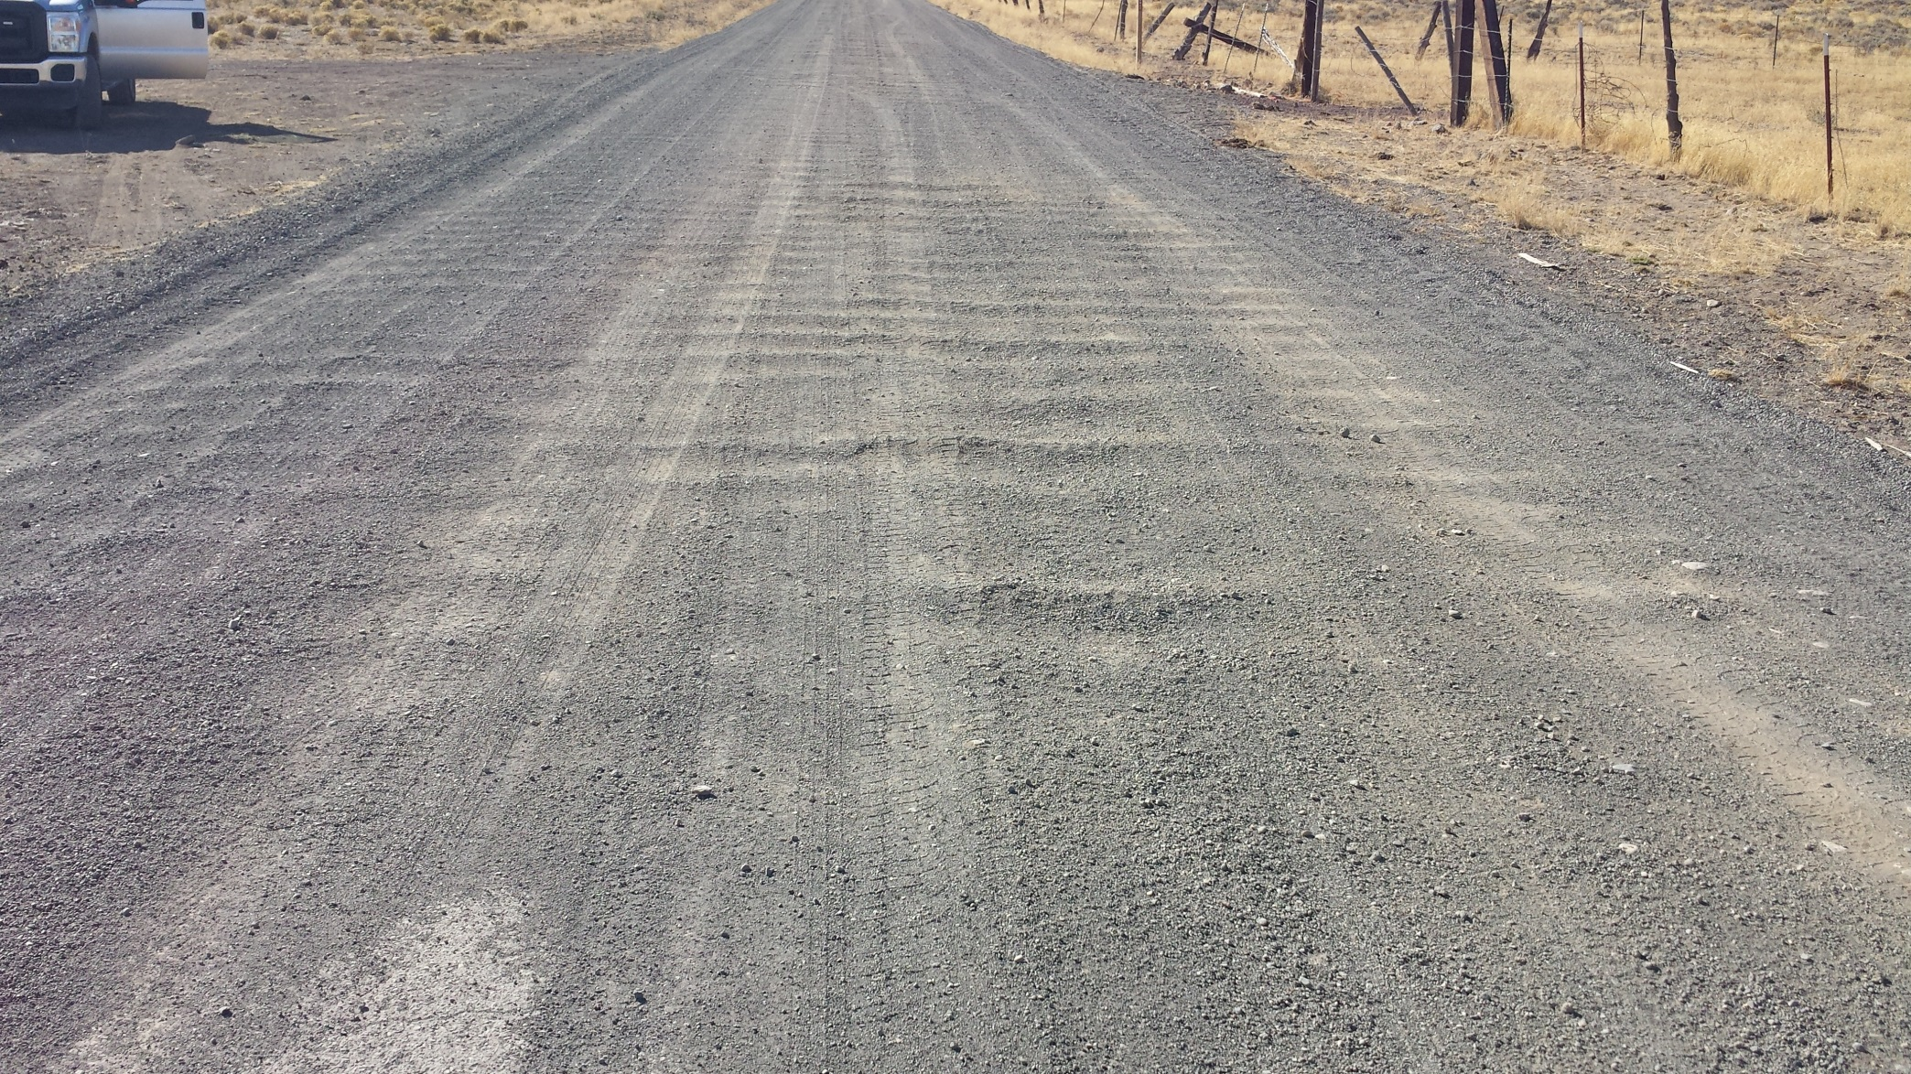
Typical gravel road washboarding

Slide 7
The goal
Find an improved low-cost surface treatment with annual surface maintenance costs that are at or near that of a high maintenance gravel road ($5,000/$7,500/mi/yr.)
Target low-volume Local/Residential facilities.
Evaluate/estimate long-term maintenance costs and strategies.
Potentially develop/evaluate partnership opportunities with adjacent property owners (ie, a “maintenance LID”) to fund the upgrade.

Slide 8
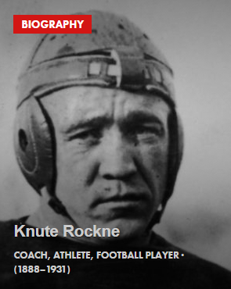
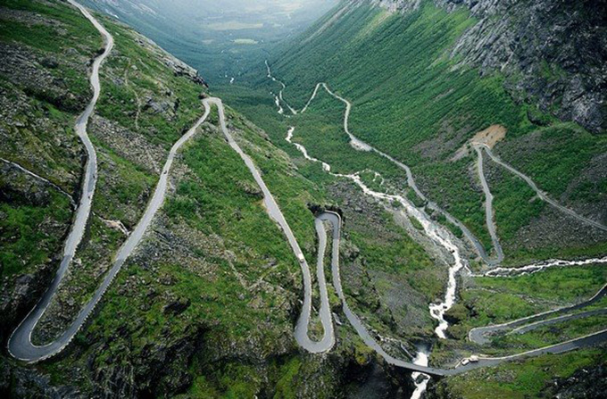
Pilot project treatment: otta seal
Otta Seal
Developed in Norway (Otta Valley) in 1960s. Relatively new to USA.
Not an “Auto Seal”
Aggregate (1”-minus) rolled into a layer of high-float liquid asphalt.
Life Expectancy: 8-12 yrs.
A poor-man’s oil mat.

Slide 9
Otta seal materials
Binder: High Float Medium Set Oil: HFMS-2
Aggregate: Gradation varies based on traffic loading
Low quality, non-paving spec rock
0.5” to 1” Max
Up to 10% fines
Dirty!
Again…..A Poor Mans Oil Mat

Slide 10
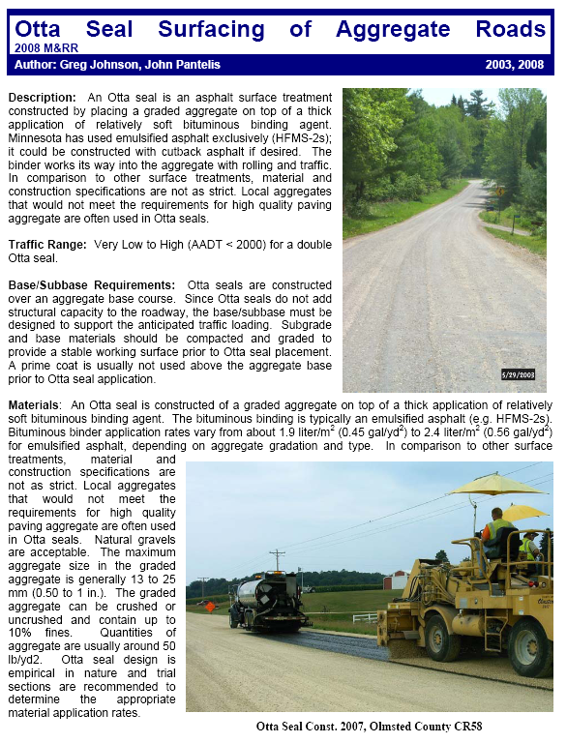
Otta seal: research
Various webinars, conferences and seminars introduced concept.
Various publications: Minnesota DOT
Internet searches, etc.
E. Washington Agencies
Vendor experience with similar seals
Bituminous surface treated (BST)

Slide 11
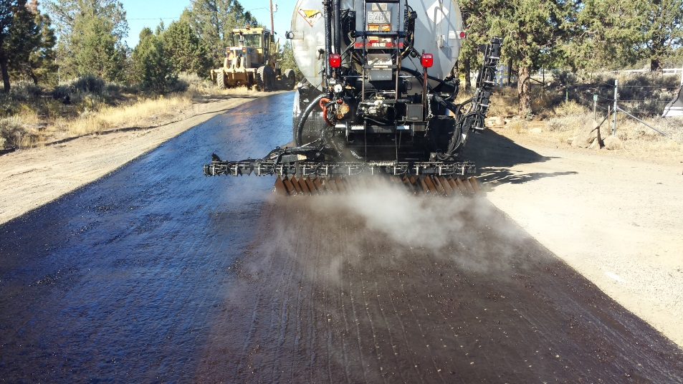
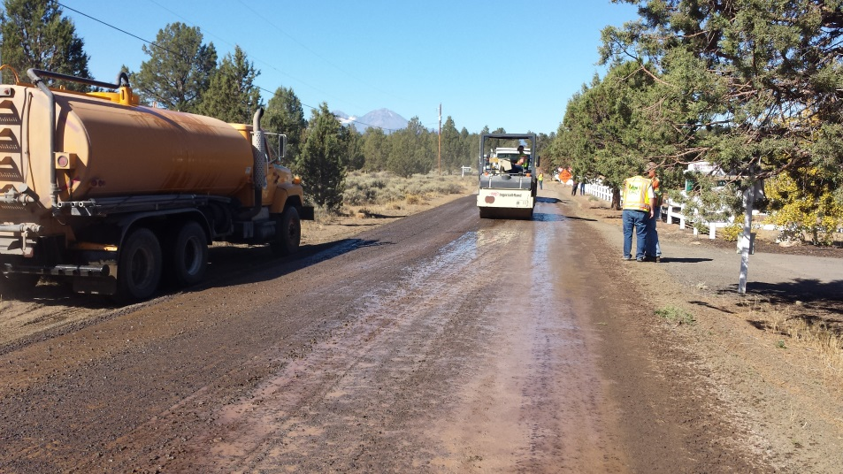
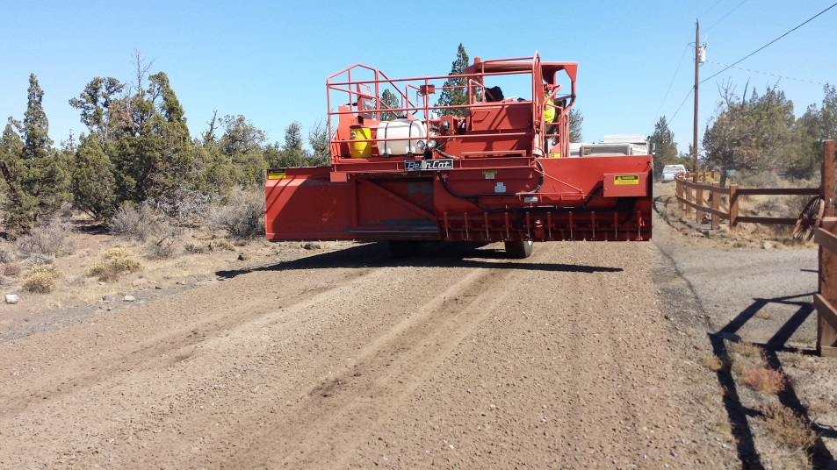
Otta seal equipment
Asphalt Distributor
Chip Spreader
Pneumatic-tired roller
Steel roller
Broom
Water Truck

Slide 12
Some gradation spec examples
Washington vendor presentation
International Focus Group
Dense = Higher than 100 ADT

Slide 13
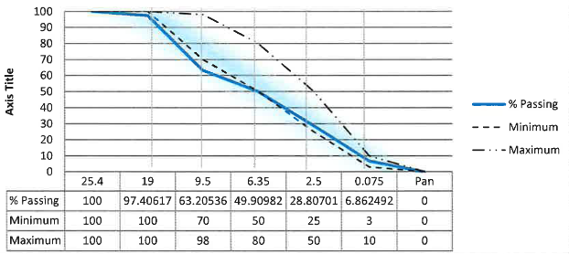
Deschutes county otta seal rock
Dense Specification: (19 mm = ¾” and 0.075mm = #200 sieve)

Slide 14
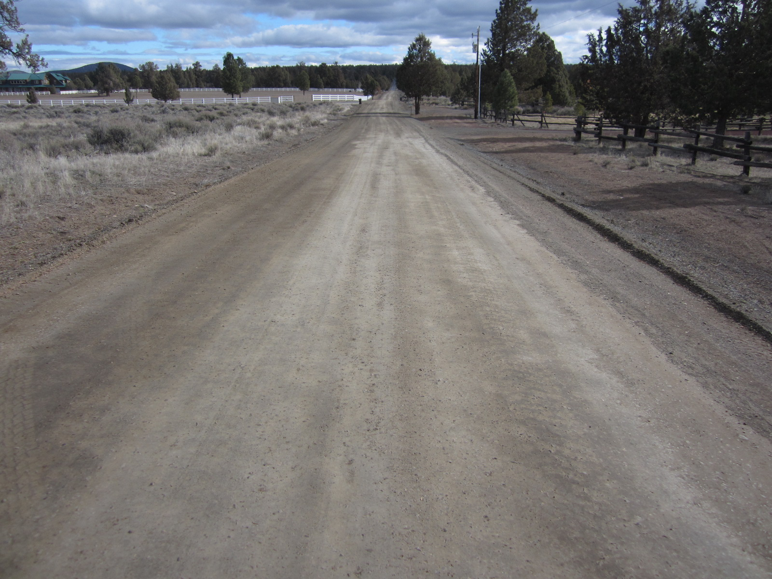
Pre-installation (typical of post grading, Plainview Road)

Slide 15
HFMS-2 Application (0.48-50 Gal/sy) (road pre-wet, 1-hour prior, Plainview Road)

Slide 16
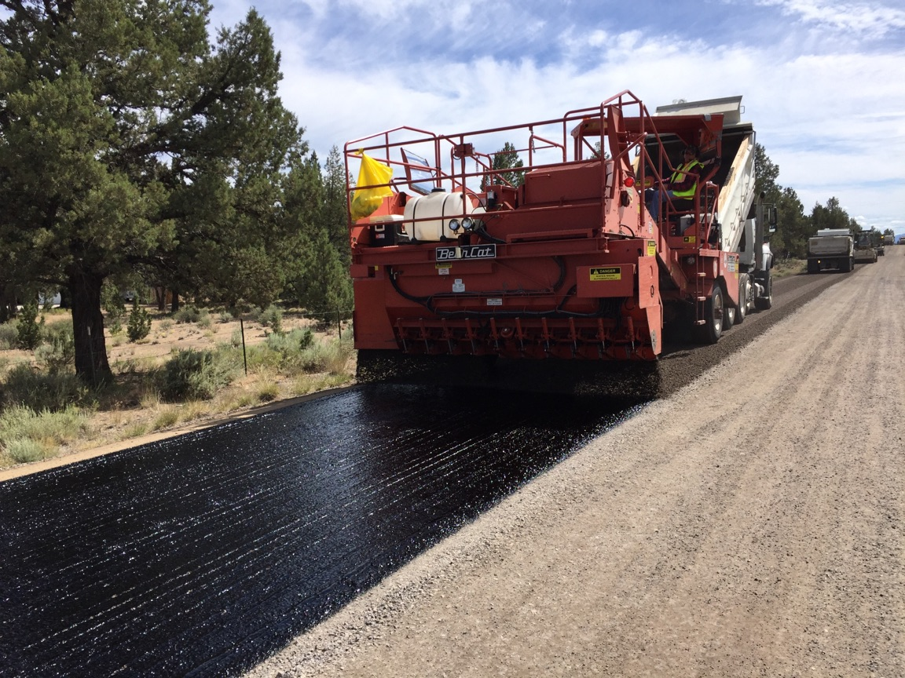
Single pass with chip spreader (1”–minus “dirty” Material, Ward Road)

Slide 17
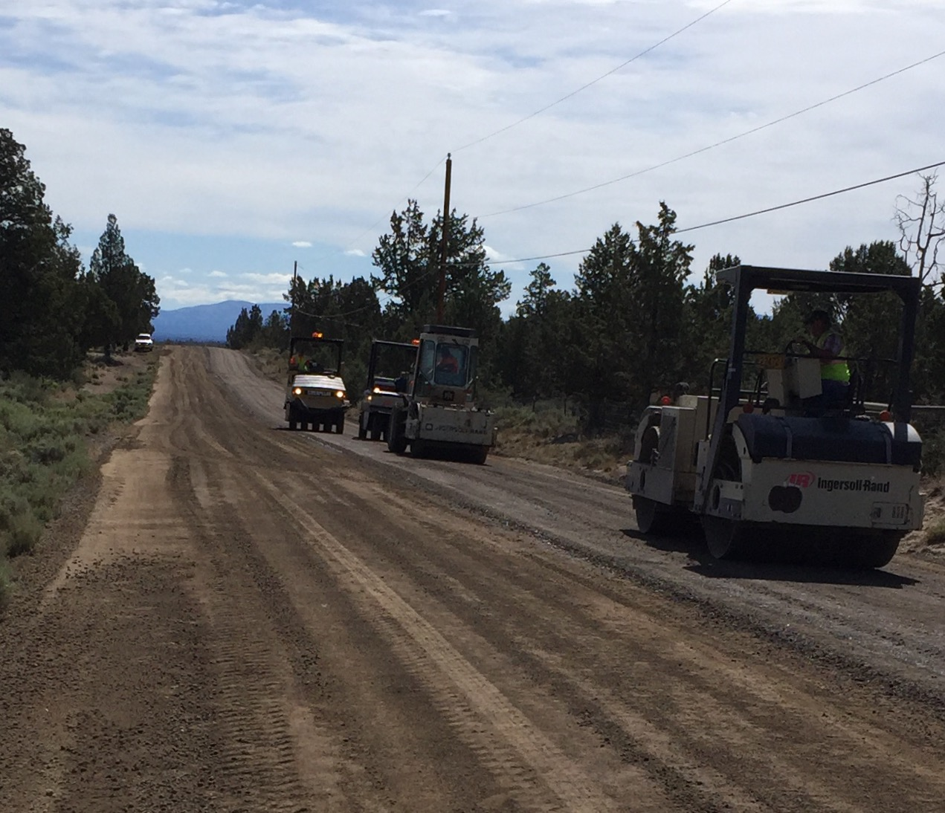
Immediate Post agg application ready to roll (and roll and roll and roll)

Slide 18
Surface integrity (very dirty appearance)

Slide 19
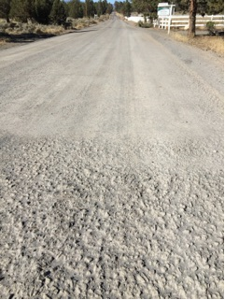
Plainview Road: 1-month (included sand seal)

Slide 20
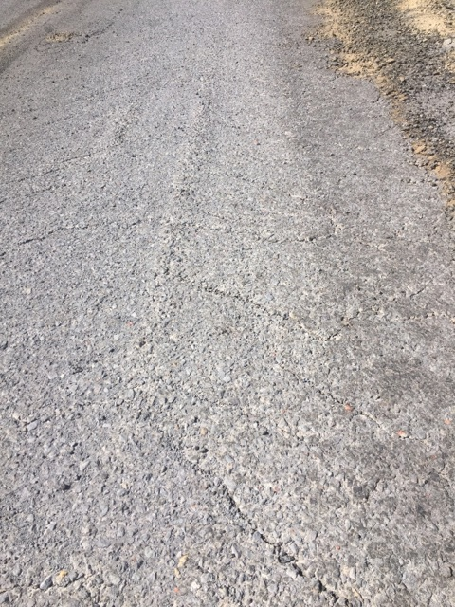
Ward Road: 2 months (Some shoving on grades and intersection approach)

Slide 21
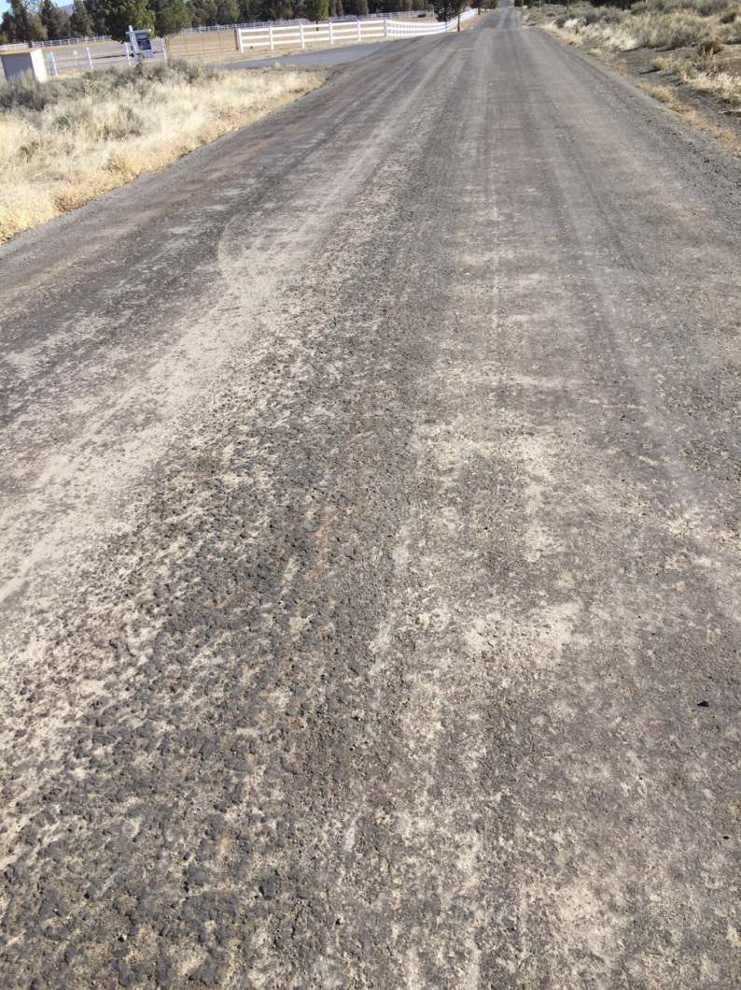
Plainview Road: 7 months

Slide 22
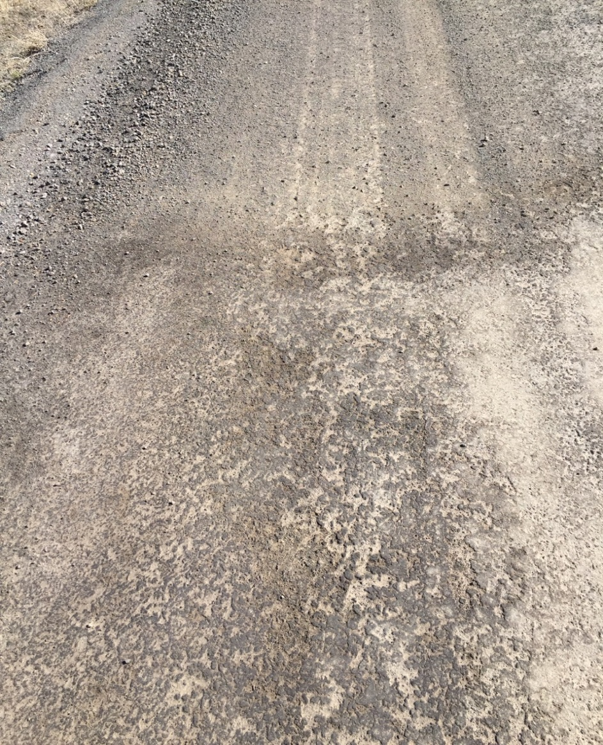
Some flaws (Plainview Road)

Slide 23
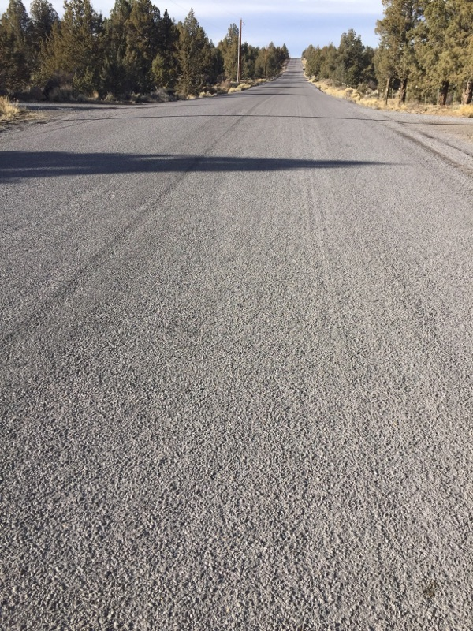
Chip seal finished product (Ward Road – emulsion, uncoated rock)
Before
After

Slide 24
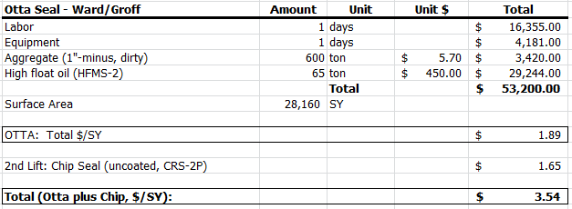
Otta seal installation cost
Hypothetical break-even point: 6.7 years
Notes:
Personnel Rate Multiplier: 3.15 (fully loaded, with overhead)
Equipment rates include depreciation.

Slide 25
Otta seal: lessons learned in application
Segregation in chip spreader – especially in center.
Will seal one lane at a time to narrow width of spread.
Fewer fines will help alleviate some segregation – maybe?
Test run?
Lighter rollers preferred.
Will not use 10-ton double-drum roller again.
Too much vibe or weight promoted “sticking” to drums.
Smooth base surface – not necessarily a good thing.
A little texture to promote adhesion, interlocking.
Wet the base to promote some infiltration of the high-float oil.
No need to wet the finished surface when rolling.

Slide 26
Otta seal: lessons learned in design
Consider grades and intersections.
Deceleration leads to shoving
Apply two-layers of Otta Seal on initial installation.
Extended construction speed zone: 25 mph
Gravel Road Conversion Issues:
Signage
Drainage
Other design issues that are overlooked with gravel roads.
Is it a good chip seal alternative?
Use care in selecting roads – customer expectation issues.

Slide 27
Next steps – otta seal
1. Evaluation of Treatments
Monitor initial degradation and estimate near-term and long-term maintenance needs.
Is this a product we can chip seal and roll into our Pavement Management Program?
If so, at what interval for first chip seal and what is the subsequent frequency of treatments?
If not, what alternative maintenance treatments or strategies are necessary?
2. Cost Analysis
How do the initial and projected maintenance investment levels compare to the annual average maintenance investment for gravel roads?
3. Refine the Process
What refinements can we make to our application technique to reduce the initial application cost of the Pilot Projects?
Plainview: $3.88 (Otta only)
Ward Road: $3.54 (Otta and chip)

