Slide 1
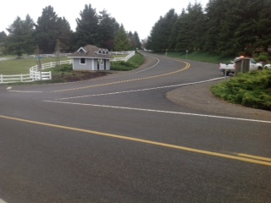
Marion County Slurry Seal Intersection Approaches & Cul-de-sacs

Slide 2
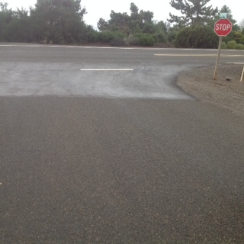
Slurry Seal Intersection Approaches & Cul-de-sacs

Slide 3
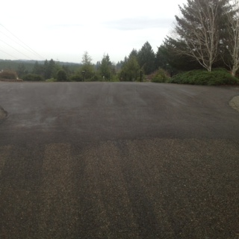
Slurry Seal Intersection Approaches & Cul-de-sacs

Slide 4
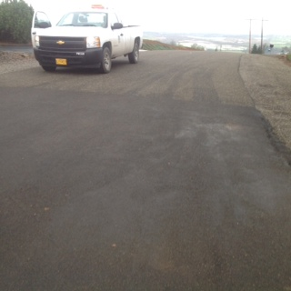
Slurry Seal Intersection Approaches & Cul-de-sacs

