Slide 1
The True Value of
Pavement Preservation
Don Newell
Marion County, Oregon

Slide 2
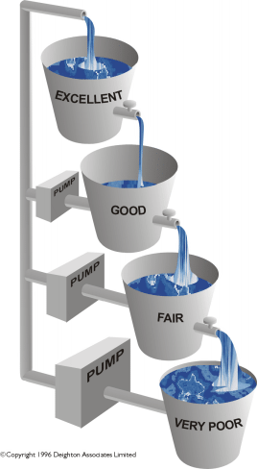
An Analogy
Process is continuous and inevitable
The rate of water flow increases as condition decreases
The effort to pump water increases with decreasing condition
Seal =
$1.50 / sq yd
Overlay =
$8 / sq yd
Reconstruct =
$30 / sq yd

Slide 3
Modeling:
Long-term Real Costs

Slide 5
55.7 Avg PCI

Slide 10
Non- maintain $4.8M with 2.5 % inflation
Maintain $2.8M with 2.5 % inflation
Non- maintain $1.59M
Maintain $1.25M

Slide 12
With 2.5% a year inflation
Maintain 3.0 BPI
Non- maintain 1.2 BPI

Slide 13
In Summary
 |  | Non Maintained |  | Maintained |  | Difference |  | %
$ spent |  | $1,590,000 |  | $1,250,000 |  | $340,000 |  | 27%
$ spent w/o Cap |  | $1,060,000 |  | $720,000 |  | $340,000 |  | 47%
PCI |  | 58.1 |  | 84.5 |  | 26.3 |  | 45%
$ spent w/ inflate |  | $4,772,813 |  | $2,838,868 |  | $1,933,945 |  | 68%
$ spent w/ inflate w/o Cap |  | $4,242,813 |  | $2,308,868 |  | $1,933,945 |  | 84%
BPI |  | 3.7 |  | 6.8 |  | 3.1 |  | 85%
BPI w/inflate |  | 1.2 |  | 3.0 |  | 1.8 |  | 144%

