Slide 1
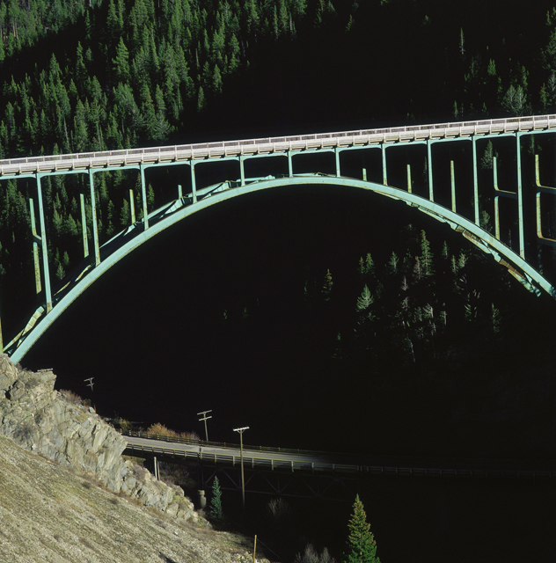
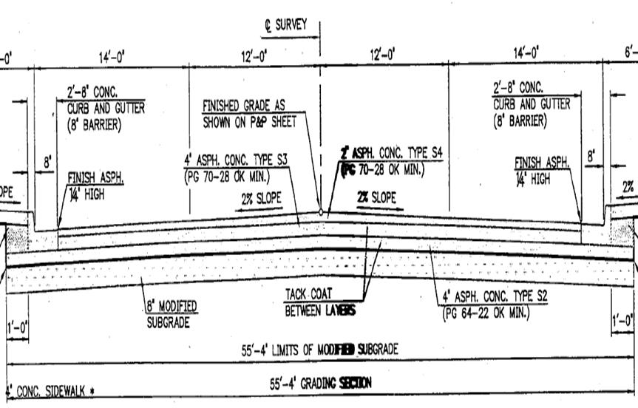
Road Pavements are “Supported” Bridges

Slide 2
Most Road Pavements failures are contribute to when the “Support” has been jeopardized
Enemies of Roads:
  Water penetration – Freeze / thaw/ expansions / voids
  Traffic Loading
    High Traffic Use (verses low traffic counts)
    Truck Loads – one loaded truck may cause the same amount of damage of 5,000 cars
  Weathering / Seasonal Climate / Age
    Breakdown of aggregate and asphalt oils
      May allow water penetration
      Need Aggregate surface for traction

Slide 3
Enemies of Roads: continued
  Artificial Damage
    Stud Tires
    Utility Cuts
    Traffic Accidents – liquids spilled
    Farm equipment dragging
    Stopping areas = pavement thrusting
    Bus Stops
  Others items that shorten the life of roads
    Poor drainage
    Poor or non-maintained shoulders
    Tree roots
    Inadequate Road Base, Design, Road Materials, Construction practices/ Workmanship, Lack of Good Maintenance, or Neglect

Slide 4
Typical Distresses
Alligator cracking
Block cracking
Longitudinal & transverse cracking
Delamination
Rutting
Potholes

Slide 5
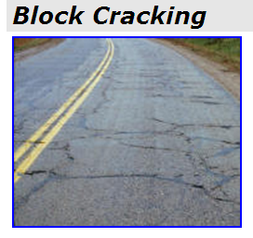
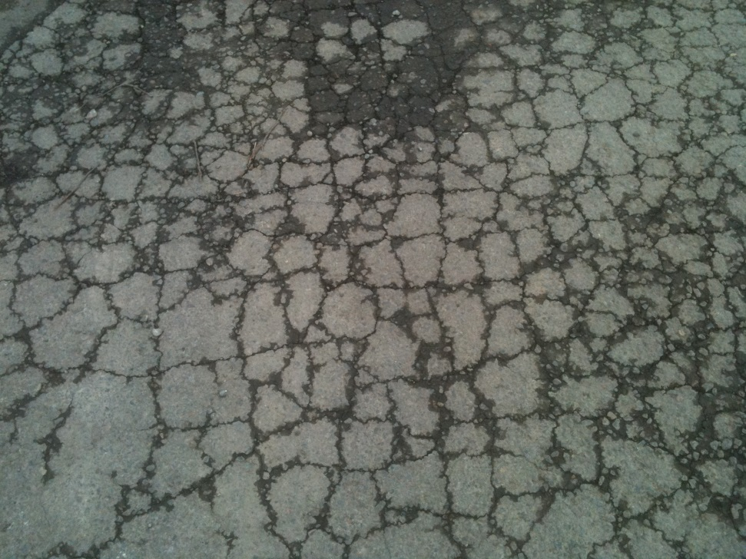
Cracking
Alligator

Slide 6
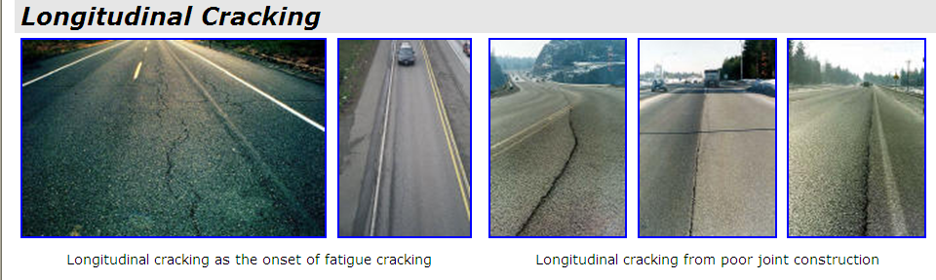
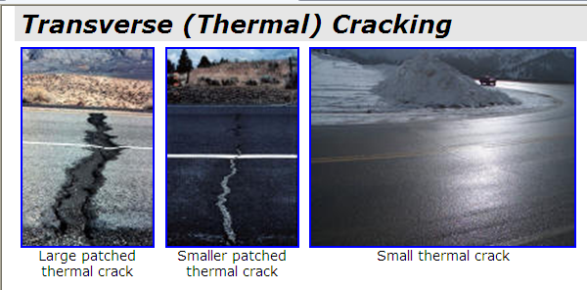
Cracking

Slide 7
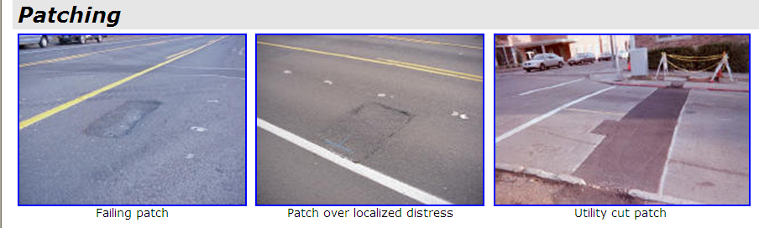
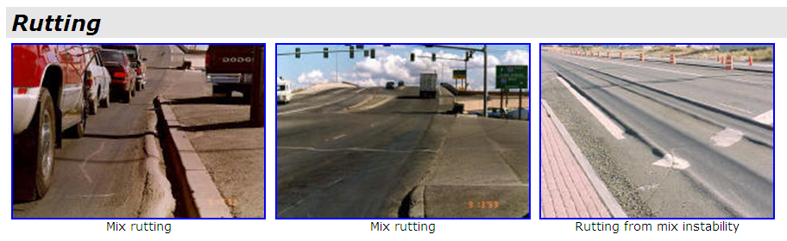

Slide 8
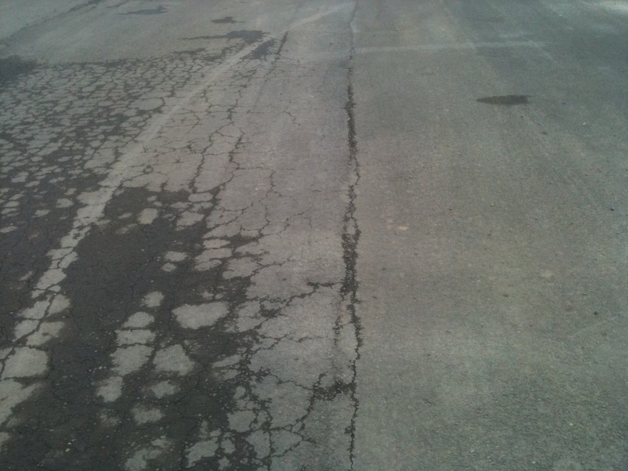
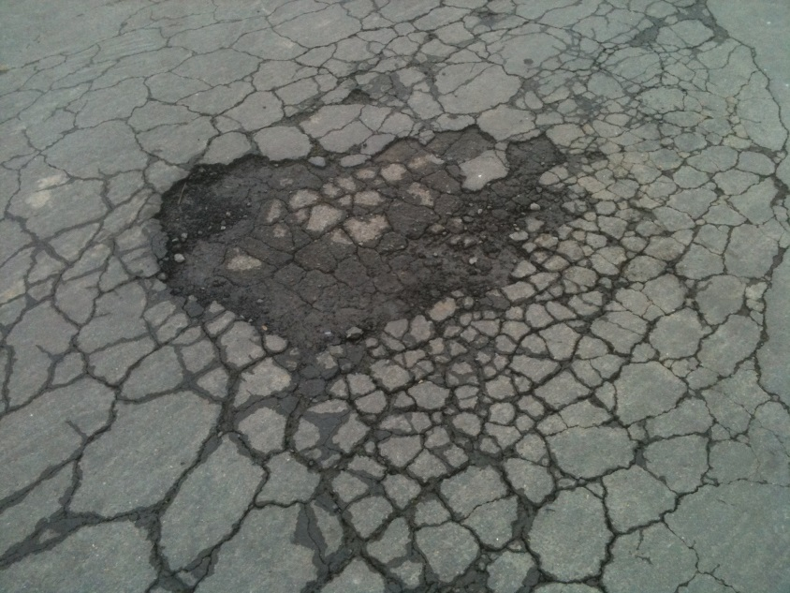
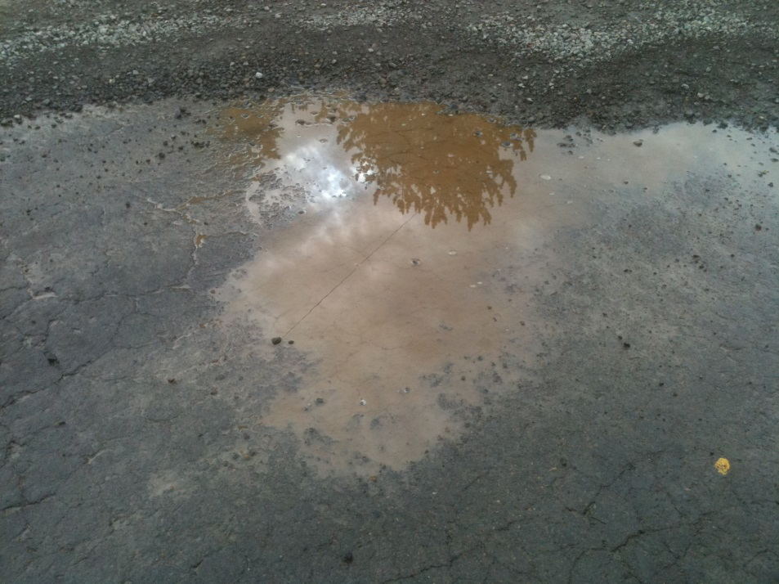
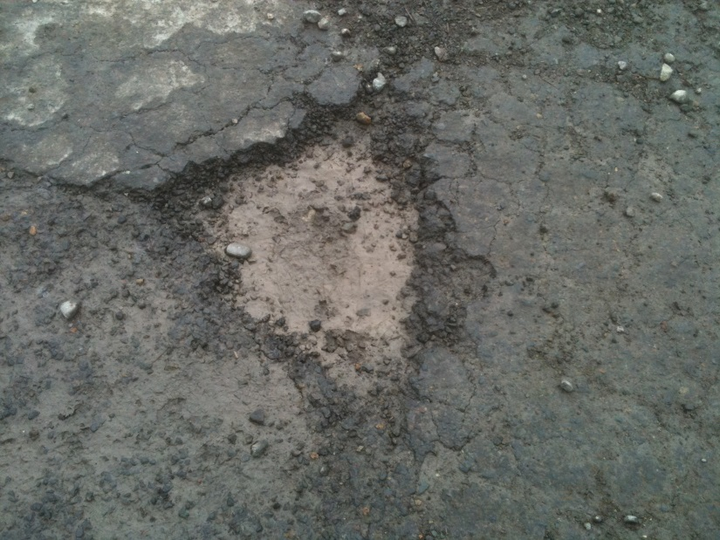
Localized Failures

Slide 9
Surface Treatments & Costs
Crack Seal: $4k/mile (3-6 years) {costs greatly vary}
Slurry Seal: $8k/mile (4-6 years) {urban street treatments}
Chip with Fog Seal with prep: $34k/mile (7-12 years)
2” Maintenance AC Overlay: $120k/mile (10-20 years)
Grind & 2” AC Inlay: $150k/mile (12-20 years)
4” Structural AC Overlay: $190/mile (14-20 years)
Reconstruction: $500k/mile (20-24 years)

Slide 10
Pavement Management Systems
Inventory of road pavements - Section Descriptions
Provides Maintenance & Rehab (M&R) history
Produce a list of upcoming M&R work
Demonstrates current health & performance of roads
Predicts roads’ projected performance and costs
Estimate a required project and system wide budget
Planning/ Maintenance/ Design Construction
Aids in defining what work should be done when

Slide 11
How PMS Software/ System Works
Segment roads into management units
Visual survey of pavements every 1-4 years
Sample ~10% of roadway surface in each segment
Enter data on various distresses
Using Pavement Condition Index (PCI) of
  100 is new/ perfect road to 0 = Failed road,
  calculate the PCI values
Output = recommended treatments within assigned budgets and many other reports

Slide 12
Pavement Condition Rating with Typical Repairs
PCI
Repair
Cost/Yard
Pay now or pay later
100
Excellent
Seal Cracks
$.80
90
80
Very Good
Single Chip Seal
$1.50
70
Good
60
Overlay
$8
50
Fair
40
Thick Overlay
$13
Poor
30
Very Poor
20
$30 plus
10
Failed
Reconstruct
0
5 yrs
10 yrs
15 yrs
20 yrs

Slide 13
Pavement Condition Index PCI
Corps of Engrs Develop for Airfields
ASTM now has standards for both highways and airfields
Analyze Distresses
  Type
  Severity
  Density
Adopted by most agencies
100
Excellent
85
Very Good
70
Good
55
Fair
40
Poor
25
Very Poor
10
Failed
0

Slide 14
Pavement Condition
100
PCI = 88
Pavement Condition Index
0
Time / Traffic Loading
10 years
20 years
Notes:
The difference between the effect of preventive and reactive maintenance is significant. Not only is the timing of application different, but the effect (represented by the slopes of the after-treatment performance curves) is also different.

Slide 15
Pavement Condition
100
Critical PCI = 65 - 70
Pavement Condition Index
0
Time / Traffic Loading
10 years
20 years
Notes:
The difference between the effect of preventive and reactive maintenance is significant. Not only is the timing of application different, but the effect (represented by the slopes of the after-treatment performance curves) is also different.

Slide 16
Critical PCI
Preventive Maintenance
100
Critical PCI
Pavement Condition Index
Corrective Maint, Rehabilitation, or Reconstruction
0
Time / Traffic Loading
10 years
20 years
Notes:
The difference between the effect of preventive and reactive maintenance is significant. Not only is the timing of application different, but the effect (represented by the slopes of the after-treatment performance curves) is also different.

Slide 17
Ideal PCI
100
85
Ideal Management Range
80
Ideal Management Range of PCI of 80 to 85
is accepted by agencies’ pavement managers
as the range or “Industry Standard”
to be the most cost-effective of
maintaining a road network.
This should be the network PCI performance target
Pavement Condition Index
0
Time / Traffic Loading
10 years
20 years
Notes:
The difference between the effect of preventive and reactive maintenance is significant. Not only is the timing of application different, but the effect (represented by the slopes of the after-treatment performance curves) is also different.

Slide 18
Preventive Maintenance
Preventive
Maintenance
$
Pavement Condition \ $ Costs
Time / Traffic Loading
10 years
20 years
Notes:
The difference between the effect of preventive and reactive maintenance is significant. Not only is the timing of application different, but the effect (represented by the slopes of the after-treatment performance curves) is also different.

Slide 19
Corrective Repairs
Corrective
Maintenance/ Repair
more$
Pavement Condition \ $ Costs
Time / Traffic Loading
10 years
20 years
Notes:
The difference between the effect of preventive and reactive maintenance is significant. Not only is the timing of application different, but the effect (represented by the slopes of the after-treatment performance curves) is also different.

Slide 20
Rehabilitation
Rehabilitation
even more$
Pavement Condition
Time / Traffic Loading
10 years
20 years
Notes:
The difference between the effect of preventive and reactive maintenance is significant. Not only is the timing of application different, but the effect (represented by the slopes of the after-treatment performance curves) is also different.

Slide 21
Reconstruction
Reconstruction
most costly$
Pavement Condition \ $ Costs
Time / Traffic Loading
10 years
20 years
Notes:
The difference between the effect of preventive and reactive maintenance is significant. Not only is the timing of application different, but the effect (represented by the slopes of the after-treatment performance curves) is also different.

Slide 22
Pavement Condition Index with Typical Repairs
Repairs Cost per Yard
100
Excellent
90
Very Good
Pay Now
Seal Cracks $.80
80
Good
or Pay Later...
Single Chip Seal $1.50
70
Fair
Thin Overlay $8
60
Pavement Deterioration Curve
Pavement Condition Index PCI
50
Poor
Thick Overlay $13
40
Very Poor
30
20
Failed
Reconstruct $30 plus
10
0
New
7 years
14 years
21 years
28 years

Slide 23
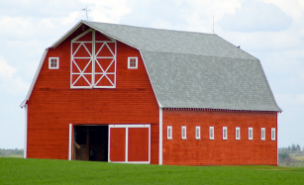
Well Maintained Barn
Road Condition: Excellent
Treatments: Minimal to None
Service Cost: Minimal to None
Inventory Trend: Severe Decrease

Slide 24
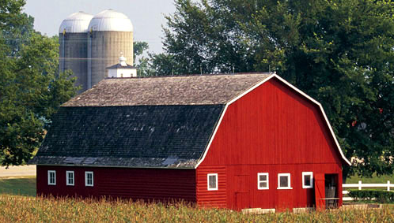
Minor Repairs
Road Condition: Very Good
Treatments: Seals & Patching
Service Cost: $1.50/ sq yd
Inventory Trend: Slight Decrease

Slide 25
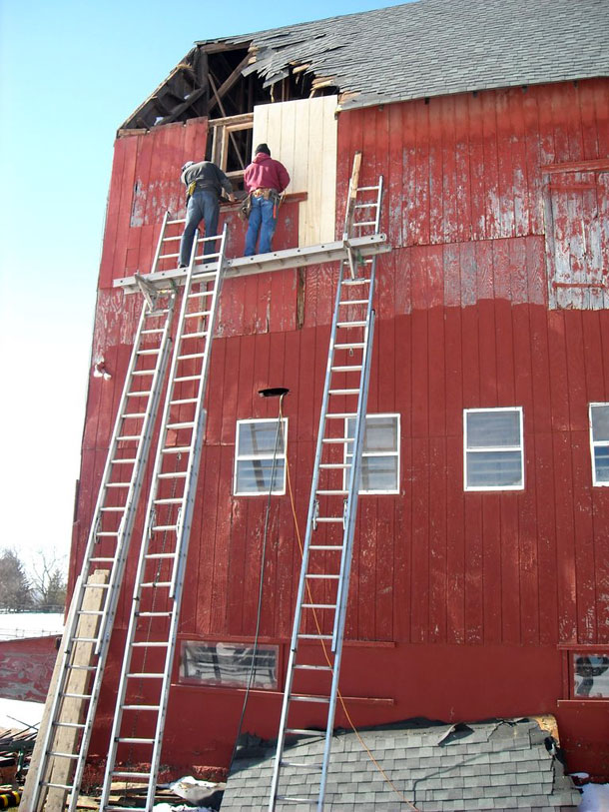
Major Repairs
Road Condition:
Good to Fair
Treatments: Overlays
Service Cost: $8/ sq yd
Inventory Trend: Severe Increase

Slide 26
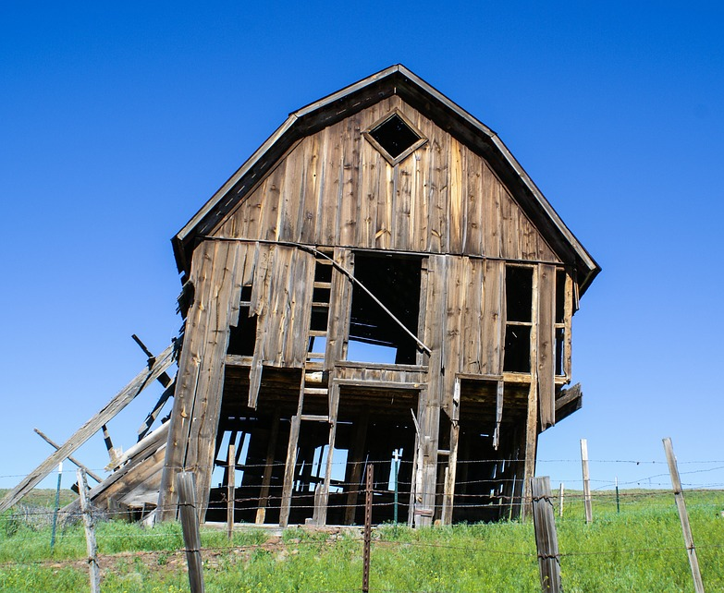
Time to Rebuild!
Road Condition: Poor to Failed
Treatments:
Generally
Reconstructions
Service Cost:
$30 plus /sq yd
Inventory Trend:
Increase

Slide 27
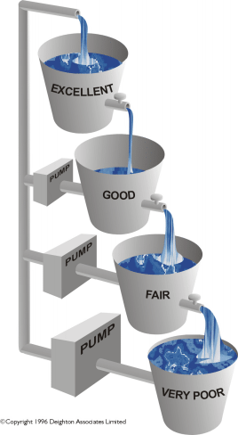
An Analogy
Process is continuous and inevitable
The rate of water flow increases as condition decreases
The effort to pump water increases with decreasing condition
Need a bigger ($) pump!
Seal =
$1.50 / sq yd
Overlay =
$8 / sq yd
Reconstruct =
$30 / sq yd

Slide 28
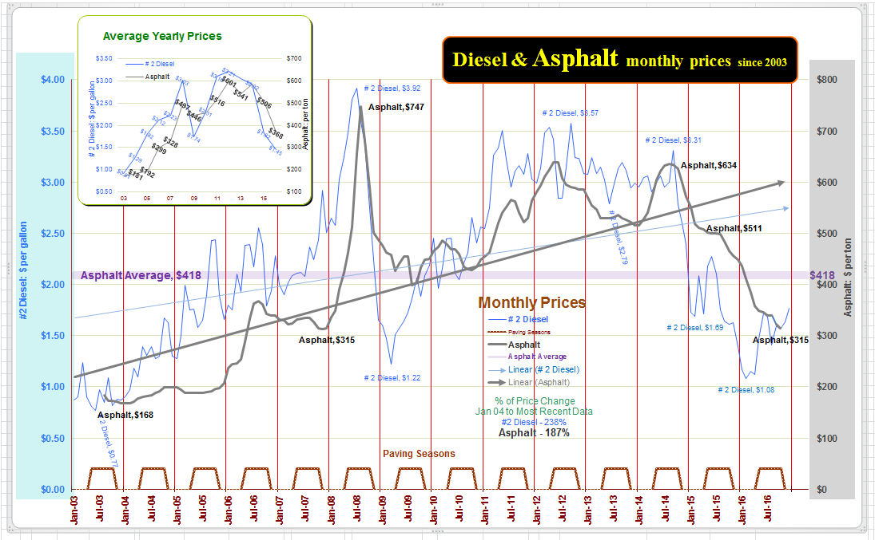

Slide 29
Maintained vs Non-Maintained County Road
Cost per Mile for 2 Lane Road Over 55 years
Pavement
Condition
Index (PCI)
Maintained
Non-Maintained
100
Excellent
80
Very Good
60
Maintained
Total =
$236 K
Life Avg.
PCI = 90
Seal
$9 K
Seal
$9 K
Overlay
$91 K
Seal
$9 K
Seal
$9 K
Overlay
$91 K
Seal
$9 K
Seal
$9 K
=
Fair
40
Initial Building Cost
$300 K
20
Non-Maintained
Total =
$600 K
Life Avg.
PCI = 76
Failed
Rebuild
$300 K
Rebuild
$300 K
=
0
0
5
10
15
20
25
30
35
40
45
50
55
Years
The poorer the road, the greater the liability.

Slide 30
Maintained vs Non-Maintained County Road
Average PCI Experienced Over 55 years
Pavement
Condition
Index (PCI)
Maintained
Non-Maintained
100
Overlay
Overlay
Maintained
Life Avg.
PCI = 90
90
80
Non-Maintained
Life Avg.
PCI = 76
70
Rebuild
Rebuild
60
50
0
5
10
15
20
25
30
35
40
45
50
55
Years

Slide 31
PCI NO$
Maintained vs Non-Maintained County Road
Average PCI Experienced per Dollar Spent Over 55 years
PCI $
Buying
Power
Ratio*
(BPR)
Maintained
Non-Maintained
35
30
Overlay
25
Overlay
20
Maintained
Life Avg.
BPR = 17.0
15
10
Non-Maintained
Life Avg.
BPR = 8.4
Rebuild
5
Rebuild
Initial investment ($300 K) is included in calculations
Comparison Ratio = 2.02
0
0
5
10
15
20
25
30
35
40
45
50
55
* Buying Power Ratio =
Avg. PCI Mile / $100,000 Invested
Years

Slide 32
Maintained vs Non-Maintained County Road
Average PCI Experienced per Dollar Spent Over 55 years
(Inflated at 3% Annually)
Buying
Power
Ratio*
(BPR)
Maintained
Non-Maintained
35
30
25
20
Overlay
15
Overlay
Maintained
Life Avg.
BPR = 10.3
10
Rebuild
Non-Maintained
Life Avg.
BPR = 3.4
5
0
Initial investment ($300 K) is included in calculations
Rebuild
Comparison Ratio = 3.03
0
5
10
15
20
25
30
35
40
45
50
55
* Buying Power Ratio =
Avg. PCI Mile / $100,000 Invested
Years

Slide 33
PCI Points Lost per Year
Model for Pavement Life of 30 years
Pavement
Condition
Index (PCI)
100
Excellent
Loss of 2-4 PCI Points per Year
80
Very Good
Good
60
Loss of 8-12 PCI Points per Year
Fair
40
Poor
Very Poor
Loss of 1-6 PCI Points per Year
20
Failed
0
0
5
10
15
20
25
30
Years

Slide 34
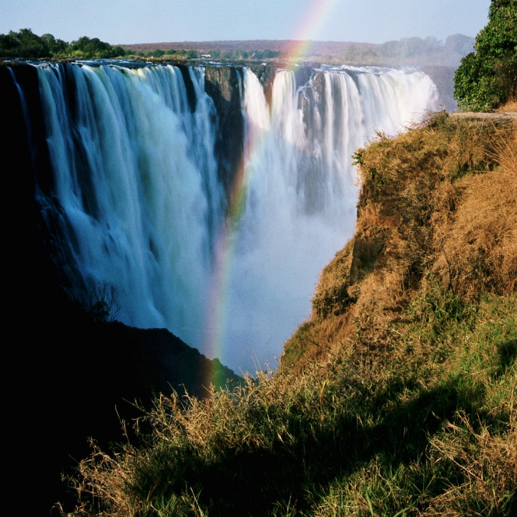
PCI Points Lost per Year
Model for Pavement Life of 30 years
Pavement
Condition
Index (PCI)
Financial liabilities
increase rapidly as the
pavement deteriorates down
the waterfall.
100
Excellent
85
Loss of 2-4 PCI Points per Year
Very Good
70
Good
Waterfall
Loss of 8-12 PCI Points per Year
50
Fair
40
Poor
25
Loss of 1-6 PCI Points per Year
Very Poor
10
Failed
0
0
5
10
15
20
25
30
Years

Slide 35
An Analogy
repeat
slide
Process is continuous and inevitable
The rate of water flow increases as condition decreases
The effort to pump water increases with decreasing condition
Need a bigger ($) pump!
Seal =
$1.50 / sq yd
Overlay =
$8 / sq yd
Reconstruct =
$30 / sq yd

Slide 36
Percentage %
( - )( )
Budget
Costs
Efficiencies
Management,
Workmanship
=
Performance
PCI,
Remove Risks/ Hazards
Page 7 of 7

