Slide 1
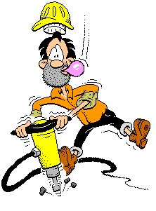
UTILIZING GRINDINGS ON RURAL ROADS:
Converting Gravel Roads to Hard Surface

Slide 2
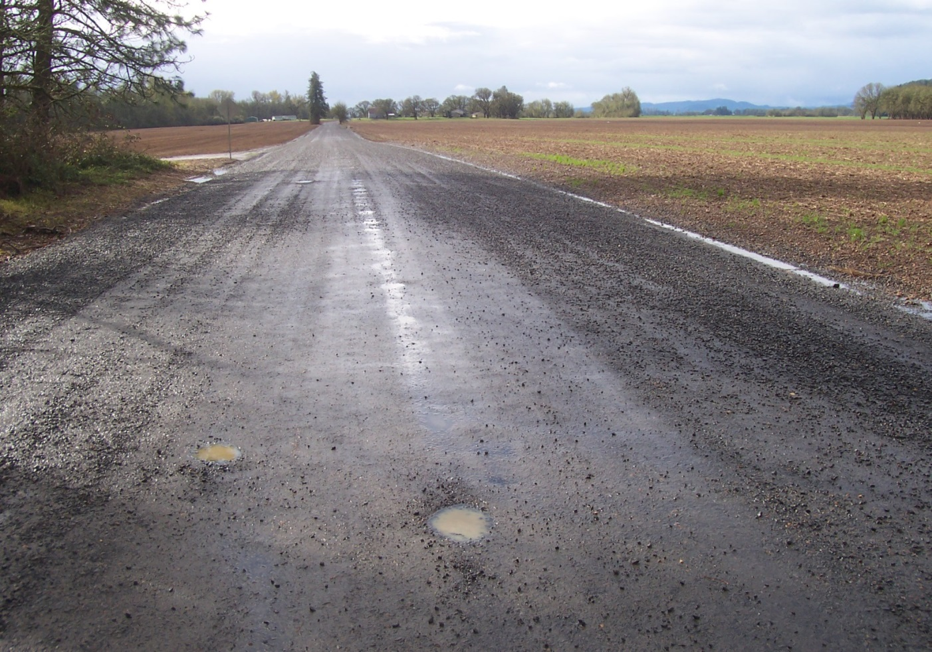
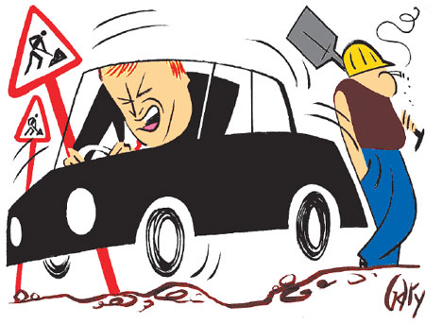
Smith Loop Before Grindings Application
2 miles of gravel road
Approximately 4 inches of gravel
Daily traffic count of 100

Slide 3
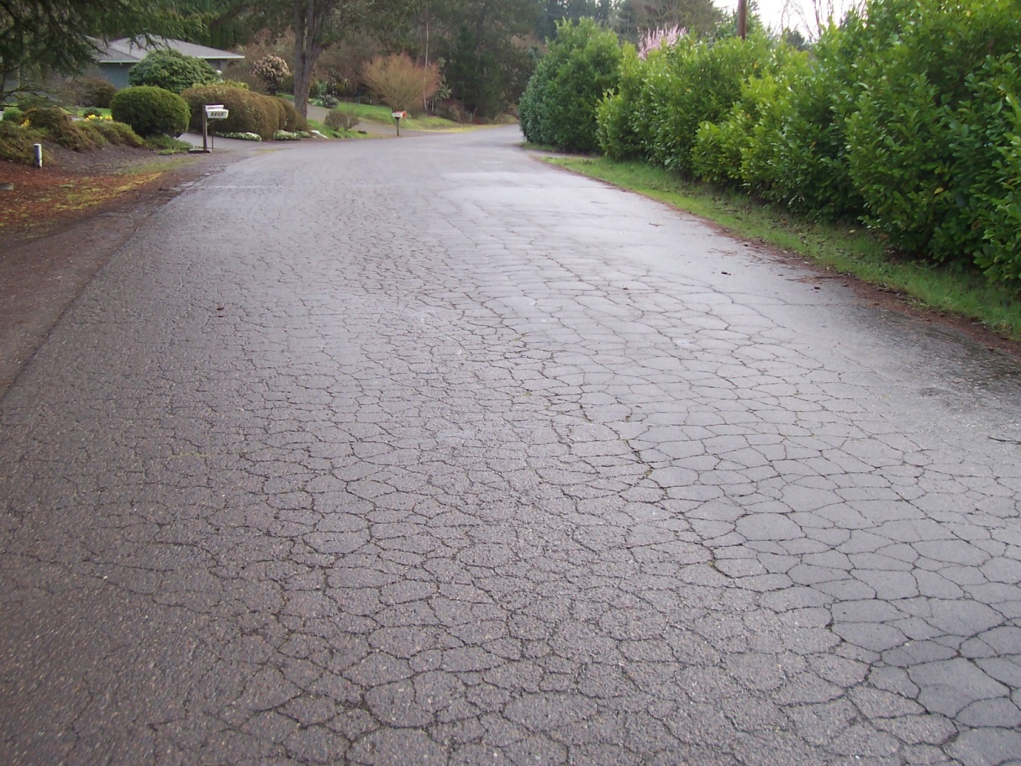
Bad Grinding Source
Quality of Product Source Very Important
Be wary of
Large alligators
F mix road
Road that has fabric

Slide 4
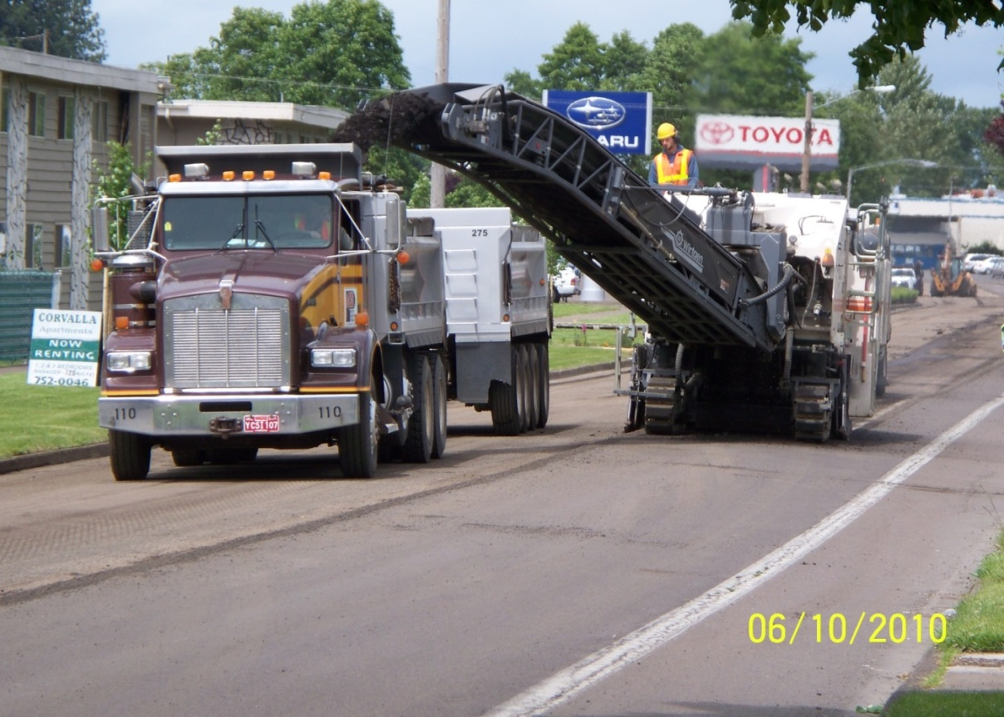
Good Grinding Source
Quality of the surface that is being torn up will affect the size of the resulting product.
Look for
Smooth surface
Not a lot of patching
No fabric
Will result in consistent product

Slide 5
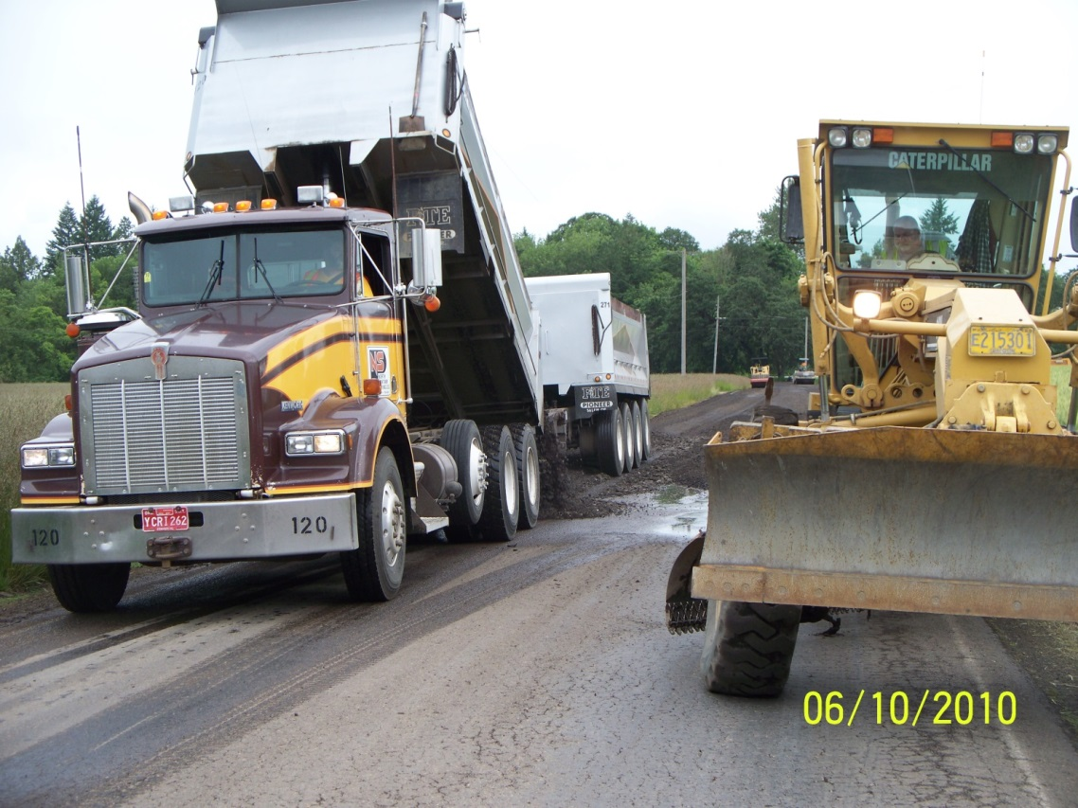
Manage Production Rates
To control the quality of work:
Know your source’s production rate,
Know your production rate,
Make a plan to control both.
e.g. We designate a stockpile site where loads can be staged.

Slide 6
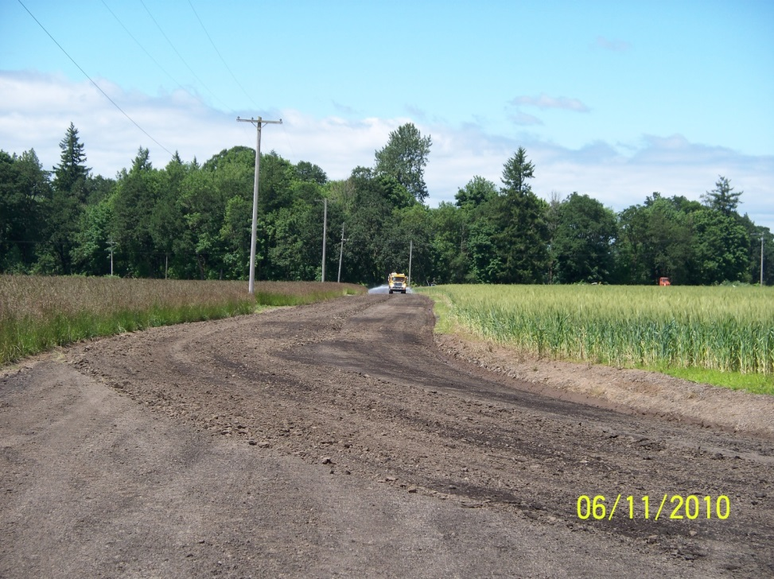
Water is Very Important in the Process: Have a Consistent Source
Helps product bind together
Helps control
fines: brings
them to surface
Source should be close
It will take more than you think

Slide 7
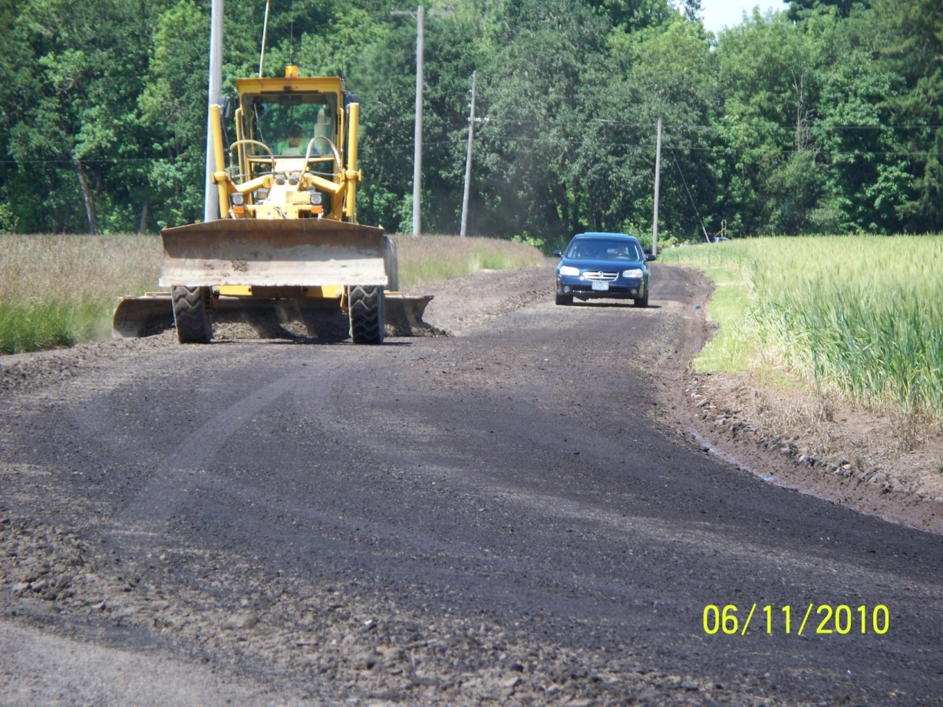
Phase 1: First Grader
First pass
Works larger grindings toward the center of the road
Sets depth of grindings
Levels surface
Lays out bigger grindings for roller

Slide 8
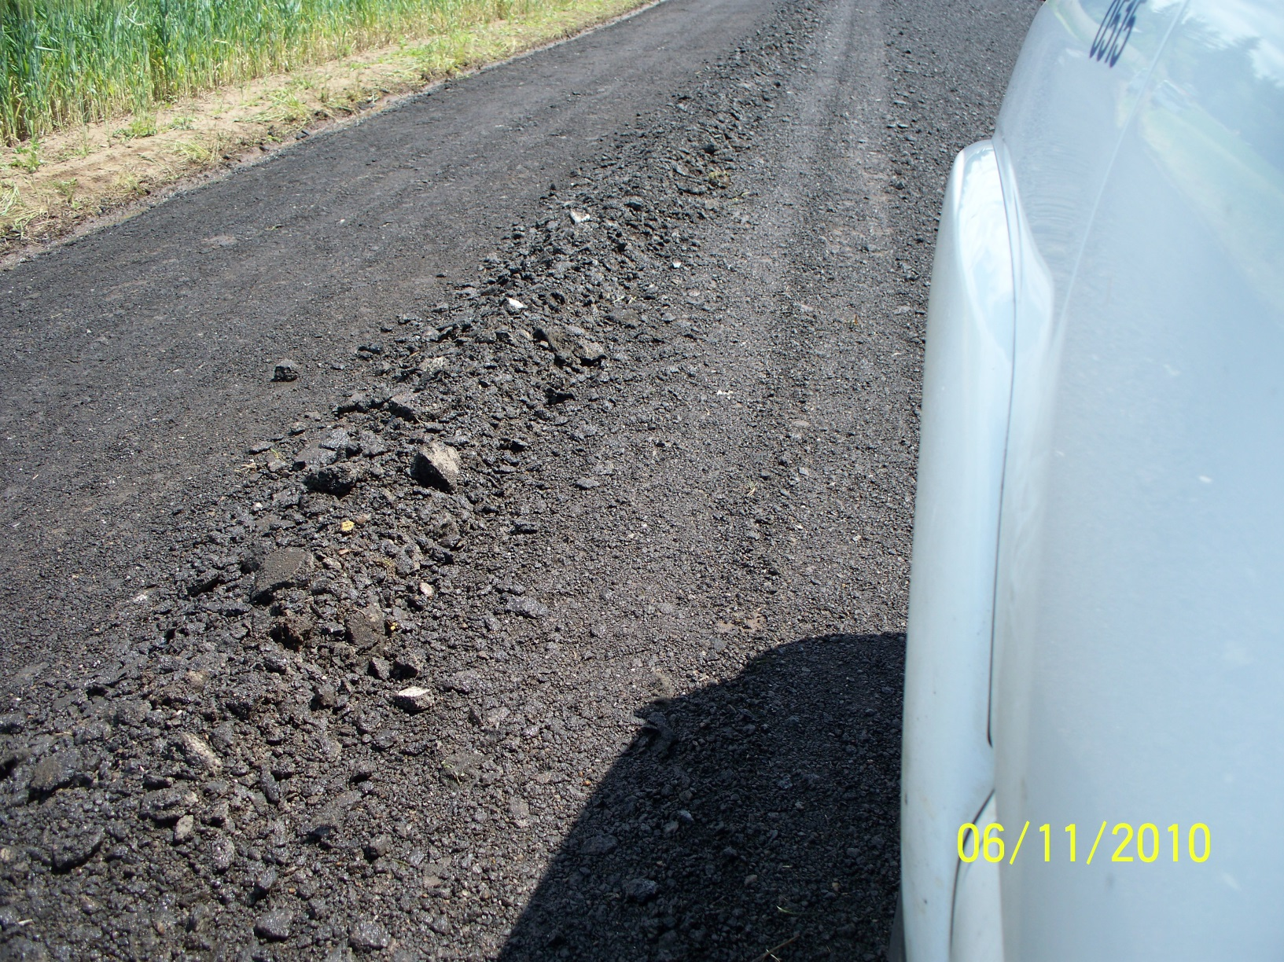
Larger Grindings Pulled to the Middle of Road

Slide 9
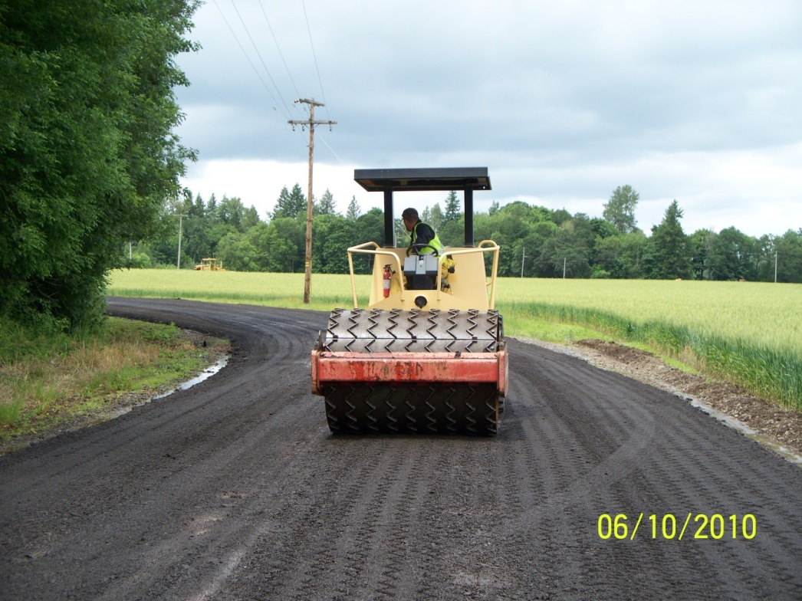
Elliott Grid Roller Breaks larger pieces to finished size
Breaks down grindings more consistently than a sheep foot roller
2) Doesn’t leave
holes in road
surface

Slide 10
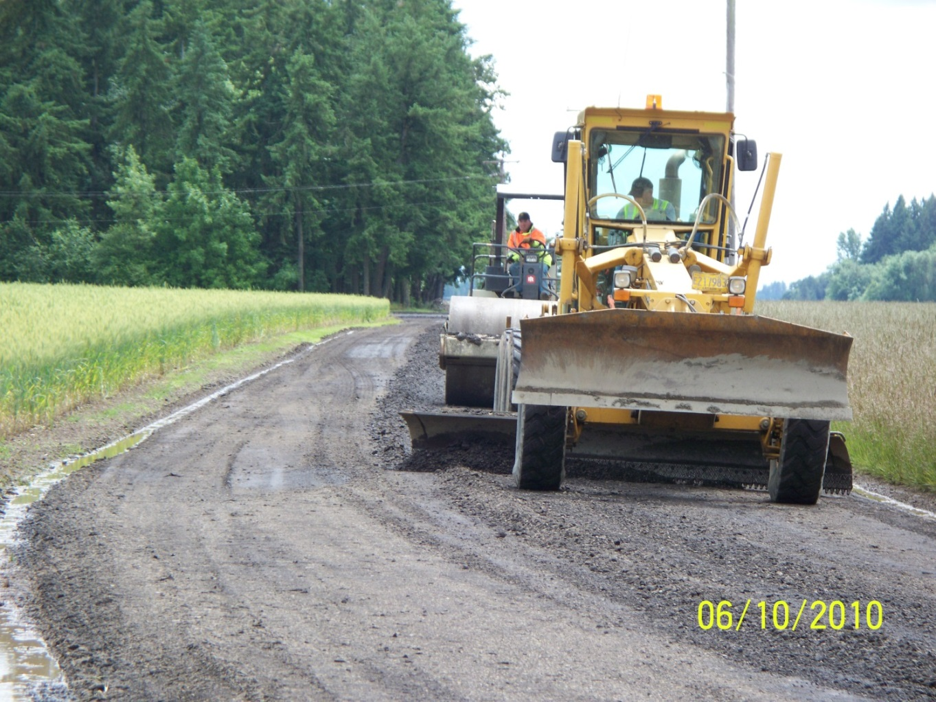
Second Grader with a Roller
First grader determines depth
Second grader shapes road
Smooth Roller follows and compacts to grade

Slide 11
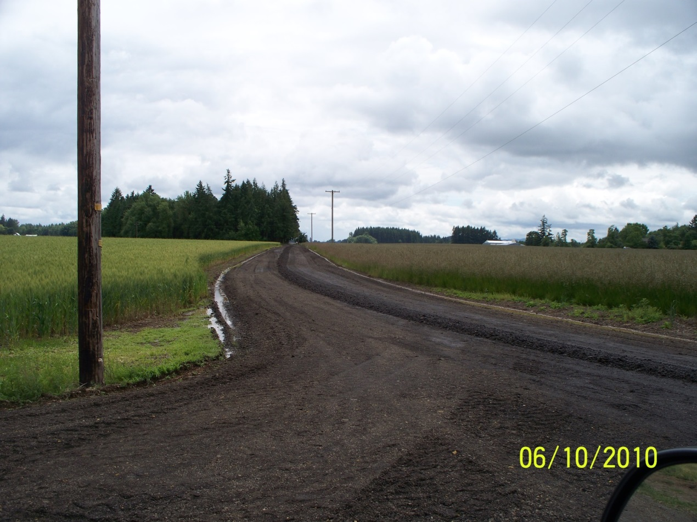
Grindings are also used to Build up Intersections and Approaches

Slide 12
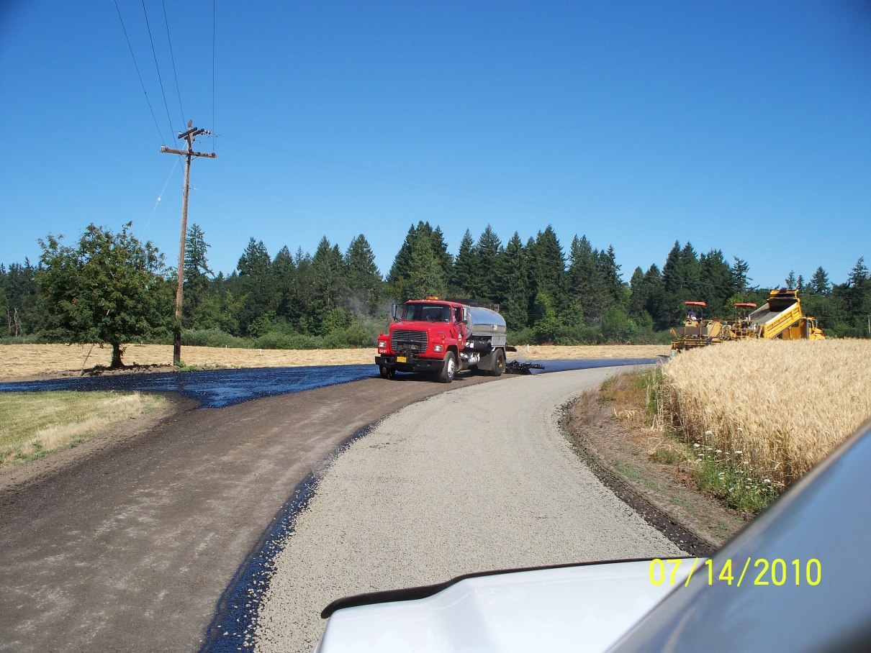
Phase 2: Chip Seal Process
After final roll, no traffic is allowed on the road until the first lift of chip seal is done.

Slide 13
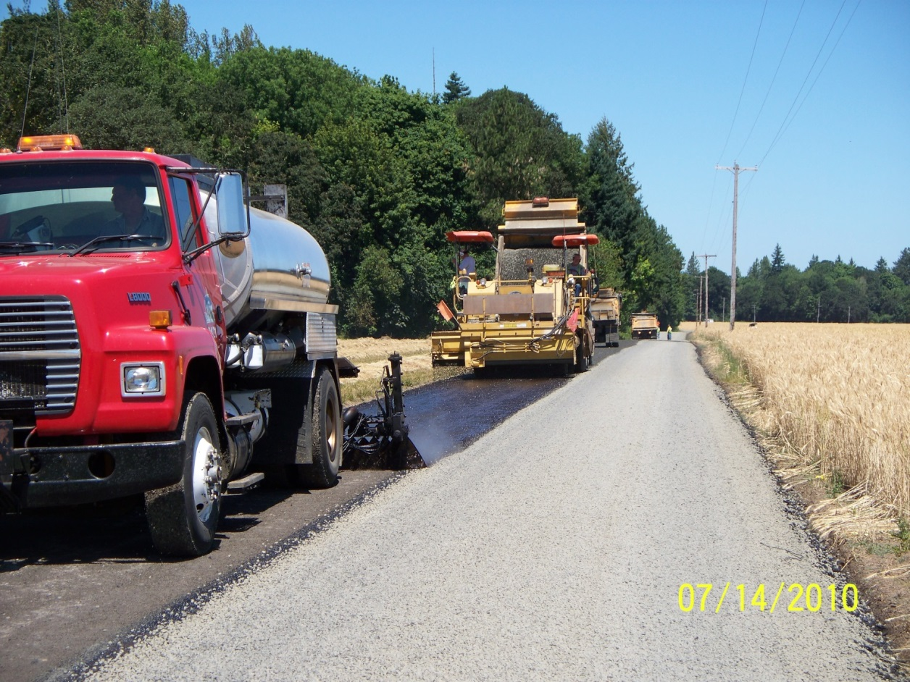
Double Chip Seal
Two options:
Two lifts of 3/8” rock (better for high truck traffic)
OR
One lift of 3/8”, and 1 of ¼” (better for bikes)
Shot rate: .40

Slide 14
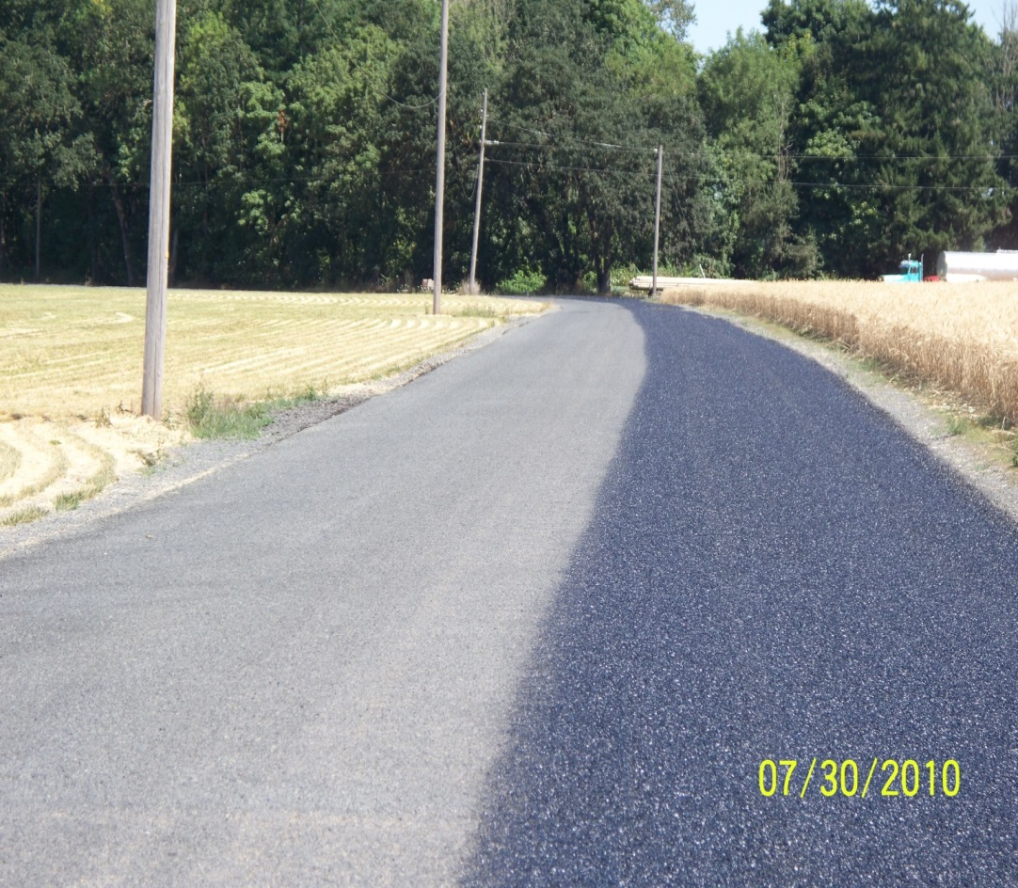
Phase 3: Fog Seal
Final step is the application of a fog seal:
Better seal Binding effect

Slide 15
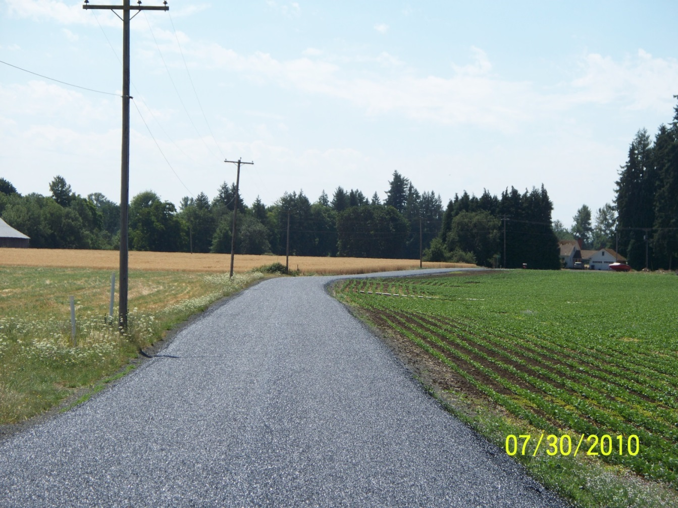
Finished Product
20 Foot Road Surface

Slide 16
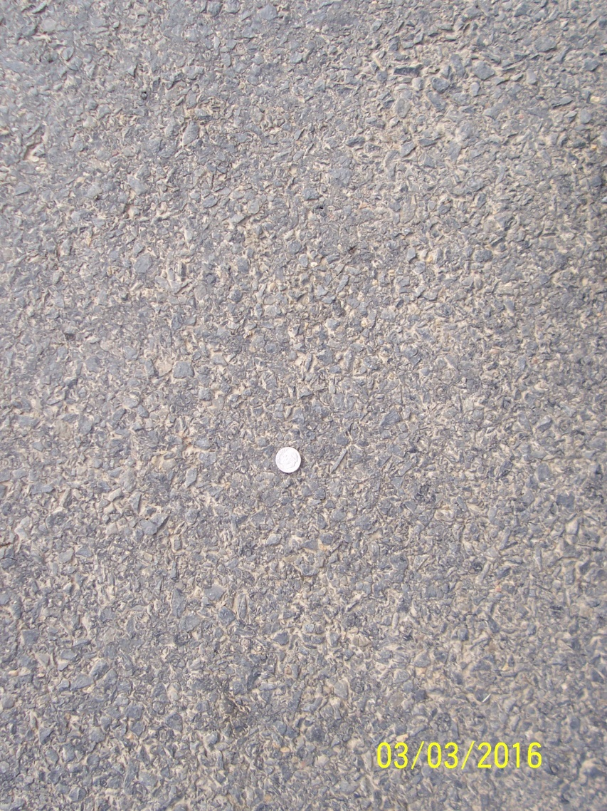
Six years later
Tight surface
Dime

Slide 17
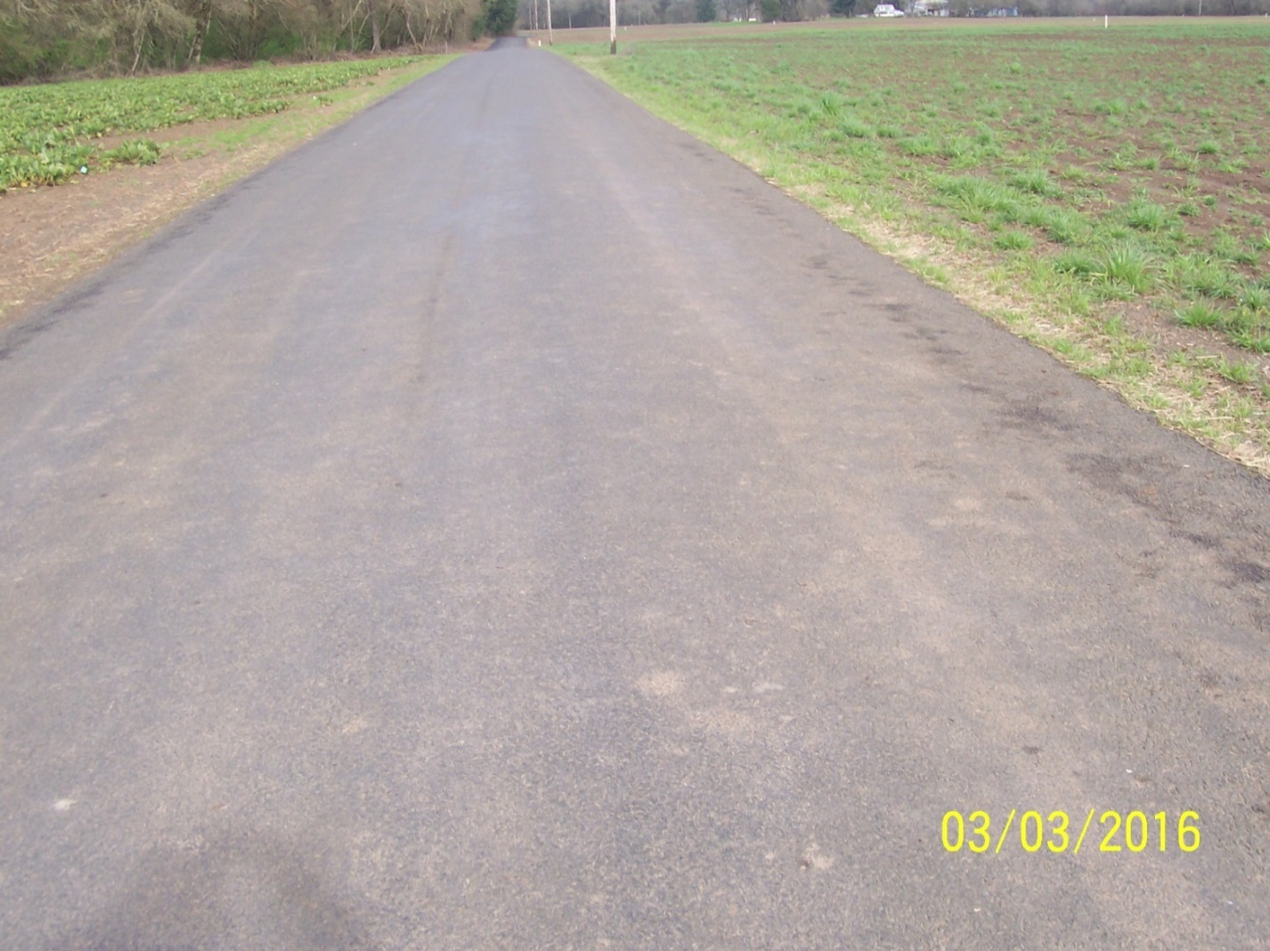
Current Photo
No Base Failures

Slide 18
Cost Summary
Base Cost:
Material
Grindings $10.20/ton for 4044tons $41,251.00
Equipment
County $11,043.00
Rental $12,400
Labor
County $17,870
Total Base Cost: $82,564.00
Surface Cost:
Chip Seal $60,000.00
Fog Seal $2,400.00
Total Surface Cost: $62,400.00
Total Cost: $144,964.00
Roughly $72,482 per mile

Slide 19
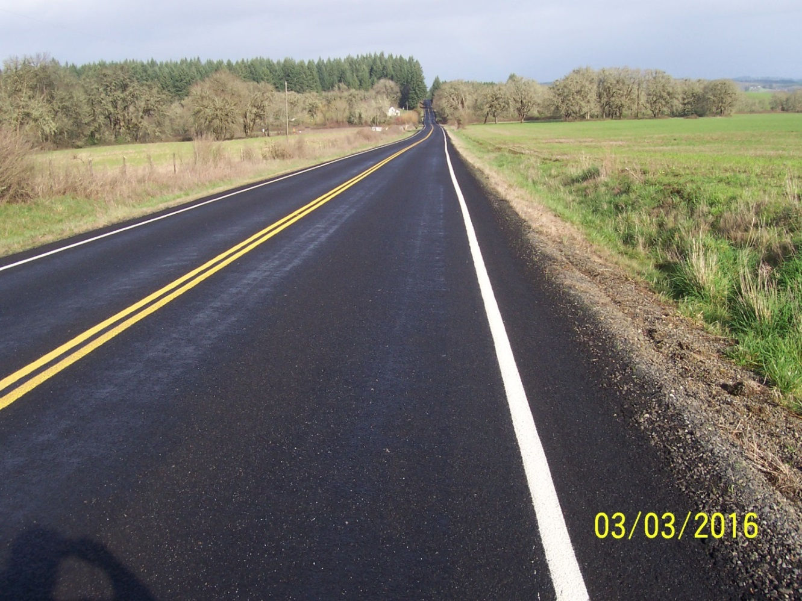
Tampico After One Year
Traffic count on this road is 250/day

Slide 20
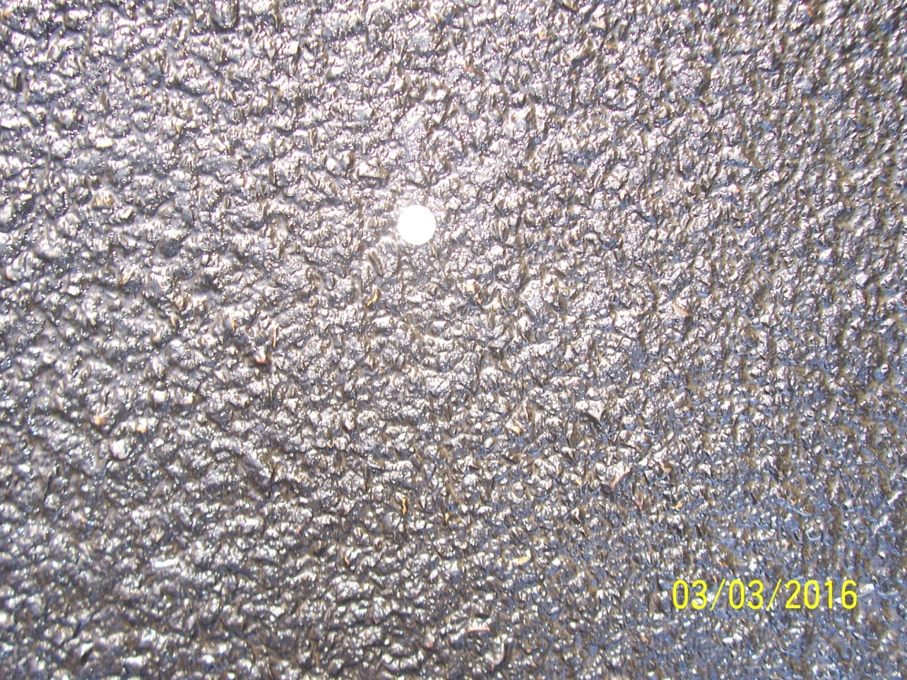
Tampico with 3/8 and ¼ Chip Seal

Slide 21
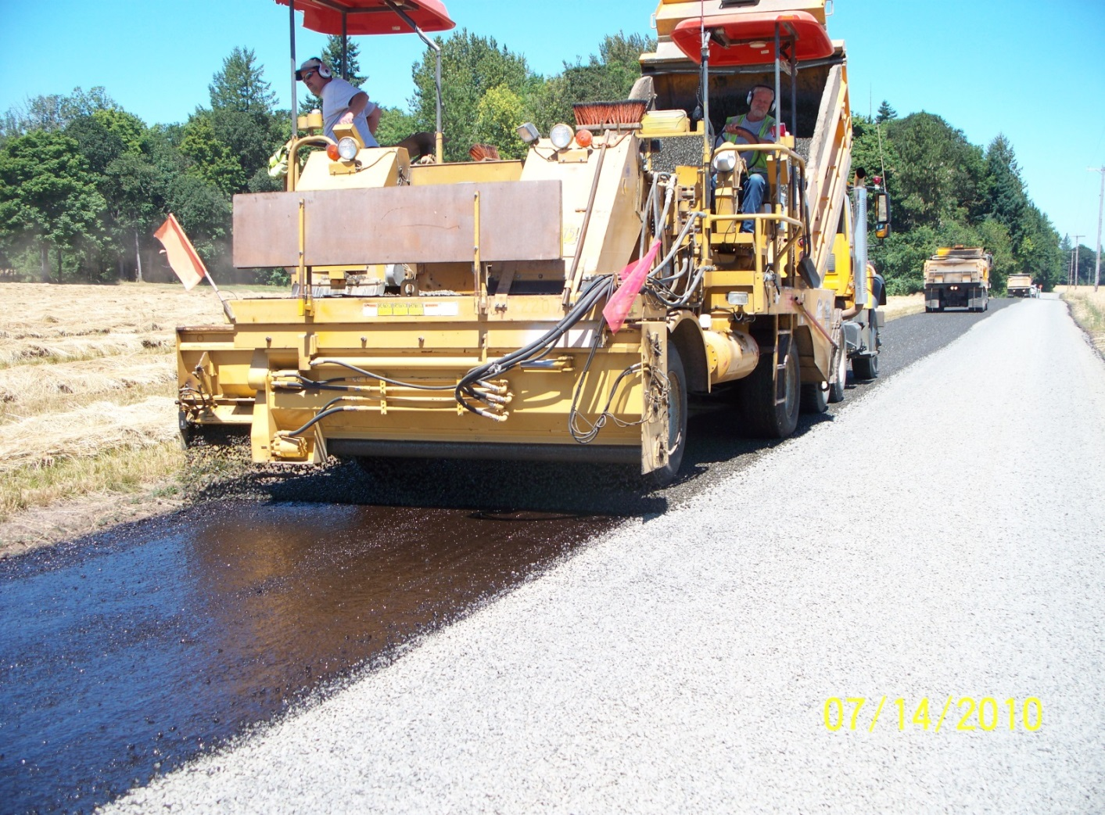
Any Questions?

