Slide 1
Gravel Road Ideas From Washington State Counties
Bob Moorhead, P.E., Maintenance Manager
OACES 2016 Enhanced Gravel Roads Treatment Workshop
Redmond, OR
March 15, 2016

Slide 2
Washington Road Mileage Summary
Jurisdiction Total Paved Unpaved
Federal Agencies 8,648 2,226 6,422
Indian Tribes 197 92 105
WSDOT 7,055 7,055 0
Other State
Agencies 8,541 172 8,369
Cities 18,084 17,191 893
Ports 15 15 0
Counties 39,208 25,651 13,557
TOTALS 81,748 52,402 29,346

Slide 3
There is a wide variance in gravel road mileage among Washington’s 39 Counties.
For the 19 Counties west of the Cascades, gravel road mileage ranges from less than 3 miles to about 74 miles (1% to 18%)
For the 20 Counties east of the Cascades, gravel road mileage ranges from less than 29 miles to more than 1,540 miles (12% to 77%).
Five Counties in Eastern Washington have more than 1,000 miles of gravel roads.
Needless to say, gravel road maintenance is a larger issue on the east side of the state.
Here are some things being tried in Washington State’s Counties:

Slide 4
Ferry County
The county has leased a Vanway V600H Linear Crusher for about 3 weeks for the past three years to reshape the template in remote locations.
The unit excavates about 8” of the roadway crown and crushes the material to about a 2” minus base course. It can also crush rocks bladed out of the ditch.
Mounts on the front of large front-end loader.
Production rate is about 3 miles per 40-hour work week.
Manufactured by Vanway Crushers, Kingston, Idaho. www.vanwaycrushers.com
Agency Contact: Lou Miller, pwprojeng@co.ferry.wa.us

Slide 5
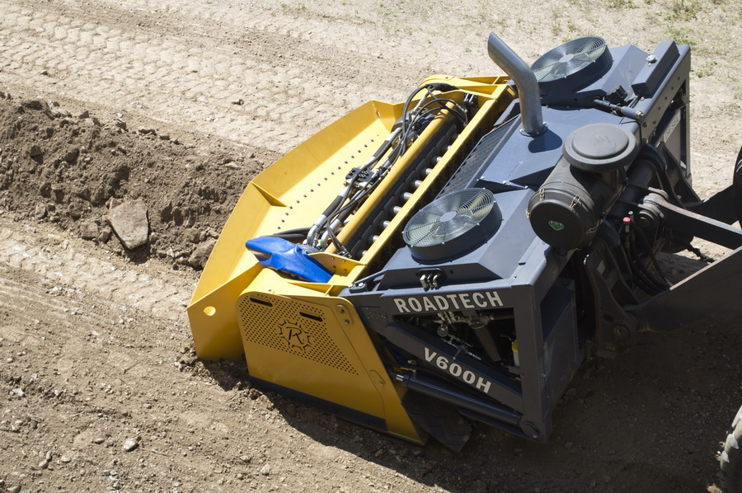
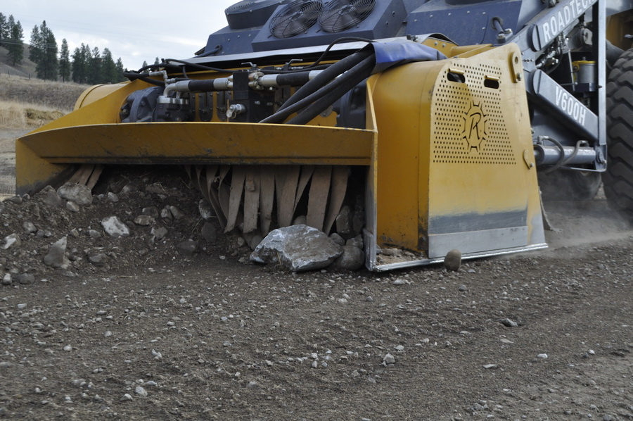

Slide 6
Columbia County
The county has recently purchased a Rock Rake.
The unit is pulled behind a 4x4 pickup truck, and has adjustable settings for the angle of the rake and the depth of the tines. The settings are adjusted hydraulically using a hand-held controller from the cab of the pickup.
By moving larger rocks to the side and sifting the gravel through the rake teeth, the surface crown can be restored and the irregular wash boarding and rutting defects can be reduced.
Manufactured by Poor Boys Grader, Tonasket, WA www.poorboysgrader.com
Agency Contact: Drew Woods, P.E., Co. Engr., andrew_woods@co.columbia.wa.us

Slide 7
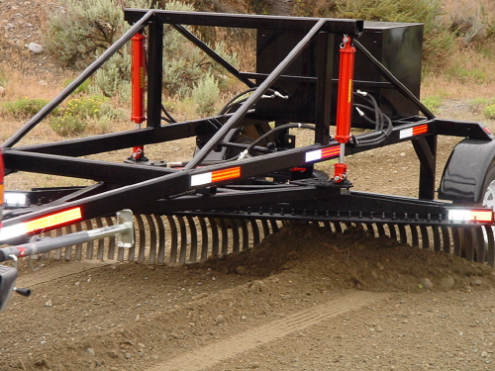

Slide 8
Adams County
Uses a mixture of 80% Magnesium Chloride/20% Lignin Sulfonate for gravel road stabilization.
Applies it only to the 500 feet of gravel road approaches to selected intersections to reduce maintenance costs.
Uses asphalt grindings as surface rock on some gravel roads. Grindings came from a major WSDOT resurfacing project on I-90.
Has identified several miles of BST county roads that will revert to gravel the next time a BST treatment is needed. The BST will be ground up in place and bladed into the gravel.
Agency Contact: Todd O’Brien, P.E., Public Works Director, toddo@co.adams.wa.us

Slide 9
Unpaved/Gravel Roads Study
The Washington State County Road Administration Board (CRAB) staff is preparing a study on current Unpaved/Gravel Roads issues and practices. It is scheduled to be adopted by the CRABoard at its meeting on April 14, 2016.
For more information, please contact:
Bob Moorhead, P.E., CRAB Maintenance Manager, (360) 350-6083, BobM@crab.wa.gov (through May 31, 2016)
Walt Olsen, P.E., CRAB Deputy Director, (360) 350-6080, Walt@CRAB.wa.gov
CRAB Website: www.CRAB.wa.gov

