Slide 1
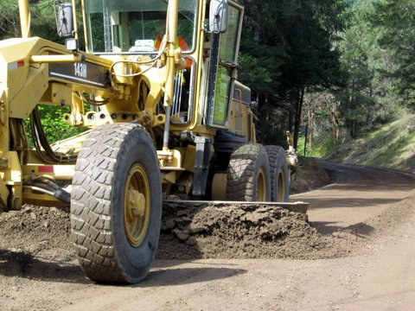
Work Zone Traffic Control
Gravel Roads

Slide 2
Work Zone Traffic Control
Gravel Roads
Challenging Facilities to Complete WZTC on
Typically are low to very low volume roads
  - So is the risk really worth the effort?
The work itself gets in the way of traffic control - No place to place cones (if you wanted them)
  - On some roads simply finding a location to place signs can be a challenge
Most operations lack staff to complete WZTC
The work zone is constantly moving and typically has a long linear length

Slide 3
Work Zone Traffic Control
Gravel Roads
The Work Does Pose Hazards to the Public and to Us
A survey of Oregon Counties found that most have had accidents or close calls with private parties while completing the work (none were serious)
Very slow moving equipment in the road
Limited visibility
Equipment can occupy much of the road
“Gigantic” berms
The road itself can contribute to a hazard, i.e heavily potholed or washboarded roads

Slide 4
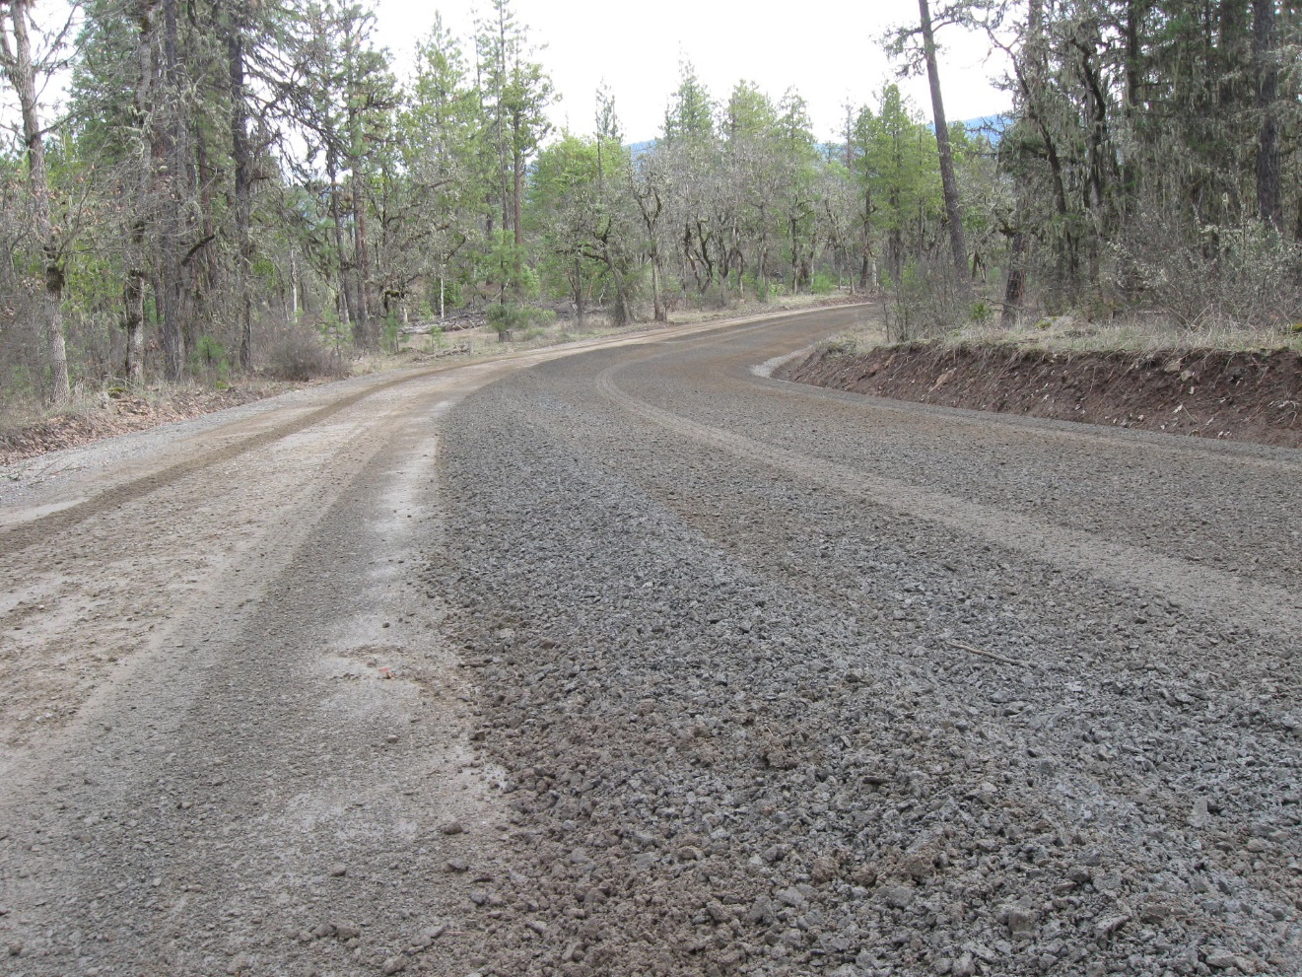

Slide 5
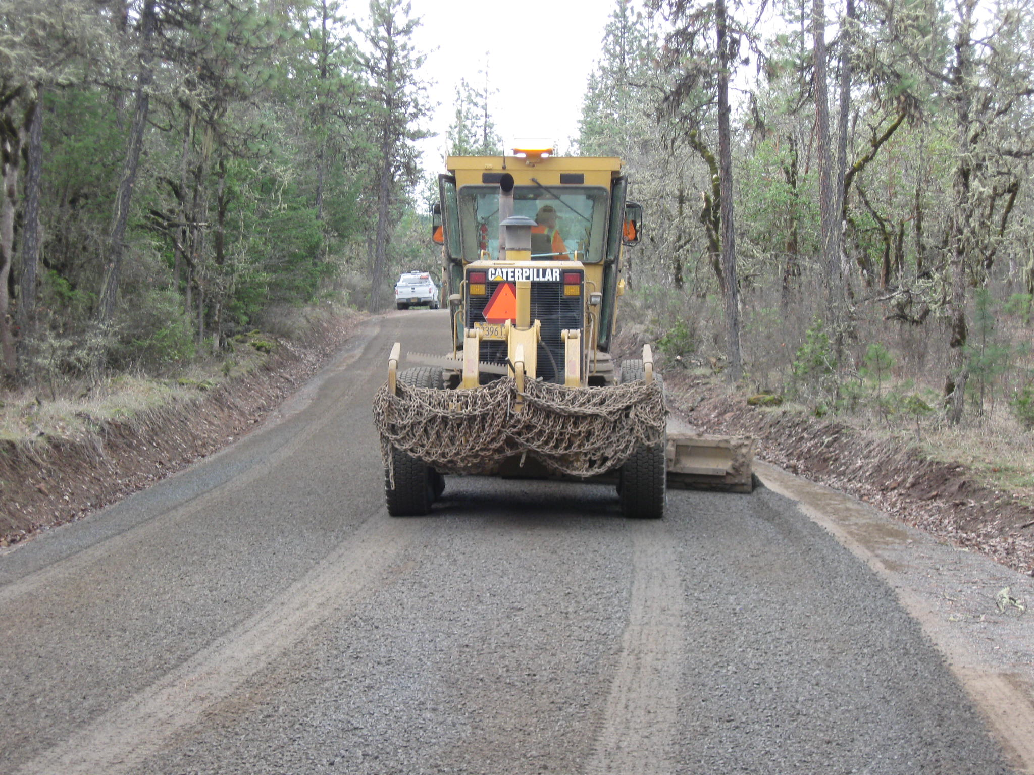

Slide 6
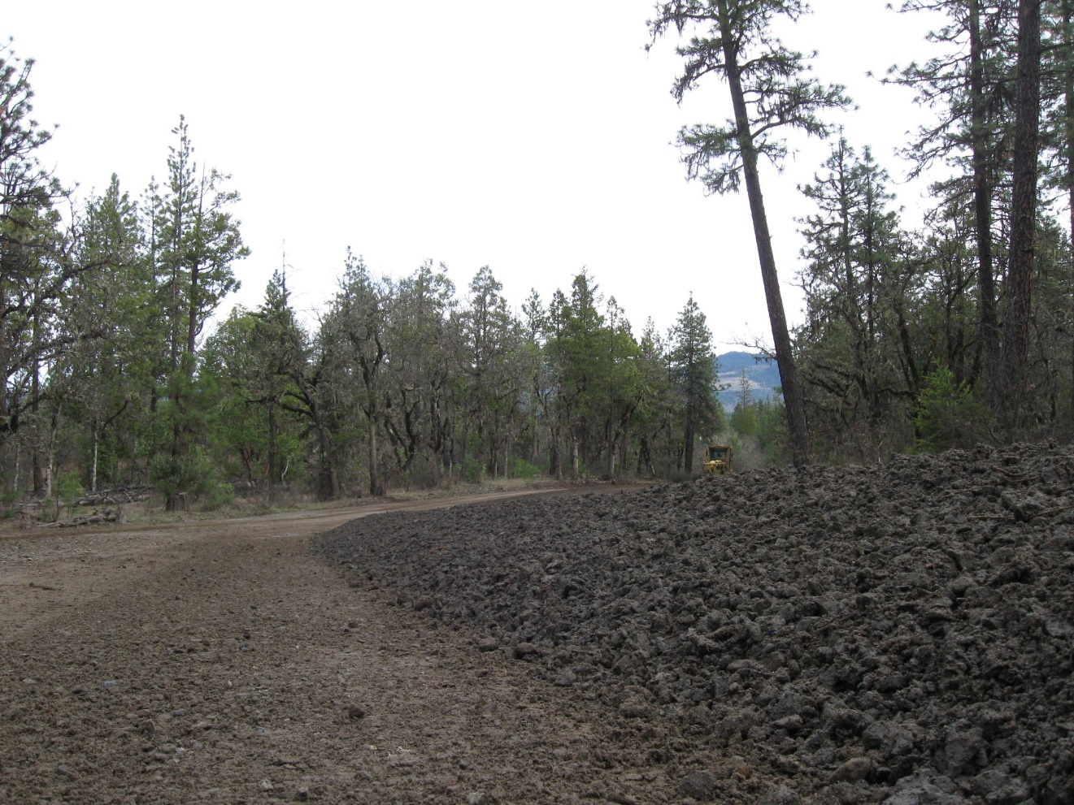

Slide 7
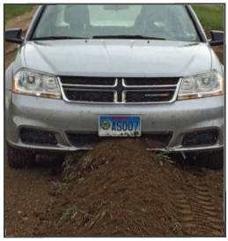

Slide 8
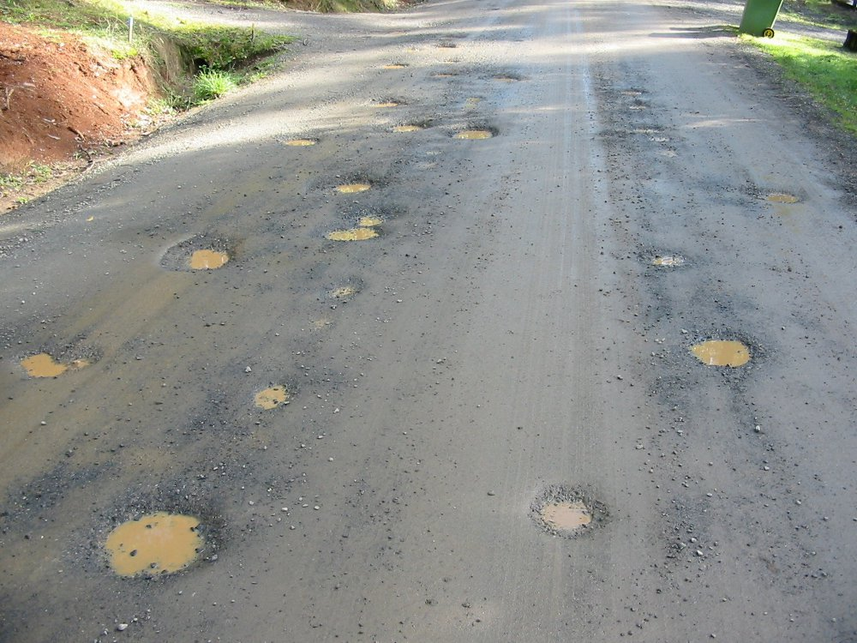

Slide 9
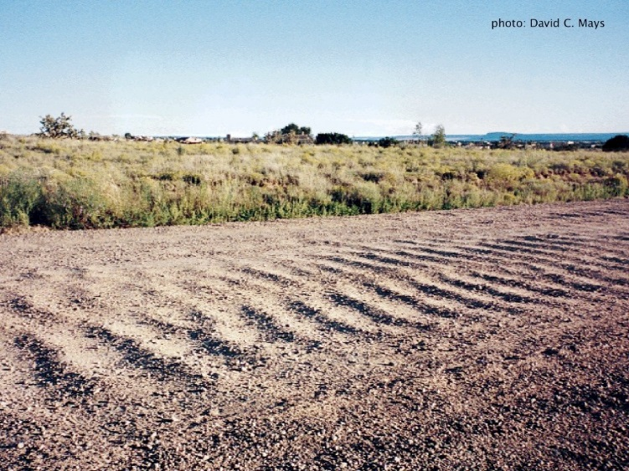

Slide 10
Work Zone Traffic Control
Gravel Roads
ORS 810.200
The Oregon Transportation Commission may exercise the following authority with respect to the marking, signing and use of traffic control devices in this state:
(a) The commission shall adopt a manual and specifications of uniform standards for traffic control devices consistent with the provisions of the vehicle code for use upon highways in this state.

Slide 12
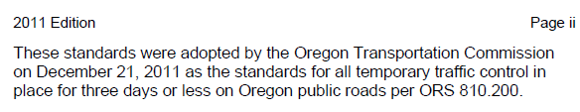
Budget Overview
Oregon Temporary Traffic Control Handbook December 2011
By way of Oregon law, all local governments should (must) use this handbook for all temporary traffic control completed by our forces.
My guess is almost none us do for WZTC on gravel roads
Creates risk and liability for us as we are not following published standards.
Notes:
Review each

Slide 13
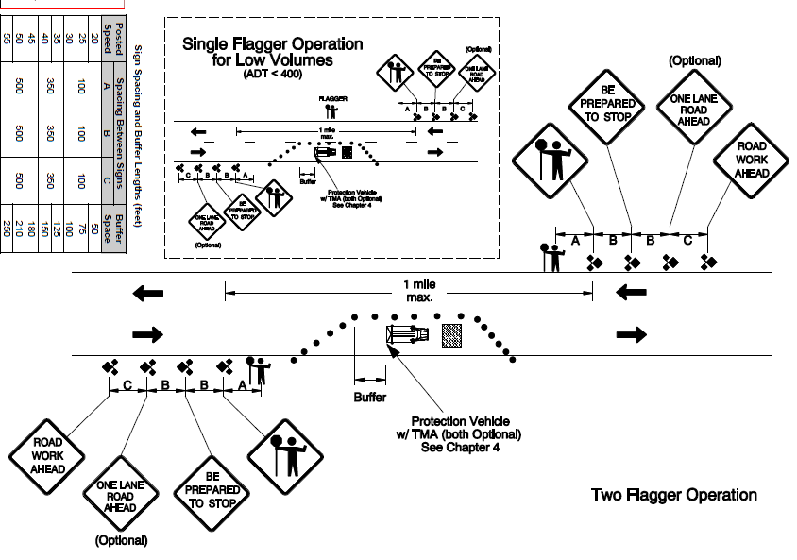
Jackson County Roads & Parks
Stationary Closure with Flaggers
(Diagram 320)

Slide 14
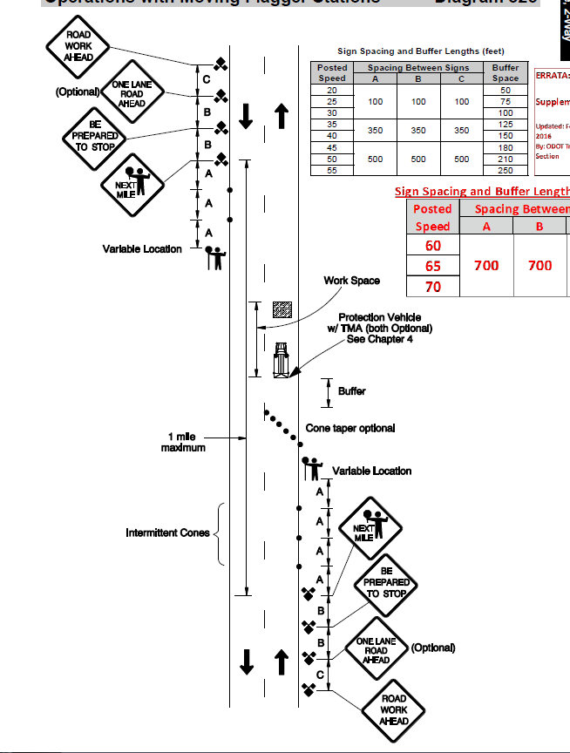
Operations with Moving Flagger Stations
(Diagram 325)

Slide 15
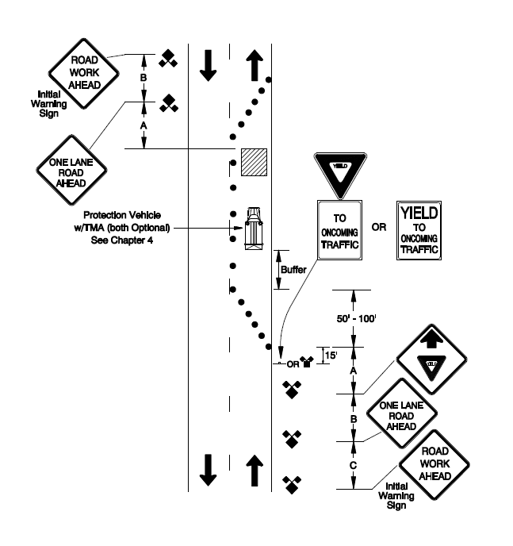
(Standard notes that this can only be used for work spaces of 200 feet or less)
Self-Regulating Lane Closure
(Diagram 350)

Slide 16
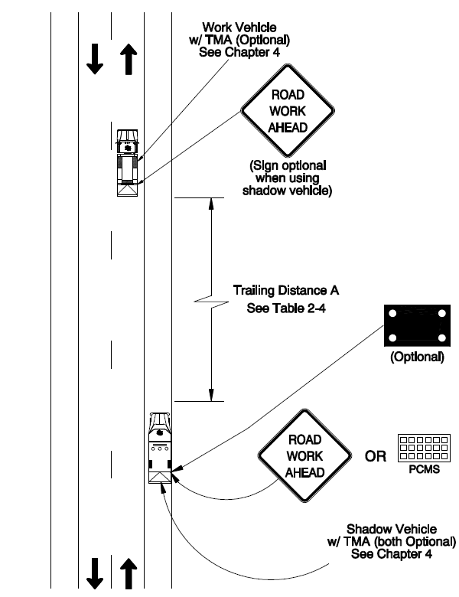
(Standard specifically notes that this standard does not apply to work on gravel roads)
Mobile Operation on Two-Lane Roads
(Diagram 110)

Slide 17
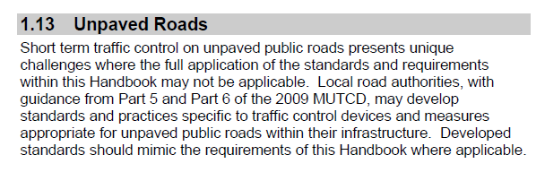
Oregon Temporary Traffic Control Handbook December 2011
ODOT recognized that the standards don’t work for gravel roads
Gave us an out – we should take advantage of that
Needs to be a formalized process
Notes:
We have been planning for Timber Revenue going away
Hiring freeze
Service reductions

Slide 18
Work Zone Traffic Control
Gravel Roads
In 2012 OACES completed a survey of Oregon Counties to determine current WZTC practices on gravel roads
All counties use flaggers with full work zones for more complex work
Grading operations rarely use flaggers – almost never
Most common work zone is a single ROAD WORK AHEAD, ROAD MACHINERY AHEAD, or GRADER AHEAD on each end and - nothing else.
(my personal favorite was a county that bolted a ROAD
WORK AHEAD on the front and back of the grader and
called it good)

Slide 19
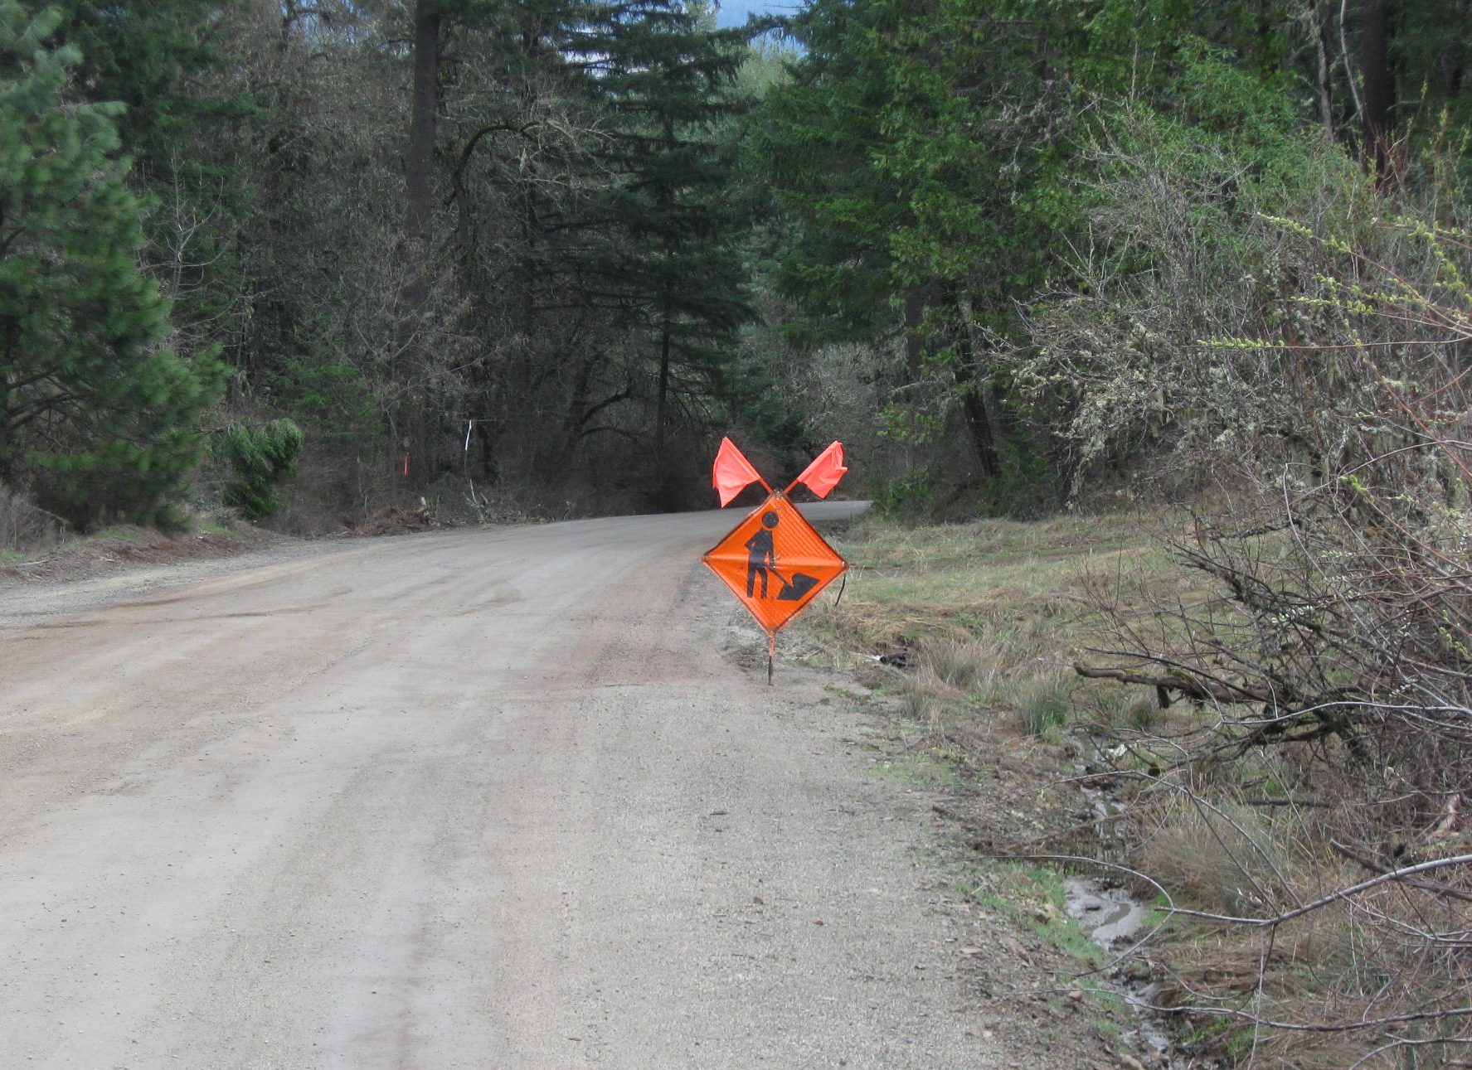
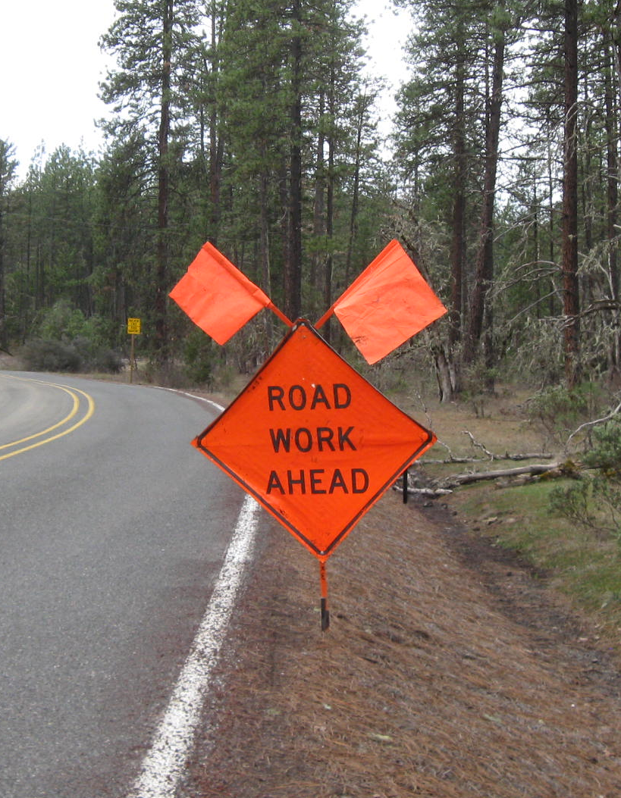

Slide 20
Work Zone Traffic Control
Gravel Roads
2012 OACES survey continued
Several counties set one sign – completes first pass – sets second sign at turn around for second pass
A few counties use two signs on each end
  Generally use two standard warning signs in combination
  ROAD WORK AHEAD + ROAD MACHINERY AHEAD or
  ROAD WORK AHEAD + GRADER AHEAD or
  Adding a SLOW sign to one of the signs above.
Cones – used by several counties
  Often spaced intermittently to keep drivers attention that they are in a work zone.
  Also placed at the beginning of berms

Slide 21
Work Zone Traffic Control
Gravel Roads
2012 OACES survey continued
Who sets the signs?
  Two counties use grader chasers (support staff that place signs, clear culverts, etc.)
  Most grader operators work alone and set their own signs
  Water or rock truck drivers set them if they are present
Work zone length varied widely
  1-mile or less was most common
  2-5 miles normal for some Central and Eastern
  “Work zone length? I don’t know, I tell them to grade outward until lunch, eat, turn around and come back and call it a day.”

Slide 22
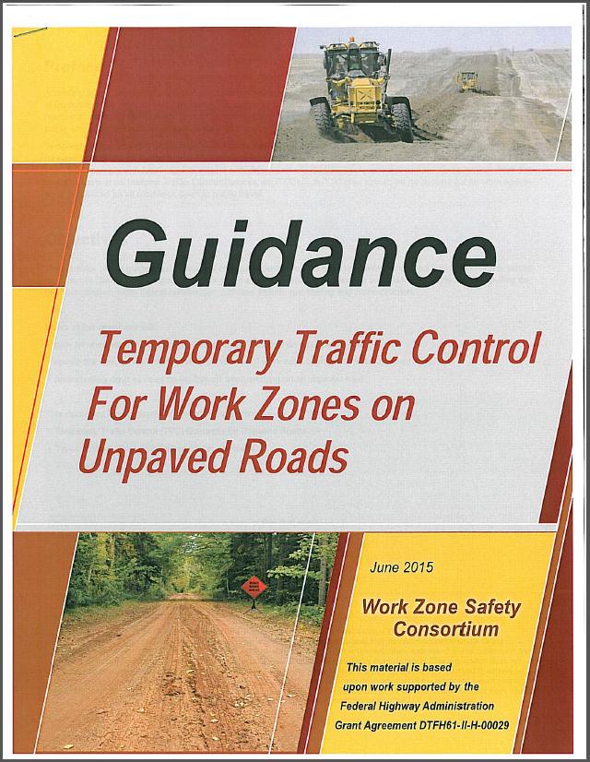
Few standards
2009 MUTCD, Parts 5 and 6 give little help
Some states have standards (not sure we want to follow those)
Work Zone Safety Consortium completed a guidance document funded through a FHWA grant
Best Practices from the counties

Slide 23
Work Zone Traffic Control
Gravel Roads
Recommendations
If your not using the Oregon Temporary Traffic Control Handbook for all your work (which none of us are) – Develop your own written and reviewed standards
OACES is going to develop a couple of model standards
If an operation is more than simple grading – increase your traffic control
Consider increasing your signs to more than one
Consider intermittent cones where width allows and traffic is higher

Slide 24
Work Zone Traffic Control
Gravel Roads
Recommendations
No night work and consider impact of fog
Use roto-beams on equipment
Consider adding flags to corners of grader moldboard
Watch the length of your work zones
    - 1-mile or less for limited sight distance roads
    - more than 1-mile probably okay in open county
Keep your berms easily traversable for expected traffic
Don’t take chances

Slide 25
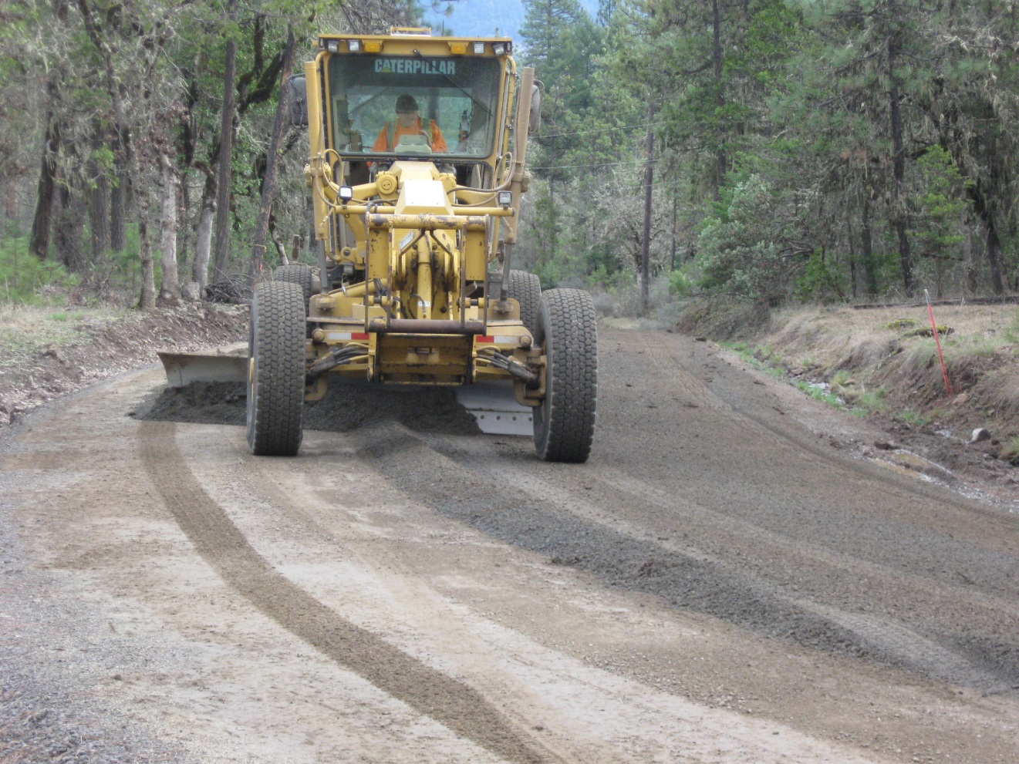
Work Zone Traffic Control
Gravel Roads
Questions or Comments

