Slide 1
OACES 2016 Enhanced Gravel Road Treatments Workshop Redmond, OR
Jackson County Dust Abatement Program and Driving Surface Aggregate

Slide 2
Jackson County has over 160 miles of gravel road within the road maintenance program. It is cost prohibitive for our department to include dust control as part of our regular maintenance. However, in order to provide some relief during the hot, dusty summer months we have developed a dust abatement program where we will treat gravel roads if the residents share the cost.

Slide 3
As the county does receive a benefit (fewer gradings), the cost to residents living on county maintained roads is a prorated cost per foot, being reduced according to a continuous, uninterrupted application of product (longer the run, the cheaper the cost). Residents pay 44% to 68% of the treatment cost. Residents living on local access roads pay full county cost plus road preparation cost.

Slide 4
Two Types of Dust Abatement used by Jackson County
Lignin
Earthbind™

Slide 5
What is Lignin?
Commercial Lignin is produced as a co-product of the paper industry. It is separated from trees by a chemical pulping process. It is used on unpaved roads to reduce environmental concerns from airborne dust particles, and to stabilize the road surface.
Creates a Denser, Firmer Road Cap
Lignin treatment binds the loose dirt and gravel into a hardened more skid-resistant surface.
Safe for the Environment
Lignin is non-toxic when properly applied, making it safe for foliage and surface water surrounding roadways.
Improves Safety
By controlling dust clouds, visibility on dirt roads is significantly increased, adding to driving comfort and safety.
Reduces Road Repairs
Hardened road surfaces are less likely to suffer the ribbed “washboard” effect common with untreated gravel or dirt roads.

Slide 6
What is Earthbind™?
Earthbind™ is a quality, versatile, dust control agent. Diluted in water, it is applied to roads and other environments where airborne dust is unwanted. Earthbind™ is considered a safe solution for dust control.
Earthbind™ is formulated with environment friendly polymers and surfactant. It works by binding loose soil or aggregate particles together, strengthening and waterproofing the soil/aggregate matrix.
All components of Earthbind™ are considered:
Free of hazardous solvents
Nonflammable
Noncorrosive to metal
Not considered to be harmful to aquatic and mammal life
Not considered to be carcinogenic

Slide 7
2015 Cost for Dust Abatement
Lignin
County Roads:
$0.97/foot……500 – 1,000 feet
$0.83/foot…..1,001 – 2,500 feet
$0.63/foot…..2,501 and over
Local Access Roads:
$1.44/foot, plus prep cost
Earthbind™
County Roads:
$1.21/foot……500 – 1,000 feet
$1.03/foot…..1,001 – 2,500 feet
$0.79/foot…..2,501 and over
Local Access Roads:
$1.59/foot, plus prep cost

Slide 8
Product is applied 16 feet wide at 300 feet per minute, with a minimum order requirement of 500 linear feet. Deadline for residents to pay is June 1st with application starting around July 1st and lasting 4 to 5 days. Jackson County has paid for re-shoots for weather damage. Some years have required up to $50,000 worth of lignin to be reapplied.

Slide 9
Totals for 2015: 162,541 linear feet 30.8 miles Monies collected for Lignin: $98,384.48 Earthbind: $6,927.19 Monies spent on contract Lignin: $185,602.31 Earthbind: $14,343.43

Slide 10
Jackson County has an effective Lignin based dust abatement program that is at times cumbersome to execute.
Potential vendors promise Jackson County a “cure all”
Will we be trading the family cow for magic beans?
=

Slide 11
We hope to identify a dust abatement/soil stabilization product that:
Works well in Southern Oregon
Eliminates ½ of the summer grading
Is equal to or more effective than lignin applied at 0.40 gal/sy
Is applied in 2 or less applications: 1 application immediately after grading and a topical application later if needed
Is a tank mixable concentrate
Is delivered in totes
Is mixable with ambient temperature creek, pond or city water
Is safe to be handled adjacent to streams bearing salmonids
Does not kill roadside trees
Can be applied with water trucks
Lasts from June application through September
Is less expensive in total value than lignin applied at 0.40 gal/sy
We would like to hear your thoughts on these statements.
Do we have realistic expectations?
Why or Why not?
What do you suggest?

Slide 12
Other Products
COHEREX®

Slide 13
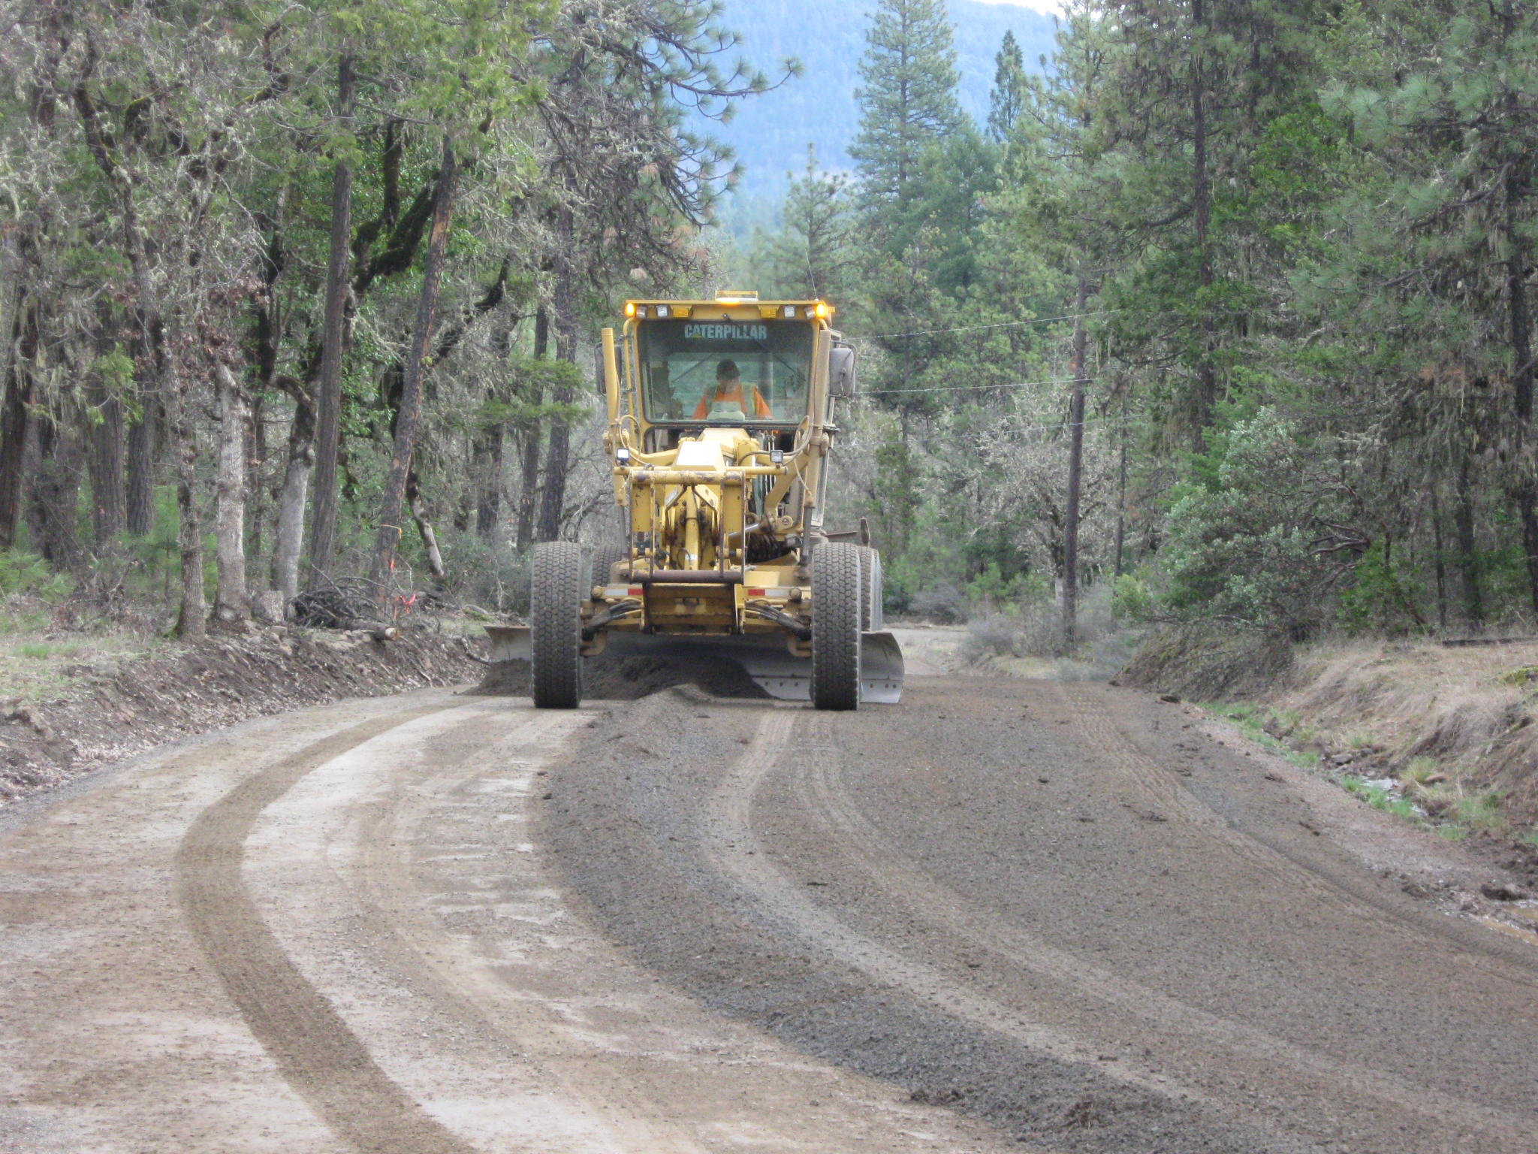
Driving Surface Aggregate

Slide 14
Driving Surface Aggregate
For many years Jackson County used ODOT Spec. ¾”-0 shoulder rock and spread decomposed granite on top to bind the surface when regarding gravel roads.

Slide 15
Driving Surface Aggregate
In 2012, Jackson County created a custom Driving Surface Aggregate Specification for the supply contracts. This specification was created after research and talking with local suppliers. The goal of this specification was to add plasticity and fines to bind the aggregate without adding to much dust or creating mud in the wet season.

Slide 16
Driving Surface Aggregate
Materials
Grading - Driving Surface Aggregate shall be crushed rock, including sand. Uniformly grade the aggregates from coarse to fine. Sieve analysis shall be determined according to AASHTO T 27.
The composition, by mass, of the 3/4"-0 Aggregate shall conform to the following table:
Screen Size Passing
1" 100%
3/4" 95-100%
3/8" 55-75%
1/4" 40-60%
#4 45-75%
#40 12-30%
#200 4-15%

Slide 17
Driving Surface Aggregate
Materials
(b) Durability - Driving Surface Aggregate shall meet the following durability requirements:
Test Test Method Requirements
Abrasion AASHTO T 96 35.0% max.
Degradation (course aggregate)
Passing No. 20 Sieve ODOT TM 208 30.0% max.
Sediment Height ODOT TM 208 3.0% max.

Slide 18
Driving Surface Aggregate
Materials
(c) Sand Equivalent – Driving Surface Aggregate shall be tested according to AASHTO T 176, and shall have a sand equivalent of not less than 25.
Furnish 3/4" - 0 Aggregate according to this specification, except that the material shall come from naturally occurring ledge rock.
(d) Plasticity Index – Driving Surface Aggregate shall be tested according to ASTM D4318 and shall have plasticity (PI) of between 2 and 8 with a target PI of 5.

Slide 19
Driving Surface Aggregate
Placement
2” minimum depth of aggregate placed
Set truck gate at “2 fist” and 5th gear
Little or no water in the winter
Saturate with water in the summer
Roll with construction roller when available
4” of gradable material already on most roads

