Slide 1



Road base stabilization
Pilot project: City Fleet parking lot, City of Portland

Slide 2
City Fleet parking lot project
City Fleet’s parking lot donated to Legacy Emanuel hospital
ODOT leased parking lot selected as replacement
  Existing pavement heavily alligatored
  City Fleet → PBOT for cost effective solution
~2 month window for completion, August through September 2014

Slide 3
Planning phase
Options considered:
  Reconstruction → $$$$$
  Epoxy existing surface → $$$$
  Full depth reclamation (FDR) with:
    Large aggregate chip seal → $$
    Thin lift (1.5”) asphalt → $$
Selected FDR w/thin lift asphalt
  Cost effective
  PBOT can pave
  Chip seal more sensitive to fall weather

Slide 4
Pilot project goals
Try different soil stabilization techniques and products
Utilize different base sealing products
Employ new thin lift asphalt designs
Go fast – only 2 month window
Result: Lower initial/life cycle costs

Slide 5
Pilot project elements
Soil stabilization strategies employed:
  Asphalt Zipper with Permazyme
  Pulverize with cement treated base
Base sealing products used:
  Enviroad - Earthbind 100
  Zydex Industries - Zycosoil
Thin lift asphalt paving mix design
  Cold climate asphalt: 58-28
  Richer mix (~6.0% oil content)
  ½” mix design at 1.5” depth
  Utilize long (1.25”) ACE Kevlar fibers

Slide 6


Soil stabilization method 1:
Asphalt Zipper w/Permazyme
Permazyme

Slide 7
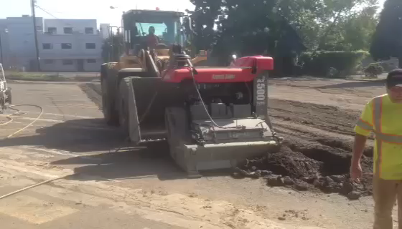
Soil stabilization method 1:
Asphalt Zipper w/Permazyme

Slide 8
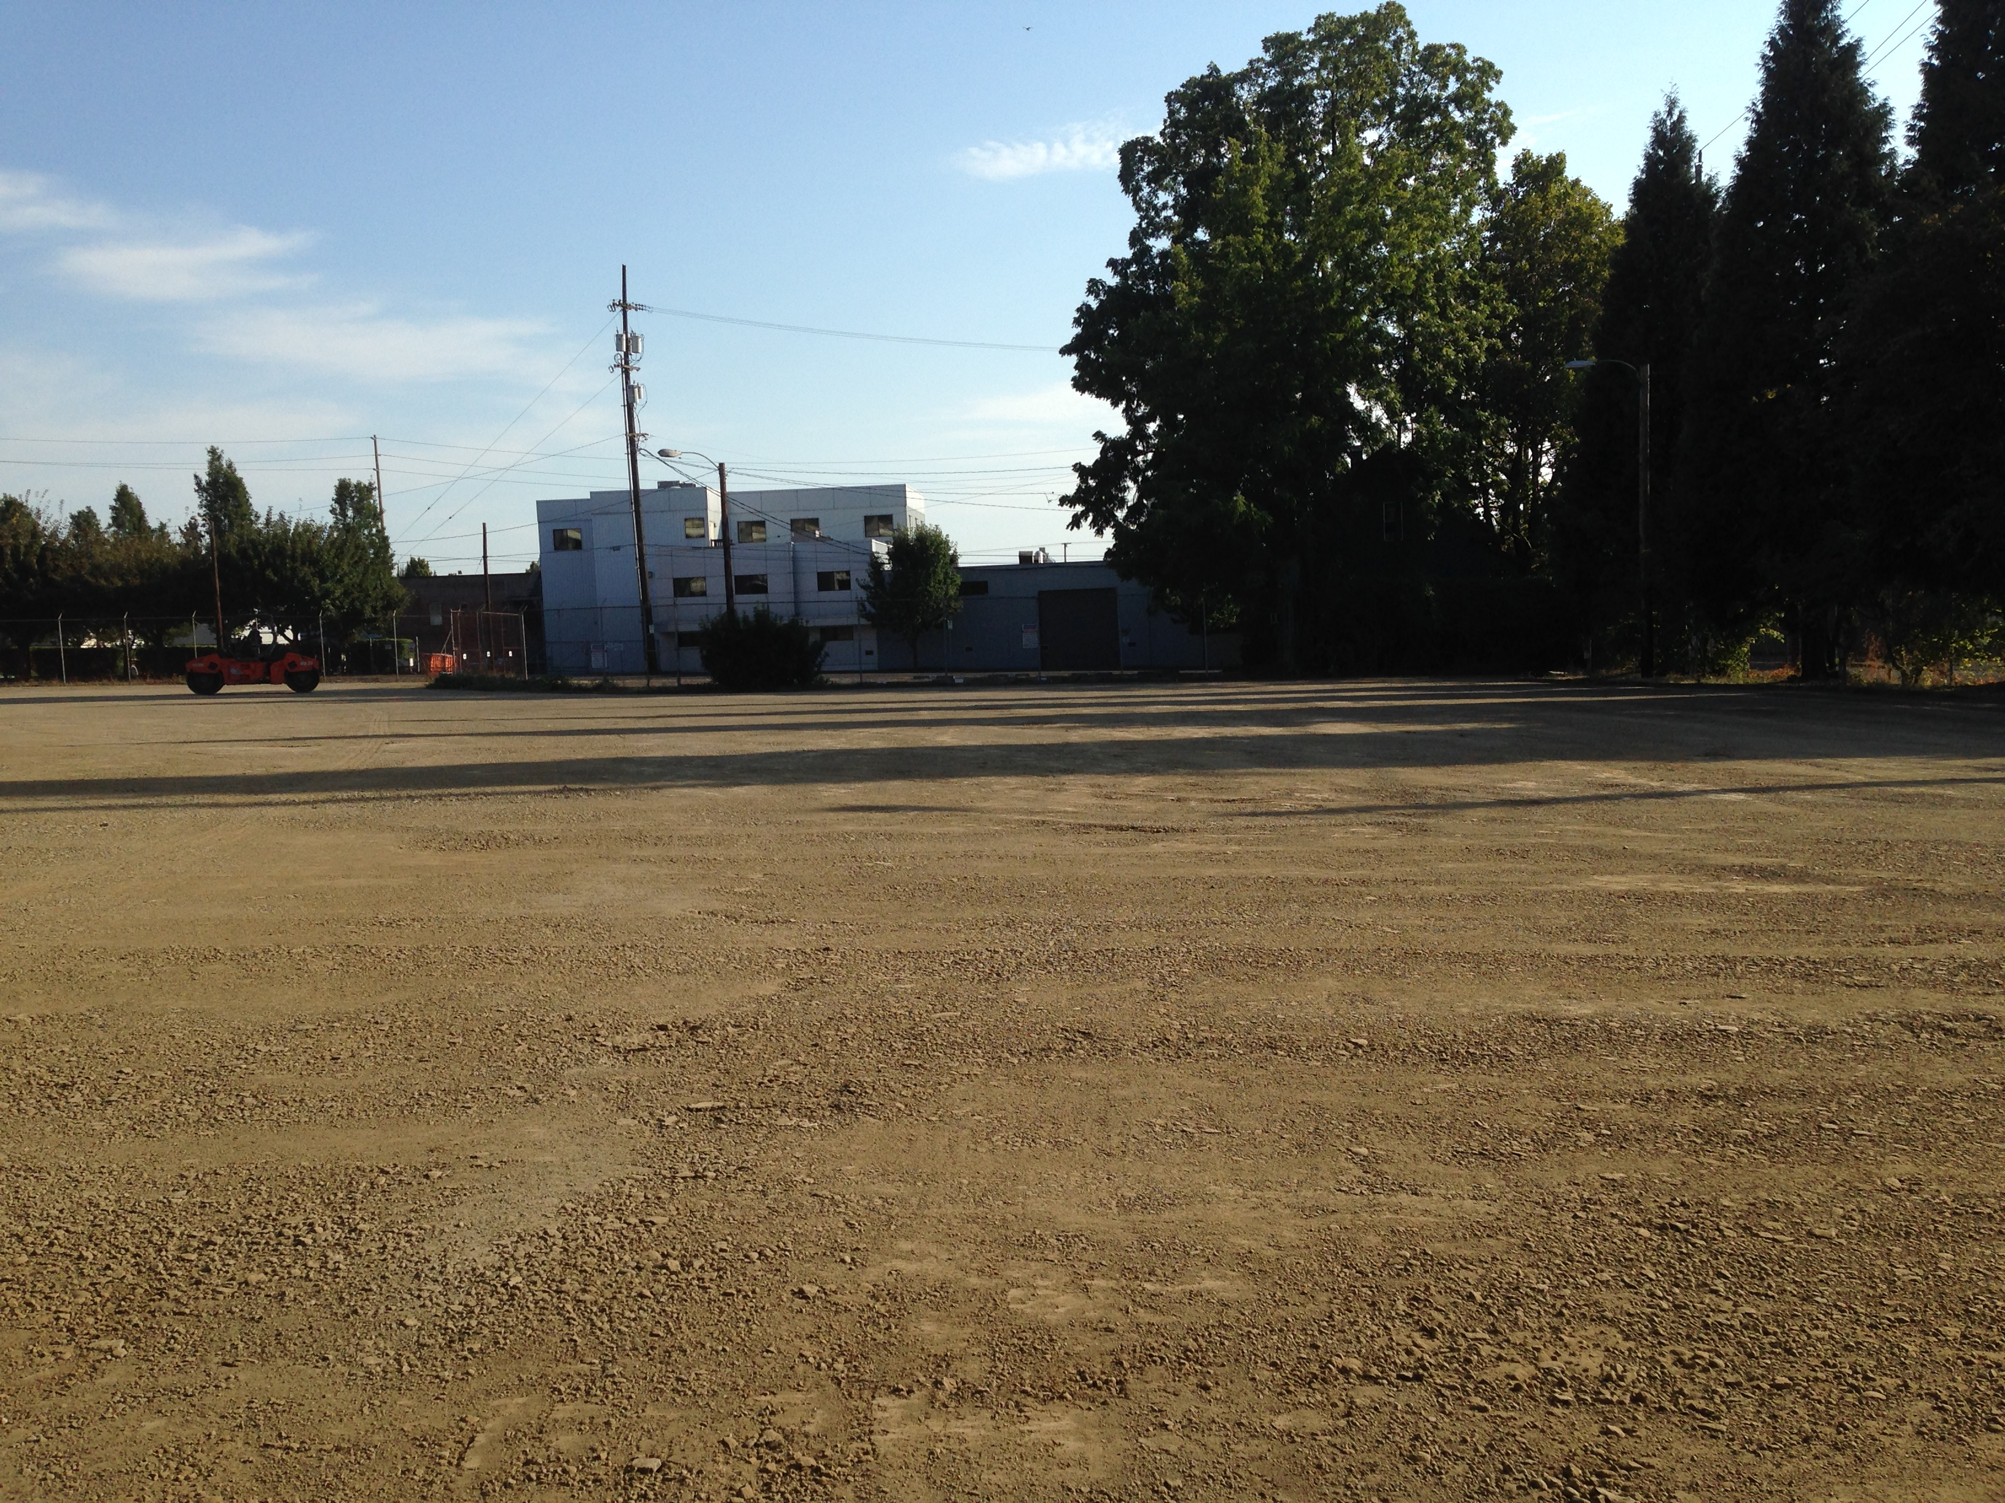
Soil stabilization method 1:
Asphalt Zipper w/Permazyme

Slide 9

Base sealing method 1:
Enviroad – Earthbind 100

Slide 10
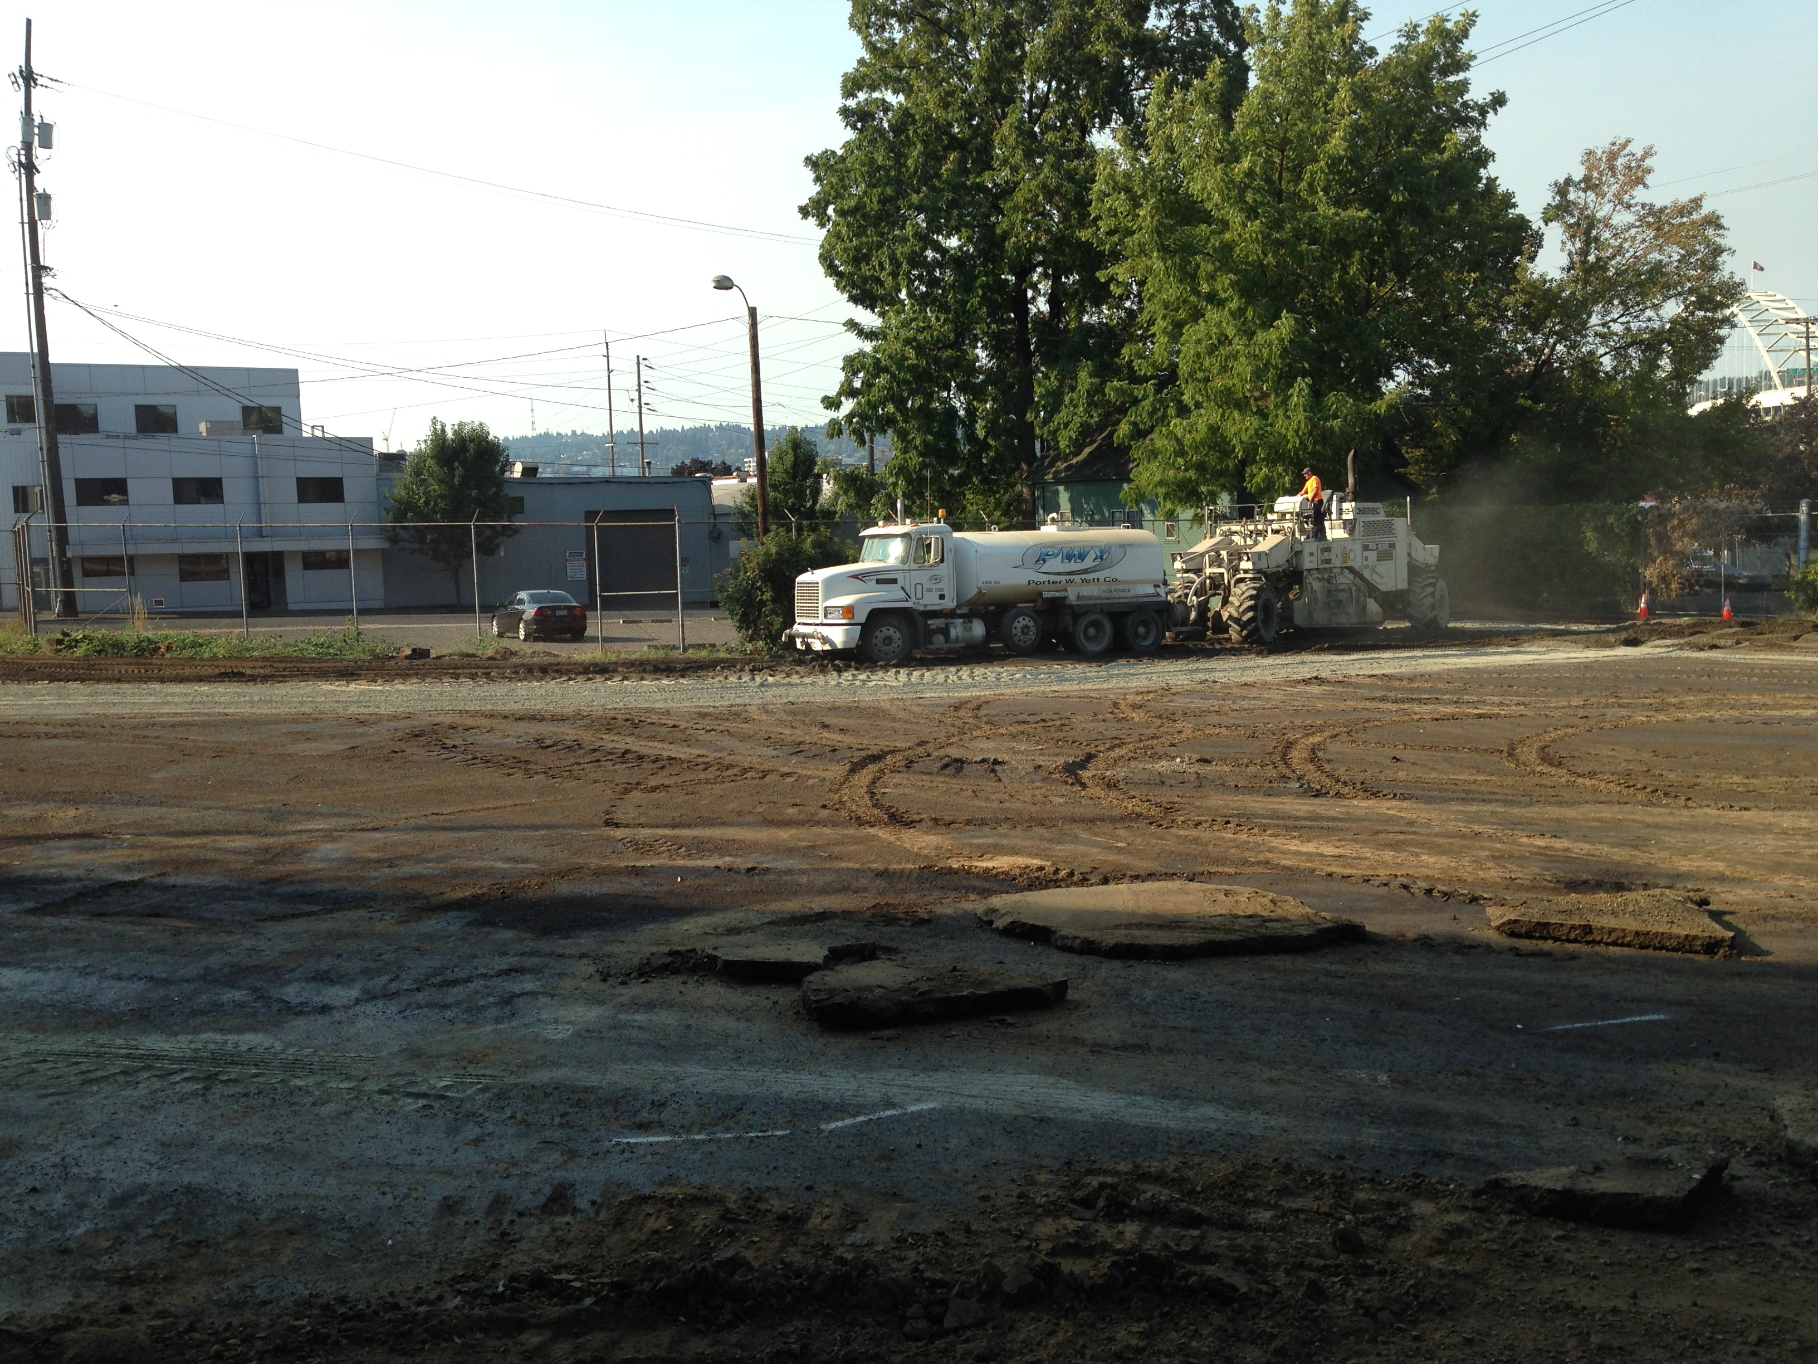
Soil stabilization method 2:
Pulverize w/cement treated base

Slide 11
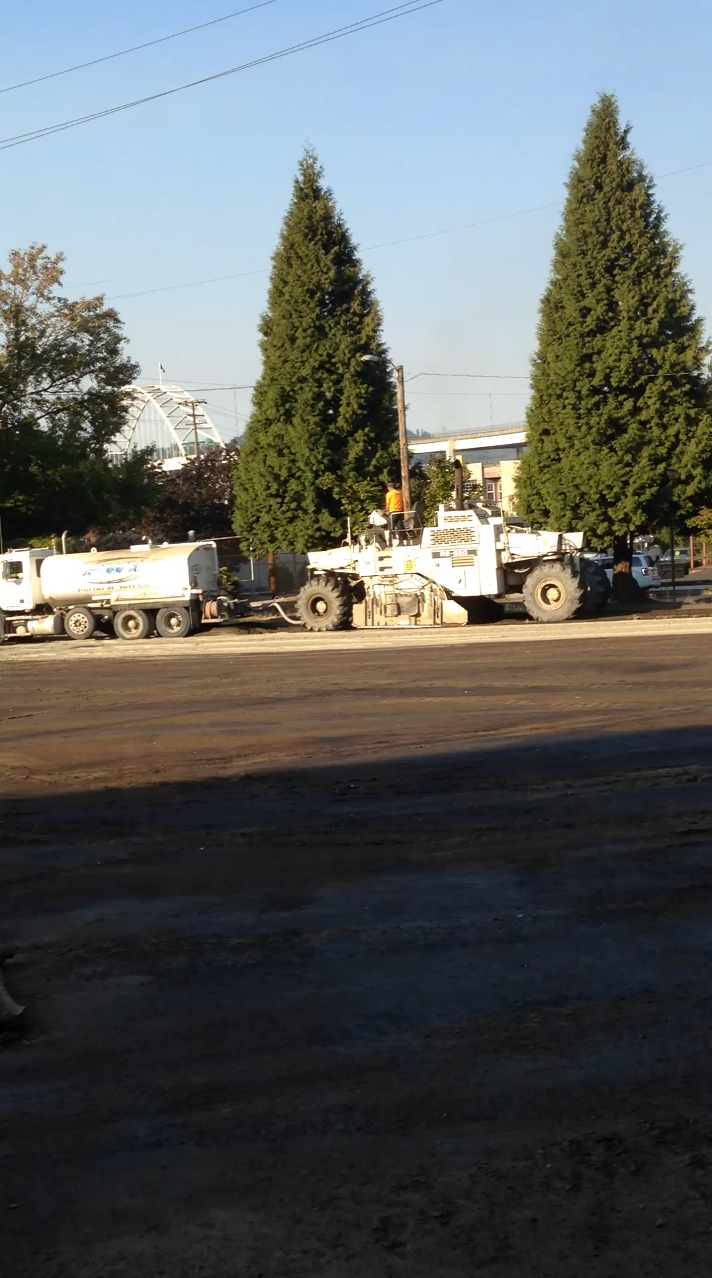

Slide 12
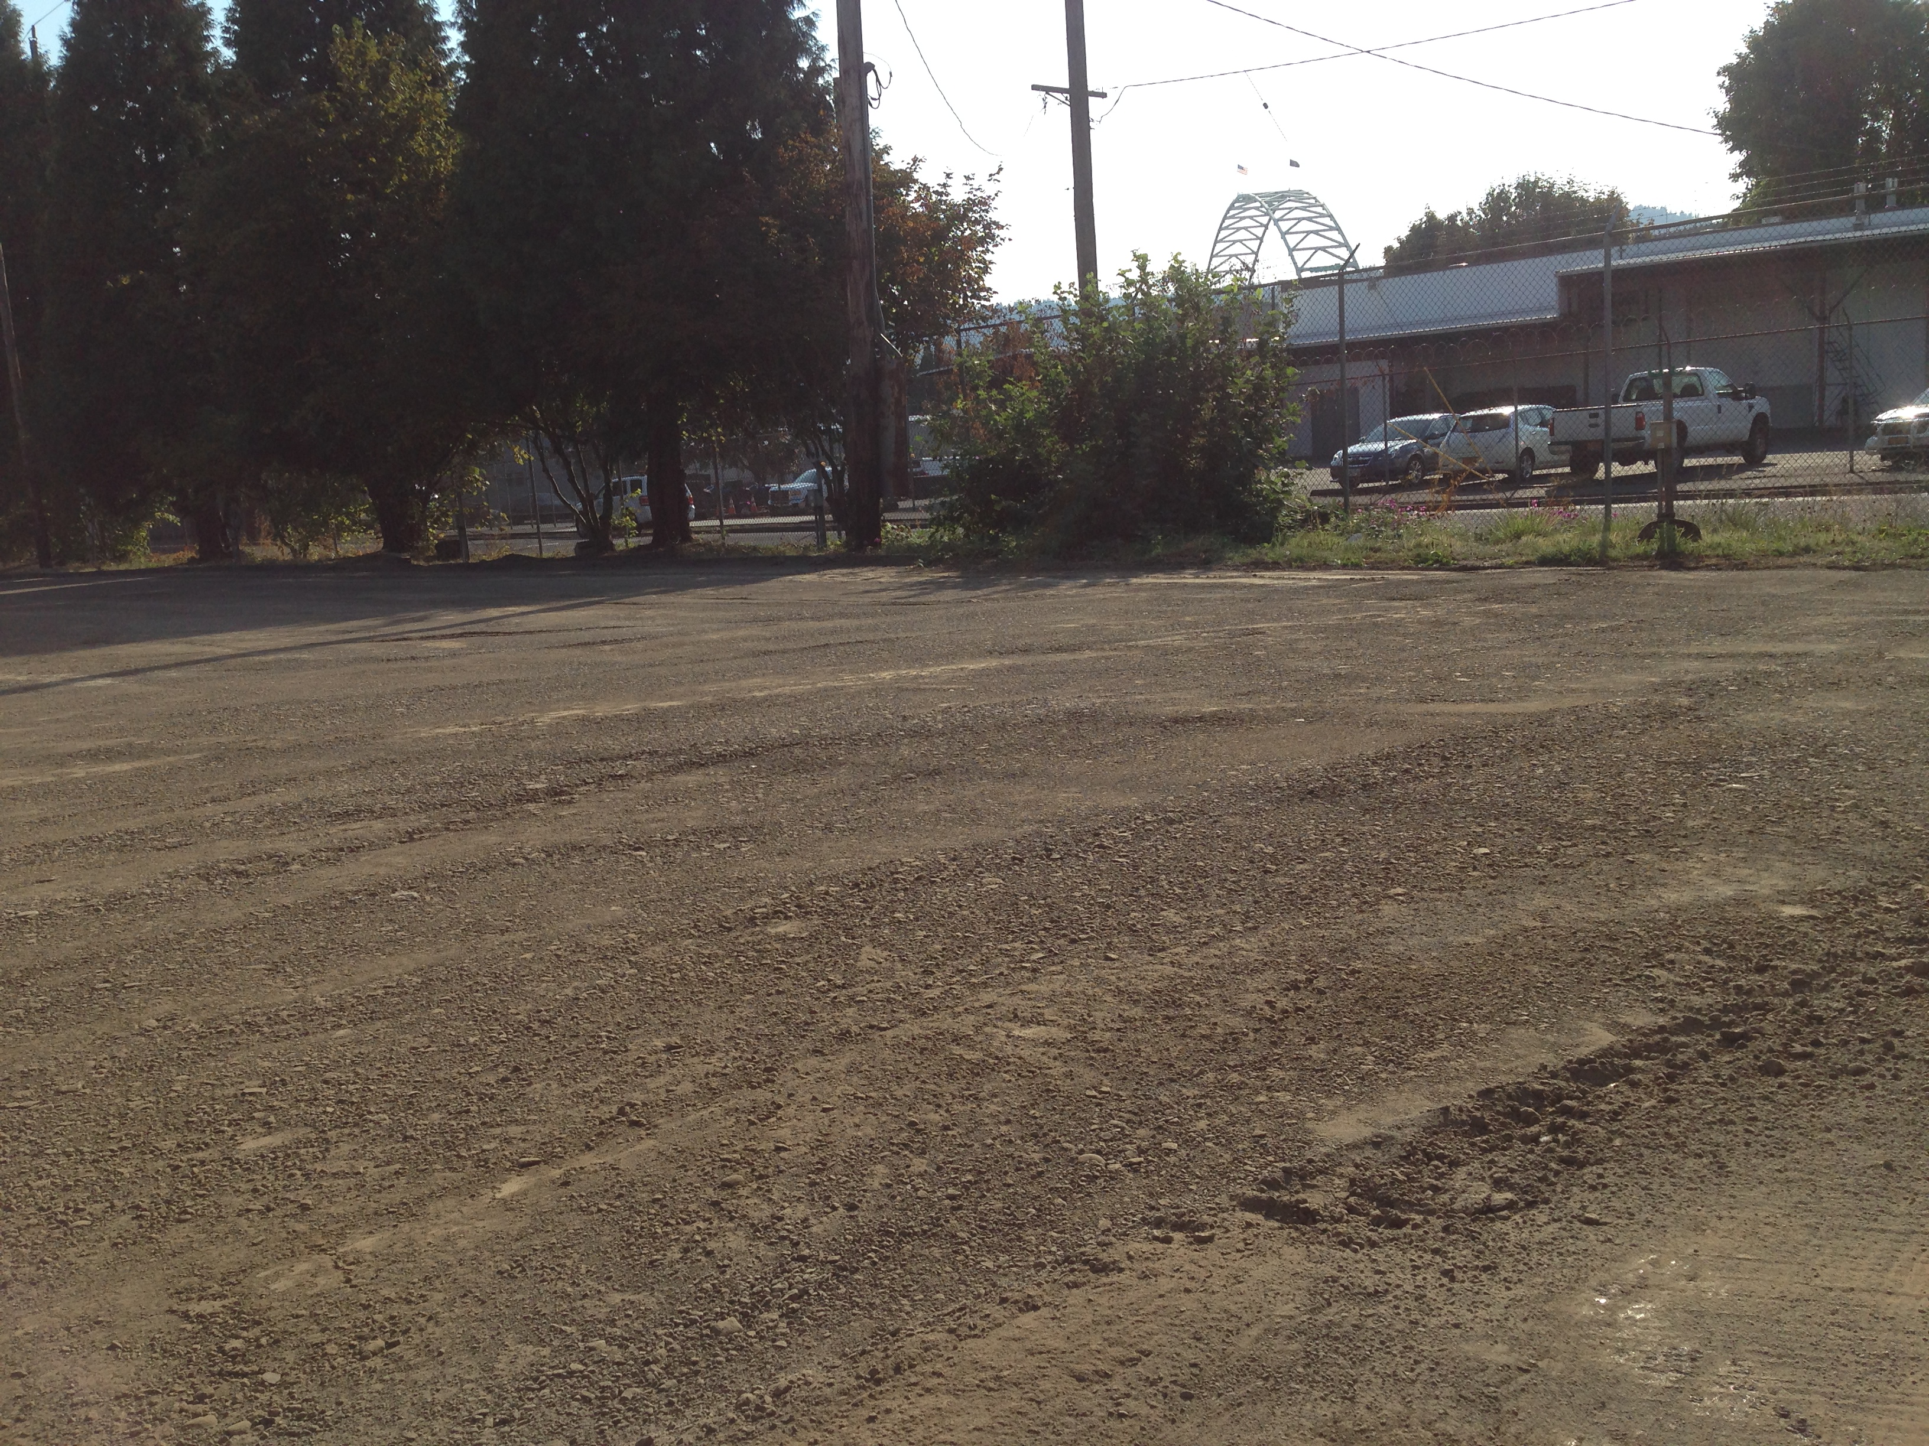
Soil stabilization method 2:
Pulverize w/cement treated base

Slide 13

Base sealing method 2:
Zydex Industries - Zycosoil

Slide 14
Thin lift asphalt mix
Cold climate asphalt: 58-28
Richer mix (~6.0% oil content)
½” mix design at 1.5” depth
Utilize long (1.25”) ACE Kevlar fibers

Slide 15
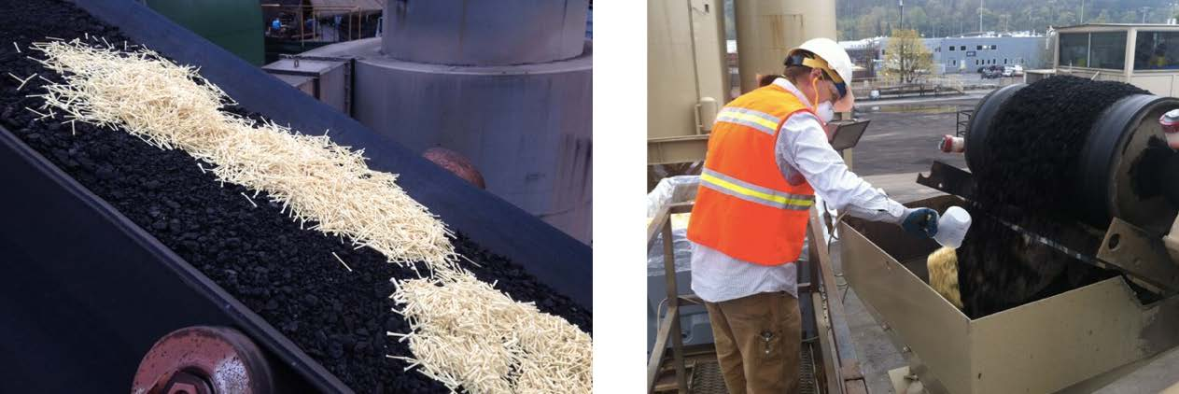
Thin lift asphalt mix

Slide 16
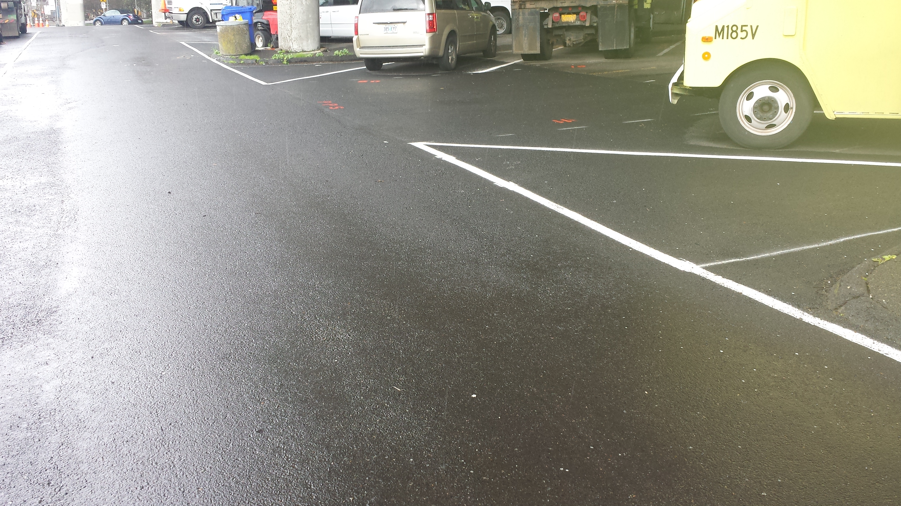
Thin lift asphalt mix

Slide 17
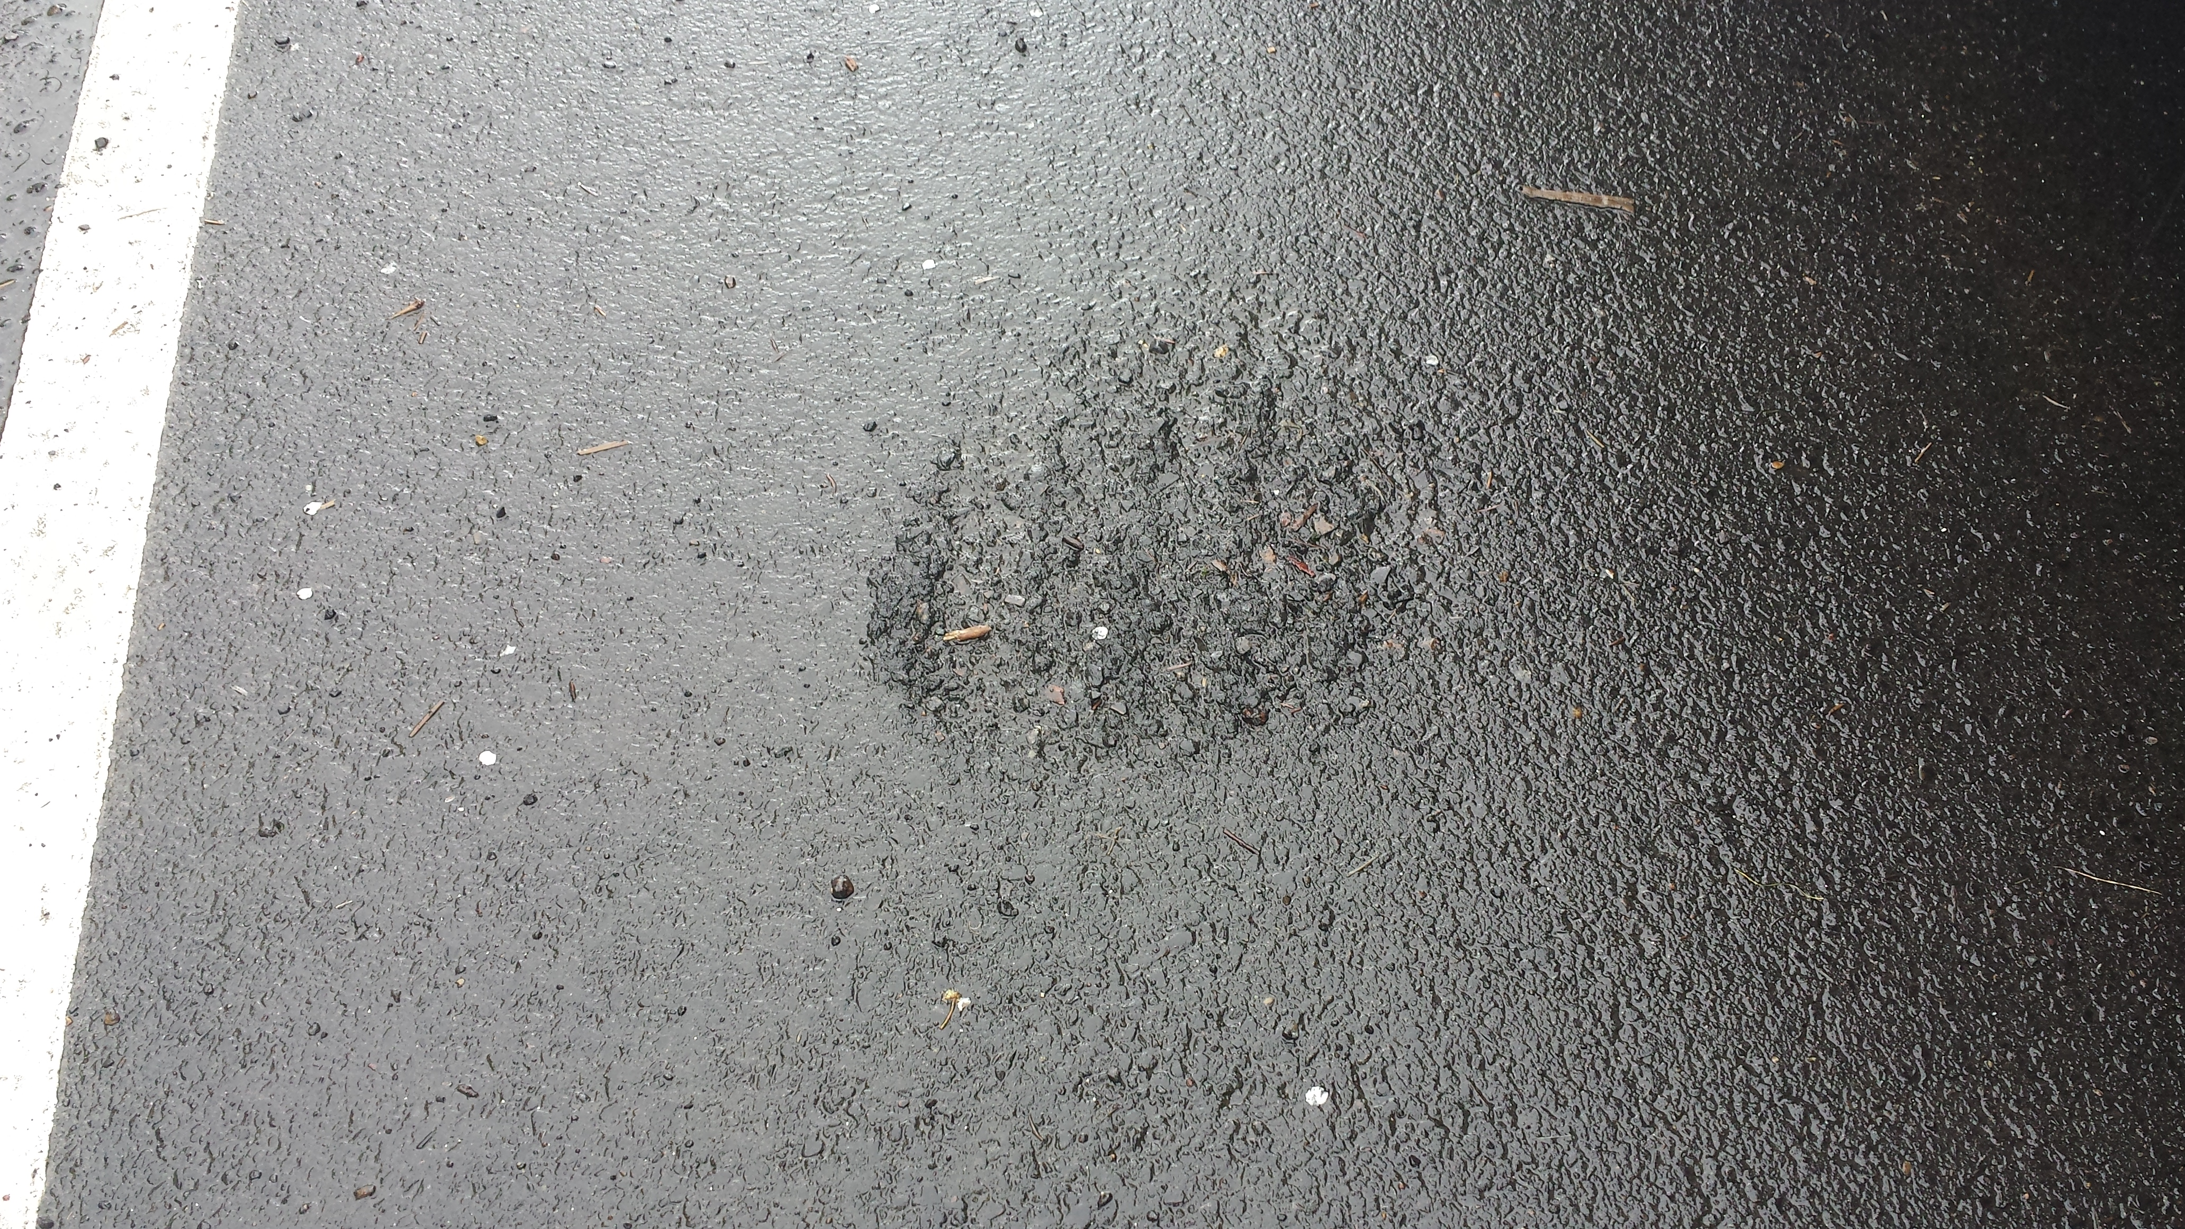
Thin lift asphalt mix

Slide 18
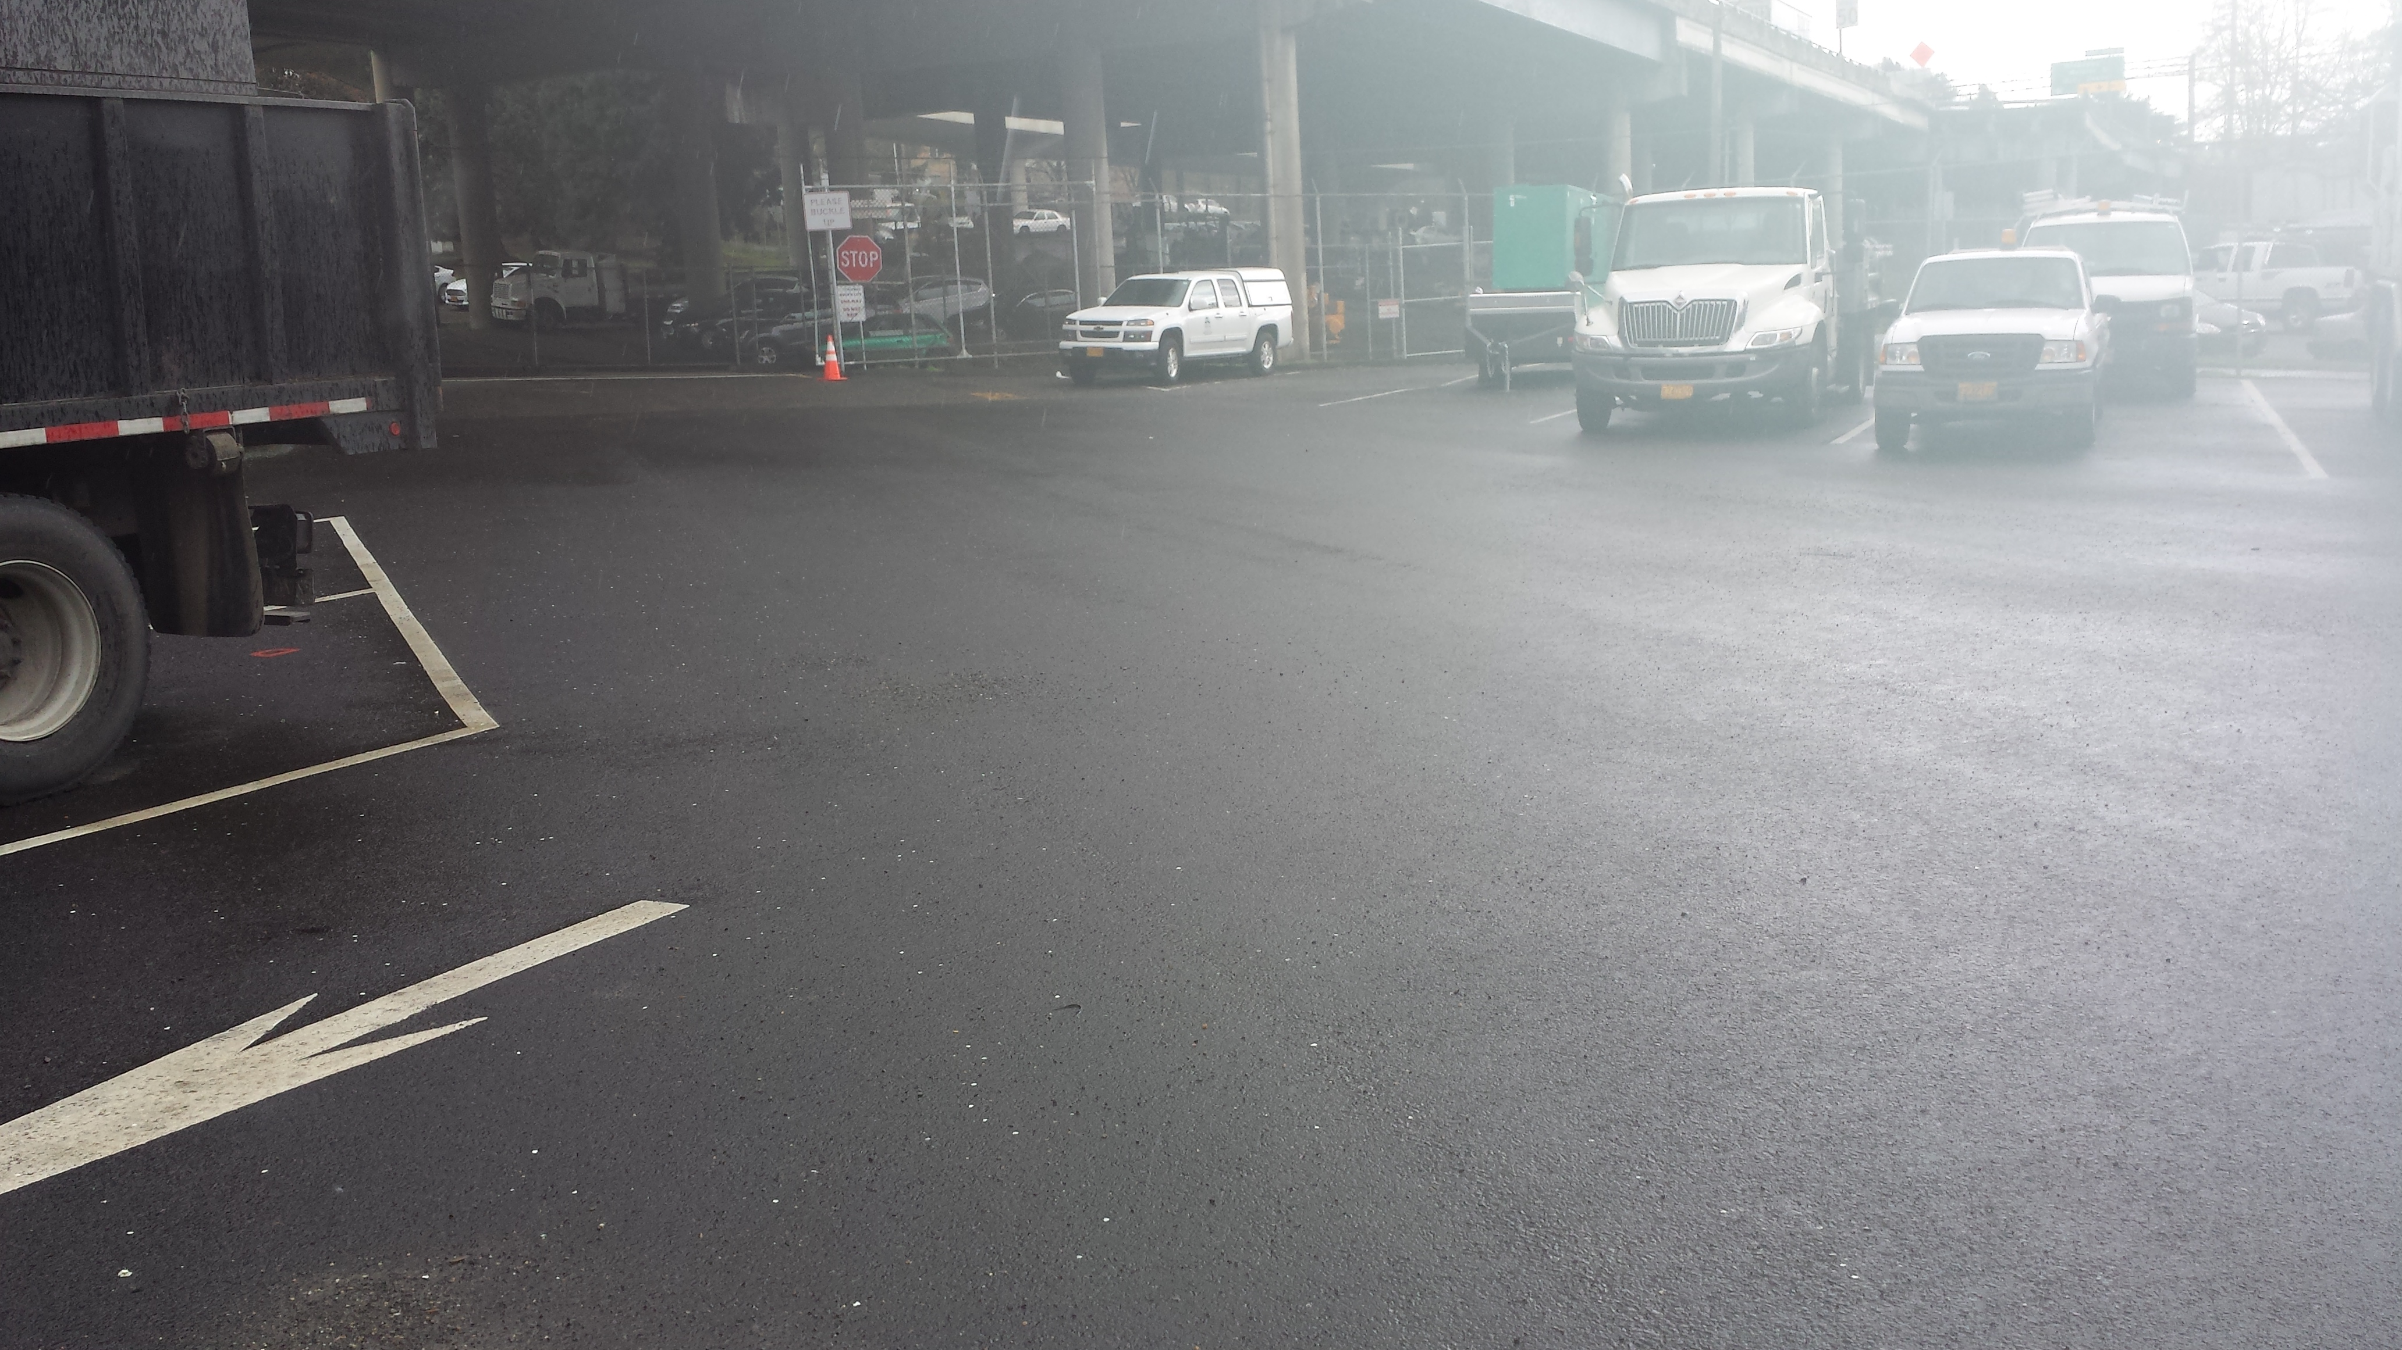
Thin lift asphalt mix

Slide 19
Pilot project summary
58-28 mix design with ACE Kevlar fibers, at 1.5” depth over treated base holding up
very well!
2 winter seasons - no cracks, raveling, delamination, or base failures
Project cost savings:
  Standard reconstruction = $200K+ (est)
  Pilot project cost = $88K

Slide 20
Lessons learned, going forward
Need clay content for enzymes to work; perform hydrometer test if unsure!
58-28 asphalt surprisingly effective
Pulverizing + soil stabilizer a fast, cost effective way to rehab streets in poor condition (i.e. beyond potholing)
Methods/products could be used to rehab low volume urban streets in poor condition
Use thin lift or chip seal over treated base

Slide 21
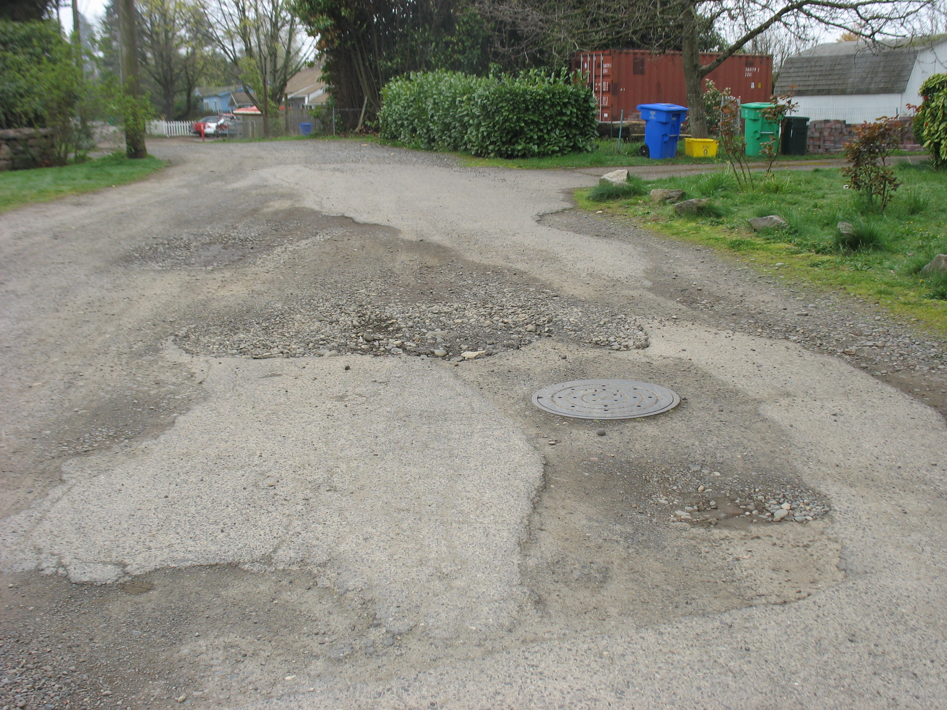
Residential street application?

Slide 22
Questions

