Slide 1
2016 OACES
Enhanced Gravel Road Treatments workshop
March 15, 2016 Redmond, Oregon
Spokane County
Washington
Some Gravel Road Photos

Slide 2
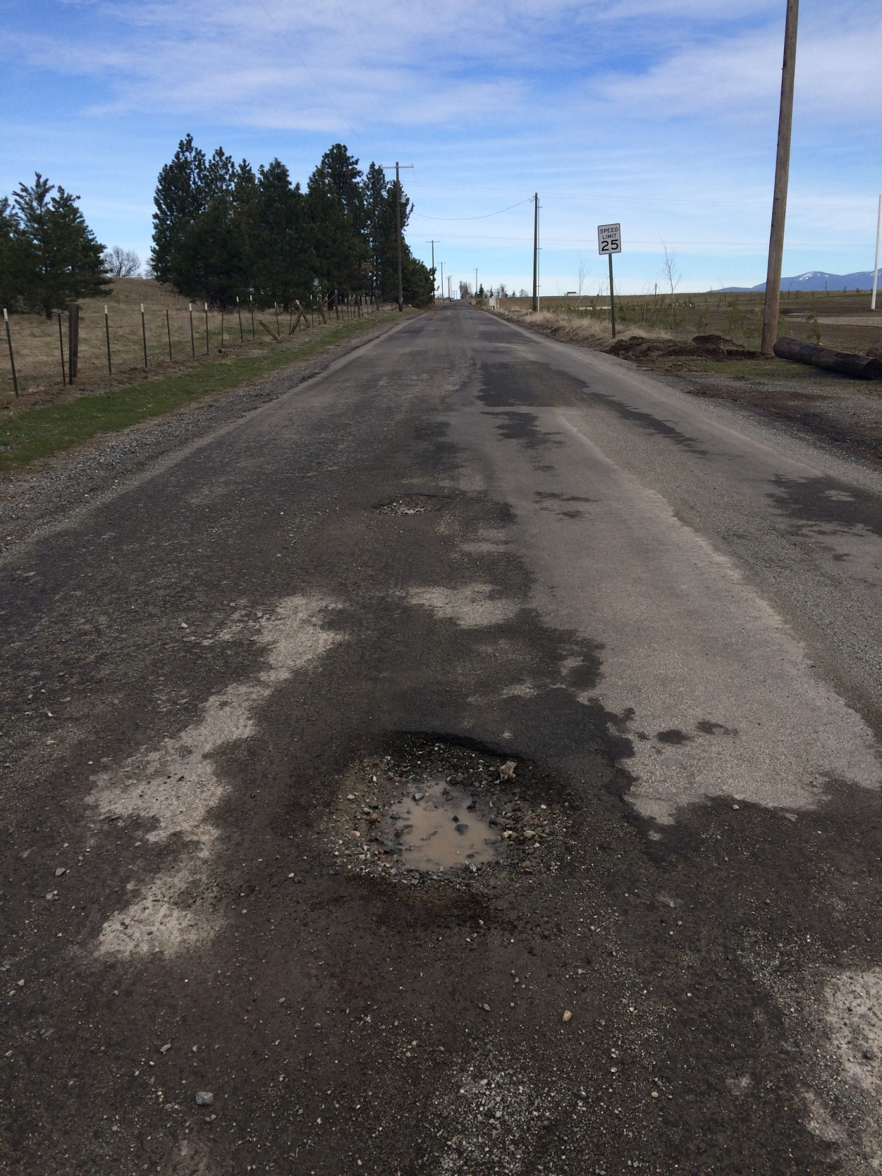
Fruit Hill
1

Slide 3
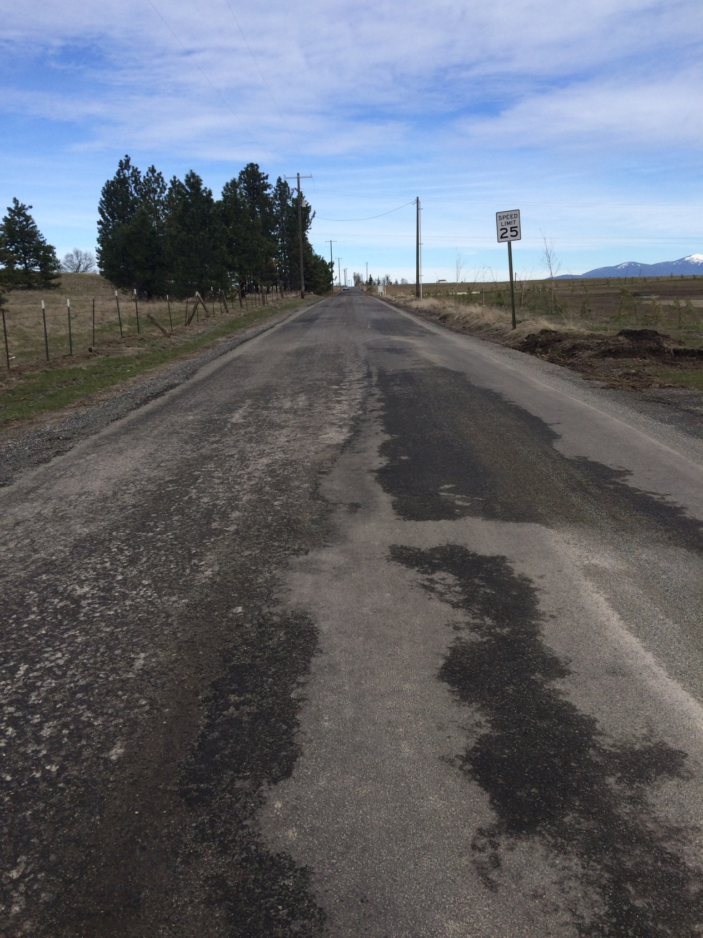
Fruit Hill
2

Slide 4
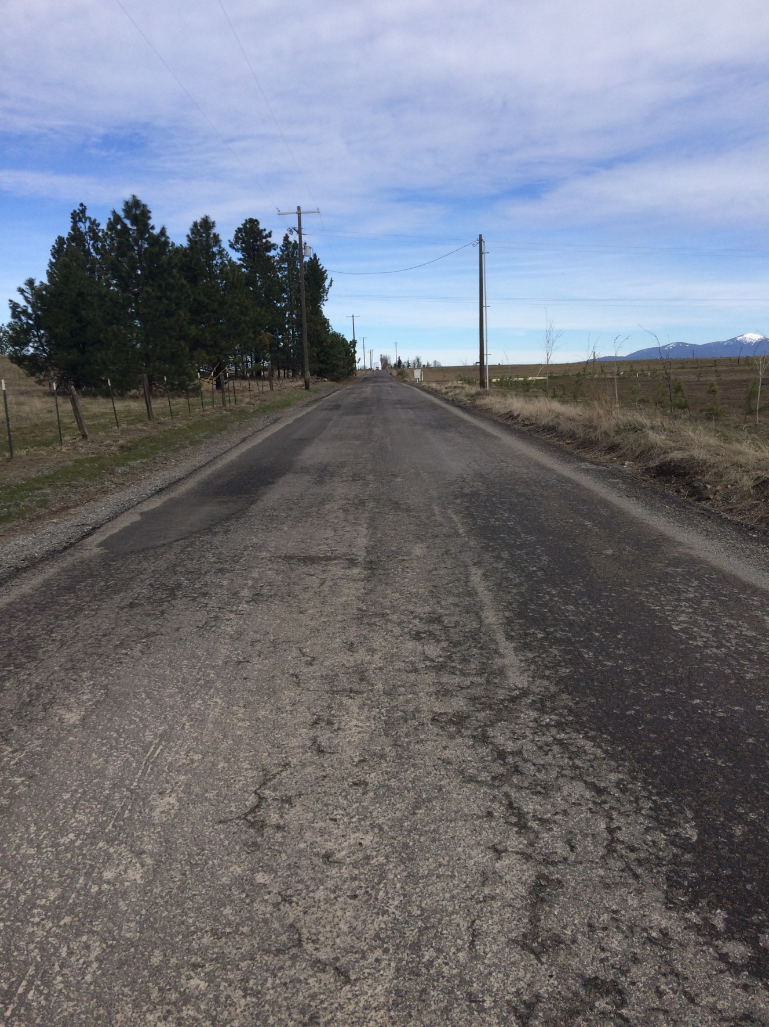
Fruit Hill
3

Slide 5
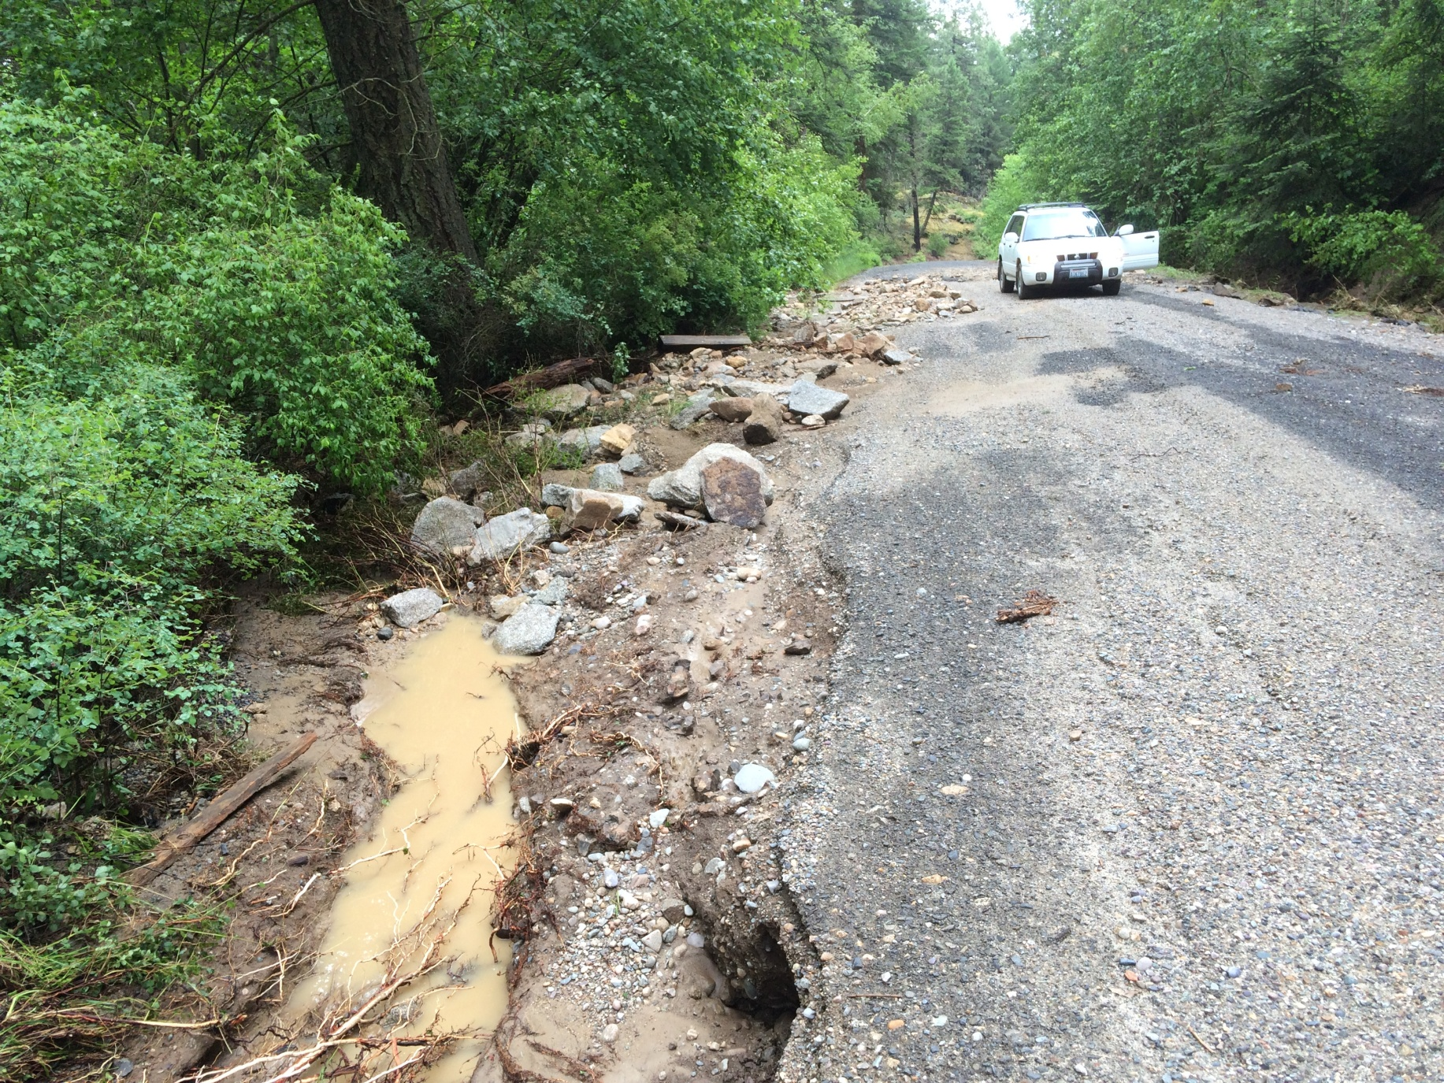
Ballard
1

Slide 6
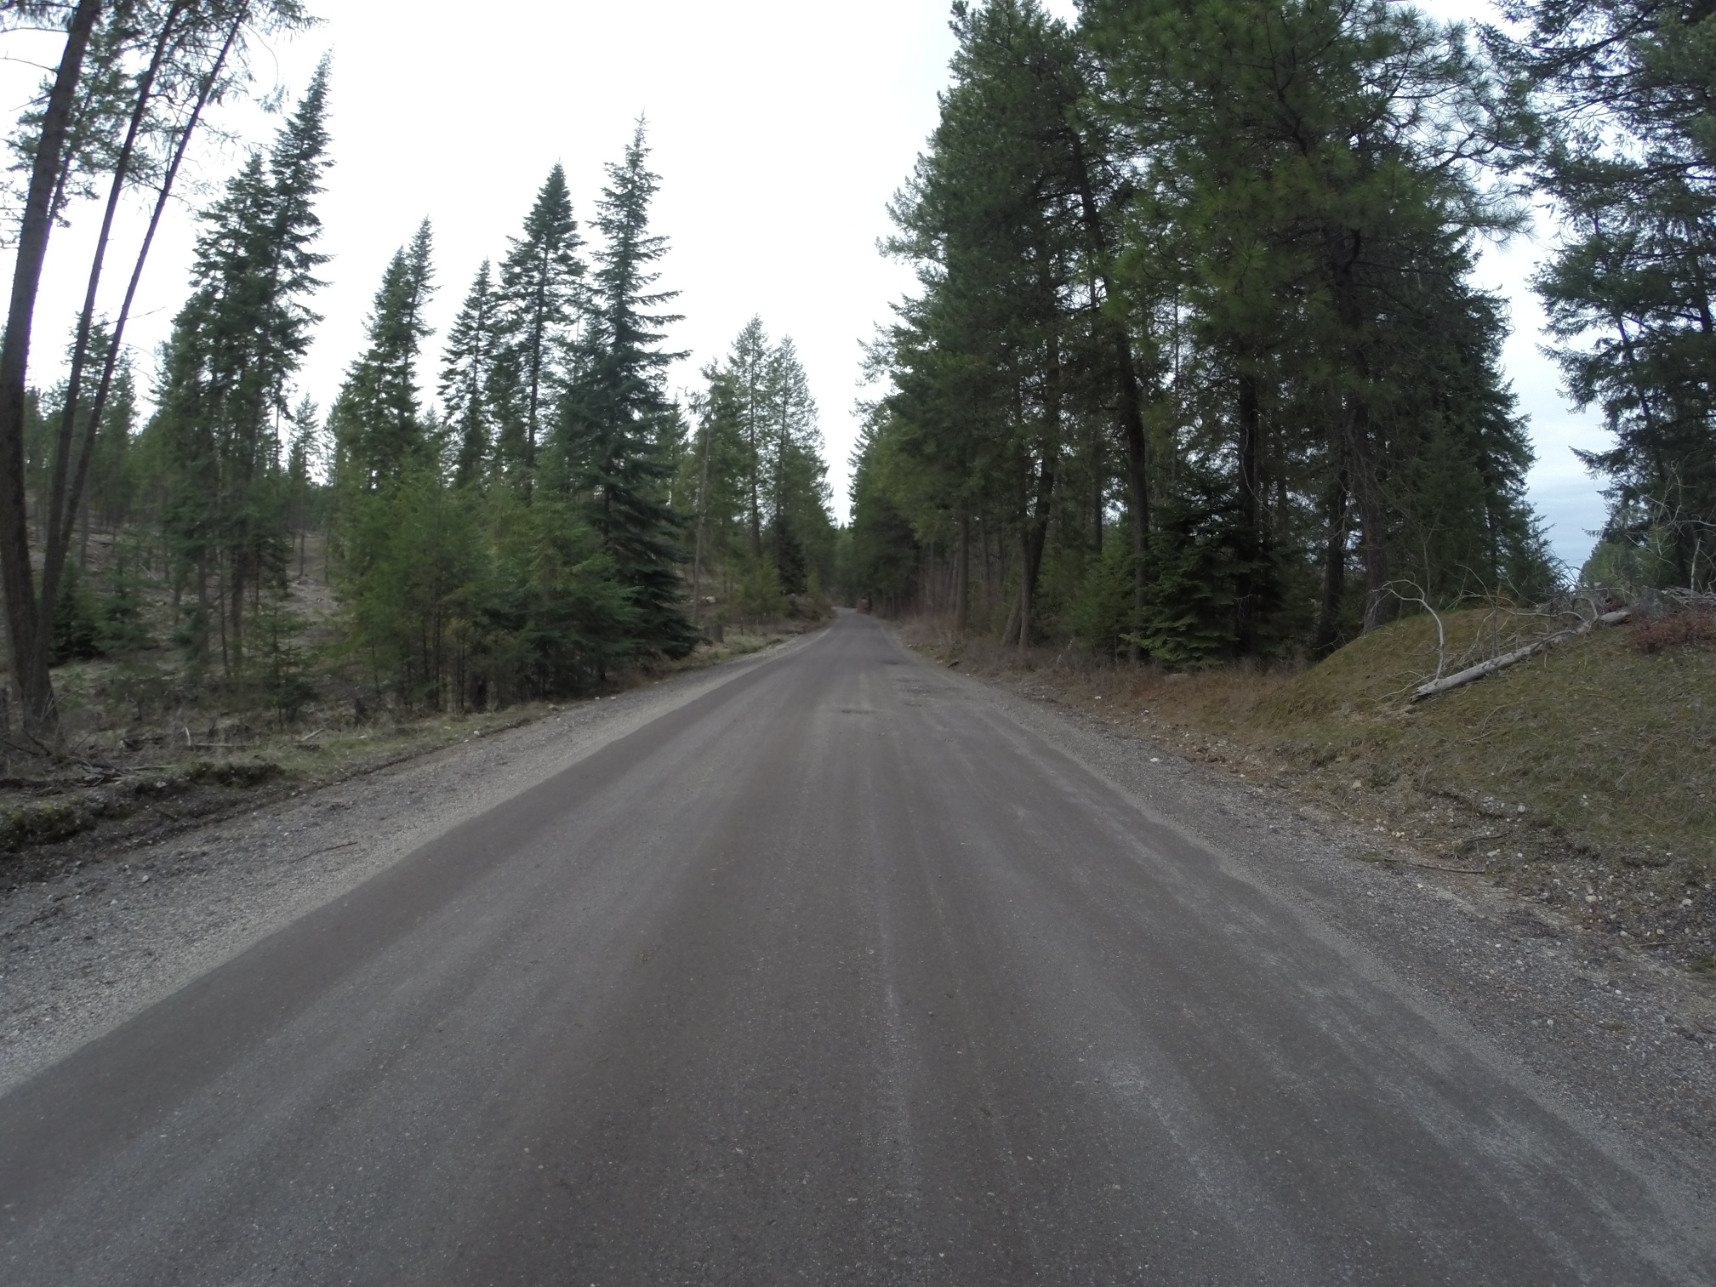
Ballard
2

Slide 7
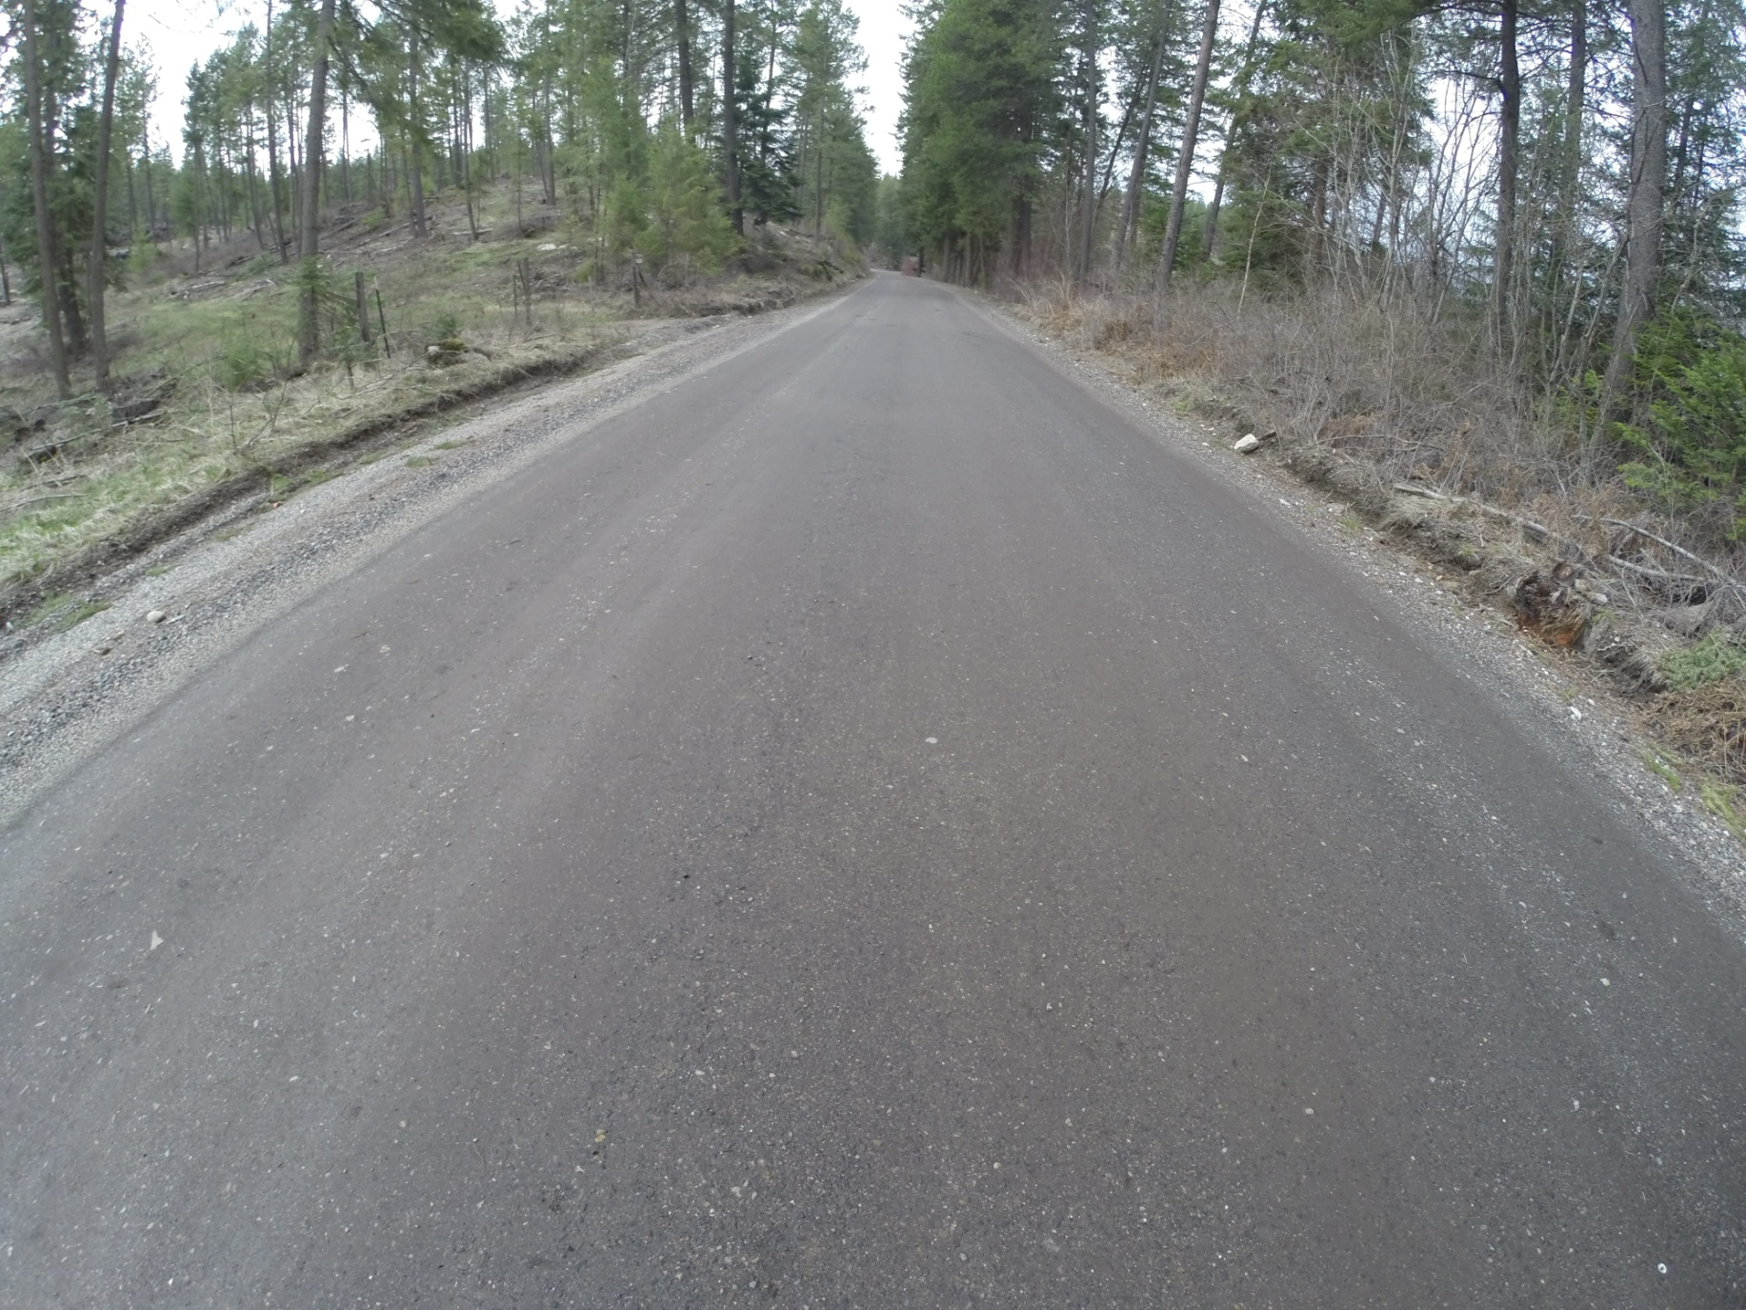
Ballard
3

Slide 8
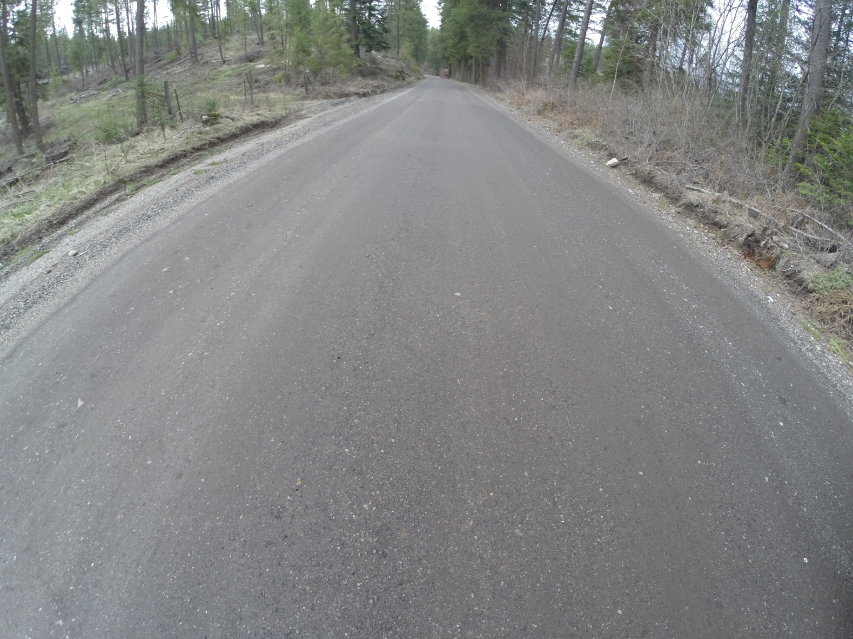
Ballard
4

Slide 9
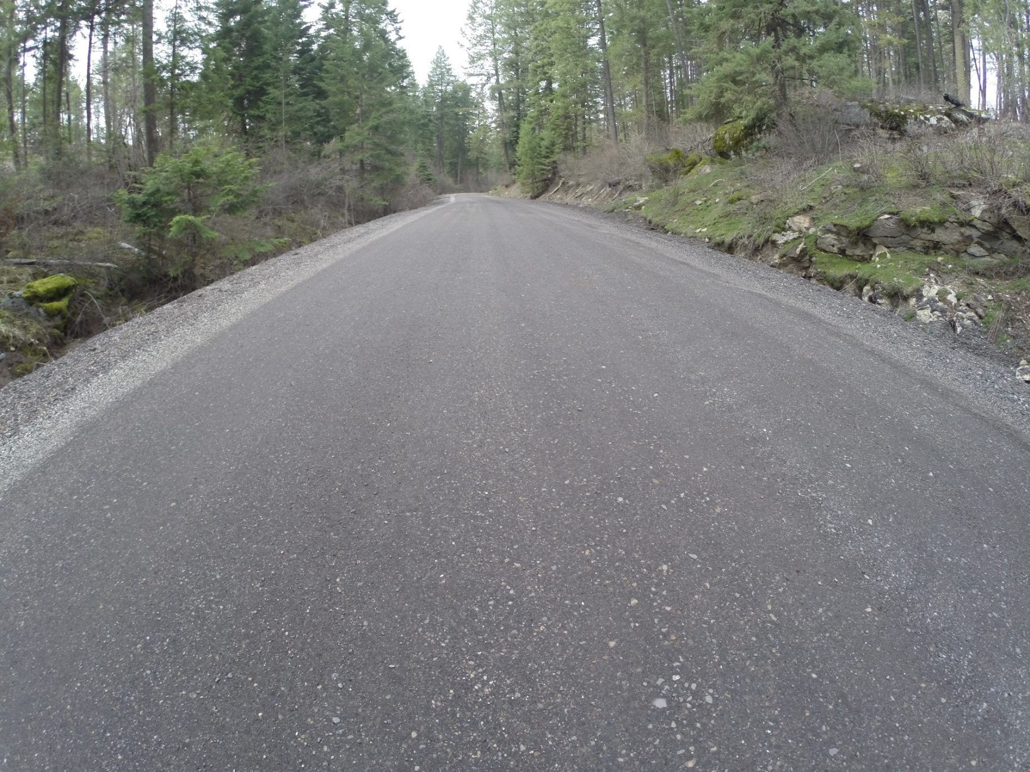
Ballard
5

Slide 10
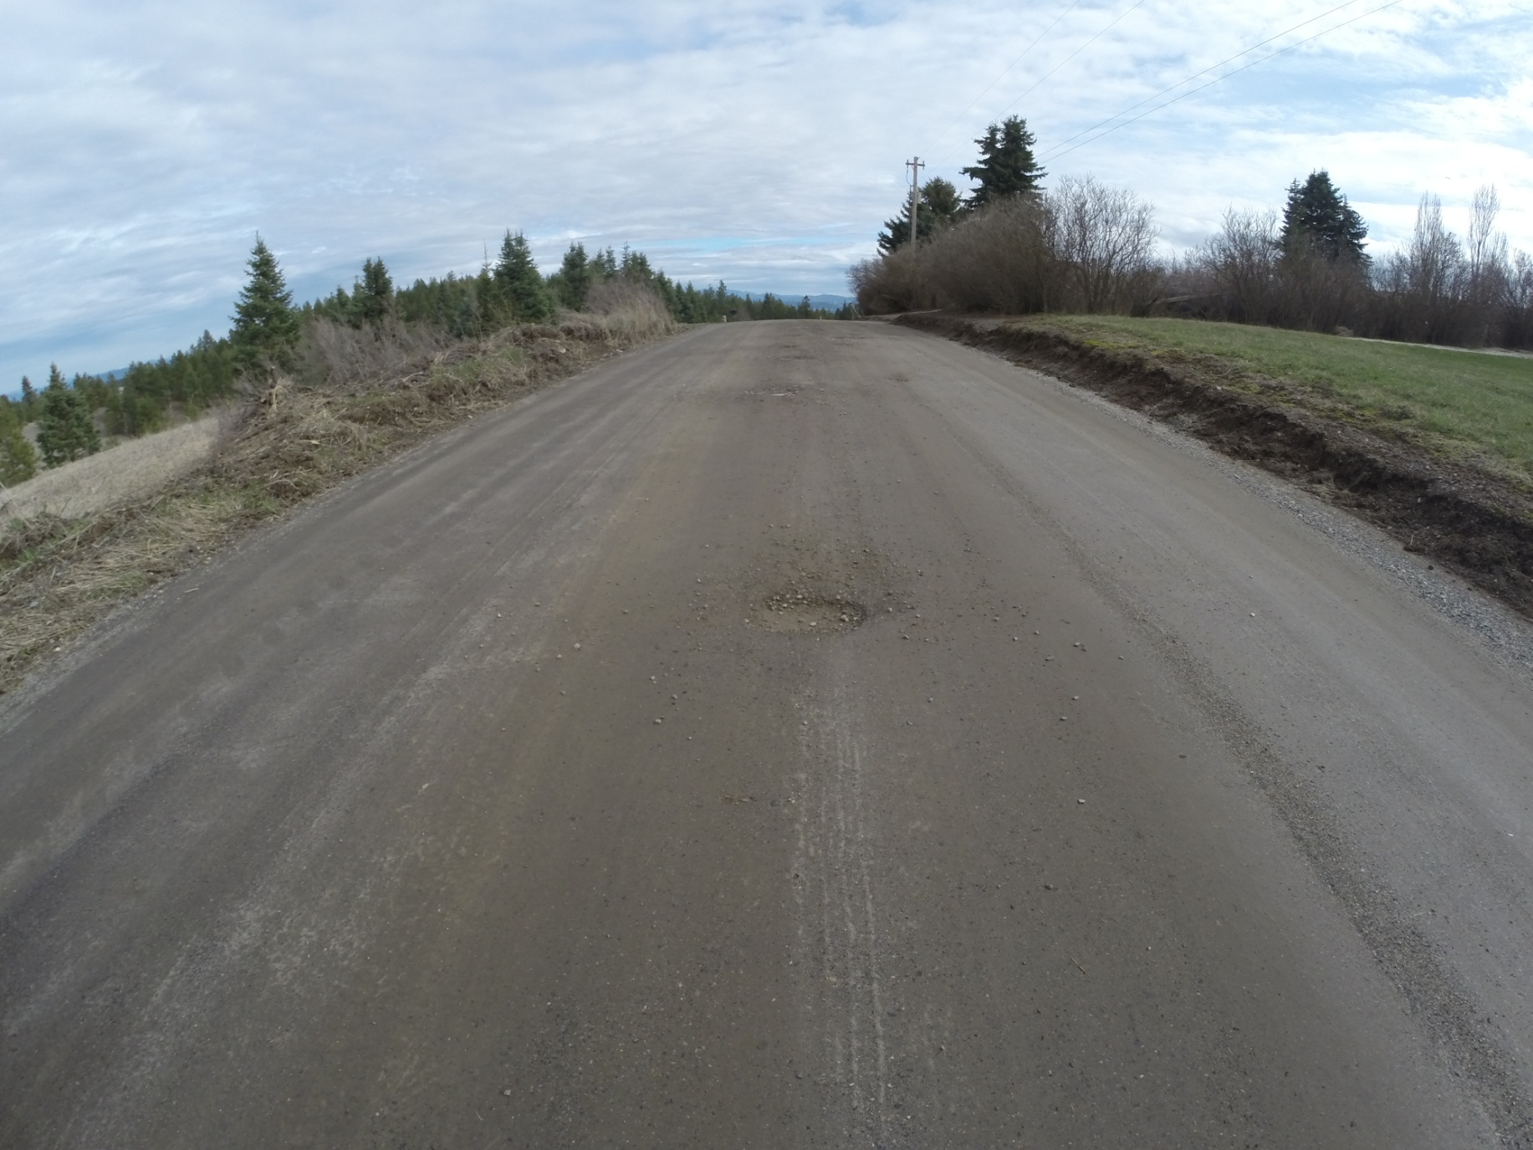
Ballard
6

Slide 11
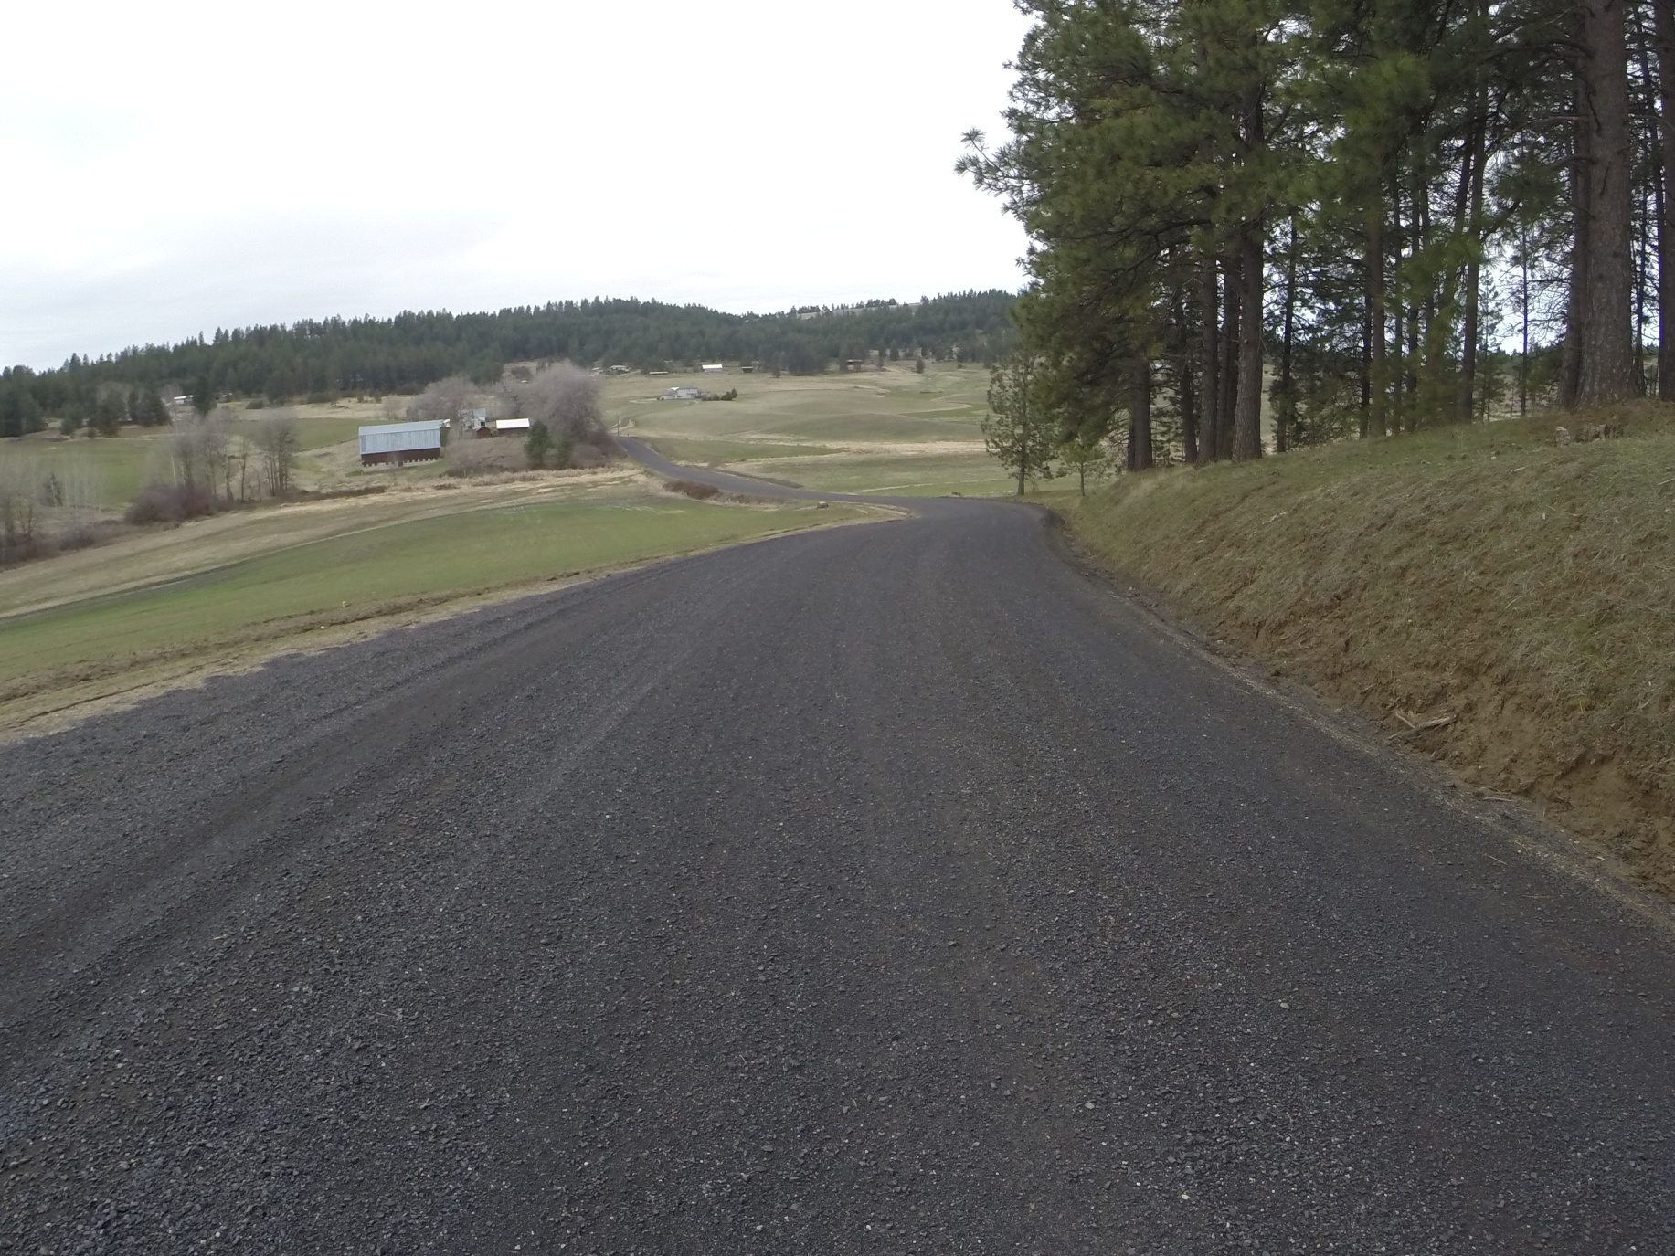
Burnhill
1

Slide 12
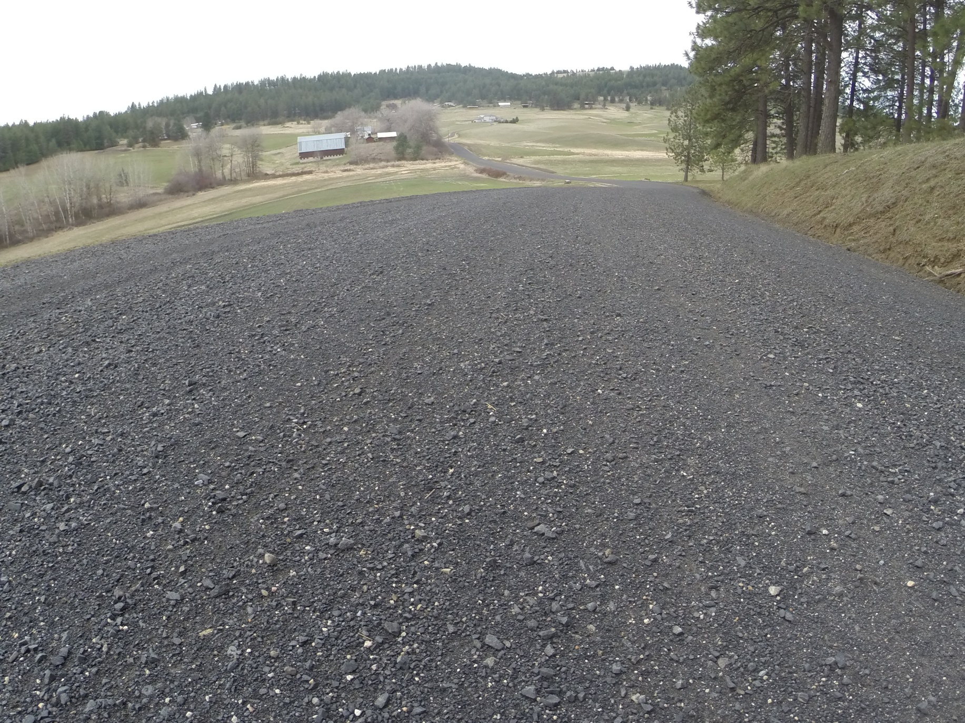
Burnhill
2

Slide 13
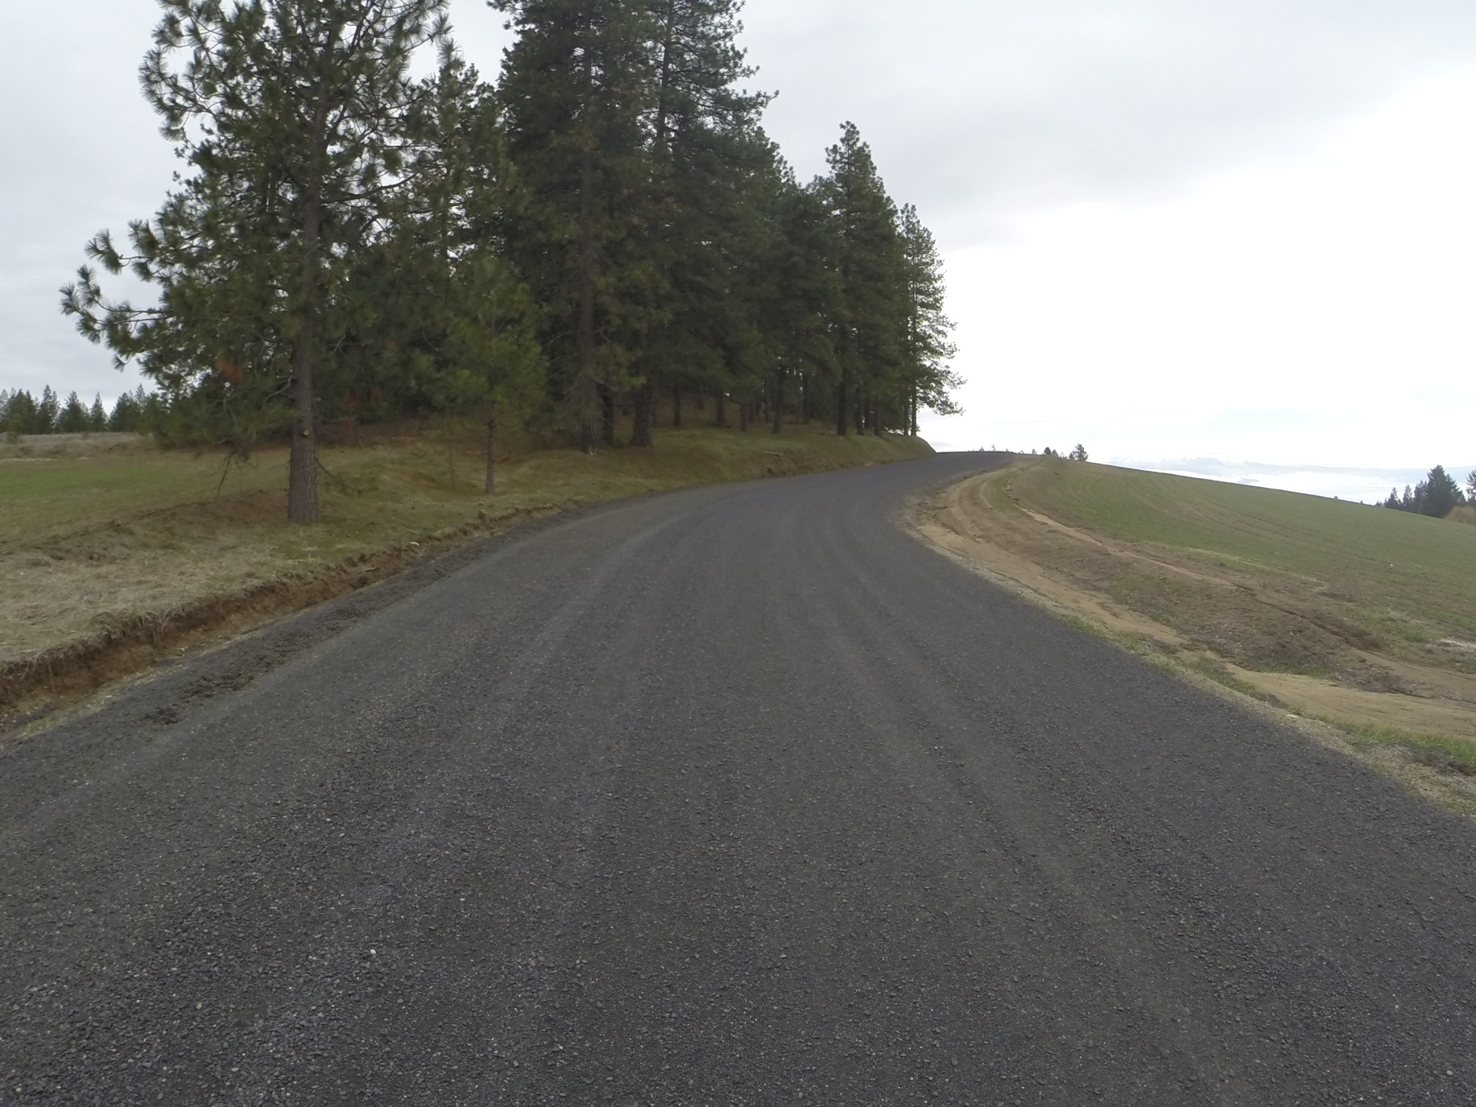
Burnhill
3

Slide 14
End of Photos

