Slide 1
Yakima County g.r.a.s.s.
Gravel Road Aggregate Surface Stabilization
Dust Control

Slide 2
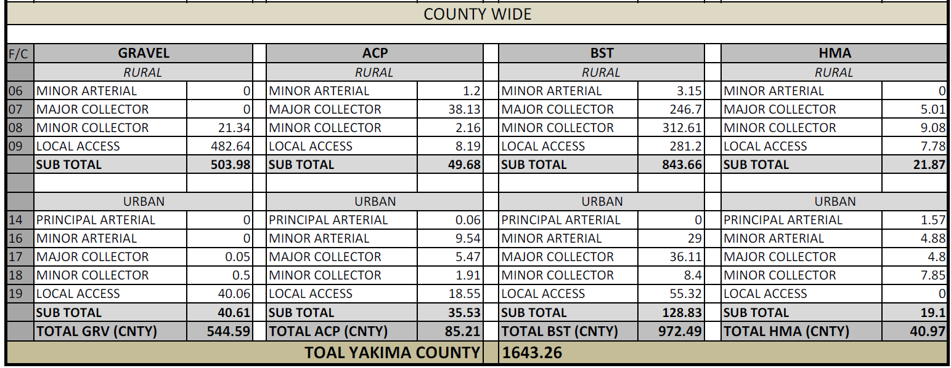
ROAD SYSTEMS
GRAVEL | 544.59 MI.
HARD SURFACE | 1100 MI.
BRIDGES | 308
CULVERTS (36” or Bigger) | 855
RAILROAD | 22 MI.

Slide 3
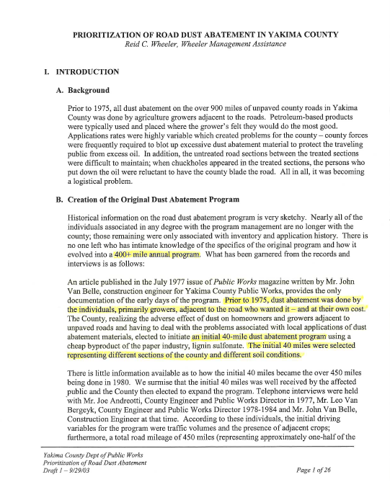
G.R.A.S.S Program
Yakima County
-Set up in 2003 w/ Reid C. Wheeler
-Criteria
- ADT
-Speed
-Res./Sense Recept.
-Traffic Safety
-Dust Sense Crops
-Crop Production Value
-Ag land Value

Slide 4
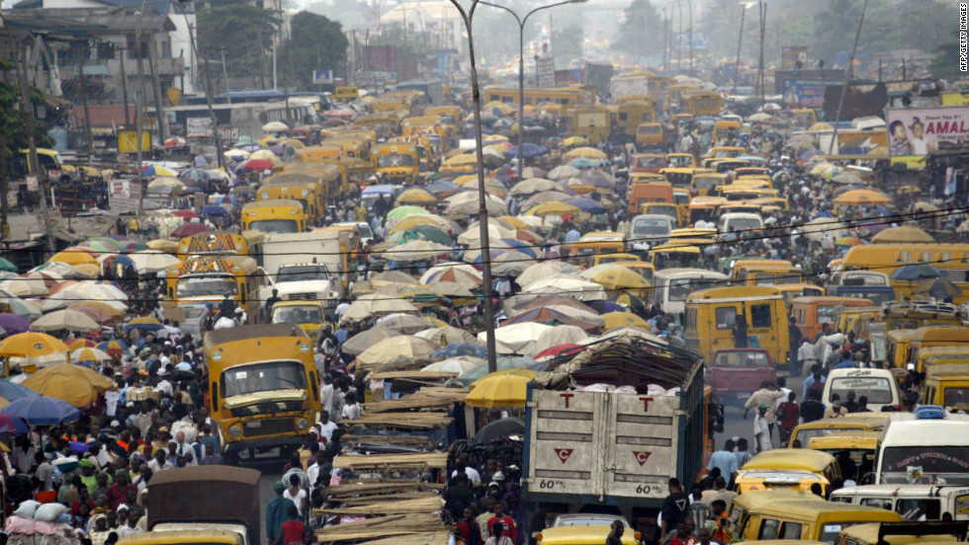
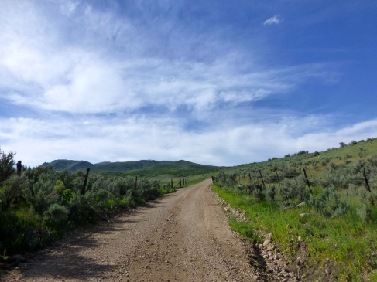
A.D.T.

Slide 5
Yakima Co. ADT
ADT
ADT | Miles | % of Total
0-50 | 162.26 | 29.84%
50-100 | 168.28 | 30.94%
100-200 | 159.87 | 29.40%
200-500 | 49.05 | 9.02%
500-1000 | 3.94 | 0.72%
1000-UP | 0.45 | 0.08%
ADT

Slide 6
G_R_A_S_S
GRAVEL ROAD AGGRIGATE SURFACE STABILIZATION
SURVEY
EVERY 2 YRS
LEAD TECHS IN WINTER MONTHS
PAPER VS TECH (FIELD FORMS OR GIS ESRI )
INPUT
STABILIZATION PROGRAMS (SPREADSHEET)
PRIORITY BASED ON PROGRAM
BUDGET
DETERMINE MILEAGE BASED ON COST
DRAW LINE ON PRIORITY.
WHAT MAKES SENSE
DEAD ENDS
ROADS WE MAY BE ABLE TO APPLY ½ RATE
JUSTIFICATION
ROUTE
FIRST LAST, LAST FIRST
MAP ROUTE

Slide 7
MgCl2

Slide 8
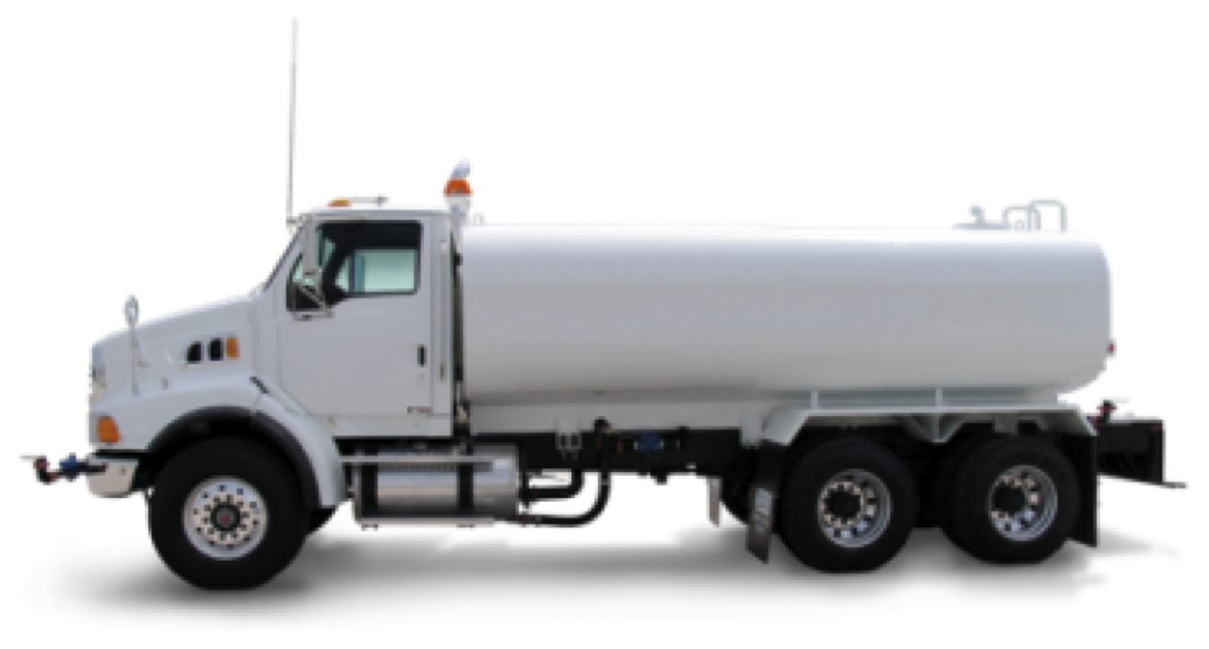
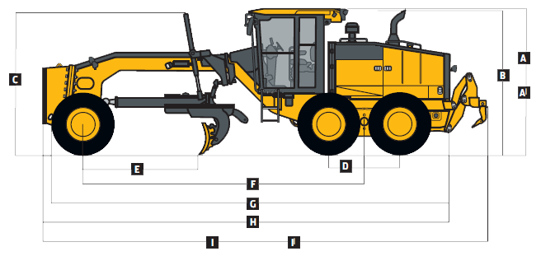
G_R_A_S_S
GRAVEL ROAD AGGRIGATE SURFACE STABILIZATION
PREP
ROADS HAVE BEEN SOFTEN UP AND GRADED AT LEAST 1 TIME
DITCHING / RE-SHAPE DONE EARLY ENOUGH
ROCK ADDED AND INCORPORATED IF NEEDED
APPLY
GRADERS (2)
WATER TRUCK(s) FOR GRADERS
DISTRIBUTOR
WATER TRUCK FOR DISTRIBUTOR
(2) TANKERS NURSE DISTRIBUTOR
MgCl2
MgCl2
H2O
MgCl2
H2O
H2O

Slide 9
G_R_A_S_S
GRAVEL ROAD AGGRIGATE SURFACE STABILIZATION
TRACK
STATS
AVG. PRODUCTION = 6 MILES/DAY
PRODUCT = DUST GUARD (ROADWISE/ENVIROTECH)
COST = $99 - $105/TON
COST / MI = $4300
MATERIAL = $3450 - 80%
LABOR/EQUIP = $850 - 20%
PROGRAM MILES 220
ISSUES
REDUCED BUDGET – PUBLIC EXPECTATIONS
MATERIAL COST – ALWAYS ON RISE
EQUIPMENT COST
RAILROAD

Slide 10
CURRENT YEAR
CURRENT YEAR | 2016
CURRENT BUDGET | 1,100,000.00
EXPECTED COST |  | % OF COST
LABOR | $118,097.07 | 10.74%
EQUIPMENT | $106,539.33 | 9.69%
MATERIALS | $855,726.05 | 77.79%
MATERIALS/FUEL | $3,660.34 | 0.33%
OTHER SERVICES | $15,977.21 | 1.45%
GROSS COST | $1,100,000.00 | 100.00%
EXPECTED MILES
RD MILES | 250.00
EXPECTED COST/MI | $4,400.00

Slide 11
