Slide 1

EMULSIONS 101: Clear as mud
Keven Heitschmidt
OACES CHIP SEAL WORKSHOP
HOODRIVER, OR
MARCH 21-22 2023

Slide 2


Topics.
What is an asphalt emulsion?
Emulsion classifications and common uses
Emulsion chemistry
Emulsion specifications and performance
Emulsion Tests.
ALBINA
ASPHALT

Slide 3
What is a emulsion?
Solution
  A homogeneous mixture of two substances
  Individual molecules of one substance (solute) are surrounded by molecules of the other substance (solvent)
  Examples:
    Water (humidity) in air
    Table salt in water
    Metal alloys
ALBINA
ASPHALT

Slide 4
What is an emulsion?
Colloid or emulsion
  A homogeneous mixture of two insoluble substances
  Particles of one substance (dispersed phase) are surrounded by molecules of the other substance (continuous phase)
ALBINA
ASPHALT
Notes:
A colloid or an emulsion has a similar definition to a solution, but an important distinction is that emulsions are made up of materials that are not soluble in each other (will not form a solution). Rather than a substance being reduced to individual molecules, larger agglomerations of molecules, or “particles” or “droplets” are dispersed and stabilized in another substance.

Slide 5
What is a emulsion?
Colloid or emulsion
  A homogeneous mixture of two insoluble substances
  Particles of one substance (dispersed phase) are surrounded by molecules of the other substance (continuous phase)
  Examples:
    Smoke or fog (ash particles or water droplets)
    Milk, butter, mayonnaise (fats)
    Asphalt!
ALBINA
ASPHALT
Notes:
Here I have highlighted a couple of phrases that are particular to colloids or emulsions. The phrase “dispersed phase” refers to the separate particles or droplets. The word “dispersed” means broken up or scattered. And “continuous phase” refers to the substance that surrounds those particles. It is referred to as continuous because you can move from one point in the continuous phase of the emulsion to any other point in that phase without leaving it. Examples of colloids or emulsions are shown. Very fine ash particles or water droplets can be suspended in air. The next three are examples of either fat particles suspended in water, or water droplets suspended in fat. And asphalt is itself a colloid or emulsion.

Slide 6
What is a emulsion?
Asphalt
  Composed of crystalline particles generally classified as “asphaltenes”
  Asphaltenes are suspended in an oily liquid continuous phase generally classified as “maltenes”
  The balance of composition determines asphalt physical properties such as rheology
ALBINA
ASPHALT

Slide 7
What is a emulsion?
Why emulsify asphalt?
  Viscosity reduction and safer use at lower temperatures
  Change from “oil based” to “water based” system
  Reduced energy use, worker exposure, burn hazard and job site odor
  Properly formulated emulsion systems provide long term performance benefits
ALBINA
ASPHALT
Notes:
Emulsification of asphalt is a complex process, so why do we do it? Why not just use hot asphalt all of the time? Asphalt in an emulsion form has some advantages over hot asphalt. Emulsions can have a water-like viscosity at normal ambient temperatures if desired. Emulsions are water based and do not require solvents to lower their viscosity. Emulsions can be stored at lower temperatures than asphalt cement, or without any heat at all, thus reducing energy use for long distance transport or long term storage. The lower temperature results in lower risk of burns or vapor exposure to workers. And very significantly, when emulsions are designed and used properly, there are long term performance benefits compared to simple hot asphalt equivalents through improved adhesion and less binder oxidation.

Slide 8
What is a emulsion?
Asphalts Soft pen, Hard pen
Emulsifiers
Chemical Activators
Additives
Polymers
ALBINA
ASPHALT

Slide 9
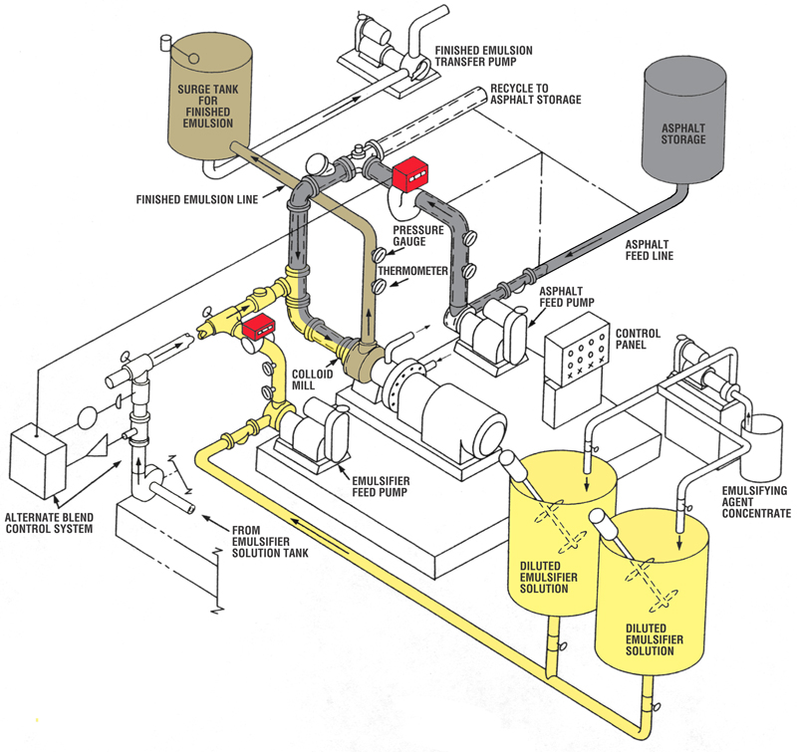
What is a emulsion?
ALBINA
ASPHALT

Slide 10
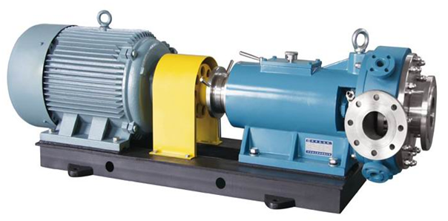
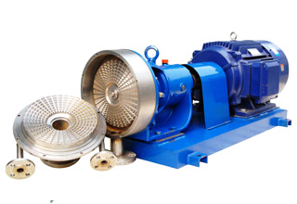
What is a emulsion?
ALBINA
ASPHALT

Slide 11
What is a emulsion?
Molten asphalt and emulsifier solution go in…
Rotor
shear
shear
Time
Stator
ALBINA
ASPHALT
Notes:
As the molten asphalt elongates, it breaks up into smaller globules. This shearing process continues over and over, shearing the asphalt down to a smaller and smaller particle size until it reaches the mill outlet. The entire process from the time a quantity of asphalt enters the mill until it exits as an emulsion lasts only a few thousandths of a second.

Slide 12
What is a emulsion?
Asphalt particle (5 microns)
Human hair (50 microns)
ALBINA
ASPHALT
Notes:
This is a photomicrograph of a dilute asphalt emulsion. The brown spheres are the asphalt particles and they are surrounded by water and other chemical additives. The asphalt particles in a typical emulsion might average 5 microns in diameter. To understand the relative size, an average human hair is 10 times that diameter.

Slide 13
What is a emulsion?
Average 3-7 microns diameter
Asphalt is usually 57-70% of the emulsion
1 gram of asphalt will form more than 10 billion particles
The total surface area of 1 gram of asphalt is 1-2 m²
One drop of emulsifier would stabilize as much as 100 billion particles or 10-20 m² of asphalt particle surface area
ALBINA
ASPHALT
Notes:
The asphalt particles in an emulsion are not visible to the naked eye. One micron is 1/1,000,000th of a meter, or 1/1000th of a millimeter. Asphalt typically makes up more than 50% of the emulsion with the water continuous phase being a minor component. Based on this, you can see that the asphalt particles must be packed very closely together. 1 gram of asphalt would be an amount about the size of a sugar cube. The sum of the surface areas of each particle and the large number of particles in an emulsion adds up to a very large total surface area of asphalt. That surface must be coated with emulsifier to stabilize the emulsion, and it is spread very thin.

Slide 14
Emulsion Classifications
Cationic
Anionic
Nonionic (usually treated as a subset of the anionic classification)
ALBINA
ASPHALT
Notes:
First, classification systems are based on emulsion type. There are two basic categories, cationic and anionic. The nonionic types are usually considered to be a subcategory of the anionic types.

Slide 15
Emulsion Classifications
Each classification is based on the electrical charge on the asphalt particles’ surface
The particle charge is determined by the emulsifier and the water pH
ALBINA
ASPHALT
Notes:
The cationic and anionic categories are differentiated by an electrical charge that each type of emulsion uses to stabilize itself. That charge is determined by the emulsifier chemistry and the emulsion pH.

Slide 16
Emulsion Classifications
Cationic
  Definition - having a positive electrical charge
  The emulsifier has a positive charge
  Since the emulsifier coats the asphalt particle surface, all of the particles have a positive charge
ALBINA
ASPHALT
Notes:
The word “cationic” refers to something that has a positive electrical charge. The asphalt particles of these emulsions have positive charges on their surfaces.

Slide 17
Emulsion Classifications
Anionic
  Definition - having a negative electrical charge
  The emulsifier has a negative charge
  Therefore, all of the asphalt particles have a negative charge
ALBINA
ASPHALT
Notes:
The word “anionic” refers to something that has a negative electrical charge. These emulsions have negatively charged asphalt particle surfaces.

Slide 18
Emulsion Classifications
Nonionic
  Definition - having no electrical charge
  The emulsifier has very little or no charge
  The asphalt particles also have little or no charge
  Particles are protected by a viscous layer formed by the emulsifier
ALBINA
ASPHALT
Notes:
The word “nonionic” means there is no electrical charge. In reality there is always some charge present, but it is of a much lower magnitude than the anionic or cationic types. These asphalt particles are protected by a slippery viscous layer that the emulsifier forms around the particle.

Slide 19
Emulsion Classifications
Common Cationic Classifications
CRS, CMS, CQS, and CSS
Each classification will have a suffix such as “-1” or “-2” (emulsion viscosity) and/or an “h” (asphalt base hardness)
Examples: CRS-2, CQS-1h, CSS-1
Other designations: P=polymer (solid or latex) LM=latex polymer, s=solvent, many others…
ALBINA
ASPHALT
Notes:
After breaking down the classification system into cationic and anionic types, each category is further divided into four types based on their setting characteristics. In the cationic group, the “C” indicates cationic, and the second two letters in each refer to the speed of set including rapid set, medium set, quick set and slow set. Each of these four classes may have a suffix attached. The suffix further identifies the emulsion viscosity and the base asphalt hardness. Other suffixes may be included to identify certain common performance enhancing additives.

Slide 20
Emulsion Classifications
Common Anionic Classifications
RS, HFRS, MS, HFMS, QS, and SS
Each classification will have a suffix such as “-1” or “-2” (emulsion viscosity) and/or an “h” (asphalt base hardness)
Examples: HFRS-2, SS-1h
Other designations: P=polymer (solid or latex) LM=latex polymer, s=solvent, many others…
ALBINA
ASPHALT
Notes:
The anionic emulsion category has the same divisions based on setting properties with the addition of the “HF” types. These are high float emulsions in which a special additive is used to impart some unusual binder rheology properties. Notice that in the case of anionics, there is no “A” on the beginning of each designation. Anionic types were developed before the cationic types, so these categories came into being before there was an anionic/cationic distinction. The same suffixes apply to anionic types as apply to cationic types.

Slide 21
Emulsion Classifications
Why do we have different classifications?
  Producing an emulsion that is stable for storage or handling is easy…
  …but emulsions must be designed to break at exactly the right time in the construction process and perform well over the long-run
ALBINA
ASPHALT
Notes:
The emulsion classification system is set up this way to make it easy to specify an emulsion that will have the correct performance properties for a given application. Emulsion viscosity and setting characteristics are important factors for constructability because the emulsion must be easy to apply and stay where you want it, and then it needs to break and convert back to asphalt binder at just the right time. For the longer term performance characteristics of the application, the binder hardness or polymer modification and overall cationic/anionic classifications are important.

Slide 22
Emulsion Classifications
Spray grade applications
Chip seals
Cape seals (the chip portion only)
Tack coats
Fog seals
Prime coats
ALBINA
ASPHALT
Notes:
These are common emulsion spray applications.

Slide 23
Emulsion Classifications
Rapid Set Medium Set Quick Set Slow Set
Mixing Grade
Emulsions
Spray Grade
Emulsions
ALBINA
ASPHALT
Notes:
Whether we are talking about cationic or anionic types, they both have these four setting categories in common. The emulsion setting characteristics fall commonly into two application types, spray applications and mixing applications.

Slide 24
Emulsion Classifications
Spray grade emulsions (rapid and medium sets)
Designed to be marginally stable
The chemical additives and dosages are chosen to allow reasonable handling stability, but easy destabilization
Break with mild destabilizing effects
Environmental exposure and/or on contact with flat surfaces
ALBINA
ASPHALT
Notes:
The rapid setting and some of the medium setting types commonly fall into the spray grade applications. These emulsions are made to be fairly easy to handle, but are chemically designed to break very easily. Exposure to the environment or to a flat surface is usually enough to cause the emulsion to break and begin building strength.

Slide 25
Emulsion Classifications
Mixing grade emulsions (medium, quick and slow sets)
Designed to be significantly more stable
The chemical additives and dosages are chosen to allow good handling stability and designed destabilization
Break with strong destabilizing effects
Exposure to high aggregate fines, pH shifts, or challenging environment
ALBINA
ASPHALT
Notes:
Some of the medium setting types and the quick and slow setting types fall into the general mixing grade category. Mixing grade emulsions are chemically designed to be significantly more stable. The emulsions are usually mixed with aggregate which has a strong destabilizing effect on the emulsion. It needs to remain emulsified for a certain amount of time before breaking so that the mix can be properly placed. The additive chemistry and emulsion formulation are often chosen based on the particular aggregate being used in the project to give a “designed” setting time.

Slide 26
Emulsion Classifications
Mixing grade applications
Slurry seals
Micro-surfacing
Cape seals (the slurry portion only)
Cold mixes (solvent and solventless)
Base stabilization, full depth reclamation, recycling, virgin aggregate intermediate and wearing courses, and patch mixes
Emulsion based warm mixes
ALBINA
ASPHALT

Slide 27
Emulsion Classifications
Mixing grade emulsions in spray applications
Tack coats and fog seals – diluted for weeks, pumped multiple times
Chip seals – where dense graded or dusty aggregates are used
Prime coats – emulsion stability needed to allow penetration into the base
ALBINA
ASPHALT
Notes:
These special cases might include applications where long term dilution stability or exceptional pump stability is needed, or stability to allow improved penetration of the emulsion into base material for example.

Slide 28
Emulsion Classifications
General emulsifier chemical structures
“Salt” formation
Surface activity of emulsifiers
ALBINA
ASPHALT
Notes:
In order to understand how asphalt emulsions perform, it is necessary to know a little bit about the chemical additives that are used to make them.

Slide 29
Emulsifier
An oil soluble part (Lipophilic)
A water soluble part (Hydrophilic)
Some characteristic that allows the molecule to protect the surface of the asphalt droplet
Electrical charge…
…or no charge, but large size
ALBINA
ASPHALT

Slide 30
Emulsifier
CH
CH
CH
CH
3
2
2
2
CH
CH
CH
CH
2
2
2
2
CH
CH
CH
CH
O
Tail group (oil soluble)
2
2
2
2
CH
CH
CH
C
2
2
2
NH
CH
CH
2
2
2
NH
NH
CH
CH
2
2
2
+/-
Head group (water soluble)
“Short hand” picture
ALBINA
ASPHALT
Notes:
This is the chemical structure of an emulsifier molecule. The “tail group” is made up of all carbon and hydrogen atoms. Compounds with this composition are of a group known as “hydrocarbons”. You are familiar with many types of hydrocarbons including oils, fats, refinery products like asphalt, diesel and gasoline. All of these compounds and materials are oil soluble. In the head group of this molecule, we find oxygen and nitrogen atoms along with the hydrocarbons. O and N are known as “heteroatoms” because they do not share electrons equally with their neighboring carbon atoms. This causes them to attain a slight positive or negative electrical charge. We call these molecules “polar” because they contain an electrical dipole. Water, which contains an oxygen atom along with two hydrogen atoms is also polar. Molecules of this type are mutually soluble. Rather than writing out all of the chemical structure, it is often easier for us to use this shorthand picture of the molecule.

Slide 31
Anionic Emulsifier Molecule
CH
CH
CH
CH
3
2
2
2
CH
CH
CH
CH
2
2
2
2
CH
CH
CH
CH
O
2
2
2
2
CH
CH
CH
C
2
2
2
OH
Tail group
Head group
ALBINA
ASPHALT
Notes:
This is an example of an anionic emulsifier molecule. This is palmitic acid, present in essentially every animal or vegetable fat source. This molecule has a 16 carbon chain length, and a carboxylic acid head group containing oxygen atoms. Oxygen atoms are heteroatoms that like to attain a negative electrical charge. These oxygen atoms will have only a partial charge.

Slide 32
Salt Formation
Anionic
=O
=O
R–C–OH + NaOH R–C–O⁻Na⁺ + H₂O
Fatty acid
Fatty acid sodium salt
“R” = Hydrocarbon tail
Cationic
=O
=O
R–C–NH₂ + HCl R–C–N⁺H₃Cl⁻
Fatty amide
Fatty amide hydrochloride salt
ALBINA
ASPHALT
Notes:
In many cases, the chemical additives that go into asphalt emulsion must undergo one last chemical reaction step prior to emulsion production, called “salt” formation. These salts are chemical relatives of the simple salts most people are familiar with such as table salt. Formation of the salt causes the surfactant head group to attain a full positive or negative electrical charge. Here you see examples of this salt formation. In the anionic case, the molecule is reacted with a strong base like NaOH. The H on the acid and the Na of the base trade places and a “salt” is formed. The oxygen atom in this case attains a full negative electrical charge, making the surfactant anionic. In the cationic case, the nitrogen reacts with a strong acid like HCl. The H from the acid attaches to the nitrogen and causes it to attain a full positive charge, resulting in a cationic surfactant.

Slide 33
Emulsifier
ALBINA
ASPHALT
Notes:
The asphalt particle surfaces become coated with the emulsifier chemical, and the electrical charge in the head groups coating the surface causes one particle to be repelled from neighboring particles.

Slide 34
Emulsifier
“Application” usually refers to spraying the emulsion onto surfaces or mixing them with aggregates
To understand emulsion performance, we need to know more about aggregate or other surfaces
ALBINA
ASPHALT
Notes:
In most cases, when an asphalt emulsion is “applied”, it comes into contact with either a surface or aggregate which provides a breaking mechanism for the emulsion. In order to understand how emulsions and surfaces or aggregates interact, we need to know more about those aggregates and surfaces.

Slide 35
Aggregate
Minerals have surface charges
The charges on the asphalt particles interact with the stone’s charges
“Opposites attract” – longer life
Silicates and slag – generally “–”
Limestones – generally 0 or “+”
ALBINA
ASPHALT

Slide 36
Surface Properties of Rocks
Surface charge measurements (Zeta potential) show that general mineral categories fall in two zones
This affects the rock’s interaction with asphalt emulsions
Carbonates
Silicates
Aged asphalt surfaces
Slag
positive
negative
0
ALBINA
ASPHALT
Notes:
Since emulsions owe their stability (or lack thereof) to surface charges, it makes sense to look at the surface charges of the materials that the emulsion will come in contact with. A simple test called “zeta potential” can measure the sign (+ or -) and the intensity of surface charges. When minerals are tested, we find that most paving grade aggregates have a negative surface charge, and fall into a class of minerals called “silicates”. Granite is an example of a silicate or siliceous mineralogy. Some paving grade aggregates have surface charges that are closer to zero, slightly positive or slightly negative. These minerals often have a similar carbonate chemistry basis. Limestone and dolomite are examples of this type. We can use this simple classification technique to understand how emulsions will interact with aggregates. It is interesting to note that typical oxidized or aged asphalt pavement as well as steel slag also has a negative surface charge.

Slide 37

The Emulsifier - Performance
+
+
+
+
+
+
More water soluble emulsifier
More oil soluble emulsifier
+
+
+
+
+
+
+
+
+
+
+
+
+
+
+
+
+
+
+
+
+
+
-
-
-
-
-
-
-
-
-
-
-
-
-
-
-
-
ALBINA
ASPHALT
Notes:
This is a simple “thought experiment” to get a basic understanding of how emulsions and aggregates interact. In this case, we will look at a cationic emulsion mixed with a siliceous or negatively charged aggregate particle. We will compare two cases of differing emulsifier chemistry. On the left is the case of an emulsifier that is slightly more water loving, and on the right is an emulsifier that is slightly more oil loving. In both cases, all other factors are equal including the number of molecules present (dosage). If a surfactant is more oil soluble as in the case on the right, a large proportion of the total surfactant will concentrate on the oil droplet surface, leaving very little remaining in the water phase of the emulsion. By contrast, if the surfactant is more water loving as in the case on the left, more of it will remain in the water phase and less on the asphalt droplet surface. When an aggregate particle is introduced, the charge difference between the surfactant and the aggregate surface will first attract the light weight, highly mobile molecules in the water phase to that surface, neutralizing some of the aggregate surface charge. The remaining charge on the aggregate will then attract the large, heavy, slower moving asphalt particle. The rate at which the asphalt particle is attracted is proportional to the total difference in charge between the particle and the aggregate surface. In the case on the right, the particle has a larger number of charges attached, and the aggregate has a larger remaining surface charge compared to the case on the left. This means the asphalt particle on the right will be attracted to and break on the aggregate surface more quickly than the one on the left. This is an example of how the emulsifier chemistry can be altered to lead to a difference in breaking speed on application.

Slide 38
Adhesion – Silicate Mineralogy (Granite, Trap Rock, Basalt, Slag…)
Cationic Emulsion
Opposite charge interaction produces a tight bond
Anionic Emulsion
Similar charge interaction produces a weak bond
Asphalt film
Asphalt film
+
+
+
+
+
-
-
-
-
-
+
+
-
-
-
+
-
+
-
-
-
-
-
-
-
-
+
+
Stone
Stone
ALBINA
ASPHALT
Notes:
Once the aggregate starts to destabilize the emulsion, the asphalt particles will stick to each other and to the aggregate forming an asphalt film on the aggregate, and the water will be forced out or evaporate away. The surfactant will continue being a surfactant. When the water is gone, the new “surface” is that between the asphalt film and the aggregate. This slide shows two cases in which an anionic and cationic emulsion is coating a mainly siliceous aggregate (no mineral is entirely pure). In the case on the left, the cationic surfactant is helping to make a desirable tight bond of the asphalt to the aggregate because the opposite charges associated with each strongly attract. In the case on the right, the charge interaction is not as desirable, and can lead to poor adhesion and possible stripping.

Slide 39
Adhesion – Carbonate Mineralogy (Limestone, Dolomite…)
Cationic Emulsion
Similar charge interaction produces a ??????
Anionic Emulsion
Opposite charge interaction produces a ??????
Asphalt film
Asphalt film
+
+
+
+
+
-
-
-
-
-
+
-
+
+
+
+
-
-
+
+
+
-
+
+
+
+
-
-
Stone
Stone
ALBINA
ASPHALT
Notes:
In this case, the same emulsions are coating a more positively charged mineralogy. Here, the emulsion on the right has the more beneficial charge interaction and will lead to a tighter bond of the binder film to the aggregate.

Slide 40
Emulsion tests.
Some examples of Emulsion tests!
ALBINA
ASPHALT

Slide 41
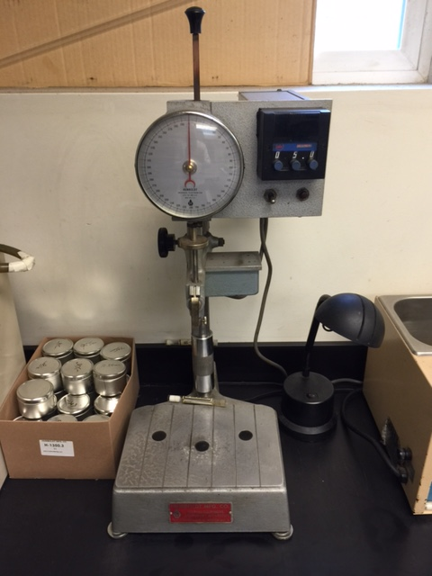
Penetration Test
ALBINA
ASPHALT

Slide 42
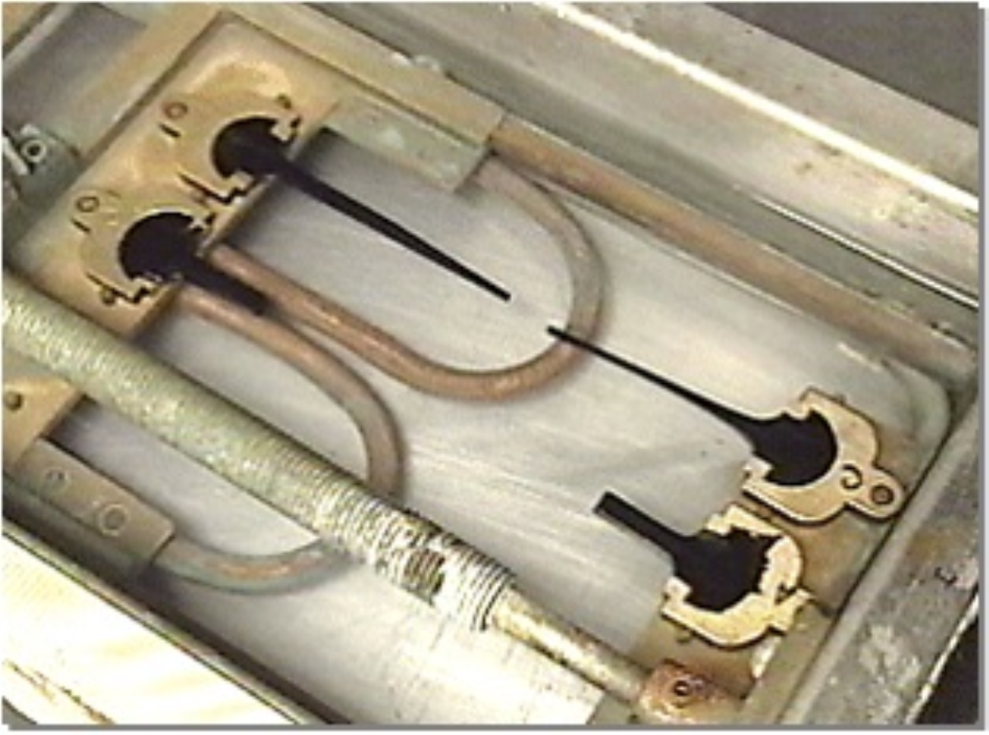
Elastic Recovery Test
ALBINA
ASPHALT

Slide 43

EMULSION VISCOSITY
ALBINA
ASPHALT

Slide 44
EmulsionsTypes
Emulsion | CRS-2 | HFRS-P2 | CRS-2P | RS-LTP | CSS-1 | CQS | AC 15P
Orig Properties
Viscosity @77°F SFS |  |  |  |  | 30-90 | 30-90
Viscosity @122°F SFS | 100-400 |  | 100-400 | >100
20 Mesh Sieve | 1.0 Max | 1.0 Max | 1.0 Max | 1.0 Max | 1.0 Max | 1.0 Max
Cement Mixing |  |  |  |  | Max 2.0% | Max 2.0%
Particle charge | Positive | Negative | Positive | Negative | Positive | Positive
Demulsibility | Min 40% | Min 40% | Min 40% | Min 40%
Distillation
Res by Distillation % | 67 | 67 | 67 | Min 65% | 62 | 62 | NA
Pen 77°F | 115 | 125 | 110 | 210 | 105 | 70 | 105
Float Test |  | 1300 sec
Ductility at 77°F | Min 40 | Min 40 | Min 40 | Min 40 | Min 40 | Min 40 | Min 40
Elastic Recovery @50°F | NA | 65% | 60% | 45% | NA | NA | 70%
Elastic Recovery @77°F | NA | 50% | 55% | NA | NA | NA | 50%
% Torsional Recovery | 0 | 24 | 23 | 20 | 0 | 0 | NA

Slide 45
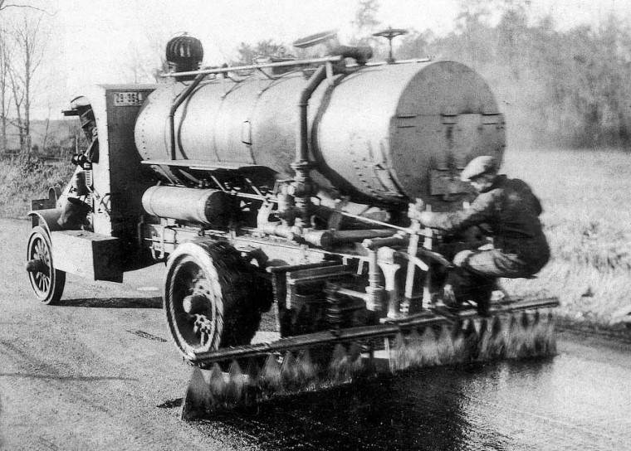
Thank You!
Questions??

