Slide 1

2019 Oaces cHip seal workshop
ABC’s of ASPHALT EMULSIONS
Keven Heitschmidt
Albina asphalt

Slide 2
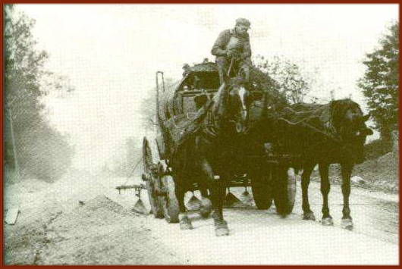
ABC’s of Asphalt Emulsions

Slide 3
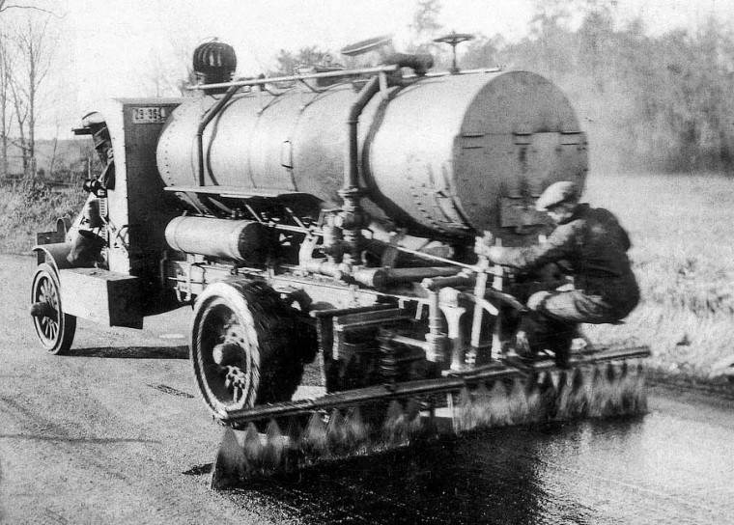
ABC’s of Asphalt Emulsions

Slide 4
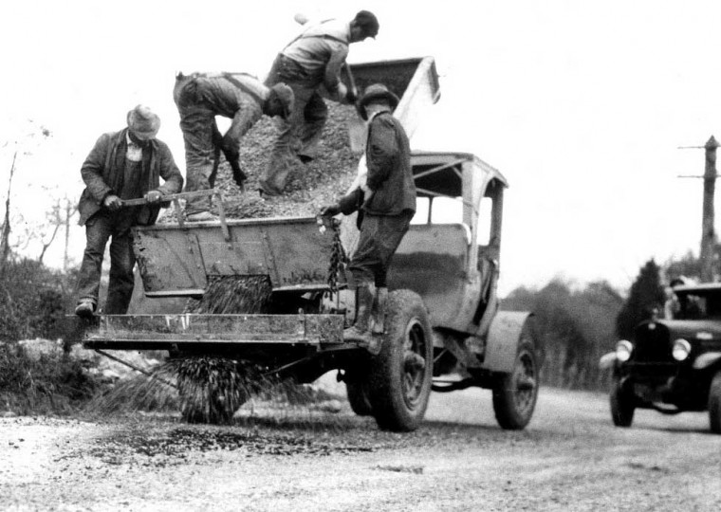
ABC’s of Asphalt Emulsions

Slide 5
ABC’s of asphalt emulsion
 |  |  |  |  | H
C |  |  |  |  | F
Q |  |  |  | E | R | A | - | E | E
S |  |  |  |  | S
- |  |  |  |  | -
1 |  | E |  |  | P
H | F | M | S | - | 2 | S
 |  | U |  |  |  | S
 |  | L |  |  |  | -
 |  | S |  |  |  | 1 |  |  |  |  |  |  | H
 |  | I |  |  |  | H |  |  |  |  |  | F
 |  | O |  |  |  |  | P |  |  |  | R
 |  | N |  |  |  |  |  | 2 |  | S
C | R | S | - | 2 | P |  |  |  | -
S |  |  |  |  | M |  |  | P |  | S
S |  |  |  |  | R |  | 2 |  |  |  | R
- |  |  |  |  | E |  |  |  |  |  |  | C
1

Slide 6
What is a Emulsion?
A Solution.
  A homogeneous mixture of two substances
  Individual molecules of one substance (solute) are surrounded by molecules of the other substance (solvent).

Slide 7
What is an Emulsion?
Examples ?
  Smoke or Fog?
  Milk.
  Butter.
  Mayo
  Asphalt!

Slide 8
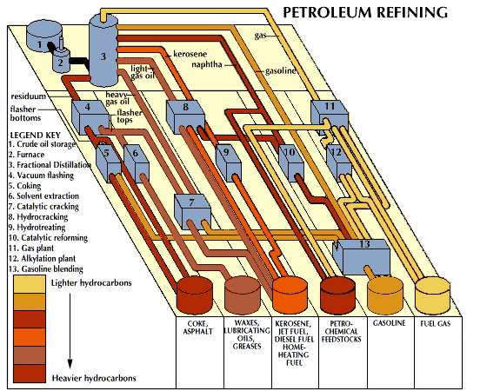
ABC’s of asphalt emulsion

Slide 9
ABC’s of asphalt emulsion
Why emulsify asphalt?
  Viscosity reduction and safer use at lower temperatures
  Change from “oil based” to “water based” system
  Reduced energy use, worker exposure, burn hazard and job site odor
  Properly formulated emulsion systems provide long term performance benefits
Notes:
Emulsification of asphalt is a complex process, so why do we do it? Why not just use hot asphalt all of the time? Asphalt in an emulsion form has some advantages over hot asphalt. Emulsions can have a water-like viscosity at normal ambient temperatures if desired. Emulsions are water based and do not require solvents to lower their viscosity. Emulsions can be stored at lower temperatures than asphalt cement, or without any heat at all, thus reducing energy use for long distance transport or long term storage. The lower temperature results in lower risk of burns or vapor exposure to workers. And very significantly, when emulsions are designed and used properly, there are long term performance benefits compared to simple hot asphalt equivalents through improved adhesion and less binder oxidation.

Slide 10
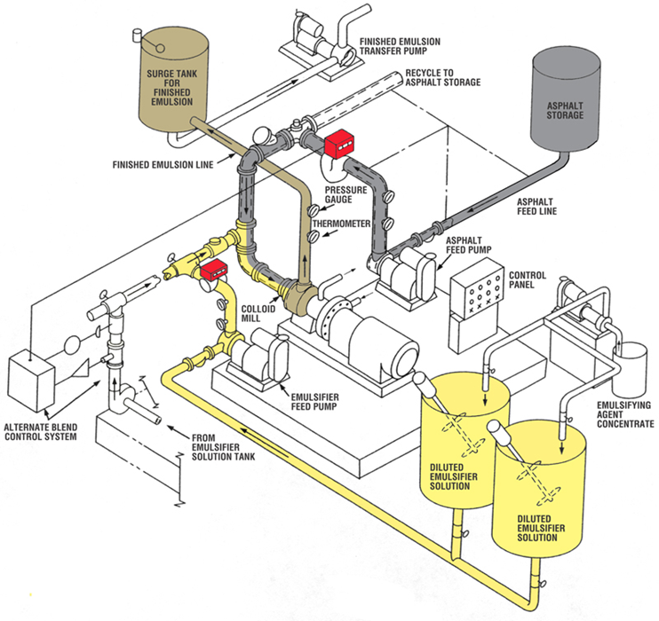
ABC’s of asphalt emulsion

Slide 11
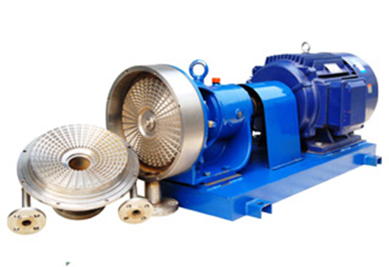
ABC’S of Asphalt Emulsions

Slide 12

ABC’s of asphalt Emulsions
Molten asphalt and emulsifier solution go in…
Rotor
shear
shear
Time
Stator
Notes:
As the molten asphalt elongates, it breaks up into smaller globules. This shearing process continues over and over, shearing the asphalt down to a smaller and smaller particle size until it reaches the mill outlet. The entire process from the time a quantity of asphalt enters the mill until it exits as an emulsion lasts only a few thousandths of a second.

Slide 13
_{ABC’S OF ASPHALT EMULSIONS}
Asphalt particle (5 microns)
Human hair (50 microns)
Notes:
This is a photomicrograph of a dilute asphalt emulsion. The brown spheres are the asphalt particles and they are surrounded by water and other chemical additives. The asphalt particles in a typical emulsion might average 5 microns in diameter. To understand the relative size, an average human hair is 10 times that diameter.

Slide 14
ABC’S of Asphalt Emulsions
Average 3-7 microns diameter
Asphalt is usually 57-70% of the emulsion
1 gram of asphalt will form more than 10 billion particles
The total surface area of 1 gram of asphalt is 1-2 m²
One drop of emulsifier would stabilize as much as 100 billion particles or 10-20 m² of asphalt particle surface area
Notes:
The asphalt particles in an emulsion are not visible to the naked eye. One micron is 1/1,000,000th of a meter, or 1/1000th of a millimeter. Asphalt typically makes up more than 50% of the emulsion with the water continuous phase being a minor component. Based on this, you can see that the asphalt particles must be packed very closely together. 1 gram of asphalt would be an amount about the size of a sugar cube. The sum of the surface areas of each particle and the large number of particles in an emulsion adds up to a very large total surface area of asphalt. That surface must be coated with emulsifier to stabilize the emulsion, and it is spread very thin.

Slide 15
Abc’s of asphalt emulsions
How do we name the emulsions?
Anionic
Cationic
Non-ionic
Notes:
First, classification systems are based on emulsion type. There are two basic categories, cationic and anionic. The nonionic types are usually considered to be a subcategory of the anionic types.
The cationic and anionic categories are differentiated by an electrical charge that each type of emulsion uses to stabilize itself. That charge is determined by the emulsifier chemistry and the emulsion pH.
The word “cationic” refers to something that has a positive electrical charge. The asphalt particles of these emulsions have positive charges on their surfaces.
The word “anionic” refers to something that has a negative electrical charge. These emulsions have negatively charged asphalt particle surfaces.

Slide 16
Emulsion Classifications
Rapid Set Medium Set Quick Set Slow Set
Spray Grade
Emulsions
Mixing Grade
Emulsions
Notes:
Whether we are talking about cationic or anionic types, they both have these four setting categories in common. The emulsion setting characteristics fall commonly into two application types, spray applications and mixing applications.

Slide 17
Categories of Asphalt Emulsions
Spray grade emulsions (rapid and medium sets)
Designed to be marginally stable
The chemical additives and dosages are chosen to allow reasonable handling stability, but easy destabilization
Break with mild destabilizing effects
Environmental exposure and/or on contact with flat surfaces

Slide 18
CATIGORIES OF ASPHALT EMULSIONS
Mixing grade emulsions (medium, quick and slow sets)
Designed to be significantly more stable
The chemical additives and dosages are chosen to allow good handling stability and designed destabilization
Break with strong destabilizing effects
Exposure to high aggregate fines, pH shifts, or challenging environment
Notes:
Some of the medium setting types and the quick and slow setting types fall into the general mixing grade category. Mixing grade emulsions are chemically designed to be significantly more stable. The emulsions are usually mixed with aggregate which has a strong destabilizing effect on the emulsion. It needs to remain emulsified for a certain amount of time before breaking so that the mix can be properly placed. The additive chemistry and emulsion formulation are often chosen based on the particular aggregate being used in the project to give a “designed” setting time.

Slide 19
What goes into a emulsion?
Asphalt
Water
Chemicals
Emulsifiers
Polymers
additives

Slide 20
Emulsifier
An oil soluble part (Lipophilic)
A water soluble part (Hydrophilic)
Some characteristic that allows the molecule to protect the surface of the asphalt droplet
Electrical charge…

Slide 21
Emulsifier
CH
CH
CH
CH
3
2
2
2
CH
CH
CH
CH
2
2
2
2
CH
CH
CH
CH
O
Tail group (oil soluble)
2
2
2
2
CH
CH
CH
C
2
2
2
NH
CH
CH
2
2
2
NH
NH
CH
CH
2
2
2
+/-
Head group (water soluble)
“Short hand” picture
Notes:
This is the chemical structure of an emulsifier molecule. The “tail group” is made up of all carbon and hydrogen atoms. Compounds with this composition are of a group known as “hydrocarbons”. You are familiar with many types of hydrocarbons including oils, fats, refinery products like asphalt, diesel and gasoline. All of these compounds and materials are oil soluble. In the head group of this molecule, we find oxygen and nitrogen atoms along with the hydrocarbons. O and N are known as “heteroatoms” because they do not share electrons equally with their neighboring carbon atoms. This causes them to attain a slight positive or negative electrical charge. We call these molecules “polar” because they contain an electrical dipole. Water, which contains an oxygen atom along with two hydrogen atoms is also polar. Molecules of this type are mutually soluble. Rather than writing out all of the chemical structure, it is often easier for us to use this shorthand picture of the molecule.

Slide 22
Anionic Emulsifier Molecule
CH
CH
CH
CH
3
2
2
2
CH
CH
CH
CH
2
2
2
2
CH
CH
CH
CH
O
2
2
2
2
CH
CH
CH
C
2
2
2
OH
Tail group
Head group
Notes:
This is an example of an anionic emulsifier molecule. This is palmitic acid, present in essentially every animal or vegetable fat source. This molecule has a 16 carbon chain length, and a carboxylic acid head group containing oxygen atoms. Oxygen atoms are heteroatoms that like to attain a negative electrical charge. These oxygen atoms will have only a partial charge.

Slide 23

The Emulsifier - Performance
+
+
+
+
+
+
More oil soluble emulsifier
More water soluble emulsifier
+
+
+
+
+
+
+
+
+
+
+
+
+
+
+
+
+
+
+
+
+
-
-
-
-
-
-
-
-
-
-
+
-
-
-
-
-
-
Notes:
This is a simple “thought experiment” to get a basic understanding of how emulsions and aggregates interact. In this case, we will look at a cationic emulsion mixed with a siliceous or negatively charged aggregate particle. We will compare two cases of differing emulsifier chemistry. On the left is the case of an emulsifier that is slightly more water loving, and on the right is an emulsifier that is slightly more oil loving. In both cases, all other factors are equal including the number of molecules present (dosage). If a surfactant is more oil soluble as in the case on the right, a large proportion of the total surfactant will concentrate on the oil droplet surface, leaving very little remaining in the water phase of the emulsion. By contrast, if the surfactant is more water loving as in the case on the left, more of it will remain in the water phase and less on the asphalt droplet surface. When an aggregate particle is introduced, the charge difference between the surfactant and the aggregate surface will first attract the light weight, highly mobile molecules in the water phase to that surface, neutralizing some of the aggregate surface charge. The remaining charge on the aggregate will then attract the large, heavy, slower moving asphalt particle. The rate at which the asphalt particle is attracted is proportional to the total difference in charge between the particle and the aggregate surface. In the case on the right, the particle has a larger number of charges attached, and the aggregate has a larger remaining surface charge compared to the case on the left. This means the asphalt particle on the right will be attracted to and break on the aggregate surface more quickly than the one on the left. This is an example of how the emulsifier chemistry can be altered to lead to a difference in breaking speed on application.

Slide 24
Cationic emulsions
Common Cationic Classifications
CRS, CMS, CQS, and CSS
Each classification will have a suffix such as “-1” or “-2” (emulsion viscosity) and/or an “h” (asphalt base hardness)
Examples: CRS-2, CQS-1h, CSS-1
Other designations: P=polymer (solid or latex) LM=latex polymer, s=solvent, many others…
Examples: crs-2p, lmcqs-1h, cms-2s

Slide 25
anionic emulsions
Common Anionic Classifications
RS, HFRS, MS, HFMS, QS, and SS
Each classification will have a suffix such as “-1” or “-2” (emulsion viscosity) and/or an “h” (asphalt base hardness)
Examples: HFRS-2, SS-1h
Other designations: P=polymer (solid or latex) LM=latex polymer, s=solvent, Examples: HFRS-P1 (90-1S), HFMS-2S.

Slide 26
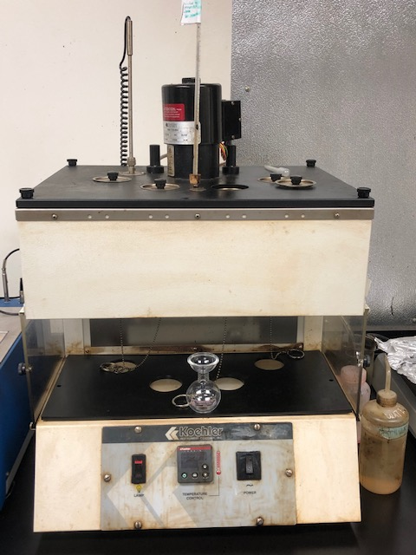
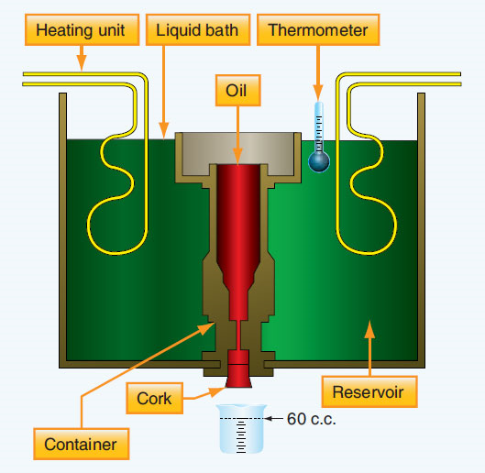
Emulsion test SFS viscosity

Slide 27
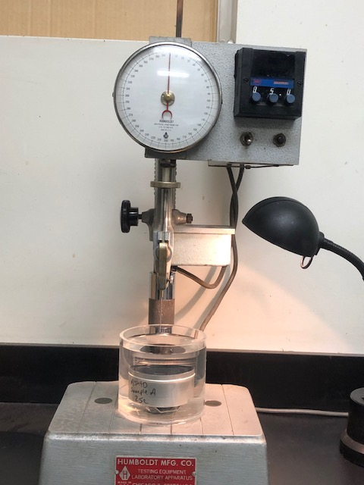
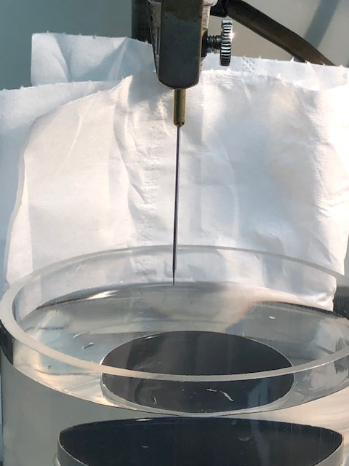
Emulsion test penetration

Slide 28
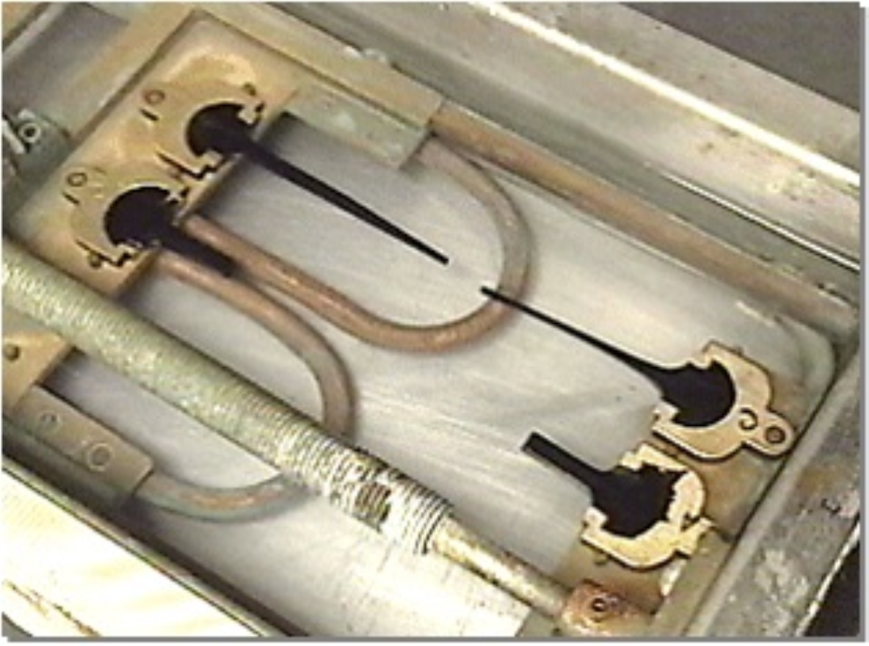
Emulsion test Elastic recovery

Slide 29
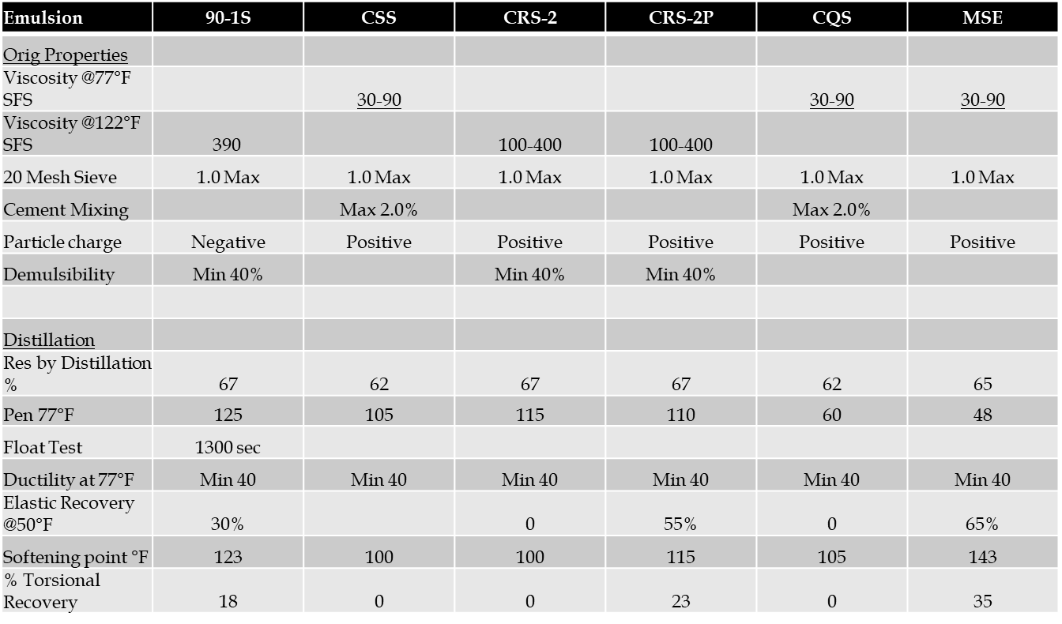
finally

Slide 30
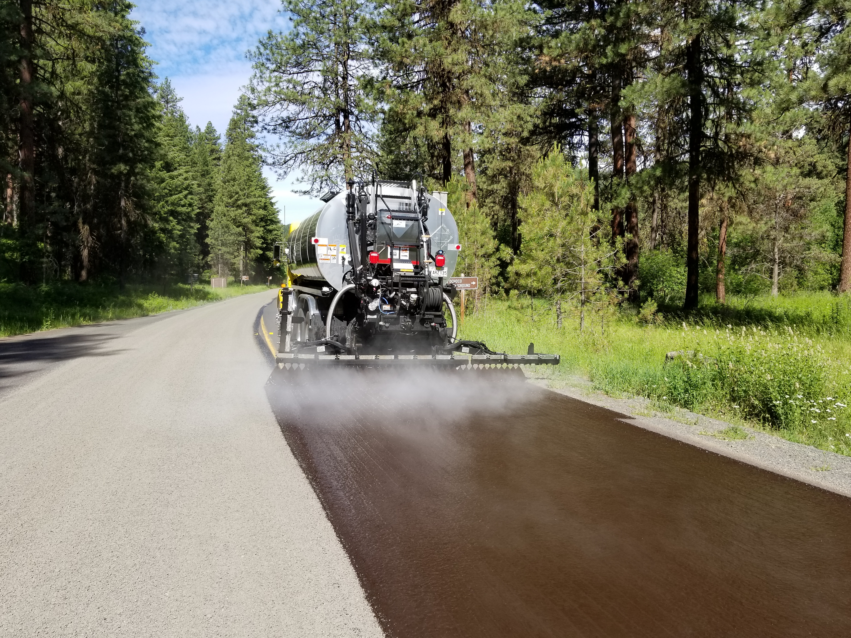
Thank you and questions??

