Slide 1
Surface treatment toolbox
in Linn County, OR
Kevin Hamilton
Operations Manager
(541) 967-3919 Office
(541) 740-1787 Cell
khamilton@co.linn.or.us
Jeff Maskal
Special Operations Group Foreman
jeff.maskal@co.linn.or.us
(541) 967-3919 Office/Message
Combatting Flushing/Bleeding Roads

Slide 2
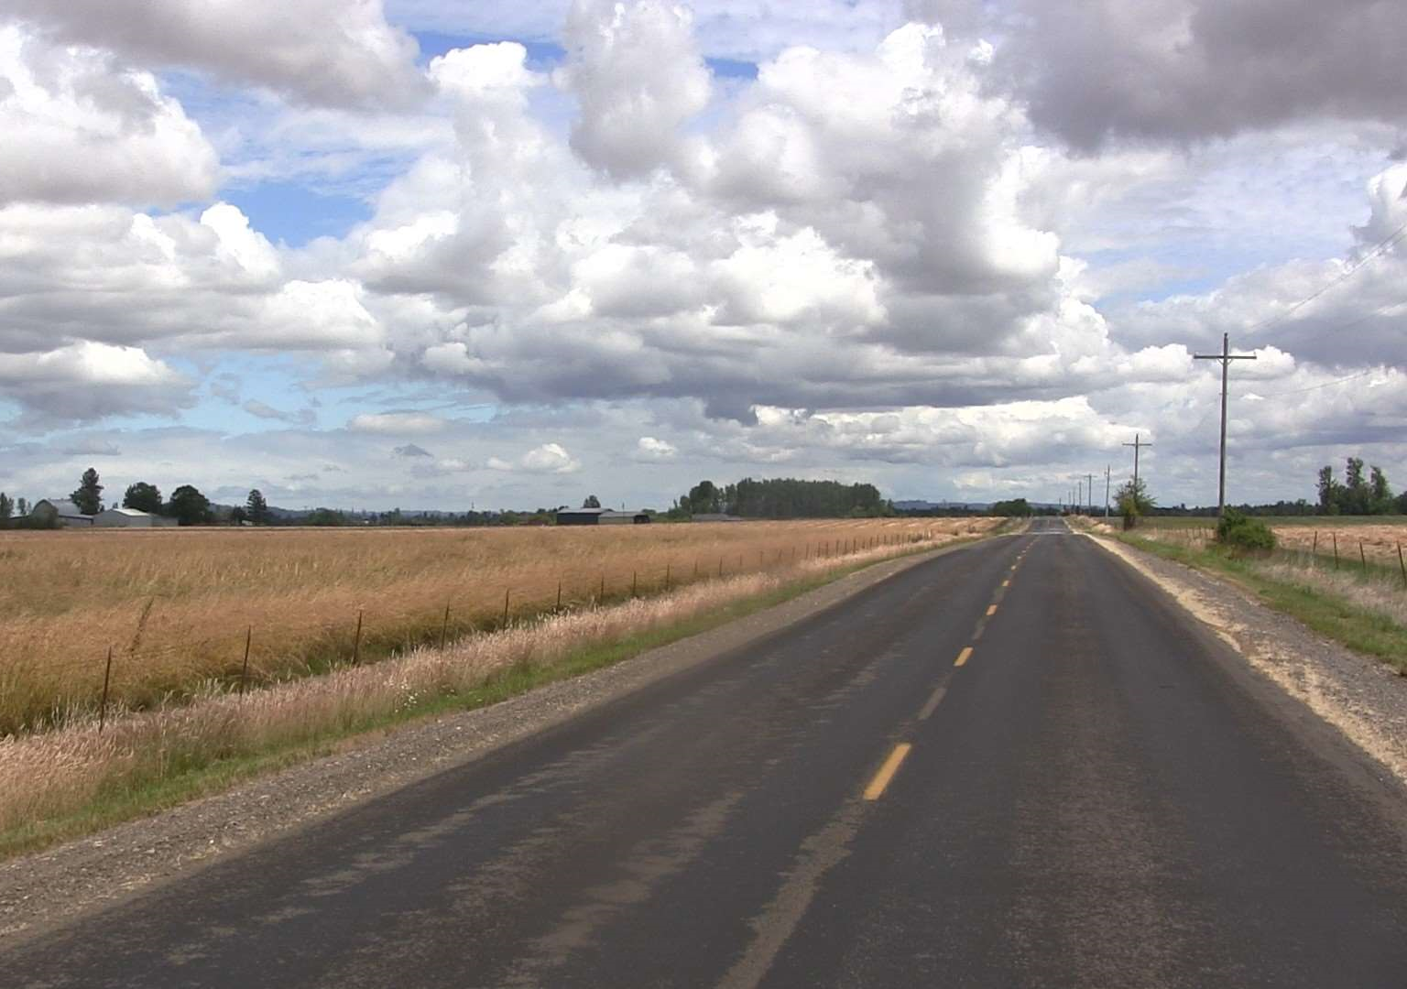
Flushing/bleeding roads
Heavy Double Shot
FIRST COURSE
¾” – ½” rock
@ 35 lbs/sy
CRS-3P
@ 0.46 gals/sy
SECOND COURSE
3/8” – 10 rock
@ 18 – 22 lbs/sy
CRS-3P
@ 0.38 gals/sy
Langmack Rd.

Slide 3
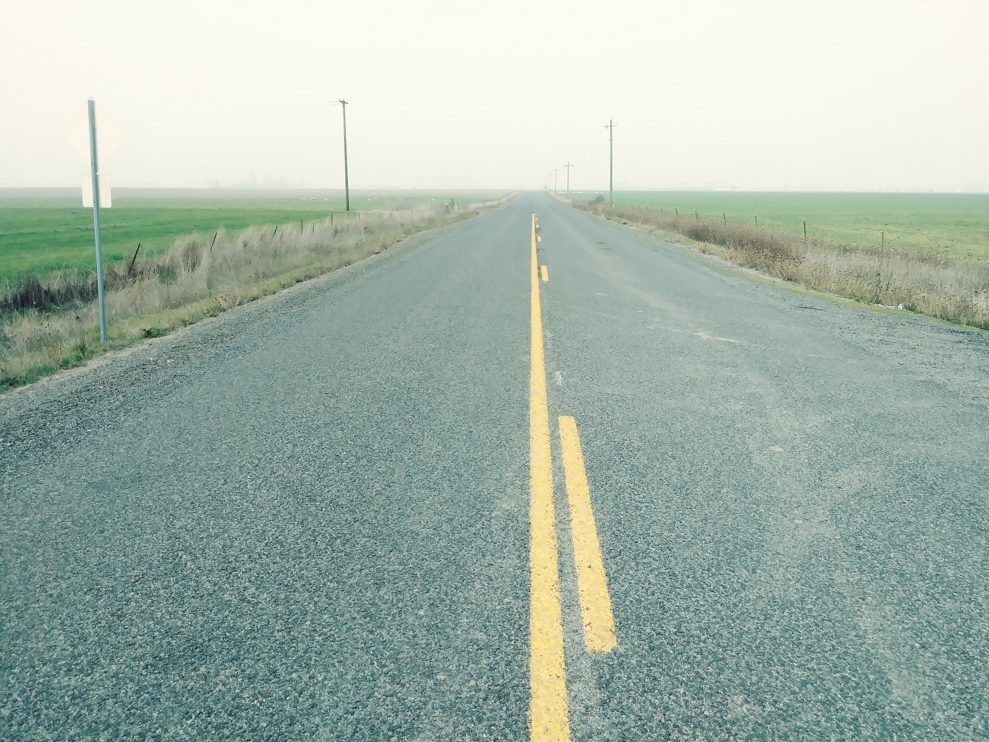
Flushing/bleeding roads
FIRST COURSE
¾” – ½” rock
@ 35 lbs/sy
CRS-3P
@ 0.46 gals/sy
SECOND COURSE
3/8” – 10 rock
@ 18 – 22 lbs/sy
CRS-3P
@ 0.38 gals/sy
Langmack Rd.

Slide 4
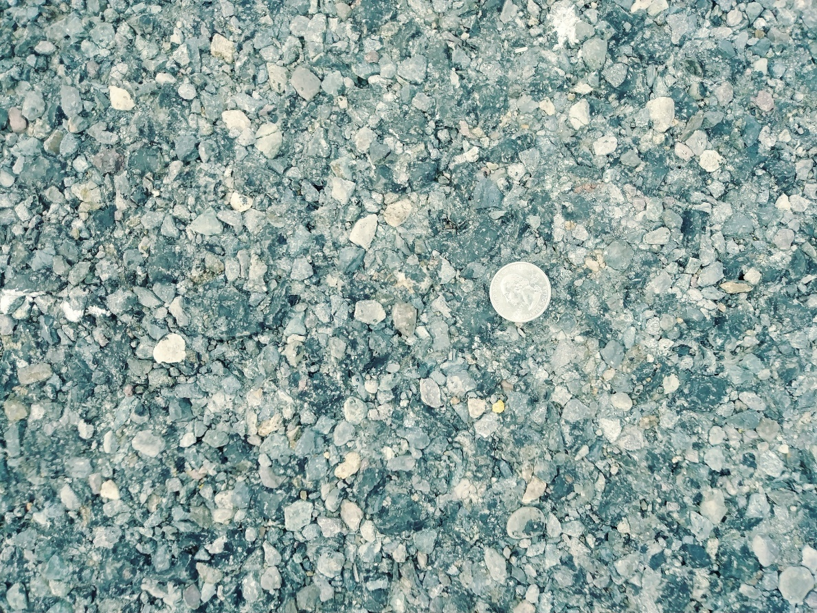
Flushing/bleeding roads
FIRST COURSE
¾” – ½” rock
@ 35 lbs/sy
CRS-3P
@ 0.46 gals/sy
SECOND COURSE
3/8” – 10 rock
@ 18 – 22 lbs/sy
CRS-3P
@ 0.38 gals/sy
Langmack Rd.
December of 2019.

Slide 5
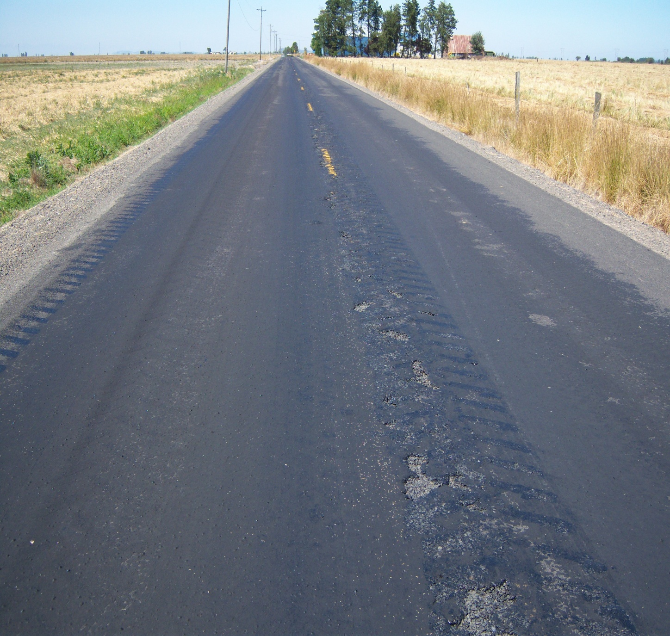
Flushing/bleeding roads
SANDWICH SEAL
Three courses of rock.
Two courses of oil.
No fog seal
Parker Rd.
2011

Slide 6
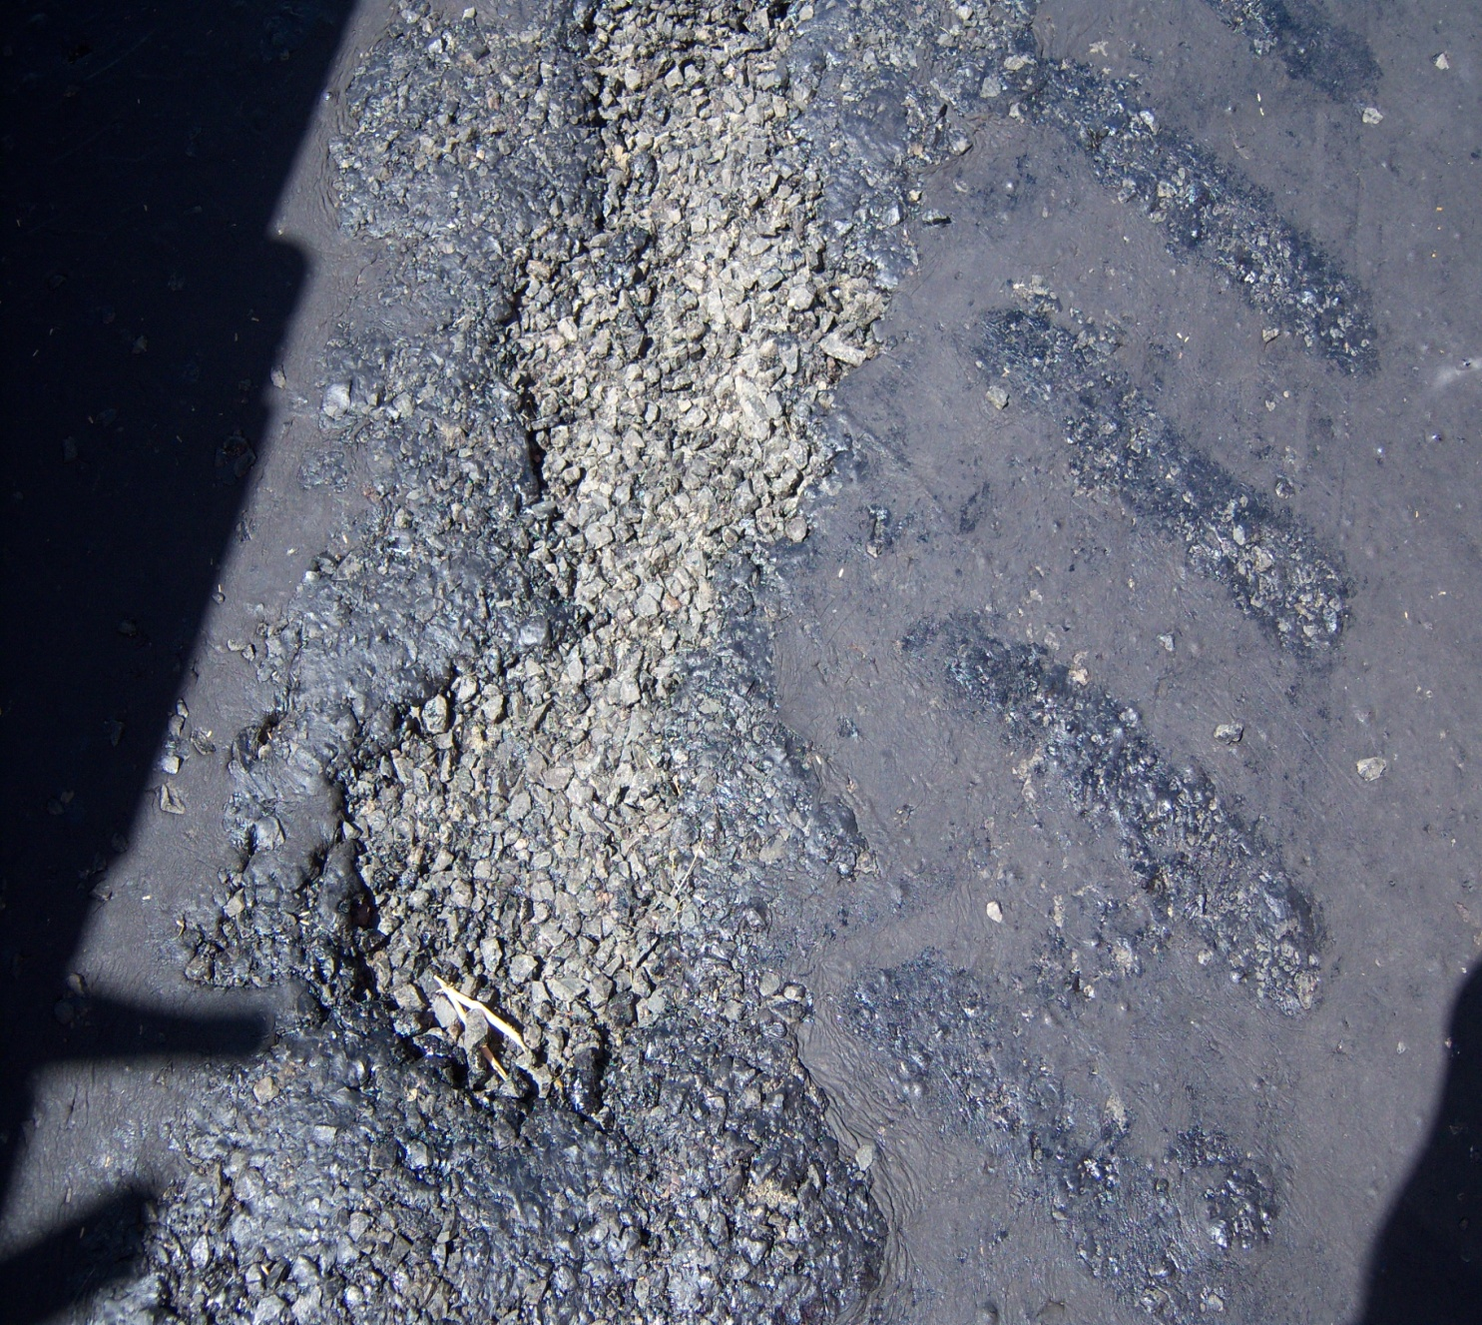
Flushing/bleeding roads
FIRST COURSE
½” – ¼” rock @ 20 – 24 lbs/sy
No oil.
Roll, roll, roll.
SECOND COURSE
Applied CRS-2P @ 0.35 gals/sy,
Then ½” – ¼” rock @ 22 - 24 lbs/sy again.
Roll, roll, roll. Then sweep.
THIRD COURSE
Applied CRS-2P @ 0.40 gals/sy
Then ¼” – 10 rock @ 18 – 20 lbs/sy.
Roll.
SANDWICH SEAL
Parker Rd.
2011

Slide 7
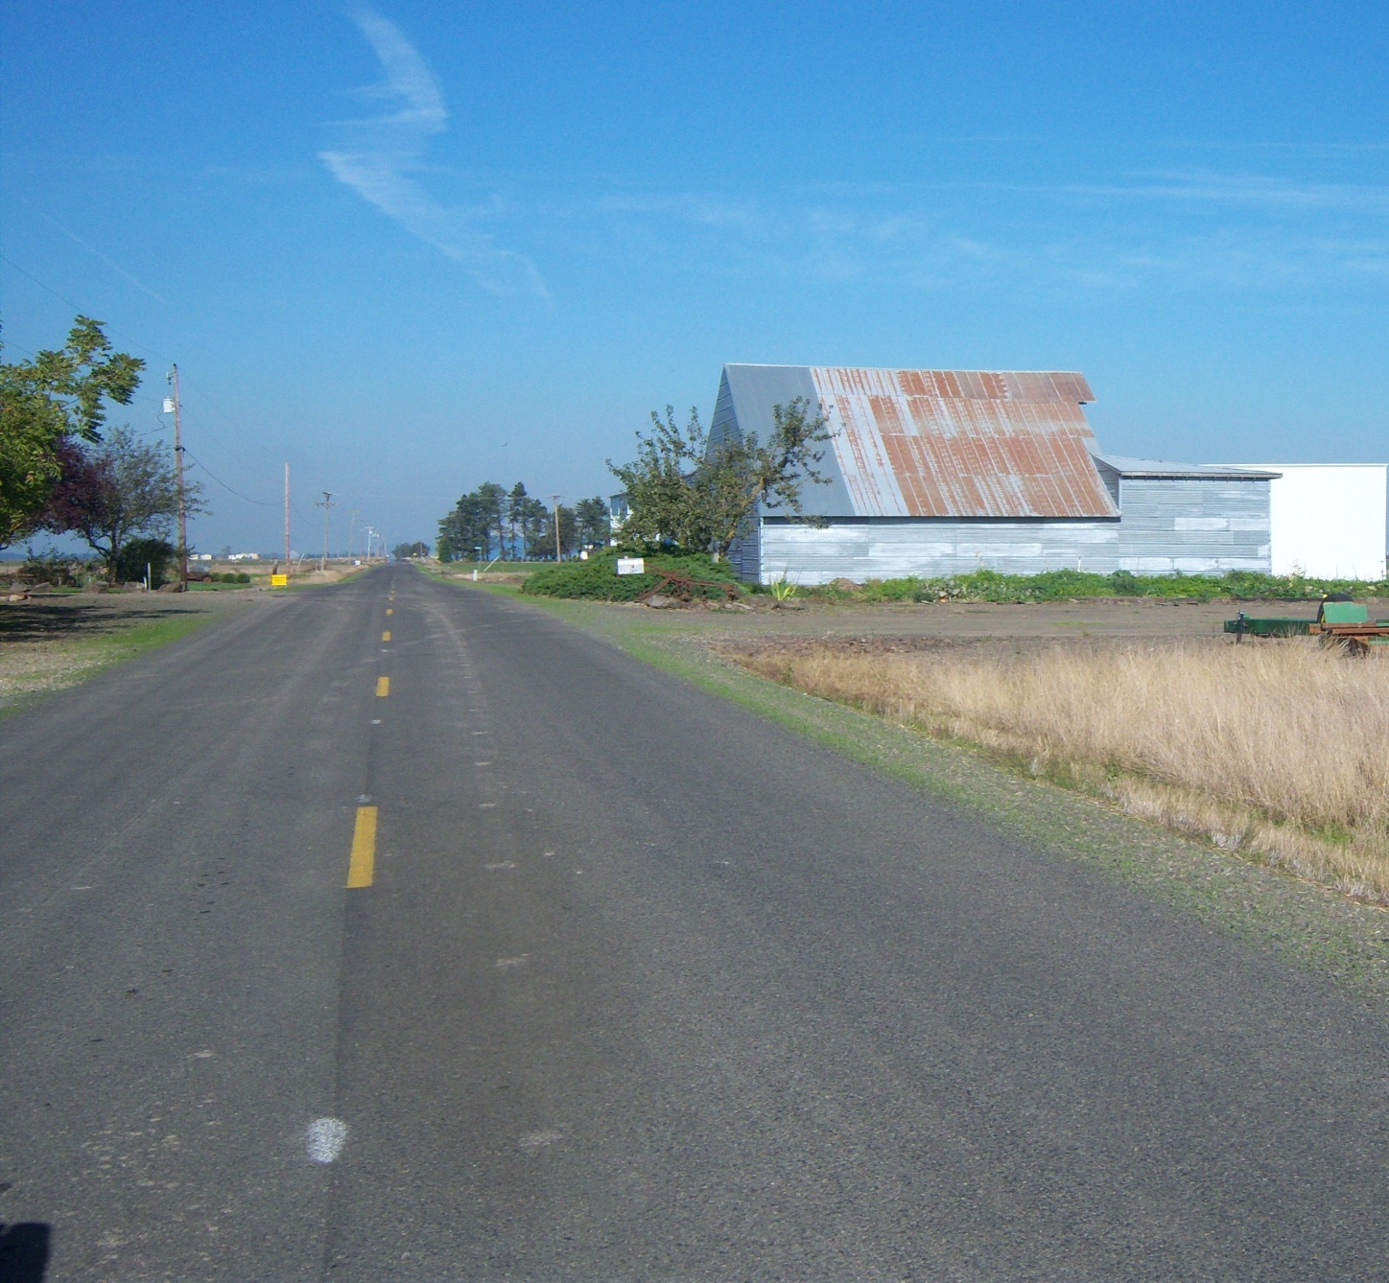
Flushing/bleeding roads
FIRST COURSE
½” – ¼” rock @ 20 – 24 lbs/sy
No oil.
Roll, roll, roll.
SECOND COURSE
Applied CRS-2P @ 0.35 gals/sy,
Then ½” – ¼” rock @ 22 - 24 lbs/sy again.
Roll, roll, roll. Then sweep.
THIRD COURSE
Applied CRS-2P @ 0.40 gals/sy
Then ¼” – 10 rock @ 18 – 20 lbs/sy.
Roll.
SANDWICH SEAL
Parker Rd.
After sandwich seal in 2011

Slide 8
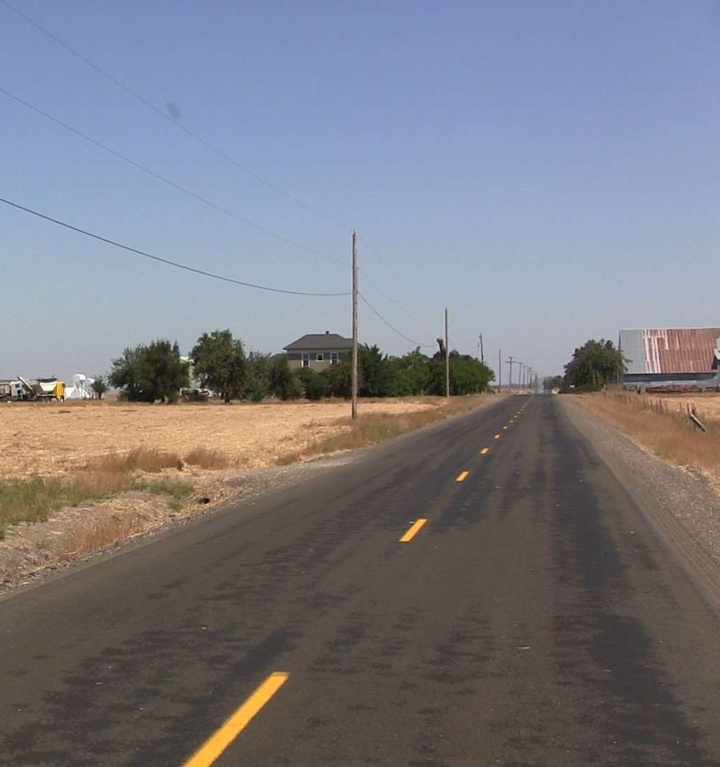
Flushing/bleeding roads
SANDWICH SEAL
Parker Rd.
July, 2018
Parker Rd.
After sandwich seal in 2011

Slide 9
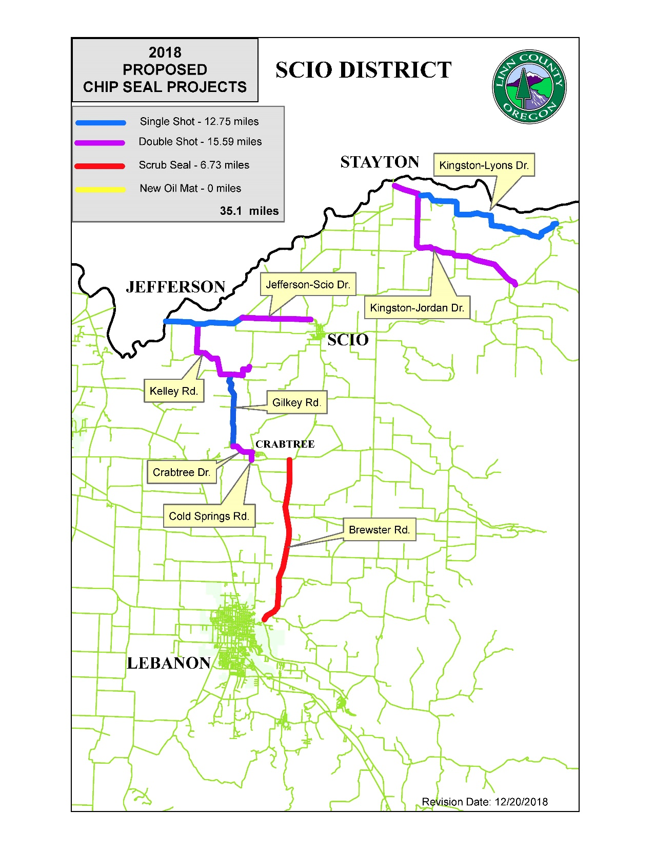
Brewster rd.
When things go wrong
6.73 miles
Major collector
ADT 5,000+

Slide 10
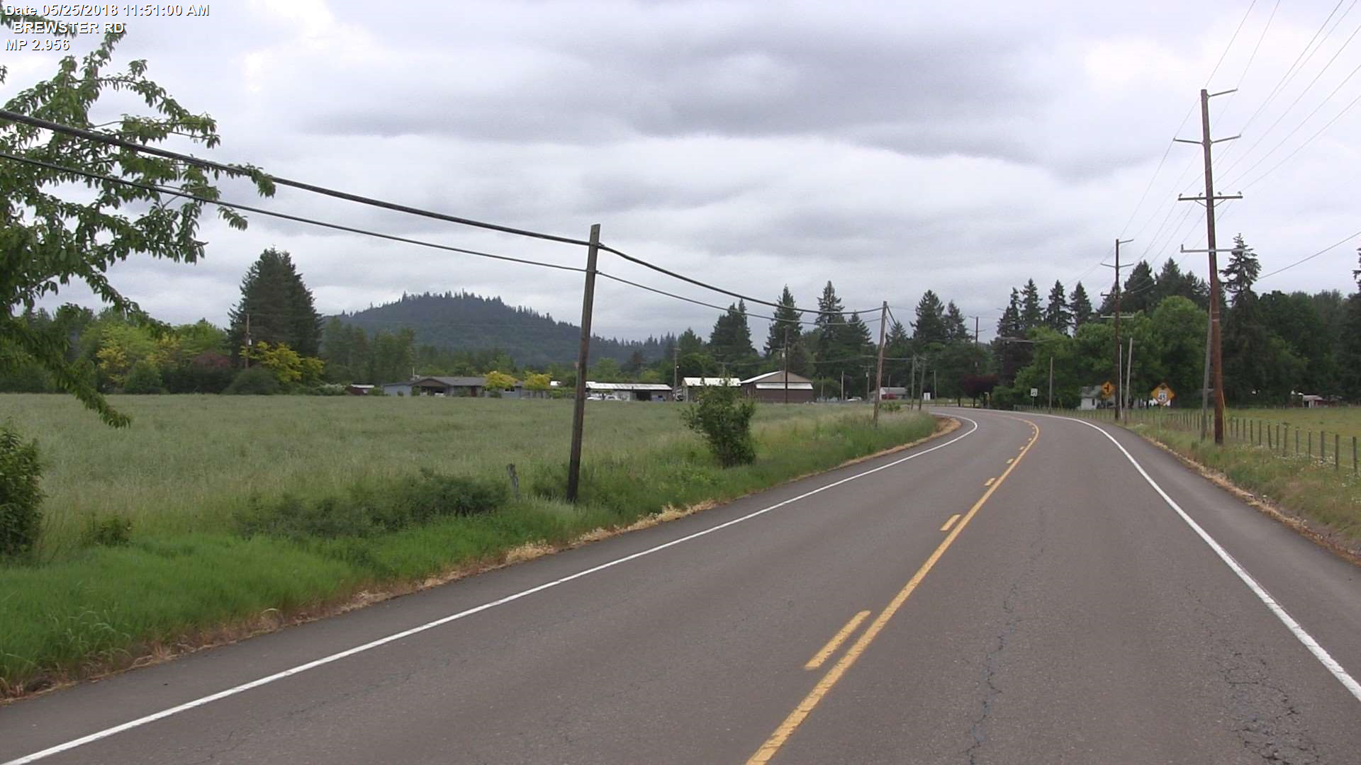
Brewster rd.
When things go wrong
PCI = 55 – 61
Mostly load cracking

Slide 11
Brewster rd.
When things go wrong
PASS MAX-CR (scrub seal oil – we did not use scrub broom)
0.40 gals/sy
3/8” – 10 rock @ 18-19 lbs/sy
Top Course (next day)
CRS-3P @ 0.30 gals/sy
¼” – 10 rock @ 12-13 lbs/sy
Fog Seal:
CSS-1h @ 0.10 gals/sy

Slide 12
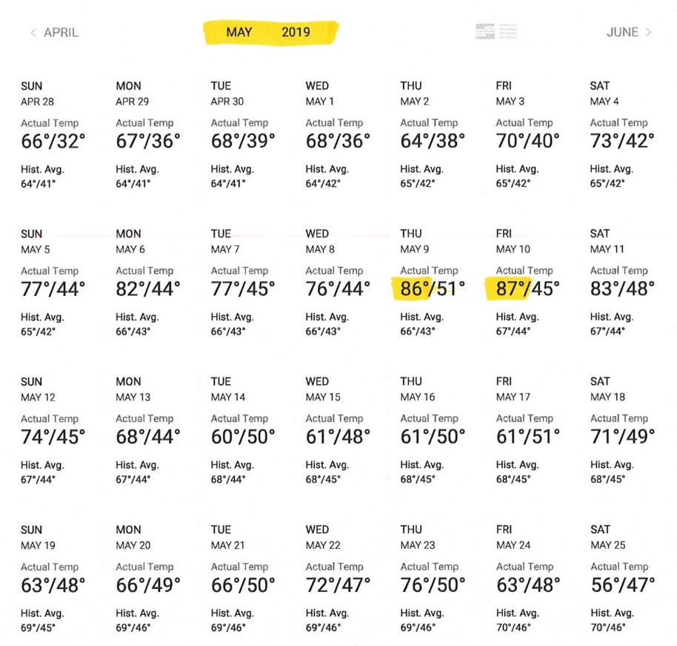
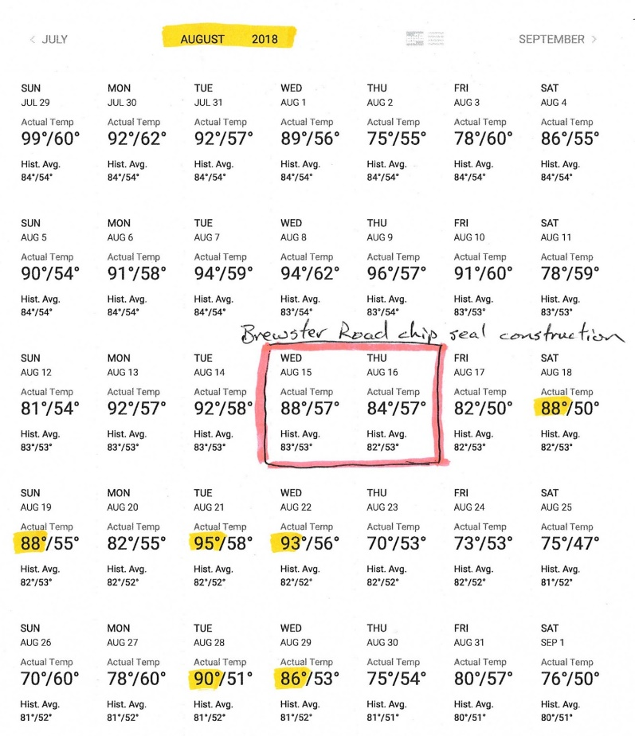
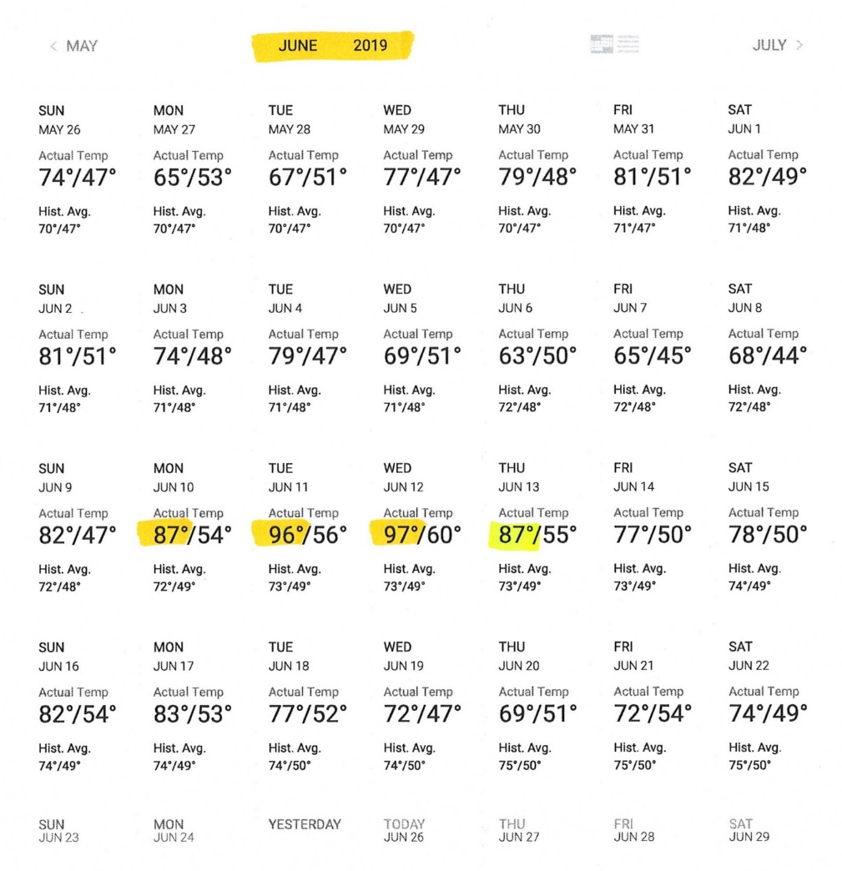
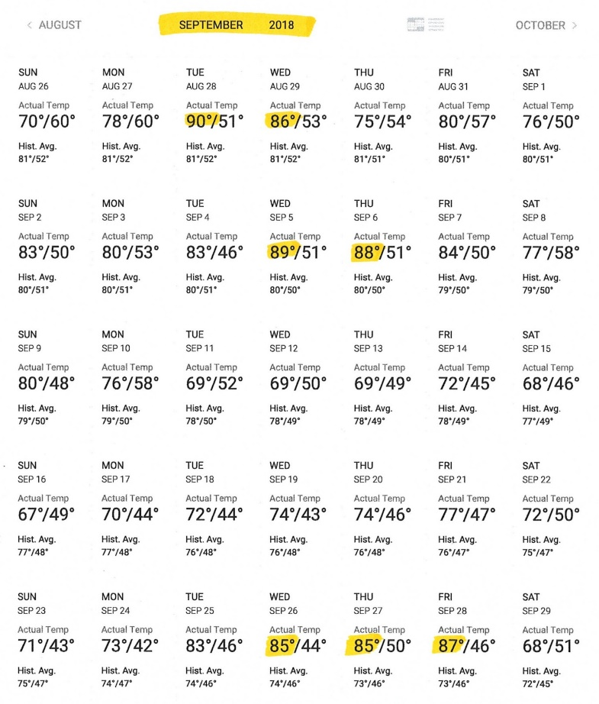
Brewster rd.
When things go wrong

Slide 13
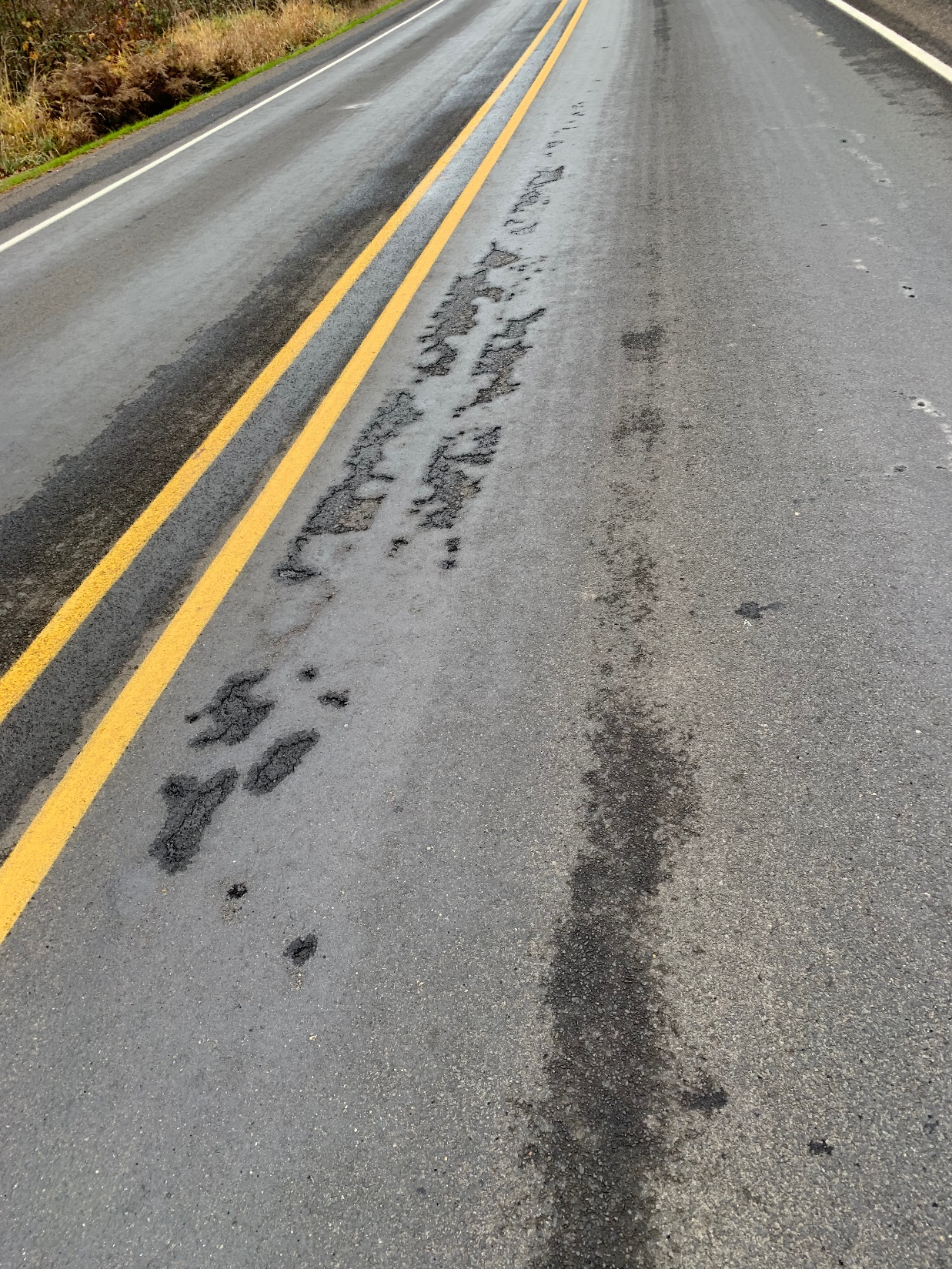
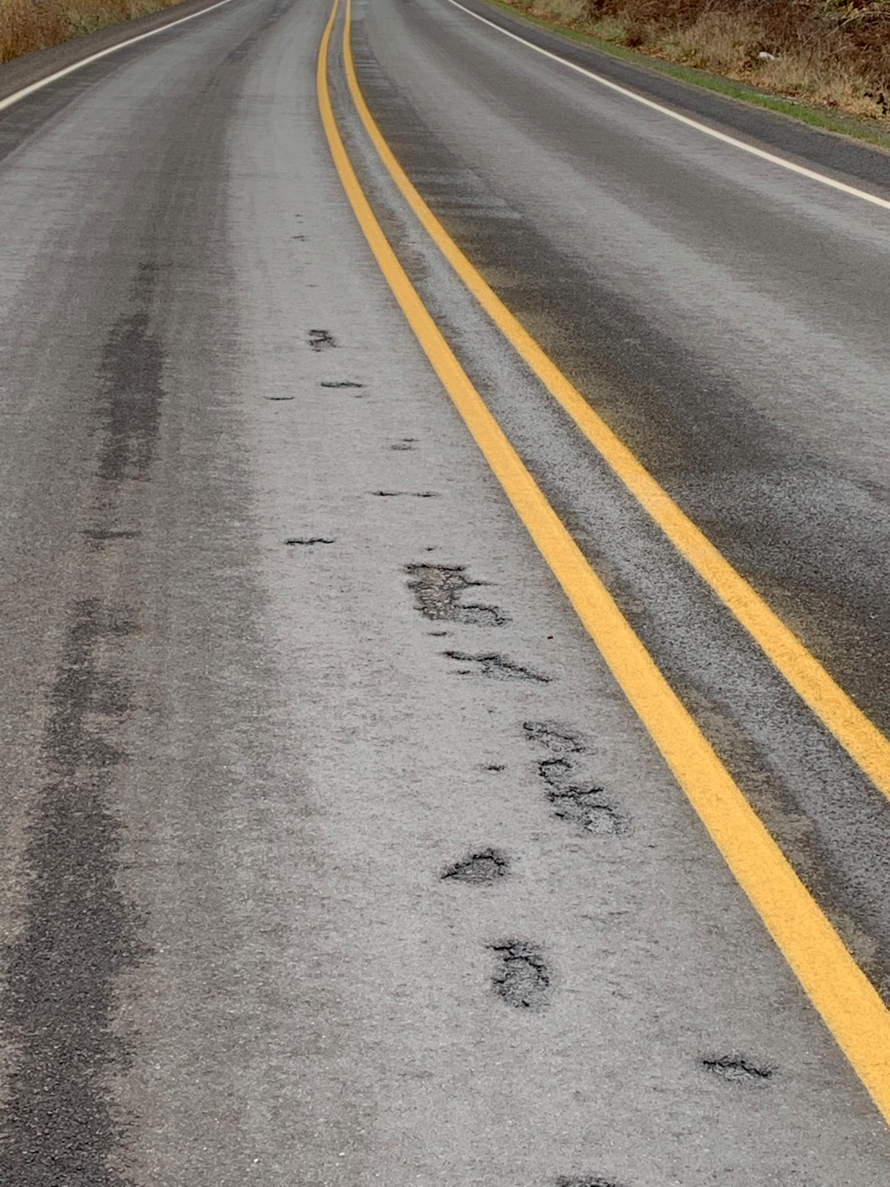
Brewster rd.
When things go wrong

Slide 14
Brewster rd.
When things go wrong
PASS MAX-CR has a low softening point.
Could have used less oil / more rock with the PASS in this application.
Could have used ½” rock on base course instead of 3/8”.
Could have used a harder oil on top course, not CRS-3P; or use CRS-3P on top and bottom – but not PASS combined with CRS-3P.
Could have skipped the fog seal.

Slide 15
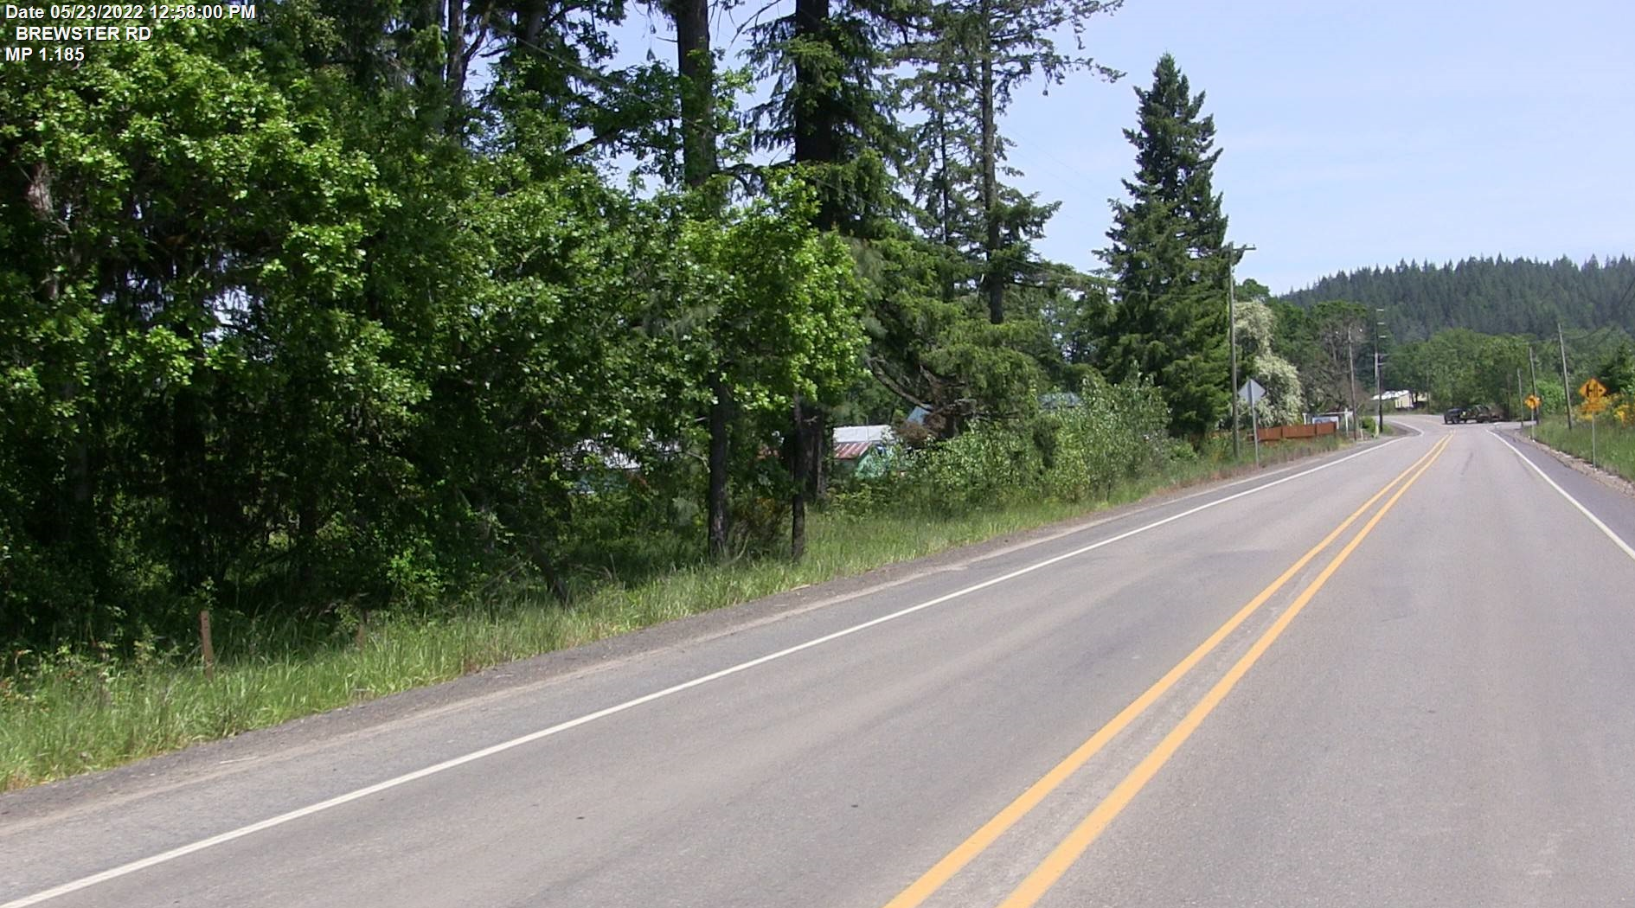
Flushing/bleeding roads
Microseal

