Slide 1
Emulsion specification and performance engineering for chip seal and fog/mastic seal
Troy Tindall
Blue Line transportation / Enviroad llc

Slide 2
Specification Chip Seal Emulsion
Specification chip seal emulsions are asphalt emulsions that conform to a wide specification range and have been the the industry standard over many years.

Slide 3
Specification CRS-2P and HFRS-P1
CRS-2P
Min | Max
100 | 400
40
65
90 | 200
45
HFRS-P1
Min | Max
100
30
65
90 | 200
30
Viscosity SFS
Demulsibility %
Residue %
Penetration
Elastic Recovery %

Slide 4
Specification CRS-3P and HFRS-P2
CRS-3P
Min | Max
150
60
65
80 | 150
58
HFRS-P2
Min | Max
100
40
65
90 | 200
58
Viscosity SFS
Demulsibility %
Residue %
Penetration
Elastic Recovery %

Slide 5
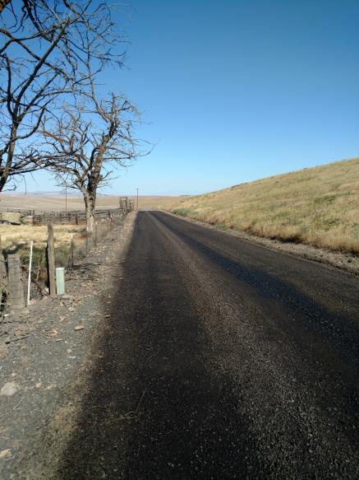
Chip loss & bleeding

Slide 6
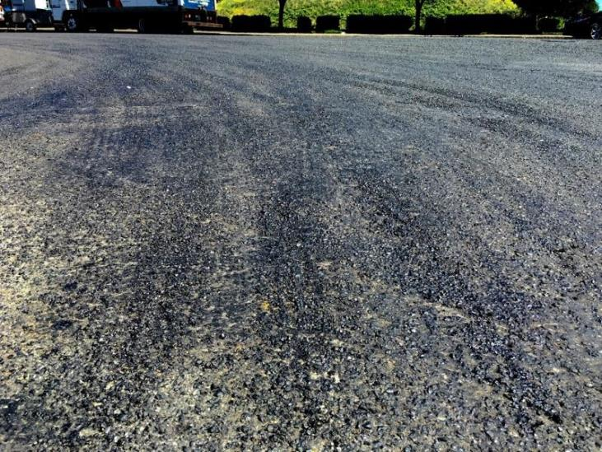
Chip loss and bleeding

Slide 7
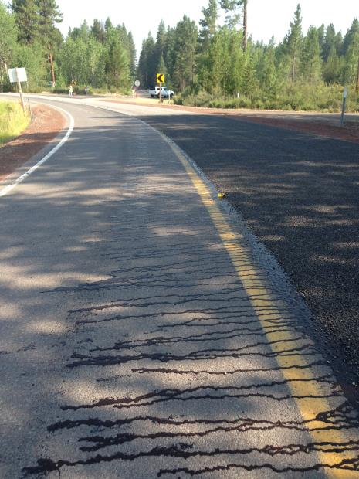
Low Viscosity

Slide 8
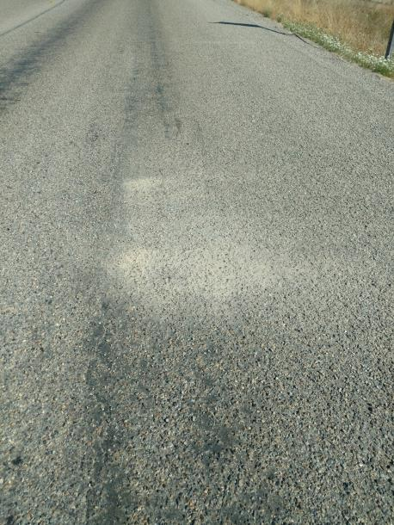
Chip loss

Slide 9
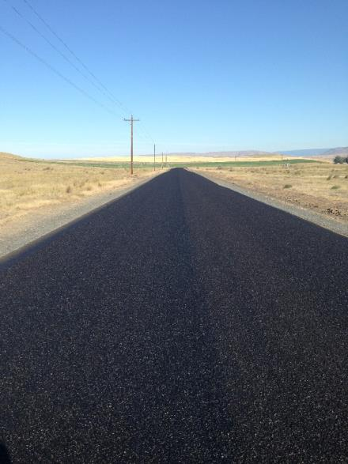
Successful specification chip seal

Slide 10
Engineered Emulsions
Engineered emulsions are designed to address performance challenges faced when utilizing specification emulsions.
  Chip loss
  Flushing/bleeding
  High ADT use
  Fast return to traffic
  Eliminate fly rock
  Performance specification – bring your game

Slide 11
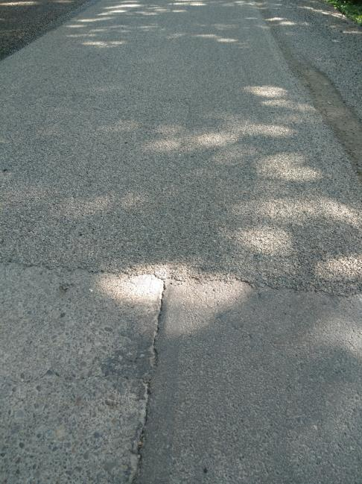
BL-3P

Slide 12
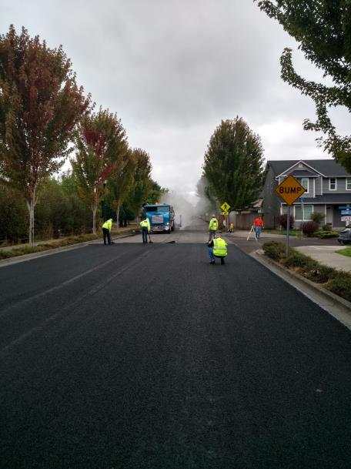
BL-3P

Slide 13
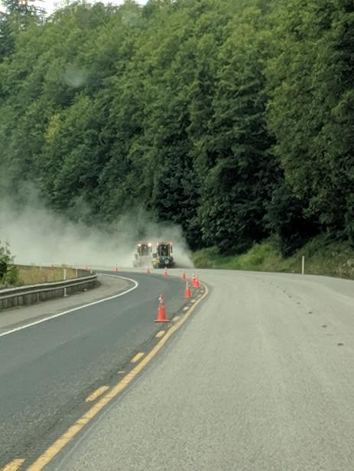
BL-3P

Slide 14
Specification Fog Seal
Specification fog seals are asphalt emulsions that conform to a wide specification range and have been the the industry standard over many years. Generally comprised of a tack or chip emulsion diluted with water 50/50.

Slide 15
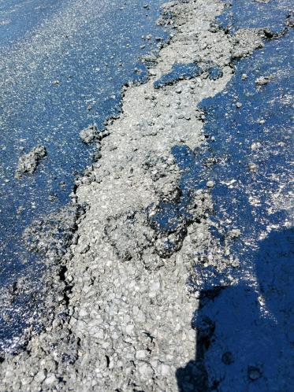
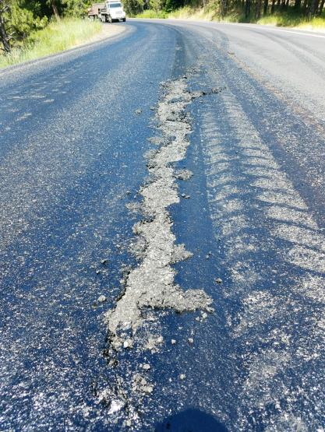
CRS-2P / HFRS-P1 Dilute

Slide 16
Engineered Fog / Mastic Seal
Engineered fog / mastic seals are formulated to meet customer expectations utilizing project data.
  Average daily traffic
  Type of traffic
  Environmental / Time of day considerations
  Road condition
  Skid resistance
  Return to traffic requirements

Slide 17
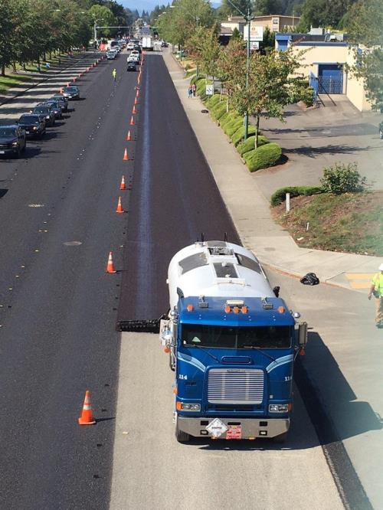
BL-Fog

Slide 18
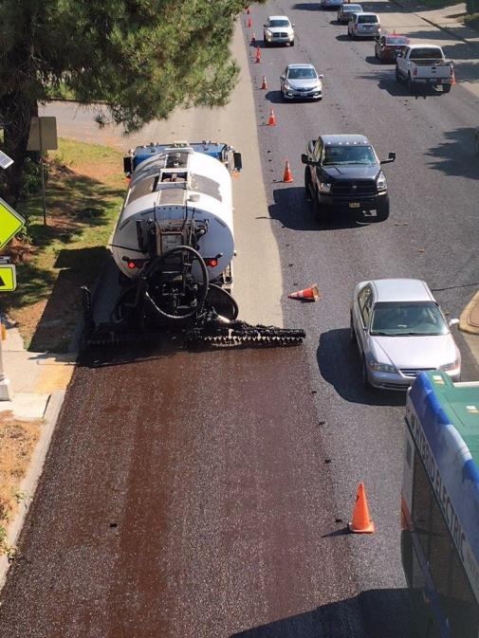
BL-Fog

Slide 19
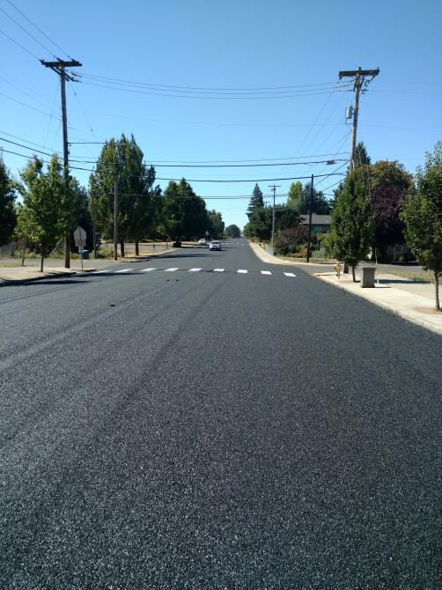
BL-Fog

Slide 20
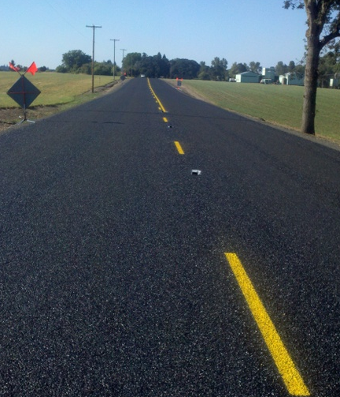
BL-Fog

Slide 21
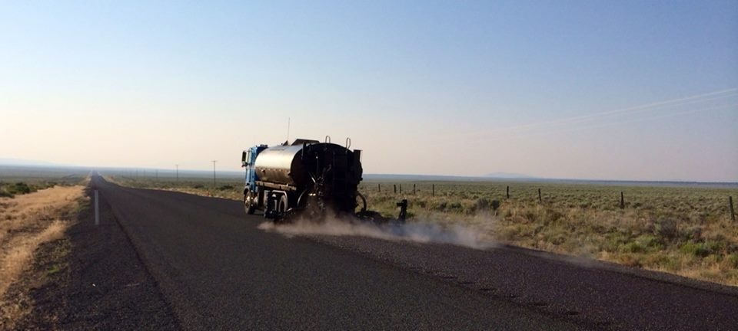
BL-Fog

Slide 22
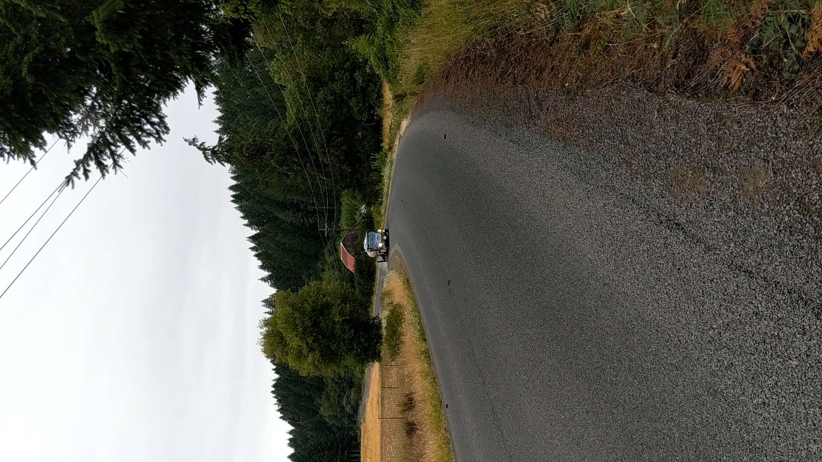
BL-Fog

Slide 23
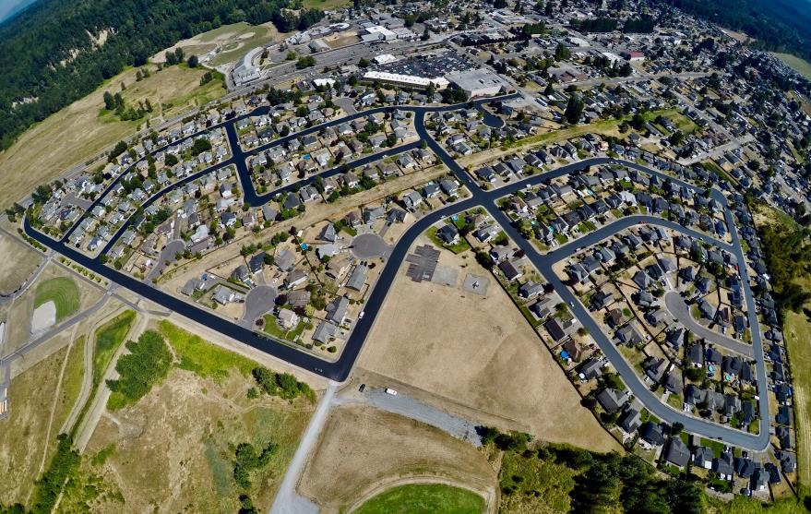
BL-Microcoat

Slide 24
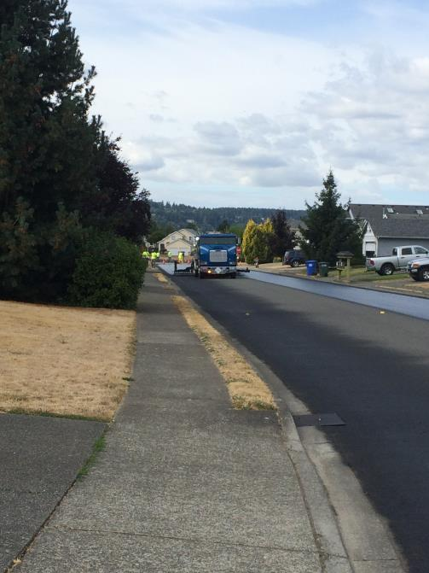
BL-Microcoat

Slide 25
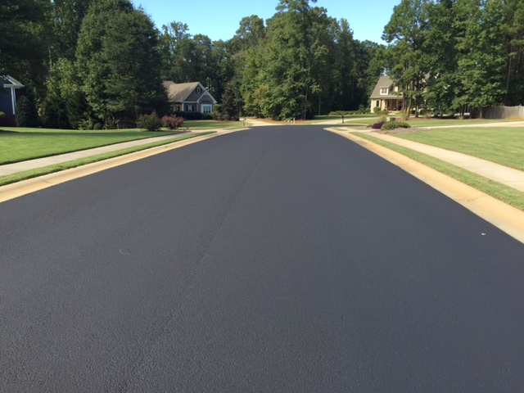
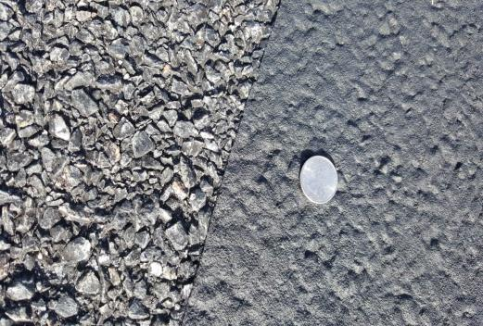
BL-Microcoat

Slide 26
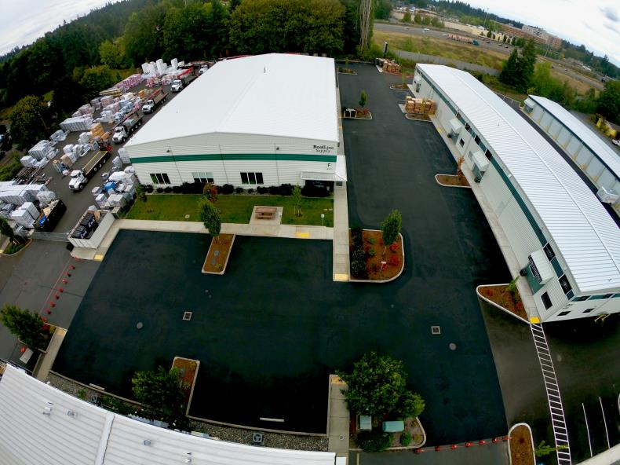
BL-Microcoat

Slide 27
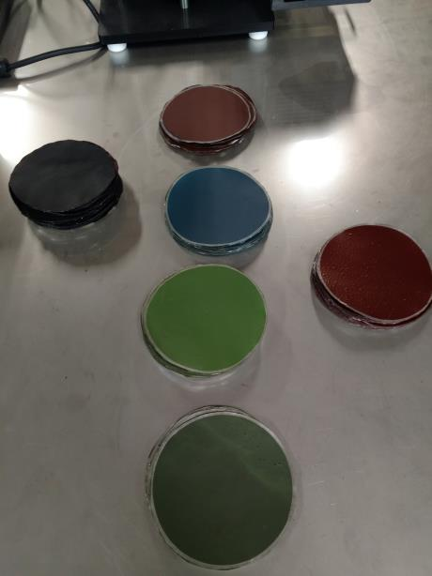
BL-Microcoat

Slide 28
Questions?
Troy Tindall
Blue Line Transportation / Enviroad LLC
troy@bluelinetrans.com
503-702-1236

