Slide 1
Understanding PCI & Observations Across the State
Joel Conder
Capitol Asset & Pavement Services

Slide 2
My History
Oregon State Univ. & Univ. of Portland, University Of Wisconsin (CEC)
Multnomah County 1978-1980
Marion County 1980-2011
Engineering Information Services ( EIS) 1998-2007)
Capitol Asset & Pavement Services Inc. (2008-2022)

Slide 3
My Travels
Rated Pavements in all 36 Oregon Counties
Rated Pavements in Washington, California, Idaho, Arizona, Colorado, Nevada
100+ HOA – Forest Service, Parks Dept, Facilities, Retail Parking Lots, School Dist.
200,000+ Miles Rated in 35+ years
60+ Counties – 100+ Cities – 40+ Various Govt. agencies
2001 Northwest Pavement Manager of the year (NWPMA)

Slide 4
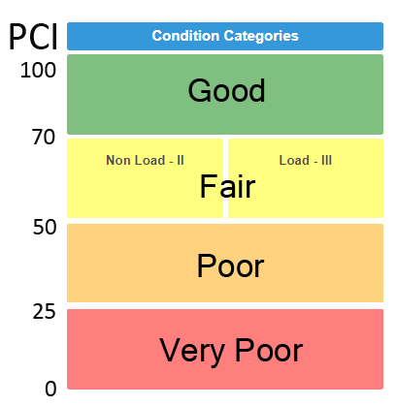
Pavement Condition Index (PCI)
Rating from 0 to 100 representing the general condition of the pavement surface
PCI of 100 = A brand new road, or newly overlaid road
Streetsaver uses 8 different distresses for AC ratings
Each distress found deducts from 100
Each distress type/severity has deduct based on amount found

Slide 5
Streetsaver Distresses
Alligator Cracking
Longitudinal/Transverse Cracking
Block Cracking
Distortions
Rutting/Depressions
Patching
Weathering
Ravelling

Slide 6
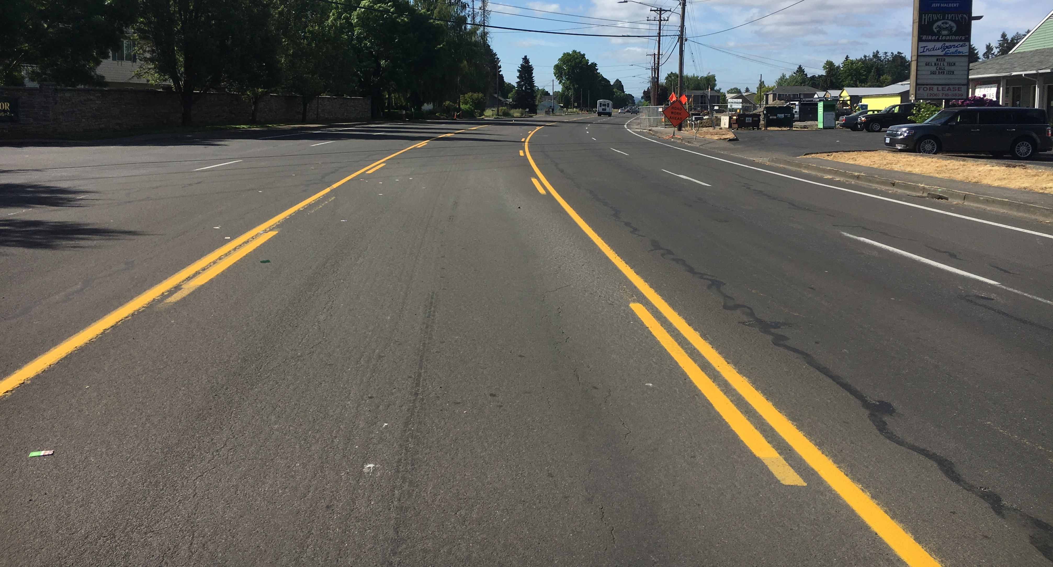
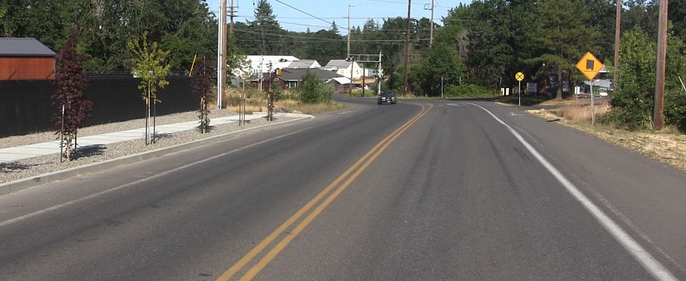
Good Condition
Streets in ‘Good’ condition have no to little distresses found on them. These streets may have some minor surface weathering or light cracking, but can generally be maintained with cost-effective preventative maintenance treatments (surface seals and crack seals).

Slide 7
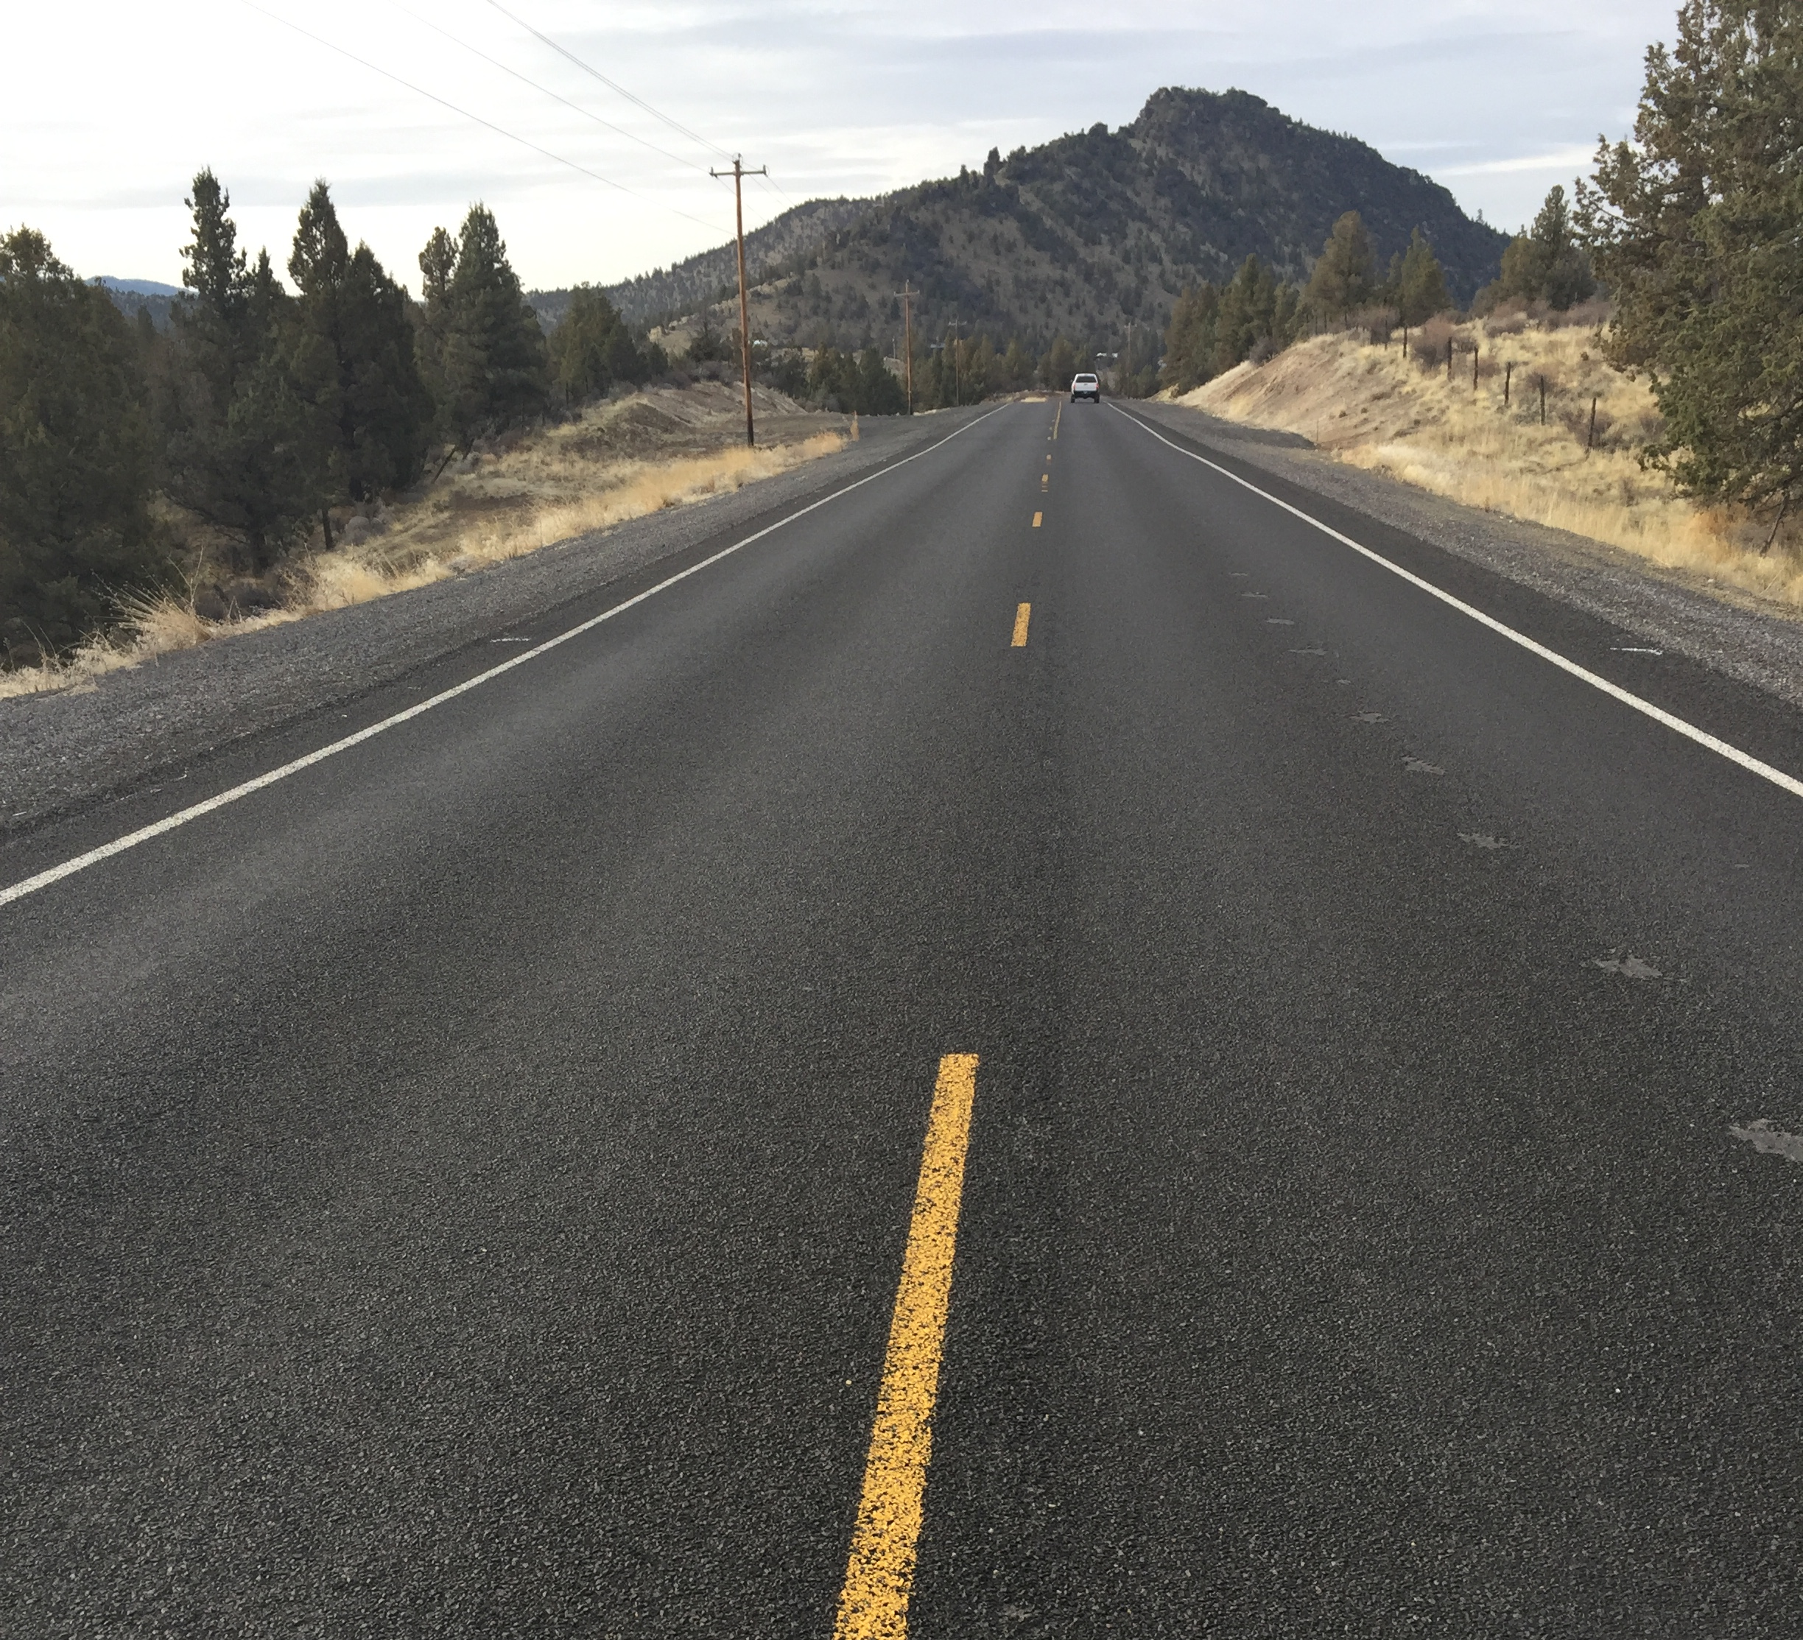
Good Condition

Slide 8
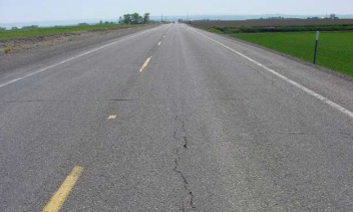
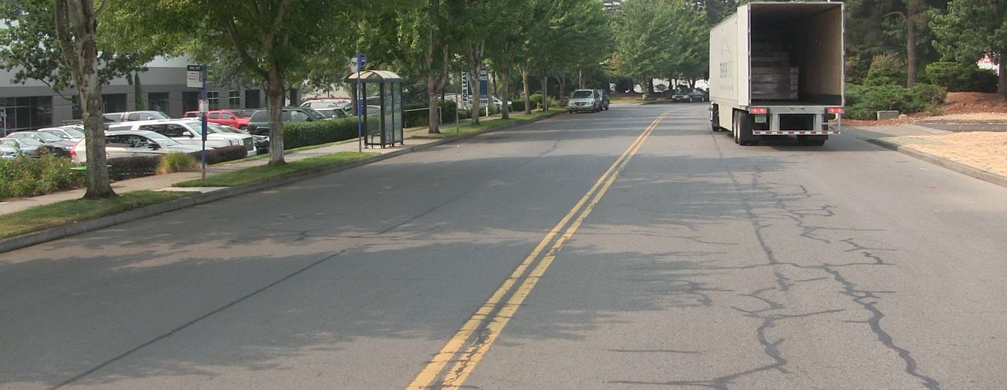
Fair Condition
Streets in ‘Fair’ condition show some form of distress caused by traffic load related activity or environmental distress that requires more than a life-extending treatment.
Pavement structure is generally stable with only minor areas of structural weakness or pavement deterioration evident. Cracks, if present, have widths generally less then ¾”. Wheel paths may have widespread, but not continuous, cracking with no or only a few interconnecting cracks and no spalling or pumping.

Slide 9
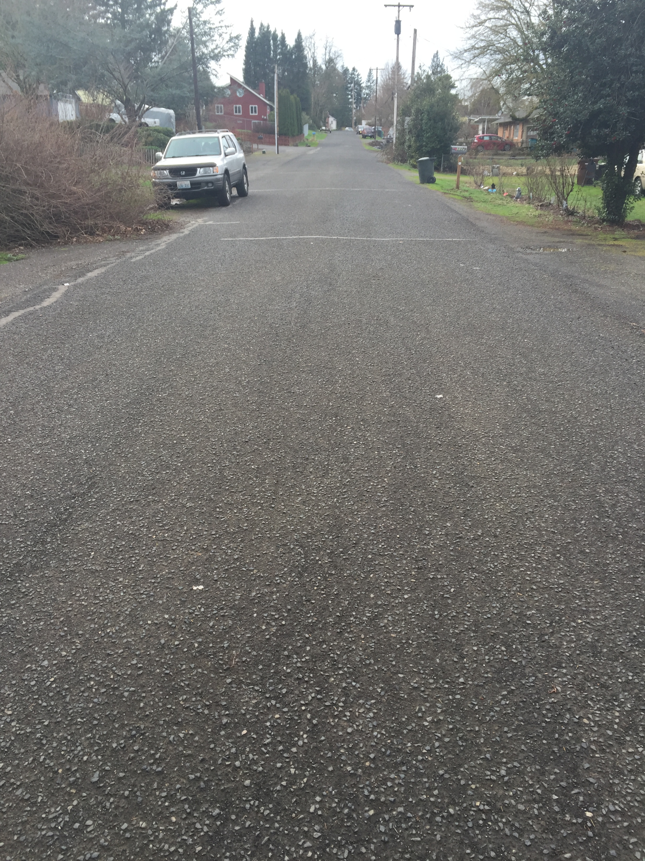
Fair Condition

Slide 10
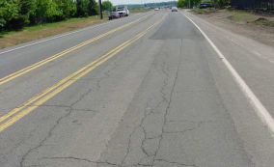
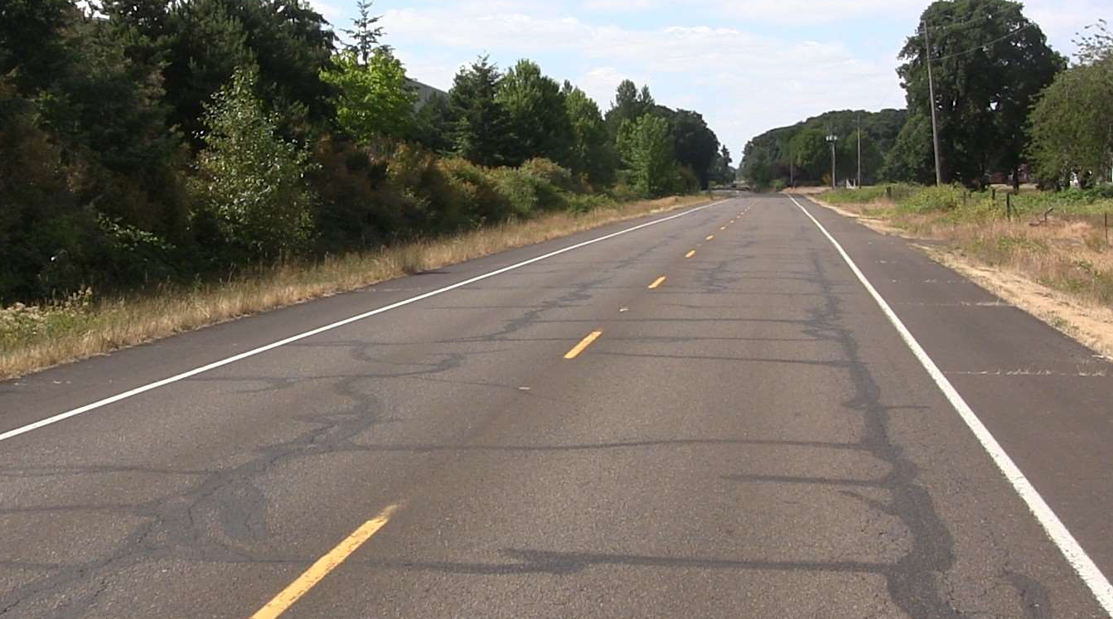
Poor Condition
Streets in ‘Poor’ condition are near the end of their service lives and often exhibit major forms of distress such as potholes, extensive alligator cracking, and/or pavement depressions.
Areas of instability, structural deficiency, or advanced pavement deterioration present in small areas (generally <10% of total pavement area). Continuous, interconnected alligator cracking often present (mostly in wheel paths). Wheel paths may have widespread, and continuous, cracking with some interconnecting cracks and/or spalling

Slide 11
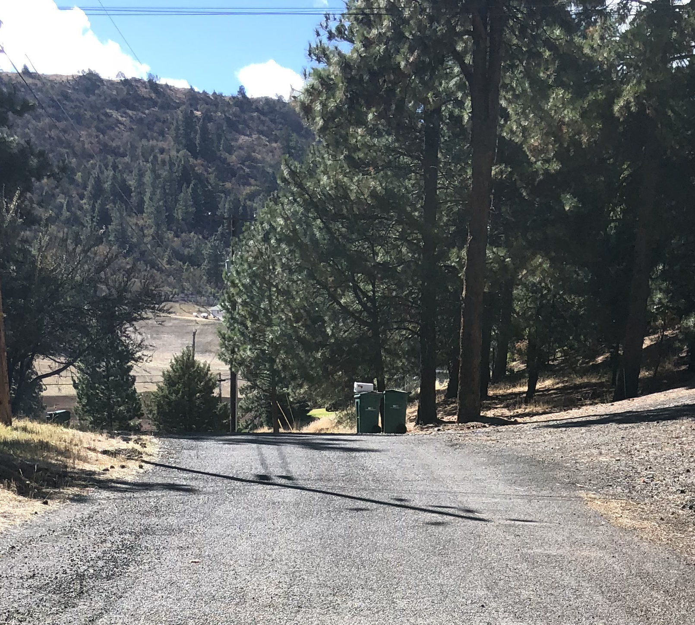
Poor Condition

Slide 12
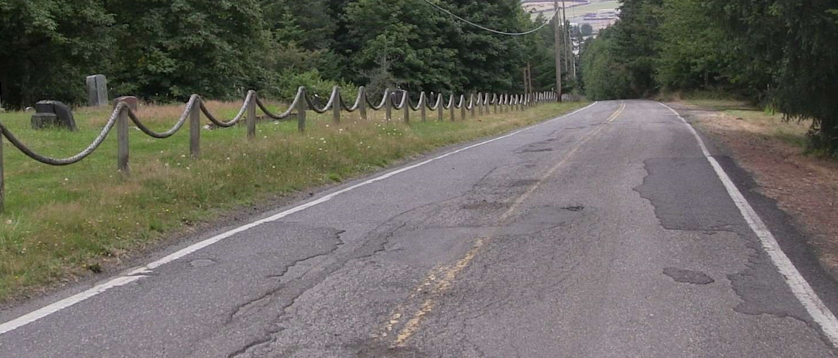
Very Poor Condition (Failed)
Streets in the ‘Very Poor’ condition category indicate that the street has failed. These pavements are at the end of their service lives and have major distresses, often indicating the failure of the sub-base
Areas of instability, structural deficiency, or advanced pavement deterioration are frequent. Large crack patterns (alligatoring), heavy and numerous patches, potholes, or deformation is very noticeable. Rutting, if present, is generally greater than ¾”.

Slide 13
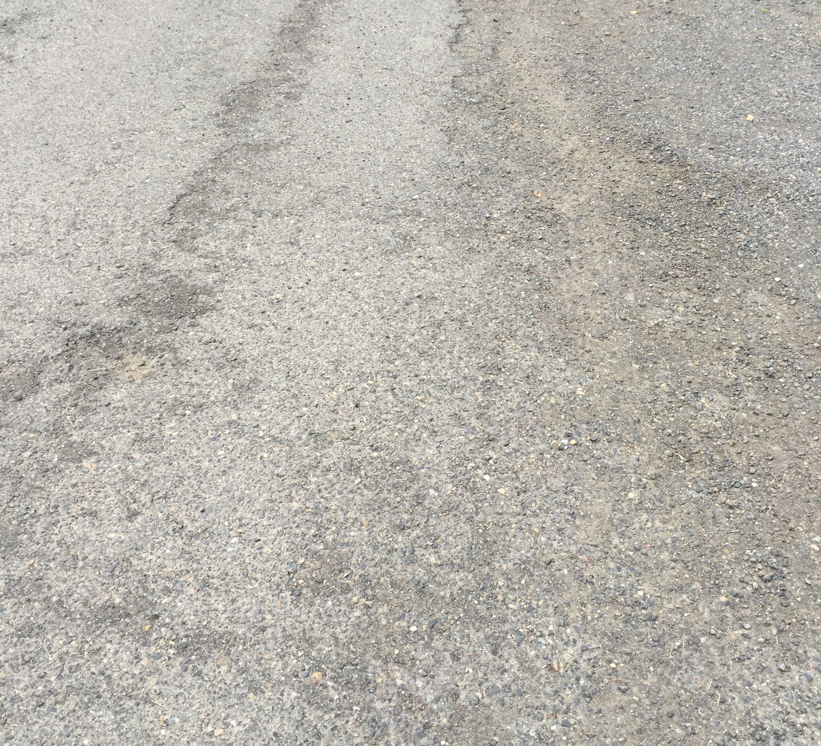
Very Poor Condition

Slide 14
Sealing over alligatoring?

Slide 15
Chip Seal over Alligatoring

Slide 16
Low Severity Bleeding

Slide 17
Medium Severity Bleeding

Slide 18
Medium Severity Bleeding

Slide 19
Medium-High Severity Bleeding

Slide 20
Very Heavy Severity Bleeding

Slide 21
Observations Across the State
Over last 10 years, most Oregon County PCIs have maintained current PCI to slight increase in PCI
Central & Eastern Oregon Counties generally in better shape
More prevalent use of chip seals
Average PCI 82 (range from 73 – 84)
Western Counties (not including coast)
Average PCI 74 (range from 52 – 80)
Coastal Counties Avg PCI 72
Average PCI 72 (range from 50 – 84)

Slide 23
Observations Continued
Counties with best PCI had most pavement maintenance funding/mile of road
Chip Seal and Slurry Seal still are the best use of limited funding
Choosing the right candidates for the right treatment at the right time
Continued monitoring of the road surface condition should be a priority!

Slide 24
Questions? Questions? Joel M Conder Capitol Asset & Pavement Services Inc. (503) 884-6663 jconder@capitolasset.net

