Slide 1

OACES Chip Seal Workshop
Oil Rock Production
Presented by : Billy Scott & Scott Ringham

Slide 2
Billy Scott
-14 Years with KRC
-Background Duties- HE/CR/TR/AC/SA
-WV Aggregate Sales & Customer Service Rep.

Slide 3
Scott Ringham
-16 Years with KRC
-Background Duties- HE/CR/PR
-WV Materials Production Superintendent

Slide 4
Top Ten Biggest Agg Producer in the Country
-American Owned & Operated
-Reside in 14 States, operate out of 19
-Oregon KRC Operations previously owned by:
MBI or MORSE BROS
-Growth Mode: Molalla/Viesko/Teevin Bros
-Peak season about 300 employees in the WV
-2.5+ Million Tons Per Year in WV!!!

Slide 5
Candy Bars:
-Hershey’s Chocolate Bar (3”-0)
-Snicker’s Chocolate Bar (3/4”-0)
-Ghirardelli Chocolate’s (Chip Rock)
Why???

Slide 6
Candy Bars: WHY???
3”- 0 is produced at higher rate per hour
3/4”- 0 is produced a little slower, more wear
& tear, higher cost but most common

Slide 7
Candy Bars: WHY???
As is Ghirardelli chocolates, Chip Rock is a Specialty product with slow production, superior quality, weather sensitive, tight specs, higher cost, more down time. . .
What else impacts the quality of this product?

Slide 8
What are the BIGGEST impacts that raise the cost of Chip Seal Materials?

Slide 9
Chip Seal Increased Cost:
-Short Notice to crush = Higher cost
-Screen Changes = Down time
-Floor Loss 10-20%
-Yard Balance
-Market Conditions
-Contamination
-Lack of volume

Slide 10
What are the BIGGEST impacts that lower the cost of Chip Seal Materials?

Slide 11
Chip Seal Cost Savings:
-Increase the spec range = Higher Production = $$$
-Plenty of Notice for planning
(Staffing, dry weather, trucking, screens, delays)
-Volume/Location/Crusher Moves
-AC Plants or Bi-products
-1/2”-1/4” order combined with 1/4”-#10???
-Base Rock options???

Slide 12
What can you do to make a difference?
-RFQ’s around same time (Nov, not April)
(More notice & earlier bidding)
-Consistent Gradation Requirements or Specs
(Bi-products & Crusher Moves = Higher Cost)
-Multiple product balance???

Slide 13
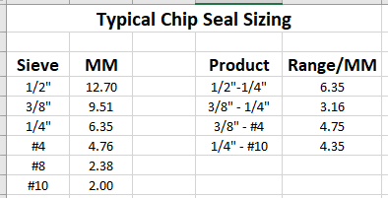

Slide 14
Generally speaking, what products would typically be cheaper to produce from the chart?

Slide 16
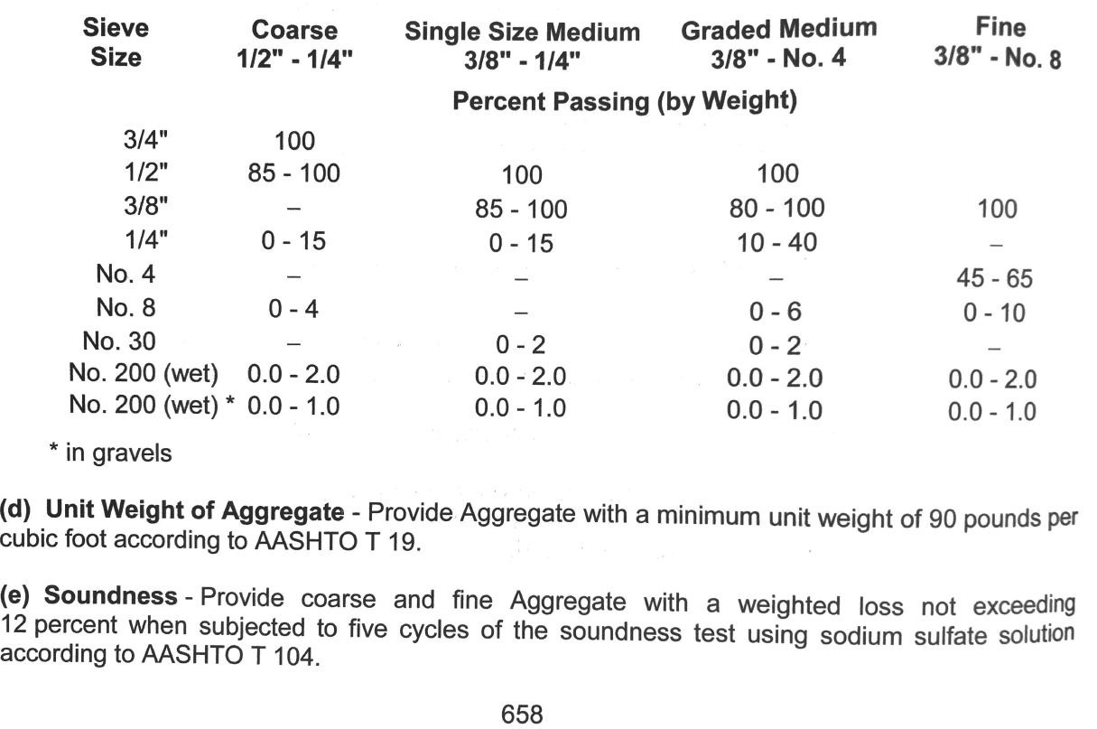

Slide 17
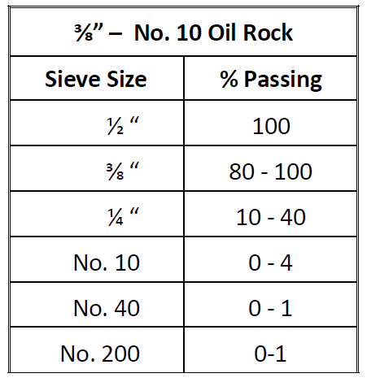

Slide 18
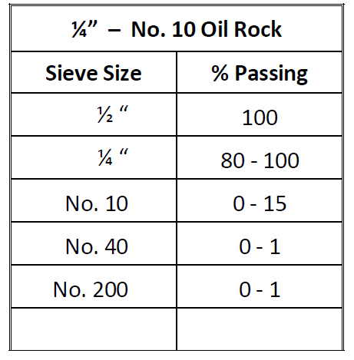

Slide 19
What are the most important factors to consider when bidding Chip Seal Materials?

Slide 20
What questions do you have?

Slide 21
OACES Chip Seal Workshop
Oil Rock Production
Presented by : Billy Scott & Scott Ringham

