Slide 1
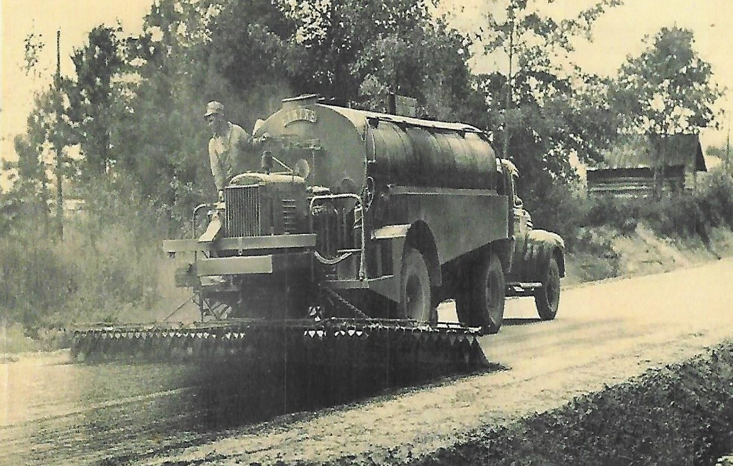
SHOT RATES
Oil and Aggregate

Slide 2
Surface Treatment Conditions

Slide 3
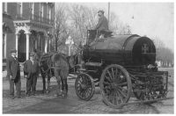
Oil Distributor

Slide 4
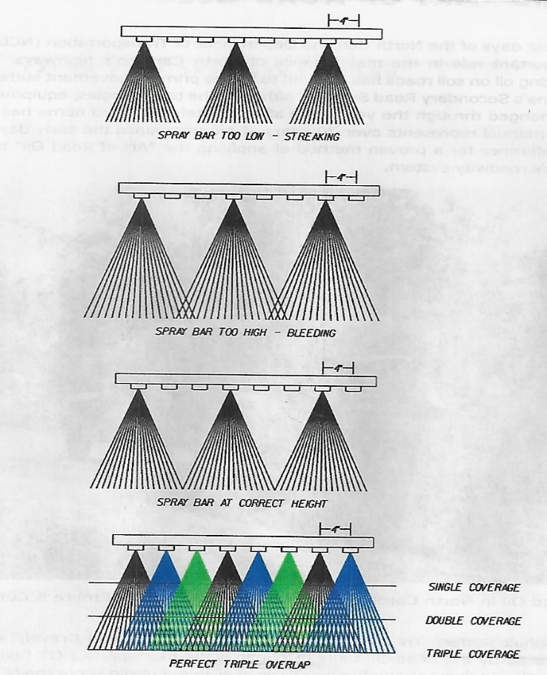
Nozzle Coverage

Slide 5
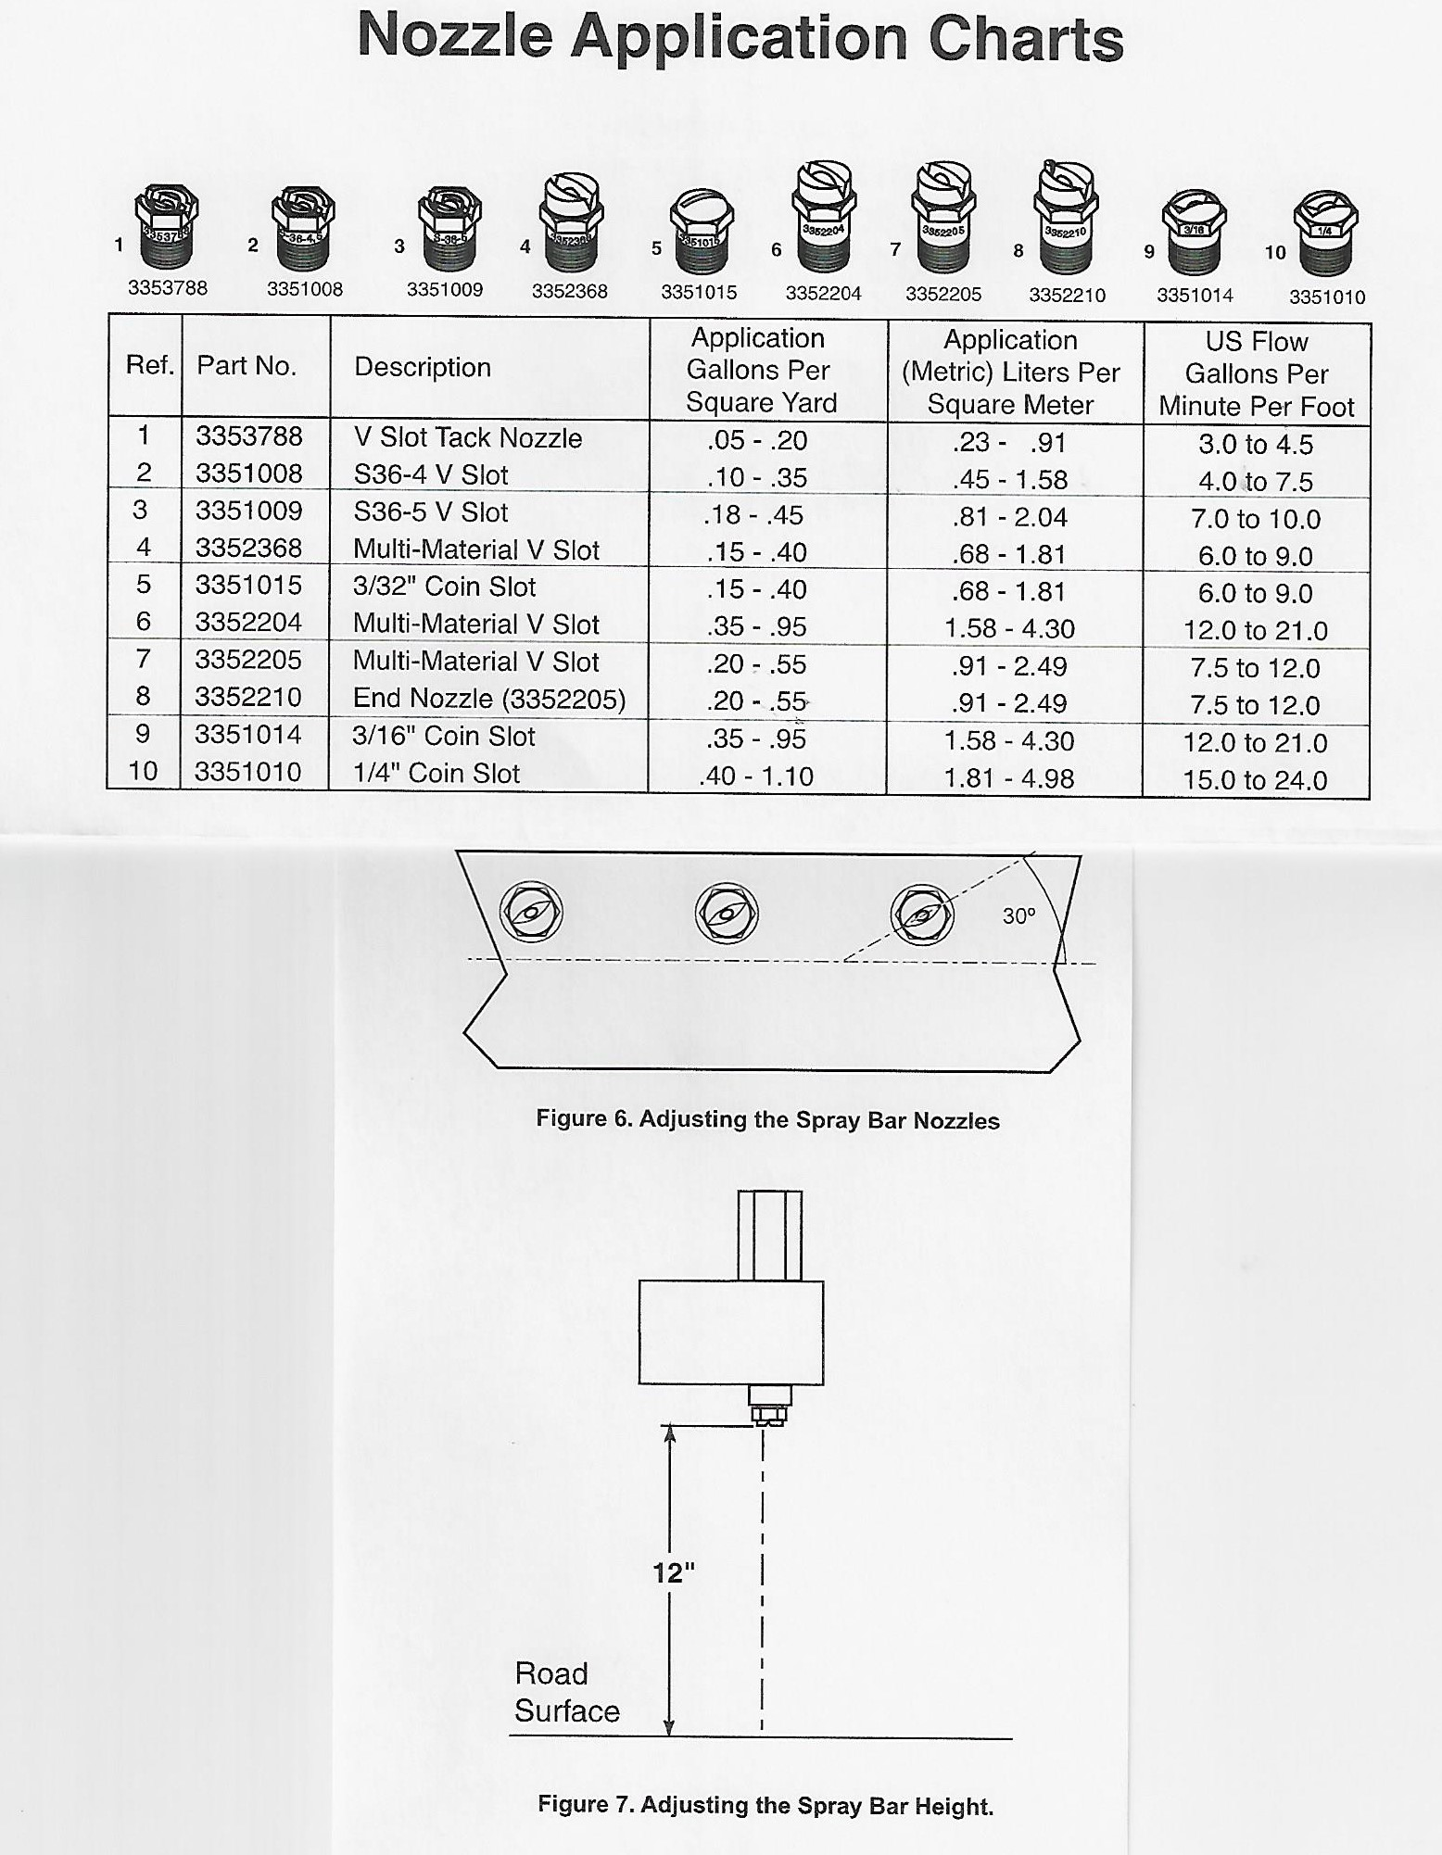

Slide 6
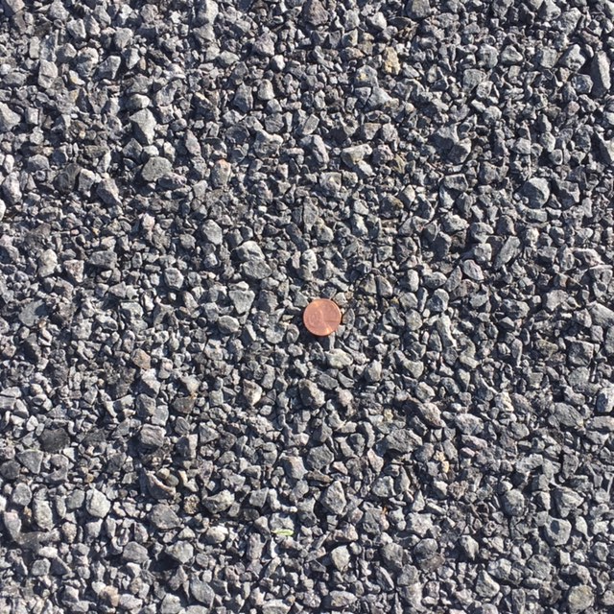
Multiple Applications *Surface Conditions may adjust application rates Less than 200 ADT – 1000 ADT
3/4-10 at 25 lbs .62-.65 shot rate CMS2-P
3/8 Graded Medium @ 18 lbs
.48 shot rate CMS2-P

Slide 7
Single Applications *Surface Conditions may adjust application rates
3/8 Graded Medium at 17 lbs
.54 shot rate CRS2-P
.16 shot rate CSS1H diluted (60/40)

Slide 8
Rock Retention

Slide 9
Gradation Graded Medium 3/8-#4
Sieve Size % Passing
½” 100
3/8” 80-100
¼” 10-40
No 4 -------
N0 200 0-2

Slide 10
Questions?

