Slide 1
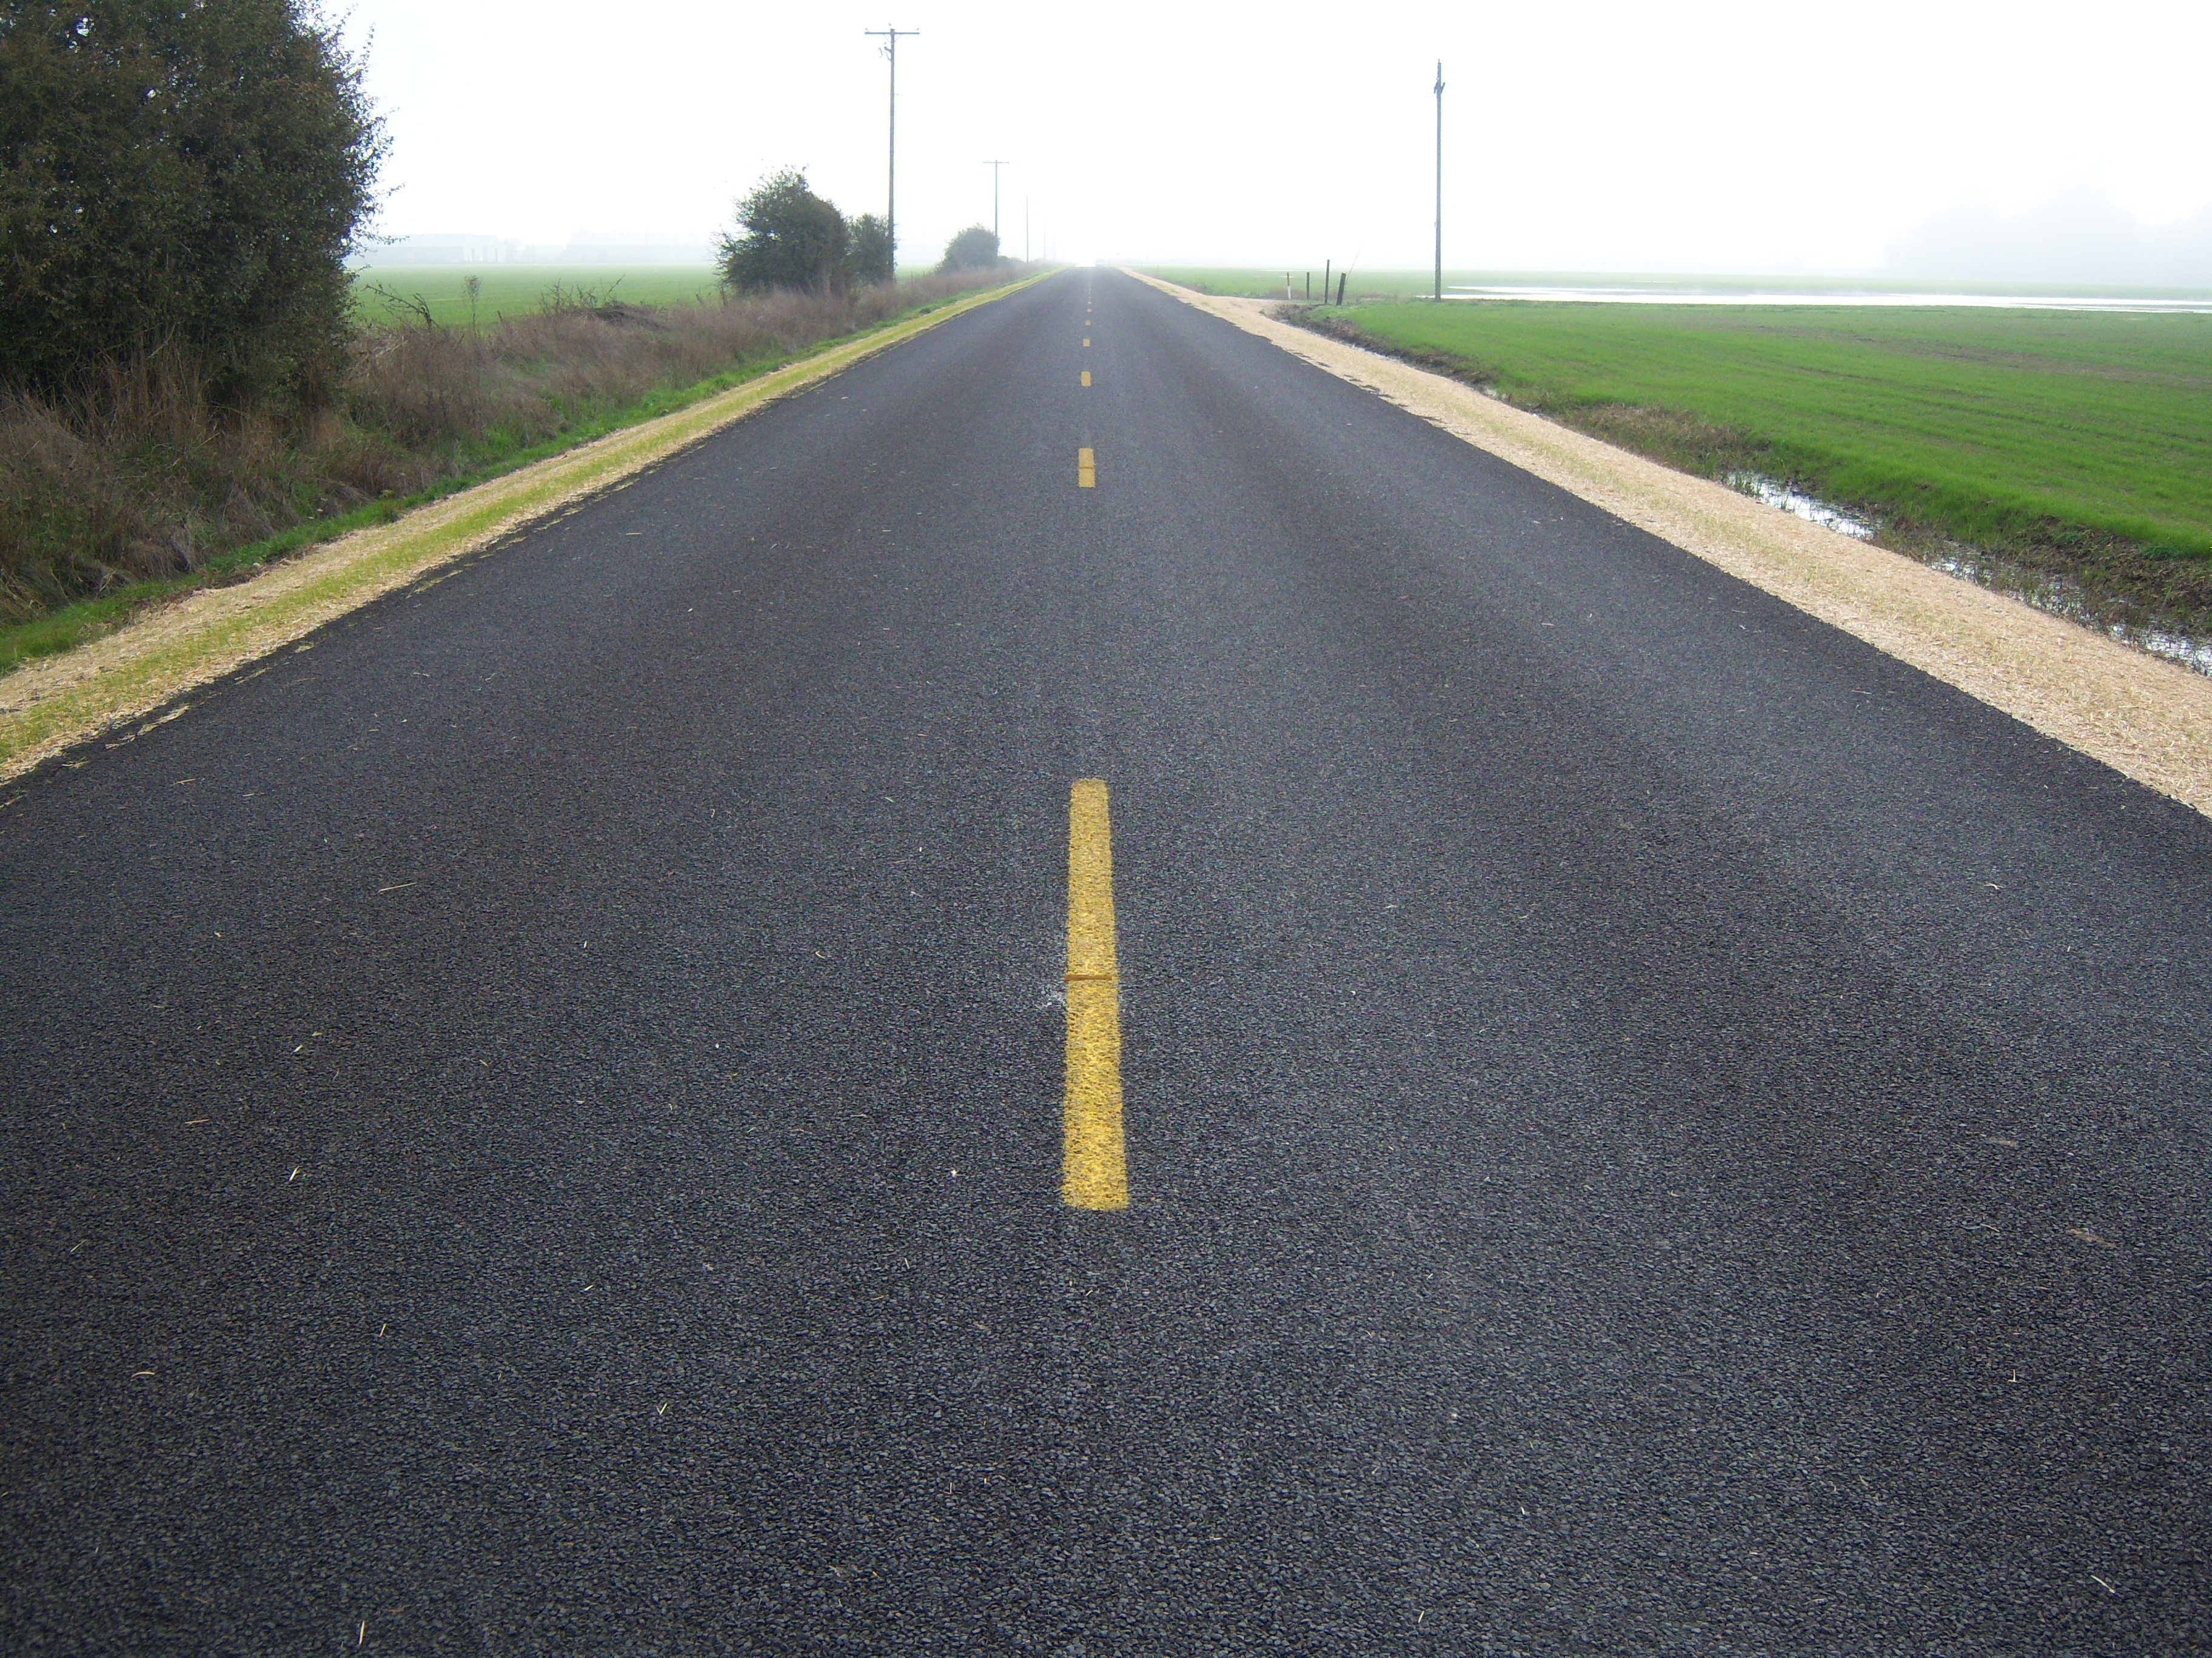
Surface treatment toolbox
in Linn County, OR
Kevin Hamilton
Operations Manager
(541) 967-3919 Office
(541) 740-1787 Cell
khamilton@co.linn.or.us
Jeff Maskal
Special Operations Group Foreman
jeff.maskal@co.linn.or.us
Mike Brant
Fleet Maintenance Leadworker
mike.brant@co.linn.or.us
Single Shot Chip Seals
Double Shot Chip Seals

Slide 2

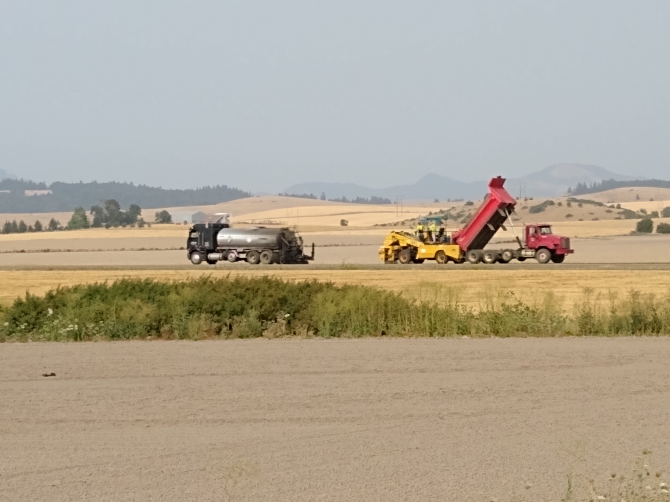
Single shot
7 – 9 miles/day, ideally
180 – 250 tons/day
Linn County:
Mostly CRS-3P or CHFRS-2P
Oil applied at 0.38 – 0.48 gals / SY
0.42 – 0.44 typical

Slide 3
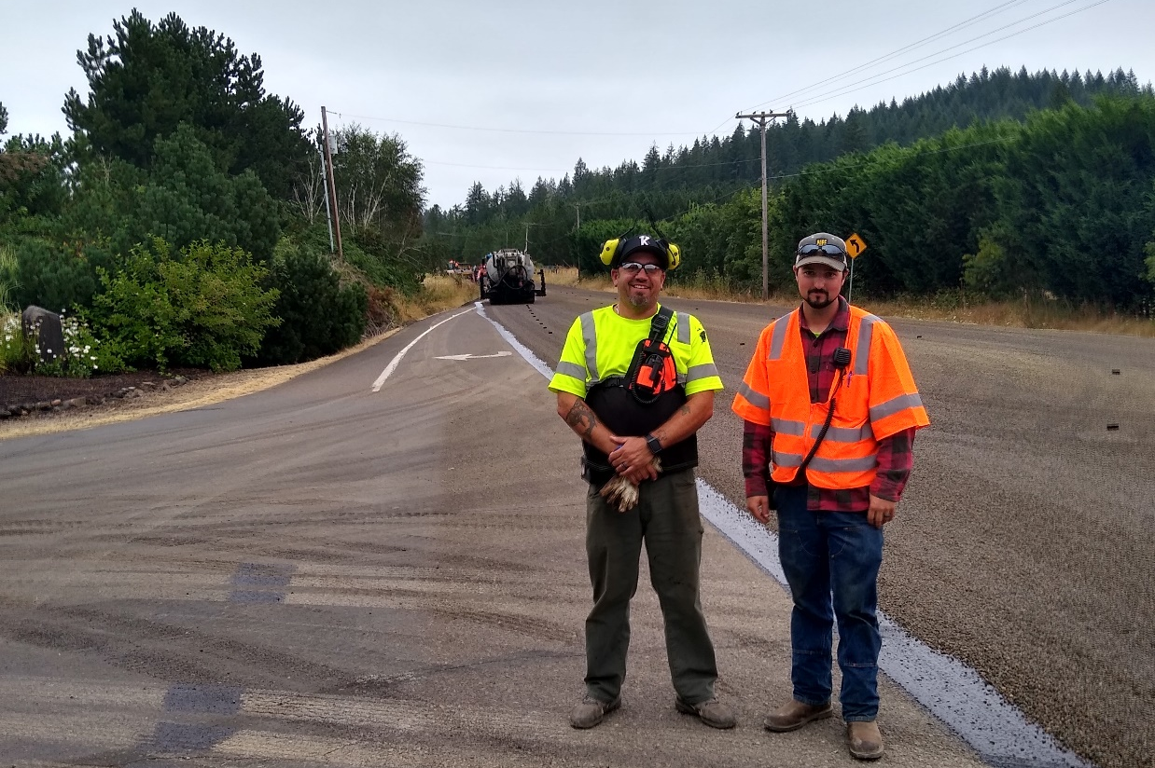
Single shot
3/8” – 10 oil rock
Rock applied at 18 – 22 Lbs / SY
Fog seal @ 0.12 – 0.13 gals/SY

Slide 4
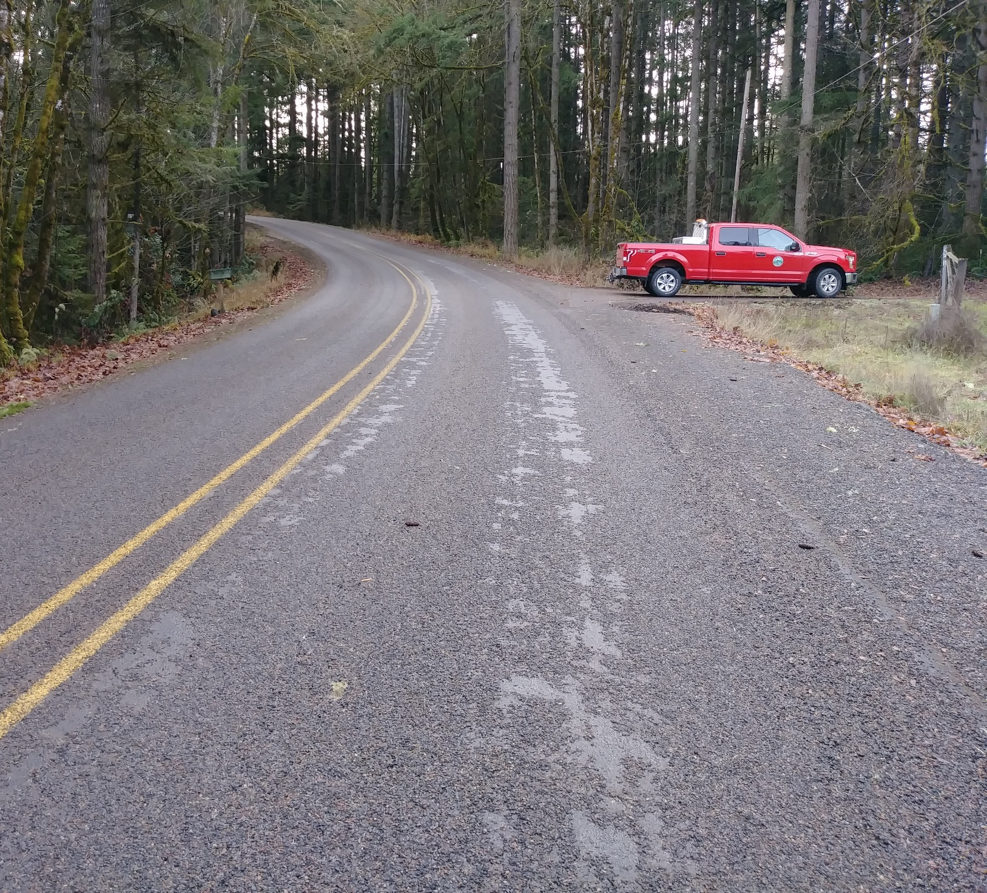
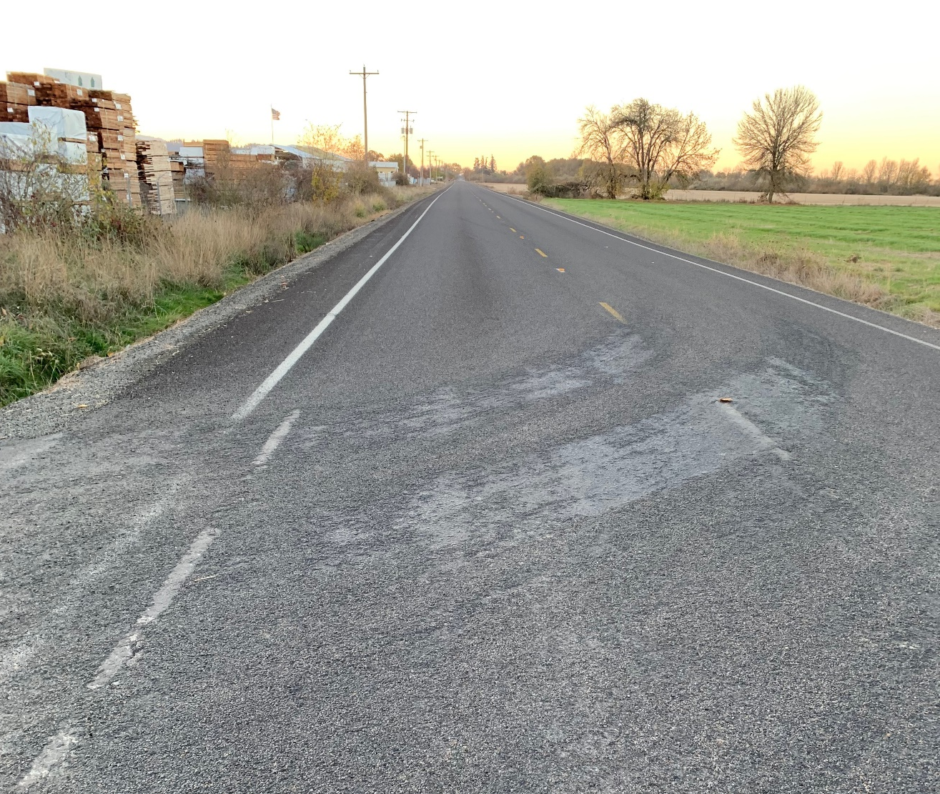
Single shot
Not enough oil
Cold oil
Contaminated oil or other problem
Dirty rock
Rock wasn’t rolled enough
Cold ground/air temps
Rain
Shade
Oil broke before rock cover
Etc., etc.
Shelling – Rock Loss
Repair: CRS-3P @ 0.30 gals/sy; ¼” – 10 rock @ 10 – 12 lbs/sy

Slide 5
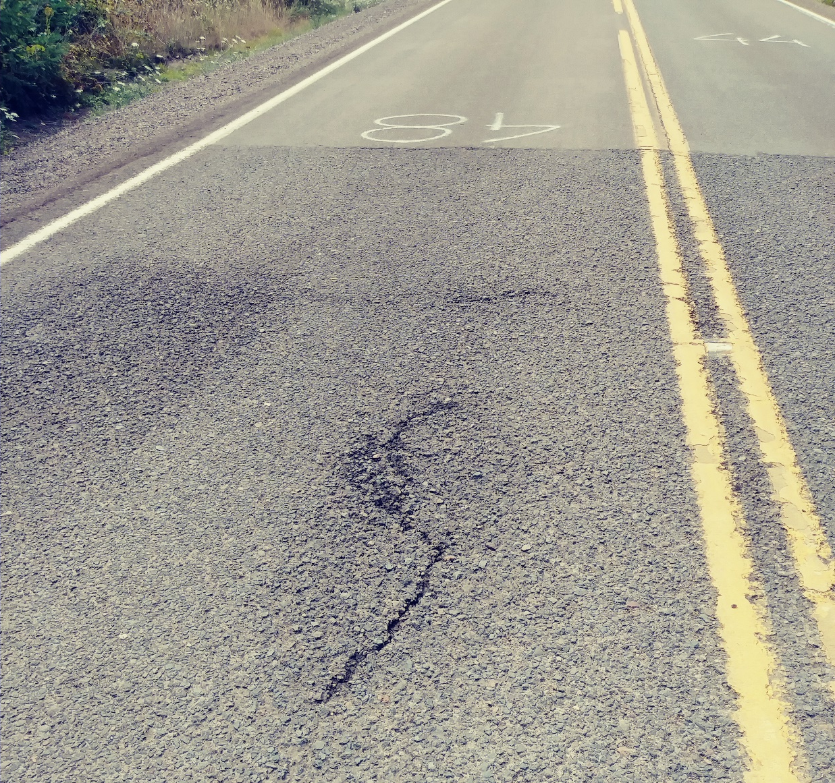
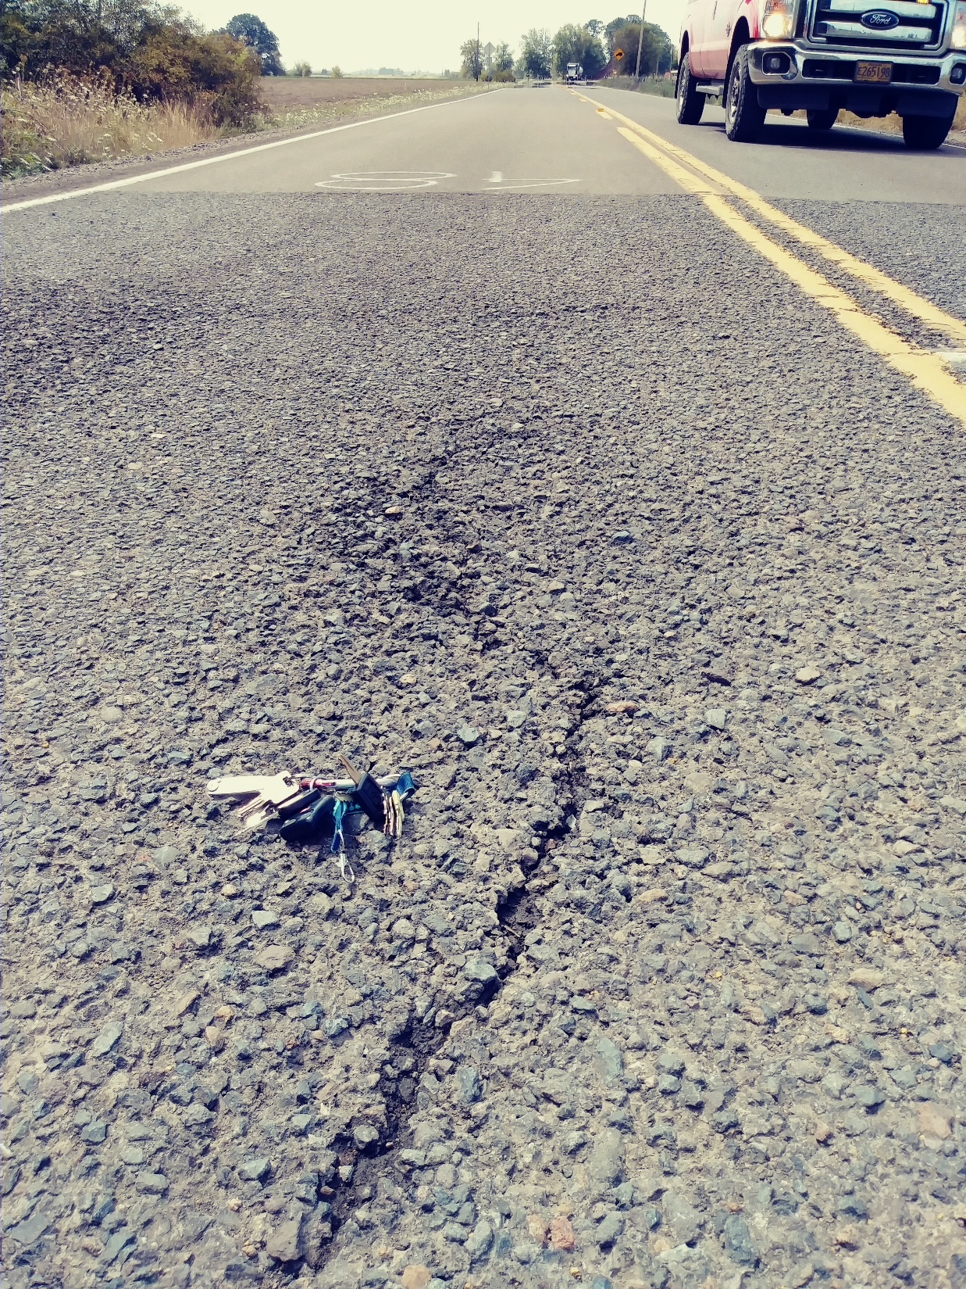
single shot
Oakville Rd.
South side of Hwy 34

Slide 6
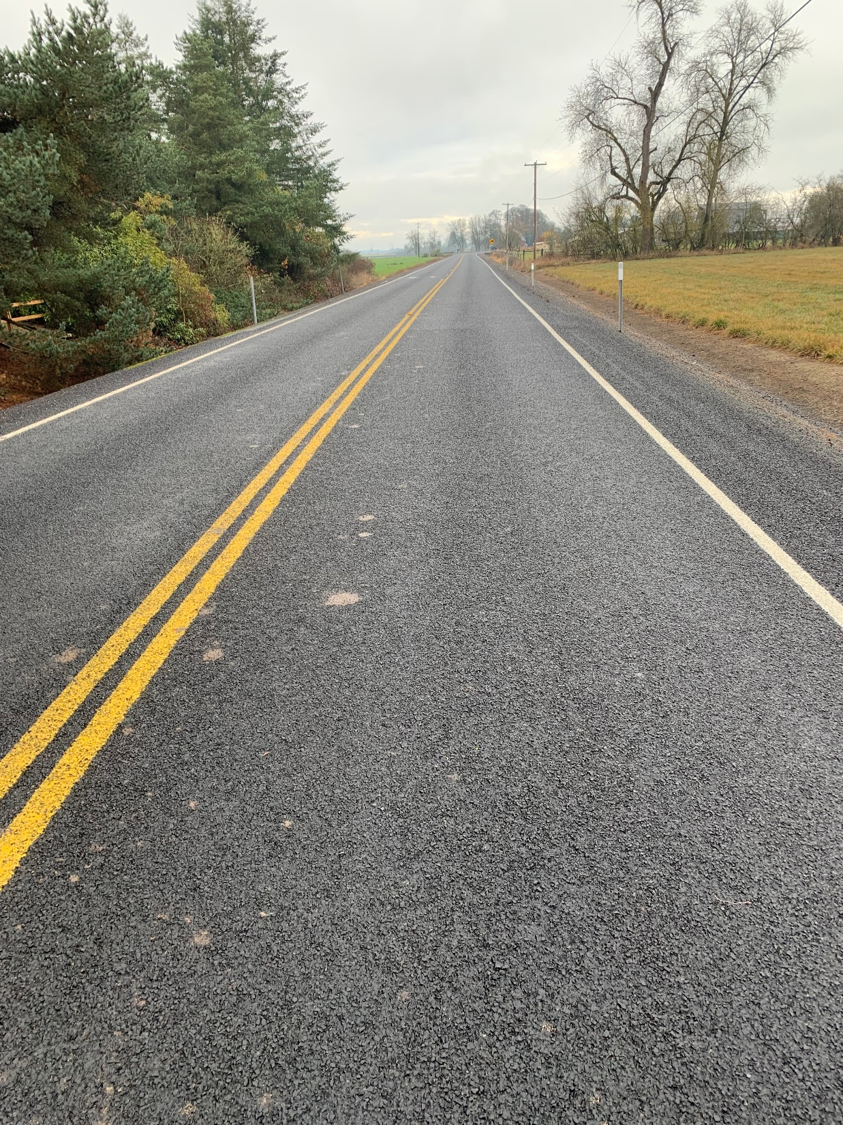
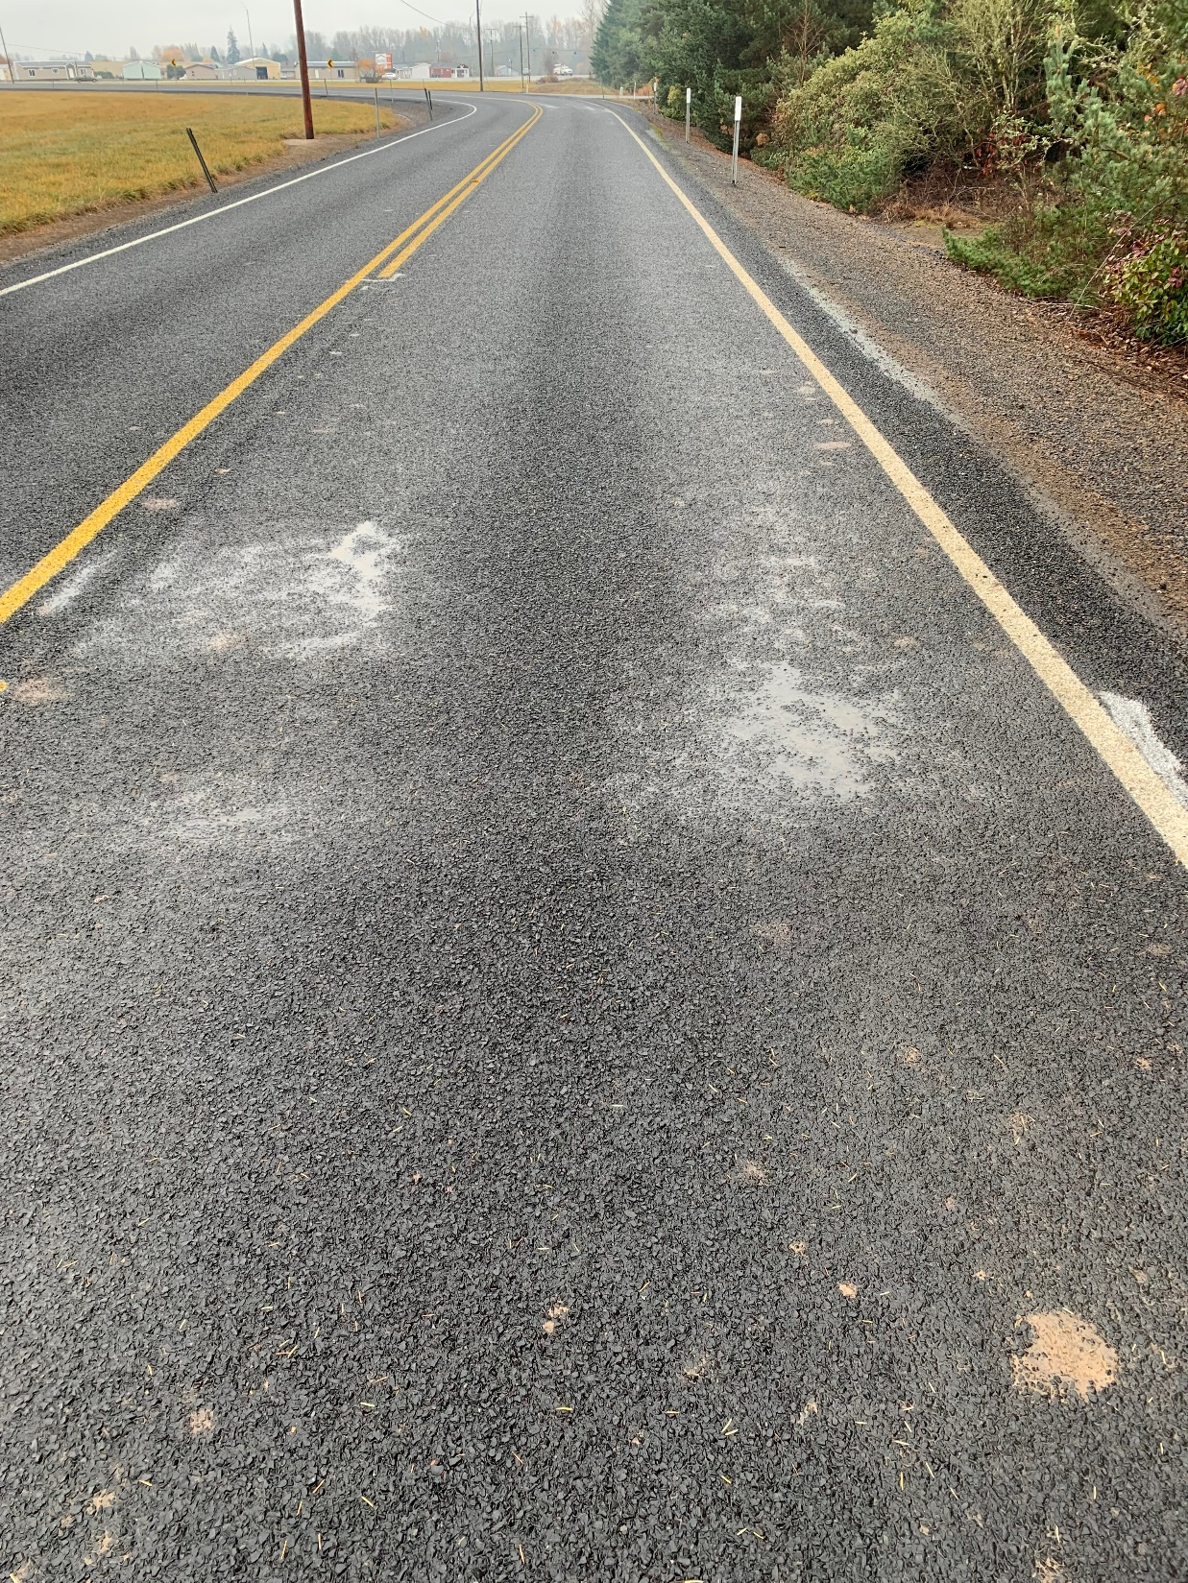
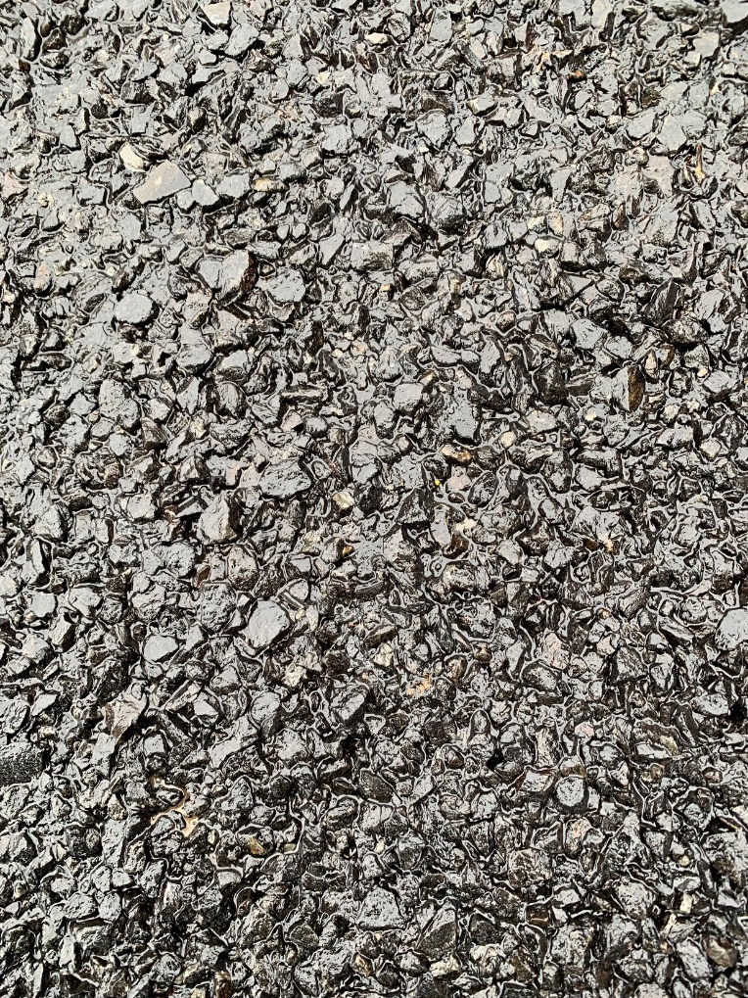
single shot
CHFRS – 2P @ 0.48 gals/SY
3/8”-10 @ 19-20 lbs/SY
Oakville Rd.
South side of Hwy 34 - 2019
Fog Seal:
BL Fog @ 0.12-0.13 gals/SY

Slide 7
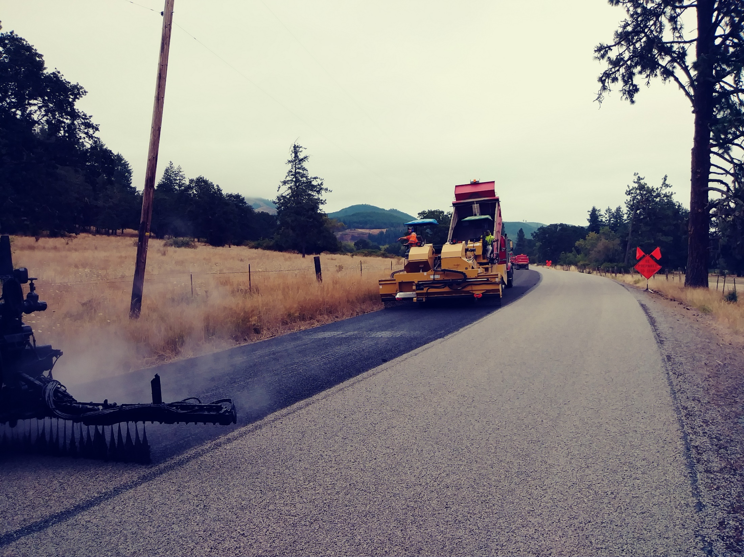
double shot

Slide 8
double shot
TYPICAL SHOTS
Approx. 4 miles/day max. if base & top on same day.
Base Course:
CRS – 3P @ 0.40 – 0.48 gals/SY; Typically 0.40 – 0.42
1/2”-1/4” @ 24-26 lbs/SY
Best practice to cure overnight before sweeping and applying the top course.
Top Course:
CRS – 3P @ 0.30 – 0.35 gals/SY
1/4” - 10 @ 13 lbs/SY
Sweep & fog seal (optional) the next day.
Fog Seal:
CQS – 1h; or QSE; or BL FOG
@ 0.10 gals/SY

Slide 9
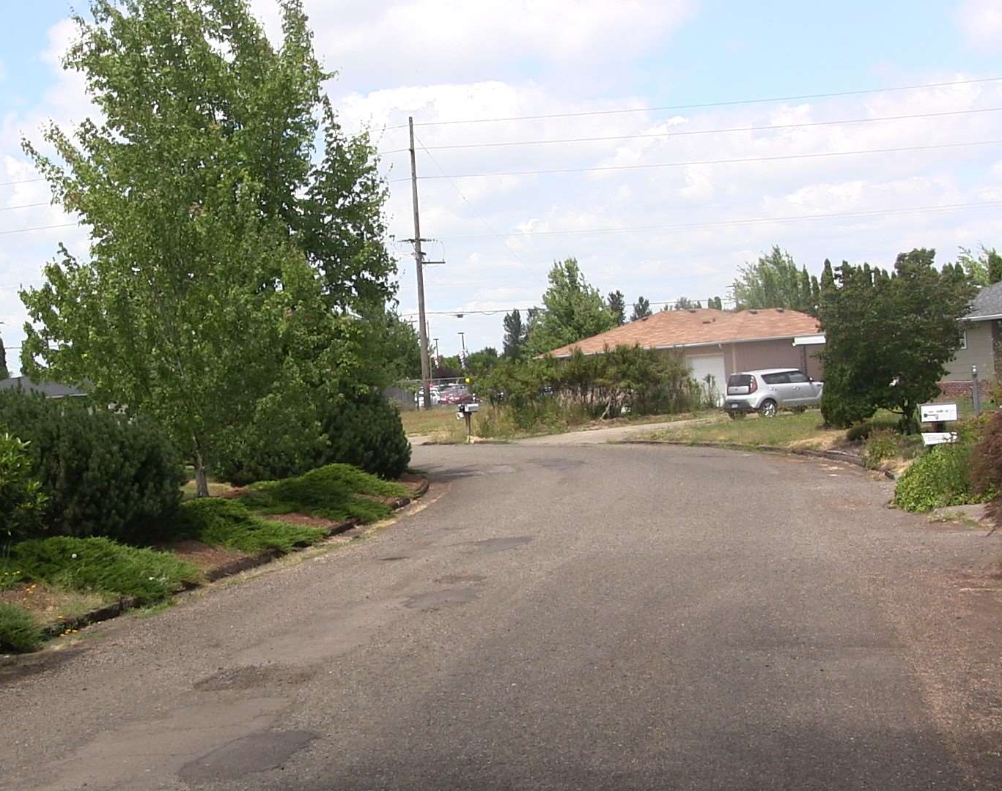
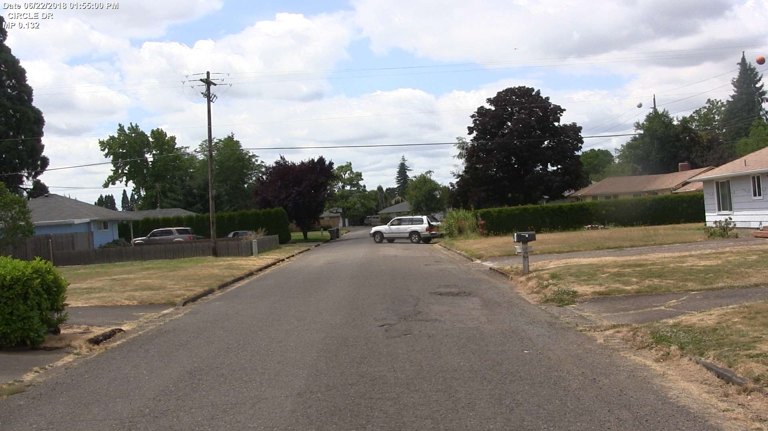
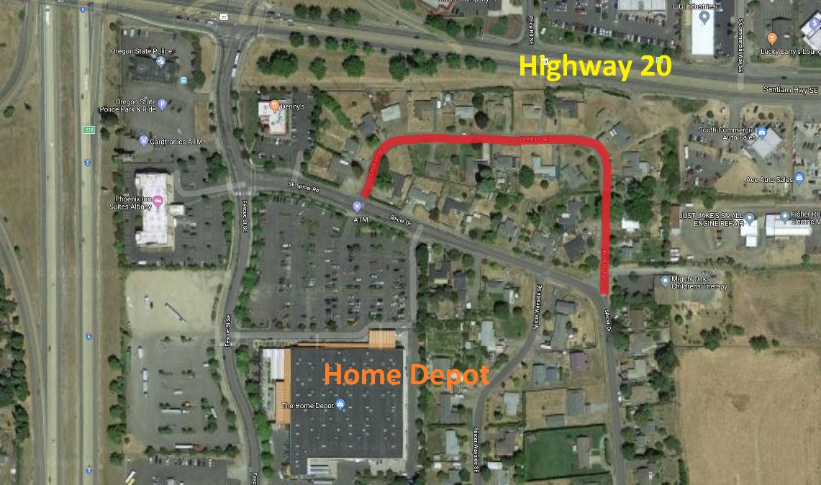
double shot
Circle Dr.
2018
PCI = 14

Slide 10
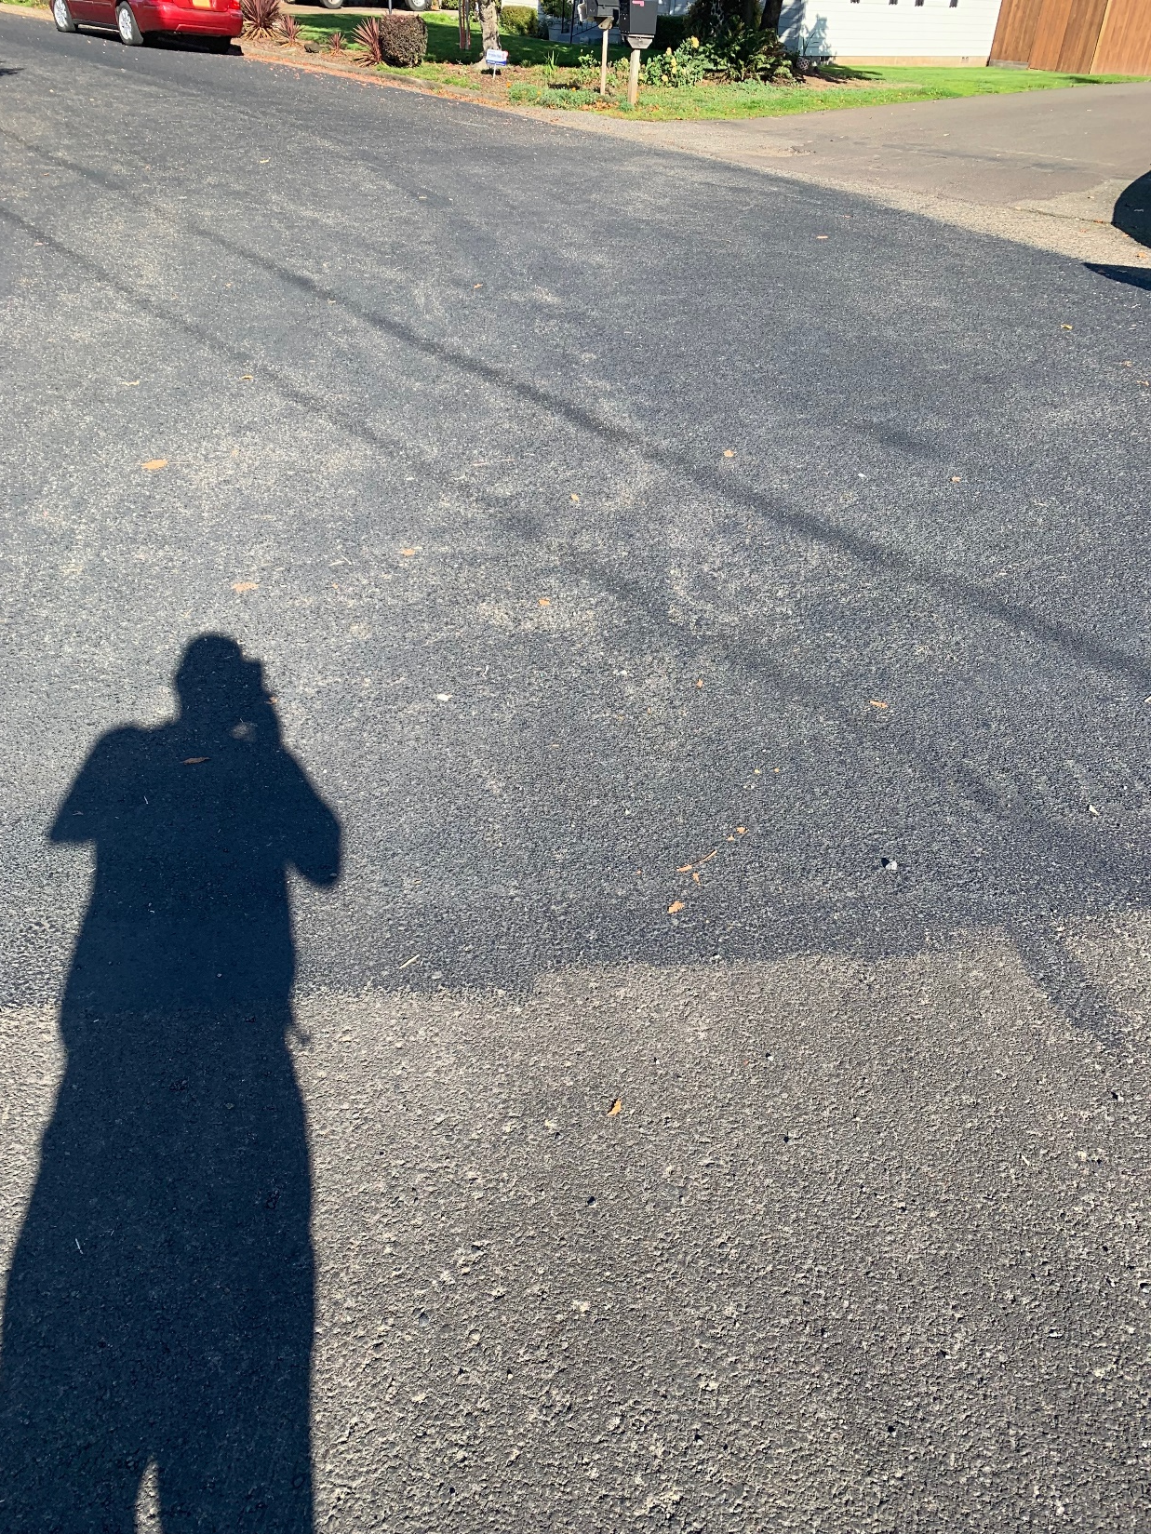
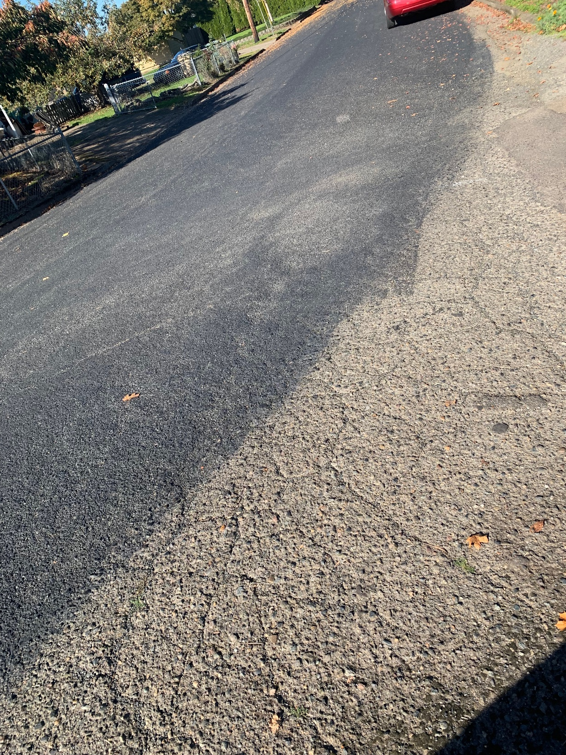
double shot
Circle Dr. 2019
Base Course:
CHFRS – 2P @ 0.48 gals/SY
1/2”-1/4” @ 24-26 lbs/SY
Top Course:
CHFRS – 2P @ 0.35 gals/SY
1/4” - 10 @ 13 lbs/SY
MicroCoat
0.35 gals/SY

Slide 11
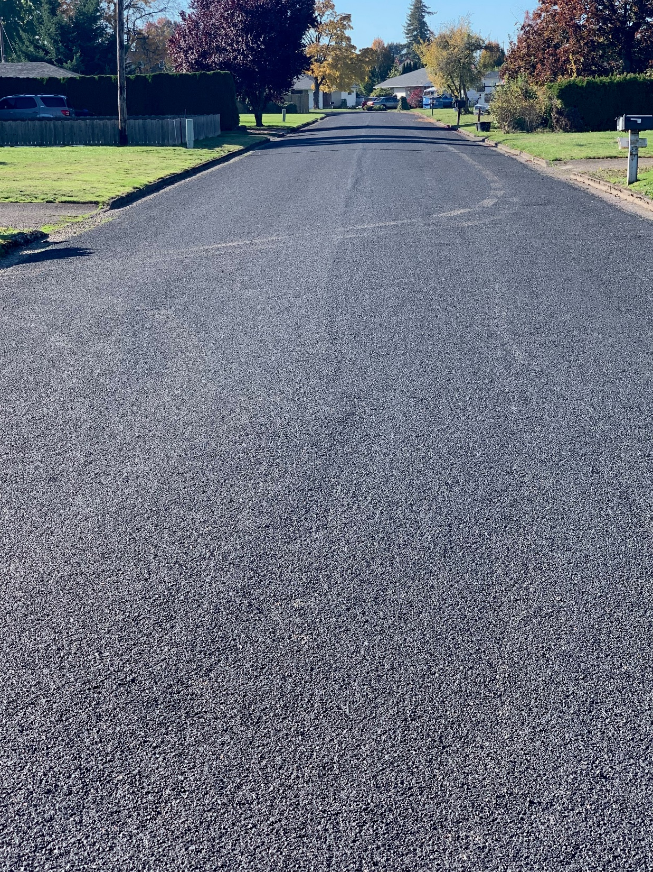
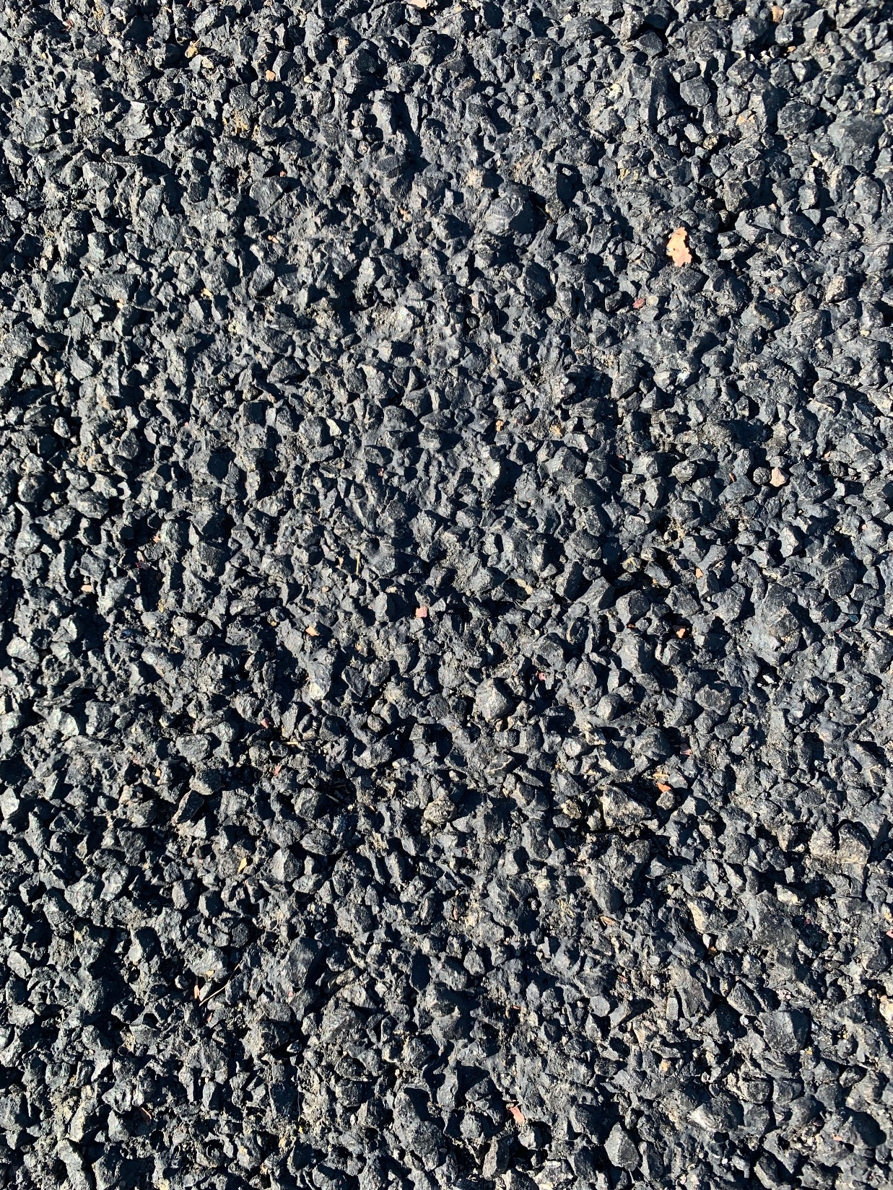
double shot
Circle Dr.
2019
Base Course:
CHFRS – 2P @ 0.48 gals/SY
1/2”-1/4” @ 24-26 lbs/SY
Top Course:
CHFRS – 2P @ 0.35 gals/SY
1/4” - 10 @ 13 lbs/SY
MicroCoat
0.35 gals/SY

Slide 12
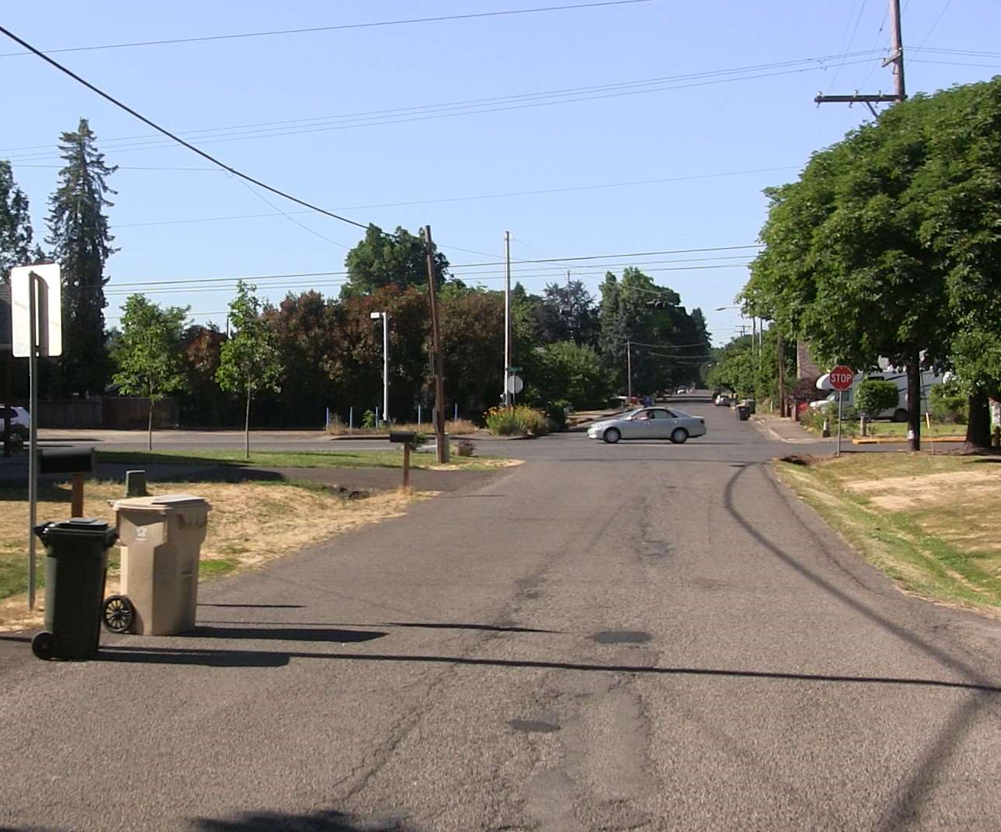
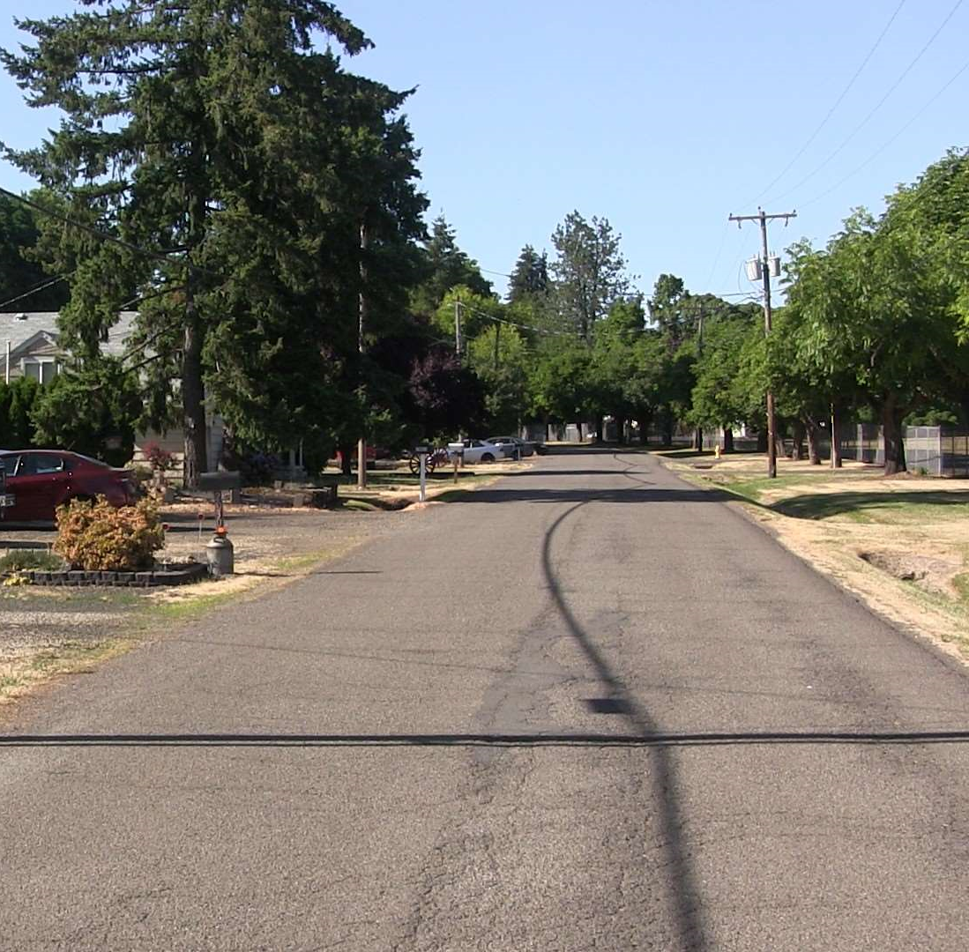
double shot
Broadway Ave.
2018
PCI = 12
No base failure

Slide 13
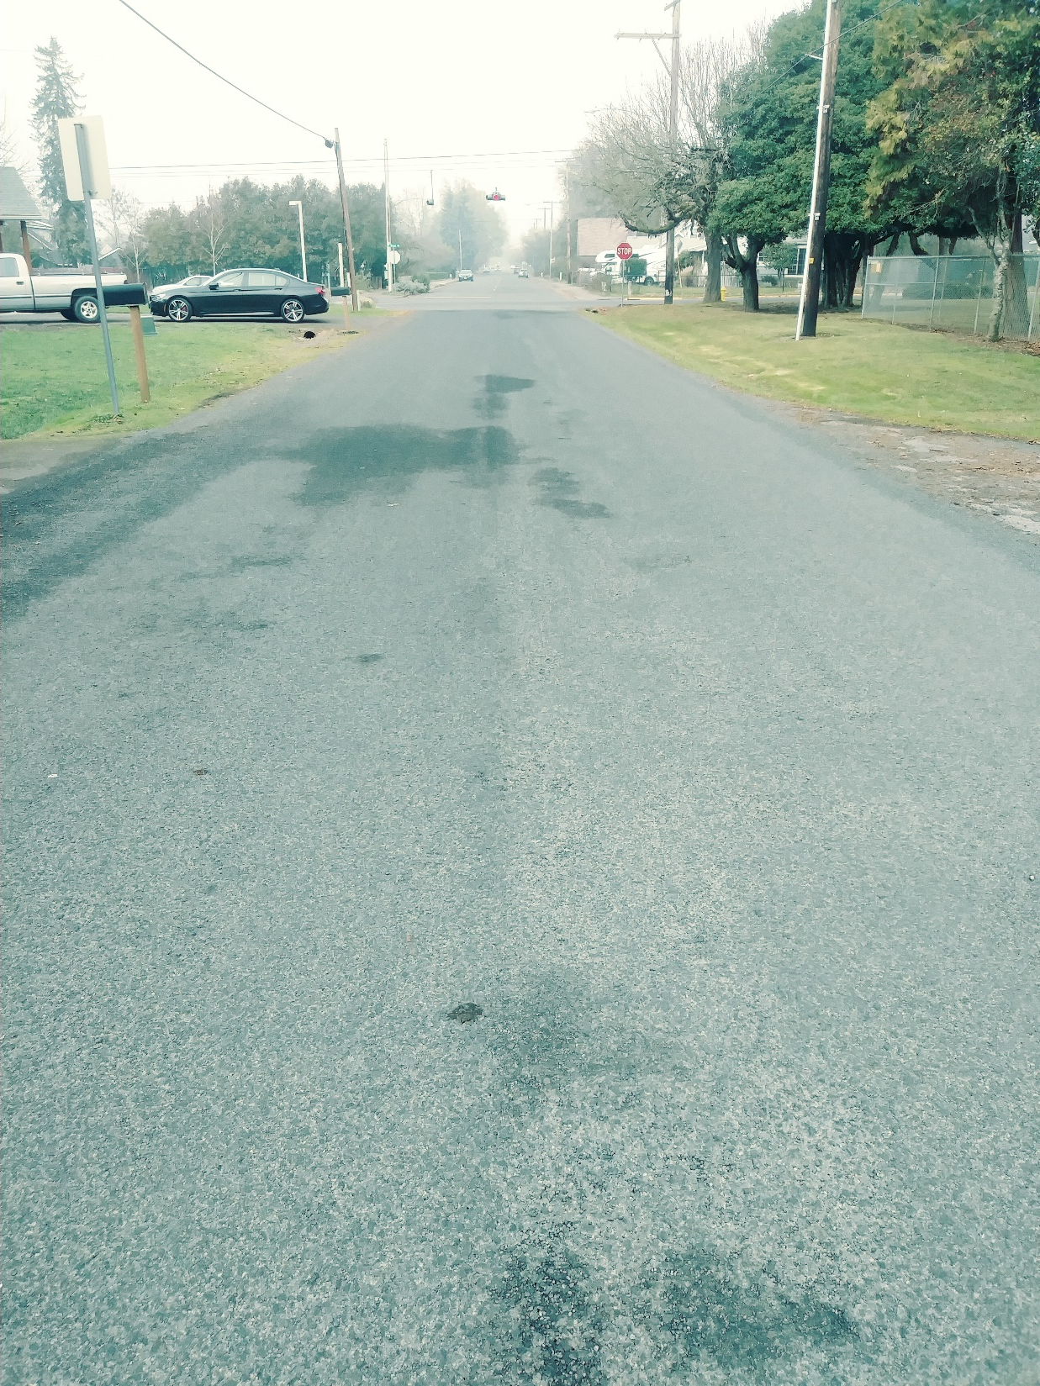
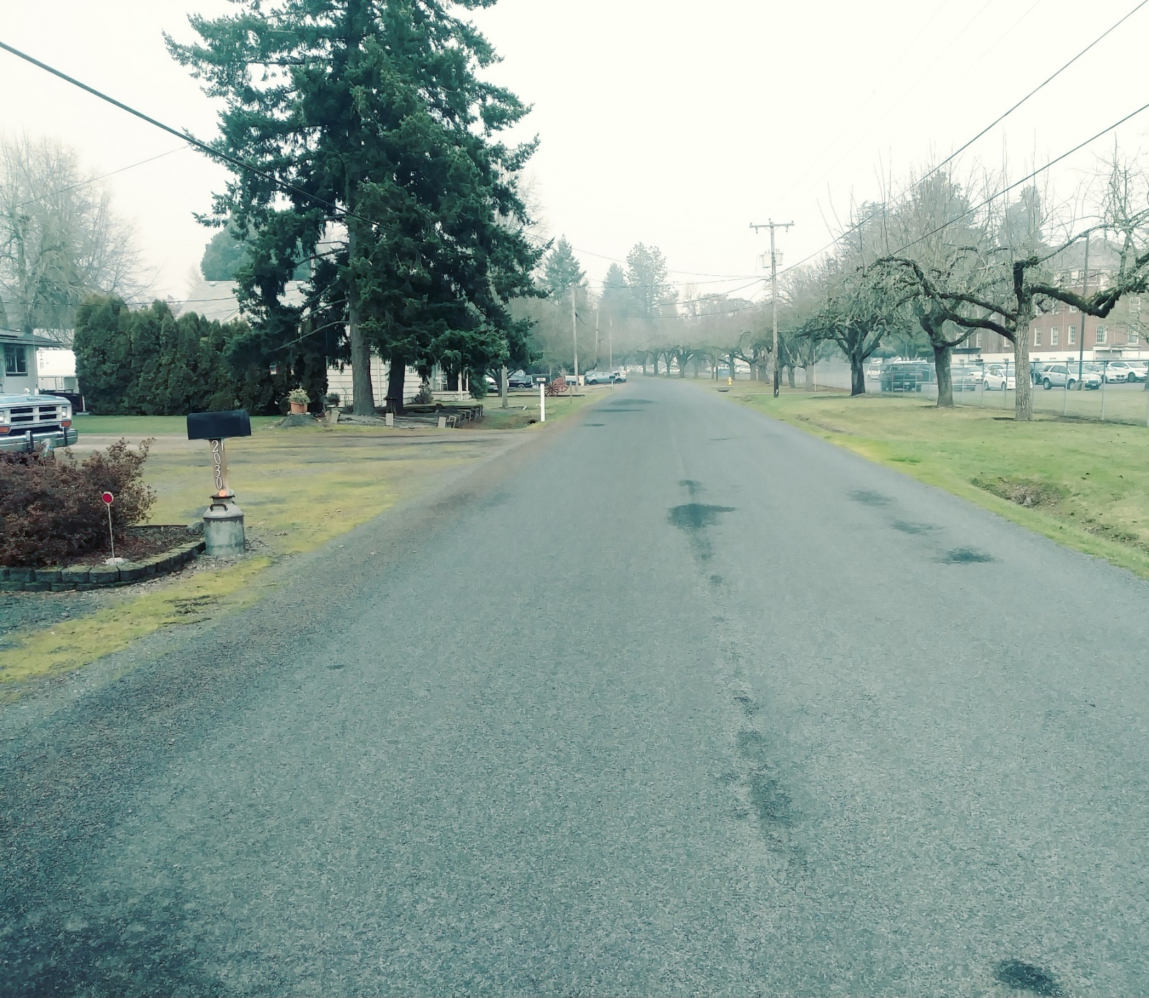
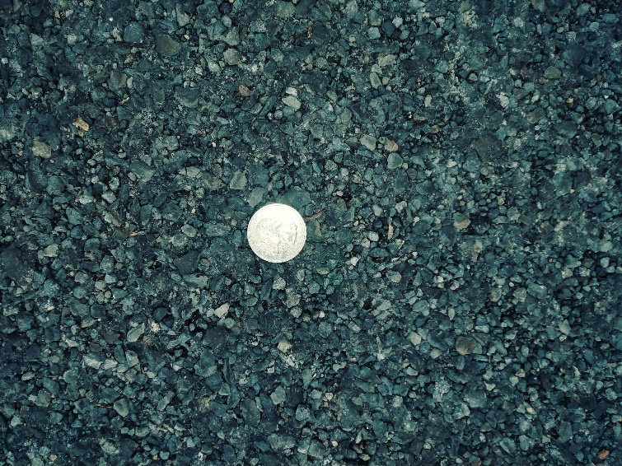
double shot
Broadway Ave.
2019
Base Course:
CRS – 3P @ 0.42 gals/SY
1/2”-1/4” @ 24 lbs/SY
Top Course:
CRS – 3P @ 0.35 gals/SY
1/4” - 10 @ 12 lbs/SY
No Fog Seal

Slide 14
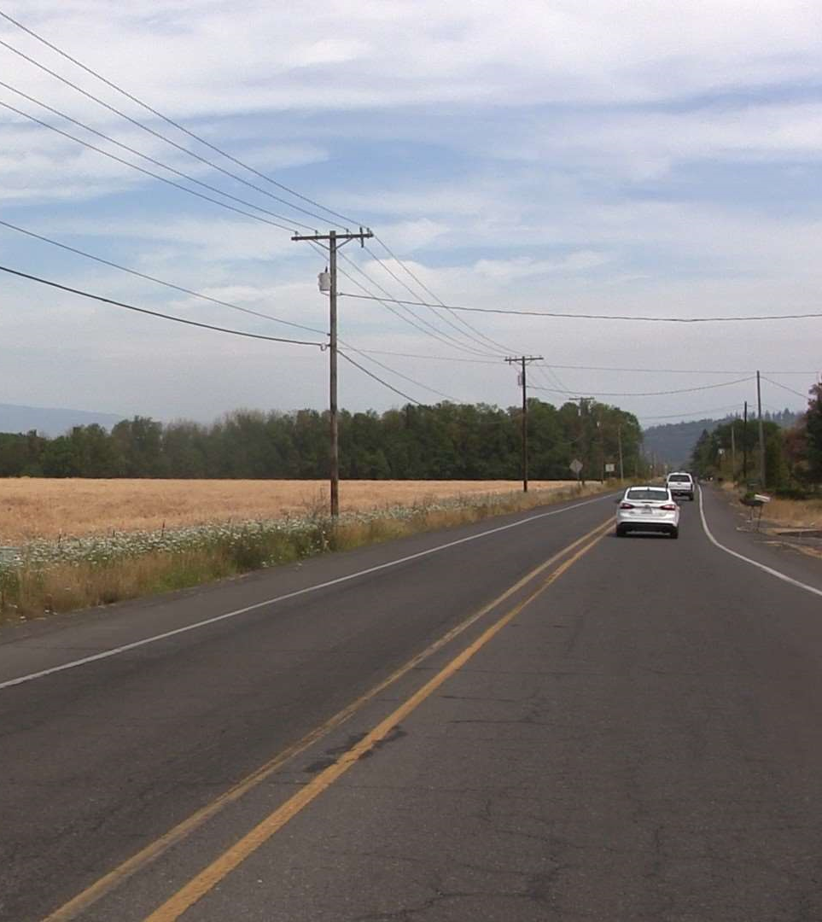
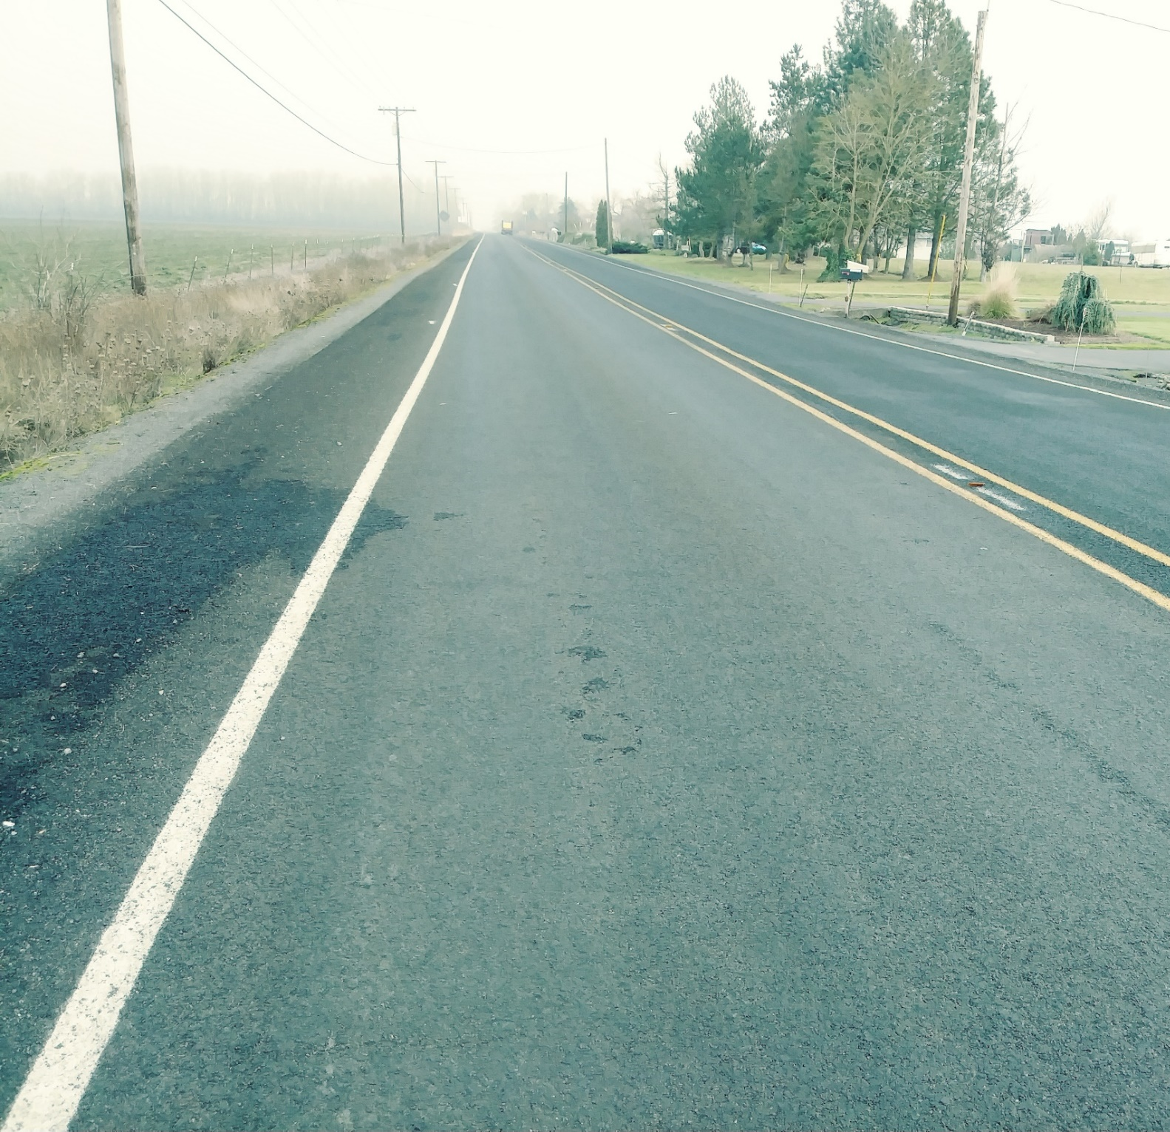
double shot
Oak ST.
2018
PCI = 53
High traffic volumes: ADT 5,000+; Truck route
Base Course:
CRS – 3P @ 0.42 gals/SY
1/2”-1/4” @ 24 lbs/SY
Top Course:
CHFRS – 2P @ 0.32 gals/SY
1/4” - 10 @ 12 lbs/SY
Fog Seal: BL Fog @ 0.10 gals/SY

Slide 15
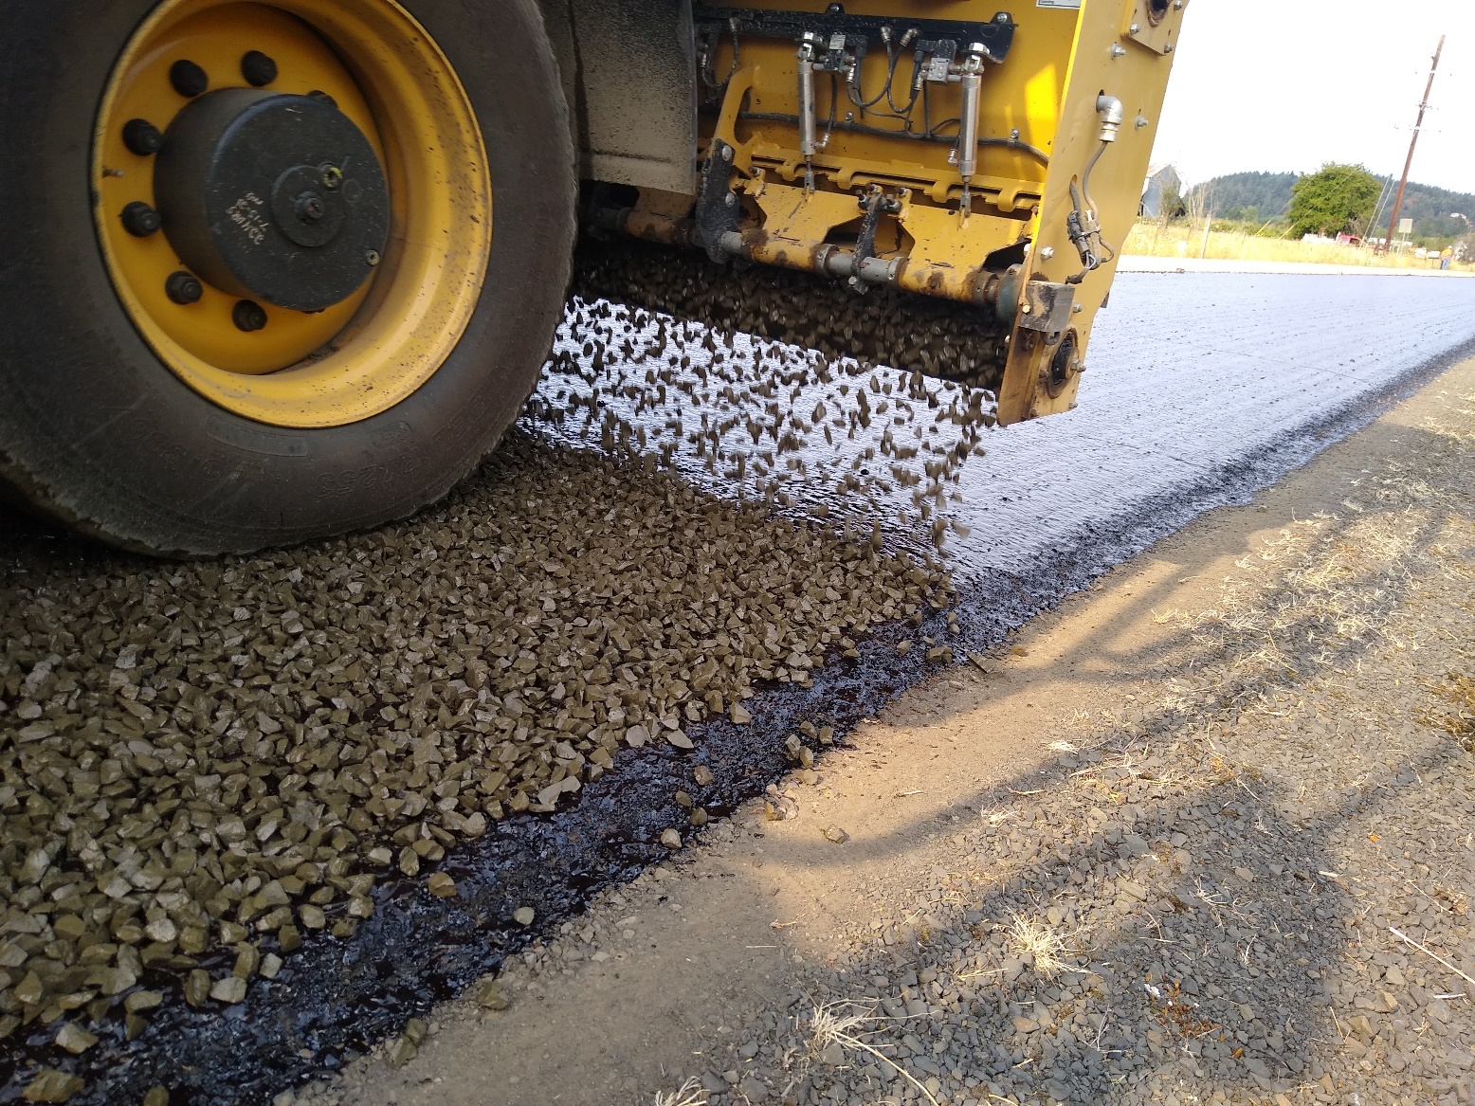
double shot
Bleeding Roads or
Bandage for a really bad road
Heavy Double Shot
Base Course:
CRS – 3P @ 0.46 – 0.48 gals/SY
3/4”-1/2” @ 35 lbs/SY
Top Course:
CRS – 3P @ 0.38 gals/SY
3/8” - 4 @ 21 lbs/SY
Fog Seal: CQS-1h@ 0.13 gals/SY

Slide 16
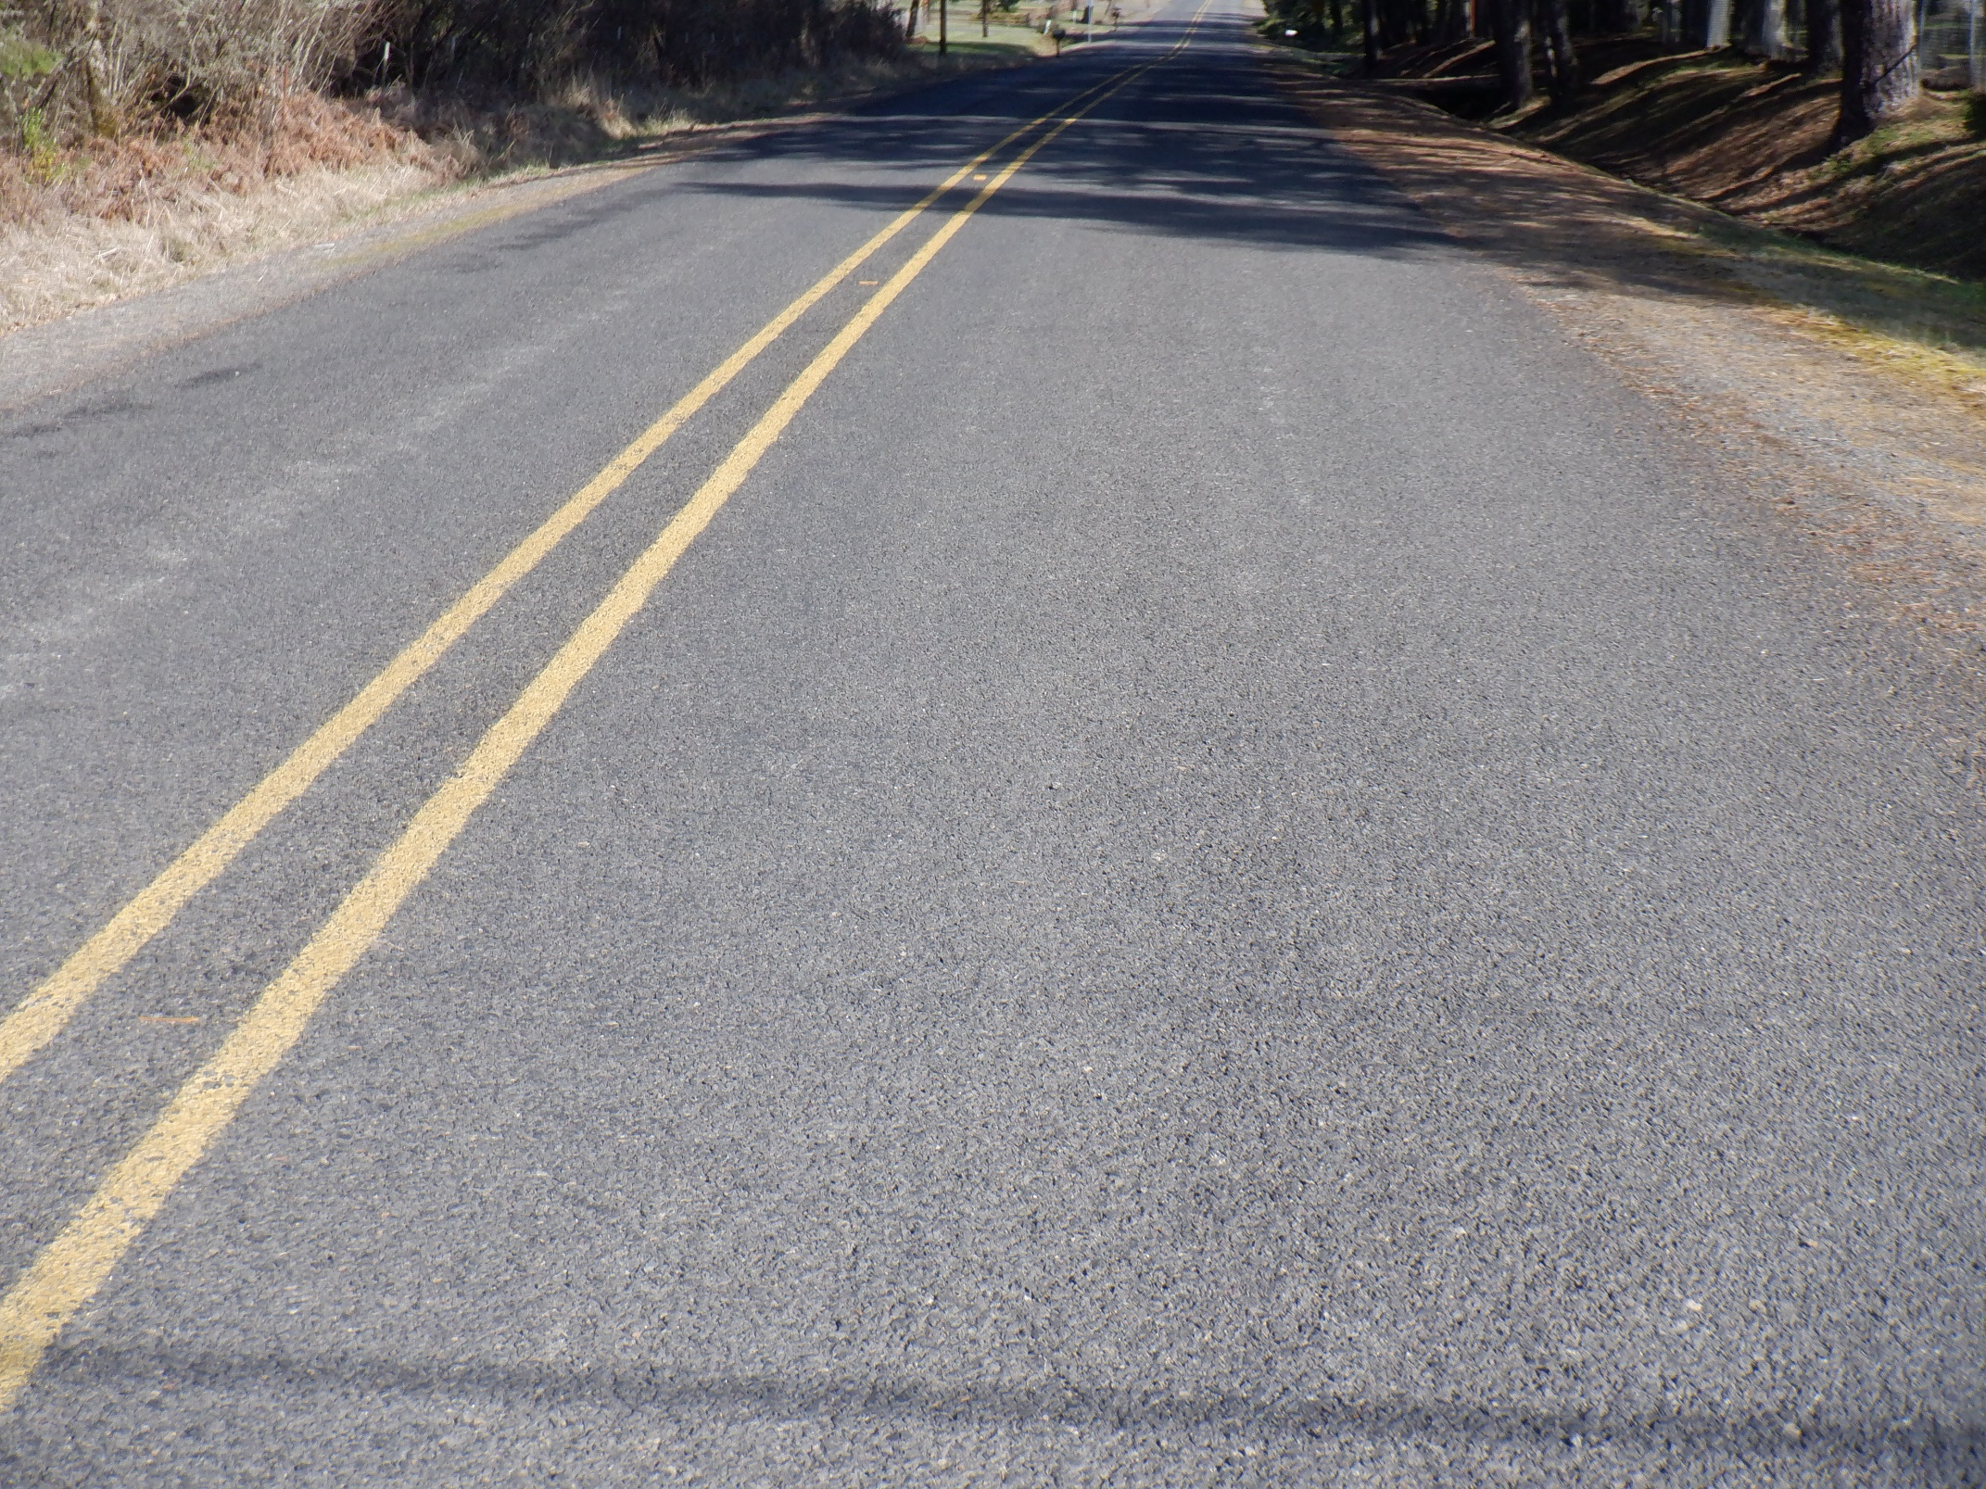
double shot
Heavy Double Shot

