Slide 1
Surface treatment toolbox
in Linn County, OR
Inter-Agency Cooperation
Communication
Contract Work
Paved Intersections
Single Shot Chip Seals
Double Shot Chip Seals
Scrub Seals
SAMI
Fog Seals
New Oil Mat Roads
Combatting Flushing/Bleeding Roads
Kevin Hamilton
Construction & Rd. Maint. Sup.
(541) 967-3919 Office
(541) 740-1787 Cell
khamilton@co.linn.or.us
Jeff Maskal
Maintenance Worker III
Leadworker for Chip Seal Operations
(541) 967-3919 Office/Message

Slide 2
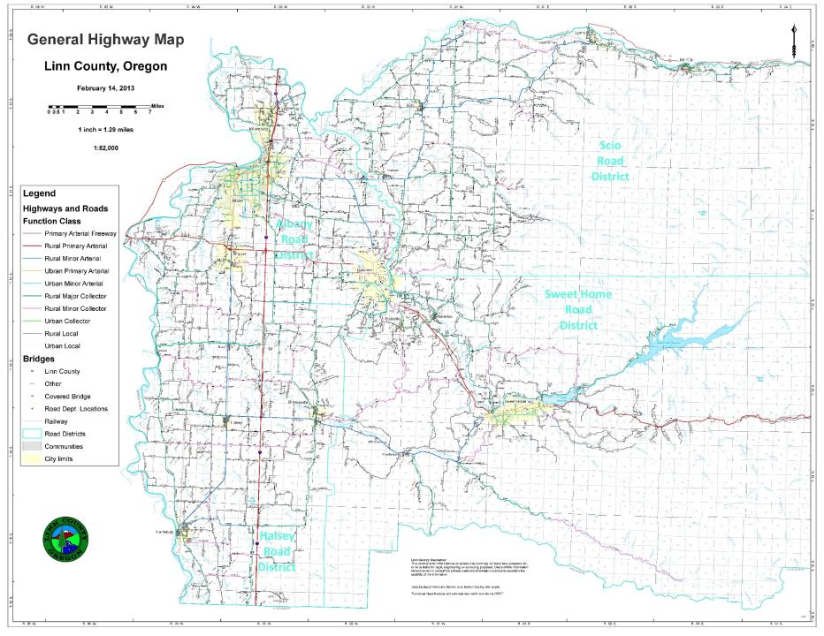
LINN COUNTY
LYONS
MILL CITY
SCIO
Approx. 1,139 total miles
Approx. 98 gravel miles
Four Maintenance Districts dividing the County into quadrants
Hilly landscapes eastern half. Flat landscapes western.
Heavy loads are mostly from logging, and hay & seed.
ALBANY
LEBANON
TANGENT
HALSEY
BROWNSVILLE
SWEET HOME
HARRISBURG

Slide 3
Surface treatment toolbox
in Linn County, OR
Inter-Agency Cooperation
Communication
Contract Work
Paved Intersections
Single Shot Chip Seals
Double Shot Chip Seals
Scrub Seals
SAMI
Fog Seals
New Oil Mat Roads
Combatting Flushing/Bleeding Roads
Kevin Hamilton
Construction & Rd. Maint. Sup.
(541) 967-3919 Office
(541) 740-1787 Cell
khamilton@co.linn.or.us
Jeff Maskal
Maintenance Worker III
Leadworker for Chip Seal Operations
(541) 967-3919 Office/Message

Slide 4
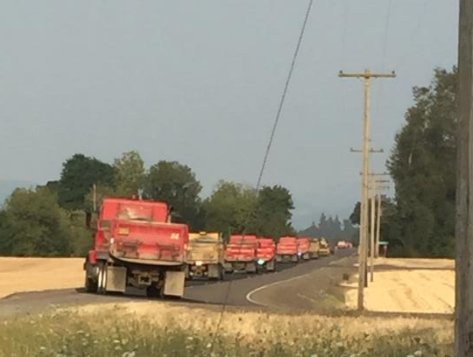
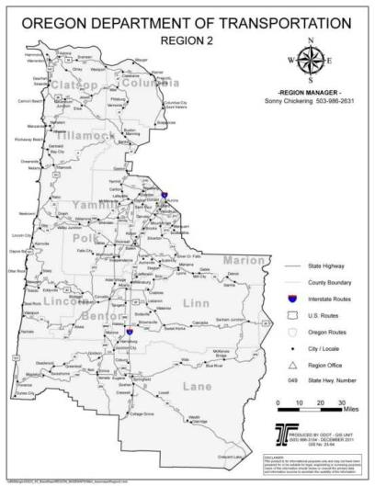
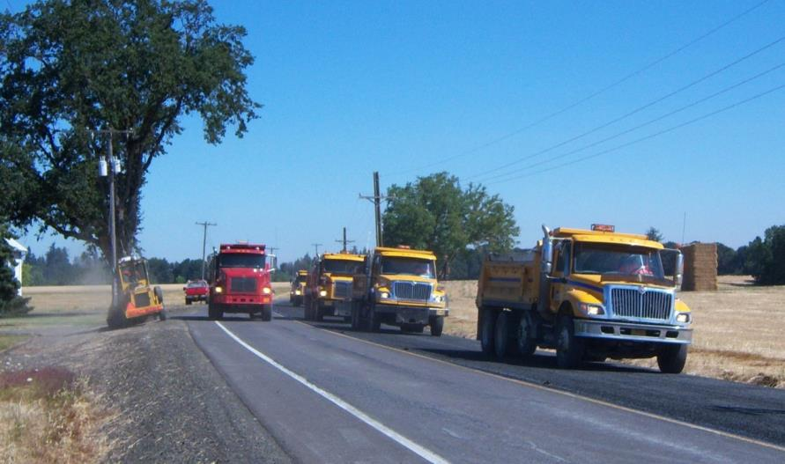
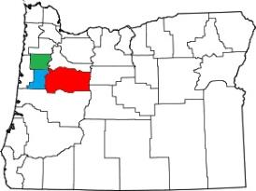
Inter-Agency Cooperation

Slide 5
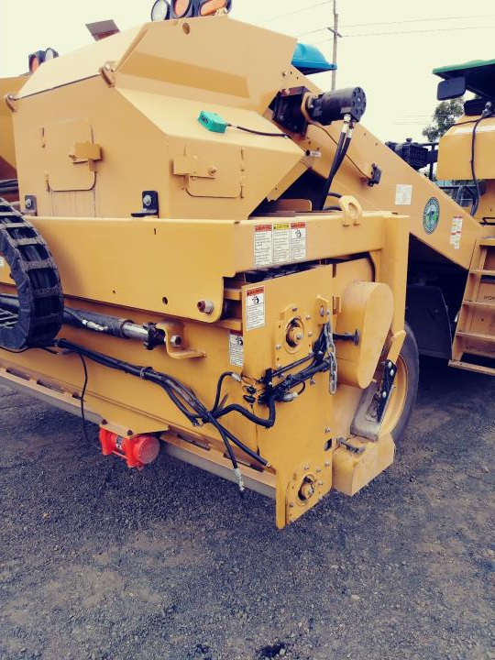
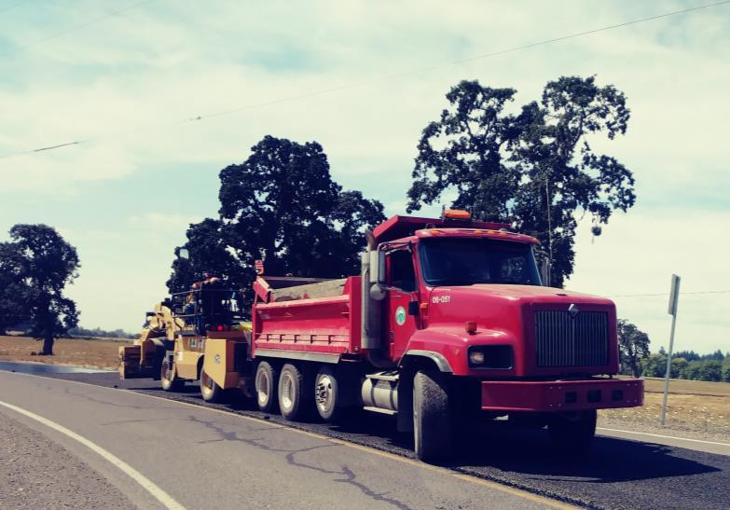
Inter-Agency Cooperation

Slide 6
Inter-Agency Cooperation

Slide 7
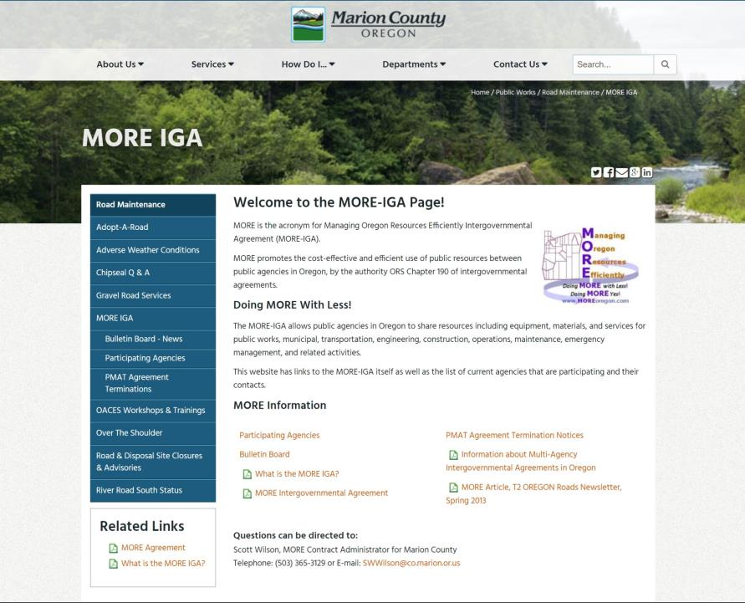
Inter-Agency Cooperation

Slide 8
Surface treatment toolbox
in Linn County, OR
Inter-Agency Cooperation
Communication
Contract Work
Paved Intersections
Single Shot Chip Seals
Double Shot Chip Seals
Scrub Seals
SAMI
Fog Seals
New Oil Mat Roads
Combatting Flushing/Bleeding Roads
Kevin Hamilton
Construction & Rd. Maint. Sup.
(541) 967-3919 Office
(541) 740-1787 Cell
khamilton@co.linn.or.us
Jeff Maskal
Maintenance Worker III
Leadworker for Chip Seal Operations
(541) 967-3919 Office/Message

Slide 9
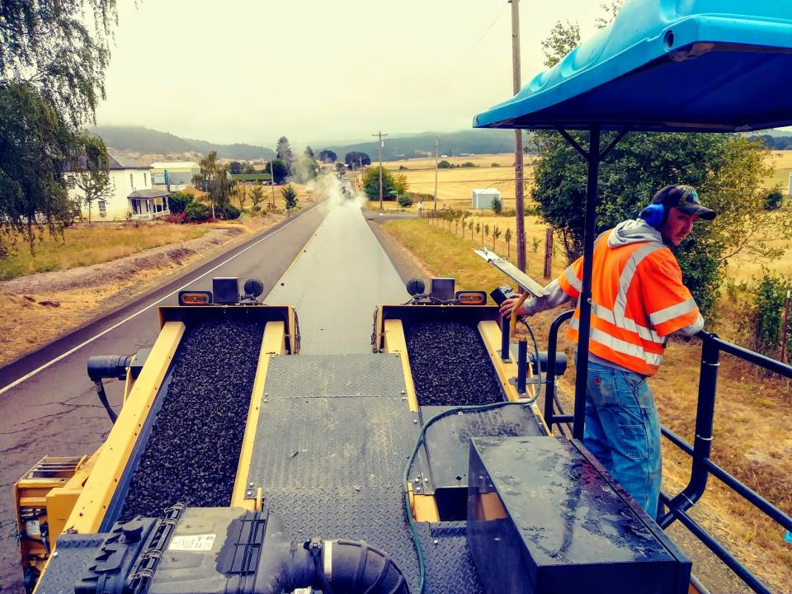
COMMUNICATION

Slide 10
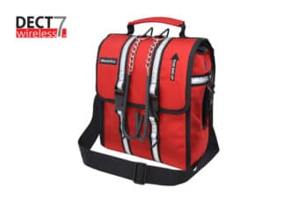
COMMUNICATION

Slide 11
COMMUNICATION
Hearing Protection

Slide 12
COMMUNICATION
Hearing Protection
Open Microphone
Efficiency of Operations

Slide 13
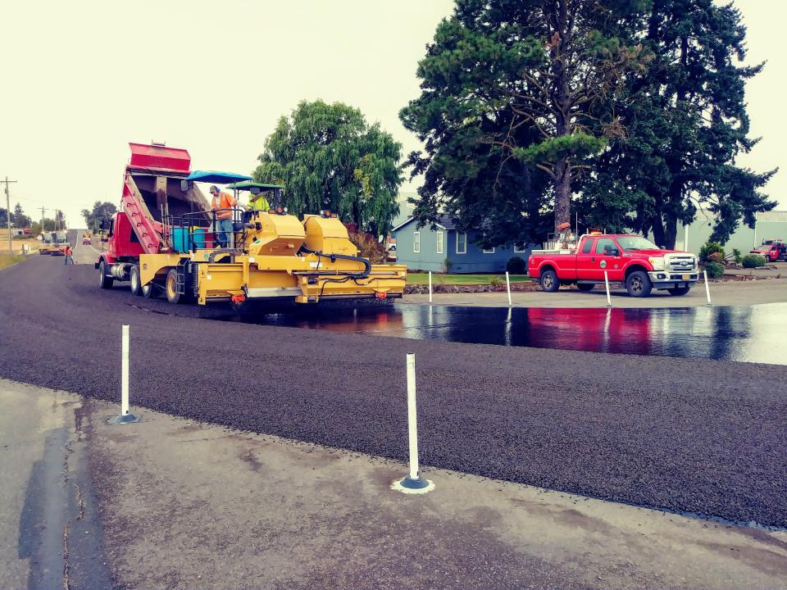
COMMUNICATION
Hearing Protection
Open Microphone
Efficiency of Operations
Safety

Slide 14
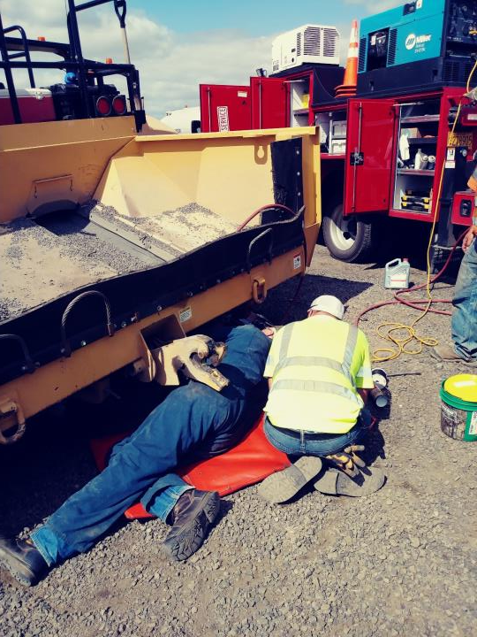
COMMUNICATION
Hearing Protection
Open Microphone
Efficiency of Operations
Safety
Listen-Through Capability

Slide 15
Surface treatment toolbox
in Linn County, OR
Inter-Agency Cooperation
Communication
Contract Work
Paved Intersections
Single Shot Chip Seals
Double Shot Chip Seals
Scrub Seals
SAMI
Fog Seals
New Oil Mat Roads
Combatting Flushing/Bleeding Roads
Kevin Hamilton
Construction & Rd. Maint. Sup.
(541) 967-3919 Office
(541) 740-1787 Cell
khamilton@co.linn.or.us
Jeff Maskal
Maintenance Worker III
Leadworker for Chip Seal Operations
(541) 967-3919 Office/Message

Slide 16
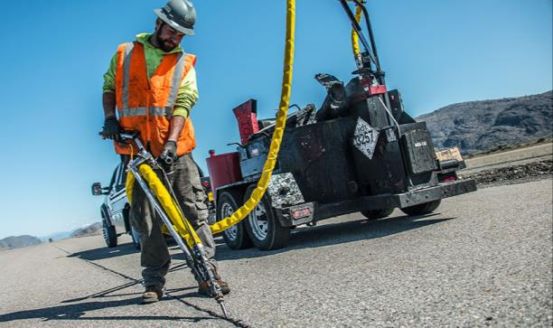
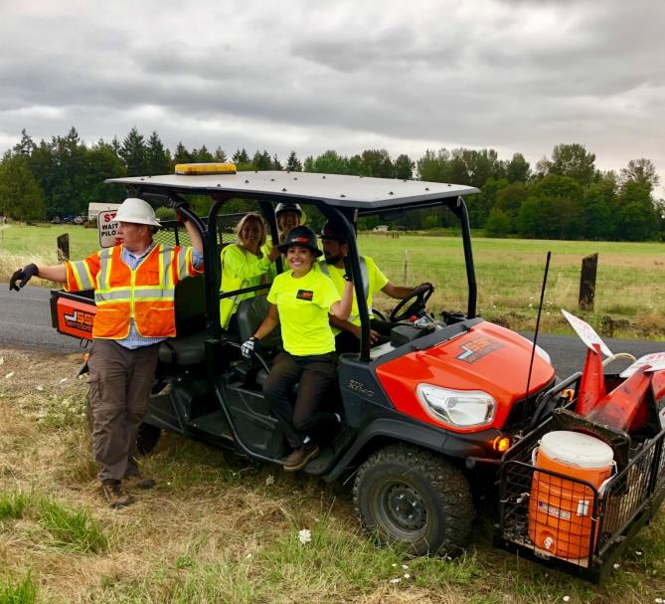
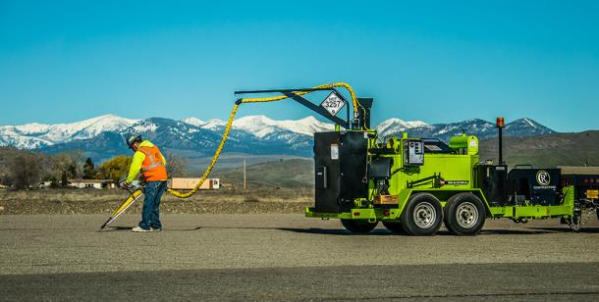
contractors
Fog Sealing
Crack Sealing
Slurry Seals / Microsurface / MicroCoat

Slide 17
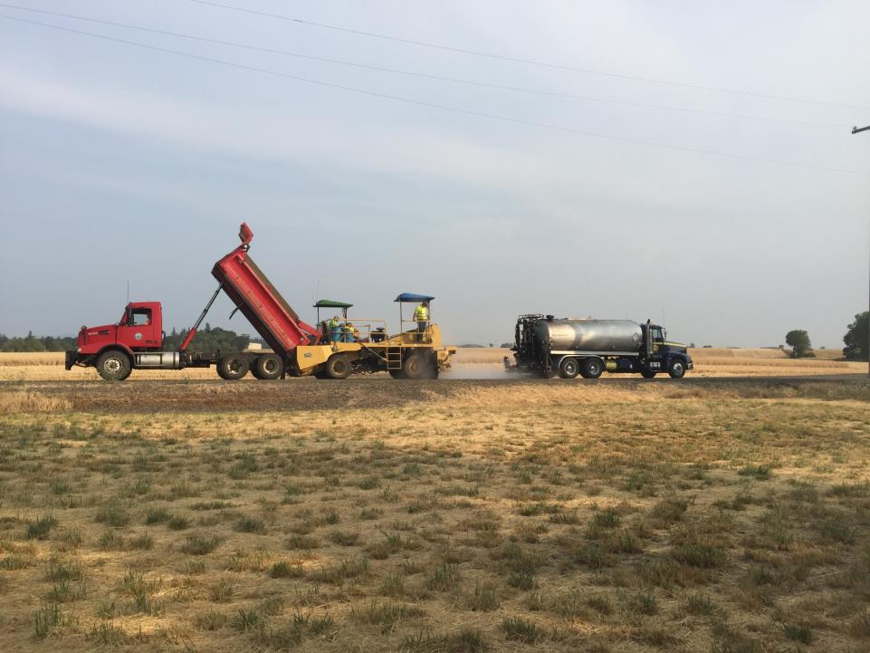
contractors
Day 1
Chip Seal by County

Slide 18
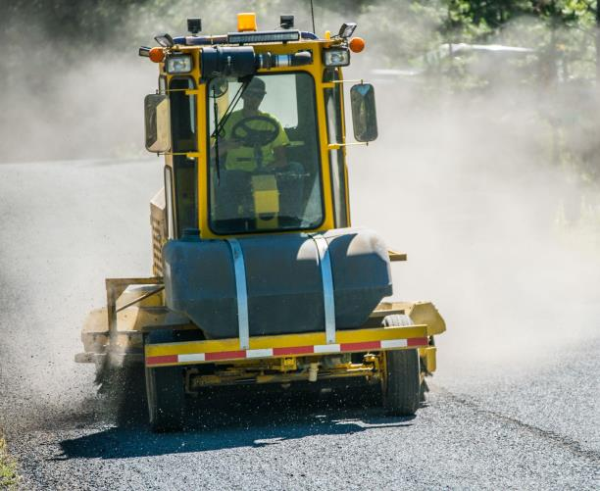
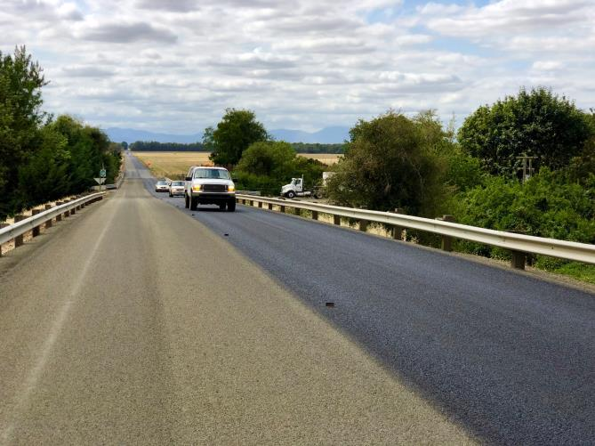
contractors
Day 2
Sweep & Fog Seal by Contractor

Slide 19
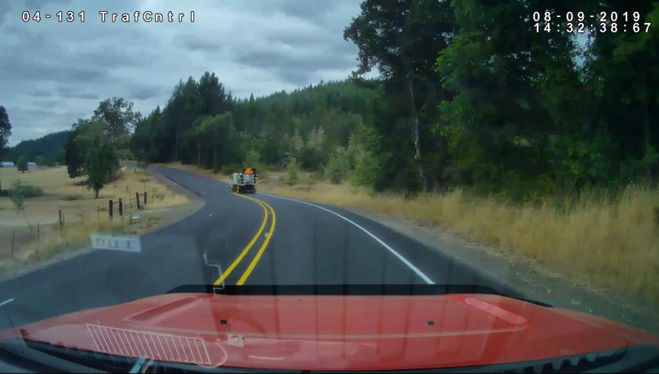
contractors
Day 3
Stripe by County

Slide 20
Surface treatment toolbox
in Linn County, OR
Inter-Agency Cooperation
Communication
Contract Work
Paved Intersections
Single Shot Chip Seals
Double Shot Chip Seals
Scrub Seals
SAMI
Fog Seals
New Oil Mat Roads
Combatting Flushing/Bleeding Roads
Kevin Hamilton
Construction & Rd. Maint. Sup.
(541) 967-3919 Office
(541) 740-1787 Cell
khamilton@co.linn.or.us
Jeff Maskal
Maintenance Worker III
Leadworker for Chip Seal Operations
(541) 967-3919 Office/Message

Slide 21
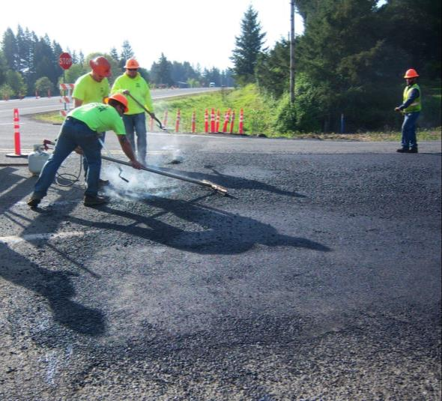
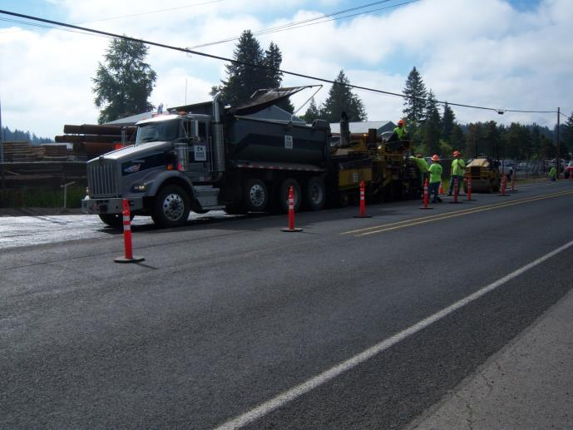
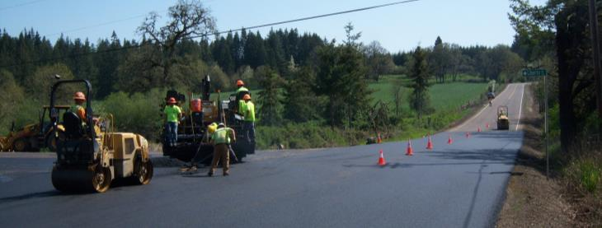
Paved intersections
Knox Butte Rd.

Slide 22
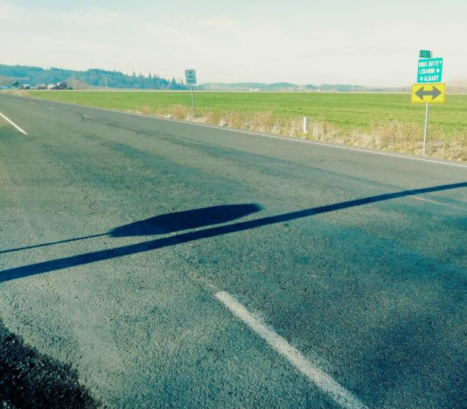
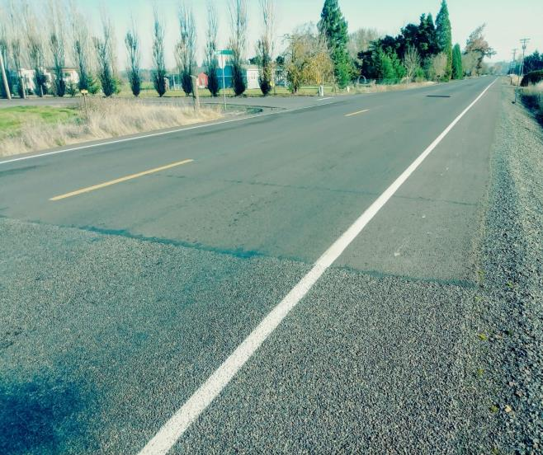
Paved intersections
Knox Butte Rd.
Harbor Rd.
Intersection
Lickskillet Rd.
Intersection

Slide 23
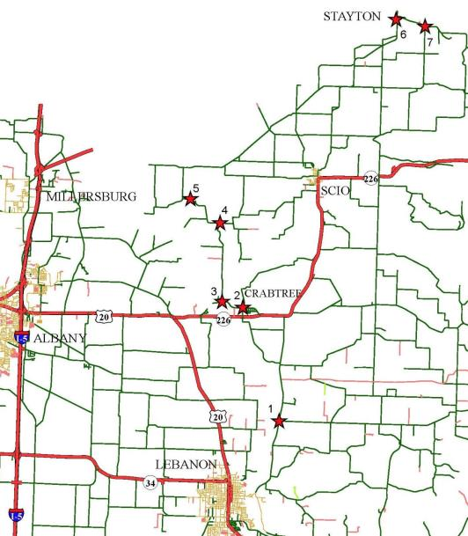
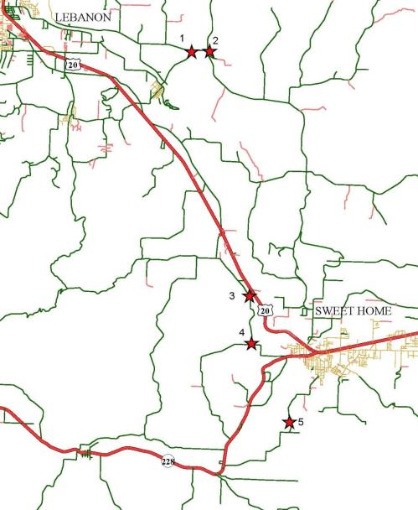
Paved intersections
Typical Contract
Scio District
Typical Contract
Sweet Home District

Slide 24
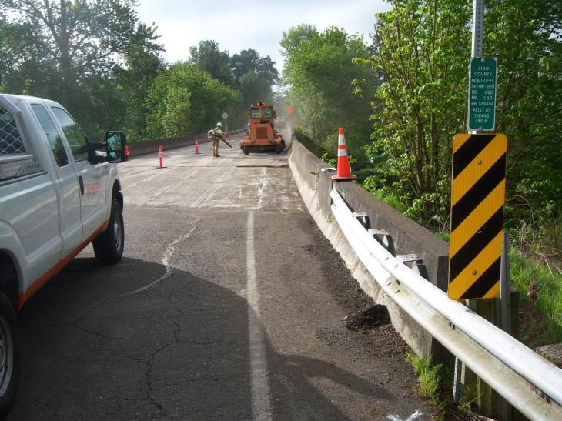
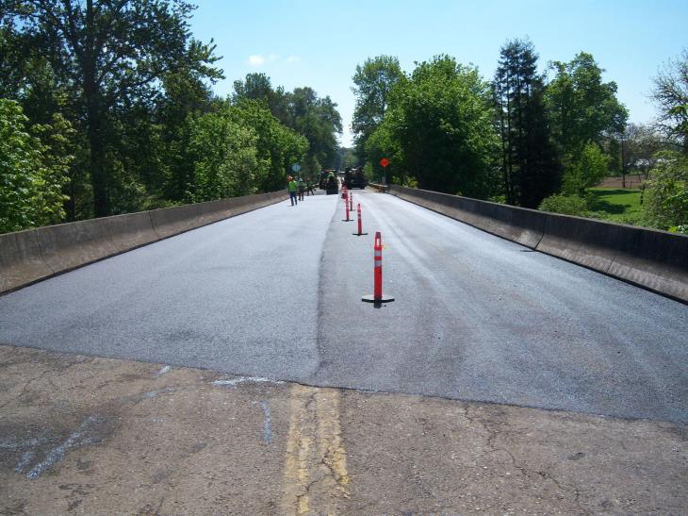
Paved intersections
Add in other work
Devaney Bridge

Slide 25
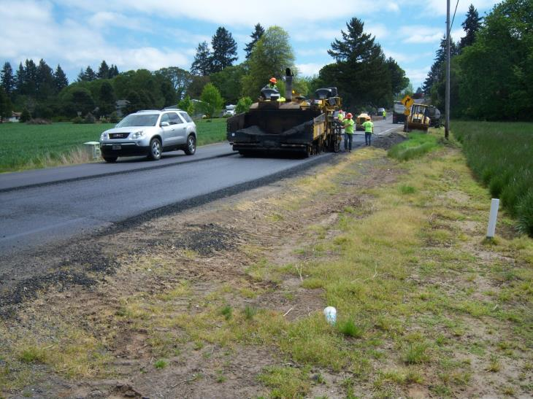
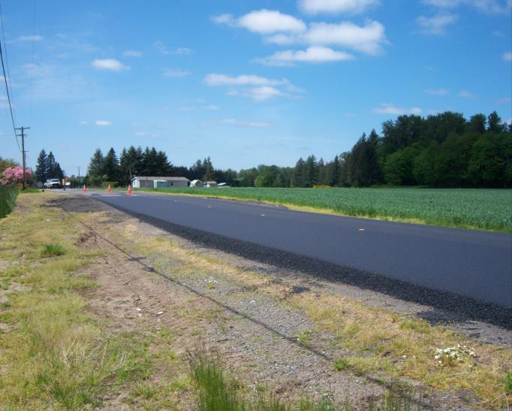
Paved intersections
Add in other work
Note: Fog seal/sand seal new asphalt before chip sealing it.
Kingston-Jordan Dr.
Pre-Level Road

Slide 26
Surface treatment toolbox
in Linn County, OR
Inter-Agency Cooperation
Communication
Contract Work
Paved Intersections
Single Shot Chip Seals
Double Shot Chip Seals
Scrub Seals
SAMI
Fog Seals
New Oil Mat Roads
Combatting Flushing/Bleeding Roads
Kevin Hamilton
Construction & Rd. Maint. Sup.
(541) 967-3919 Office
(541) 740-1787 Cell
khamilton@co.linn.or.us
Jeff Maskal
Maintenance Worker III
Leadworker for Chip Seal Operations
(541) 967-3919 Office/Message

Slide 27
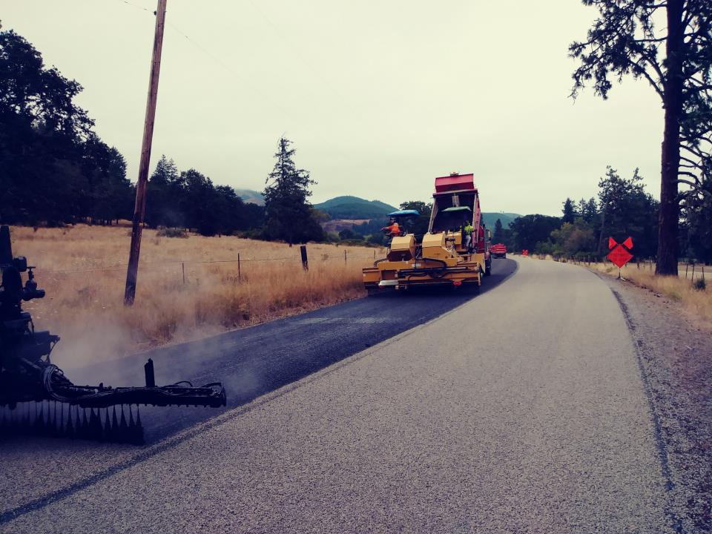
Single shot
7 – 9 miles/day, ideally
180 – 250 tons/day
Linn County:
Mostly CRS-3P or CHFRS-2P
Oil applied at 0.38 – 0.48 gals / SY
0.42 – 0.44 typical

Slide 28
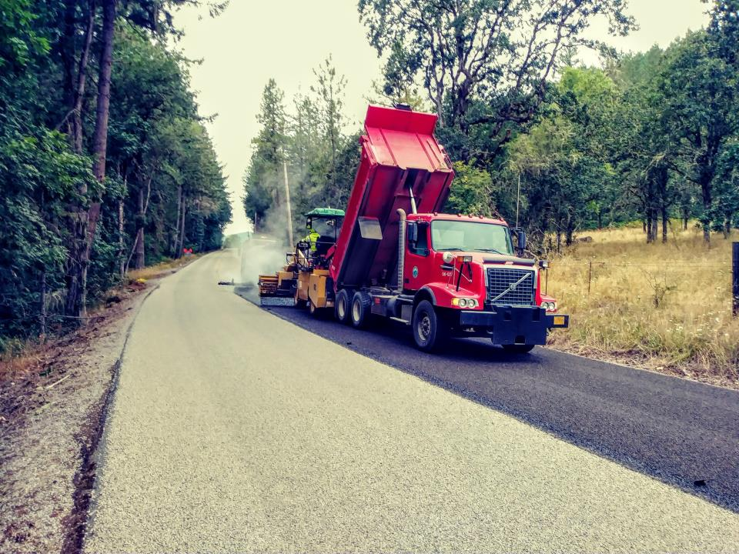
Single shot
3/8” – 10 oil rock
Rock applied at 17 – 20 Lbs / SY
18 pounds typical
Fog seal @ 0.12 – 0.13 gals/SY

Slide 29
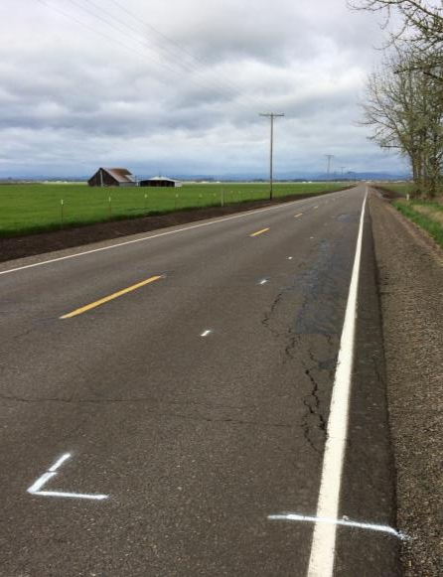
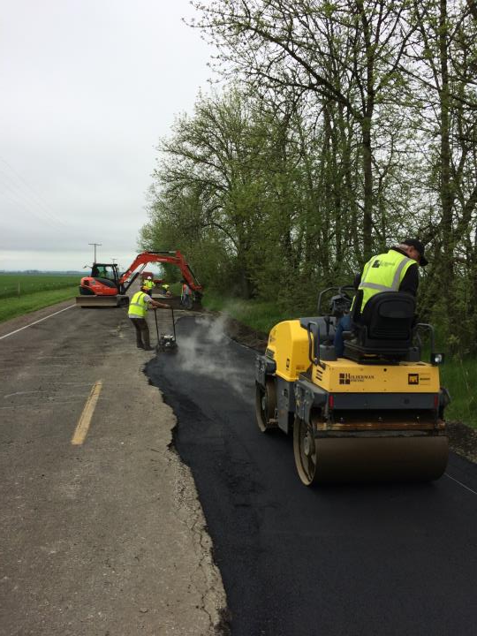
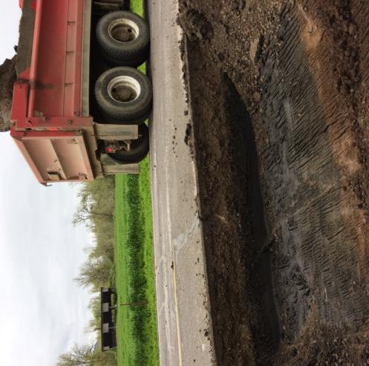
Single shot
Best Practice:
Repair potholes & base failures
Diamond Hil Dr. 2017

Slide 30
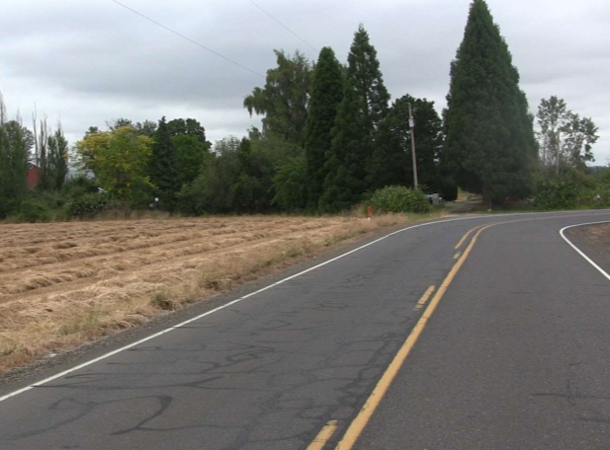
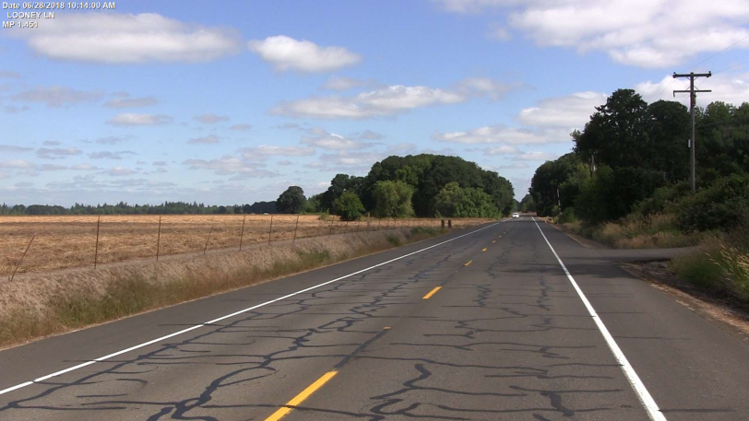
Single shot
Best Practice:
Seal cracks
Preferably the year before chip seal is scheduled
Repair ruts
Kennel Road 2018
Looney Lane 2018

Slide 31
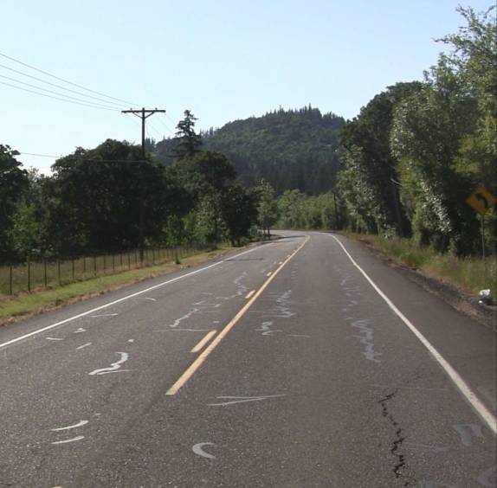
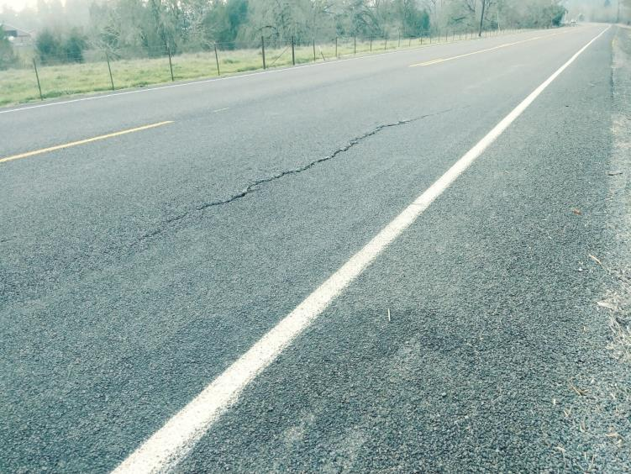
Single shot
What if you can’t get to all the repairs or get the crack sealing done?
Chip it anyway.
Berlin Rd. 2018
Berlin Road 2019

Slide 32
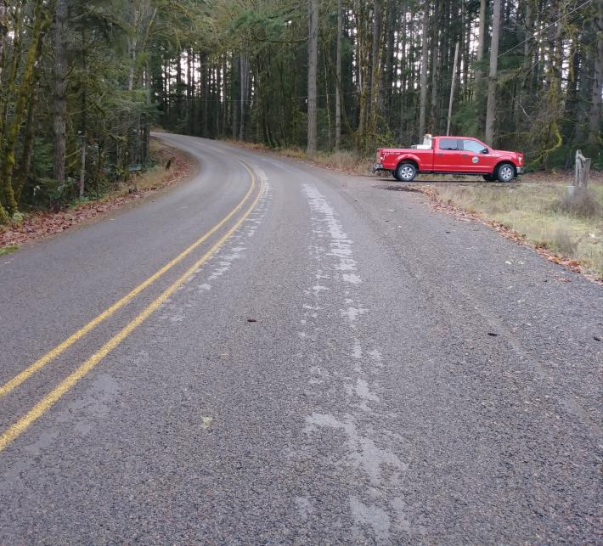
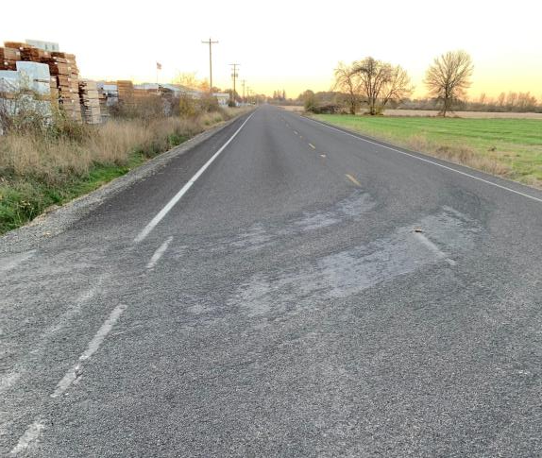
Single shot
Not enough oil
Cold oil
Contaminated oil or other problem
Dirty rock
Rock wasn’t rolled enough
Cold ground/air temps
Rain
Shade
Oil broke before rock cover
Etc., etc.
Shelling – Rock Loss
Repair: CRS-3P @ 0.30 gals/sy; ¼” – 10 rock @ 10 – 12 lbs/sy

Slide 33
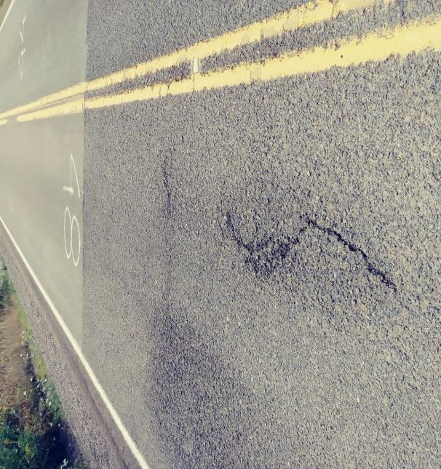
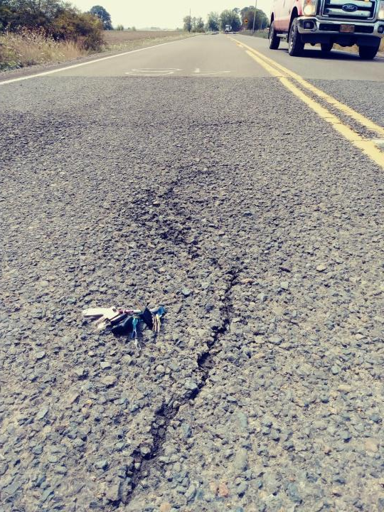
single shot
Oakville Rd.
South side of Hwy 34

Slide 34
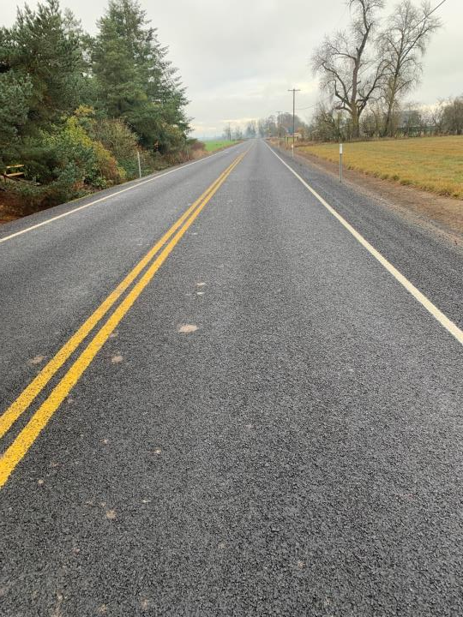
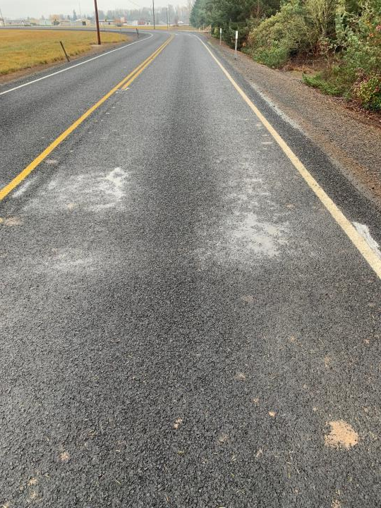
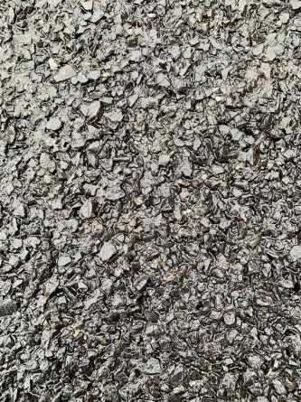
single shot
CHFRS – 2P @ 0.48 gals/SY
3/8”-10 @ 19-20 lbs/SY
Oakville Rd.
South side of Hwy 34 - 2019
Fog Seal:
BL Fog @ 0.12-0.13 gals/SY

Slide 35
Surface treatment toolbox
in Linn County, OR
Inter-Agency Cooperation
Communication
Contract Work
Paved Intersections
Single Shot Chip Seals
Double Shot Chip Seals
Scrub Seals
SAMI
Fog Seals
New Oil Mat Roads
Combatting Flushing/Bleeding Roads
Kevin Hamilton
Construction & Rd. Maint. Sup.
(541) 967-3919 Office
(541) 740-1787 Cell
khamilton@co.linn.or.us
Jeff Maskal
Maintenance Worker III
Leadworker for Chip Seal Operations
(541) 967-3919 Office/Message

Slide 36
double shot
TYPICAL SHOTS
Approx. 4 miles/day max. if base & top on same day.
Base Course:
CRS – 3P @ 0.40 – 0.48 gals/SY; Typically 0.40 – 0.42
1/2”-1/4” @ 24-26 lbs/SY
Best practice to cure overnight before sweeping and applying the top course.
Top Course:
CRS – 3P @ 0.30 – 0.35 gals/SY
1/4” - 10 @ 13 lbs/SY
Sweep & fog seal (optional) the next day.
Fog Seal:
CQS – 1h; or QSE; or BL FOG
@ 0.10 gals/SY

Slide 37
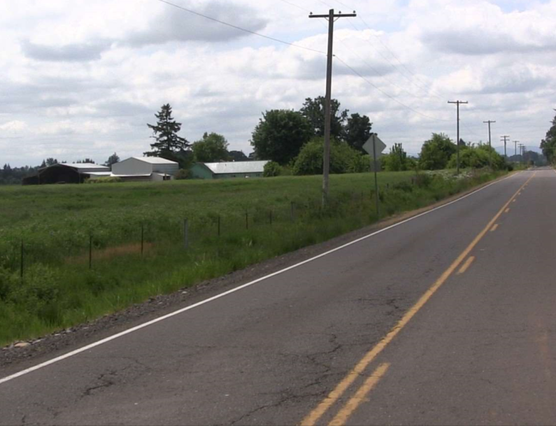
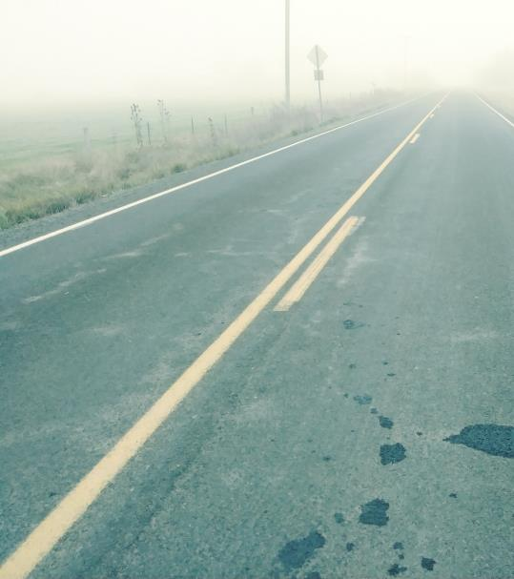
double shot
Base Course:
CRS – 3P @ 0.46 gals/SY
1/2”-1/4” @ 24-26 lbs/SY
Top Course:
CRS – 3P @ 0.35 gals/SY
1/4” - 10 @ 13 lbs/SY
Fog Seal:
CSS – 1h @ 0.10 gals/SY
Gilkey Road 2018
PCI = 59
Gilkey Road 2019

Slide 38
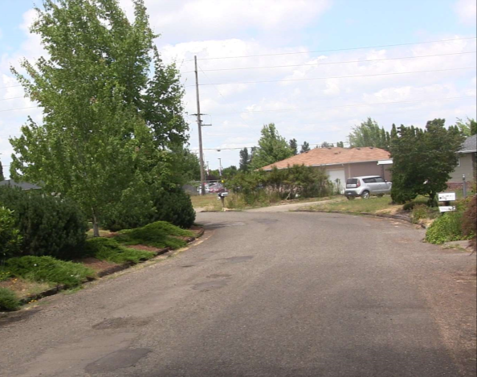
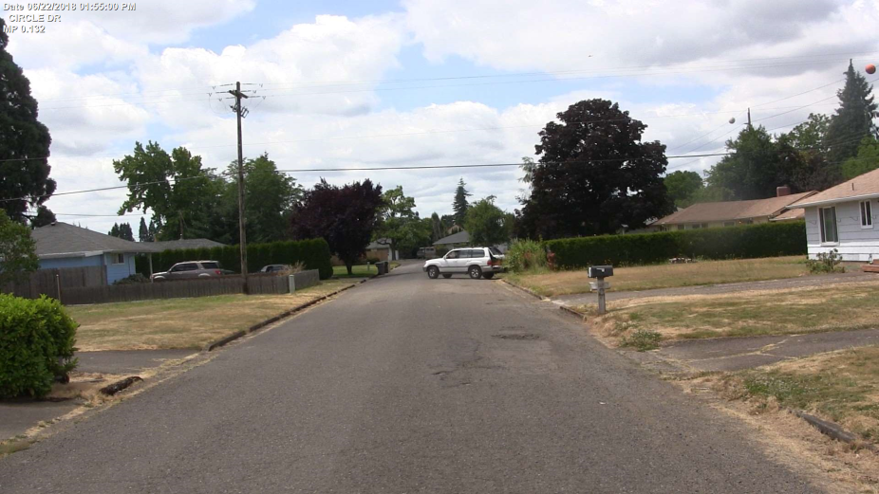
double shot
Circle Dr.
2018
PCI = 14

Slide 39
double shot
Circle Dr. 2019
Base Course:
CHFRS – 2P @ 0.48 gals/SY
1/2”-1/4” @ 24-26 lbs/SY
Top Course:
CHFRS – 2P @ 0.35 gals/SY
1/4” - 10 @ 13 lbs/SY
MicroCoat
0.35 gals/SY

Slide 40
double shot
Circle Dr.
2019
Base Course:
CHFRS – 2P @ 0.48 gals/SY
1/2”-1/4” @ 24-26 lbs/SY
Top Course:
CHFRS – 2P @ 0.35 gals/SY
1/4” - 10 @ 13 lbs/SY
MicroCoat
0.35 gals/SY

Slide 41
double shot
Broadway Ave.
2018
PCI = 12
No base failure

Slide 42
double shot
Broadway Ave.
2019
Base Course:
CRS – 3P @ 0.42 gals/SY
1/2”-1/4” @ 24 lbs/SY
Top Course:
CRS – 3P @ 0.35 gals/SY
1/4” - 10 @ 12 lbs/SY
No Fog Seal

Slide 43
double shot
Oak ST.
2018
PCI = 53
High traffic volumes: ADT 5,000+; Truck route
Base Course:
CRS – 3P @ 0.42 gals/SY
1/2”-1/4” @ 24 lbs/SY
Top Course:
CHFRS – 2P @ 0.32 gals/SY
1/4” - 10 @ 12 lbs/SY
Fog Seal: BL Fog @ 0.10 gals/SY

Slide 44
Surface treatment toolbox
in Linn County, OR
Inter-Agency Cooperation
Communication
Contract Work
Paved Intersections
Single Shot Chip Seals
Double Shot Chip Seals
Scrub Seals
SAMI
Fog Seals
New Oil Mat Roads
Combatting Flushing/Bleeding Roads
Kevin Hamilton
Construction & Rd. Maint. Sup.
(541) 967-3919 Office
(541) 740-1787 Cell
khamilton@co.linn.or.us
Jeff Maskal
Maintenance Worker III
Leadworker for Chip Seal Operations
(541) 967-3919 Office/Message

Slide 45
SCRUB SEAL
The Effectiveness of the Broom on Filling the Cracks (1)
Click video image to play.

Slide 46
SCRUB SEAL
The Effectiveness of the Broom on Filling the Cracks (2)
Click video image to play.

Slide 47
SCRUB SEAL
Running a Wave in Front of the Broom
Click video image to play.

Slide 48
Powerline Road
Conditions Prior to Scrub Seal
Ravelling and severe block cracking at 22174 Powerline.
Pictures taken in June of 2016.

Slide 49
Powerline Road
Conditions After the Scrub Seal
Ravelling and Severe Block Cracking at 22174 Powerline.
Picture taken in December of 2016.

Slide 50
Powerline Road
Conditions After the Scrub Seal
Ravelling and Severe Block Cracking at 22174 Powerline.
June of 2016.
December of 2016.

Slide 51
Powerline Road
Conditions After the Scrub Seal
Ravelling and Severe Block Cracking at 22174 Powerline.
Picture taken 12/05/2019.
June of 2016.
December of 2016.

Slide 52
Powerline Road
Conditions Before the Scrub Seal
Alligator Cracking North of Lake Creek Dr.
Northbound Lane
Southbound Lane
June of 2016.

Slide 53
Powerline Road
Conditions After the Scrub Seal
Alligator Cracking North of Lake Creek Dr.
Viewing North
Viewing South
December of 2016.

Slide 54
Powerline Road
Conditions After the Scrub Seal
Alligator Cracking North of Lake Creek Dr.
June of 2016.
December of 2016.

Slide 55
Powerline Road
Conditions After the Scrub Seal
Alligator Cracking North of Lake Creek Dr.
June of 2016.
December of 2019.
December of 2016.

Slide 56
Powerline Road
Conditions After the Scrub Seal
Alligator Cracking at Smith Seed in Halsey
December of 2016.
June of 2016.

Slide 57
Powerline Road
Conditions After the Scrub Seal
Alligator Cracking at Smith Seed in Halsey
December of 2016.
December of 2019.
June of 2016.

Slide 58
American Dr.
Quarter placed on scrub seal
Scrub sealed in 2017
Picture taken at a bridge abutment, showing end of scrub seal.
Pictures taken 12/03/2019
Quarter as shown at right

Slide 59
American Dr.
Scrub seal

Slide 60
Brewster rd.
When things go wrong
6.73 miles
Major collector
ADT 5,000+

Slide 61
Brewster rd.
When things go wrong
PCI = 55 – 61
Mostly load cracking

Slide 62
Brewster rd.
When things go wrong
PASS MAX-CR (scrub seal oil – we did not use scrub broom)
0.40 gals/sy
3/8” – 10 rock @ 18-19 lbs/sy
Top Course (next day)
CRS-3P @ 0.30 gals/sy
¼” – 10 rock @ 12-13 lbs/sy
Fog Seal:
CSS-1h @ 0.10 gals/sy

Slide 63
Brewster rd.
When things go wrong

Slide 64
Brewster rd.
When things go wrong

Slide 65
Brewster rd.
When things go wrong
PASS MAX-CR has a low softening point.
Could have used less oil / more rock with the PASS in this application.
Could have used ½” rock on base course instead of 3/8”.
Could have used a harder oil on top course, not CRS-3P; or use CRS-3P on top and bottom – but not PASS combined with CRS-3P.
Could have skipped the fog seal.

Slide 66
Surface treatment toolbox
in Linn County, OR
Inter-Agency Cooperation
Communication
Contract Work
Paved Intersections
Single Shot Chip Seals
Double Shot Chip Seals
Scrub Seals
SAMI
Fog Seals
New Oil Mat Roads
Combatting Flushing/Bleeding Roads
Kevin Hamilton
Construction & Rd. Maint. Sup.
(541) 967-3919 Office
(541) 740-1787 Cell
khamilton@co.linn.or.us
Jeff Maskal
Maintenance Worker III
Leadworker for Chip Seal Operations
(541) 967-3919 Office/Message

Slide 67
SAMI
Stress Absorbing Membrane Interlayer

Slide 68
SAMI
Stress Absorbing Membrane Interlayer
Five Rivers Road Overlay Project
10.5 mile long project; $4.5 million
Located in Lincoln County; 25 miles east of Waldport
Managed by theFederal Highway Administration
Contract awarded to Brix Paving Northwest, Inc.
Diamond Grind existing HMAC road surface for profile and crack seal material removal.
Scrub seal performed by Sierra Santa Fe as subcontractor.
Two inch asphalt concrete overlay placed by prime contractor.

Slide 69
SAMI
Helmick Road
Case Study in Polk County
This road was originally the old Highway 99. It had an 8.5” concrete base placed in 1923. The original concrete was also the wearing surface, no HMAC present. Very poor condition.
2013 – 3” HMAC overlay placed on 4 miles of roadway. After one year reflective cracking had already begun to come through the overlay.
2017 – New treatment applied to a 4 mile road segment contiguous to the above overlay. Double chip seal as SAMI: CRS-3P @ 0.42 with 3/8” - #4 @ 21 lbs. Two 1.5” lifts of HMAC placed over SAMI. HMAC dense graded mix; PG 64-22 asphalt w/ 30% RAP.
Additionally, two bridges were ground at their abutments with Geogrid installed as SAMI.
As of December 2019 no reflective cracking has appeared through the 2017 overlay.

Slide 70
Surface treatment toolbox
in Linn County, OR
Inter-Agency Cooperation
Communication
Contract Work
Paved Intersections
Single Shot Chip Seals
Double Shot Chip Seals
Scrub Seals
SAMI
Fog Seals
New Oil Mat Roads
Combatting Flushing/Bleeding Roads
Kevin Hamilton
Construction & Rd. Maint. Sup.
(541) 967-3919 Office
(541) 740-1787 Cell
khamilton@co.linn.or.us
Jeff Maskal
Maintenance Worker III
Leadworker for Chip Seal Operations
(541) 967-3919 Office/Message

Slide 71
Fog Seals
Single shot chip seals:
0.11 – 0.13 gals/SY (0.12 typical)
Linn County now applies a fog seal to every single shot chip seal
Better chip retention
Better contrast for pavement markings
Double shot chip seals:
0.09 – 0.10 gals/SY (0.10 typical)
Optional but generally recommended on double shots for the above reasons
Linn County does not perform fog seals as a stand-alone treatment.

Slide 72
Fog Seals
Pictures taken on same day
Double shot with fog seal
Tangent Dr.
Double shot – No fog seal
Engel Rd.

Slide 73
Fog Seals
Stop using CSS-1h
Better products exist
BL Fog
QSE or
CQS-1h
CQS-1h
These products break faster; stay black longer

Slide 74
Surface treatment toolbox
in Linn County, OR
Inter-Agency Cooperation
Communication
Contract Work
Paved Intersections
Single Shot Chip Seals
Double Shot Chip Seals
Scrub Seals
SAMI
Fog Seals
New Oil Mat Roads
Combatting Flushing/Bleeding Roads
Kevin Hamilton
Construction & Rd. Maint. Sup.
(541) 967-3919 Office
(541) 740-1787 Cell
khamilton@co.linn.or.us
Jeff Maskal
Maintenance Worker III
Leadworker for Chip Seal Operations
(541) 967-3919 Office/Message

Slide 75
New oil roads
Make sure you have enough good base.
This project: Arthur Dr.
16” total base section. Pothole in advance to know existing road base in multiple locations.
Digout end areas: 12” of 3”-0 with 4” of ¾” – 0 on top.
Construct in multiple well compacted lifts.
3” – 0 added to existing road base per design to achieve minimum design base thickness.
¾” – 0 placed at 4” deep, graded to shape and finished grade elevation.

Slide 76
New oil roads
Water and roll … a lot.
The surface should be tightly graded and moist, but not wet.
Wet enough to keep the gravel base from absorbing the oil. You want the oil to stay on the surface for the oil rock to adhere.

Slide 77
New oil roads
FIRST COURSE
¾” – ½” rock @ 52 – 55 lbs/sy
CRS-3P @ 0.50 – 0.60 gals/sy
SECOND COURSE
½” – ¼” rock @ 22 – 25 lbs/sy
CRS-3P @ 0.40 gals/sy
THIRD COURSE
¼” – 10 rock @ 12 – 14 lbs/sy

Slide 78
New oil roads
FIRST COURSE
Don’t let the gravel road dry out in front of the chip spreader.

Slide 79
New oil roads
Give the oil time to cure between courses.
Roll, roll, roll.

Slide 80
Surface treatment toolbox
in Linn County, OR
Inter-Agency Cooperation
Communication
Contract Work
Paved Intersections
Single Shot Chip Seals
Double Shot Chip Seals
Scrub Seals
SAMI
Fog Seals
New Oil Mat Roads
Combatting Flushing/Bleeding Roads
Kevin Hamilton
Construction & Rd. Maint. Sup.
(541) 967-3919 Office
(541) 740-1787 Cell
khamilton@co.linn.or.us
Jeff Maskal
Maintenance Worker III
Leadworker for Chip Seal Operations
(541) 967-3919 Office/Message

Slide 81
Flushing/bleeding roads
FIRST COURSE
¾” – ½” rock
@ 52 – 55 lbs/sy
CRS-3P
@ 0.46 gals/sy
SECOND COURSE
3/8” – 10 rock
@ 18 – 22 lbs/sy
CRS-3P
@ 0.38 gals/sy
Langmack Rd.
May of 2018.

Slide 82
Flushing/bleeding roads
FIRST COURSE
¾” – ½” rock
@ 52 – 55 lbs/sy
CRS-3P
@ 0.46 gals/sy
SECOND COURSE
3/8” – 10 rock
@ 18 – 22 lbs/sy
CRS-3P
@ 0.38 gals/sy
Langmack Rd.
December of 2019.

Slide 83
Flushing/bleeding roads
FIRST COURSE
¾” – ½” rock
@ 52 – 55 lbs/sy
CRS-3P
@ 0.46 gals/sy
SECOND COURSE
3/8” – 10 rock
@ 18 – 22 lbs/sy
CRS-3P
@ 0.38 gals/sy
No fog seal
Langmack Rd.
December of 2019.

Slide 84
Flushing/bleeding roads
SANDWICH SEAL
Three courses of rock.
Two courses of oil.
No fog seal
Parker Rd.
2011

Slide 85
Flushing/bleeding roads
FIRST COURSE
½” – ¼” rock @ 20 – 24 lbs/sy
No oil.
Roll, roll, roll.
SECOND COURSE
Applied CRS-2P @ 0.35 gals/sy,
Then ½” – ¼” rock @ 22 - 24 lbs/sy again.
Roll, roll, roll. Then sweep.
THIRD COURSE
Applied CRS-2P @ 0.40 gals/sy
Then ¼” – 10 rock @ 18 – 20 lbs/sy.
Roll.
SANDWICH SEAL
Parker Rd.
2011

Slide 86
Flushing/bleeding roads
FIRST COURSE
½” – ¼” rock @ 20 – 24 lbs/sy
No oil.
Roll, roll, roll.
SECOND COURSE
Applied CRS-2P @ 0.35 gals/sy,
Then ½” – ¼” rock @ 22 - 24 lbs/sy again.
Roll, roll, roll. Then sweep.
THIRD COURSE
Applied CRS-2P @ 0.40 gals/sy
Then ¼” – 10 rock @ 18 – 20 lbs/sy.
Roll.
SANDWICH SEAL
Parker Rd.
After sandwich seal in 2011

Slide 87
Flushing/bleeding roads
SANDWICH SEAL
Parker Rd.
July, 2018
Parker Rd.
After sandwich seal in 2011

