Slide 1
CHIP SEAL EFFICIENCY IN OPERATIONS
MORROW COUNTY
2018-2019
Eric Imes
541-256-0576

Slide 2
INTRODUCTION
Chip Seal Operations Planning
Pre Construction Meeting
Post Construction Meeting
Data Entry

Slide 3
CHIP SEAL OPERATIONS PLANNING
Crew and Equipment Capabilities
Rock source
Equipment Staging
Municipality Communication
Land Owner Communication
Asphalt Supplier Capabilities
Projected Schedule
Back Up Plan

Slide 4
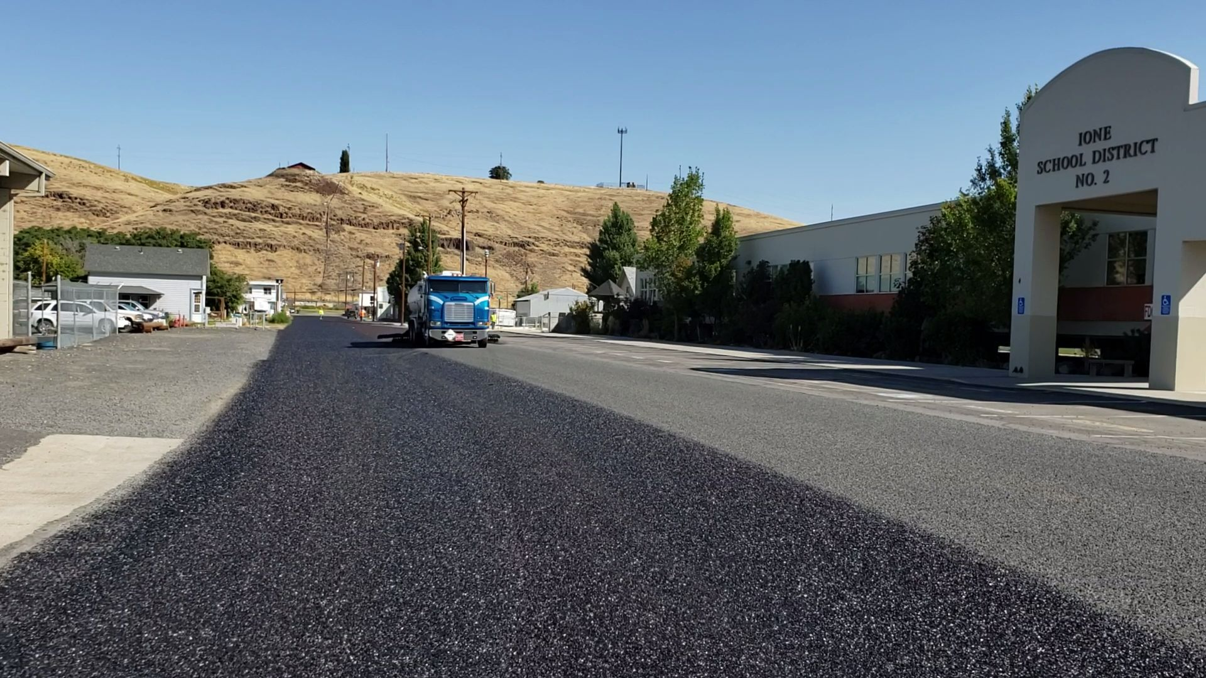

Slide 5
CHIP SEAL FISCAL YEAR 2018
ROAD NAME | projected date | AREA | MILES | LENGTH | WIDTH | SQUARE YDS. | projected rock tons | projected gallons | projected shot
ALPINE | june 3rd. | North Lexington | 2.12 | 11200 | 20 | 24889 | 261 | 11200 | 0.45
PATTERSON FERRY north of 730 | june 4th. | Irrigon | 3.34 | 17635 | 26 | 50946 | 535 | 21907 | 0.43
PATTERSON FERRY south of 730 | june 5th. | Irrigon | 2.86 | 15101 | 26 | 43625 | 458 | 18759 | 0.43
COLUMBIA | june 5,6 | Irrigon | 2.43 | 12830 | 25 | 35639 | 374 | 17820 | 0.5
KUNZE west of main | june 6,10 | Boardman | 4.78 | 25239 | 33.5 | 93945 | 986 | 39457 | 0.42
KUNZE east of main | june 11th. | Boardman | 1.24 | 6547 | 22-24 | 16731 | 176 | 7362 | 0.44
MILLER | june 11th. | Boardman | 0.5 | 2660 | 20 | 5911 | 89 | 2956 | 0.5
PETERS north of Kunze | june 11th. | Boardman | 0.5 | 2630 | 20 | 5844 | 61 | 2630 | 0.45
TOMS CAMP north of Kunze | june 11th. | Boardman | 0.5 | 2650 | 20 | 5889 | 88 | 2945 | 0.5
WILSON west of Paul Smith | june 12th. | Boardman | 2.39 | 12640 | 29 | 40729 | 428 | 18328 | 0.45
TOWER | june 13,17,18 | Boardman | 8.3 | 43845 | 26 | 126663 | 1330 | 53199 | 0.42
TOTAL |  |  | 28.96 | 152977 |  | 450811 | 4786 | 196563 | 0.454

Slide 6
PRE CONSTRUCTION MEETING
Oil award
RFQ
Project cost comparison
Expectations of oil supplier
Flagging
Lead men leave shop @ 6:00
Manage sign sets
Briefing w/ hired flaggers on days schedule & JHA
Communicate with hired flaggers/sign time slips
Shadow brooms when necessary
Brooms
Sweep ahead of chip crew
Pull stick n’ stomps
Sweep chip seal
Distributer
Has right of way
Limited sight distance
Many distractions
Extreme danger while shooting intersections and turn lanes
Hot oil under pressure
Maintain 20 feet of space between you and back end of truck
Expect sudden changes in movements/direction
Chip spreader
Stay aboard unless communicated with operator
Expect sudden changes in movements/direction
Operator will hook to trucks
Watch belt man for hand signals
Haul trucks
Communicate with lead driver on protocol
Route
Loading procedures
Entering construction zone
In construction zone staging
Leaving chip spreader
Communicate with belt man by hand signals
Try to cross meet lines where others have also
Spit tracks
Look for chip rock problems on road
Keep track of loads per road

Slide 8
PRE CONSTRUCTION MEETING
Rollers
Patterns
Watch for well rolled wheel paths
Sections
Roll in sections to make room for ground crew
Safety
Three point contact rule
Look before changing directions
Watch for ground crew
Shoulders
Ground crew
Repair imperfections
Rake joints
Sweep & rake intersections
Stick n’ stomps
Safety
Constant personal awareness
Always have an escape route
Chip Seal Foreman
Quality control
Roadway prep
Communicate with oil supplier on oil and rock rates
Communicate with lead men
Organize stock pile sites
Floor prep
Rock quantities
Loader logistics
Staging sites for equipment and oil tankers
Communicate with landowners
Prep stage location
Manage schedule
Project dates and locations
Communicate with municipalities and schools
Communicate with land owners (harvest)
Manage operational changes

Slide 9
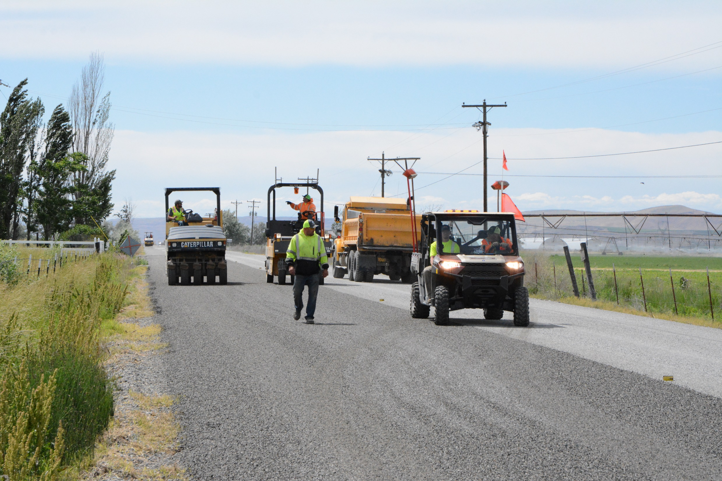

Slide 10
POST CONSTRUCTION MEETING
Discussed what went well
Discussed what to change
Discussed safety concerns
It was valuable discussion

Slide 11
DATA ENTRY
CHIP SEAL FISCAL YEAR 2018
ROAD NAME | projected date | actual date | AREA | MILES | LENGTH | WIDTH | SQUARE YDS. | projected gallons | projected shot | square yds shot | gallons shot | shot rate
ALPINE | june 3rd. | june 3rd | North Lexington | 2.12 | 11200 | 20 | 24889 | 11200 | 0.45 | 26874 | 11100 | 0.413
PATTERSON FERRY north of 730 | june 4th. | june 4th | Irrigon | 3.34 | 17635 | 26 | 50946 | 21907 | 0.43 | 52380 | 22725 | 0.434
PATTERSON FERRY south of 730 | june 5th. | june 5,6 | Irrigon | 2.86 | 15101 | 26 | 43625 | 18759 | 0.43 | 42723 | 19725 | 0.462
COLUMBIA | june 5,6 | june 4,5 | Irrigon | 2.43 | 12830 | 25 | 35639 | 17820 | 0.5 | 37133 | 16600 | 0.447
KUNZE west of main | june 6,10 | june 6,10 | Boardman | 4.78 | 25239 | 33.5 | 93945 | 39457 | 0.42 | 93673 | 45244 | 0.483
KUNZE east of main | june 11th. | june 11th. | Boardman | 1.24 | 6547 | 22-24 | 16731 | 7362 | 0.44 | 16731 | 8081 | 0.483
MILLER | june 11th. | june 11th. | Boardman | 0.5 | 2660 | 20 | 5911 | 2956 | 0.5 | 6879 | 3725 | 0.542
PETERS north of Kunze | june 11th. | june 10th. | Boardman | 0.5 | 2630 | 20 | 5844 | 2630 | 0.45 | 6456 | 3050 | 0.472
TOMS CAMP north of Kunze | june 11th. | june 11th. | Boardman | 0.5 | 2650 | 20 | 5889 | 2945 | 0.5 | 6333 | 3500 | 0.553
WILSON west of Paul Smith | june 12th. | june 12th. | Boardman | 2.39 | 12640 | 29 | 40729 | 18328 | 0.45 | 41395 | 19400 | 0.469
TOWER | june 13,17,18 | june 12,13,17 | Boardman | 8.3 | 43845 | 26 | 126663 | 53199 | 0.42 | 127233 | 57250 | 0.45
TOTAL |  |  |  | 28.96 | 152977 |  | 450811 | 196563 | 0.454 | 457810 | 210400 | 0.46
FOG SEAL FISCAL YEAR 2018
ROAD NAME | projected date | actual date | AREA | MILES | LENGTH | WIDTH | SQUARE YDS. | projected gallons | projected shot | square yds shot | gallons shot | shot rate
ALPINE |  |  | North Lexington
PATTERSON FERRY north of 207 | june 19th. | june 18th. | Irrigon | 3.34 | 17635 | 26 | 50946 | 6114 | 0.12 | 51931 | 5193 | 0.1
PATTERSON FERRY south of 207 | june 19,20 | june 18th. | Irrigon | 2.86 | 15101 | 26 | 43625 | 5235 | 0.12 | 44590 | 4459 | 0.1
COLUMBIA | june 20th. | june 18th. | Irrigon | 2.43 | 12830 | 25 | 35639 | 4277 | 0.12 | 37619 | 4425 | 0.118
KUNZE west of main | june 20,24 | june 19th. | Boardman | 4.78 | 25239 | 33.5 | 93945 | 11273 | 0.12 | 94522 | 9830 | 0.104
KUNZE east of main | june 24th. | june 19th. | Boardman | 1.24 | 6547 | 22-24 | 16731 | 2008 | 0.12 | 17464 | 1816 | 0.104
MILLER | june 25th. | june 19th. | Boardman | 0.5 | 2660 | 20 | 5911 | 709 | 0.12 | 6695 | 675 | 0.101
PETERS north of Kunze | june 25th. | june 19th. | Boardman | 0.5 | 2630 | 20 | 5844 | 701 | 0.12 | 6695 | 675 | 0.101
TOM CAMP | june 25th. | june 19th. | Boardman | 0.5 | 2650 | 20 | 5889 | 707 | 0.12 | 6695 | 675 | 0.101
WILSON west of Paul Smith | june 26th. | june 19th. | Boardman | 2.39 | 12640 | 29 | 40729 | 4888 | 0.12 | 42476 | 4375 | 0.103
TOWER | june 26th. | june 20th. | Boardman | 8.3 | 43845 | 26 | 126663 | 15200 | 0.12 | 127117 | 13200 | 0.104
TOTAL | 15 days | 12 days |  | 26.84 | 141777 |  | 425922 | 51112 | 0.12 | 435804 | 45323 | 0.1036

Slide 12
DATA ENTRY
CHIP SEAL FISCAL YEAR 2019
ROAD NAME | projected date | actual date | AREA | MILES | LENGTH | WIDTH | SQUARE YDS. | projected gallons | projected shot | square yds shot | gallons shot | shot rate
RHEA CREEK BRIDGE SECTION | 19-Aug | 19-Aug | IONE | 0.587 | 3100 | 24 | 8267 | 3968 | 0.48 | 8194 | 4000 | 0.488
IONE-GOOSEBERRY | 20-Aug | 20-Aug | IONE | 19.54 | 103152 | 22-31 | 276900 | 132912 | 0.48 | 281183 | 135550 | 0.482
 | 21-Aug | 21-Aug
 | 22-Aug | 22-Aug
 | 26-Aug | 26-Aug
 | 27-Aug | 27-Aug
 | 28-Aug
private aircraft
hanger apron and taxiway
were added and completed
in this time frame
 |  |  |  | 20.127 | 106252 |  | 285167 | 136880 | 0.480 | 289377 | 139550 | 0.485
FOG SEAL FISCAL YEAR 2019
ROAD NAME | projected date | actual date | AREA | MILES | LENGTH | WIDTH | SQUARE YDS. | projected gallons | projected shot | square yds shot | gallons shot | shot rate
RHEA CREEK BRIDGE SECTION | 29-Aug | 28-Aug | IONE | 0.587 | 3100 | 24 | 8267 | 992 | 0.12 | 8327 | 1100 | 0.13
IONE-GOOSEBERRY | 3-Sep | 28-Aug | IONE | 19.54 | 103152 | 22-31 | 276900 | 27690 | 0.1 | 293267 | 40925 | 0.14
 | 4-Sep | 29-Aug
 | 5-Sep
private aircraft
hanger apron and taxiway
were added and completed
in this time frame
 | 11 days | 8 days |  | 20.127 | 106252 |  | 285167 | 28682 | 0.11 | 301594 | 42025 | 0.135

Slide 13
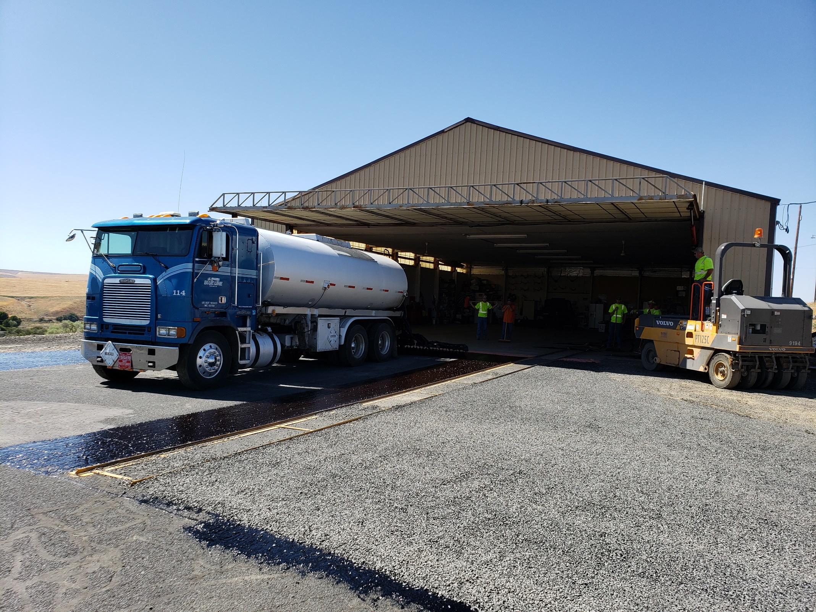

Slide 14
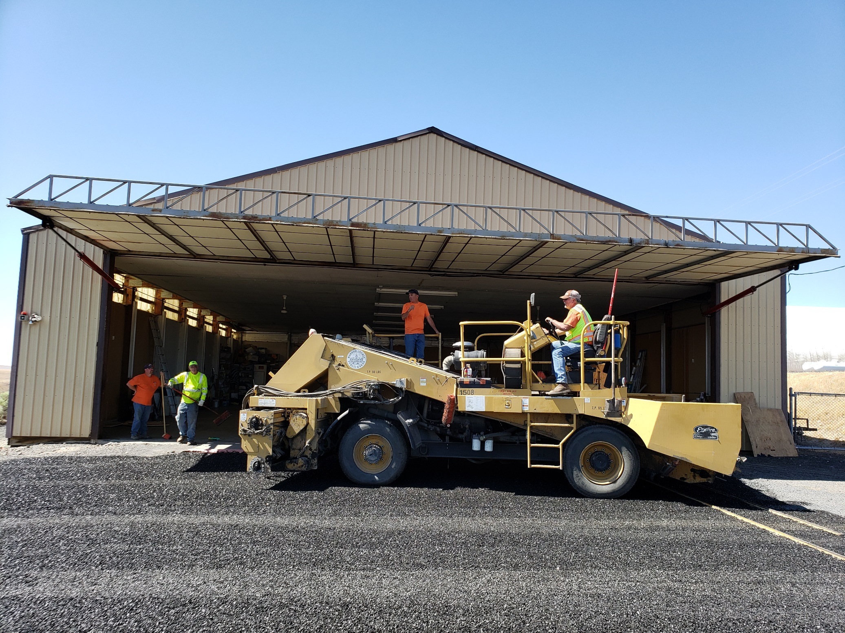

Slide 15
IN CLOSING
Faster Capabilities = more oil on the ground in a day
Faster pump turnaround = more oil on the ground in a day
Seamless Flagging = more oil on the ground in a day
Matching rock trucks to dist = more oil on the ground in a day
Maximum oil on the ground in a day = maximum project efficiency
7 DAYS AHEAD OF SCHEDULE & LOWER ROCK RATES SAVED AN ADDITIONAL $204,000 IN TOTAL PROJECT COSTS THIS YEAR
Eric Imes 541-256-0576

