Slide 1
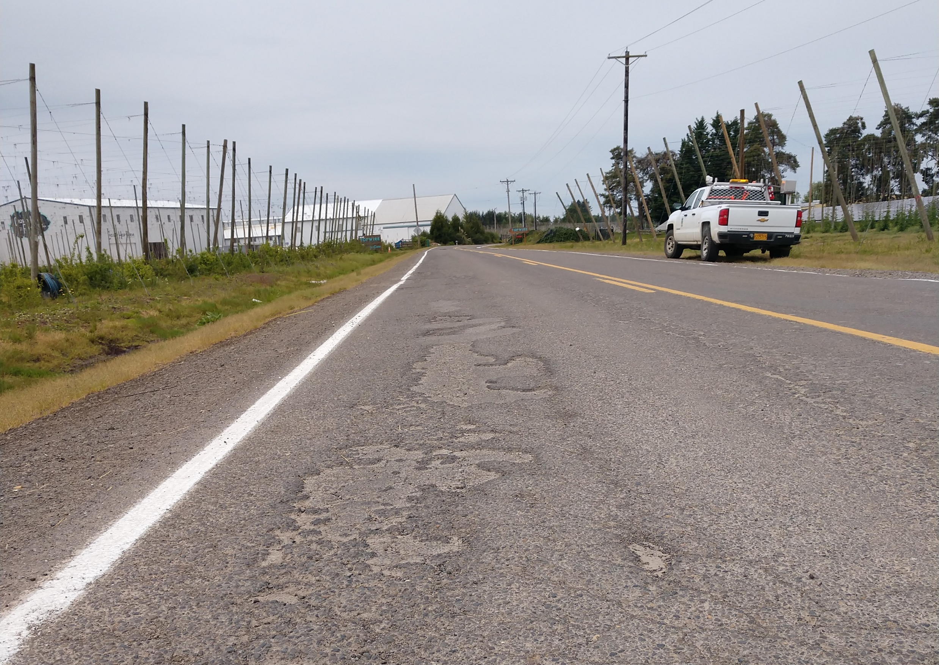
OACES Chipseal Workshop
March 21-22, 2023
Hood River OR
Crosby Rd NE – Scrub Seal
1.6-mile section of rural road located in an agricultural area with an ADT of 949 and PCI of 22.
In close proximity with another scheduled scrub seal project.
Numerous potholes, delaminated areas, and block cracking.
Opportunity to use the scrub seal as the 1st application of a double chip seal

Slide 2
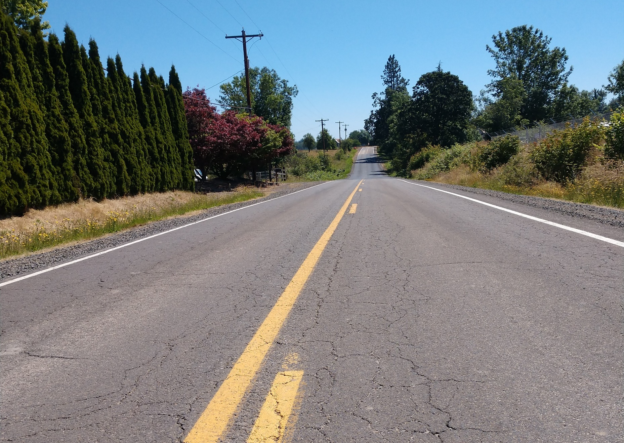
OACES Chipseal Workshop
March 21-22, 2023
Hood River OR
Overall cross section was in good condition with no base failures
Has not received any pavement treatments in over 20+ years.

Slide 3
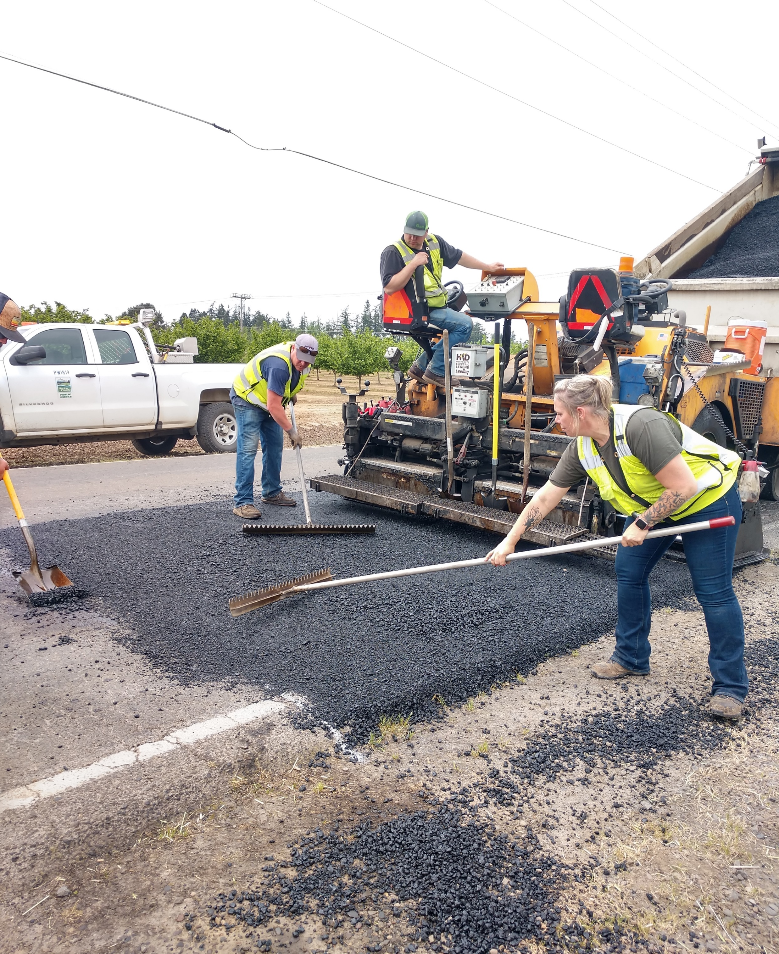
OACES Chipseal Workshop
March 21-22, 2023
Hood River OR
Prep work involved filling in the potholes and delaminated areas, a levelling course over the degradated areas, and intersections.

Slide 4
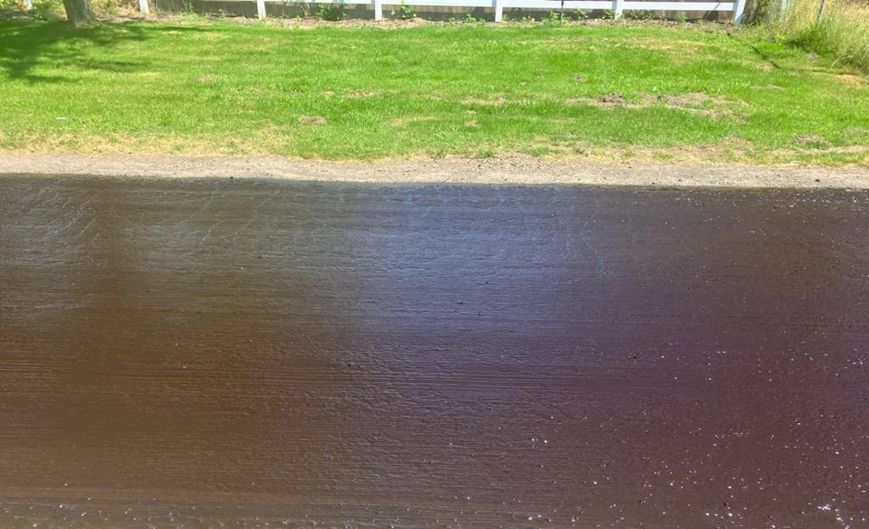
OACES Chipseal Workshop
March 21-22, 2023
Hood River OR
First shot of the double chipseal scrub seal using a polymer modified rejuvenating emulsion (PMRE) @ ~.38 gal/sq yd. and ½ ” – ¼” chip rock.

Slide 5
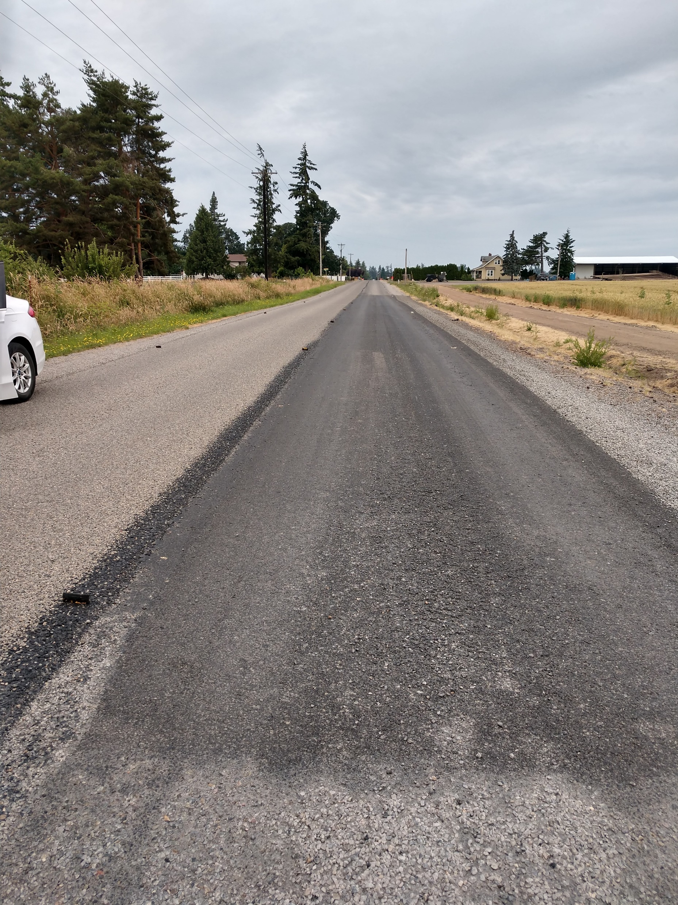
OACES Chipseal Workshop
March 21-22, 2023
Hood River OR
1st application scrub seal was shot between the asphalt patches
Applied the 2nd application of chipseal over the entire road using HFRS-P2 emulsion @ ~.48 gal/sq yd.
2nd application used 3/8” - #4 chip rock @ ~25 lbs/sq yd.

Slide 6
OACES Chipseal Workshop
March 21-22, 2023
Hood River OR
Applied final fog coat of HFRS-P1 (50% dilute)
The patched areas and scrub seal areas were measured and mapped to reference for future monitoring.
Final project resulted in an overall improvement with the rideability and a uniform surface wear course.
Questions?

