Slide 1
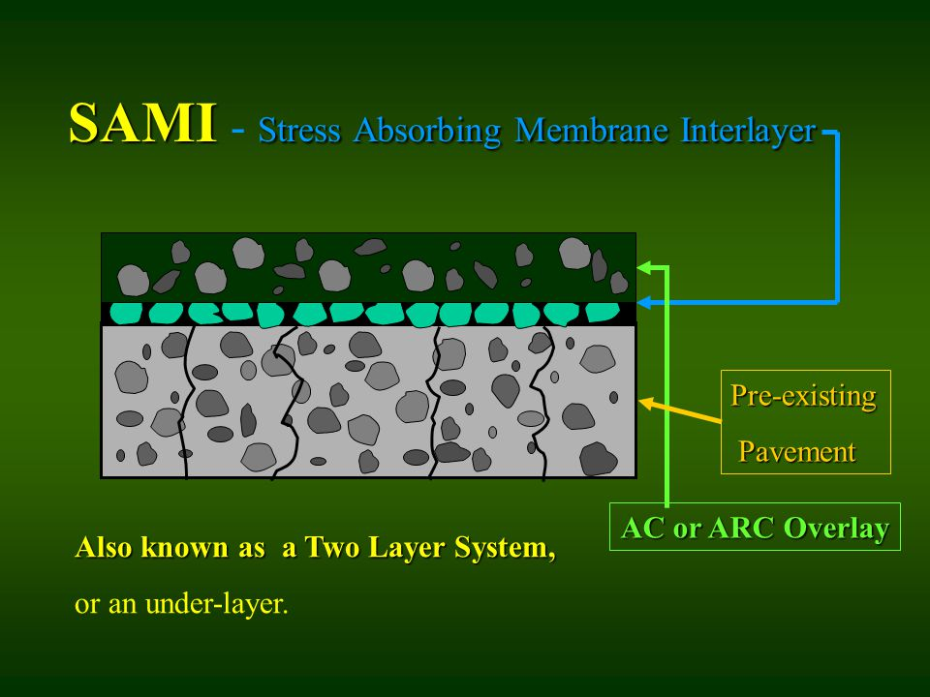
SAMI
Stress Absorbing Membrane Interlayer

Slide 2
2017 Helmick Rd Overlay
Todd Whitaker, PE
Polk County Public Works

Slide 3
History
Original Construction – 1928
- Cummins & LaPointe
Widening – 2007
- Knife River
North Overlay – 2012
- North Santiam Paving
- Level 3, ½” HMAC, 2” thickness
- w/o Crack Control
South Overlay – 2017
- Salem R&D
- Level 2, ½” HMAC, 3” thickness
- With Crack Control

Slide 4
2017 Overlay
Total Length = 4 miles
Crack Control Methods
Method 1 – Double Chip Seal
Method 2 – Paving Grid

Slide 5
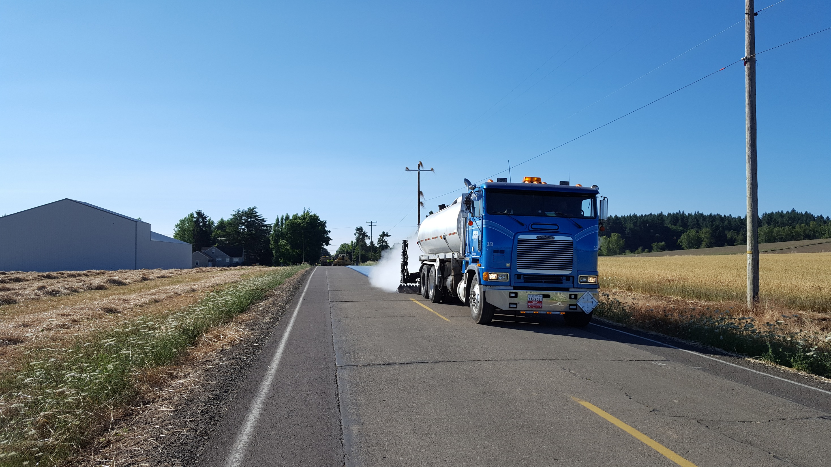

Slide 6
Double Chip Seal
Emulsion – Blue-Line CRS-3P @ 0.42 gal/SY
1st Layer:
Oil Shot – 0.42 gal/sy
Aggregate – 3/8”-#4 @ 26 lbs/SY
As-Built shows 20 lbs/SY
2nd Layer (1 week later):
Oil Shot – 0.42 gal/SY
Aggregate 3/8”-#4 @ 26 lbs
Cost: $4/SY
Total Area of treatment: 55,000 SY

Slide 7
Composite Paving Grid
- Mirafi PGM-G4
Cost: $7/SY installed
Total area of treatment: 750 SY total

Slide 8
Results and Conclusions
5 years later
- No observed cracking in southern section
- No difference between double chip and geogrid performance (yet)
- Polk County will continue monitoring
- Double chip seal shows promise as a crack control treatment

Slide 9
SAMI
OACES Chipseal Workshop
March 21-22, 2023
Hood River OR
Marion County
Arndt Road NE

Slide 10
Arndt RD NE -SAMI Treatment
OACES Chipseal Workshop
March 21-22, 2023
Hood River OR
1.3-mile segment located in northern Marion County. Completed July 2022
Collector in the northern region that connects Aurora area to St Paul Hwy with ADTs of 1,892
High maintenance section with regular pothole repairs and patching with a PCI of 14.
Pavement design recommended full depth reconstruction and a 6” HMA overlay.
Urgent need to repair due to increased traffic from the current ODOT I-5 Aurora/Donald Interchange Project.

Slide 11
OACES Chipseal Workshop
March 21-22, 2023
Hood River OR
Preliminary prep work involved filling in potholes and delaminated areas

Slide 12
OACES Chipseal Workshop
March 21-22, 2023
Hood River OR
Applied levelling courses over the patches

Slide 13
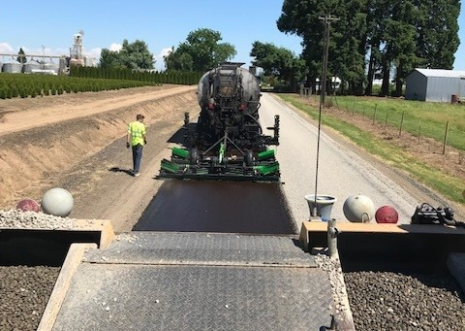
OACES Chipseal Workshop
March 21-22, 2023
Hood River OR
Single shot scrub seal (Sierra Santa Fe) using a polymer modified rejuvenating emulsion (PMRE)
Shot rate = ~.38 gal/sq yd.

Slide 14
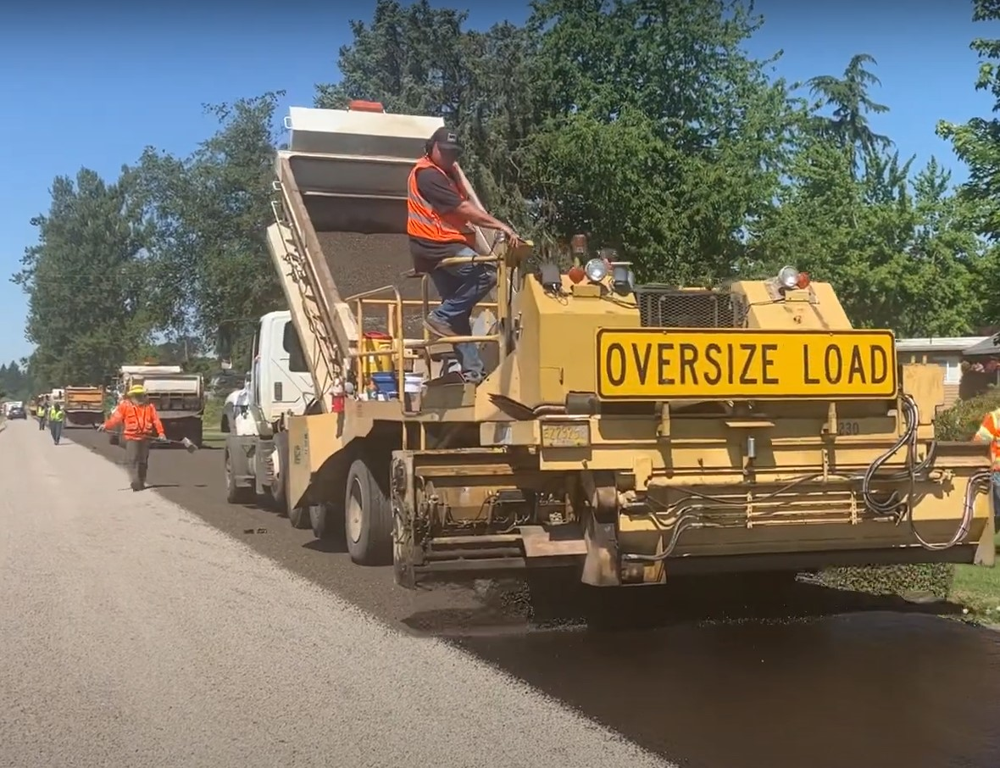
OACES Chipseal Workshop
March 21-22, 2023
Hood River OR
Applied a single layer of 3/8”- #4 chip over the scrub seal
@ ~ 25 lbs/sq yd

Slide 15
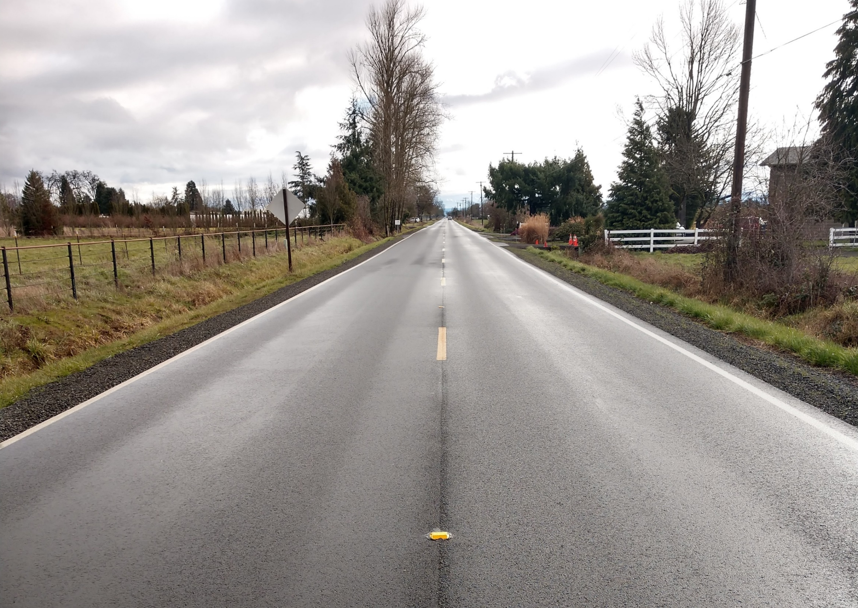
OACES Chipseal Workshop
March 21-22, 2023
Hood River OR
Followed up with two lifts of 1” & 2” AC overlay.
QUESTIONS?

Slide 16
SAMI
Stress Absorbing Membrane Interlayer
Five Rivers Road Overlay Project
10.5 mile long project; $4.5 million
Located in Lincoln County; 25 miles east of Waldport
Managed by theFederal Highway Administration
Contract awarded to Brix Paving Northwest, Inc.
Diamond Grind existing HMAC road surface for profile and crack seal material removal.
Scrub seal performed by Sierra Santa Fe as subcontractor.
Two inch asphalt concrete overlay placed by prime contractor.

