Slide 1
Surface treatment toolbox
in Linn County, OR
Kevin Hamilton
Operations Manager
(541) 967-3919 Office
(541) 740-1787 Cell
khamilton@co.linn.or.us
Jeff Maskal
Special Operations Group Foreman
jeff.maskal@co.linn.or.us
Mike Brant
Fleet Maintenance Leadworker
mike.brant@co.linn.or.us
Project Design & Execution
Inter-Agency Cooperation
Communication
Contract Work
Paved Intersections
Prep Work
Fog Seals
When Things Go Wrong

Slide 2
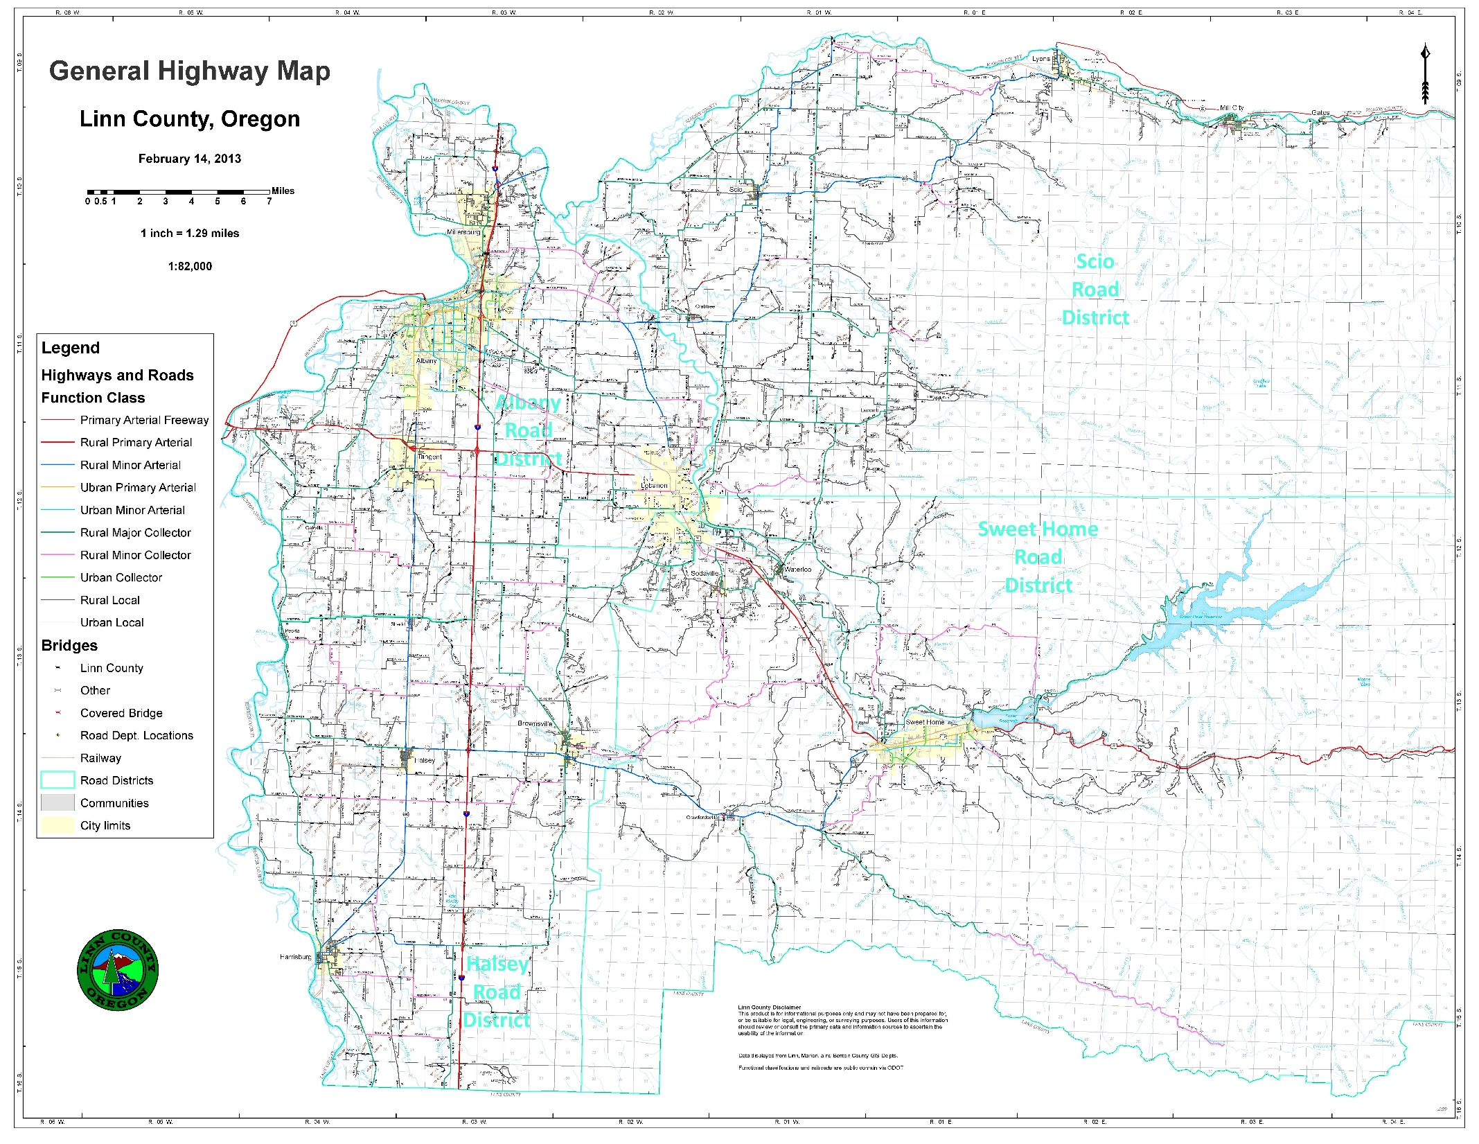
LINN COUNTY
LYONS
MILL CITY
SCIO
Approx. 1,139 total miles
Approx. 98 gravel miles
Four Maintenance Districts dividing the County into quadrants
Hilly landscapes eastern half. Flat landscapes western.
Heavy loads are mostly from logging, and hay & seed.
ALBANY
LEBANON
TANGENT
HALSEY
BROWNSVILLE
SWEET HOME
HARRISBURG

Slide 3
Project design & execution
Lay out the work to minimize mobilization between projects. Don’t jump back and forth.
Have a “Shake-out Day” to test the equipment and train new people. Do this well before your project start day is scheduled.
Have a Pre-Construction meeting with the whole crew before the project starts
Plan & Order Ahead – know your quantities and schedules. Communicate with your vendor.
Have project sections laid out in advance
Have a T.C.S. (or 2 or 3) on site. This should not be the project coordinator
Have flaggers already set up at the next section
Have a project coordinator on site. Inspect work, troubleshoot problems, ensure communication.
Shoot with two distributors
Have enough rollers, and keep them moving
Trucks are part of the rolling operations: “Split” their tracks
Have enough trucks and equipment, flaggers, operators, etc. Contact your neighbors.

Slide 4
Surface treatment toolbox
in Linn County, OR
Kevin Hamilton
Operations Manager
(541) 967-3919 Office
(541) 740-1787 Cell
khamilton@co.linn.or.us
Jeff Maskal
Special Operations Group Foreman
jeff.maskal@co.linn.or.us
Mike Brant
Fleet Maintenance Leadworker
mike.brant@co.linn.or.us
Project Design & Execution
Inter-Agency Cooperation
Communication
Contract Work
Paved Intersections
Prep Work
Fog Seals
When Things Go Wrong

Slide 5
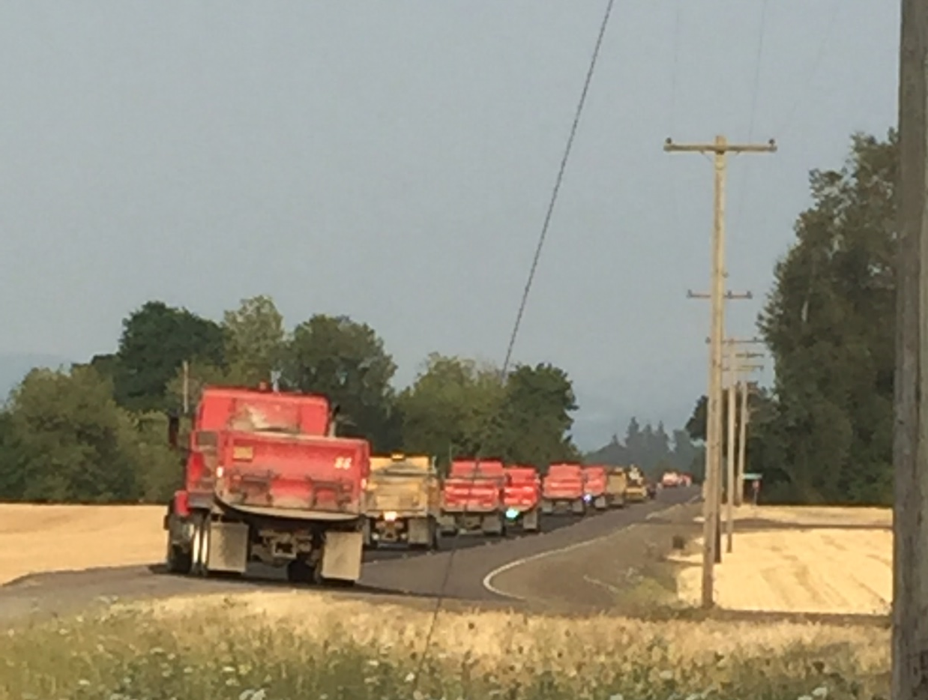
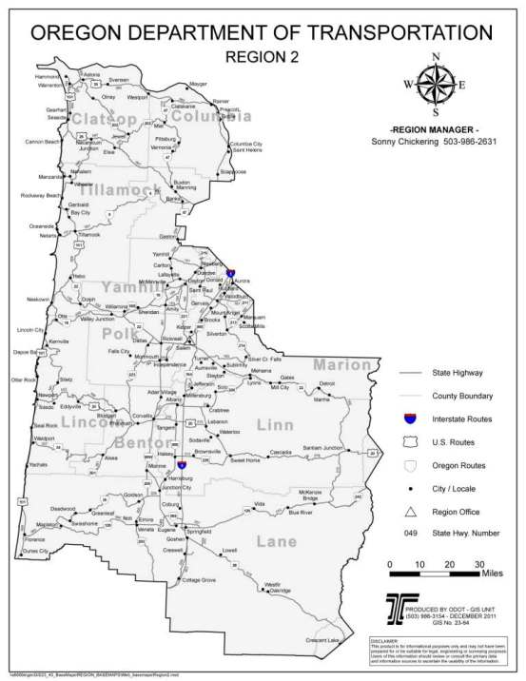
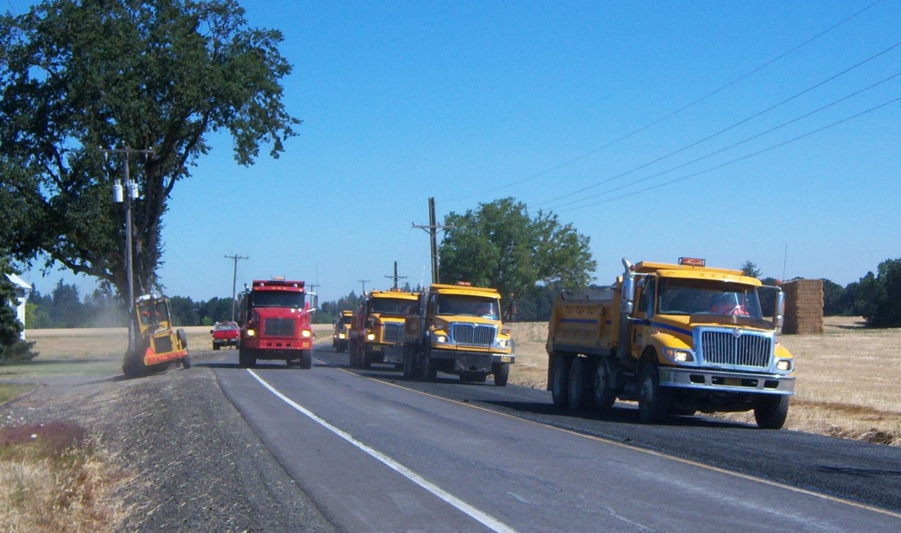
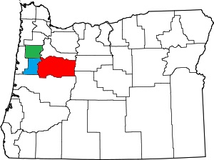
Inter-Agency Cooperation

Slide 6
Inter-Agency Cooperation

Slide 7
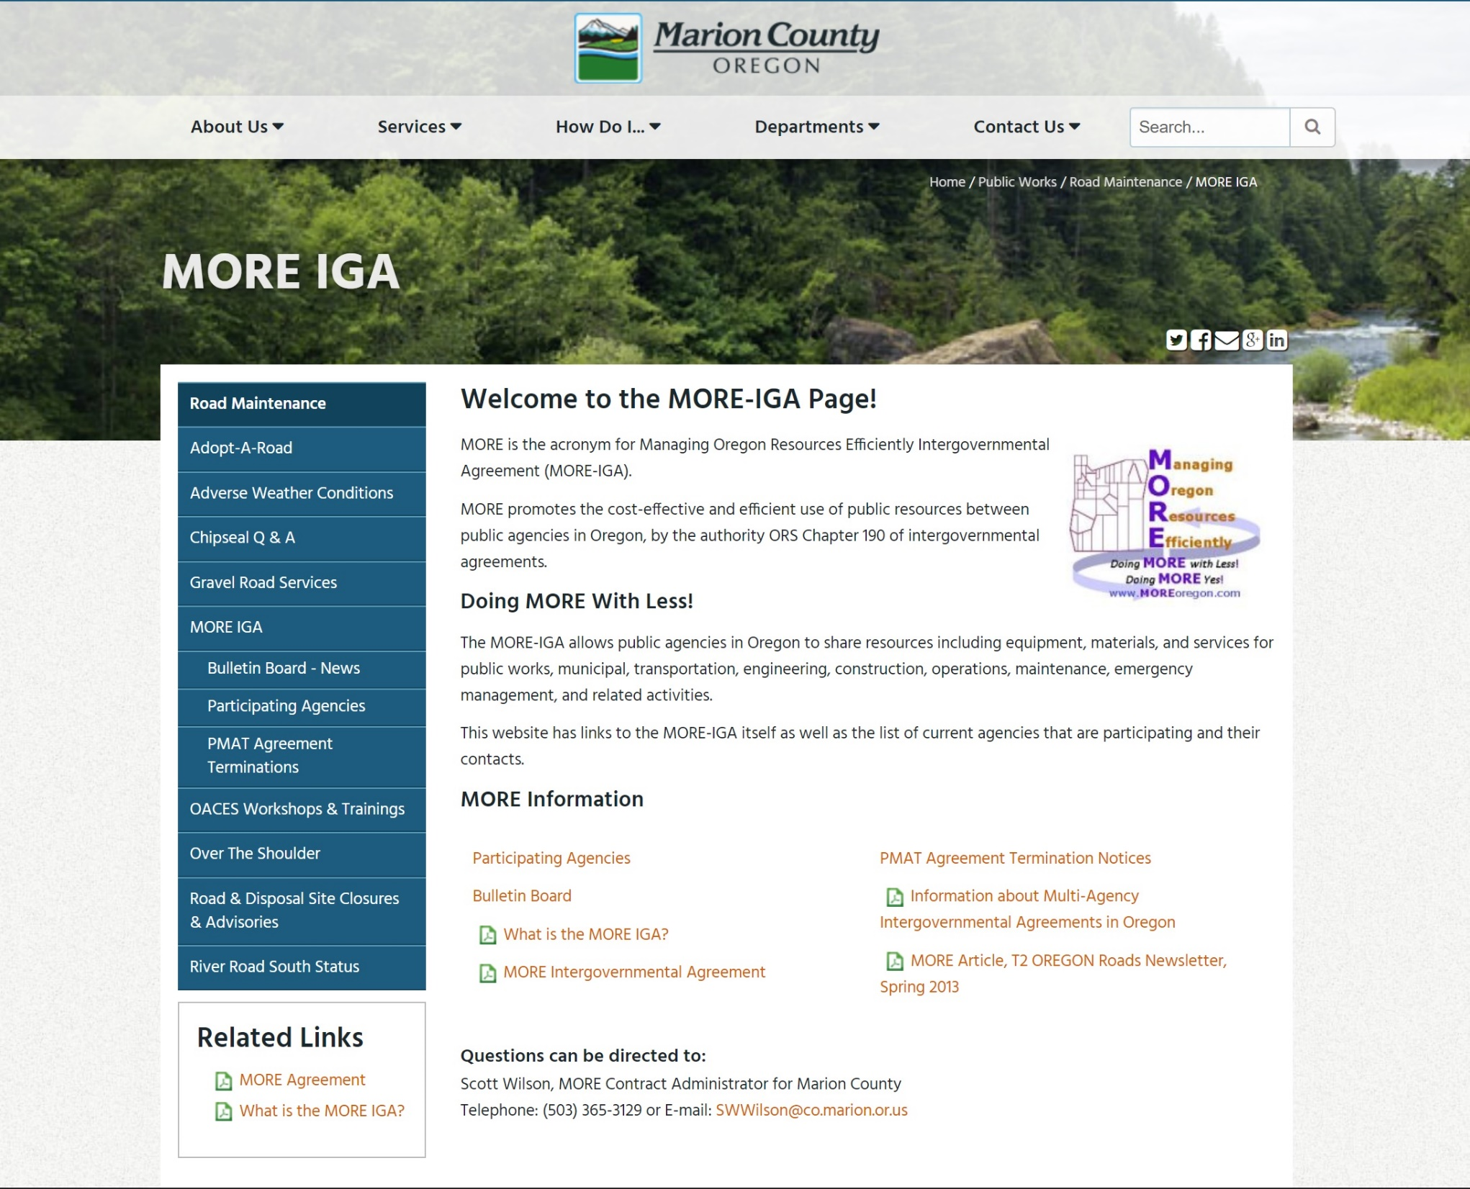
Inter-Agency Cooperation

Slide 8
Surface treatment toolbox
in Linn County, OR
Kevin Hamilton
Operations Manager
(541) 967-3919 Office
(541) 740-1787 Cell
khamilton@co.linn.or.us
Jeff Maskal
Special Operations Group Foreman
jeff.maskal@co.linn.or.us
Mike Brant
Fleet Maintenance Leadworker
mike.brant@co.linn.or.us
Inter-Agency Cooperation
Communication
Contract Work
Paved Intersections
Prep Work
Fog Seals
When Things Go Wrong

Slide 9
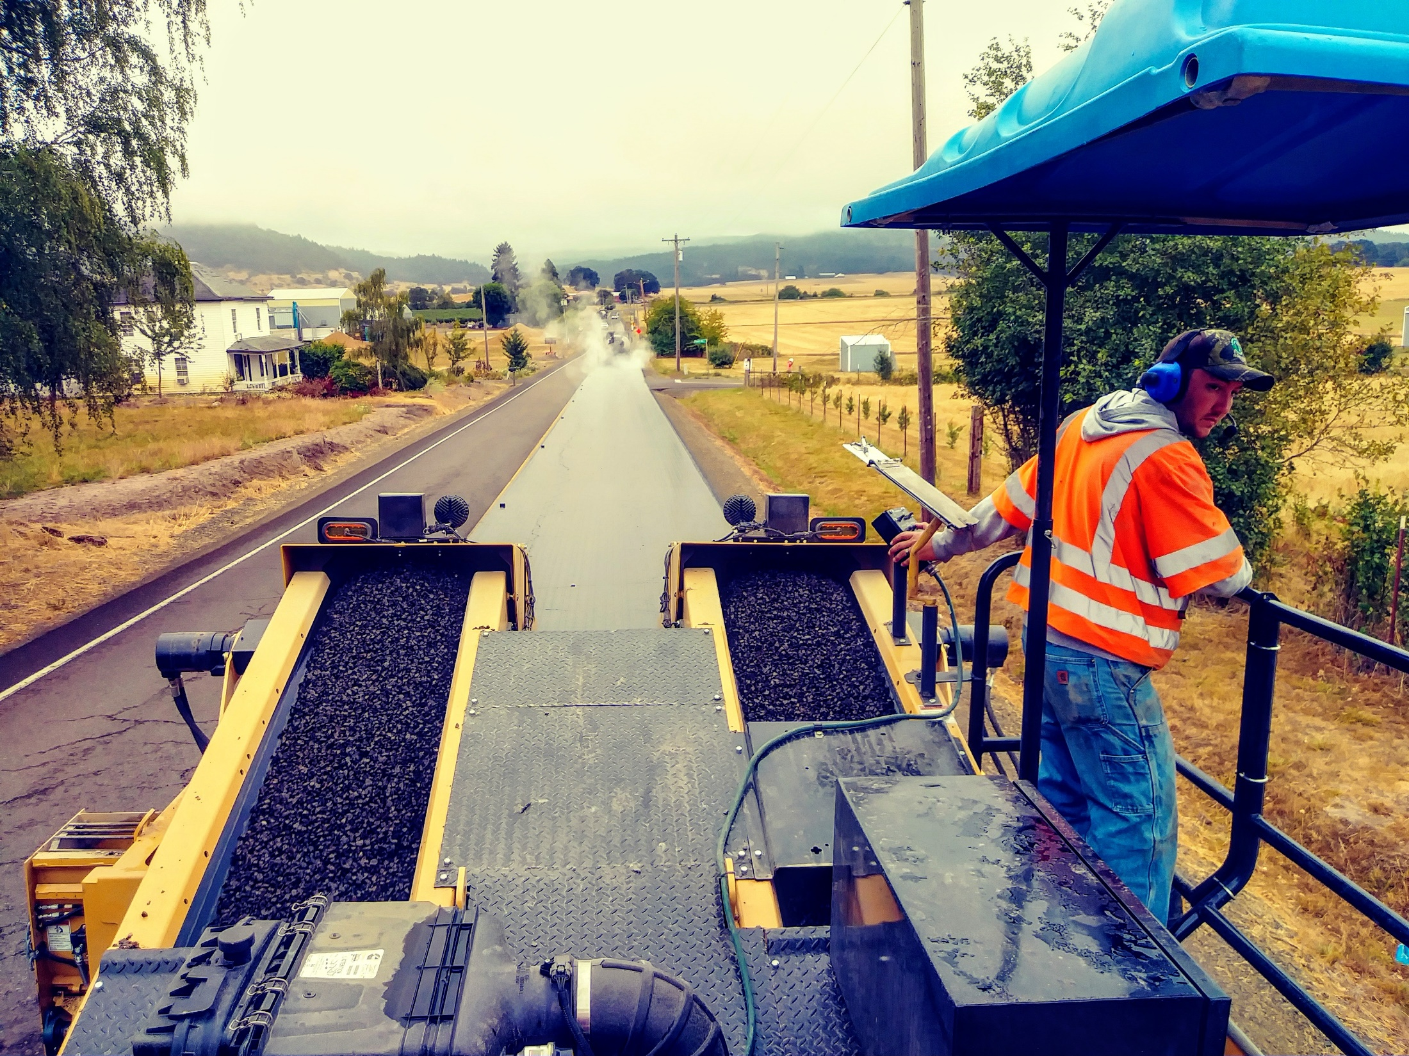
COMMUNICATION

Slide 10
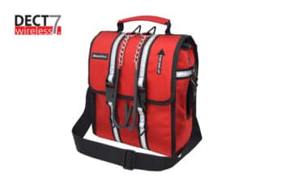
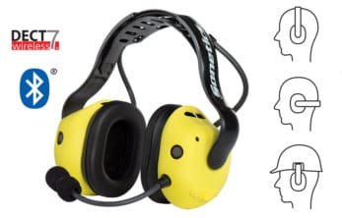
COMMUNICATION

Slide 11
COMMUNICATION
Hearing Protection

Slide 12
COMMUNICATION
Hearing Protection
Open Microphone
Efficiency of Operations

Slide 13
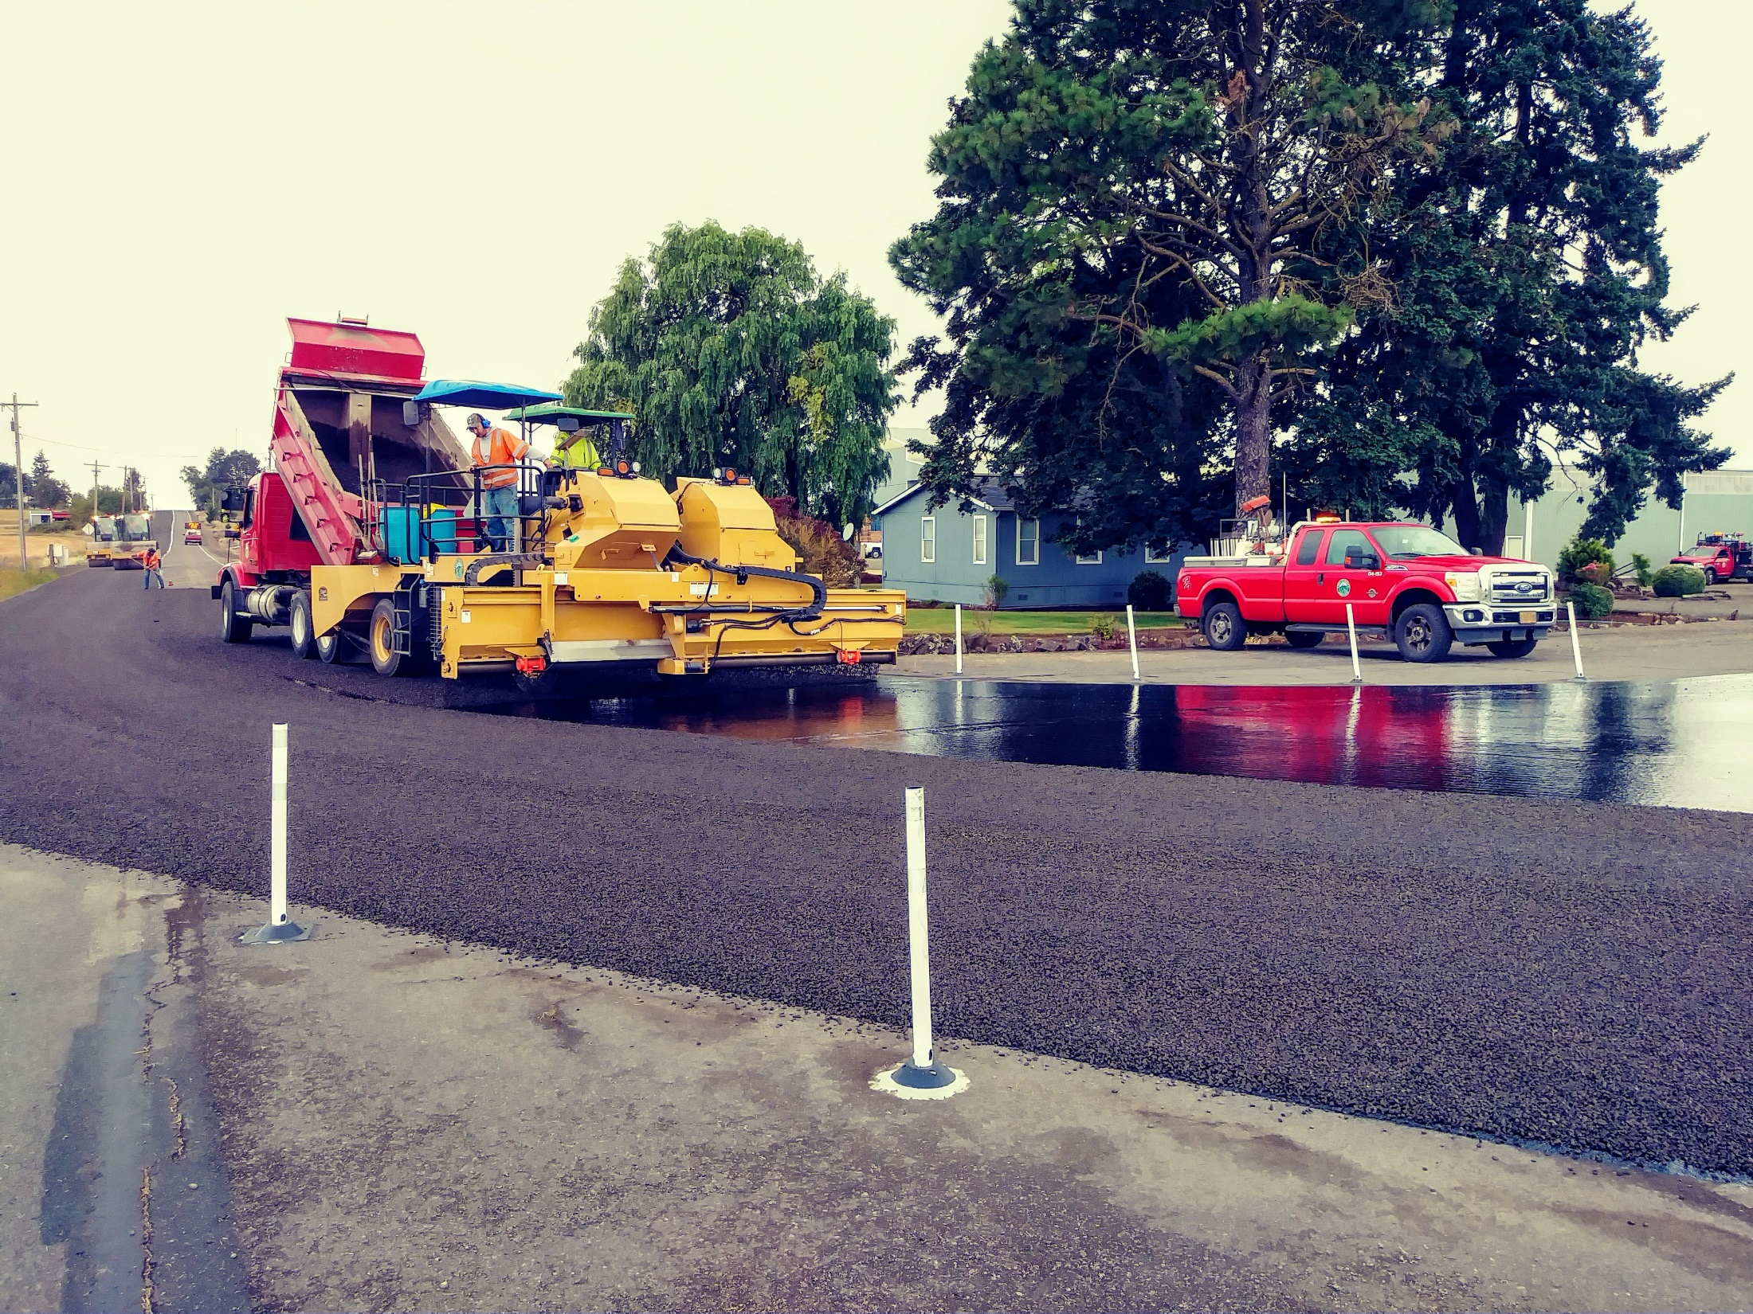
COMMUNICATION
Hearing Protection
Open Microphone
Efficiency of Operations
Safety

Slide 14
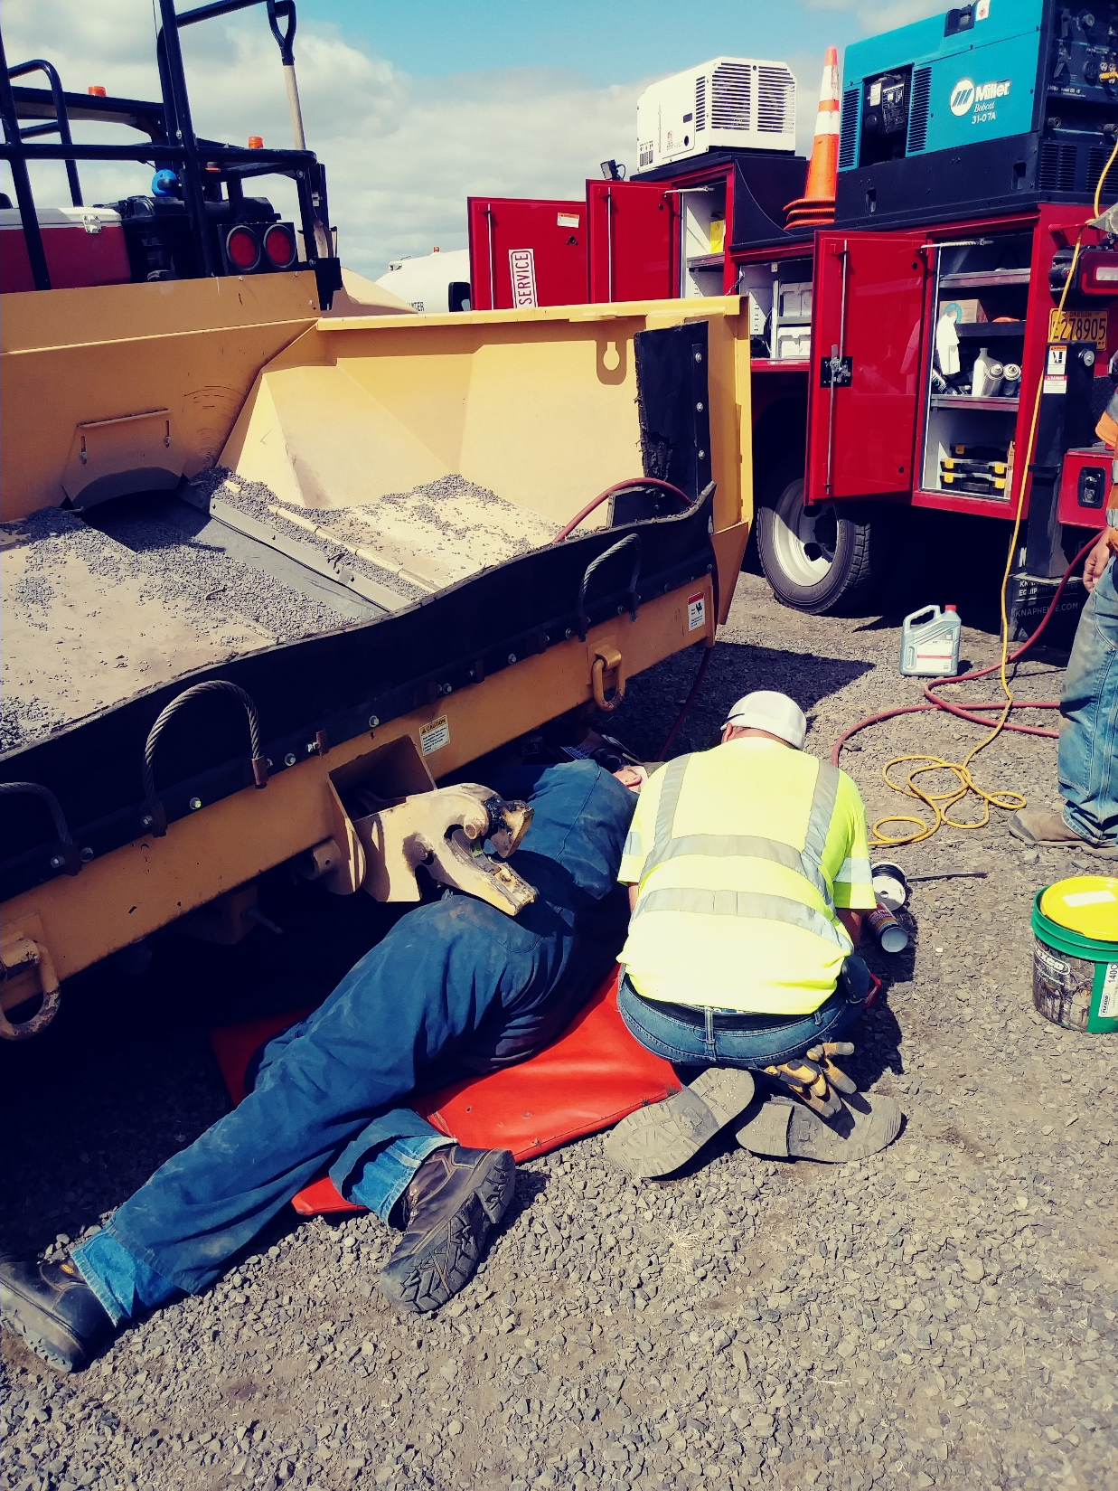
COMMUNICATION
Hearing Protection
Open Microphone
Efficiency of Operations
Safety
Listen-Through Capability

Slide 15
Surface treatment toolbox
in Linn County, OR
Kevin Hamilton
Operations Manager
(541) 967-3919 Office
(541) 740-1787 Cell
khamilton@co.linn.or.us
Jeff Maskal
Special Operations Group Foreman
jeff.maskal@co.linn.or.us
Mike Brant
Fleet Maintenance Leadworker
mike.brant@co.linn.or.us
Inter-Agency Cooperation
Communication
Contract Work
Paved Intersections
Prep Work
Fog Seals
When Things Go Wrong

Slide 16
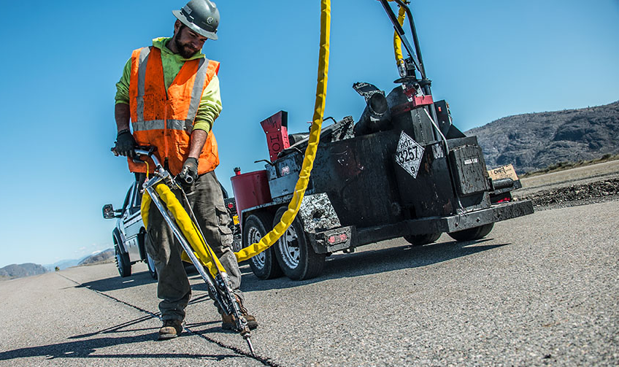
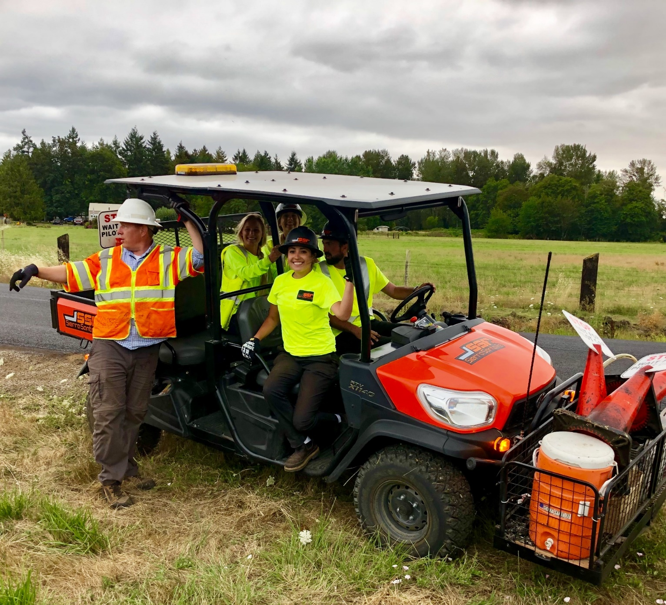
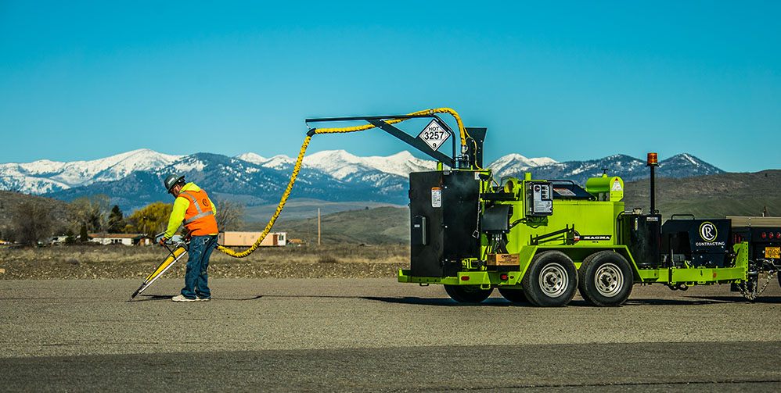
contractors
Fog Sealing
Crack Sealing
Slurry Seals / Microsurface / MicroCoat

Slide 17
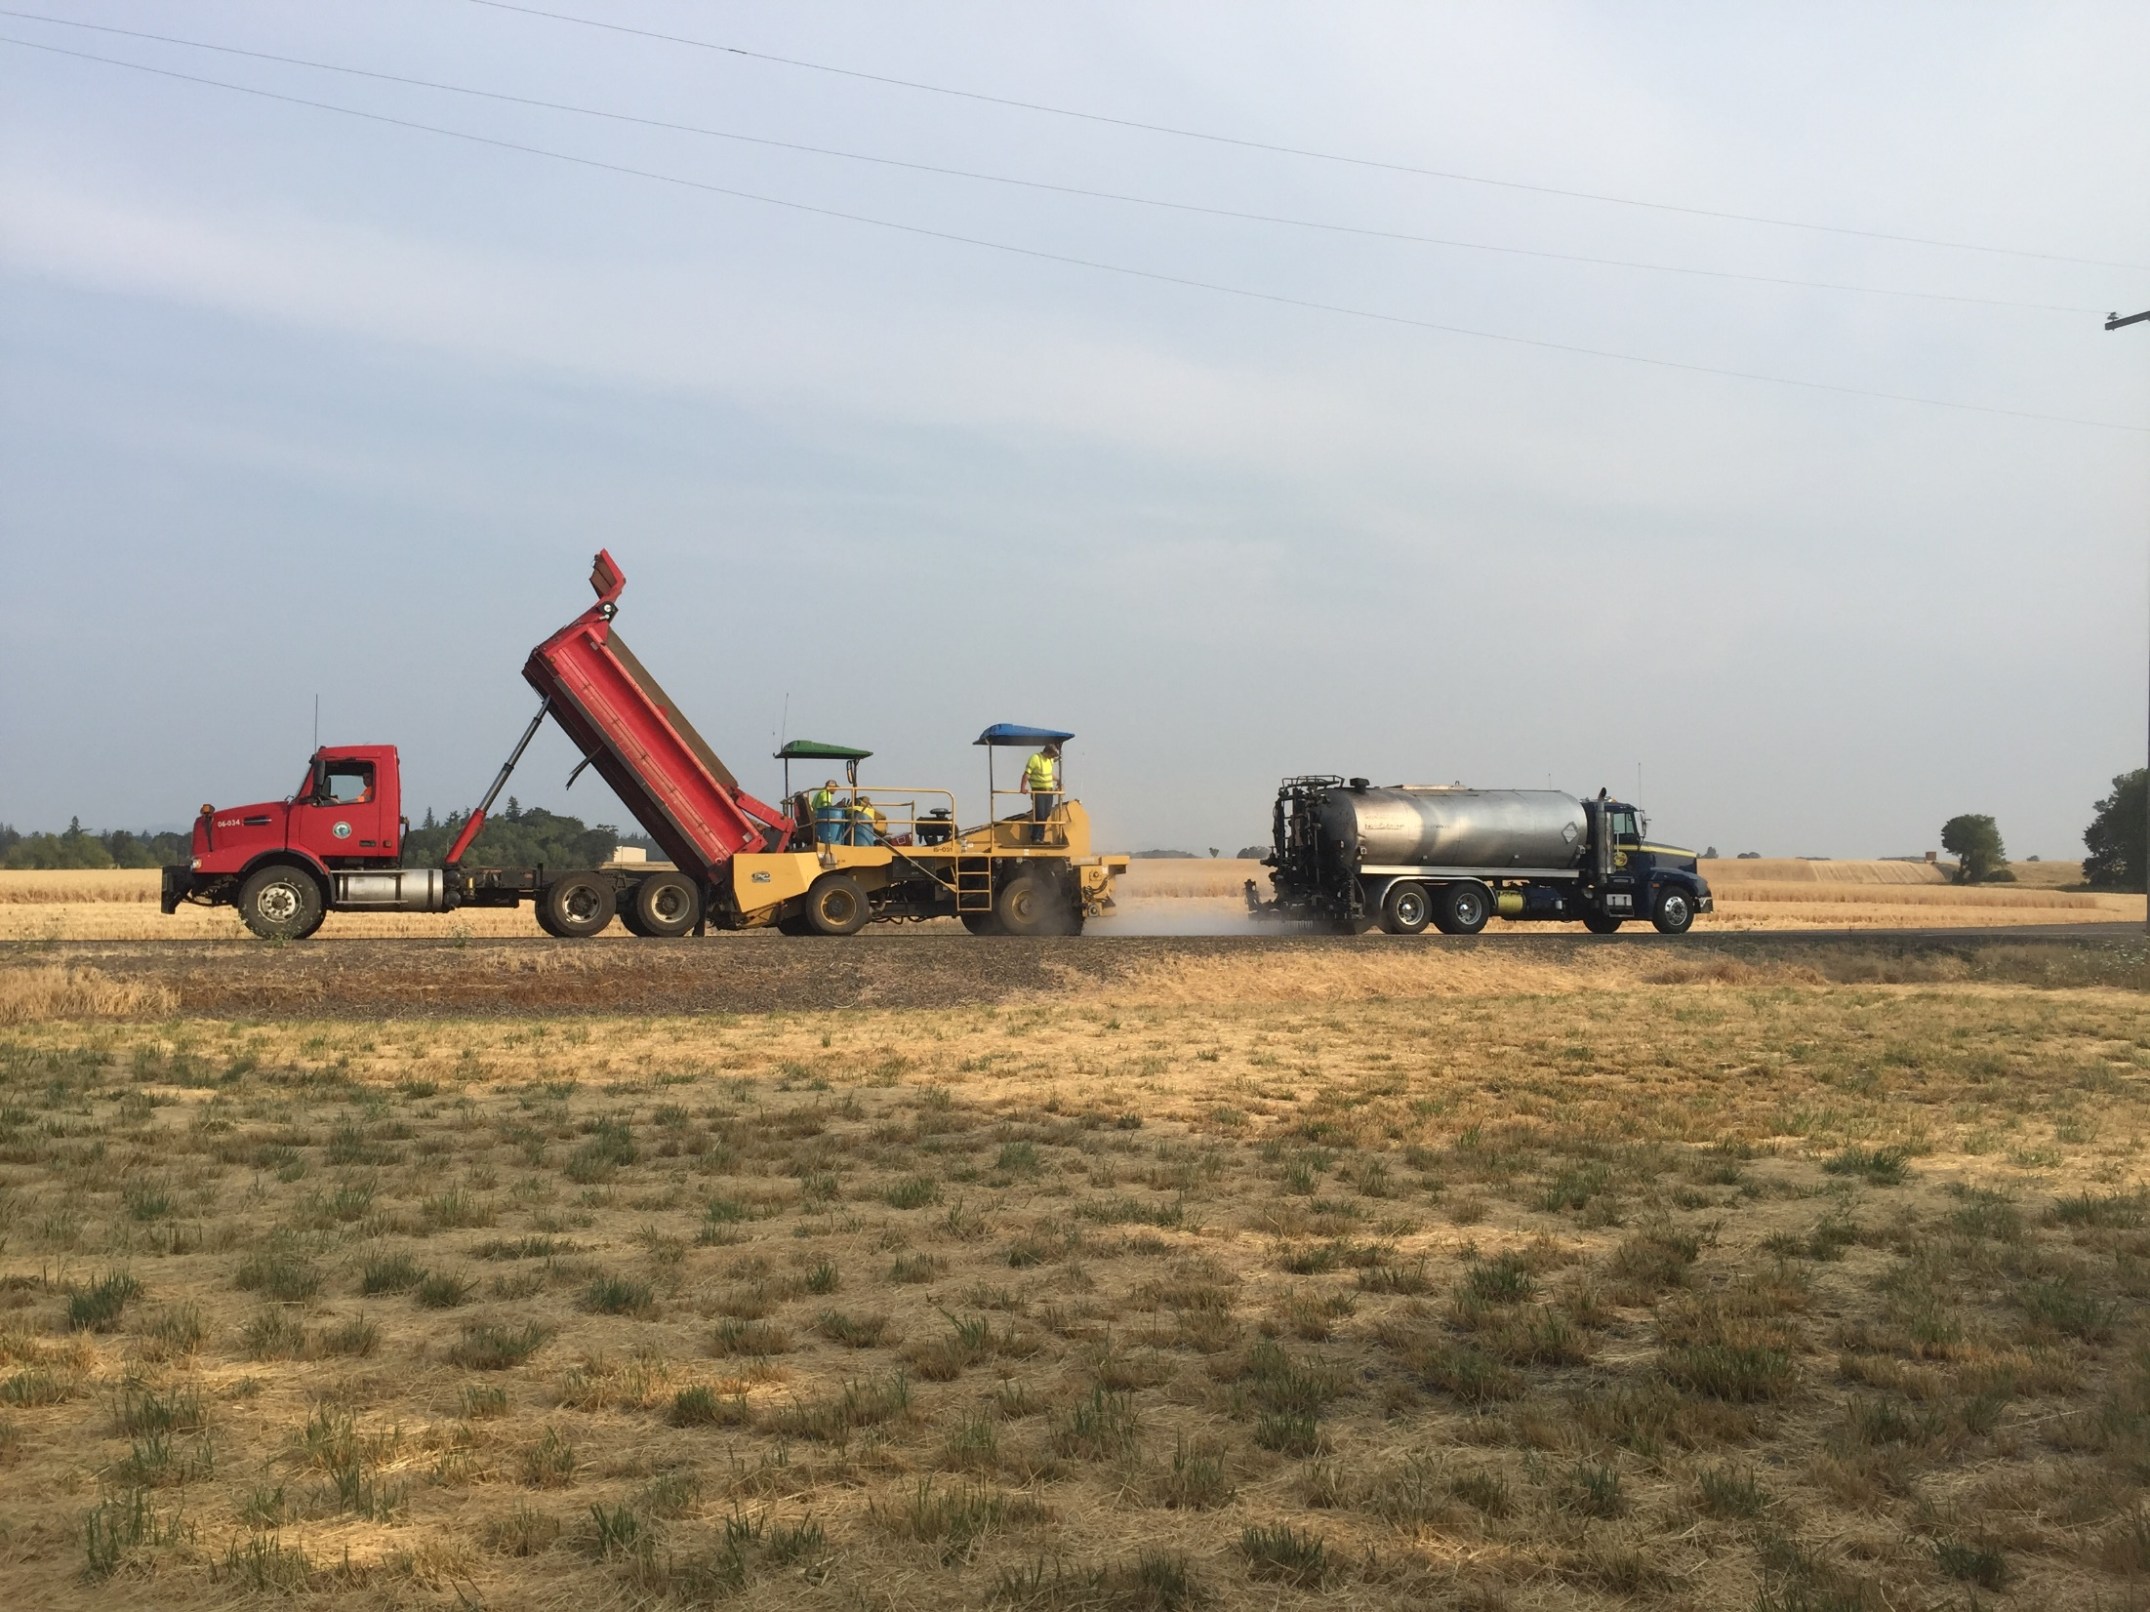
contractors
Day 1
Chip Seal by County

Slide 18
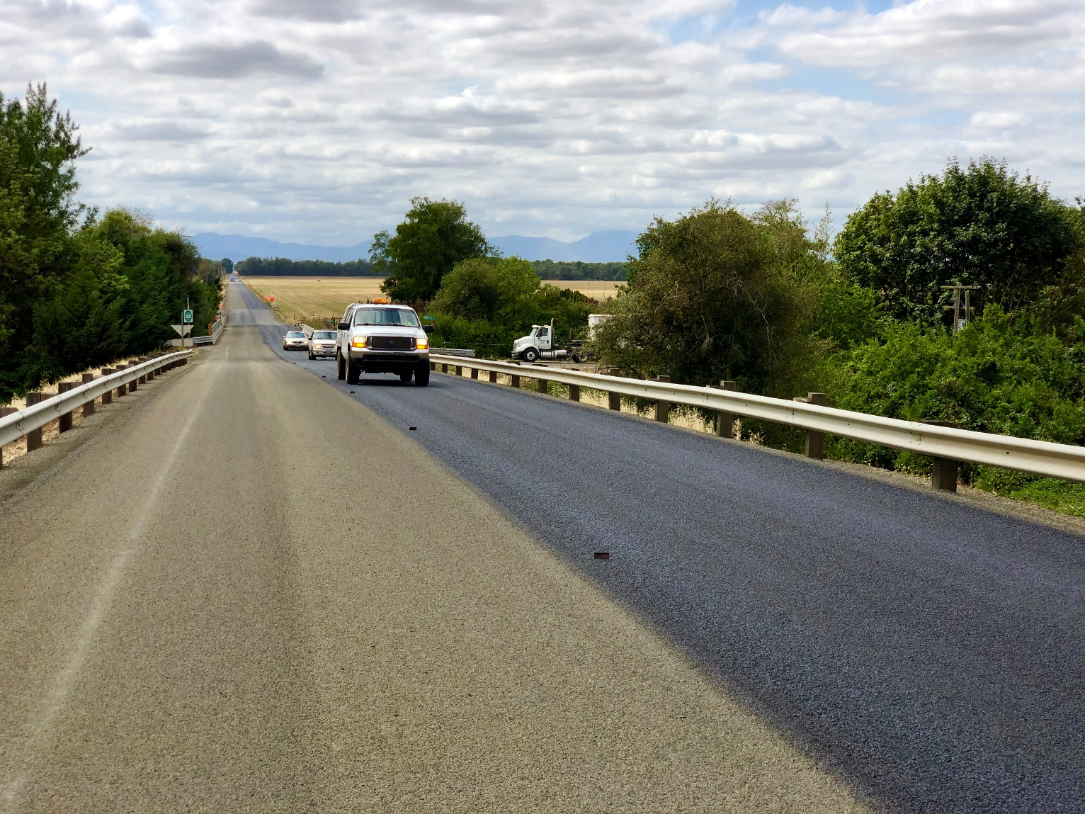
contractors
Day 2
Sweep & Fog Seal by Contractor

Slide 19
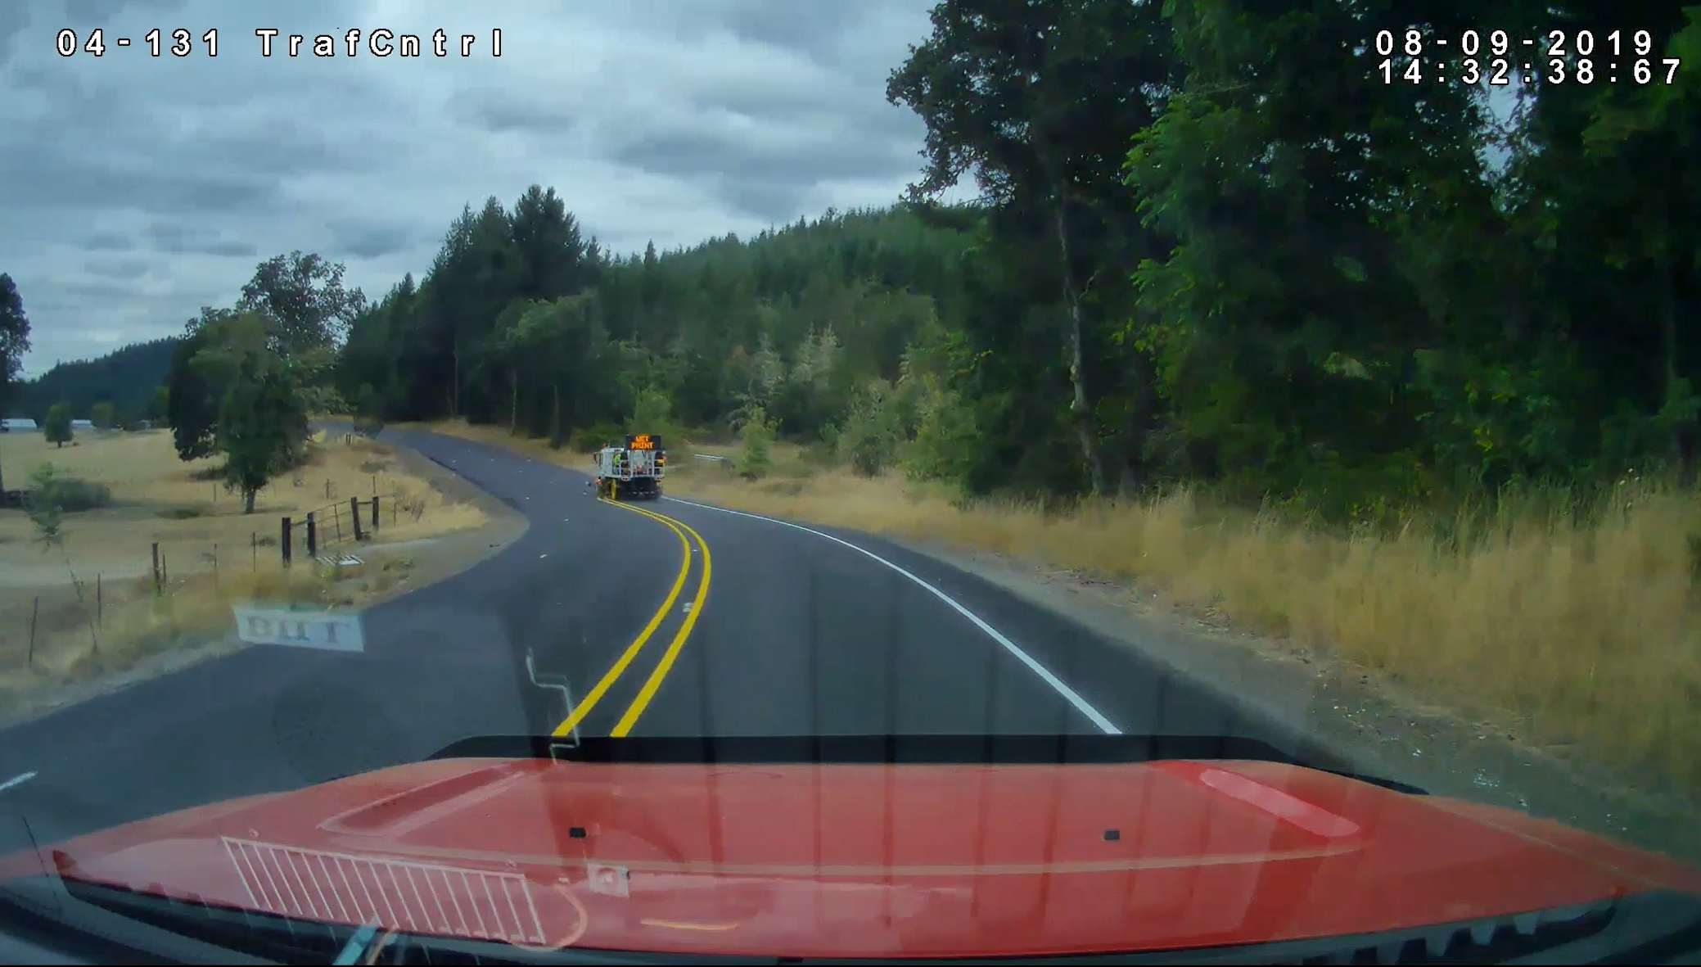
contractors
Day 3
Stripe by County

Slide 20
Surface treatment toolbox
in Linn County, OR
Kevin Hamilton
Operations Manager
(541) 967-3919 Office
(541) 740-1787 Cell
khamilton@co.linn.or.us
Jeff Maskal
Special Operations Group Foreman
jeff.maskal@co.linn.or.us
Mike Brant
Fleet Maintenance Leadworker
mike.brant@co.linn.or.us
Inter-Agency Cooperation
Communication
Contract Work
Paved Intersections
Prep Work
Fog Seals
When Things Go Wrong

Slide 21
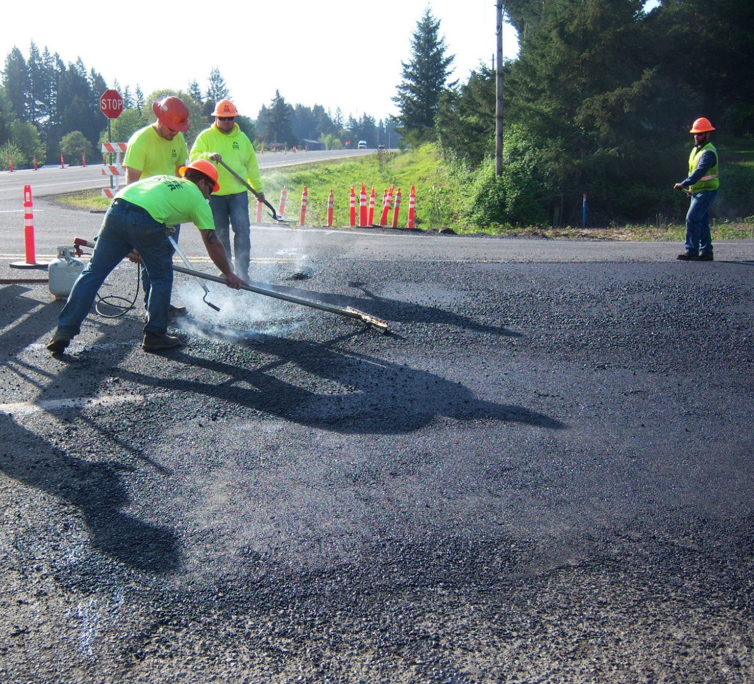
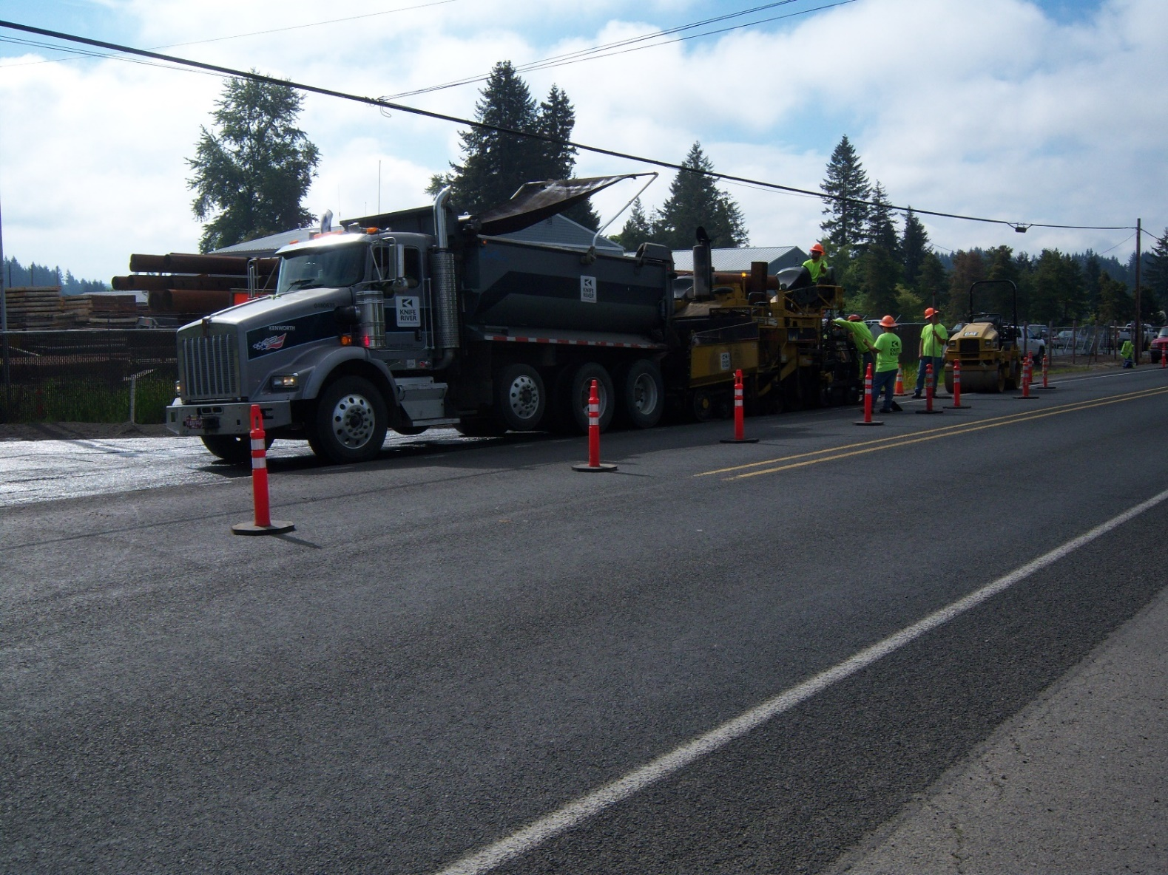
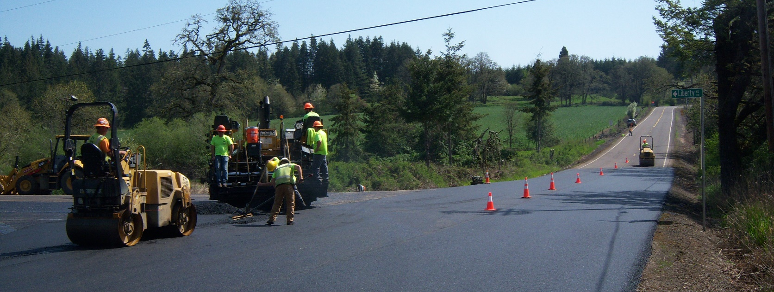
Paved intersections
Knox Butte Rd.

Slide 22
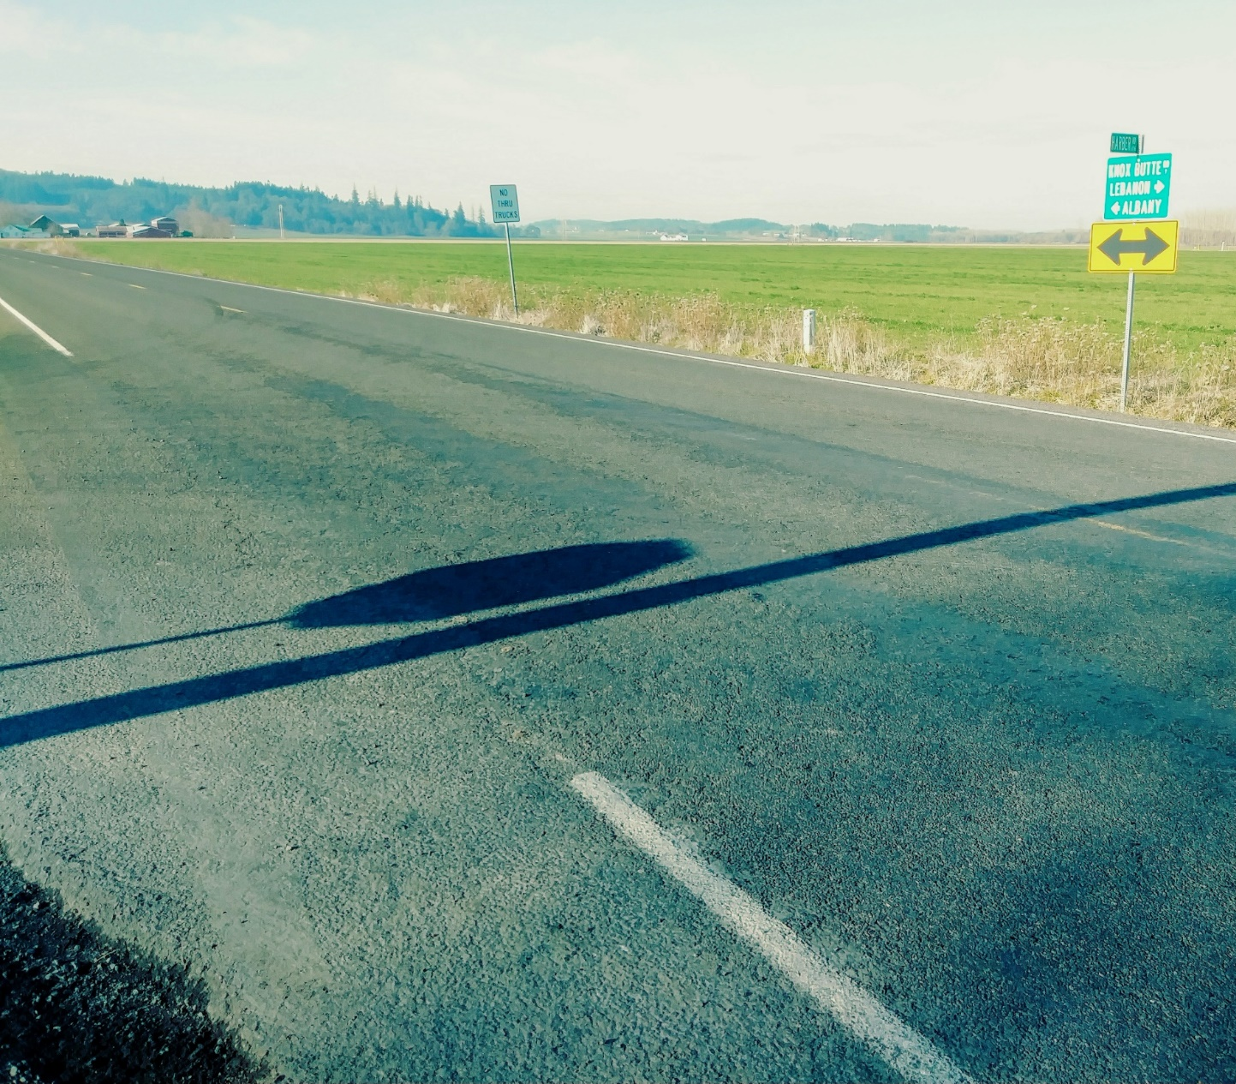
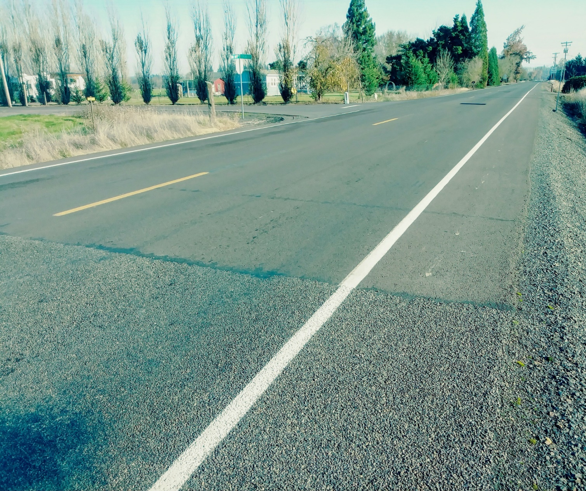
Paved intersections
Knox Butte Rd.
Harbor Rd.
Intersection
Lickskillet Rd.
Intersection

Slide 23
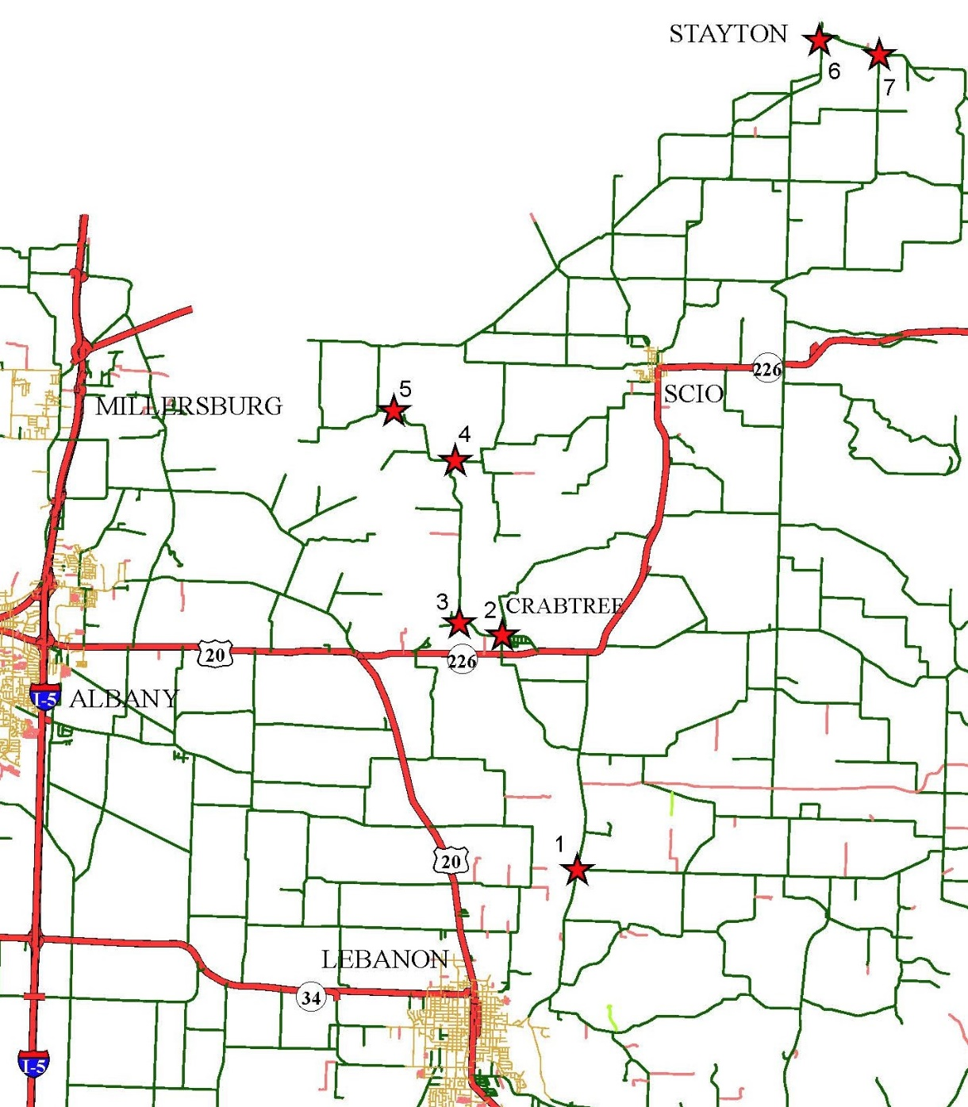
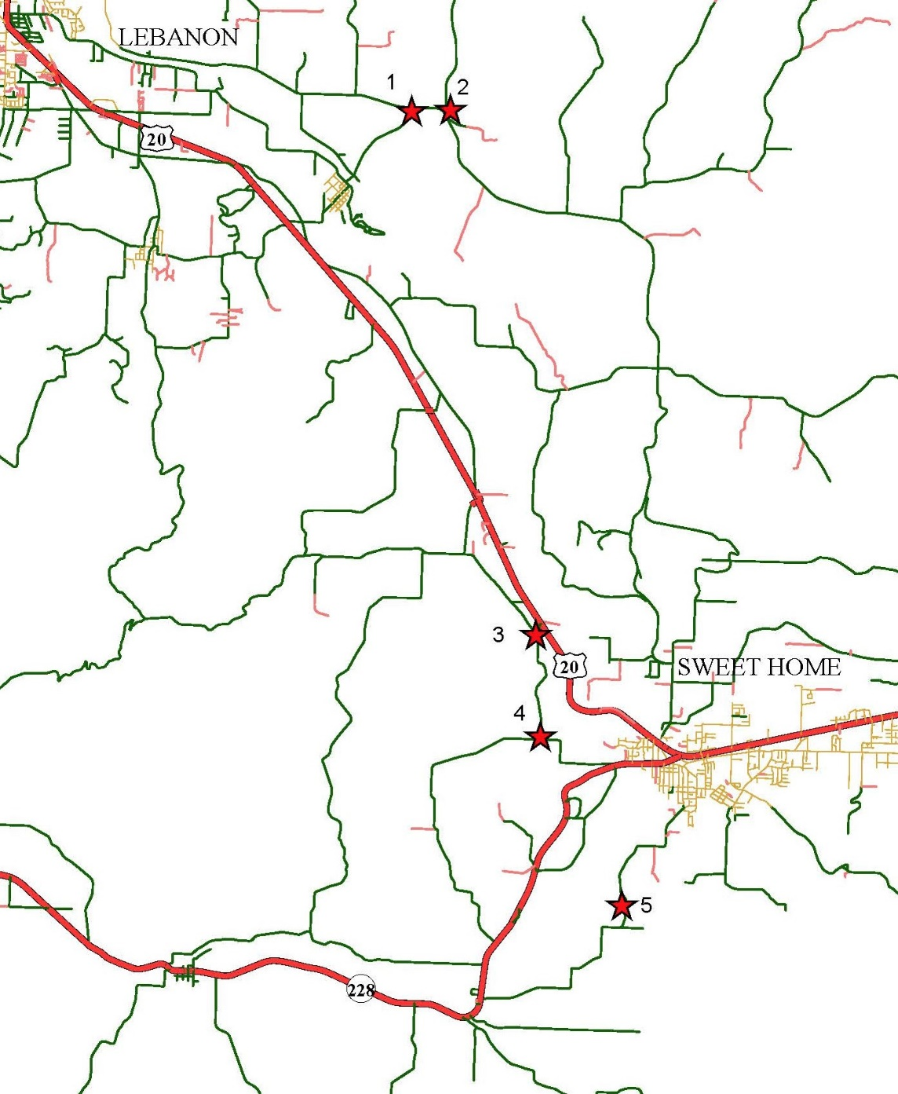
Paved intersections
Typical Contract
Scio District
Typical Contract
Sweet Home District

Slide 24
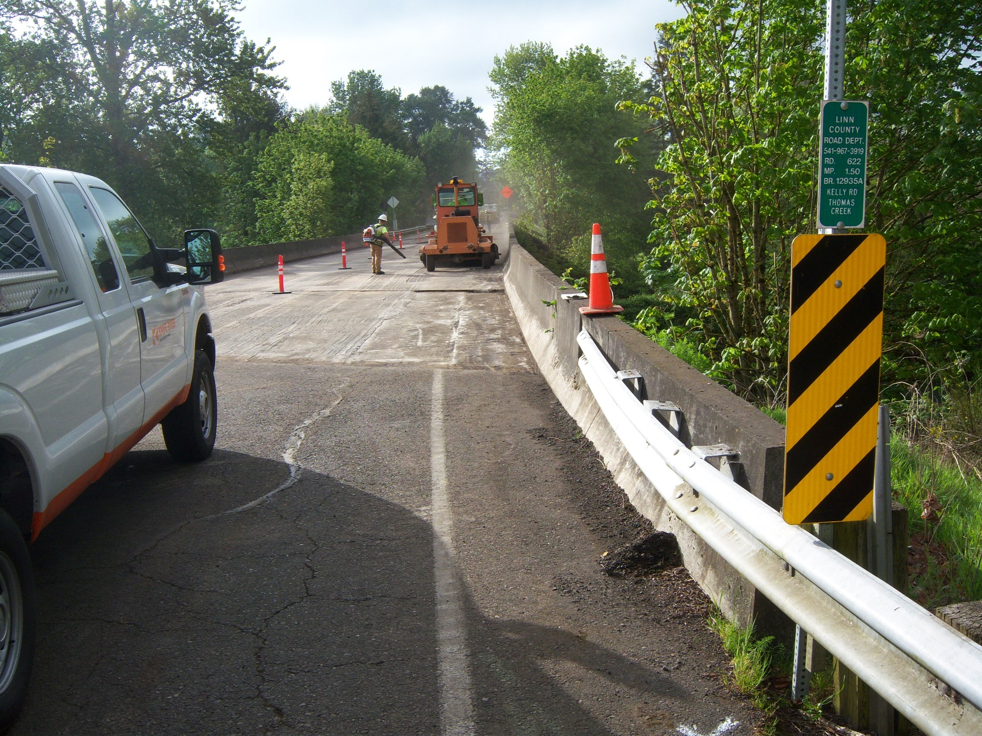
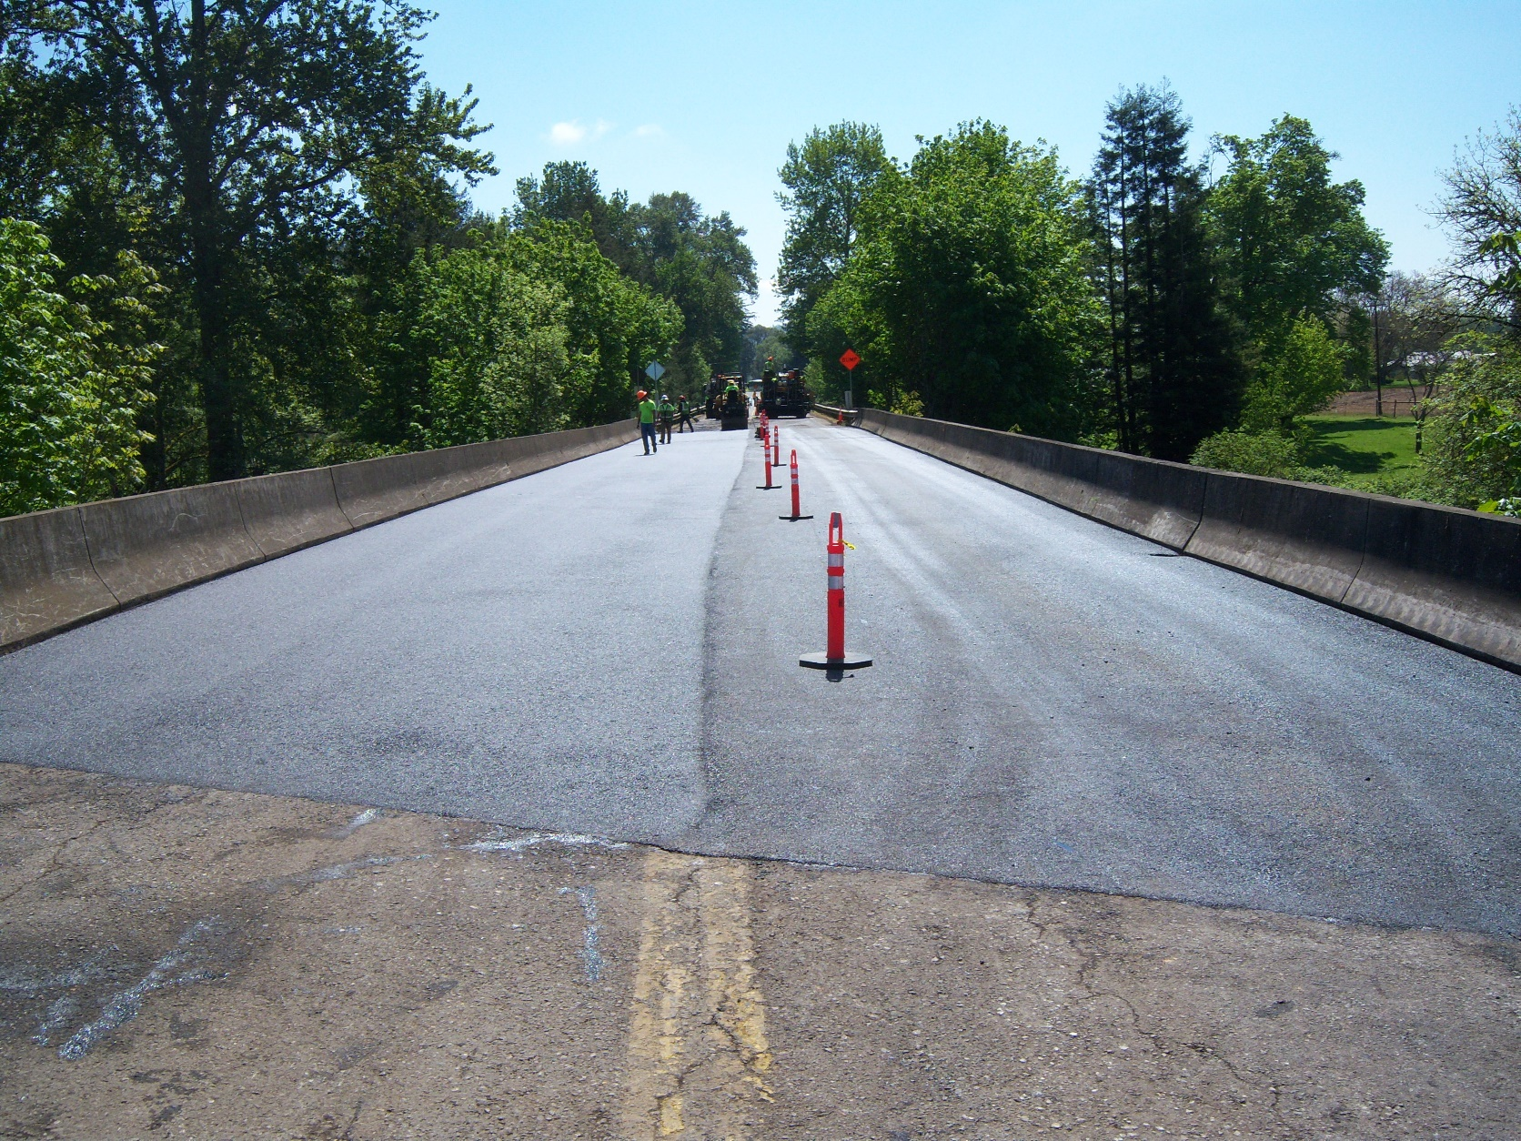
Paved intersections
Add in other work
Devaney Bridge

Slide 25
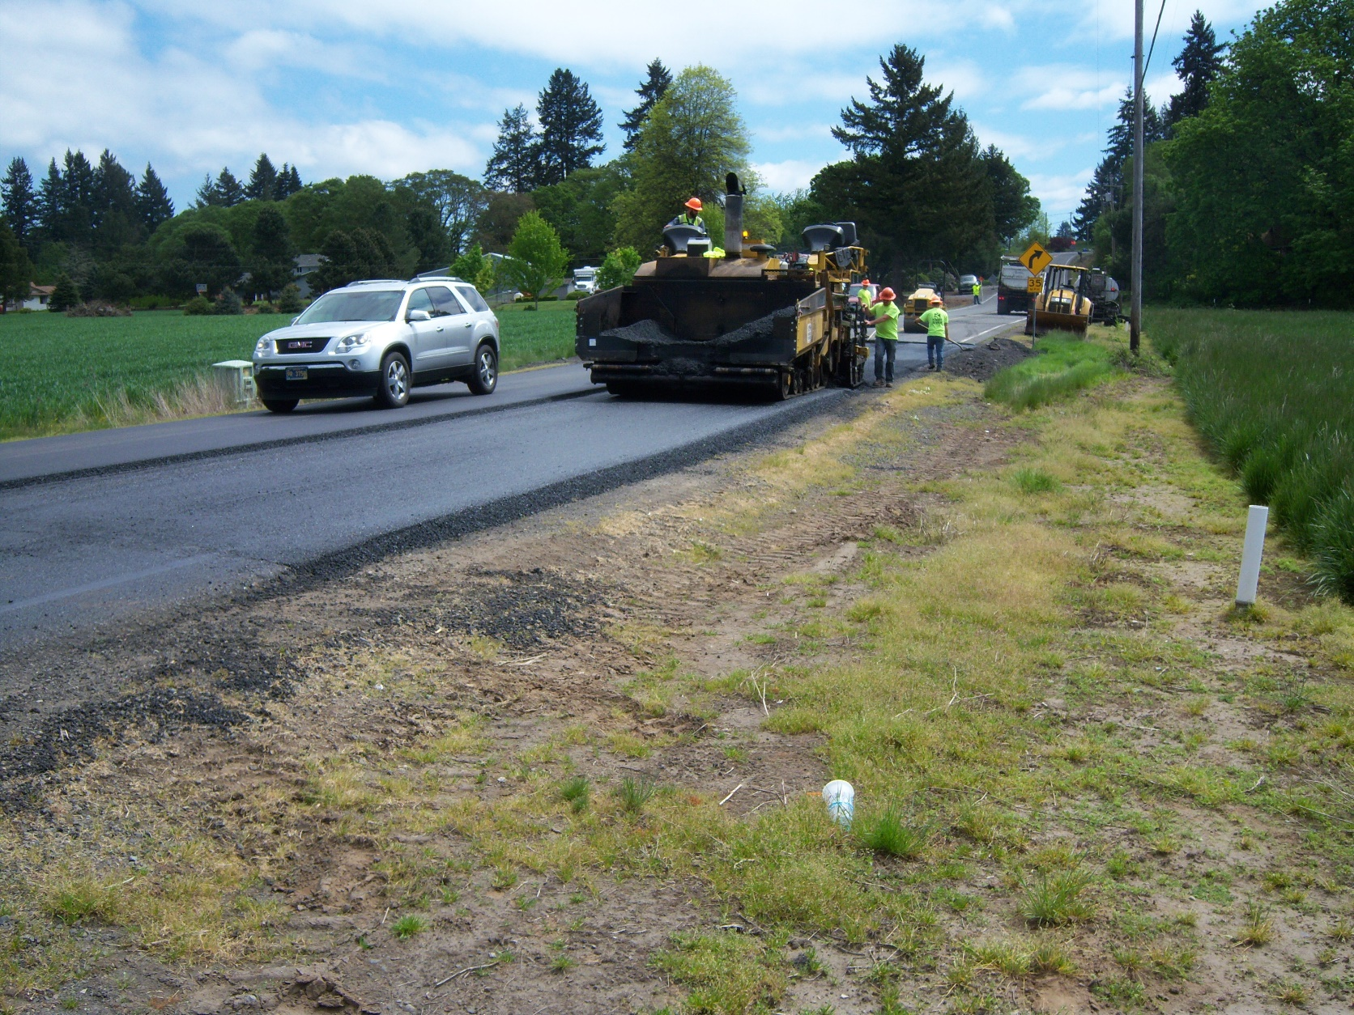
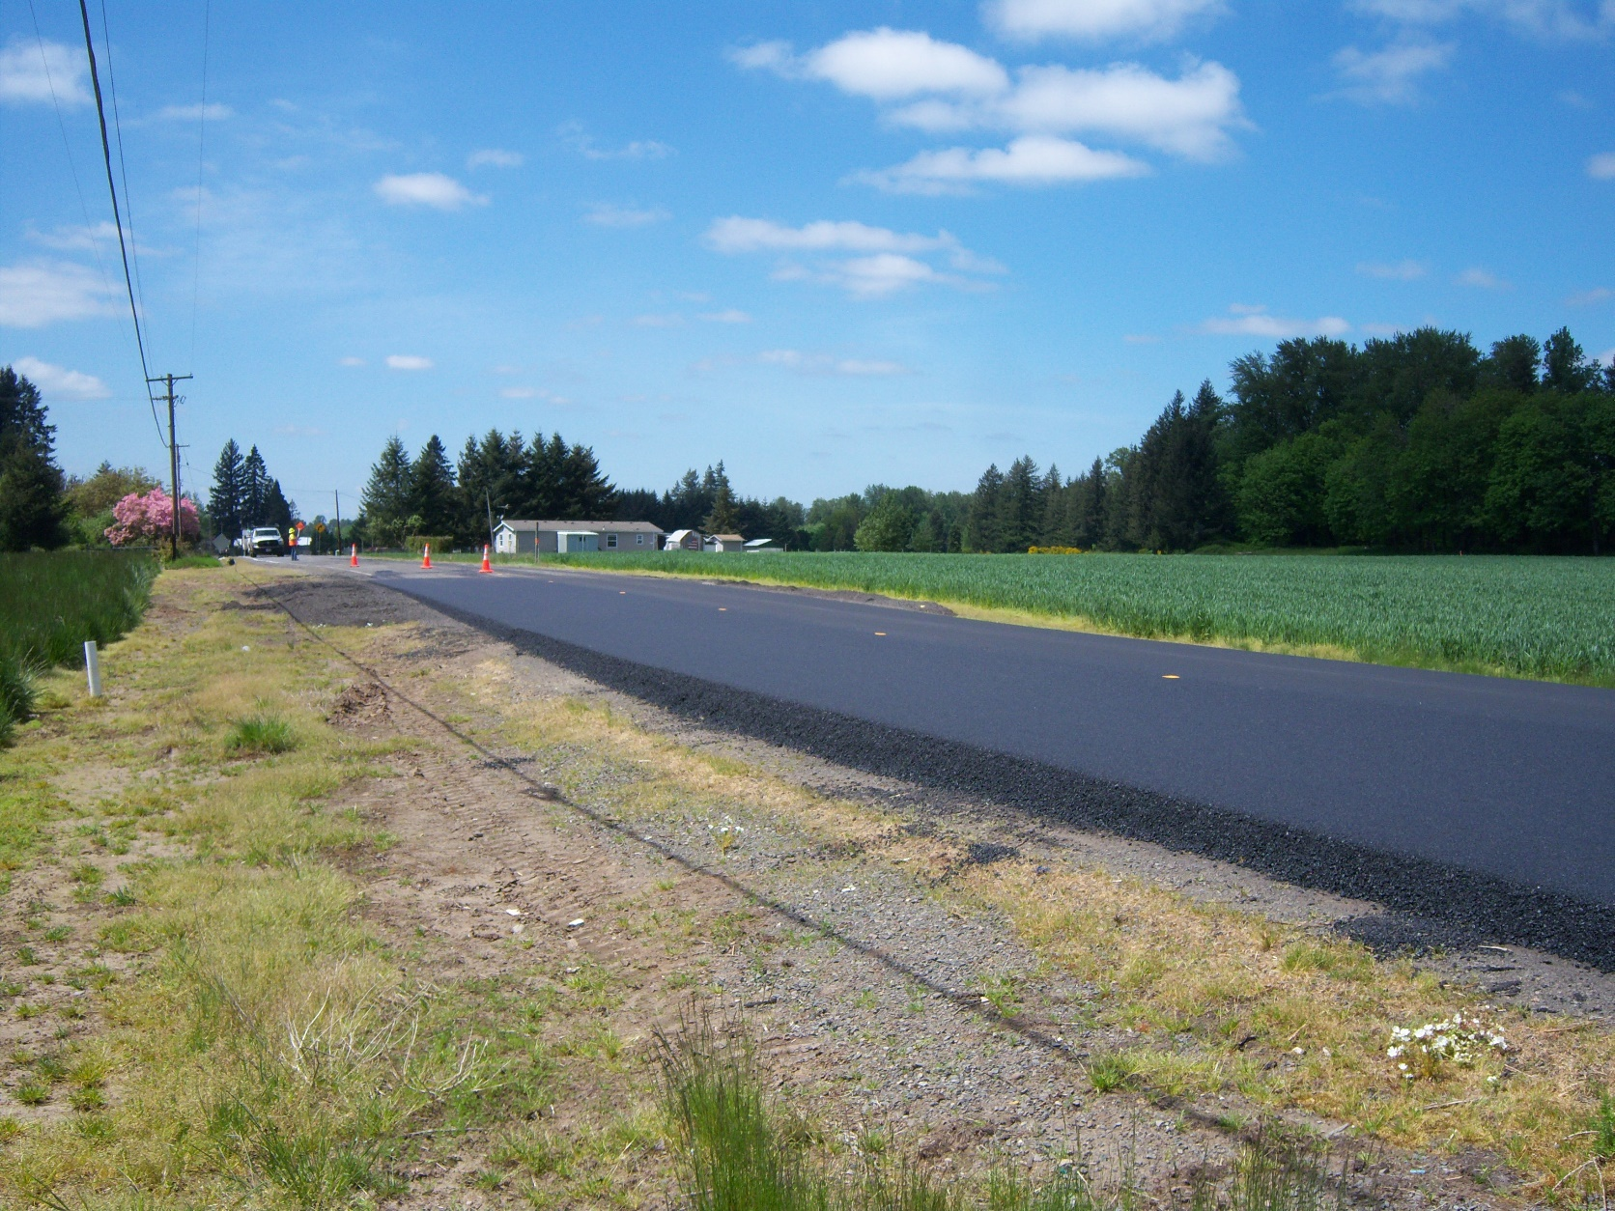
Paved intersections
Add in other work
Note: Fog seal/sand seal new asphalt before chip sealing it.
Kingston-Jordan Dr.
Pre-Level Road

Slide 26
Surface treatment toolbox
in Linn County, OR
Kevin Hamilton
Operations Manager
(541) 967-3919 Office
(541) 740-1787 Cell
khamilton@co.linn.or.us
Jeff Maskal
Special Operations Group Foreman
jeff.maskal@co.linn.or.us
Mike Brant
Fleet Maintenance Leadworker
mike.brant@co.linn.or.us
Inter-Agency Cooperation
Communication
Contract Work
Paved Intersections
Prep Work
Fog Seals
When Things Go Wrong

Slide 27
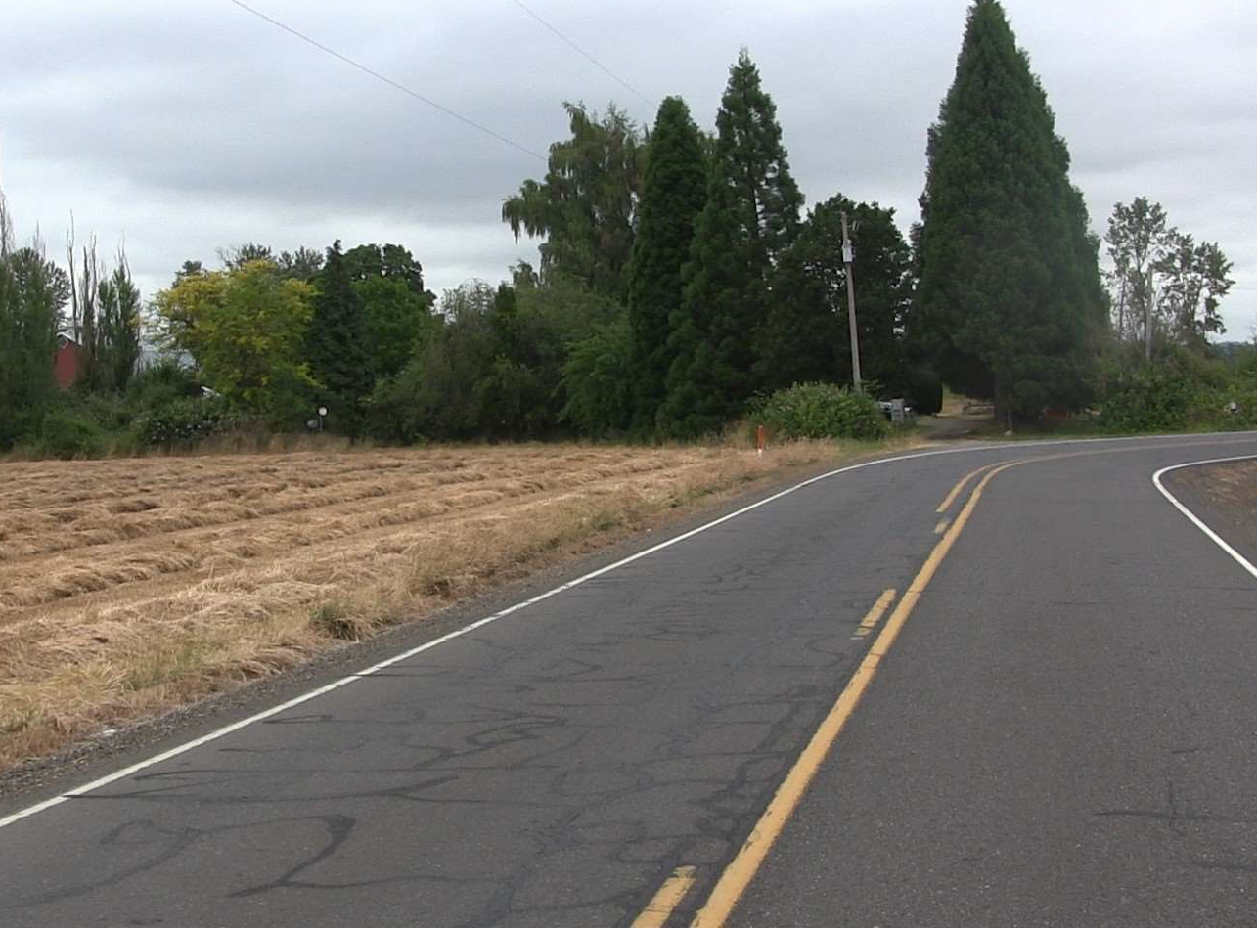
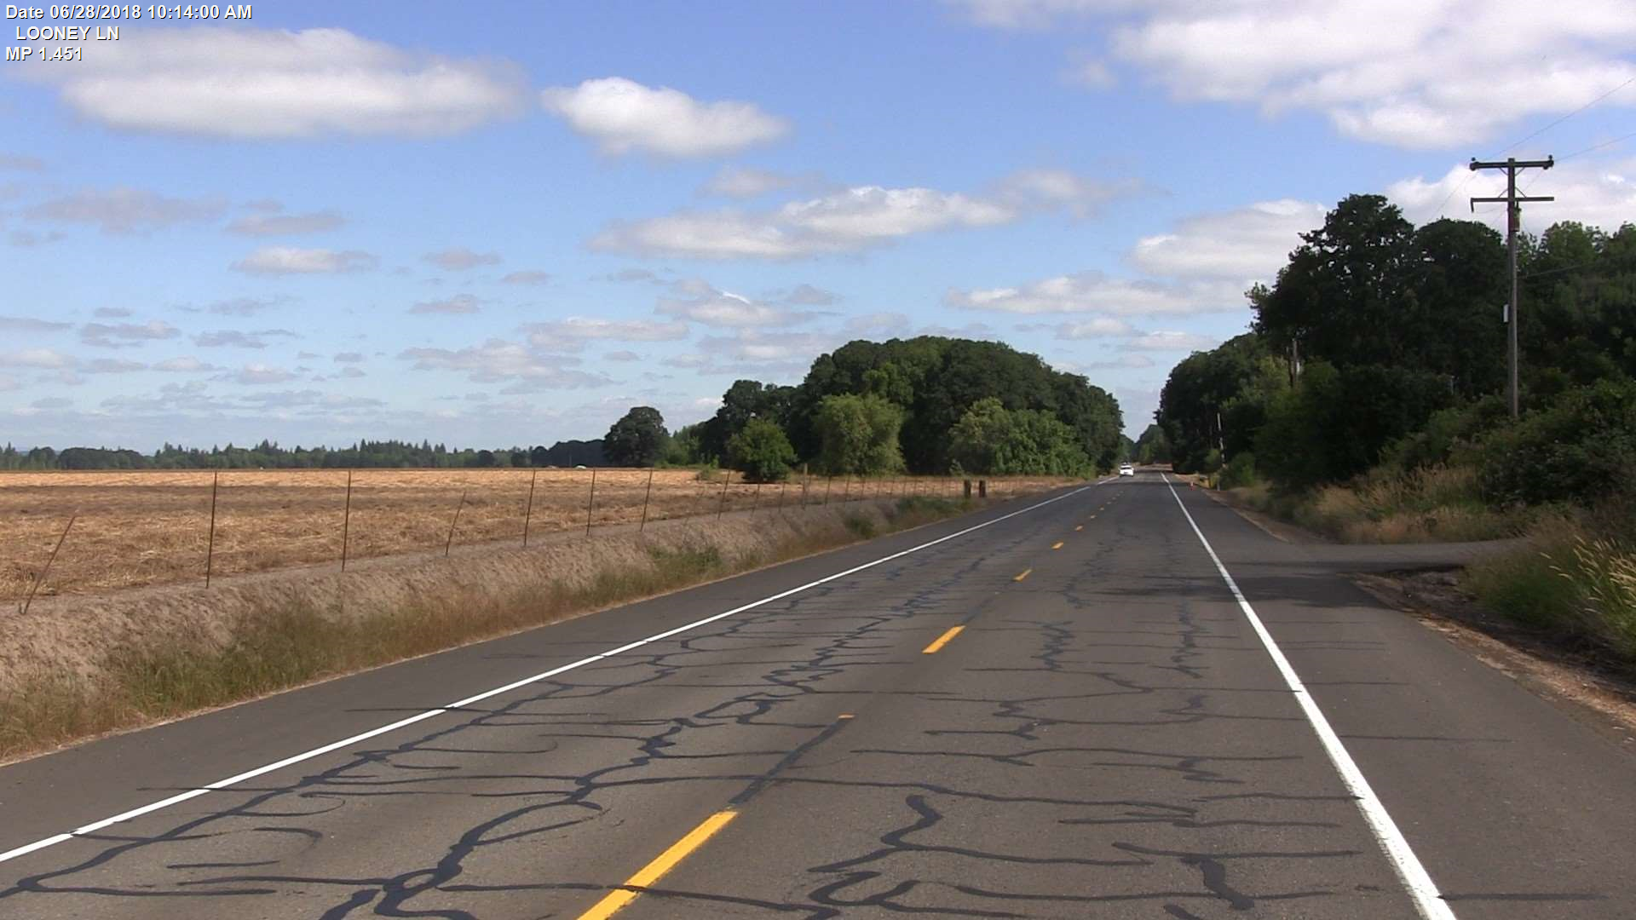
PREP WORK
Best Practice:
Seal cracks
Preferably the year before chip seal is scheduled
Repair ruts
Kennel Road
Looney Lane

Slide 28
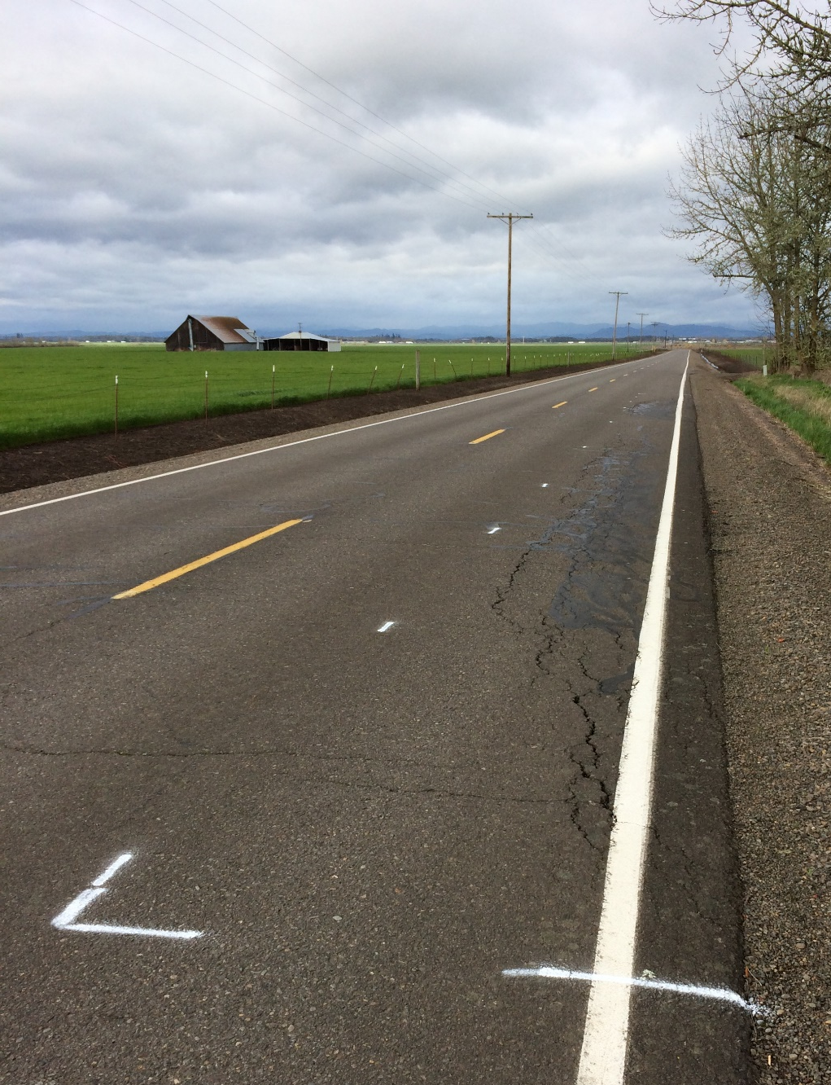
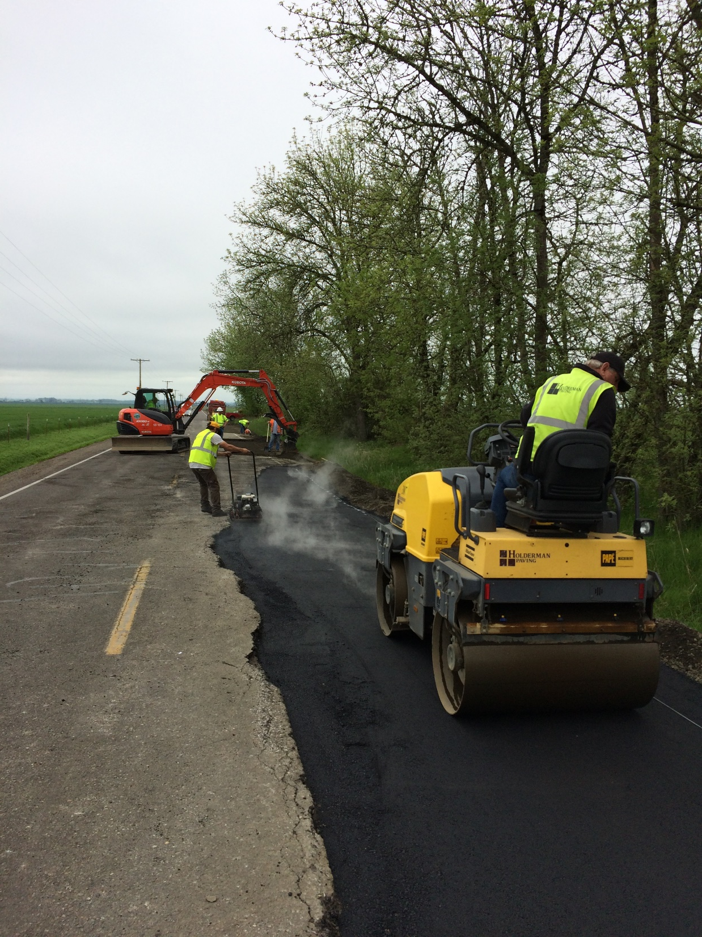
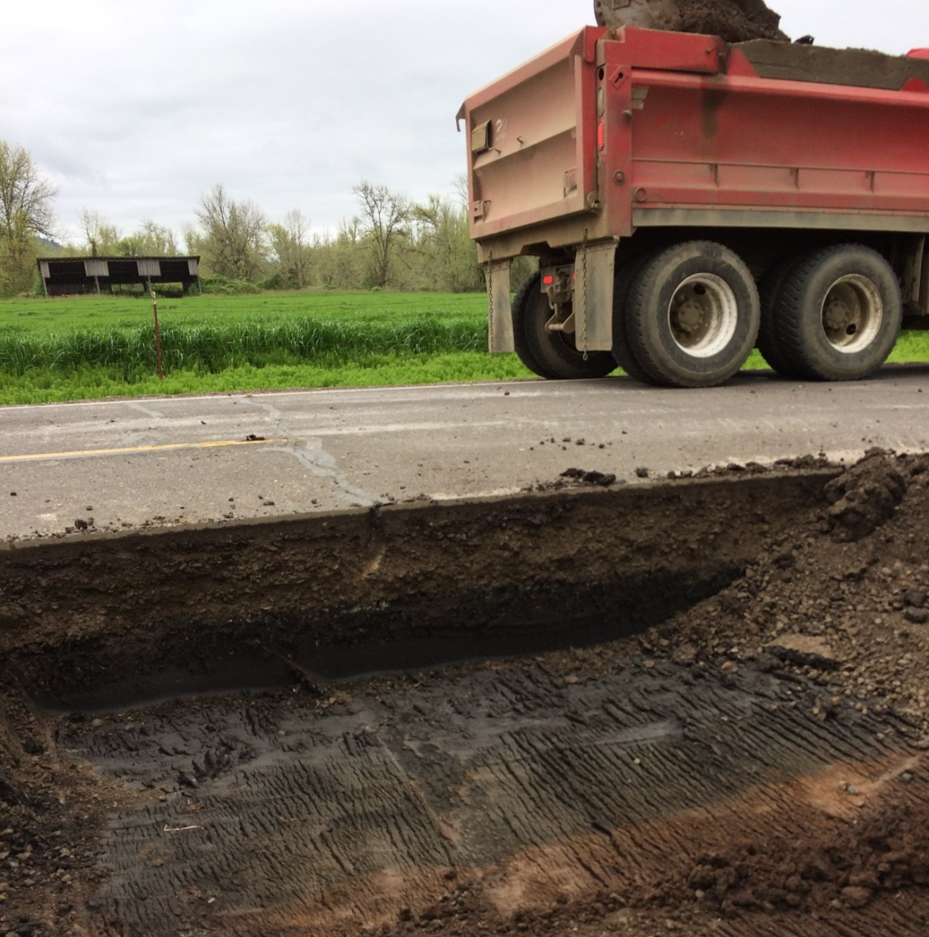
Prep work
Best Practice:
Repair potholes & base failures
Diamond Hil Dr. 2017

Slide 29
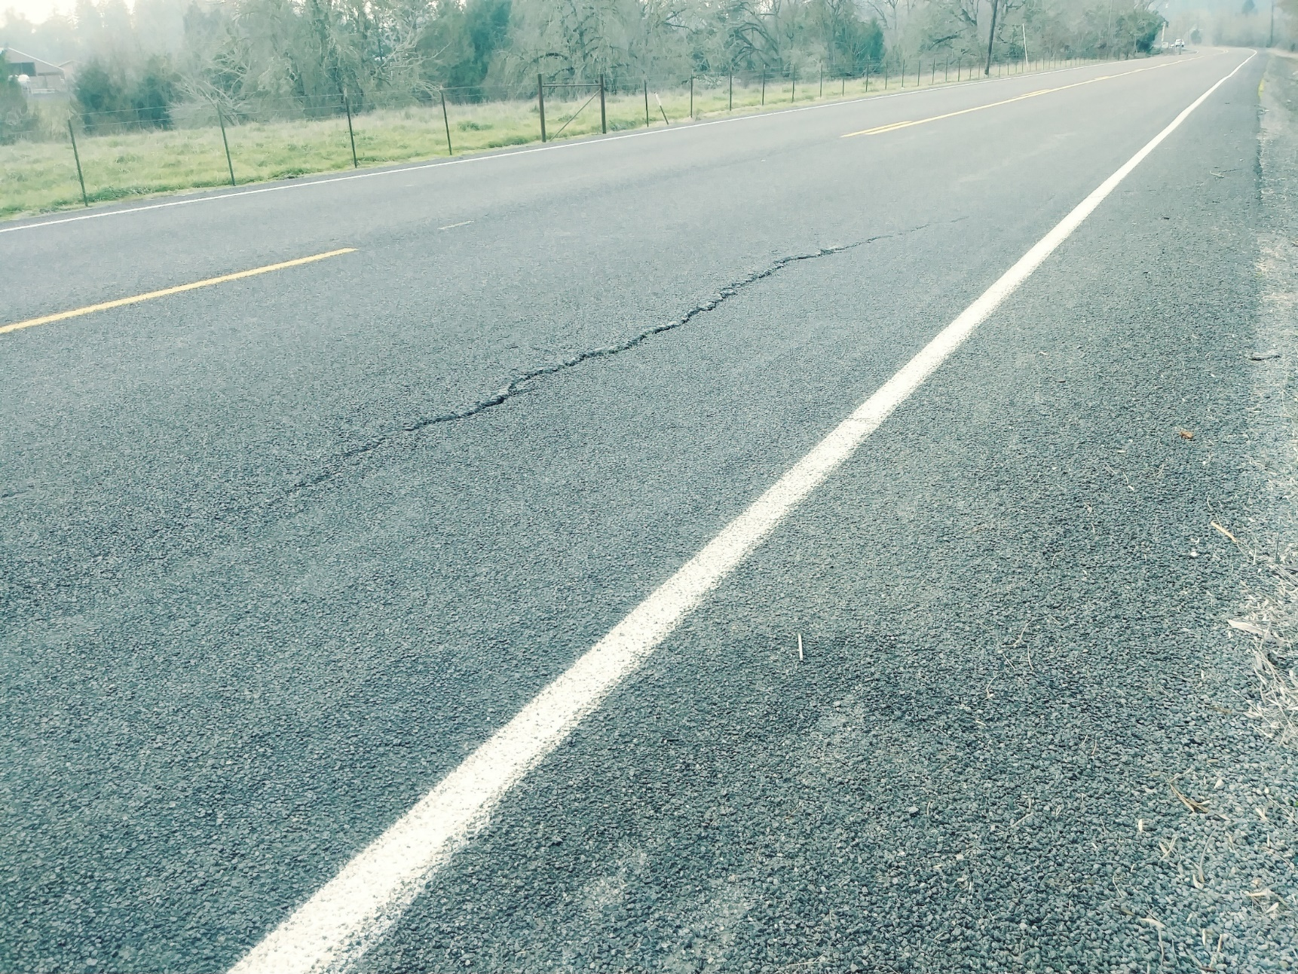
Single shot
What if you can’t get to all the repairs or get the crack sealing done?
Chip it anyway.
Berlin Rd. 2018
Berlin Road 2019

Slide 30
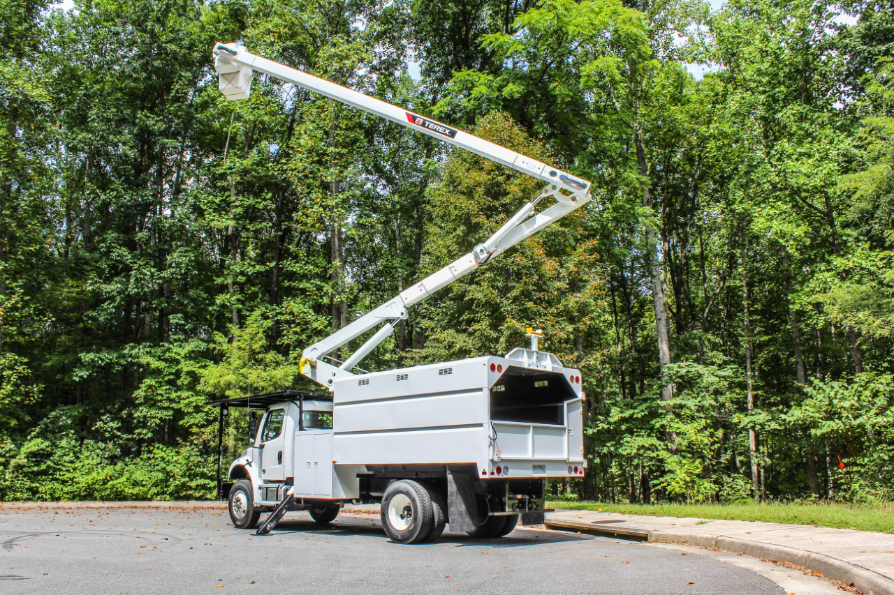
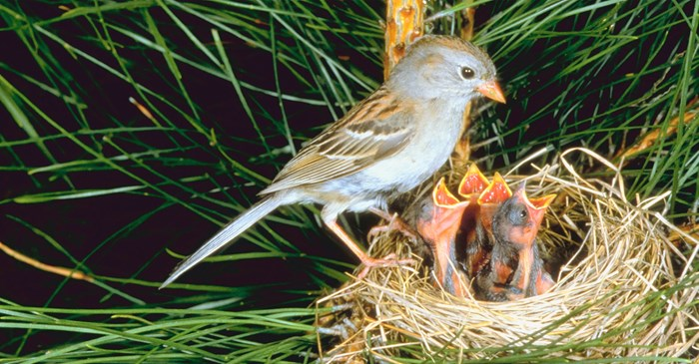
PREP WORK
Best Practice:
Tree Trimming
Cut ‘em high, all the way to the ROW line.
Mind the Migratory Bird Treaty Act!
NOTE: This image was shamelessly stolen from the internet.

Slide 31
Surface treatment toolbox
in Linn County, OR
Kevin Hamilton
Operations Manager
(541) 967-3919 Office
(541) 740-1787 Cell
khamilton@co.linn.or.us
Jeff Maskal
Special Operations Group Foreman
jeff.maskal@co.linn.or.us
Mike Brant
Fleet Maintenance Leadworker
mike.brant@co.linn.or.us
Inter-Agency Cooperation
Communication
Contract Work
Paved Intersections
Prep Work
Fog Seals
When Things Go Wrong

Slide 32
Fog Seals
Single shot chip seals:
0.11 – 0.13 gals/SY (0.12 typical)
Linn County now applies a fog seal to every single shot chip seal
Better chip retention
Better contrast for pavement markings
Double shot chip seals:
0.09 – 0.10 gals/SY (0.10 typical)
Optional but generally recommended on double shots for the above reasons
Linn County does not perform fog seals as a stand-alone treatment.

Slide 33
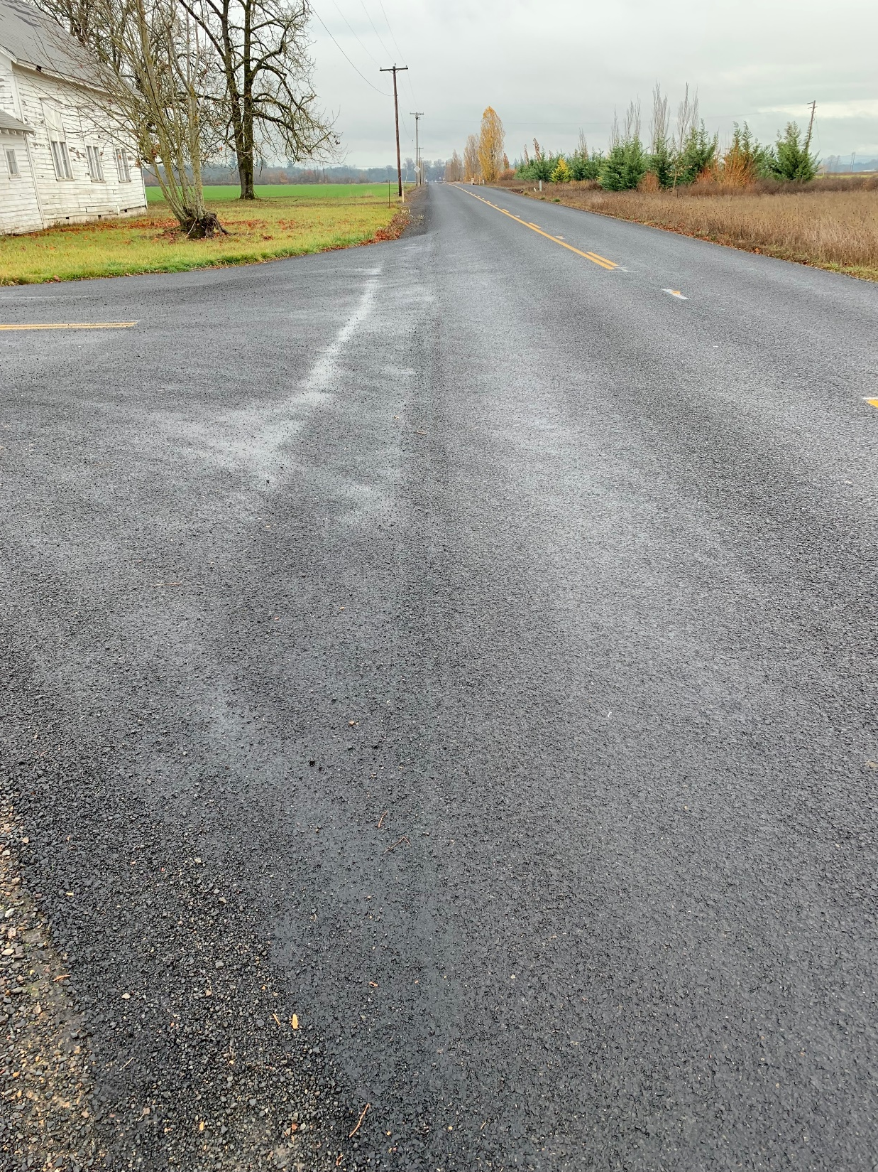
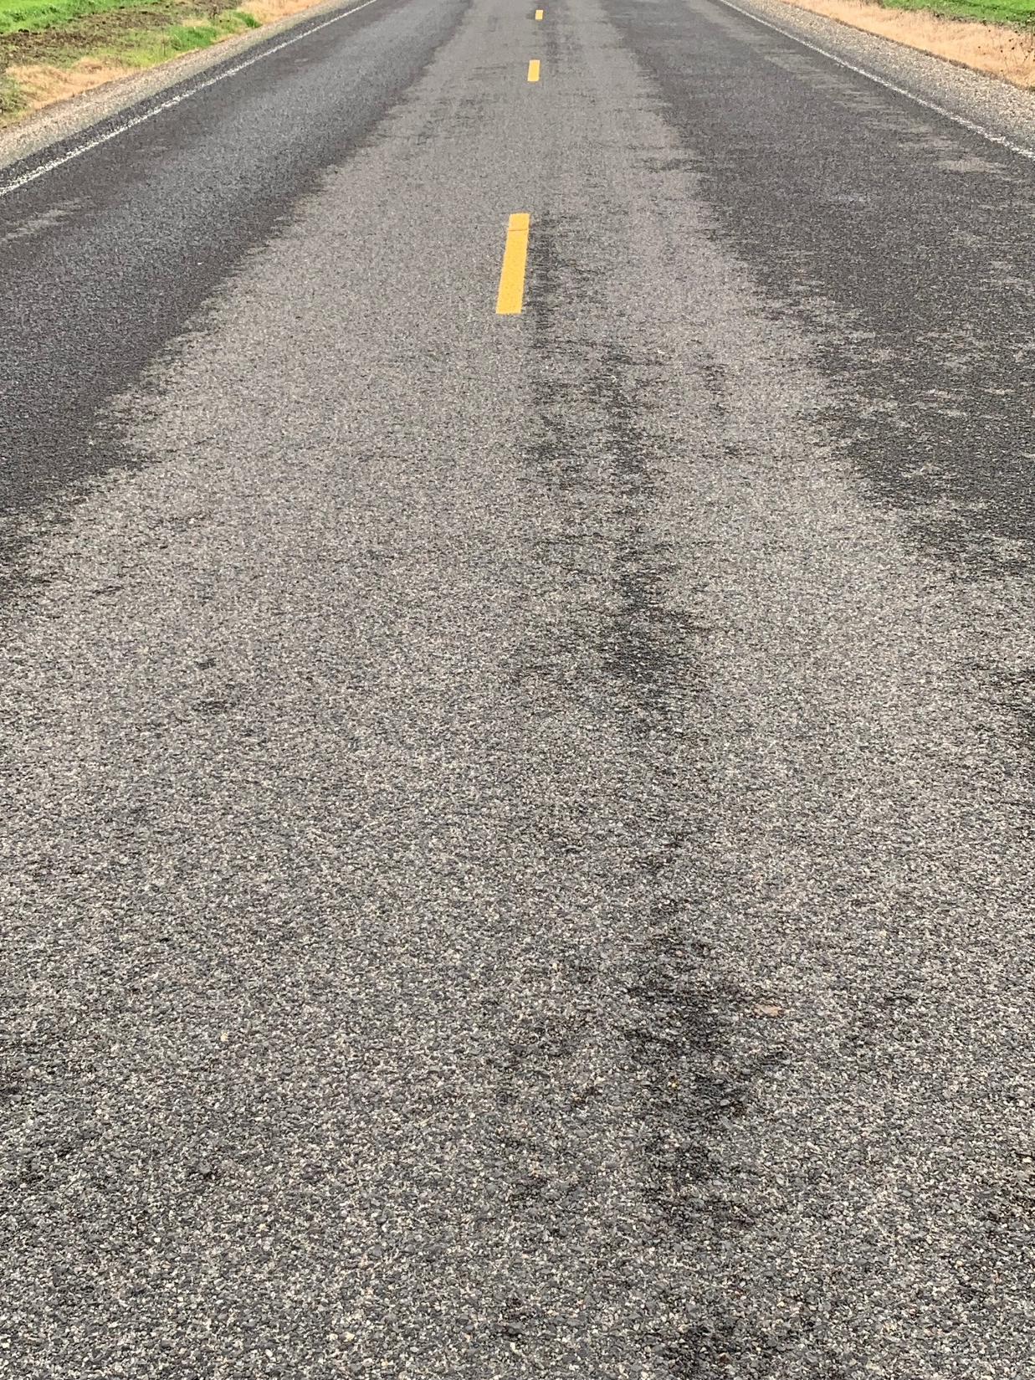
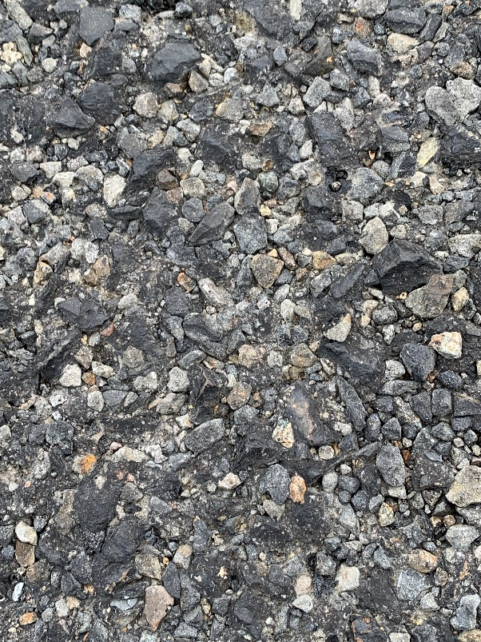
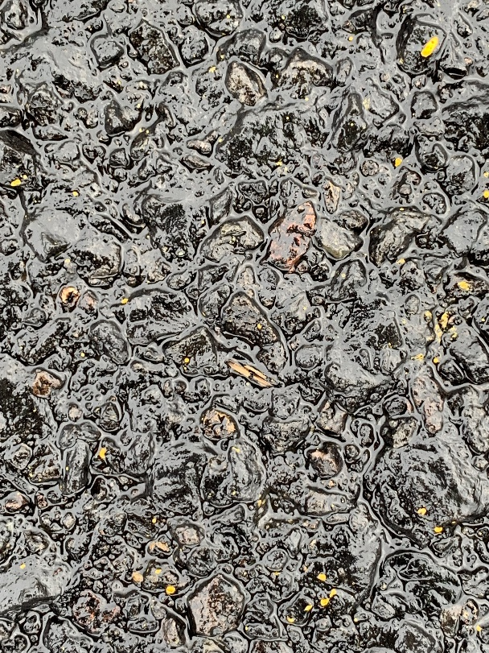
Fog Seals
Pictures taken on same day
Double shot with fog seal
Tangent Dr.
Double shot – No fog seal
Engel Rd.

Slide 34
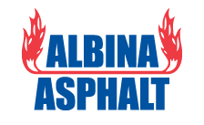
Fog Seals
Stop using CSS-1h
Better products exist
BL Fog
QSE or
CQS-1h
CQS-1h
These products break faster; stay black longer

Slide 35
Surface treatment toolbox
in Linn County, OR
Kevin Hamilton
Operations Manager
(541) 967-3919 Office
(541) 740-1787 Cell
khamilton@co.linn.or.us
Jeff Maskal
Special Operations Group Foreman
jeff.maskal@co.linn.or.us
Mike Brant
Fleet Maintenance Leadworker
mike.brant@co.linn.or.us
Inter-Agency Cooperation
Communication
Contract Work
Paved Intersections
Prep Work
Fog Seals
When Things Go Wrong

Slide 36
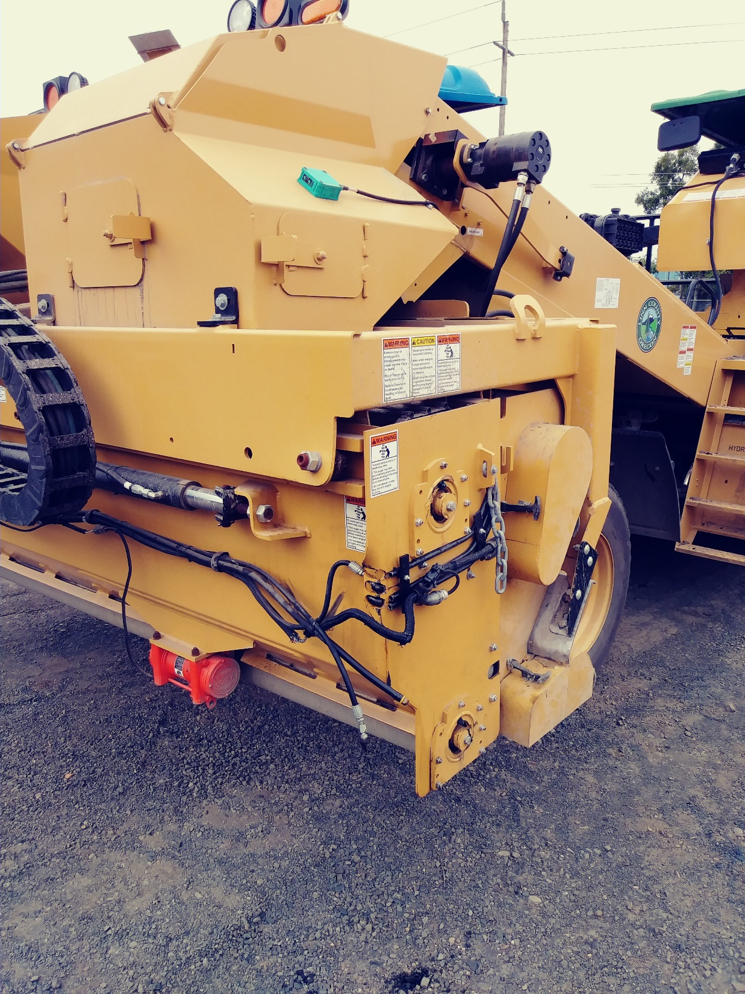
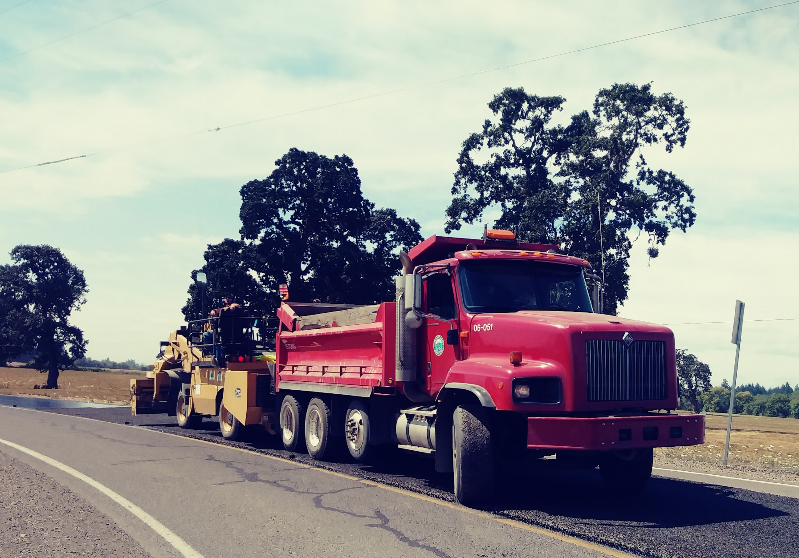
When Things go wrong

Slide 37
Kevin Hamilton
Operations Manager
(541) 967-3919 Office
(541) 740-1787 Cell
khamilton@co.linn.or.us
Jeff Maskal
Special Operations Group Foreman
jeff.maskal@co.linn.or.us
Mike Brant
Fleet Maintenance Leadworker
mike.brant@co.linn.or.us

