Slide 1
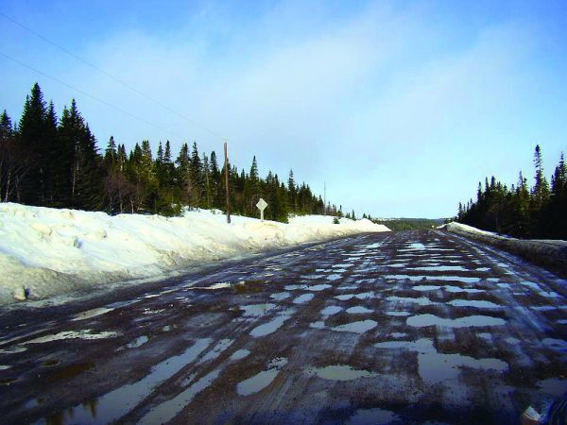
GRAVEL ROAD MAINTENANCE

Slide 2
Customer Satisfaction-101

Slide 3
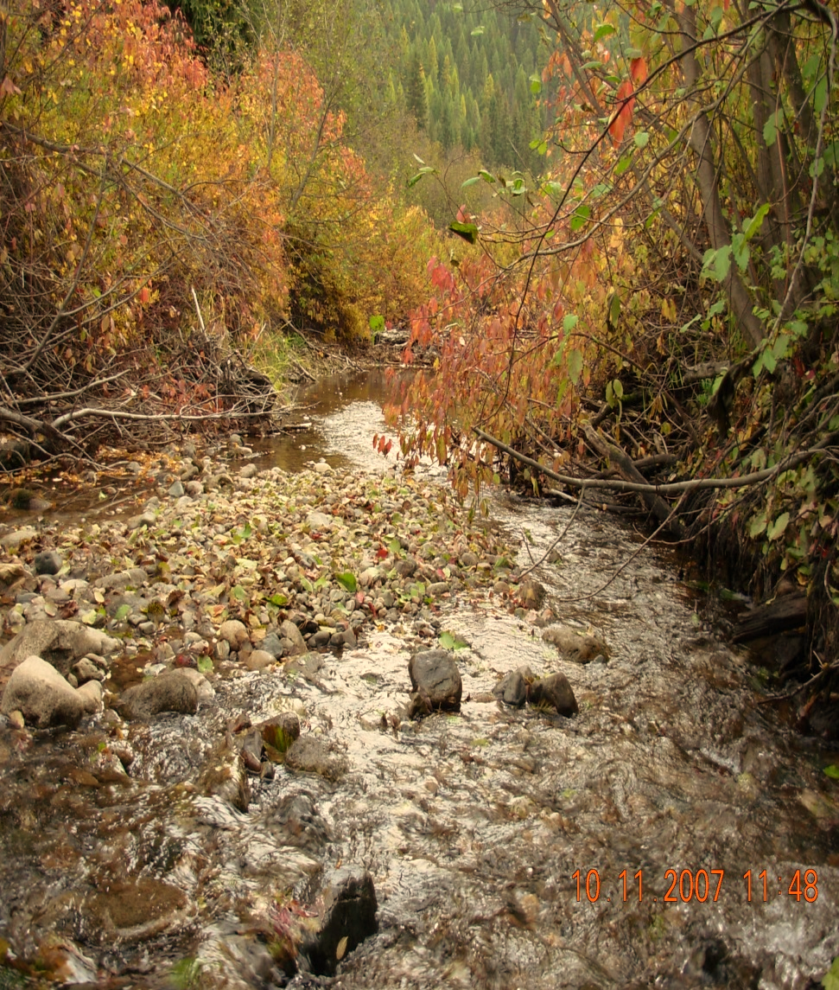
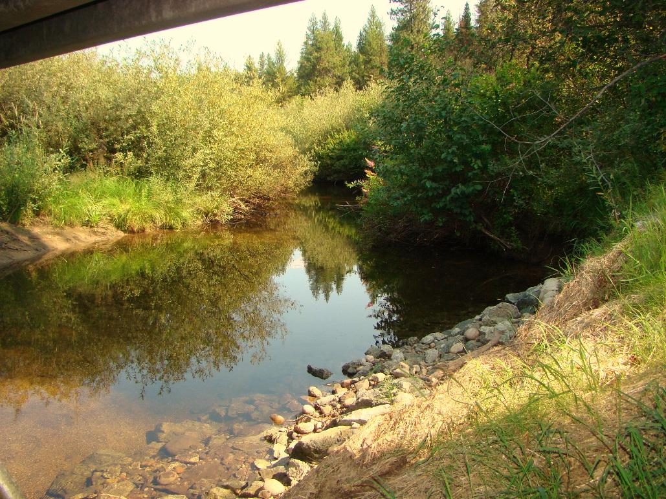
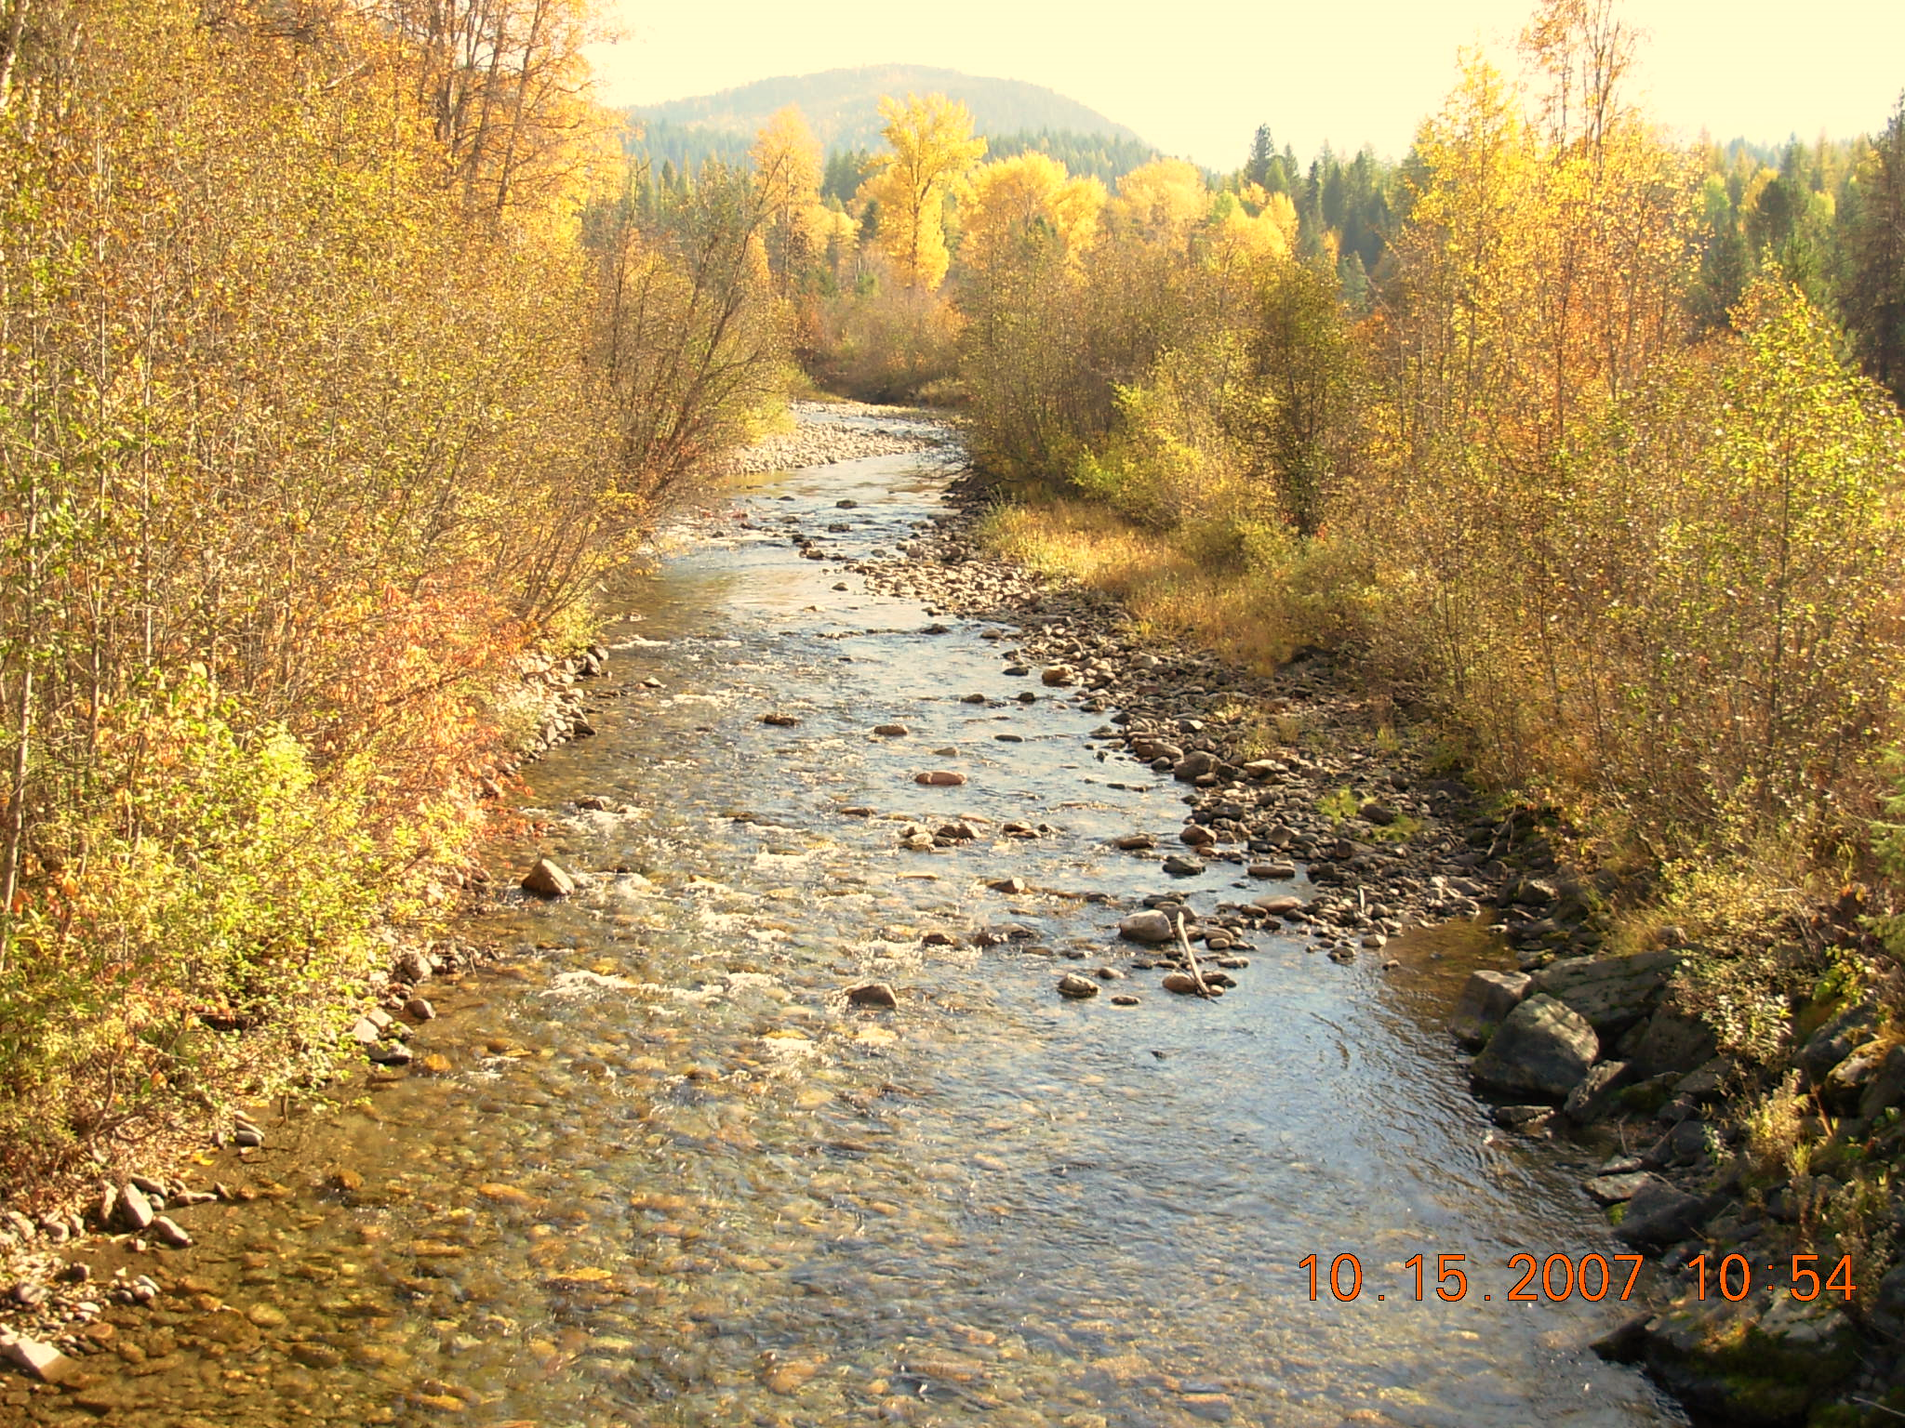
About Pend Oreille County
A population of 12, 985 in 2014
0.18% of Washington’s total population!
Total area of 1,425 square miles
25 square miles is water
Founded in 1911
Last county to be created
in the state of Washington
Split off of Stevens County
County seat located in Newport, WA
Only one stoplight !!
Pend Oreille County

Slide 4
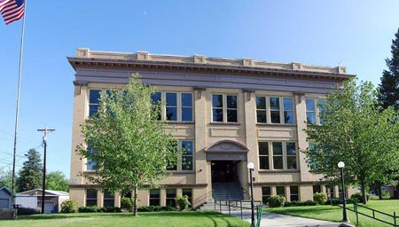
About Pend Oreille County Road Department
3 districts
Maintenance facilities located in Newport, Usk, and Ione
19 Full Time Road Department Employees
District 1: 7 employees
District 2: 7 employees
District 3: 5 employees
Engineering: 2 employees
ER and R: 2 mechanics
- 3 On Call Temp Employees in winter

Slide 5
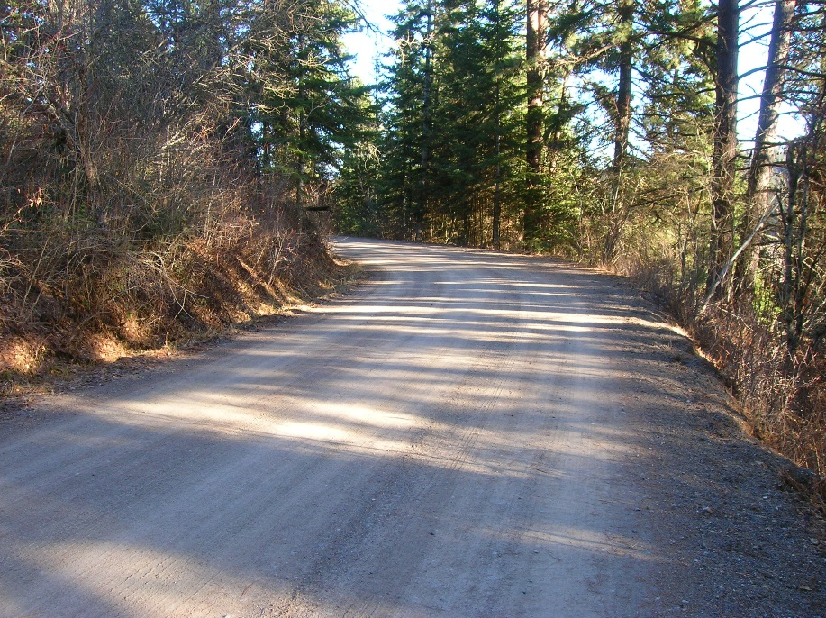
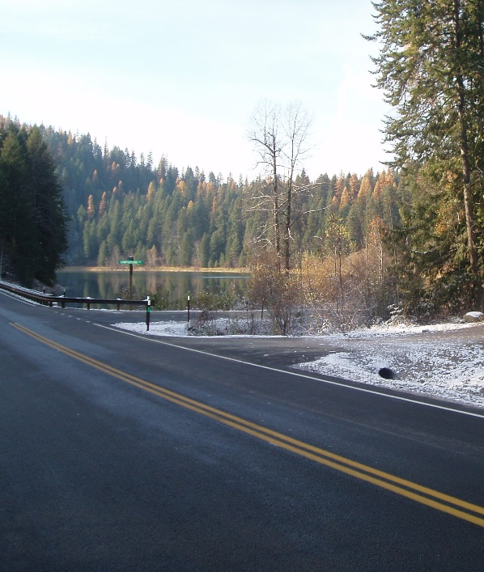
About Pend Oreille County Road Department
Road Miles in the County = 500 Miles
Paved Roads -250 Miles
Gravel Roads – 250 Miles

Slide 6
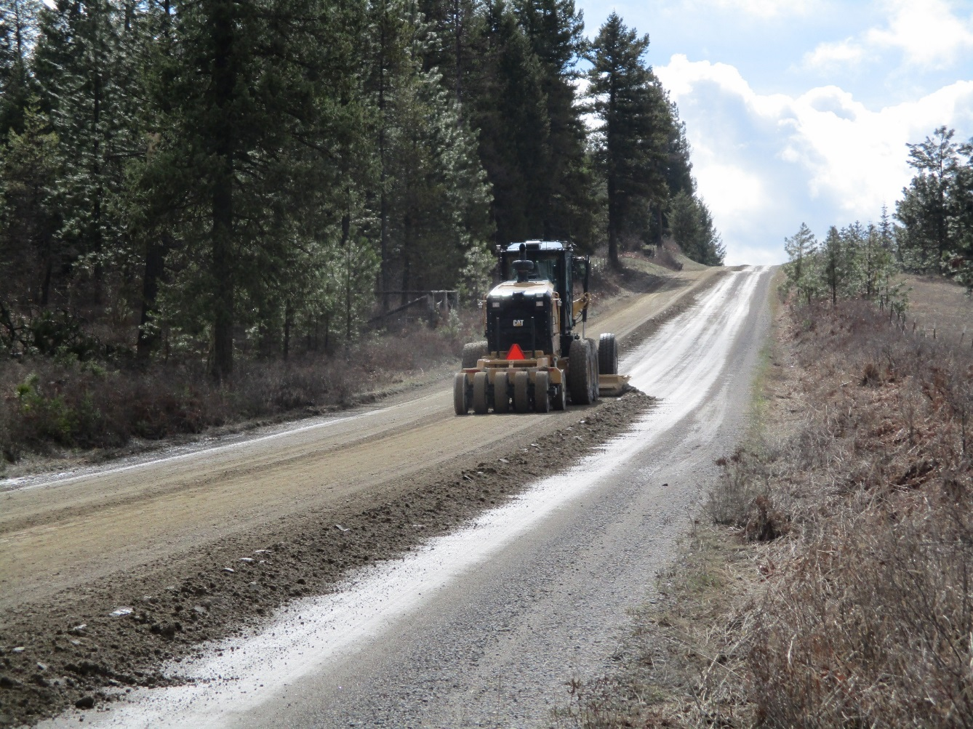
Calcium Chloride Program 2006
460 tons of calcium applied
The cost was approximately $230 per ton

Slide 7
2010
By 2010 the program was unfunded, but the benefit of past years was still evident

Slide 8
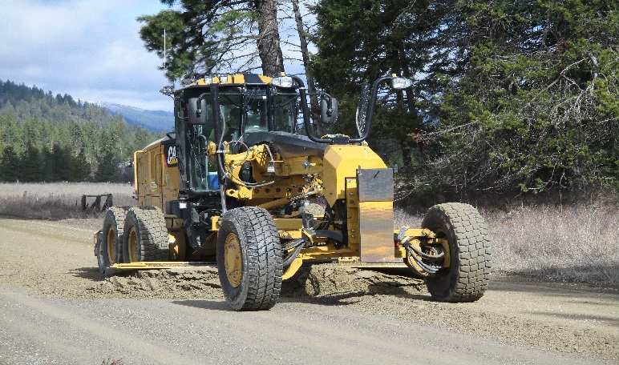
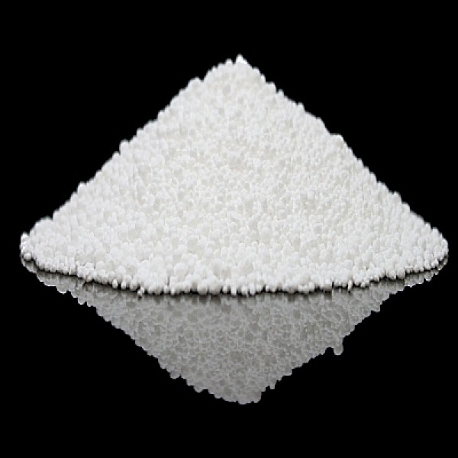
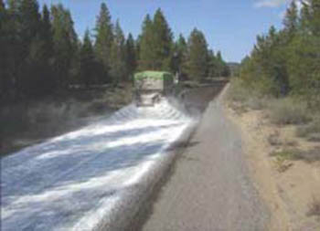
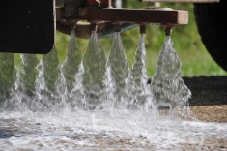
To start, the road surface is prepared and grade is set
Then Calcium is applied in dry pellet form
and hydrated, which then is absorbed by the gravel surface

Slide 9
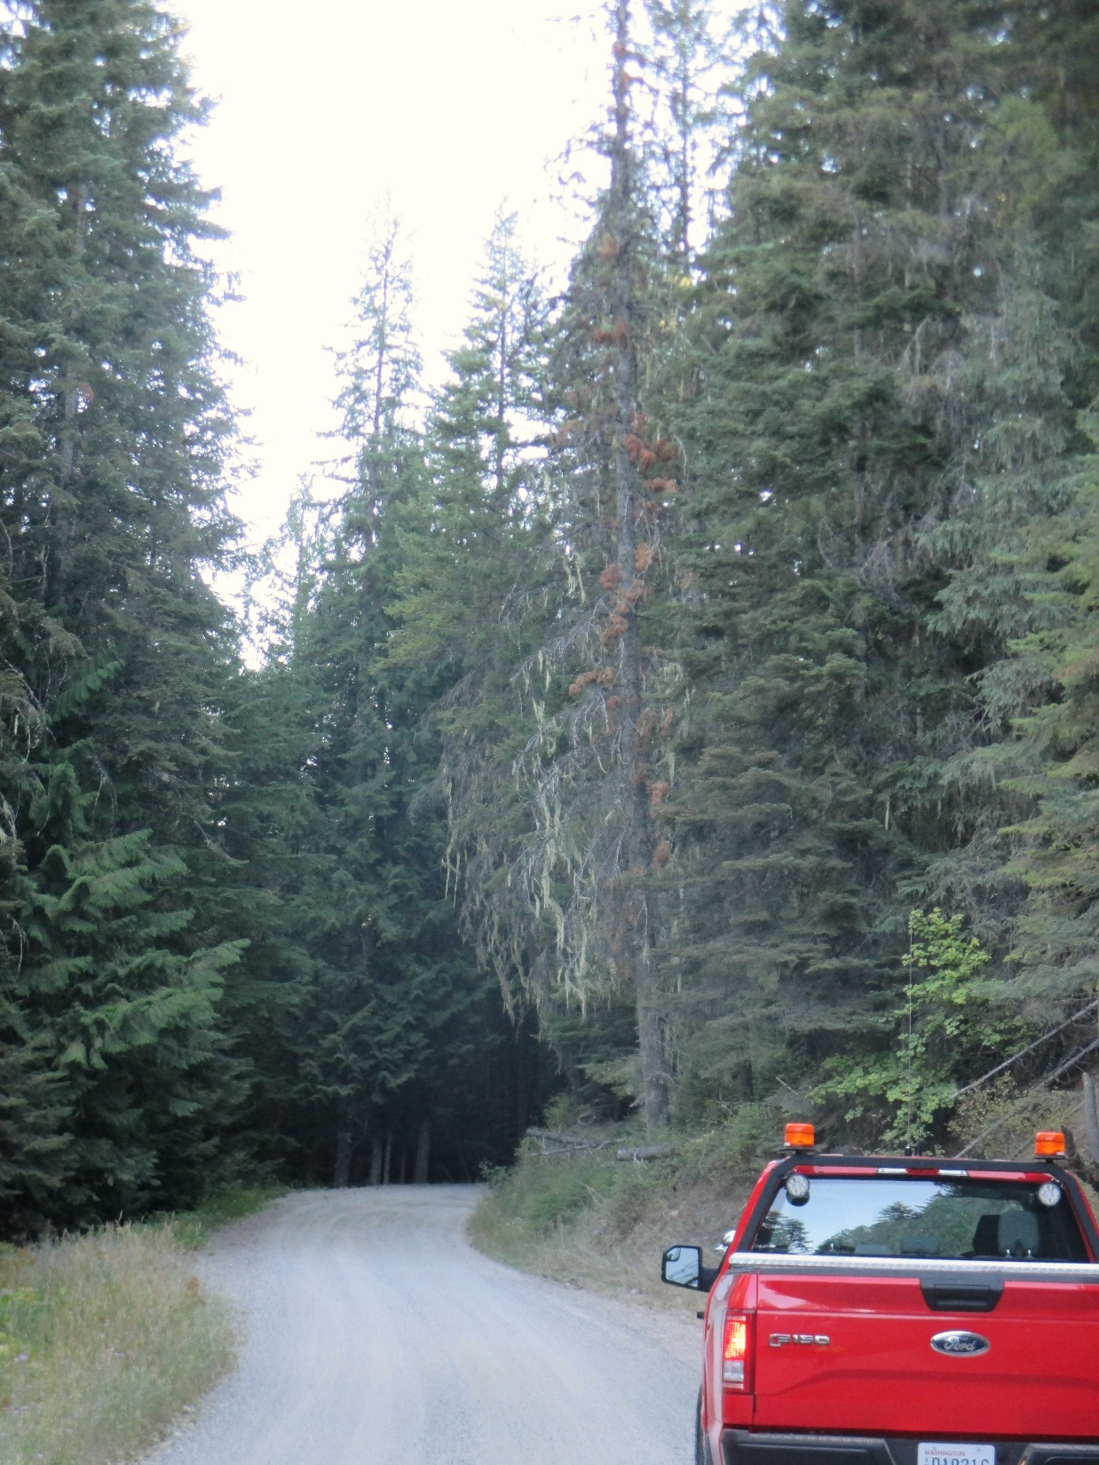
2015
Customer satisfaction with road conditions was at an all time low, so the decision was made to infuse $45,000 into our corridors that were most susceptible to washboarding.

Slide 10
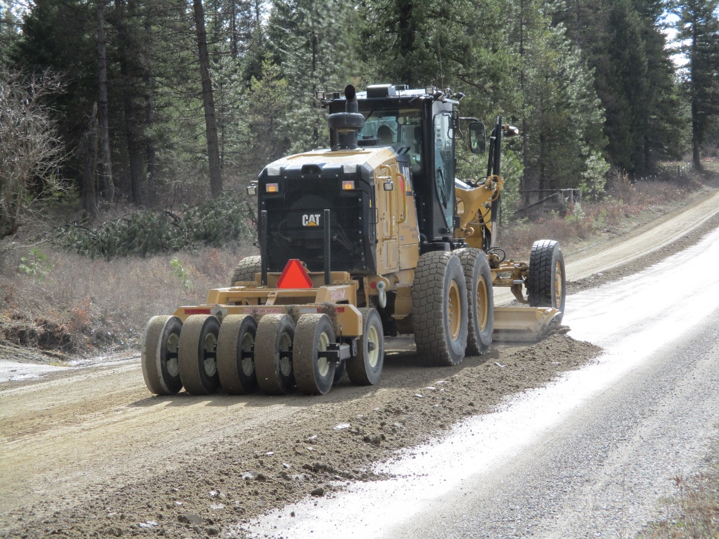
2016
Once again, the immediate results of application could be felt, so the program was budgeted at $60,000 for materials this year.
Budget: $60,000
Product Cost: $450 per ton
Quantity: 125 tons
Road Miles:13

Slide 11
This year we will experiment with “Mix in Place”. The goal of this will be to achieve a deeper penetration of the product
2016

Slide 12
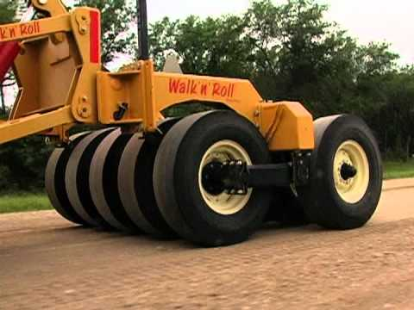
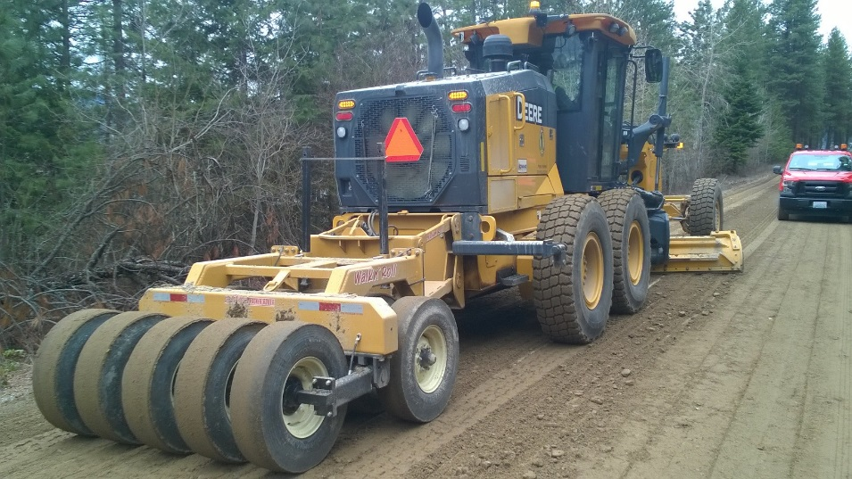
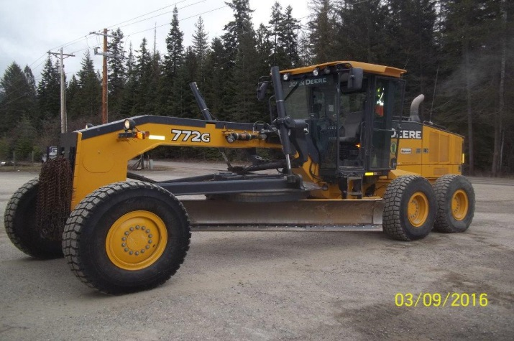
Currently 2 of our motor graders are equipped with Walk & Roll” Systems.
We will be adding a 3rd system this spring, which will
give us wheel packing capabilities in each road district.

Slide 13
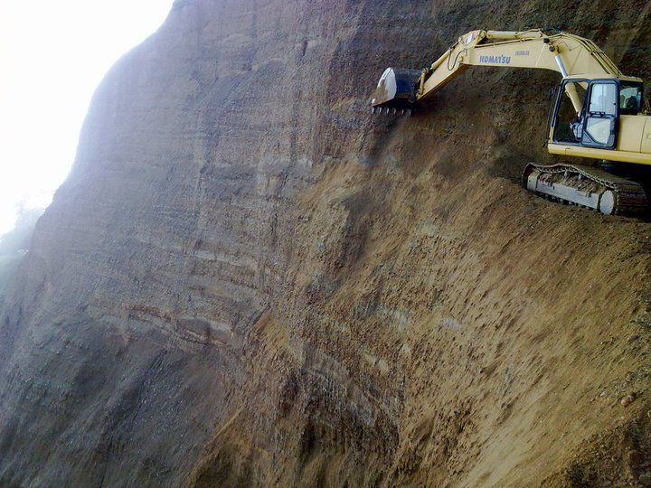
Thank you!

