Slide 1
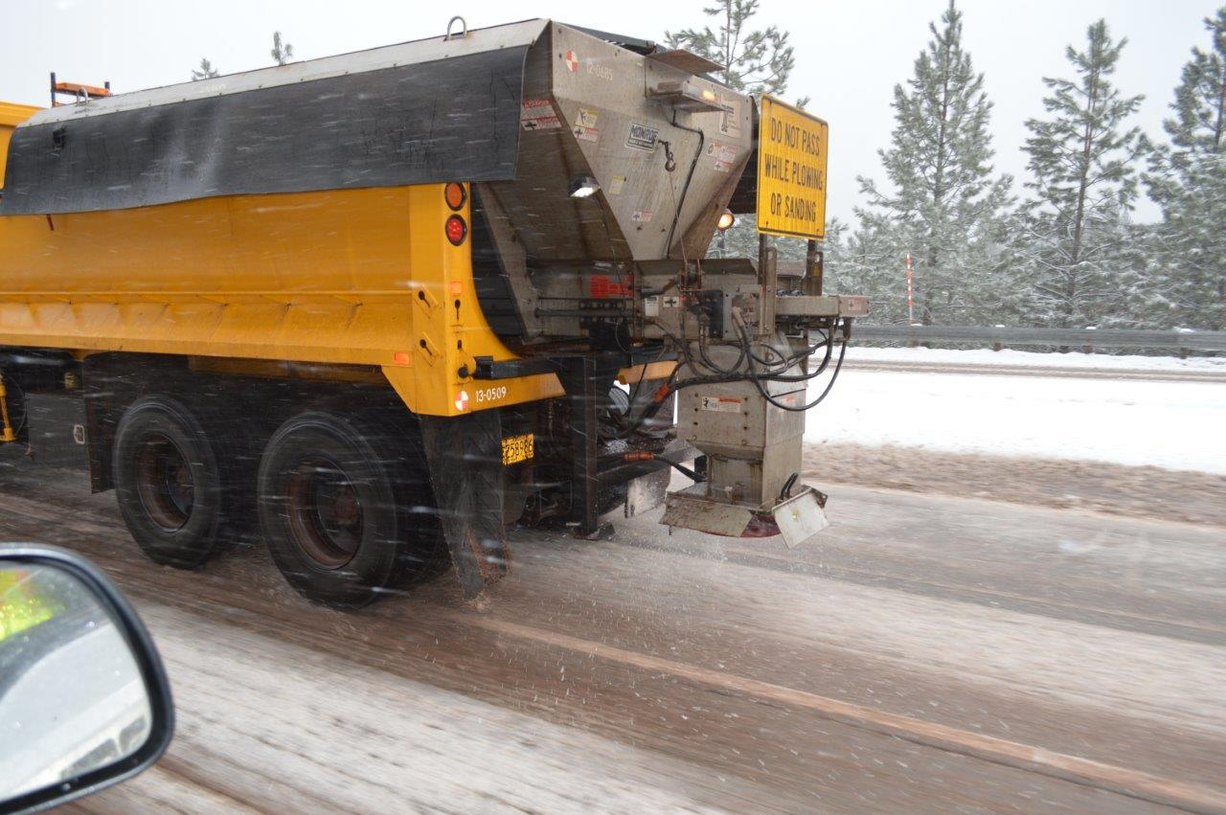
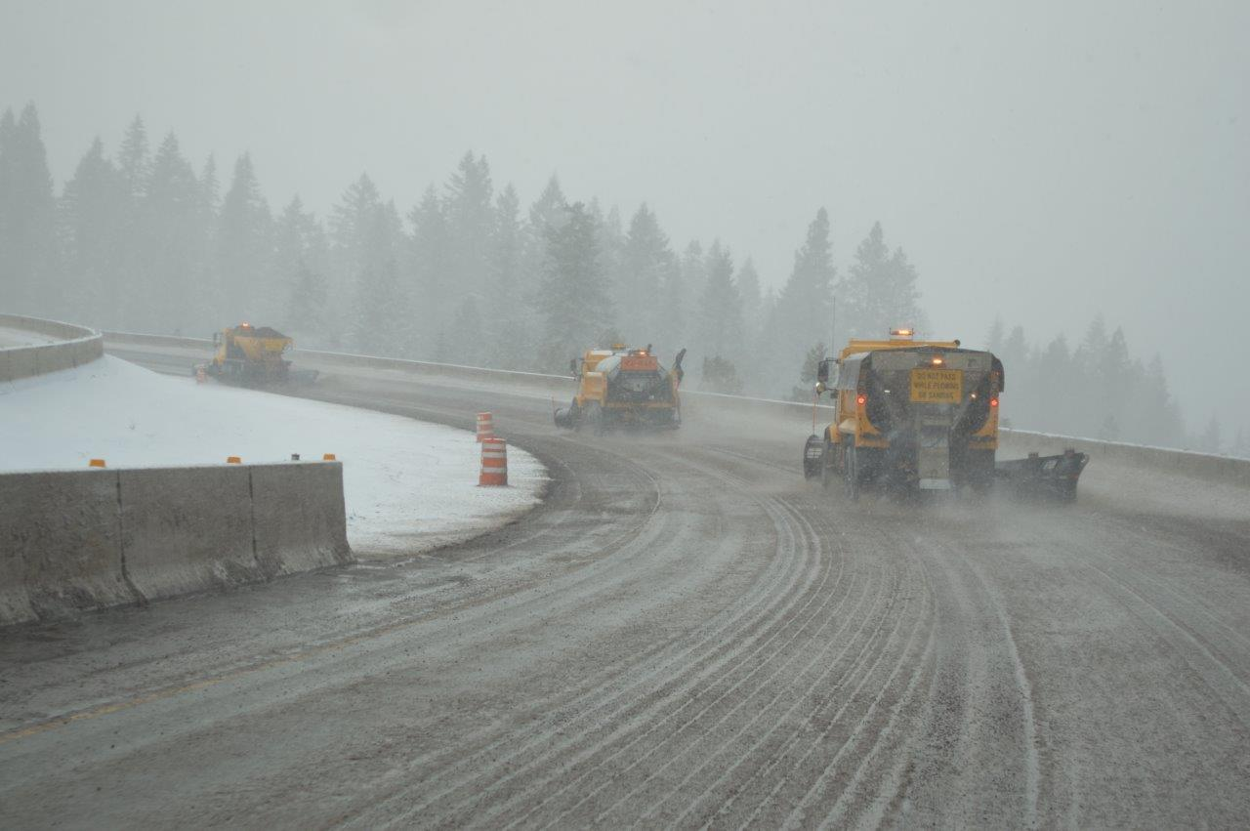
Salt
A balancing act
Patti Caswell
ODOT Maintenance and Operations Branch
October 2017

Slide 2
Snow removal
Plows
Sanders
Blowers
Sanding rock
Liquid deicer
Magnesium chloride (MgCI₂)
Chains
Traction tires
Notes:
What we’ve done traditionally

Slide 3
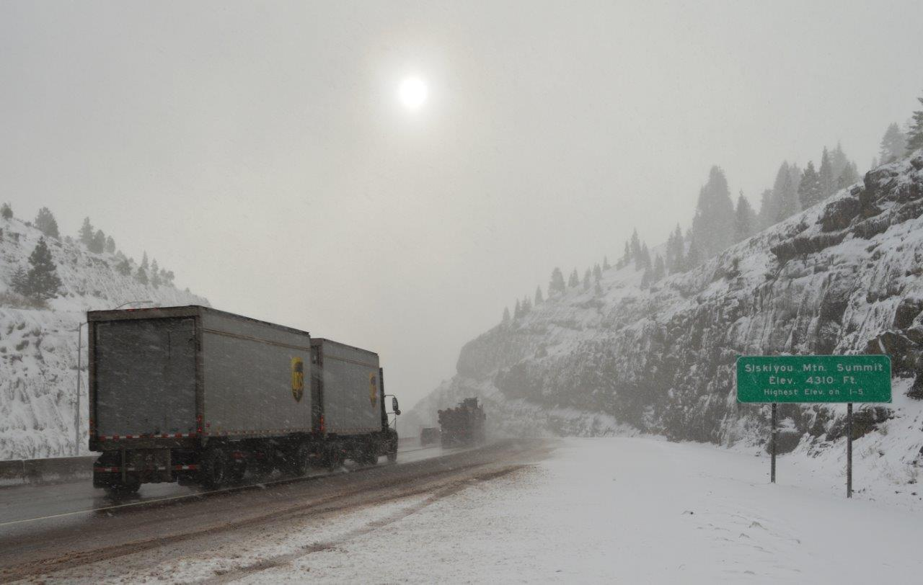
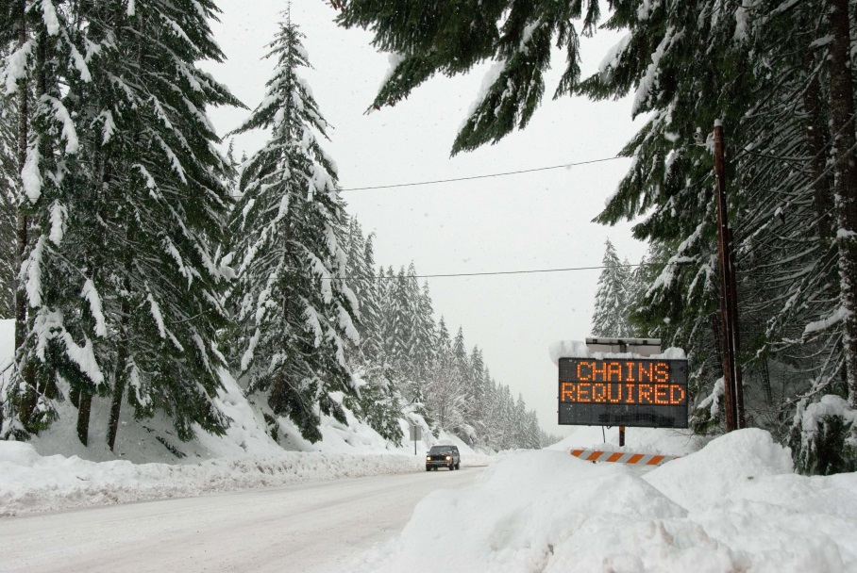
Shared responsibility for safe travel
Recognize your responsibility to travel safely
Be prepared;
Delay if needed
Wash your vehicle!
Notes:
What we’ve done traditionally

Slide 4
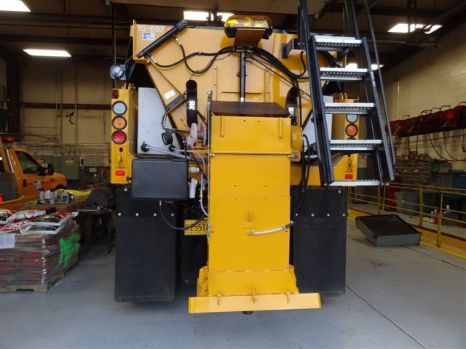
2012—present
Implement best management practices
Notes:
Salt pilot—goals and monitoring
Implement best management practices for storage, handling, use
Storage sheds are costly but important: sheds are constructed to keep salt inside and under cover; sheds are large enough to load/unload under cover;
Pre-wetting salt before it hits the pavement is important to prevent bounce and scatter and keep salt on the road where it is needed. Trucks are equipped with saddle tanks that carry liquid mag chloride, which is sprayed onto the salt as it comes down the chute on the back of the spreader.
ODOT has appropriate environmental permits from both the Department of Environmental Quality and the National Marine Fisheries Services that acknowledge the use of chloride deicers for winter maintenance. The use of solid salt still falls under these current approvals.

Slide 5
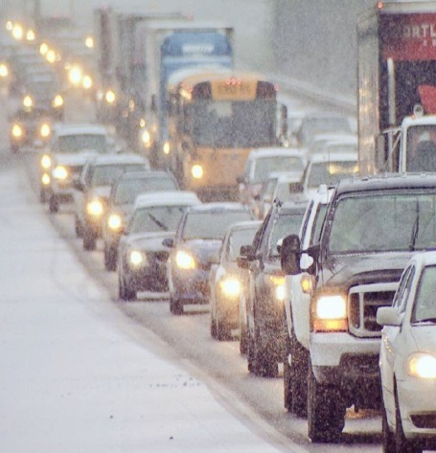
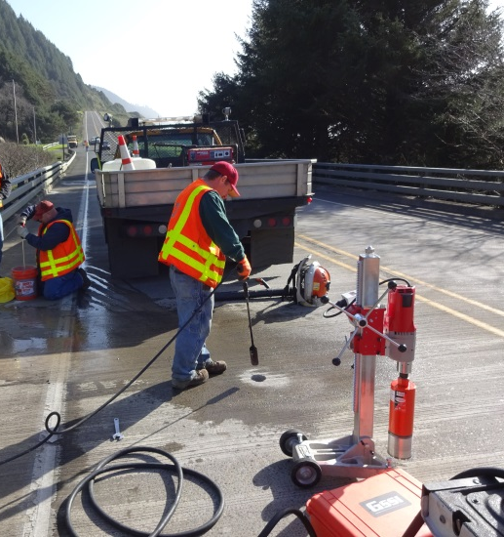
2012—present
Minimize use
Track closures and crashes
Monitor damage to infrastructure & impacts to environment
Notes:
Salt pilot—goals and monitoring
Minimize use: operators are trained and understand how to use salt in conjunction with other tools. Pavement temperature is a big factor in how and when to use salt and at what rate. All salt and deicer application equipment is equipped with pavement temperature sensors.
Winter conditions can result in crashes or driving conditions that warrant highway closures or that vehicles use chains. These situations reduce highway mobility
Chloride deicers can adversely impact the environment and infrastructure. ODOT is supporting research efforts that will help in determining potential watershed impacts based on highway runoff. ODOT is monitoring concrete bridge decks for chloride penetration and damage. ODOT reports annually to DEQ and NMFS in terms of where salt is being stored, used, and how much salt we are using.

Slide 6
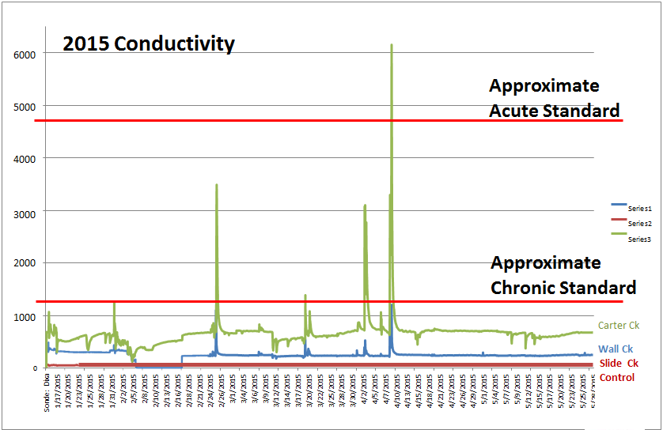
Results through 2015/16
No impact to vegetation
Elevated chloride levels in one stream
No observed impacts to roads and bridges
Notes:
Salt pilot—results so far
Bridge impacts from salt weren’t realized; bridge decks in the pilot locations were sealed prior to salt being applied.
Baseline data was collected on concrete pavement on I-5 and the concrete was sampled again during the last winter of the pilot. Results aren’t final but it appears chloride damage was observed.
One stream has shown higher levels of chloride. Spikes that exceed state water quality standards occurred in the middle of winter. Potential indication that highway activities contribute to stream chlorides.

Slide 7
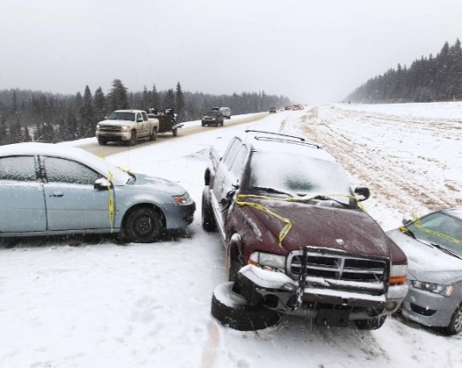
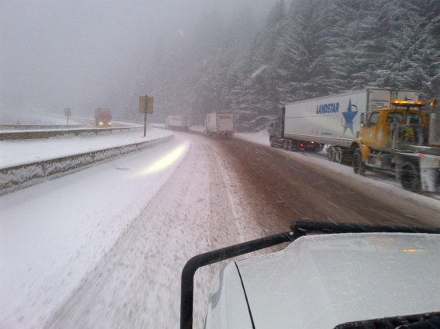
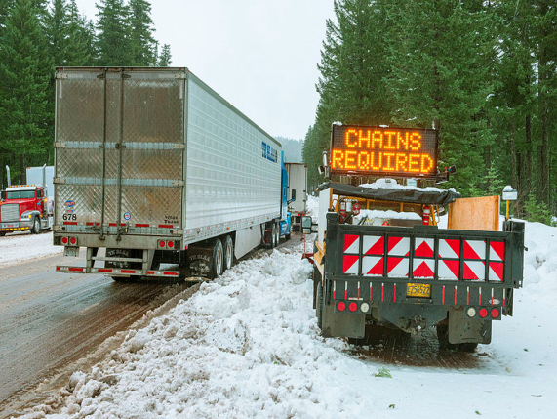
Results through 2015/16
Fewer crashes
I-5: -27%
U.S. 95: -23%
Fewer holds/ closures
I-5: -75%
Fewer chain restrictions
I-5: -78%
Notes:
Salt pilot—results so far
Fewer avg. crashes/year
I-5: 30 to 22 (down 27%)
U.S. 95: 26 to 20 (down 23%)
Fewer avg. holds and closures/year
I-5: 12 to 3 (down 75%)
Fewer avg. chain restrictions/year
I-5: 49 to 11 (down 78%)

Slide 8
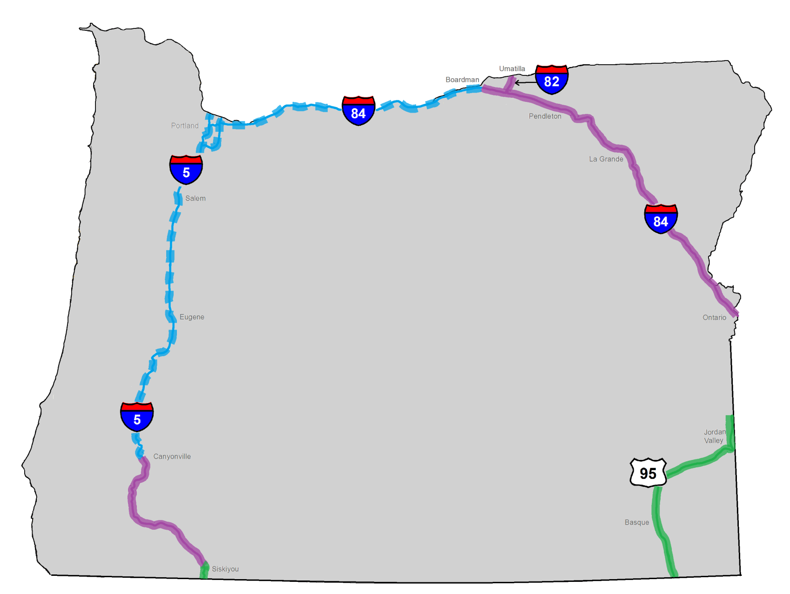
Salt pilot expansion locations
Notes:
Phase 1 (2012-2015)
Phase 2 expansion

Slide 9
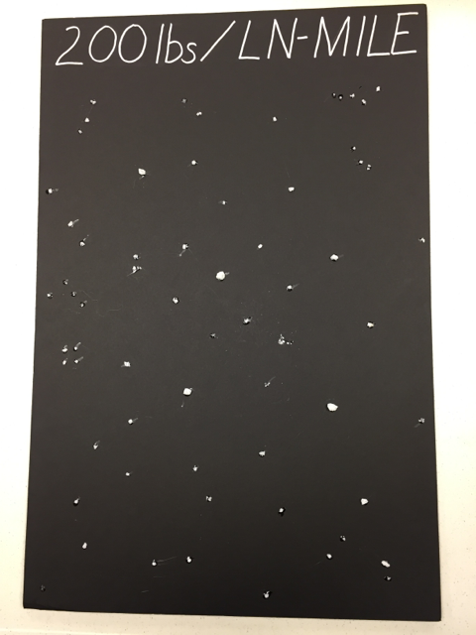
Goals
Minimal use with maximum benefit
Target storms followed by days of subfreezing temperatures
Notes:
Continue to track use and be transparent with findings.

Slide 10
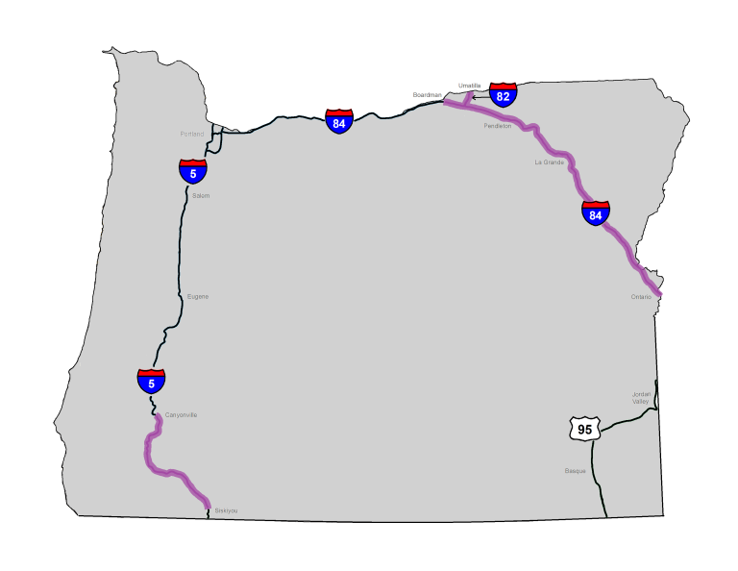
Phase 2 timing
No sooner than November, 2017
May be later in the winter
Procuring:
Salt
Salt sheds
Salt trucks
Training

Slide 11
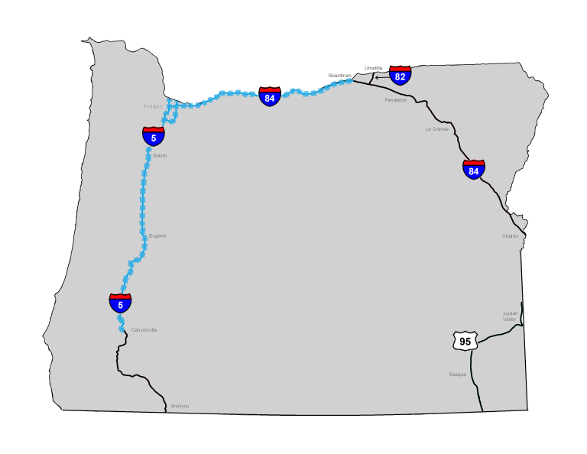
Targeted use
Interstates
Portland freeways
Exception process
Need access to:
Salt
Salt trucks
Trained Operators
Notes:
ODOT has identified other key interstate locations Part of that effort includes considering how to get salt and use it in infrequent yet extreme events when the use of a solid deicer would significantly benefit pavement conditions compared to liquid. ODOT is drawing up criteria that will be used to determine whether liquid or solid deicer would be appropriate based on various parameters.
Limited use areas (facilities aren’t planned, but opportunistic storage improvements may occur); salt is allowed on a case by case basis based on conditions. General requirements: use is warranted based on predicted event/pavement conditions; salt is available at the right time and in the right quantity to be effective

Slide 12
Exception process
I-5
I-84
Portland-area freeways
In limited areas
In extreme winter conditions—NOT every storm
Notes:
The area where salt may be used via an exception process includes the remainder of Interstate 5, Interstate 84, and Portland Freeways.
ODOT does not have the resources or infrastructure to use salt outside of the phase 2 pilot areas, except in almost one-off, extremely limited circumstances.
We are still working on these details.
Exceptions will be considered in limited areas based on extreme winter conditions such as we experienced in Portland recently.
These areas are ones that receive snow much more infrequently, but where liquid deicers aren’t adequate and the limited and targeted use of salt in a specific location could benefit safety and mobility.
We will refine the spot locations, types of storms and the benefit we see to the rest of the system in order to determine when and where to use salt.
It is important to know that ODOT does not foresee widespread use of salt or even using salt in every storm.
We still need drivers to be prepared for winter conditions and take precautionary measures when snow is in the forecast.
We will continue to work to find the right balance for safety and mobility versus cost and impact to the environment, infrastructure and vehicles.

Slide 13
Thank you

