Slide 1
2019 OACES Chip Seal Workshop December 10, 2019 Slurry in conjunction with chip seals in cul-de-sacs and intersections BONUS Content: 1” Overlay and Double Chip Case Study

Slide 3
Why slurry?
Why not chip everything?
Difficulty of construction
Raveling in turning zones
Leaving untreated areas is unsightly
Leaving untreated areas results in more distress
Intersections need treatment!
Relative low cost

Slide 4
Costs
2014 In-house chip seal $2.24 SY
2014 Contract Cost for intersection and cul-de-sacs $1.65 SY

Slide 5
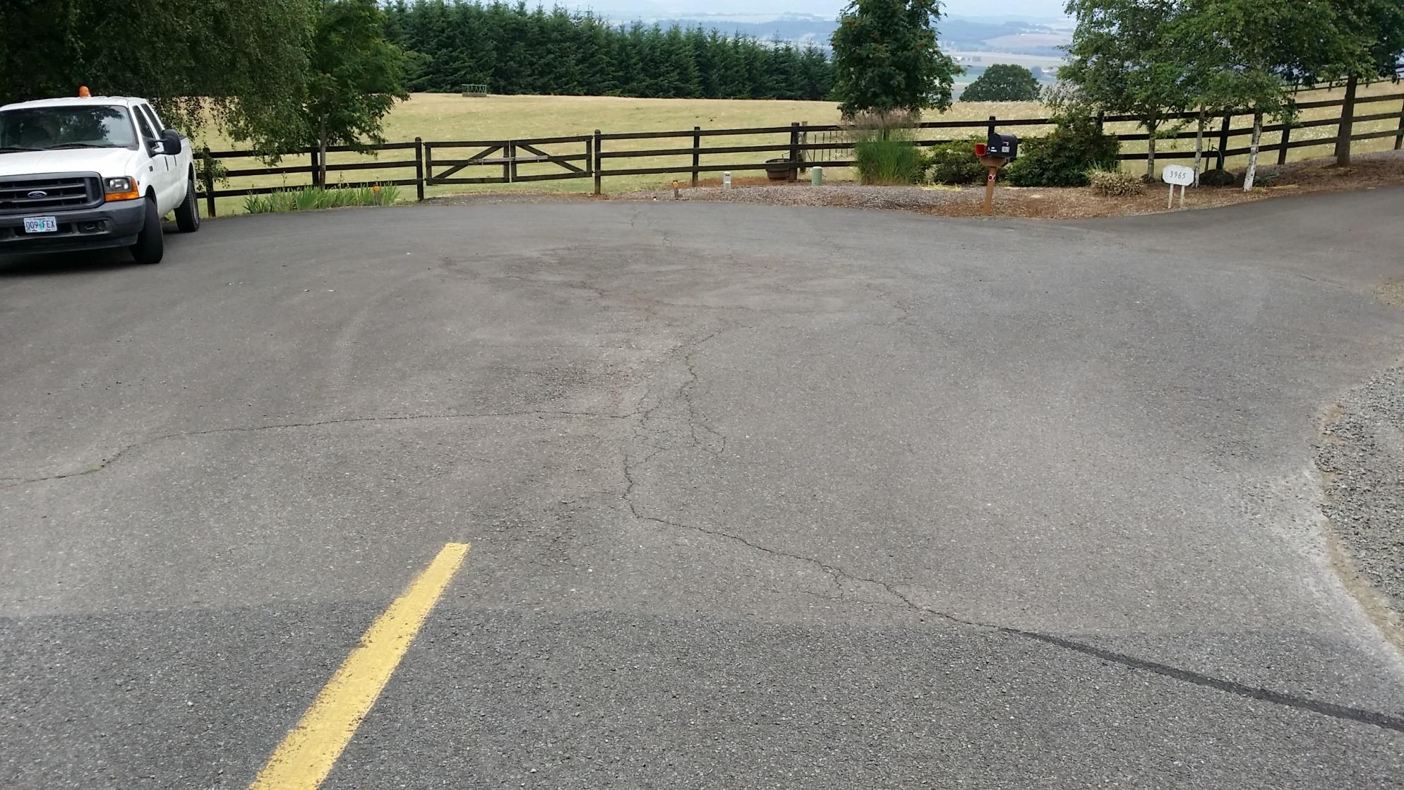
2014 Before Slurry

Slide 6
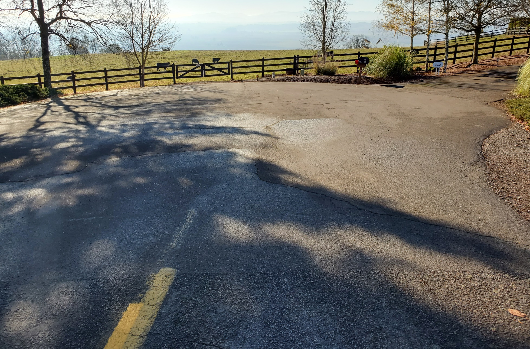
2019

Slide 7
Intersection

Slide 8
Close up texture

Slide 9
Cul-De-Sac

Slide 10
Worn Lap Joint

Slide 11
Results
Residents were happy!
Chip seals outlast slurry in this scenario
Chip seals better at concealing cracks
Cost effective in this scenario

Slide 12
1” Overlay + Double Chip: Why?
Lower traffic roads in disrepair PCI range 38-56
Overlay budgets restricted to higher volume roads
Operations dealing with complaints
Operations wanted to prep for chip but only had a Layton box

Slide 13
1” Overlay + Double Chip
1” overlay performed by contractor in 2005
Level 2 ½” Asphalt Concrete Pavement
Double Chip applied the same summer

Slide 14
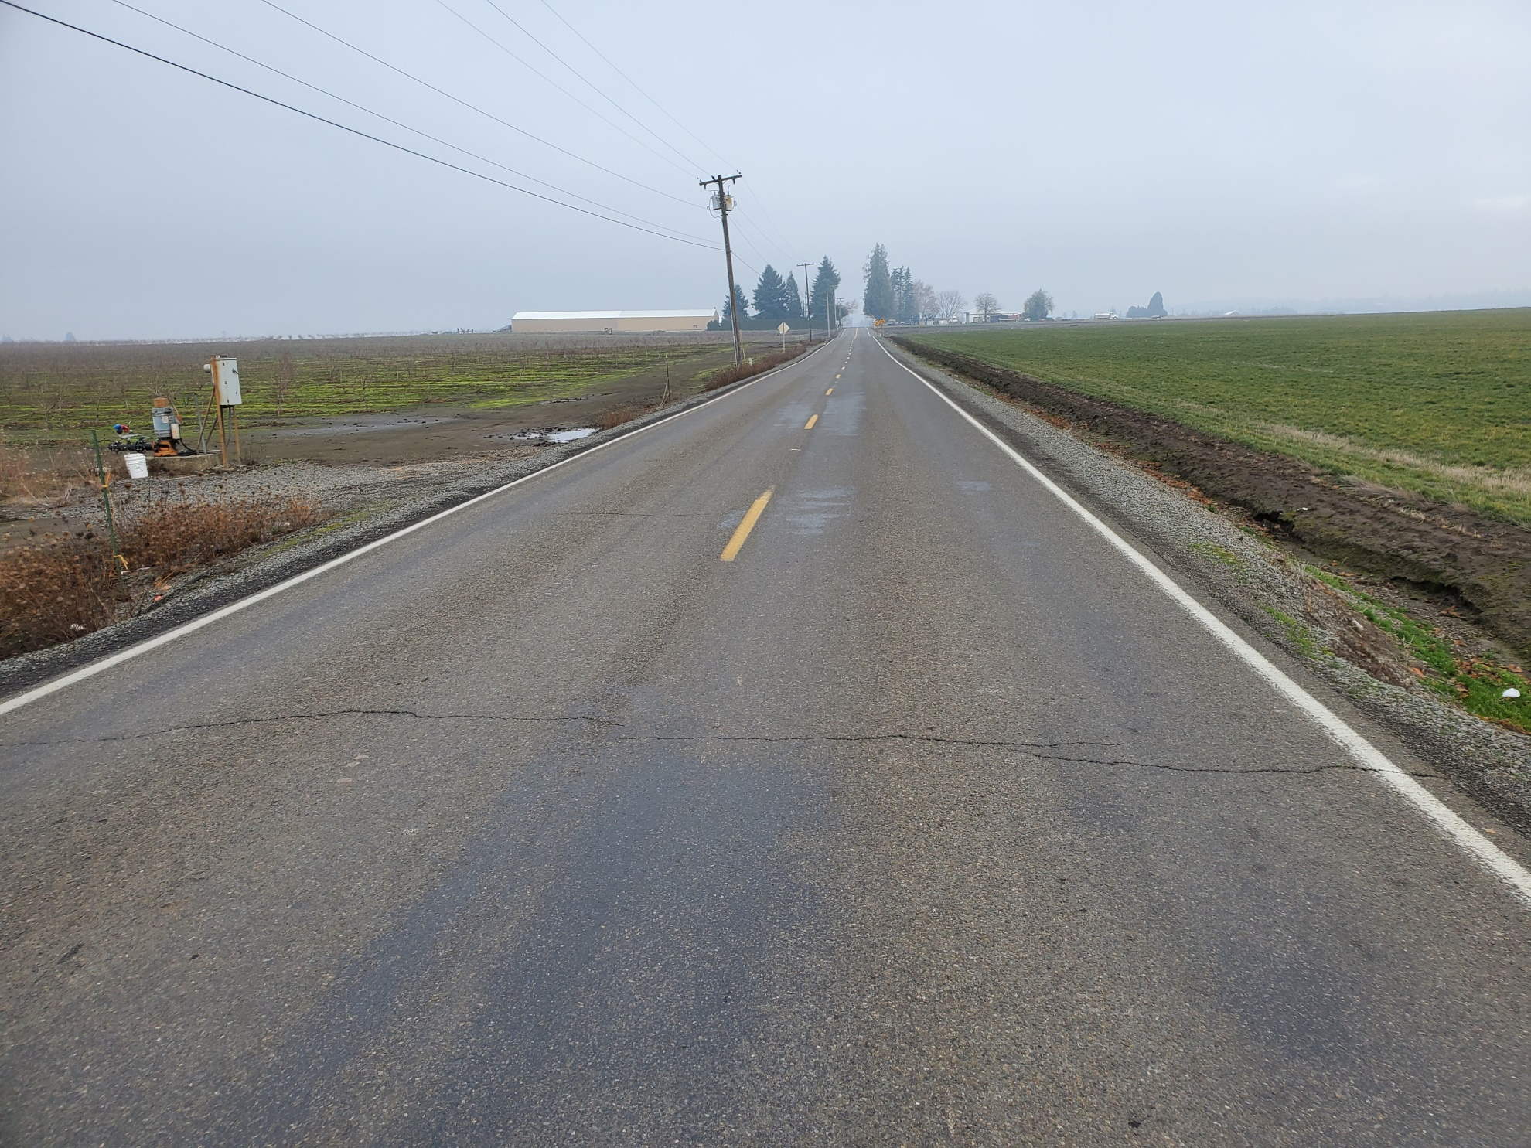

Slide 15
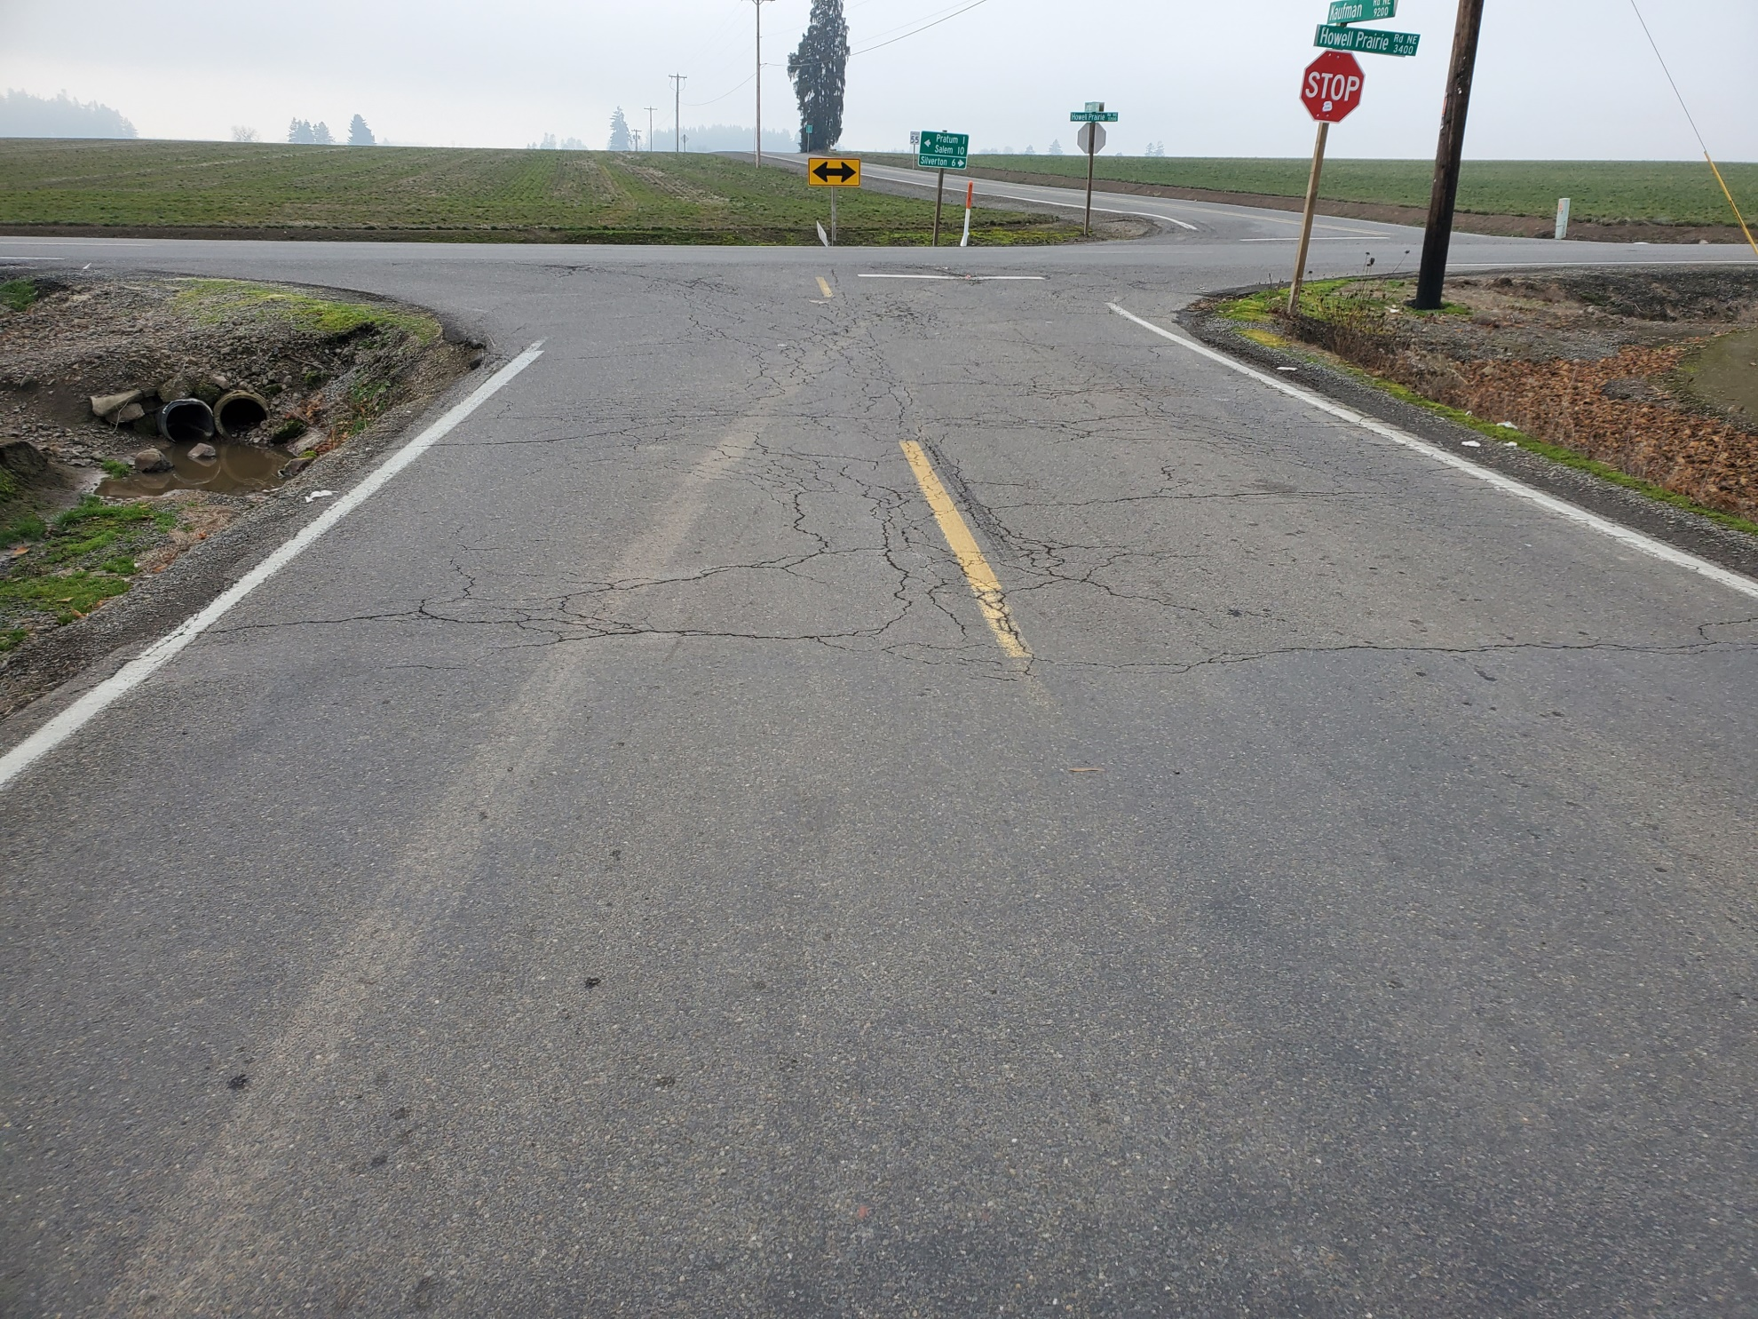

Slide 16
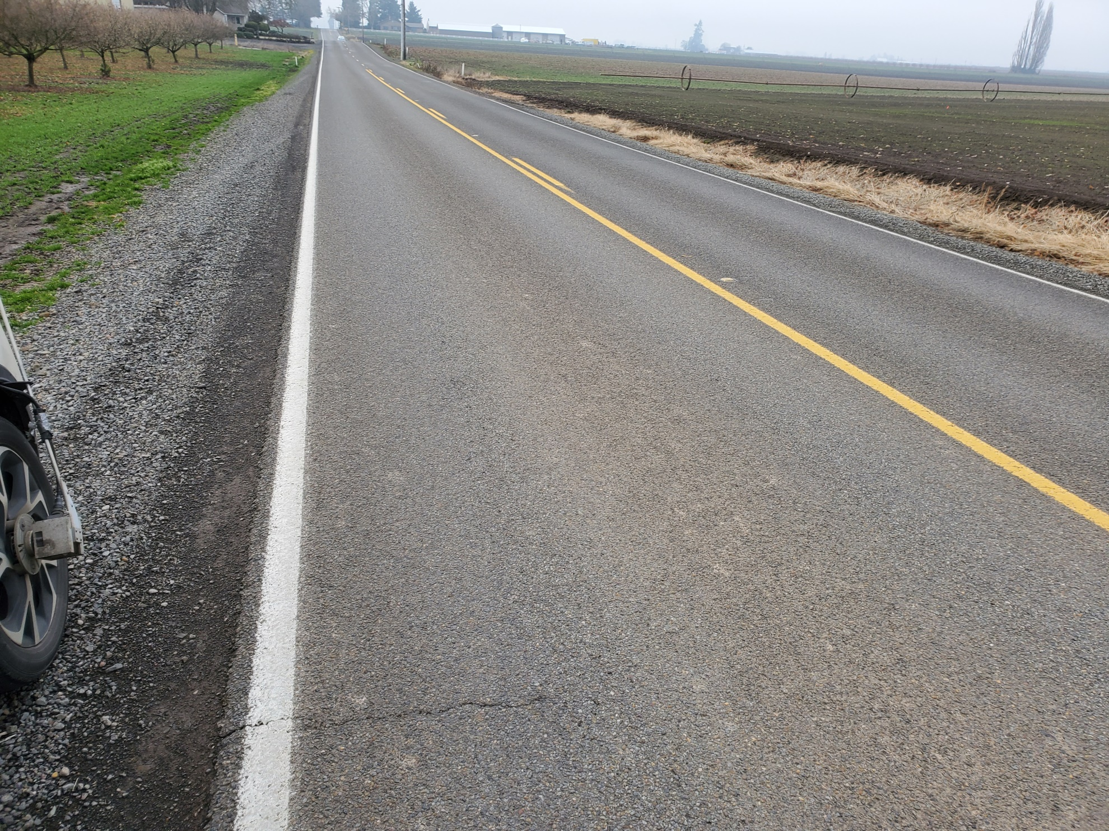

Slide 17
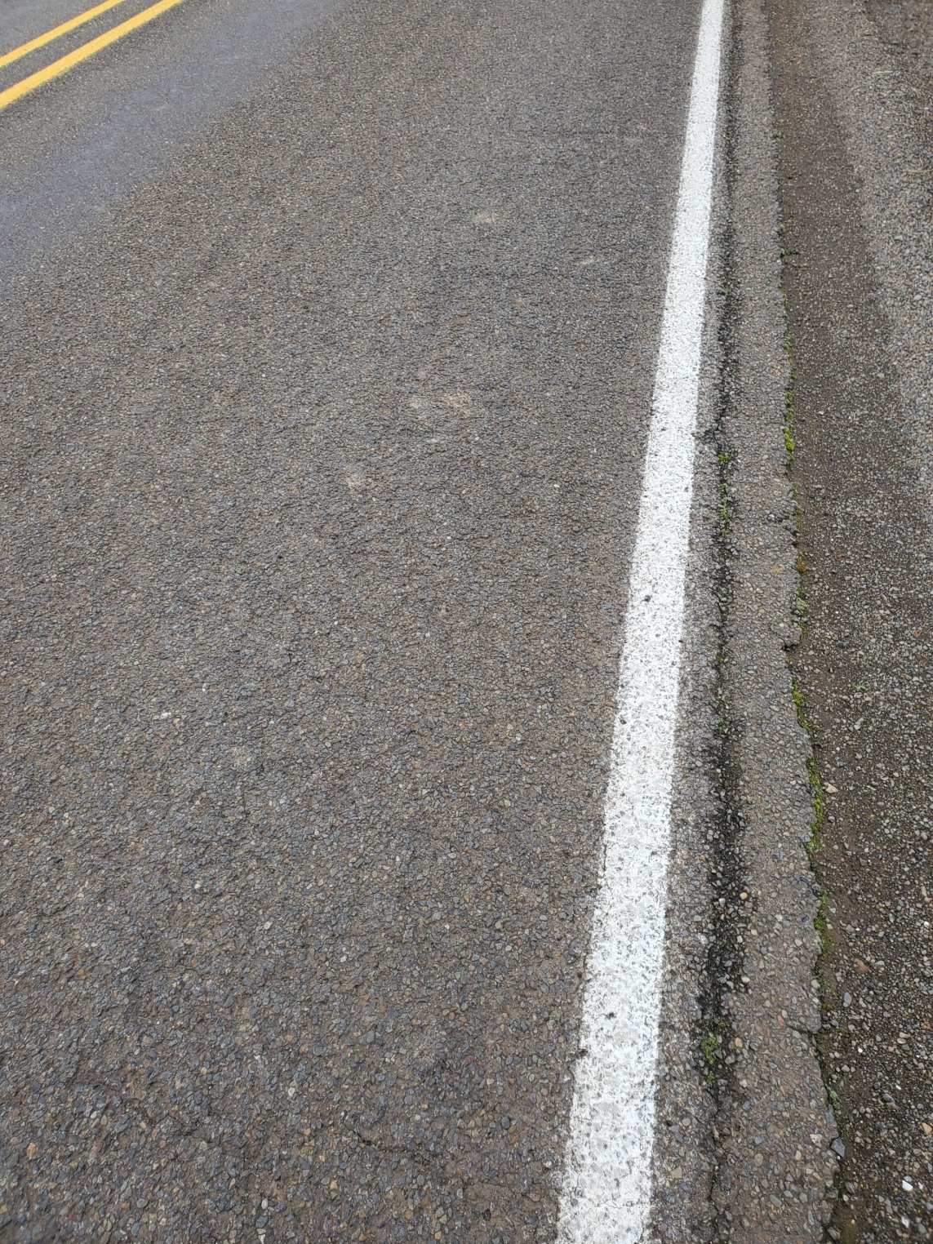

Slide 18
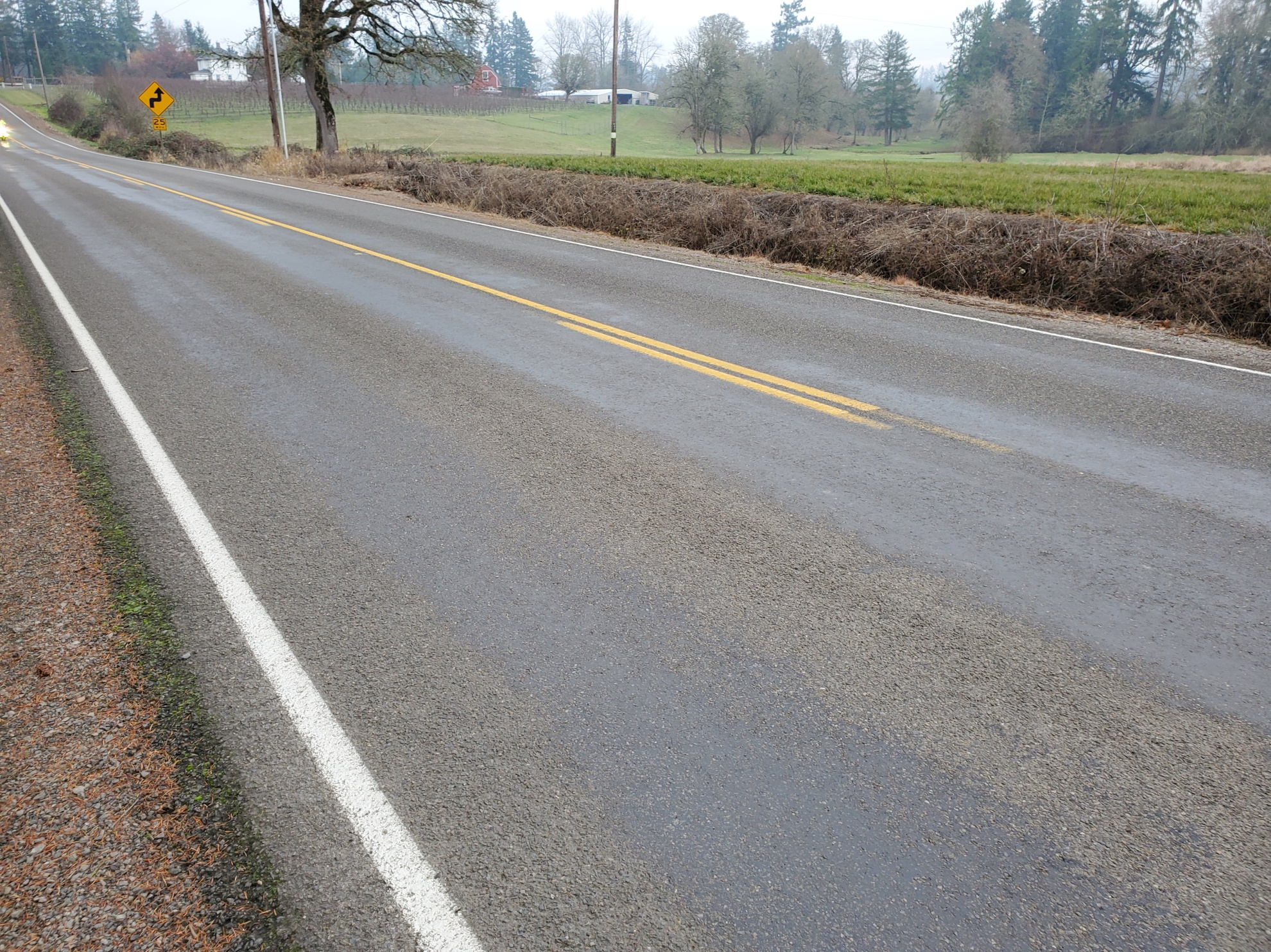

Slide 19
1” Overlay + Double Chip: Results
PCI 14 years later still 80-83
Overlay results in smoother ride compared to multiple patches

Slide 21
Unknowns
Could we get away with a single chip
Could we just do a 3/8” mix @ 1.5” depth- industry claims 3/8” mix is impervious due to higher oil content
What would have happened with a chip as an interlayer

Slide 22
2020 Project
Does 3/8” need chip sealed?
Stayton Road overlaid 2019 using 3/8” ACP
Already chip sealing on both ends of project
We plan to chip ½ of the project and see what happens

Slide 23
Questions?
Spencer Hohenshelt
503-365-3138
shohenshelt@co.marion.or.us

